Slide 1
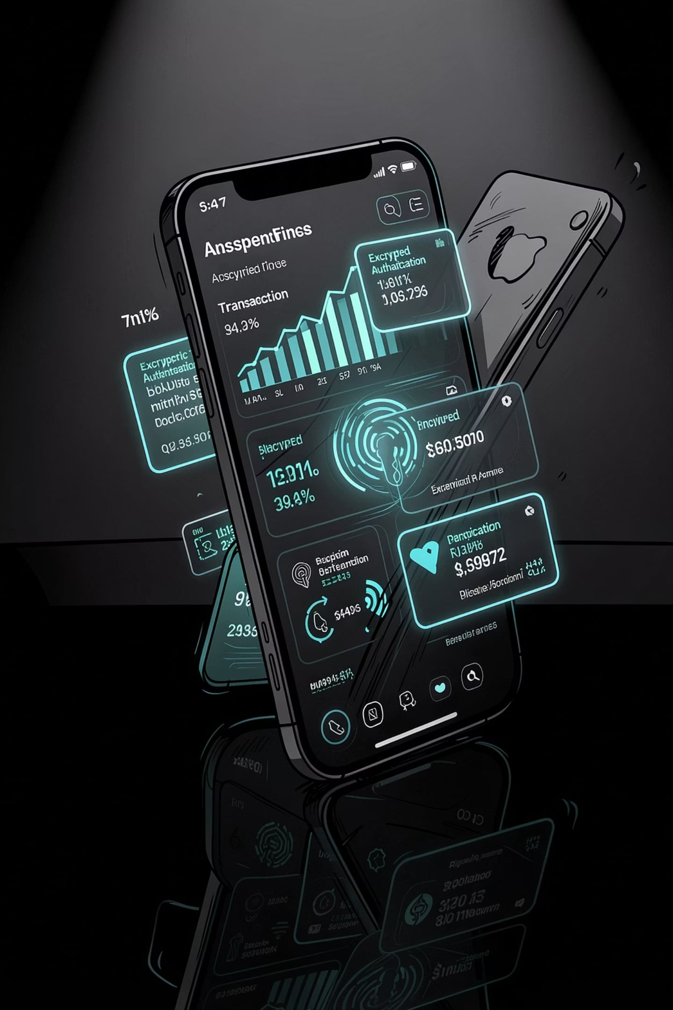
Spendly
Offline-First · Zero-Knowledge · Peer-to-Peer Finance Ecosystem
Semester VII · Information Technology
Student Name · Enrollment Number · College Name

Slide 2
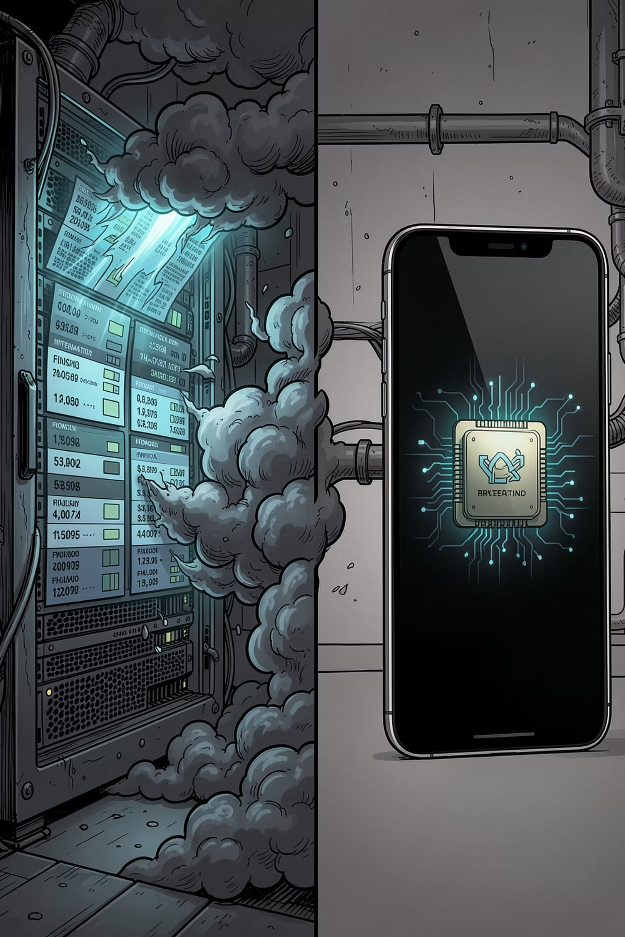
The Problem Is Everywhere
Modern finance systems are fragile by design — exposing users to privacy breaches, downtime, and dependency.
Privacy at Risk
Centralized databases create single points of failure — one breach exposes everything.
Always Online
Cloud dependency means no service in low-connectivity or offline environments.
Recurring Costs
Monthly POS subscriptions burden small merchants with unnecessary overhead.
Data Breaches
Centralized storage is a permanent target — financial data is never truly safe.

Slide 3


Introducing Spendly
Three applications. One ecosystem. Zero compromise.
Spendly
The consumer app. Offline-first expense tracking, encrypted local storage, and peer-to-peer merchant communication — no internet required.
Spendly Shop
The merchant terminal. Inventory management, QR invoicing, cash wallet, and EMI alerts — all running locally on-device.
Spendly Radar
The discovery layer. Real-time offer detection, coupon validation, and proximity-based deal sharing between peers.

Slide 4
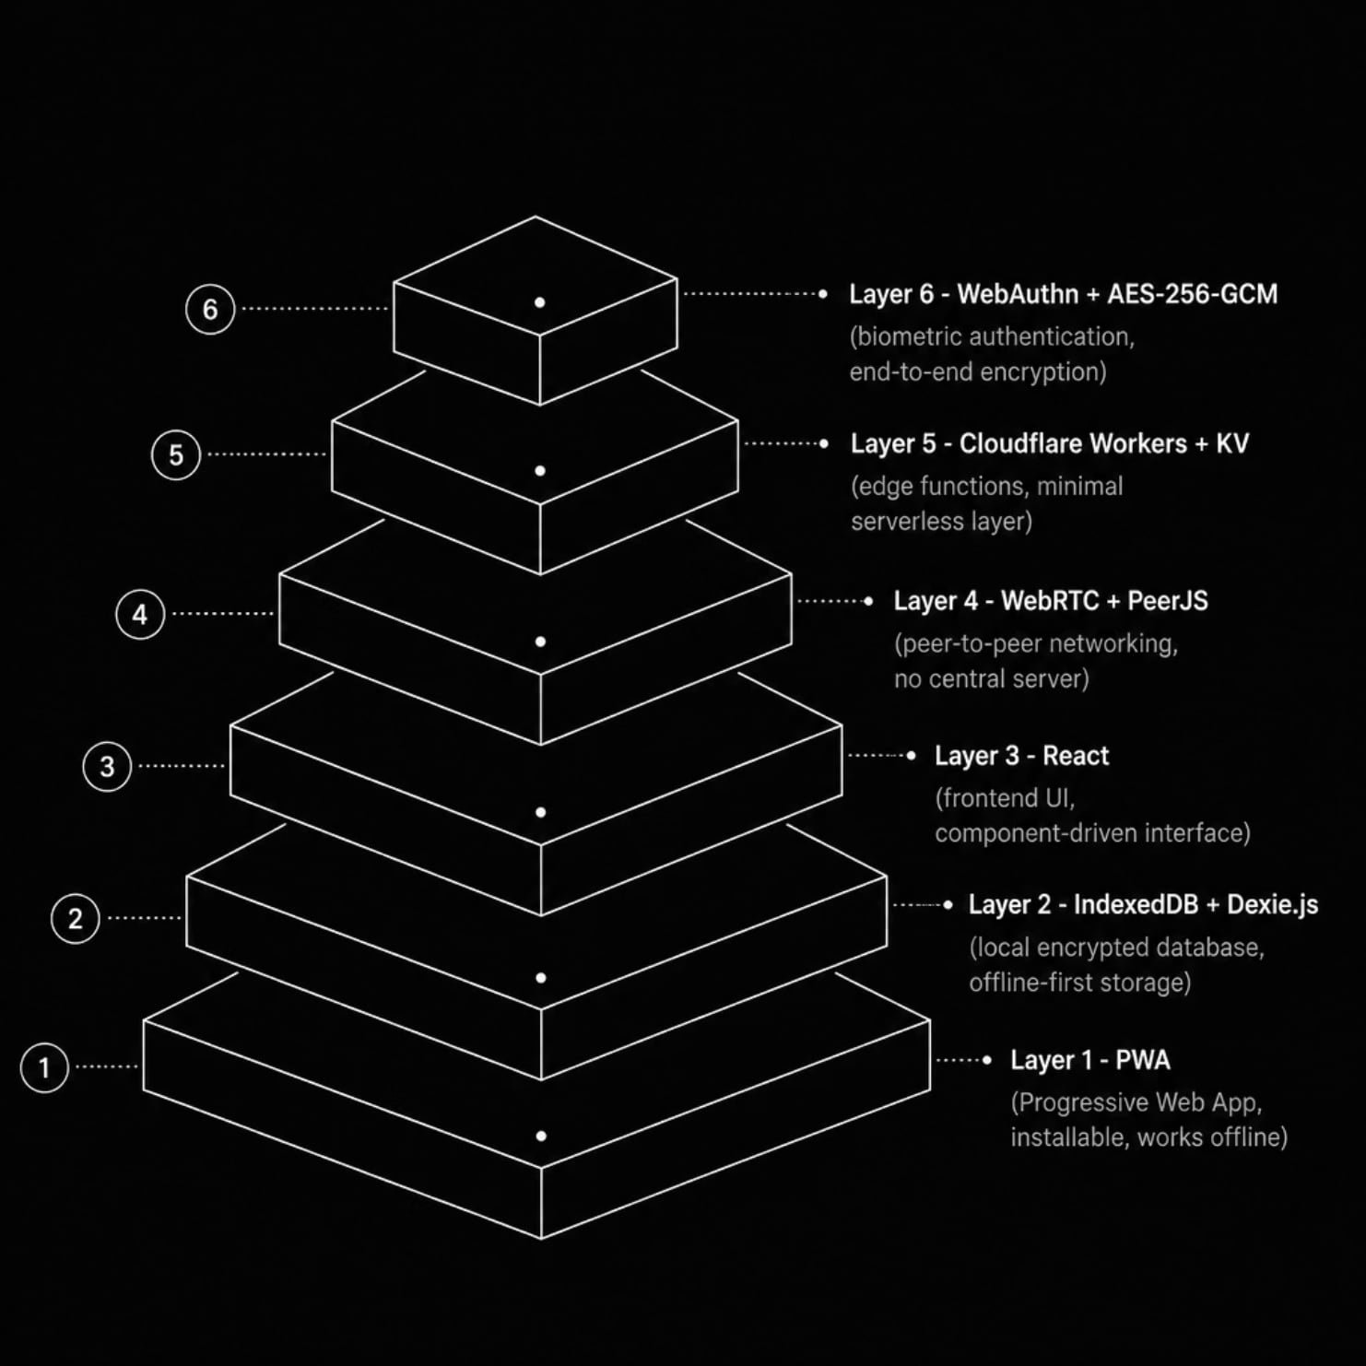
System Architecture
Every Layer, Purpose-Built
Spendly's architecture is an exploded stack of transparent, independent layers — each chosen for resilience, privacy, and performance.
React — Component-driven, responsive UI layer
IndexedDB + Dexie.js — Encrypted offline-first local database
WebRTC + PeerJS — Direct device-to-device communication
Cloudflare Workers + KV — Minimal edge serverless functions
WebAuthn + AES-256-GCM — Hardware-backed biometric security
PWA — Installable, works without internet

Slide 5
How It Works
01
02
03
Offer Discovery
Coupon Claim & Barcode Scan
Offer Validation
Spendly Radar detects nearby merchant offers via peer-to-peer proximity.
Zero-knowledge proof verifies eligibility without exposing user data.
User claims offer; barcode scanned for product lookup and validation.
04
05
Invoice Generation & Sharing
Expense Saving & Analytics
Encrypted invoice created locally and shared peer-to-peer instantly.
Transaction logged offline; analytics generated on-device with full privacy.

Slide 6

Technology Stack
Frontend
React · PWA · Responsive UI
Backend & Edge
Cloudflare Workers · KV Storage
Networking
WebRTC · PeerJS · Offline Sync
Database
IndexedDB · Dexie.js
Security
WebAuthn · AES-256-GCM · Secure Enclave
Deployment
Installable PWA · Zero Server Infrastructure

Slide 7

Security by Design
Spendly's security model is not a feature — it is the foundation. Every transaction, every record, every authentication event is designed to never leave the device unless explicitly intended.
Zero-Knowledge
No server ever sees your financial data. Proofs are verified without revealing underlying information.
Offline-First
All data resides in IndexedDB — encrypted, local, and inaccessible to external threats.
WebAuthn + Biometric
Hardware-backed authentication via fingerprint or face — no passwords, no replay attacks.
AES-256-GCM
Military-grade encryption applied to every stored record and peer-to-peer transmission.

Slide 8
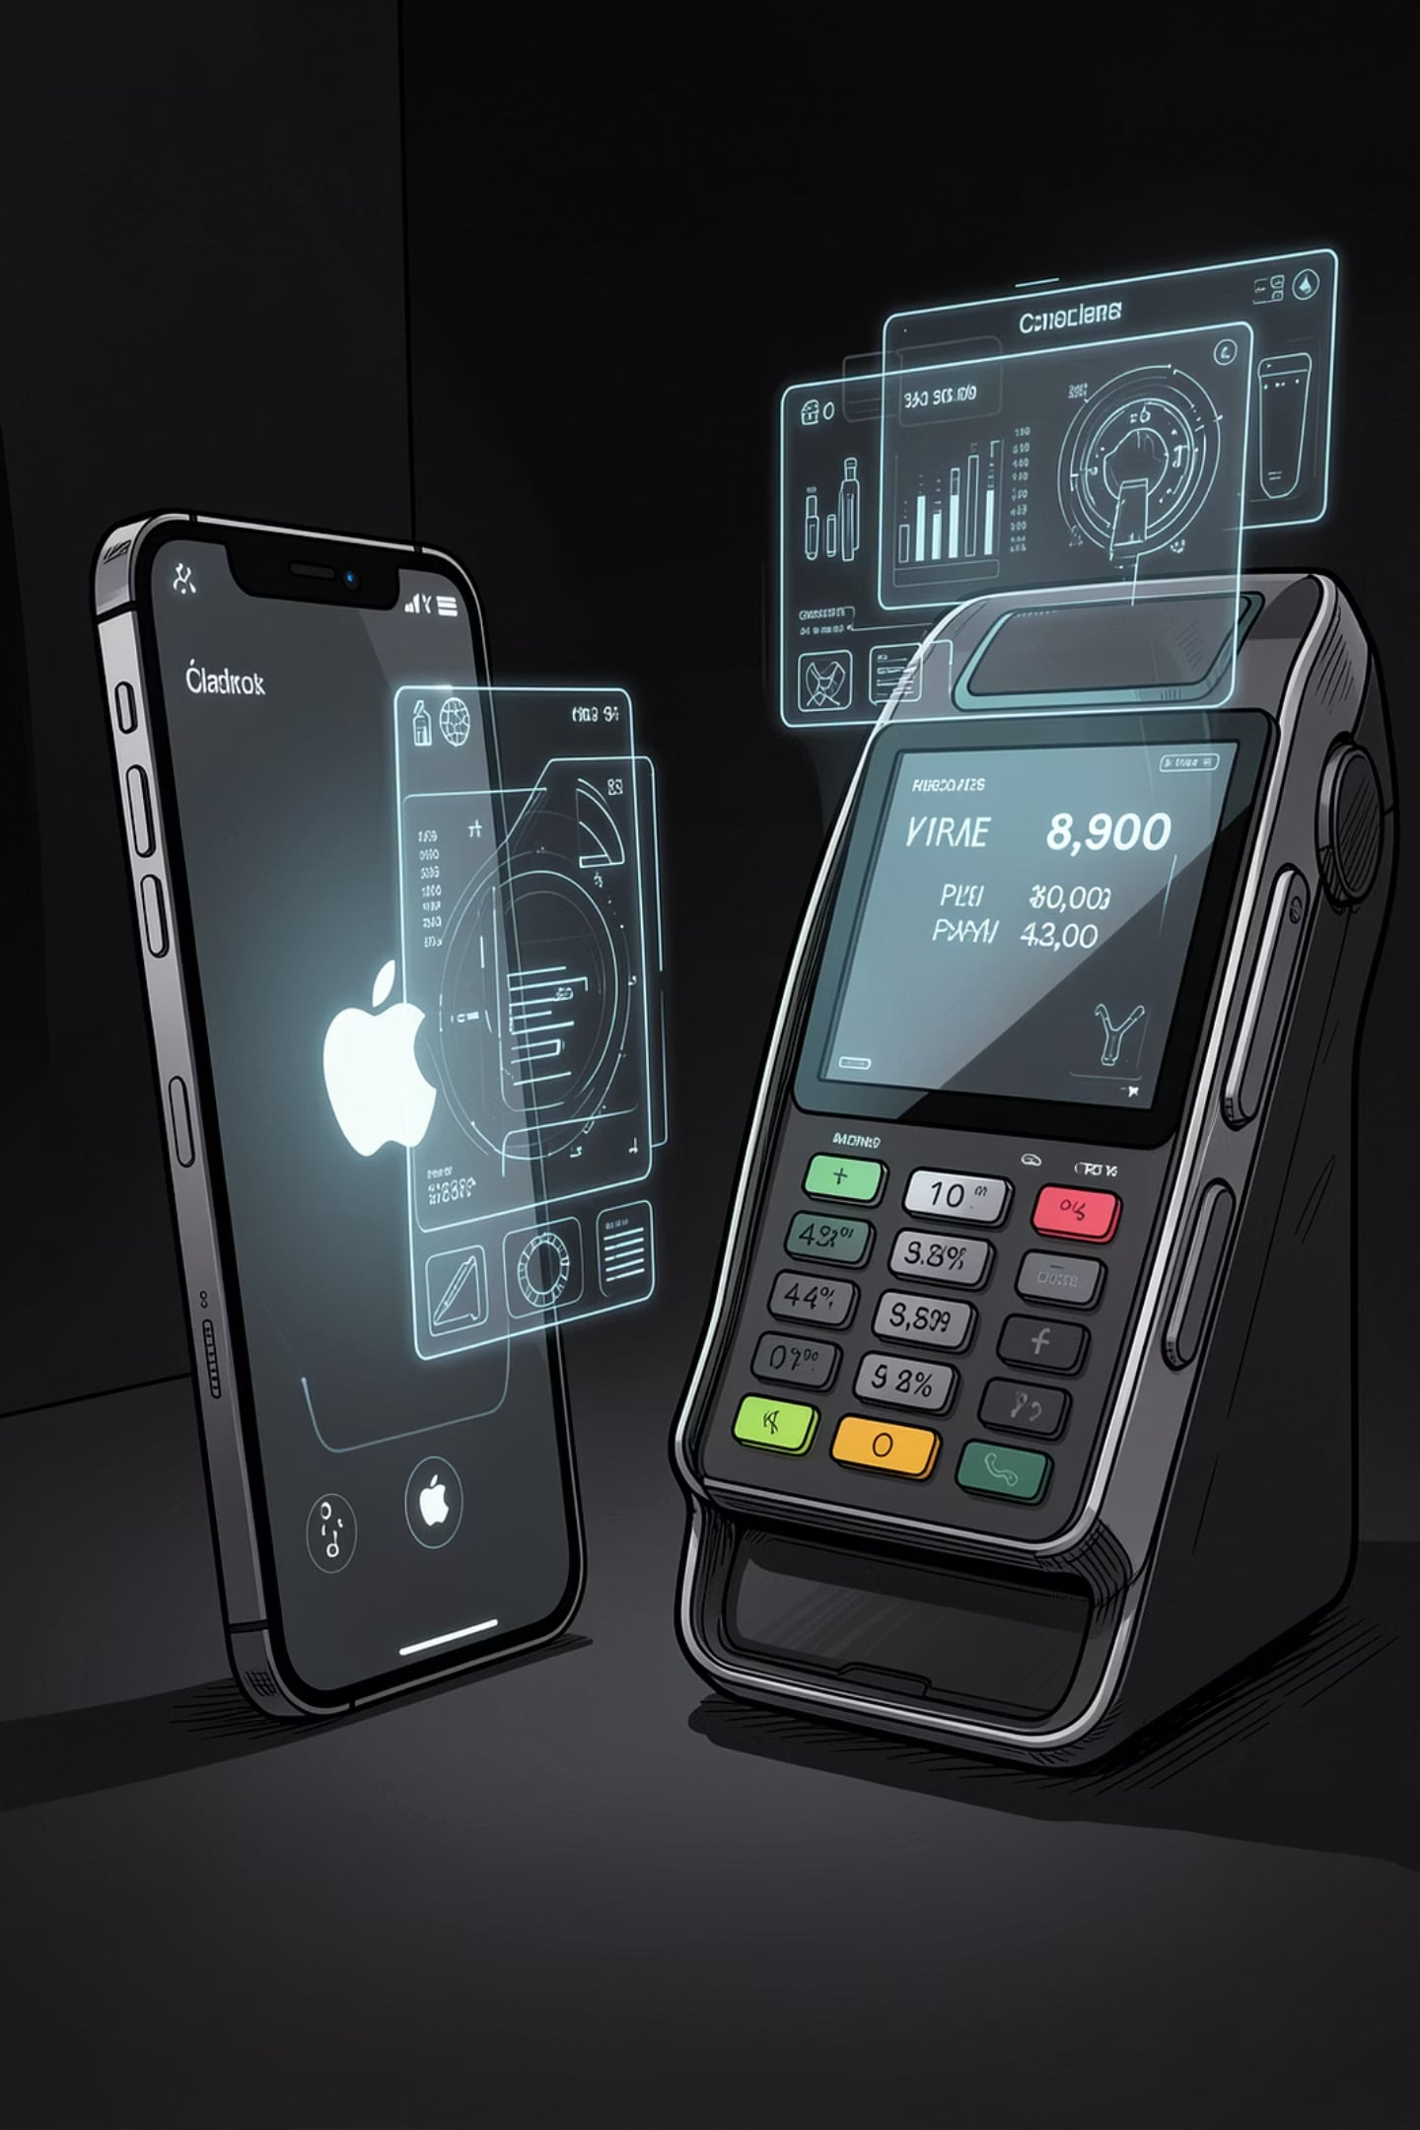




Features
Expense Tracking
Real-time categorization and spending insights — all processed on-device.
Merchant Billing
Instant QR invoice generation with offline capability and peer delivery.
Inventory & Cash Wallet
Stock management and digital cash ledger for merchants — no internet needed.
EMI Alerts & Analytics
Automated payment reminders and on-device financial analytics with full privacy.

Slide 9
Advantages & Future Scope
Core Advantages
Future Scope
Offline-First — Fully functional without internet connectivity
Zero Server Cost — No infrastructure, no subscriptions, no overhead
Privacy-First — Zero-knowledge architecture protects every user
Fast Billing — Instant peer-to-peer invoice exchange via WebRTC
P2P Communication — Direct device-to-device, no intermediaries
AI Insights — On-device spending pattern intelligence
Voice Billing — Natural language transaction commands
UPI & NFC — Native payment rail integration
GST Compliance — Automated tax invoice generation
Multi-Store — Merchant network management at scale

Slide 10
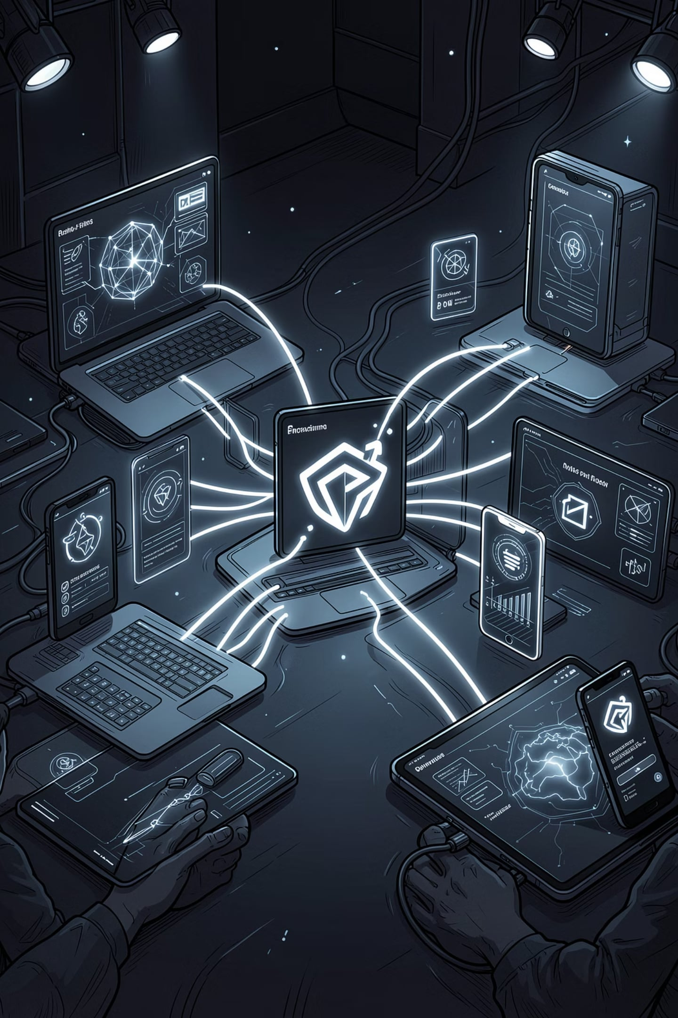
Spendly
A finance ecosystem built for the world as it is — not as we wish it to be. Offline. Private. Peer-to-peer.
Thank You · Questions Welcome
Semester VII · Information Technology

