Slide 1
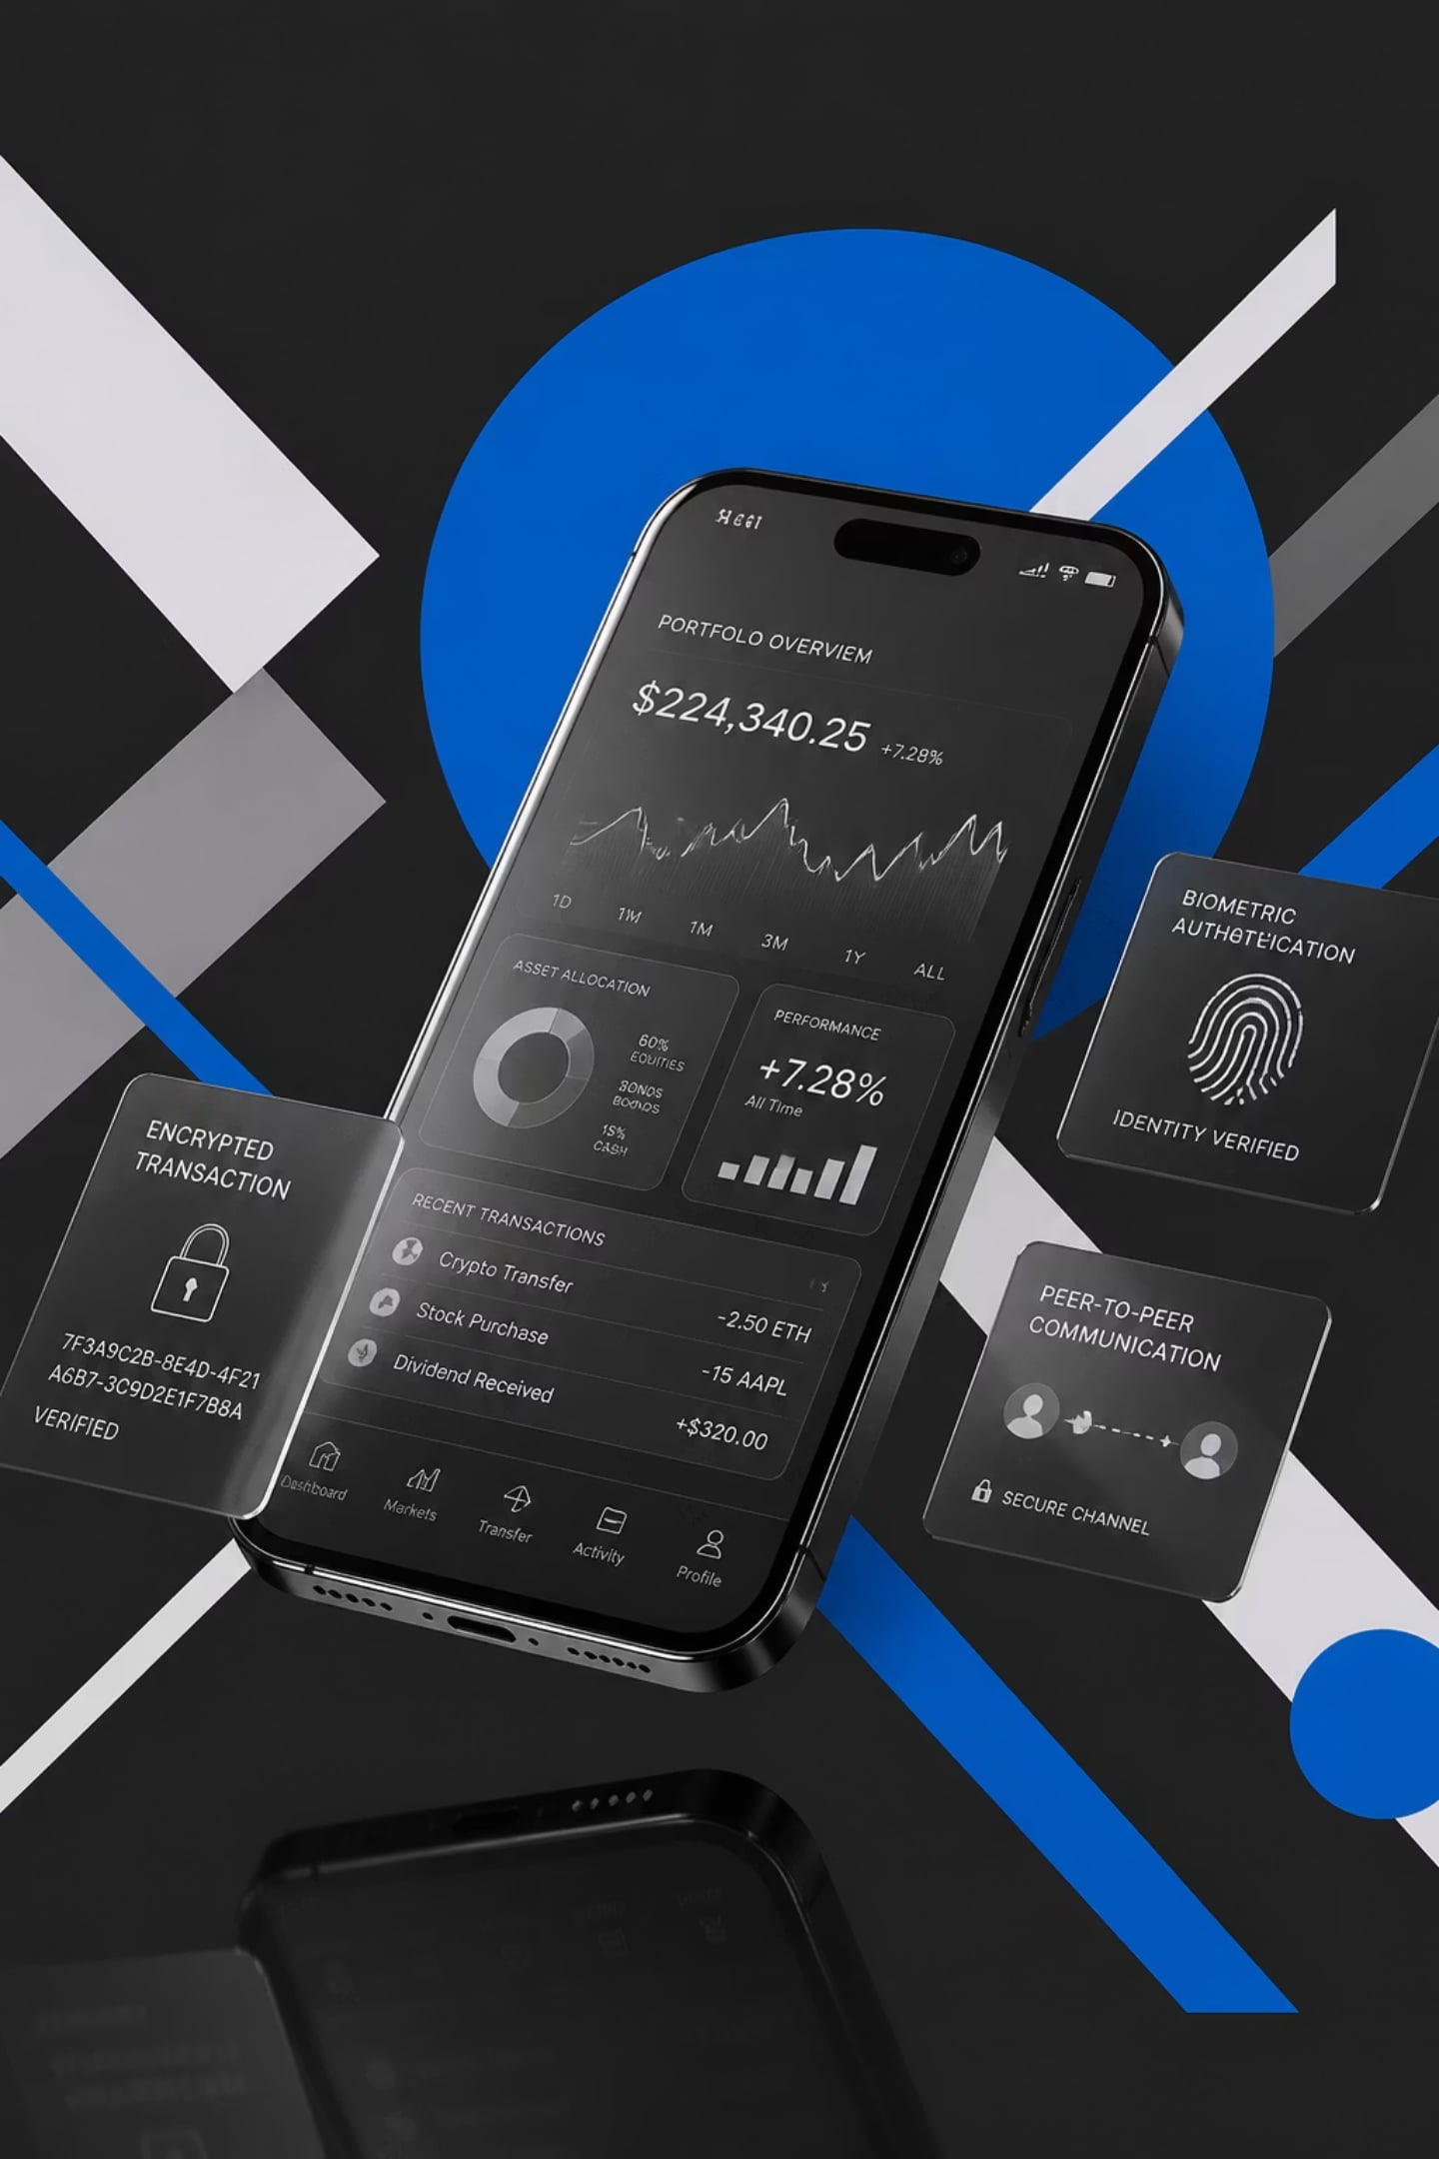
Spendly
Offline-First Zero-Knowledge Peer-to-Peer Finance Ecosystem
[Student Name] · [Enrollment Number] · Semester VII · Information Technology · [College Name]

Slide 2
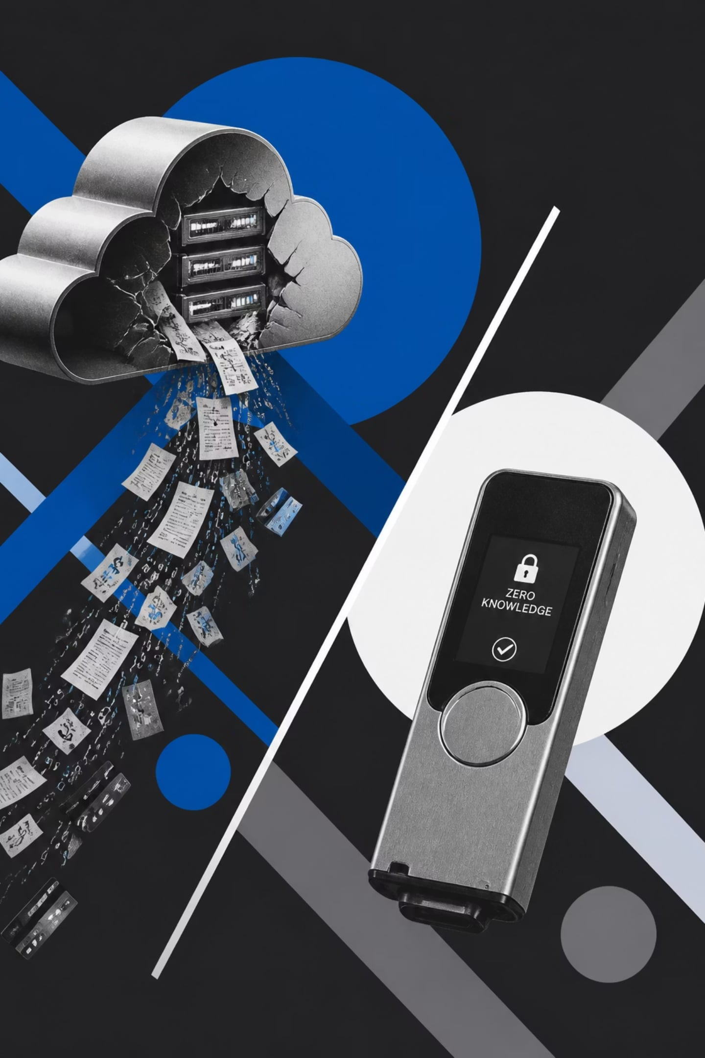

THE PROBLEM
Finance Is Broken by Design
Privacy at Risk
Every transaction, wallet balance, and spending habit is uploaded to centralized servers — exposed to breaches, surveillance, and misuse.
Cloud Dependency
Internet outages halt billing, inventory, and payments. Businesses lose revenue every time connectivity drops.
Centralized Databases
A single point of failure. One breach exposes millions of users' financial identities simultaneously.
Expensive POS Systems
Traditional Point-of-Sale systems demand monthly subscriptions, hardware costs, and internet connectivity — locking small merchants out.

Slide 3

THE SOLUTION
Three Apps. One Ecosystem. Zero Compromise.
💳 Spendly
🛒 Spendly Shop
Personal Finance PWA — expense tracking, wallet management, EMI reminders, and complete financial privacy. Data stays on-device.
Offline Merchant POS — scan products, generate GST invoices, apply discounts, and deliver receipts via WebRTC, QR, or print.
📡 Spendly Radar
Merchant Management Hub — inventory control, stock updates, offer management, and anonymous local business analytics.

Slide 4

ARCHITECTURE
System Architecture
Frontend Layer
React · Vite · Tailwind CSS · Zustand · Framer Motion
Offline Storage
IndexedDB · Dexie.js — encrypted local-first database
Peer Network
WebRTC · PeerJS · ntfy.sh — serverless device-to-device communication
Edge & Security
Cloudflare Workers · Worker KV · WebAuthn · AES-256-GCM
Every layer operates independently. No single point of failure. No centralized data store. Complete privacy by architecture.

Slide 5
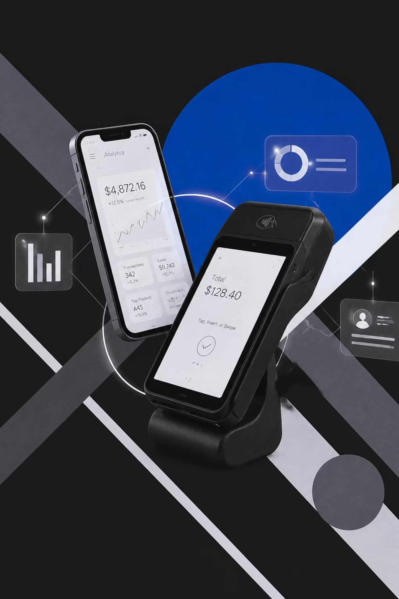

ECOSYSTEM
How the Spendly Ecosystem Works
💳 Spendly → Personal Finance
Records expenses, manages wallets, stores invoices locally. Receives encrypted invoices from Spendly Shop via WebRTC. All data protected by WebAuthn biometric authentication.
🛒 Spendly Shop → Merchant Billing
Scans products, calculates GST, generates professional invoices. Retrieves pricing from Spendly Radar via peer-to-peer. Delivers receipts via WebRTC, QR, WhatsApp, or print.
📡 Spendly Radar → Management Hub
Stores products, inventory, and campaigns locally. Responds instantly to Shop requests. Updates stock post-checkout. Generates anonymous business insights — zero customer data stored.

Slide 6
TECHNOLOGY
Technology Stack
Frontend
Backend
Networking
React · Vite · Tailwind CSS · Zustand · Framer Motion
Cloudflare Workers · Worker KV — serverless edge compute
WebRTC · PeerJS · ntfy.sh — peer-to-peer without servers
Security
Database
WebAuthn · AES-256-GCM — biometric + military-grade encryption
IndexedDB · Dexie.js — offline-first local storage

Slide 7





SECURITY
Zero Knowledge. Zero Compromise.
Zero-Knowledge Architecture
No financial data ever leaves the device. The server knows nothing about your transactions.
Offline-First Design
Full functionality without internet. Data syncs peer-to-peer when devices are in range.
WebAuthn Biometric Unlock
Hardware-backed authentication. Face ID, Touch ID, or Windows Hello protect every session.
AES-256-GCM Encryption
Military-grade encryption for all stored and transmitted financial data.

Slide 8
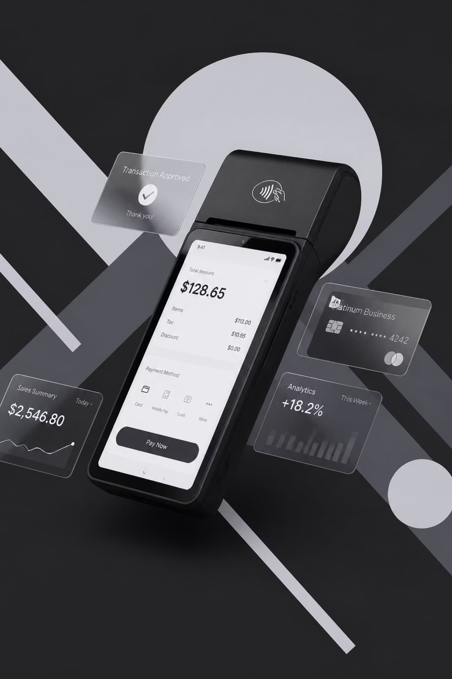




FEATURES
Everything You Need. Nothing You Don't.
Expense Tracking & Analytics
Real-time dashboards, wallet balances, and spending insights — generated locally, never uploaded.
Merchant Billing & QR Invoices
Scan, calculate GST, apply discounts, and deliver invoices via WebRTC, QR Code, or WhatsApp.
Inventory & Stock Management
Track products, update stock post-checkout, and manage promotional campaigns from Radar.
Cash Wallet & EMI Reminders
Manage cash balances and track EMI schedules — all stored securely inside IndexedDB.

Slide 9


WHAT'S NEXT
Advantages & Future Scope
Today's Advantages
Offline-First — fully functional without internet
Zero Server Cost — no infrastructure, no subscriptions
Privacy by Design — zero-knowledge, on-device storage
Fast Billing — instant peer-to-peer invoice delivery
Secure Communication — encrypted WebRTC channels
Future Roadmap
AI Analytics — intelligent spending insights
Voice Billing — hands-free merchant interaction
NFC & UPI — contactless payment integration
GST Compliance — automated tax filing
Multi-Store — chain merchant support

Slide 10
Spendly
Privacy-First. Offline-Ready. Peer-to-Peer.
Spendly redefines personal and merchant finance through zero-knowledge architecture, offline-first design, and encrypted peer-to-peer communication — no centralized servers, no data exposure, no compromise.
Thank You
Questions & Answers

