Slide 1
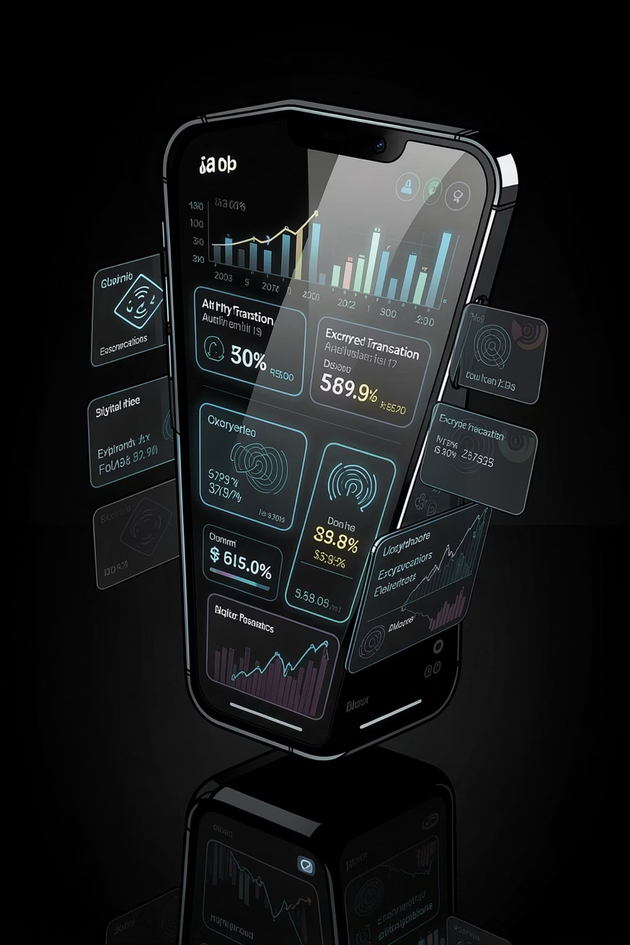
Spendly
Offline-First Zero-Knowledge Peer-to-Peer Finance Ecosystem
Student Name · Enrollment Number · Semester VII · Information Technology · College Name

Slide 2
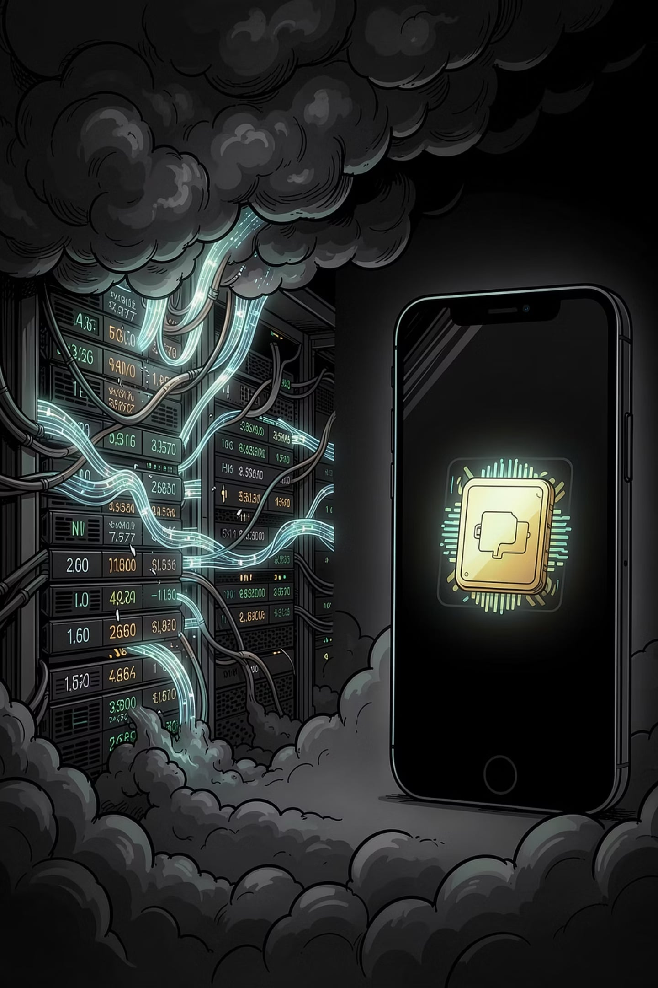
The Problem With Finance Today
Privacy at Risk
Always Online
Centralized databases expose user data to breaches, surveillance, and third-party exploitation.
Internet dependency makes every transaction fragile — no connectivity, no commerce.
Costly Infrastructure
Monthly POS fees and cloud hosting create barriers for small merchants and local businesses.

Slide 3

Three Apps. One Ecosystem.
Spendly
Spendly Shop
The consumer wallet. Track expenses, claim offers, pay merchants — entirely offline.
The merchant terminal. Inventory, billing, and analytics without a server.
Spendly Radar
The discovery layer. Find nearby offers and merchants through encrypted peer-to-peer signals.

Slide 4
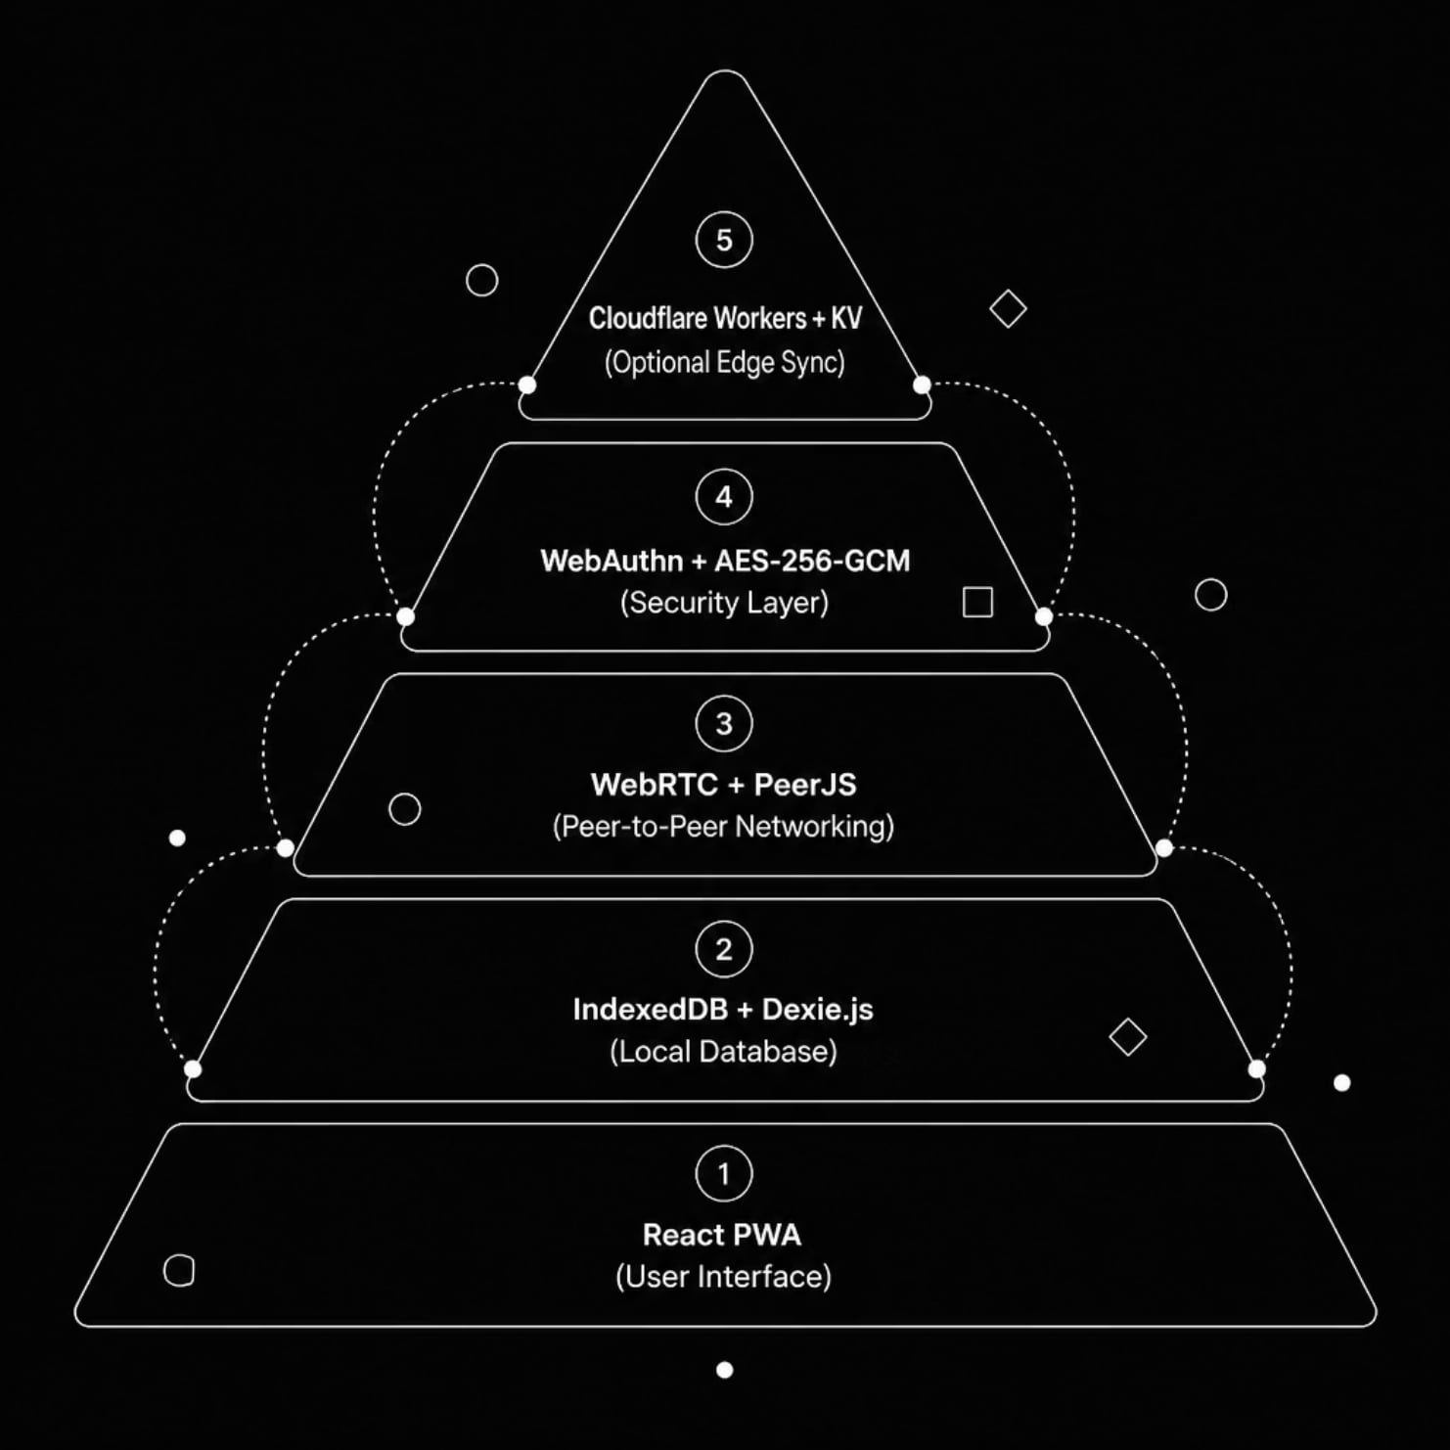
System Architecture
A fully offline-first stack — every layer operates locally, synchronizing peer-to-peer only when needed. No central server. No cloud dependency. Zero-knowledge by design.

Slide 5

How a Transaction Flows
01
Offer Discovery
Radar detects nearby merchant offers via encrypted peer-to-peer signals.
02
Coupon Claim & Scan
User claims offer, scans barcode — all processed locally on device.
03
Validation & Invoice
Product lookup, offer validation, and invoice generation happen offline.
04
Share & Analyze
Invoice shared peer-to-peer; expense saved and analytics updated instantly.

Slide 6


Technology Stack
Frontend
React · PWA · Responsive Design
Database
IndexedDB · Dexie.js · Local-First Storage
Networking
WebRTC · PeerJS · Cloudflare Workers
Security
WebAuthn · AES-256-GCM · Zero-Knowledge Proofs

Slide 7
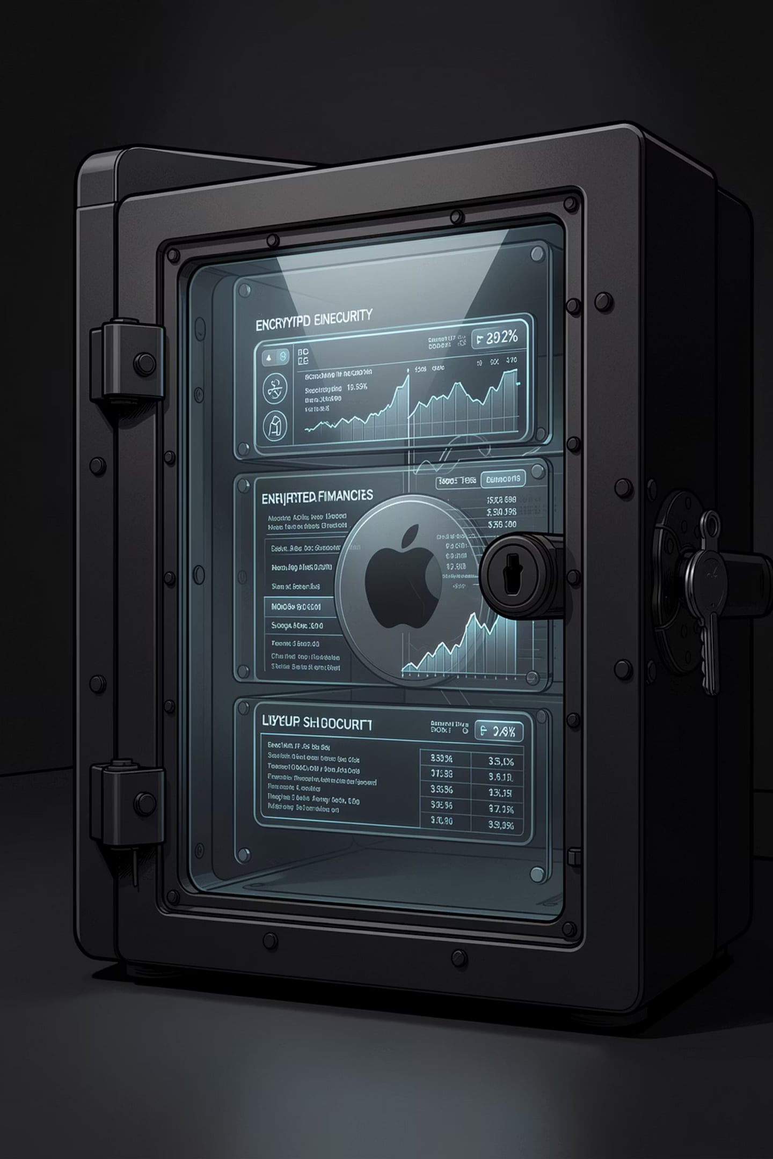
Security by Architecture
Zero-Knowledge
Offline-First
No transaction data ever leaves the device unencrypted. Merchants see only what is required.
All data resides in IndexedDB. No cloud breach surface. No third-party exposure.
Hardware-Grade Auth
WebAuthn + Biometric Unlock + AES-256-GCM encryption — the same standard as Apple Secure Enclave.

Slide 8
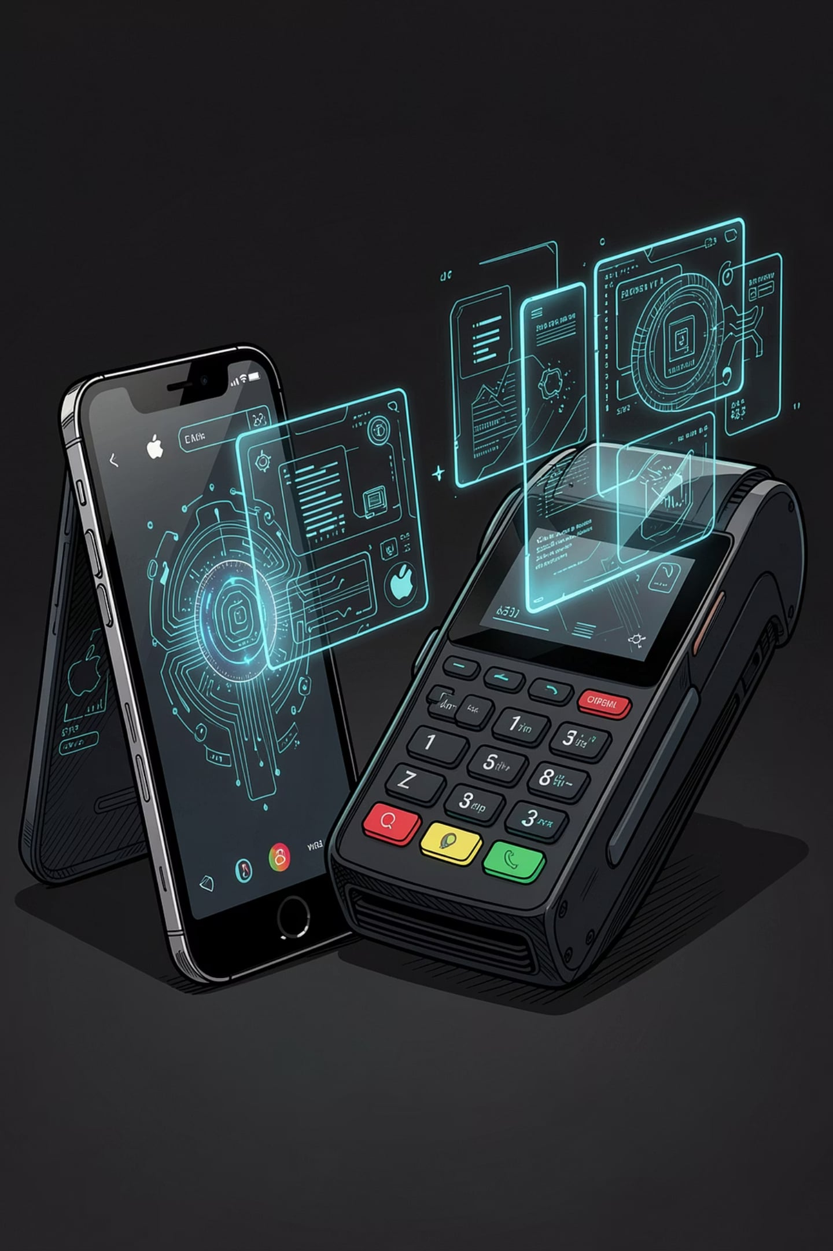




Features That Redefine Commerce
Expense & Cash Wallet
Real-time tracking of every rupee — offline, private, instant.
Merchant Billing & QR Invoice
Generate, share, and settle invoices without internet or hardware.
Inventory & EMI Alerts
Smart stock management with automated payment reminders.
Offline Sync & Analytics
Deep insights that sync silently when connectivity is restored.

Slide 9

Advantages & What Comes Next
Core Advantages
Future Scope
Zero Server Cost — No cloud infrastructure, no monthly fees.
AI-Powered Spending Insights
Voice-Activated Billing
True Privacy — Data never leaves the device without consent.
UPI & NFC Integration
GST Compliance & Multi-Store
Fast Billing — Peer-to-peer transactions in milliseconds.
Offline-First — Works without internet, everywhere.

Slide 10
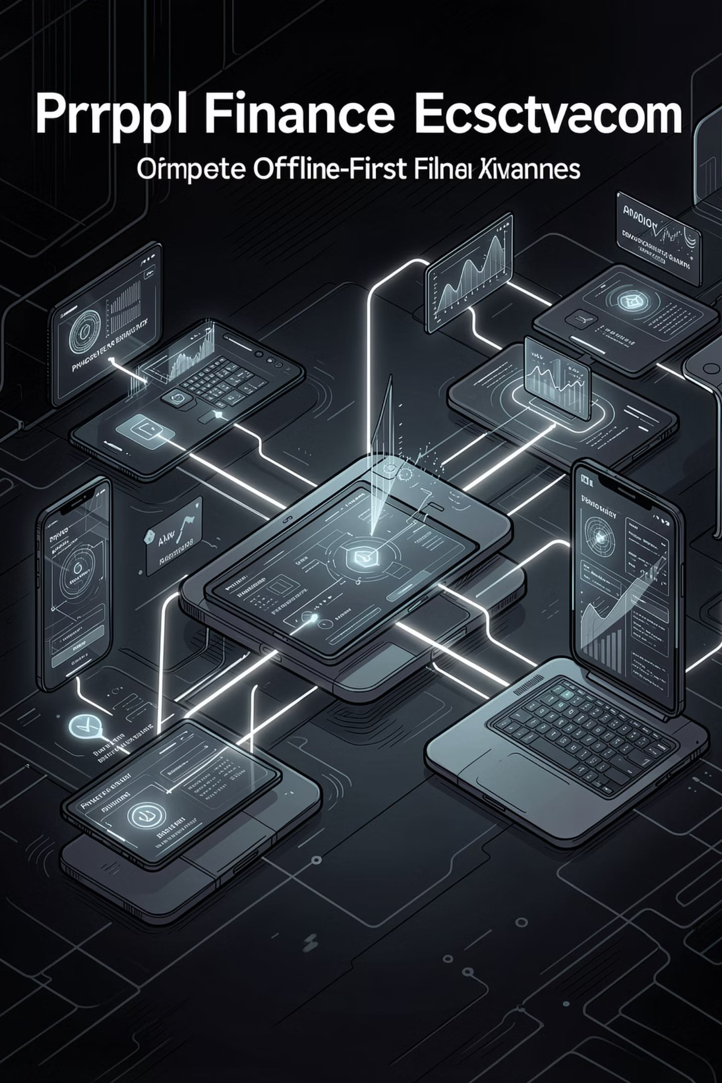
Spendly
Finance. Private. Offline. Yours.
A new standard for peer-to-peer commerce — built for a world that demands privacy, resilience, and elegance.
Thank You · Questions Welcome

