Slide 1

Spendly
Offline-First Zero-Knowledge Peer-to-Peer Finance Ecosystem
A semester VII Information Technology major project redefining how financial data is stored, shared, and secured — entirely offline, entirely private, entirely yours.
[Student Name] · [Enrollment Number] · Semester VII · Information Technology · [College Name]

Slide 2


The Problem with How Finance Works Today
Every transaction you make leaves a trace — stored on servers you don't control, processed by systems you can't audit, and exposed to breaches you never see coming.
Privacy at Risk
Centralized databases store sensitive financial data in single points of failure, vulnerable to mass breaches and unauthorized access.
Always-Online Dependency
Modern finance collapses without internet connectivity — no payments, no records, no operations in low-connectivity environments.
Recurring Infrastructure Costs
Monthly POS subscriptions, cloud hosting fees, and server maintenance create unsustainable overhead for small merchants.
Zero Data Ownership
Users surrender complete control of their financial history to third-party platforms with opaque data policies.

Slide 3
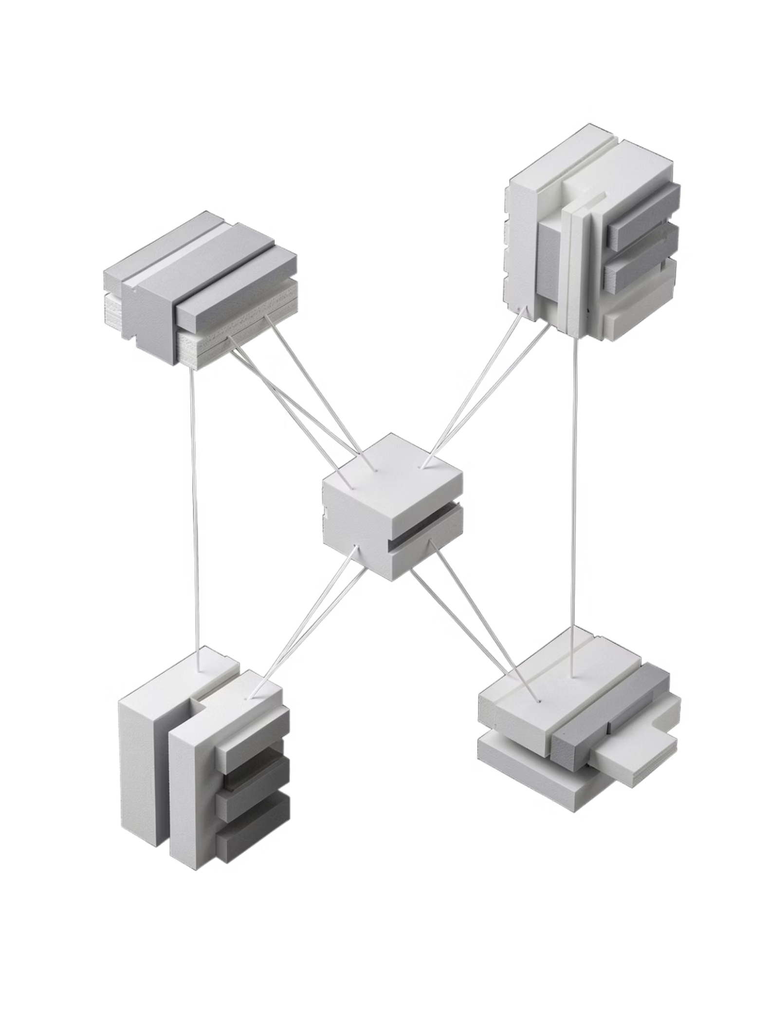
Introducing Spendly
Three applications. One unified ecosystem. Zero servers. Every component operates independently, communicates directly, and stores nothing in the cloud.
Spendly
Spendly Shop
The consumer wallet. Track expenses, claim offers, scan barcodes, and manage your complete financial life — offline-first, encrypted at rest.
The merchant terminal. Accept payments, generate invoices, manage inventory, and issue QR receipts without any monthly subscription or internet connection.
Spendly Radar
The discovery layer. Broadcast localized offers and promotions peer-to-peer to nearby users — no central server, no tracking, no intermediaries.

Slide 4

System Architecture
Spendly's architecture is built like a precision instrument — each layer has a singular purpose, and every component communicates through well-defined, secure interfaces.
01
Frontend Layer
React PWA with IndexedDB via Dexie.js — fully offline-capable UI with persistent local storage and instant load times.
02
Networking Layer
WebRTC and PeerJS enable direct device-to-device communication. Cloudflare Workers with KV provide optional edge relay for discovery.
03
Security Layer
WebAuthn for passwordless authentication. AES-256-GCM encryption for all stored data. Secure Enclave integration for biometric unlock.
04
Deployment Layer
Cloudflare Workers serverless edge functions. Zero persistent infrastructure. Sub-millisecond global response times when online.

Slide 5





How a Transaction Flows
From discovery to settlement, every step happens locally and peer-to-peer. No round-trips to a server. No waiting. No exposure.
Discover
User discovers a local offer via Spendly Radar's peer-to-peer broadcast in proximity.
Claim
Coupon claimed and stored in encrypted IndexedDB. Barcode generated for in-store redemption.
Validate
Merchant scans barcode. Spendly Shop validates offer locally — no server call required.
Invoice
Invoice generated, shared peer-to-peer, and archived. Expense recorded. Analytics updated instantly.

Slide 6
Technology Stack
Every technology choice was deliberate. Each tool was selected for its ability to operate without a server, protect data without compromise, and scale without infrastructure.
Layer
Technology
Purpose
Frontend
React + PWA
Installable, offline-first user interface
Database
IndexedDB + Dexie.js
Encrypted local persistence on device
Networking
WebRTC + PeerJS
Direct peer-to-peer device communication
Edge
Cloudflare Workers + KV
Serverless relay and ephemeral state
Security
WebAuthn + AES-256-GCM
Biometric auth and military-grade encryption

Slide 7
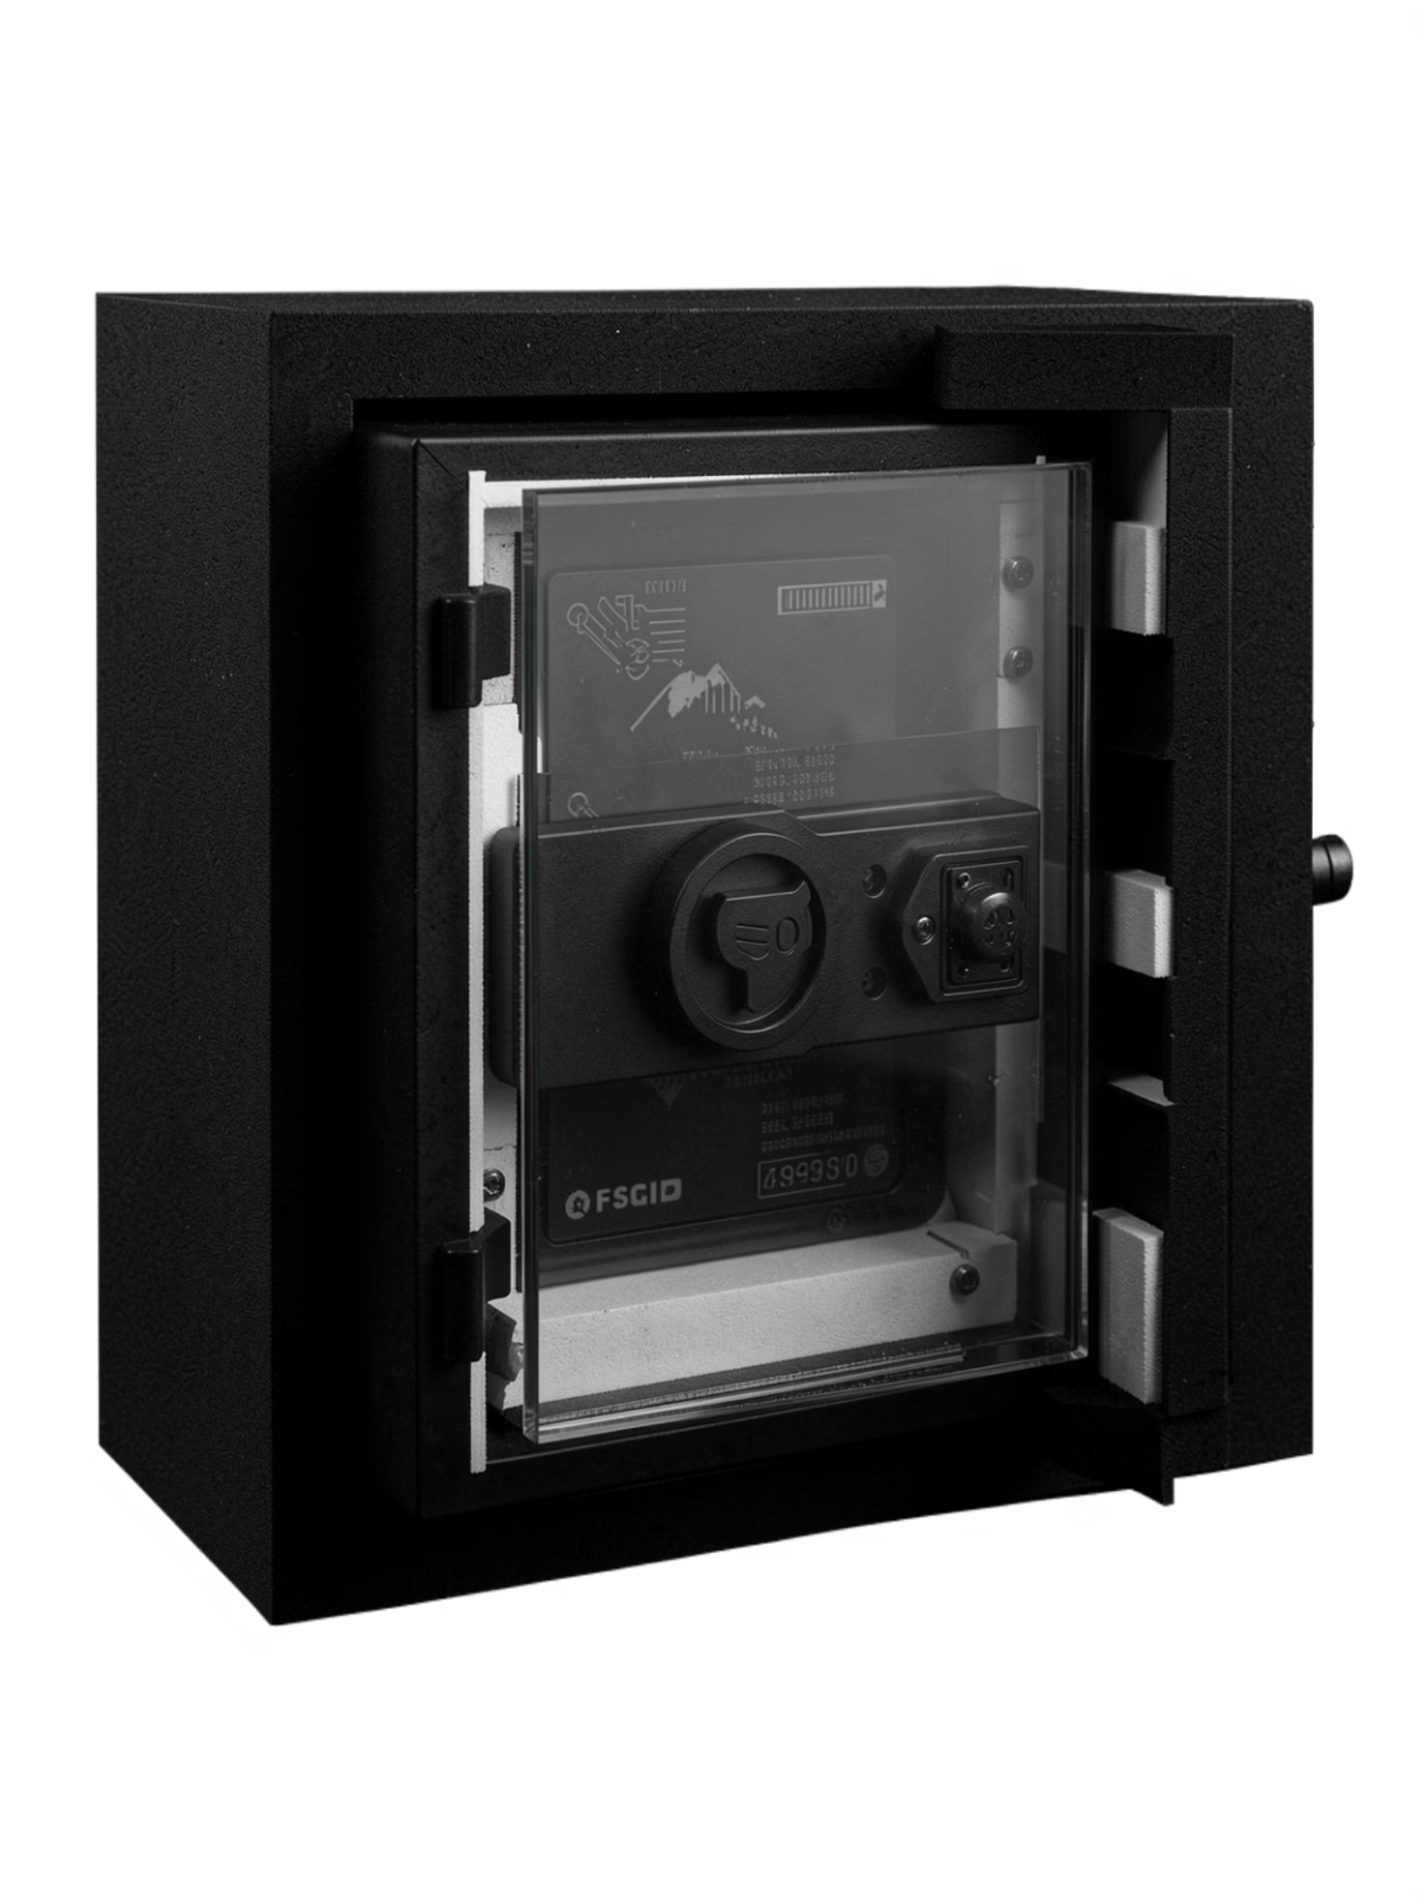

Security by Design
Spendly doesn't add security as a feature — security is the foundation. Every architectural decision begins with the question: how do we protect this without a server?
Zero-Knowledge Architecture
No financial data ever leaves the device in plaintext. The server knows nothing about your transactions, balance, or identity.
WebAuthn Biometric Unlock
Passwordless authentication via fingerprint or face recognition. Credentials stored in the device's Secure Enclave — never on a server.
AES-256-GCM Encryption
All data at rest is encrypted using authenticated encryption. Tamper detection built in. Keys derived from biometric hardware bindings.
Offline-First Data Model
IndexedDB stores all records locally. Sync is optional and peer-to-peer. The application is fully functional without any network connection.

Slide 8
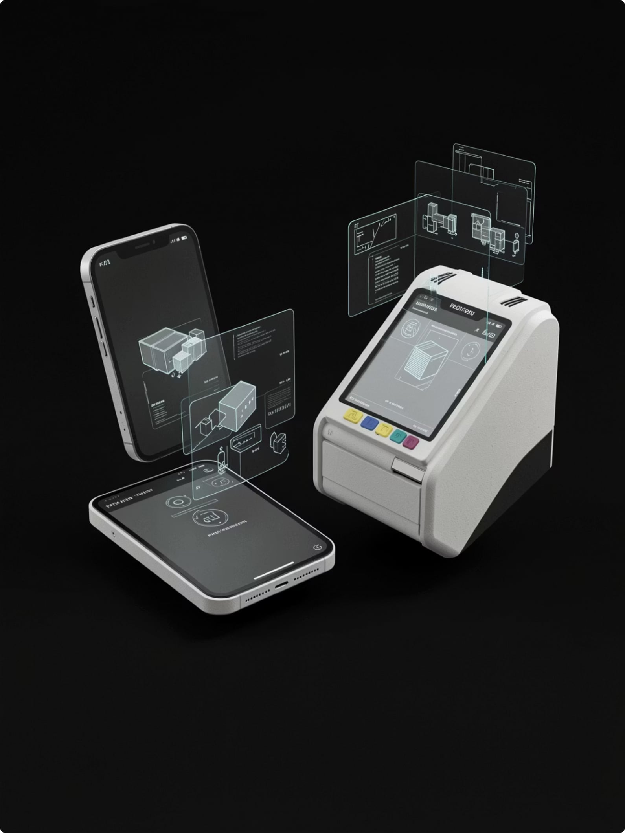




Core Features
Every feature was designed to replace an existing tool — wallet, POS terminal, expense tracker, loyalty card, and analytics dashboard — in a single, private, offline-capable application.
Expense & Wallet
Real-time expense tracking with a built-in cash wallet. Categorize, filter, and analyze spending — all stored locally.
Merchant Billing & QR Invoice
Generate and share itemized invoices via QR code. No printer required. No paper. No server.
Inventory & EMI Alerts
Track stock levels in Spendly Shop. Set automated EMI and payment reminders for customers and merchants alike.
Offline Sync & Analytics
Full functionality without internet. When connectivity returns, peer-to-peer sync resolves conflicts silently and securely.

Slide 9

Advantages & What Comes Next
Spendly eliminates the cost, latency, and risk of traditional finance infrastructure — and the roadmap extends that vision further.
Current Advantages
Future Scope
Offline First — Fully operational without internet connectivity
Zero Server Cost — No hosting, no subscriptions, no infrastructure
Complete Privacy — Zero-knowledge architecture, no data leakage
Fast Billing — Instant peer-to-peer invoice generation and sharing
P2P Communication — Direct device-to-device, no intermediaries
AI Insights — On-device spending pattern analysis and predictions
Voice Billing — Hands-free merchant transactions via voice commands
UPI & NFC — Native integration with India's payment infrastructure
GST Compliance — Automated tax invoice generation for merchants
Multi-Store — Unified dashboard for merchant chains and franchises

Slide 10
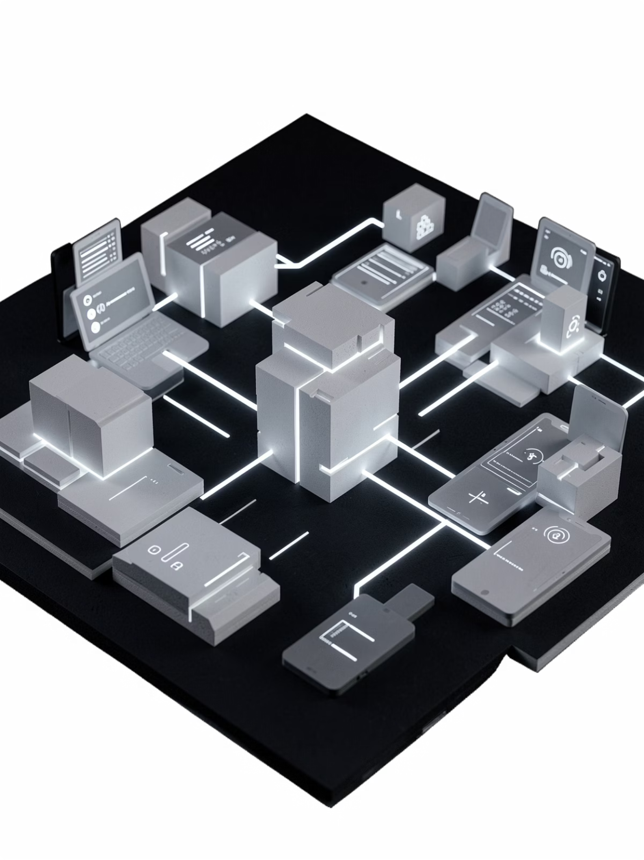
Spendly
Finance. Rebuilt for privacy. Built for offline. Built for you.
Spendly is not an incremental improvement on existing finance apps. It is a fundamental rethinking of what financial infrastructure should look like when privacy is the default, offline is the norm, and the user owns their data completely.
Offline-First
Zero-Knowledge
Works everywhere, always
No one sees your data
Peer-to-Peer
No servers, no middlemen
Thank you. Questions are welcome.

