Slide 1

SEMESTER VII · INFORMATION TECHNOLOGY · MAJOR PROJECT
Spendly
Offline-First Zero-Knowledge Peer-to-Peer Finance Ecosystem
A privacy-preserving, serverless financial infrastructure — operating entirely offline, secured through zero-knowledge cryptography, and built for the next generation of commerce.
Student Name · Enrollment Number · Semester VII · Information Technology · College Name

Slide 2


The Problem with Modern Finance
Every digital transaction today creates a vulnerability — a traceable record stored on someone else's server, exposed to breaches, surveillance, and dependency. The current architecture is fundamentally broken.
Privacy at Risk
Centralized databases are prime targets. Every transaction leaks behavioral, financial, and personal data to third parties.
Internet Dependency
POS systems, billing apps, and wallets fail without connectivity — crippling commerce in low-bandwidth or remote environments.
Monthly POS Costs
Merchants pay recurring subscription fees for hardware and software that could operate independently at zero cost.
Data Breach Exposure
A single centralized breach compromises millions of users simultaneously. There is no containment, no recovery.

Slide 3

Introducing Spendly
Three interconnected applications forming a complete, privacy-first financial ecosystem — no servers, no subscriptions, no compromise.
Spendly
Spendly Shop
The consumer-facing app. Track expenses, claim offers, scan barcodes, and manage personal finance — entirely offline, entirely private.
A merchant POS application. Generate invoices, manage inventory, accept payments, and sync peer-to-peer — zero monthly fees.
Spendly Radar
The discovery layer. Broadcast localized offers and coupons via WebRTC mesh — reaching nearby users without internet or central servers.

Slide 4
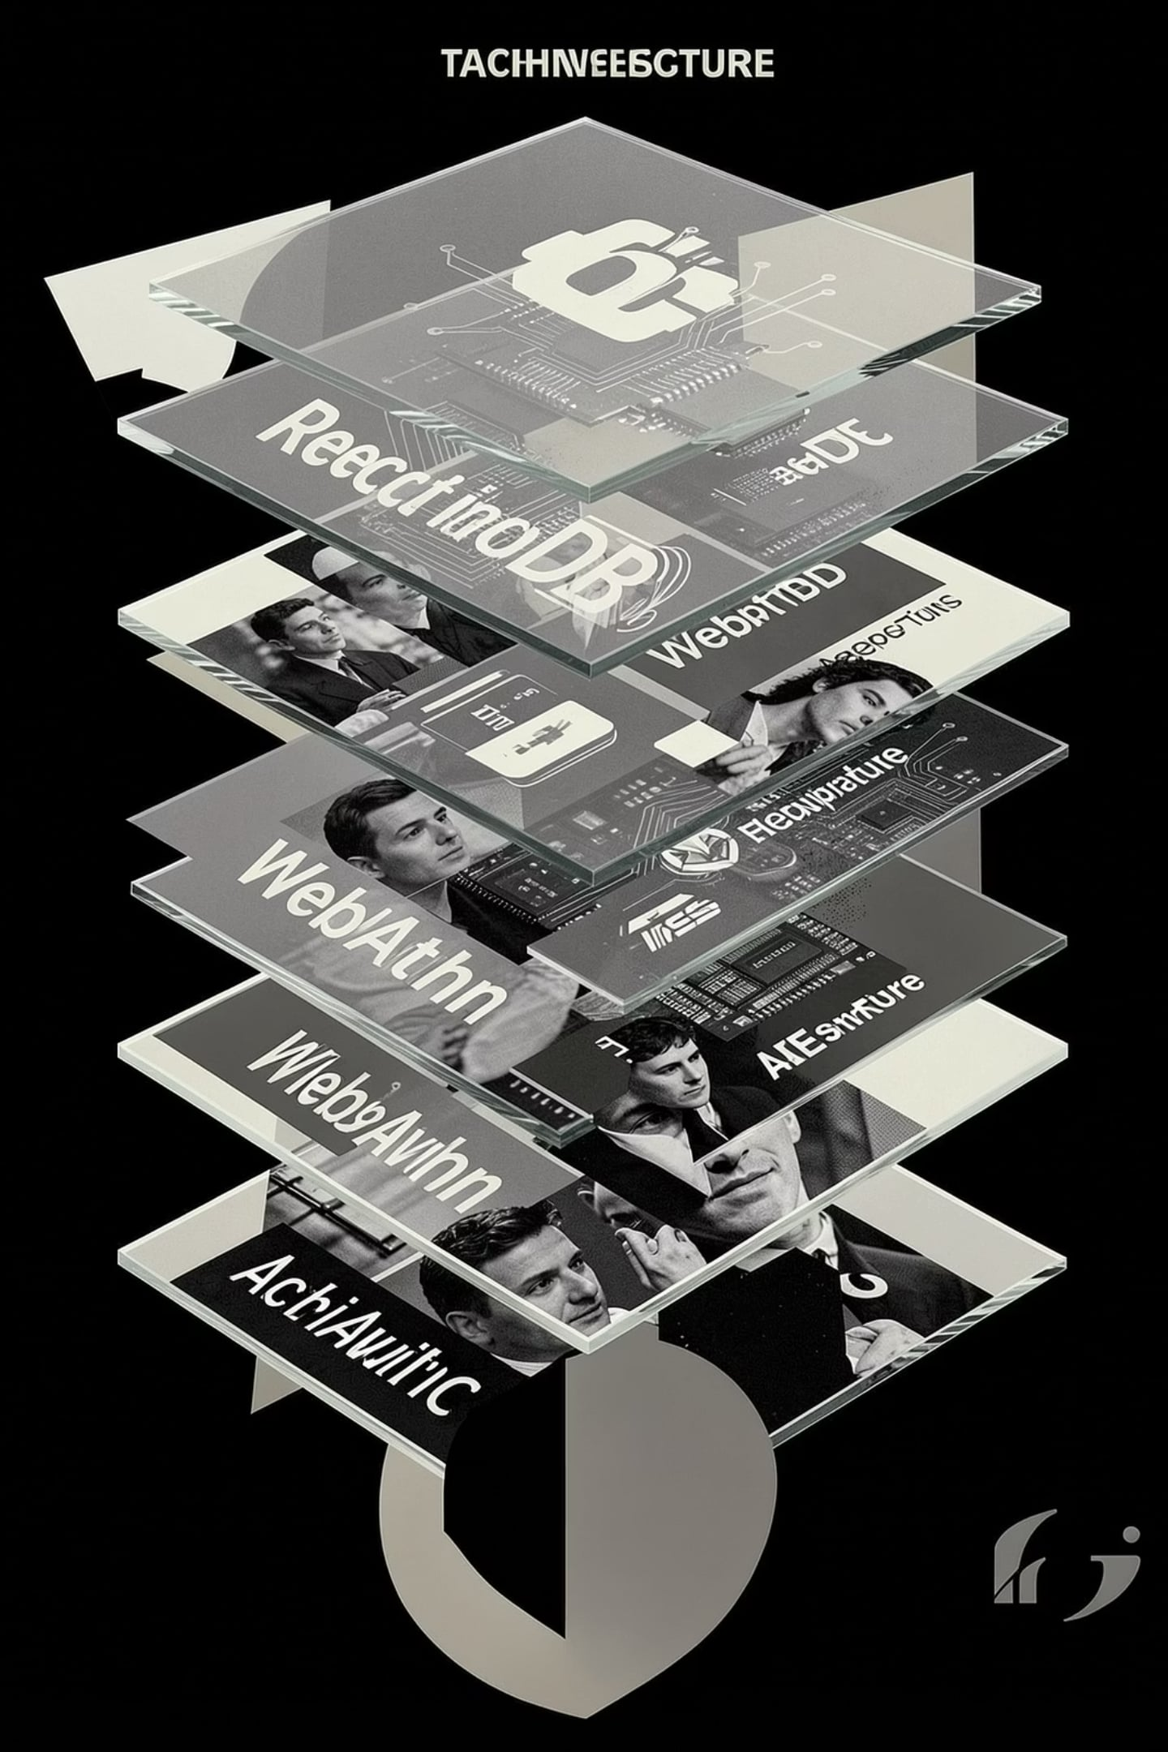

System Architecture
Spendly's architecture is a deliberate departure from cloud-native design. Every layer is chosen to enable offline operation, peer-to-peer communication, and cryptographic security — without a single centralized server in the critical path.
Frontend Layer
1
React + PWA — a fully installable, offline-capable progressive web app with responsive UI and IndexedDB local storage via Dexie.js.
Networking Layer
2
WebRTC + PeerJS — direct browser-to-browser encrypted channels for real-time peer-to-peer data exchange without intermediaries.
Edge Layer
3
Cloudflare Workers + KV — optional lightweight edge functions for non-sensitive metadata, never for financial data or user state.
Security Layer
4
WebAuthn + AES-256-GCM — hardware-backed biometric authentication and authenticated encryption for all stored and transmitted data.

Slide 5
How Spendly Works
From discovery to settlement — every step is local, encrypted, and peer-to-peer. No round-trips to a server. No latency. No exposure.
01
02
Offer Discovery
Coupon Claim
Spendly Radar broadcasts localized coupons via WebRTC mesh to nearby devices.
User claims offer — stored locally in IndexedDB, validated offline.
03
04
Barcode Scan
Product Lookup
Product identified via on-device scan — no external API call required.
Inventory matched from local cache synchronized peer-to-peer with Spendly Shop.
05
06
Offer Validation
Invoice Generation
Coupon applied and validated through encrypted local logic — zero server contact.
Spendly Shop generates signed invoice, transmitted directly to user's device via WebRTC.
07
08
Invoice Sharing
Expense Saving & Analytics
Encrypted invoice shared peer-to-peer — user stores locally, merchant retains copy.
Spending categorized and analyzed entirely on-device — insights never leave the user's hardware.

Slide 6



Technology Stack
Every technology in Spendly is selected for a single reason: enabling a fully functional, secure, and private financial system without a traditional backend.
Frontend
React · PWA · Dexie.js
Responsive, installable, and fully offline-capable user interface with structured local data management.
Networking
WebRTC · PeerJS
Direct encrypted peer-to-peer channels — no relay servers, no intermediaries, no latency.
Database
IndexedDB · Cloudflare KV
Browser-native structured storage for all financial data; KV for optional non-sensitive edge metadata.
Security
WebAuthn · AES-256-GCM
Hardware-backed biometric authentication and authenticated encryption for all stored and transmitted data.

Slide 7





Security by Design
Spendly does not trust servers. It does not trust networks. It trusts only the user's device and cryptographic proof. Every architectural decision begins and ends with security.
Zero-Knowledge
No financial data ever leaves the device. The server knows nothing — by design, not by policy.
Offline-First
All core operations — billing, inventory, authentication — function without any internet connection.
WebAuthn
Hardware-backed biometric authentication replaces passwords entirely. No credentials to steal.
AES-256-GCM
All data at rest and in transit is encrypted with authenticated encryption — tamper-evident by default.

Slide 8
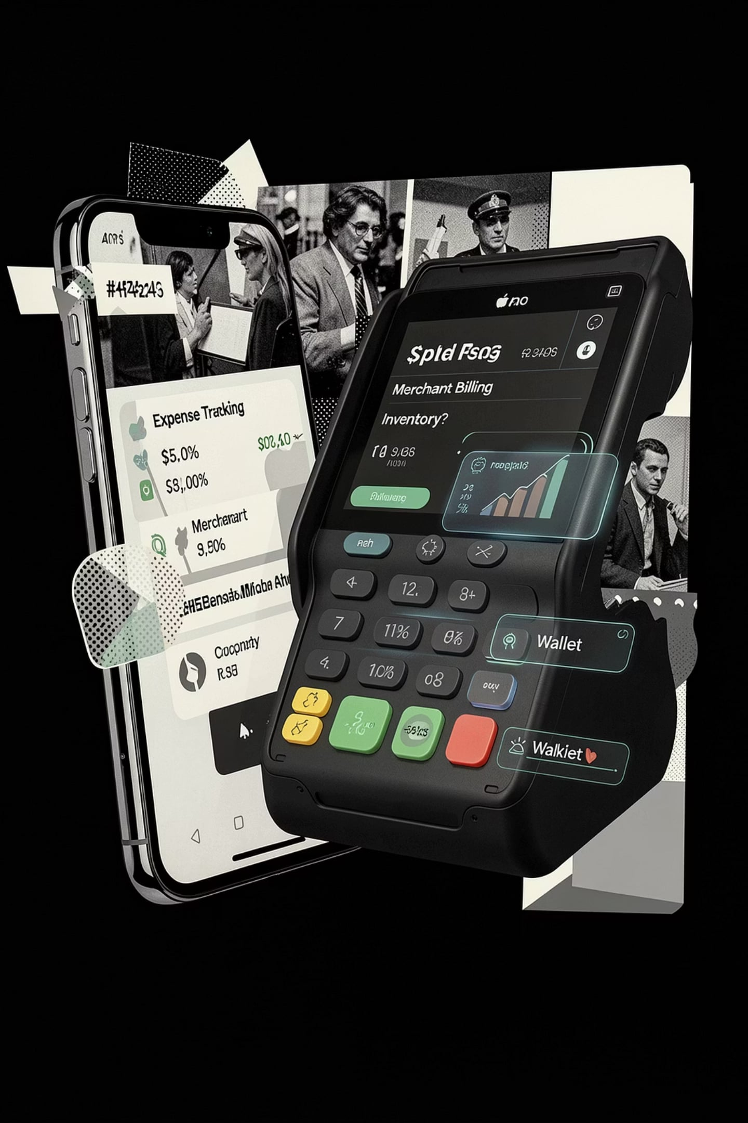




Features
Spendly is a complete financial operating layer — not a single-feature app. Every capability is designed to work independently, offline, and without compromise.
Expense Tracking & Analytics
Real-time categorization, spending trends, and savings insights — computed entirely on-device with zero data exposure.
Merchant Billing & QR Invoice
Generate, sign, and share encrypted invoices peer-to-peer. QR-based checkout eliminates hardware dependency.
Inventory & Cash Wallet
Local inventory management with offline stock sync. Digital cash wallet operates without banking infrastructure.
EMI Alerts & Offline Sync
Automated installment reminders and conflict-free peer-to-peer synchronization when connectivity is restored.

Slide 9

Advantages & Future Scope
Spendly is not merely a project — it is a foundation. The current release delivers a production-grade offline-first finance layer. The roadmap extends it into an intelligent, voice-driven, interoperable commerce platform.
Current Advantages
Offline-First — Full functionality without internet
Zero Server Cost — No infrastructure expenses for merchants
Privacy by Architecture — Data never leaves the device
Fast P2P Billing — Instant peer-to-peer invoice exchange
Future Scope
AI Insights — Predictive spending intelligence
Voice Billing — Hands-free merchant interaction
UPI & NFC — Native payment rail integration
GST & Multi-Store — Compliance-ready merchant tools

Slide 10
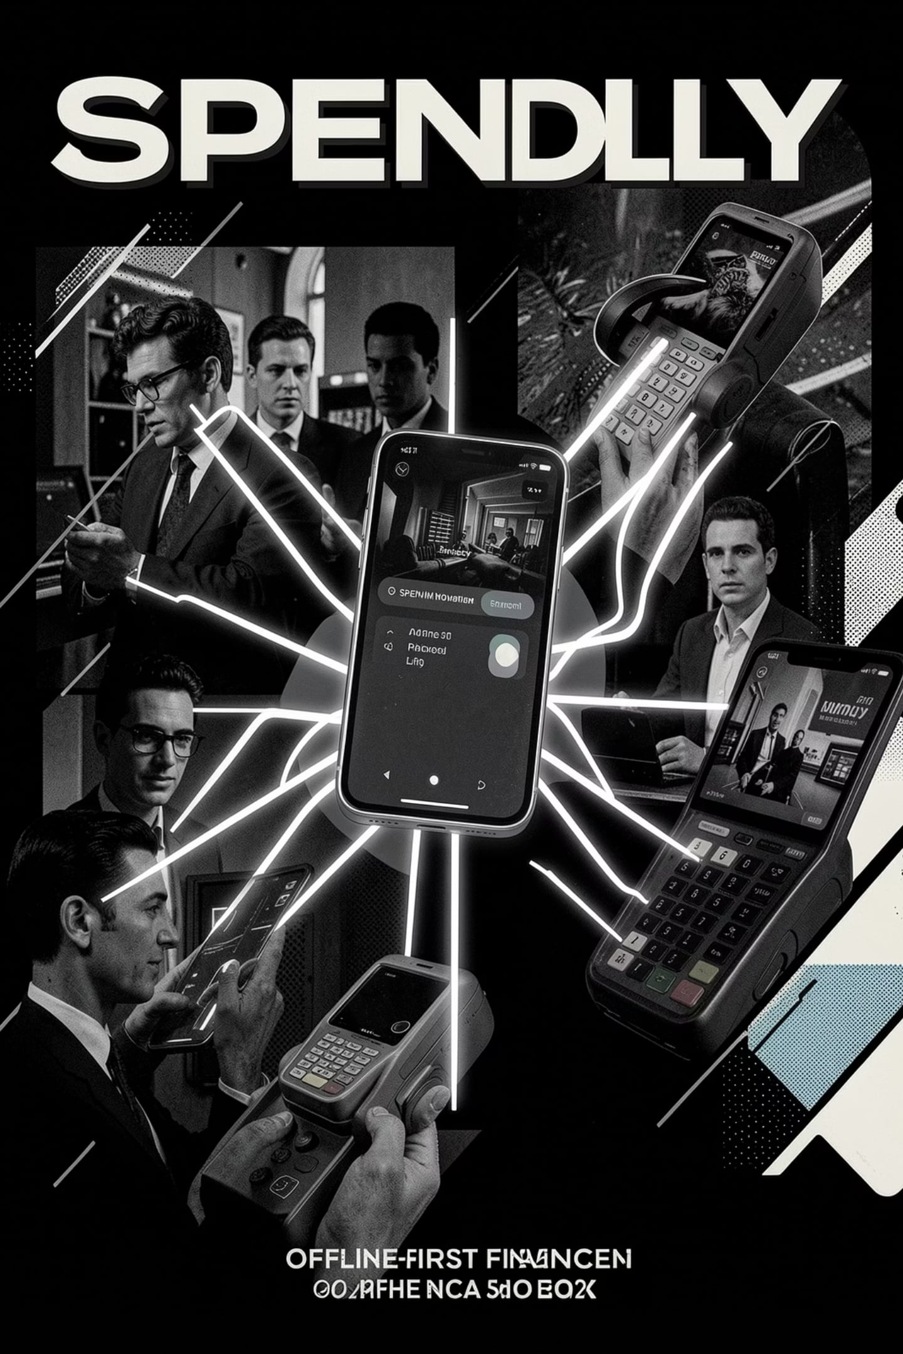
Spendly
The Future of Private Commerce
Spendly redefines what a financial system can be — one that belongs entirely to its users, operates without dependency, and trusts nothing but cryptographic proof. This is not an incremental improvement. This is a new architecture for commerce.
Offline-First
Zero-Knowledge
Always available. Always private.
Your data. Your device. Your rules.
Peer-to-Peer
No servers. No intermediaries.
Thank you. Questions are welcome.

