Slide 1
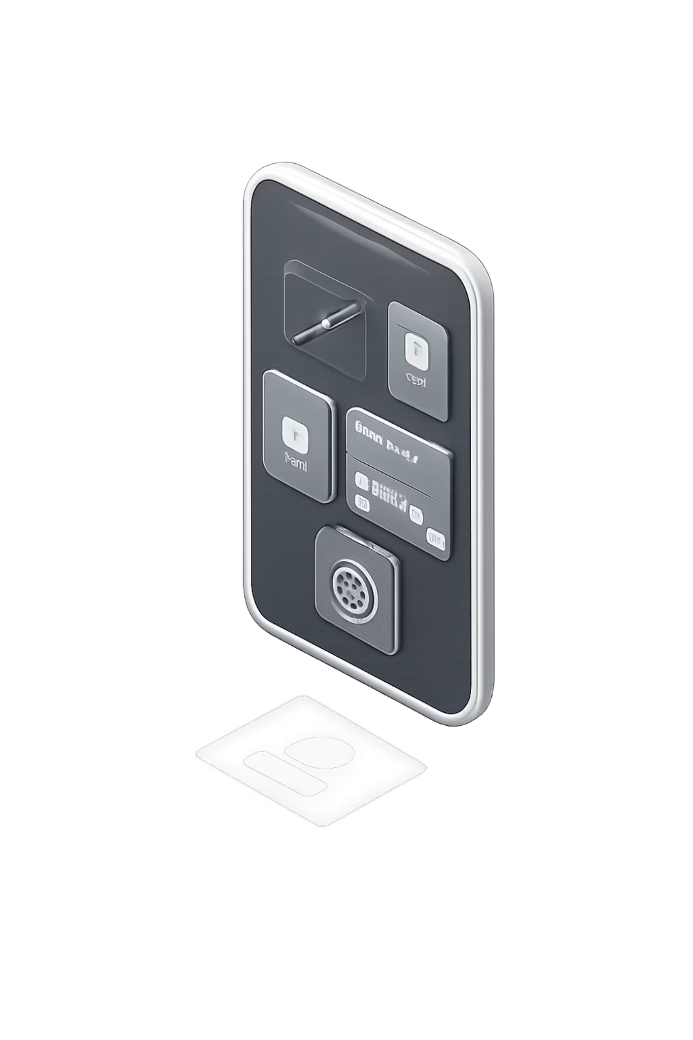
Spendly
Offline-First · Zero-Knowledge · Peer-to-Peer Finance Ecosystem
A semester VII major project in Information Technology — redefining how financial data is stored, shared, and secured. No cloud. No exposure. No compromise.
[Student Name] · [Enrollment Number] · Semester VII · Information Technology · [College Name]

Slide 2

THE PROBLEM
Finance Is Broken by Design
Every transaction you make today is stored on someone else's server, exposed to breaches, and dependent on a connection you may not have. The infrastructure is fragile — and your data pays the price.
Cloud Dependency
Every transaction requires internet. No connectivity means no commerce.
Privacy Exposure
Centralized databases are single points of failure. Breaches are inevitable.
Recurring Costs
Monthly POS subscriptions and server fees burden small merchants.
Data Breaches
Financial records on third-party servers are permanently at risk.

Slide 3


THE SOLUTION
Three Apps. One Ecosystem. Zero Compromise.
Spendly is not a single application — it is a coordinated ecosystem of three purpose-built tools, each designed to operate entirely offline, communicate peer-to-peer, and never expose your data to a central authority.
Spendly
The consumer wallet. Track expenses, claim coupons, generate invoices, and manage your financial life — all locally, all privately.
Spendly Shop
The merchant terminal. Accept payments, manage inventory, issue QR invoices, and sync offline — with zero monthly fees.
Spendly Radar
The discovery layer. Find nearby offers, validate coupons, and connect to merchants through encrypted peer-to-peer signals.

Slide 4
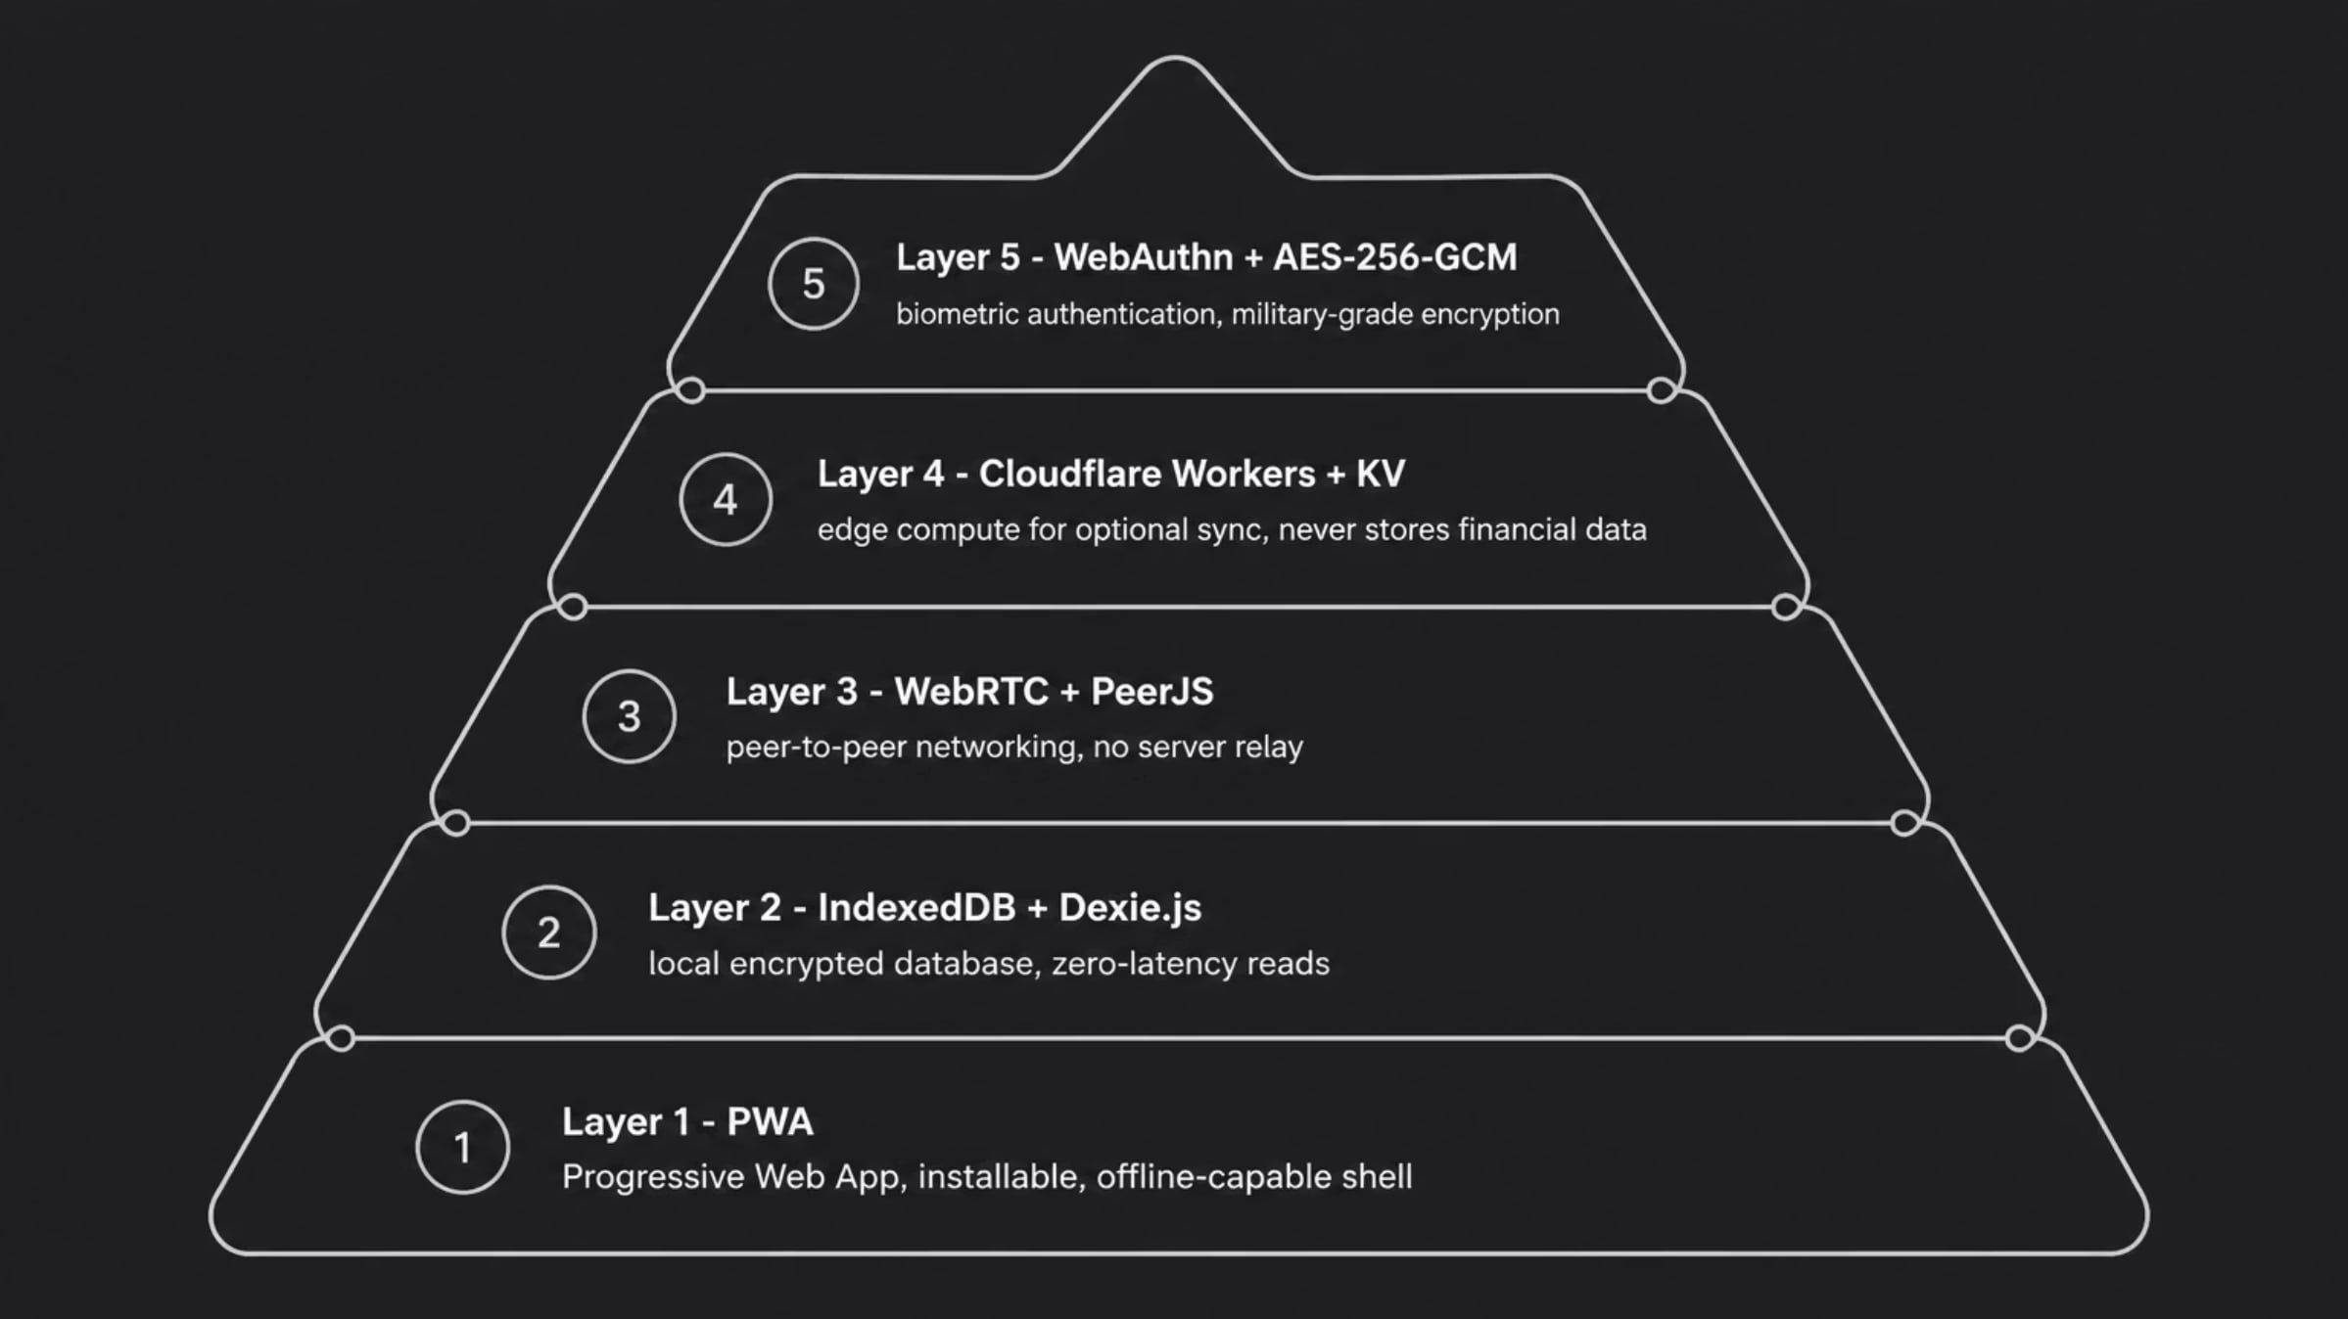
ARCHITECTURE
Layered Like Silicon. Secured Like a Vault.
Spendly's architecture is modeled after the precision of Apple's silicon stack — each layer has a singular responsibility, communicates through clean interfaces, and operates independently. The result is a system that is fast, resilient, and impossible to compromise from the outside.
Each layer is independently replaceable. The system degrades gracefully — even with all external services offline, core financial functions remain fully operational.

Slide 5

USER FLOW
From Discovery to Analytics — In Seconds.
Spendly's transaction flow eliminates every unnecessary step. A customer discovers an offer, claims it, scans a barcode, and receives a validated invoice — all without internet, all without exposing personal data to any server.
Offer Discovery
Coupon Claim
Barcode Scan
Radar detects nearby merchant offers via peer-to-peer signal.
Customer claims offer locally — no server round-trip required.
Product lookup and price validation happen on-device.
Invoice Generation
Expense Analytics
Encrypted invoice created and shared peer-to-peer instantly.
Real-time savings and spending insights, computed locally.

Slide 6
TECHNOLOGY
Every Technology Chosen With Intent.
Spendly's stack is not a collection of popular tools — it is a deliberate assembly of technologies that share a single philosophy: operate at the edge, respect privacy, and never depend on a central authority. Each component was selected for its offline-first capabilities, security guarantees, or peer-to-peer architecture.
Frontend
Core Stack
React — component-driven UI
PWA — installable, offline shell
WebAuthn — passwordless biometric auth
Database: IndexedDB + Dexie.js — encrypted local storage
Networking: WebRTC + PeerJS — direct device-to-device
Edge: Cloudflare Workers + KV — optional sync layer
Security: AES-256-GCM — authenticated encryption

Slide 7

SECURITY
Your Data Never Leaves Your Device.
Spendly implements a zero-knowledge architecture by design. The server knows nothing about your transactions, your balance, or your identity. Every piece of financial data is encrypted with AES-256-GCM before it is written to storage — and the decryption key never leaves your secure enclave.
Zero-Knowledge
No server ever sees your financial data. Not in transit. Not at rest.
Offline-First
All operations execute locally. Connectivity is optional, not required.
WebAuthn
Biometric authentication replaces passwords. Your face is your key.
AES-256-GCM
Military-grade authenticated encryption for every stored record.

Slide 8





FEATURES
Everything a Modern Finance Ecosystem Demands.
Spendly delivers a complete financial toolkit — for consumers and merchants alike. Every feature operates without internet, without a subscription, and without exposing your data to third parties. This is what finance looks like when it is built for the real world.
Expense Tracking
Real-time categorization and spending insights, computed entirely on-device.
Merchant Billing
Generate, sign, and share encrypted invoices without any POS hardware.
Cash Wallet + EMI
Track cash balances, set EMI alerts, and manage payment schedules offline.
QR Invoice + Offline Sync
Share invoices via QR. Sync peer-to-peer when connectivity is available.

Slide 9
ADVANTAGES · ROADMAP
Built for Today. Designed for Tomorrow.
Core Advantages
Future Scope
Offline-First — fully functional without internet
Zero Server Cost — no monthly POS or cloud fees
Privacy by Default — zero-knowledge architecture
Fast Billing — local computation, no latency
P2P Communication — direct, encrypted device links
AI Insights — on-device spending intelligence
Voice Billing — hands-free merchant transactions
UPI + NFC — native payment rail integration
GST Compliance — automated tax invoice generation
Multi-Store — unified merchant dashboard

Slide 10
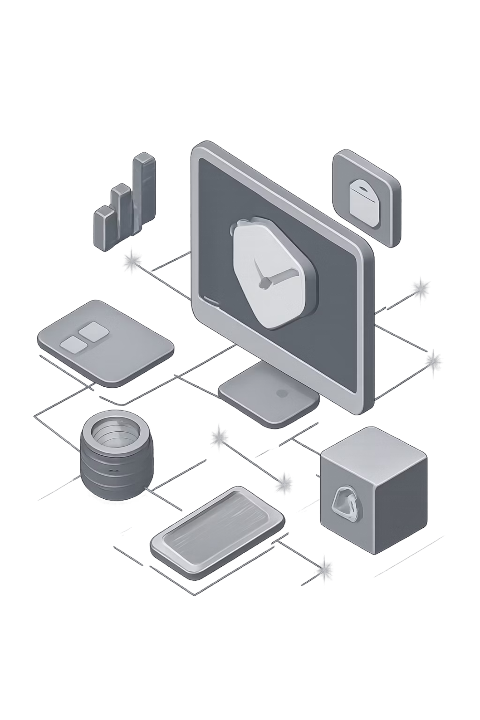

Spendly.
Privacy. Innovation. Offline-First Finance.
Spendly is more than a capstone project — it is a statement about what financial technology should be. Local-first. Zero-knowledge. Peer-to-peer. Built for a world where connectivity is unreliable, privacy is non-negotiable, and small merchants deserve enterprise-grade tools without enterprise-grade costs.
Thank You
Questions are welcome. The Spendly ecosystem is open for discussion.

