Slide 1
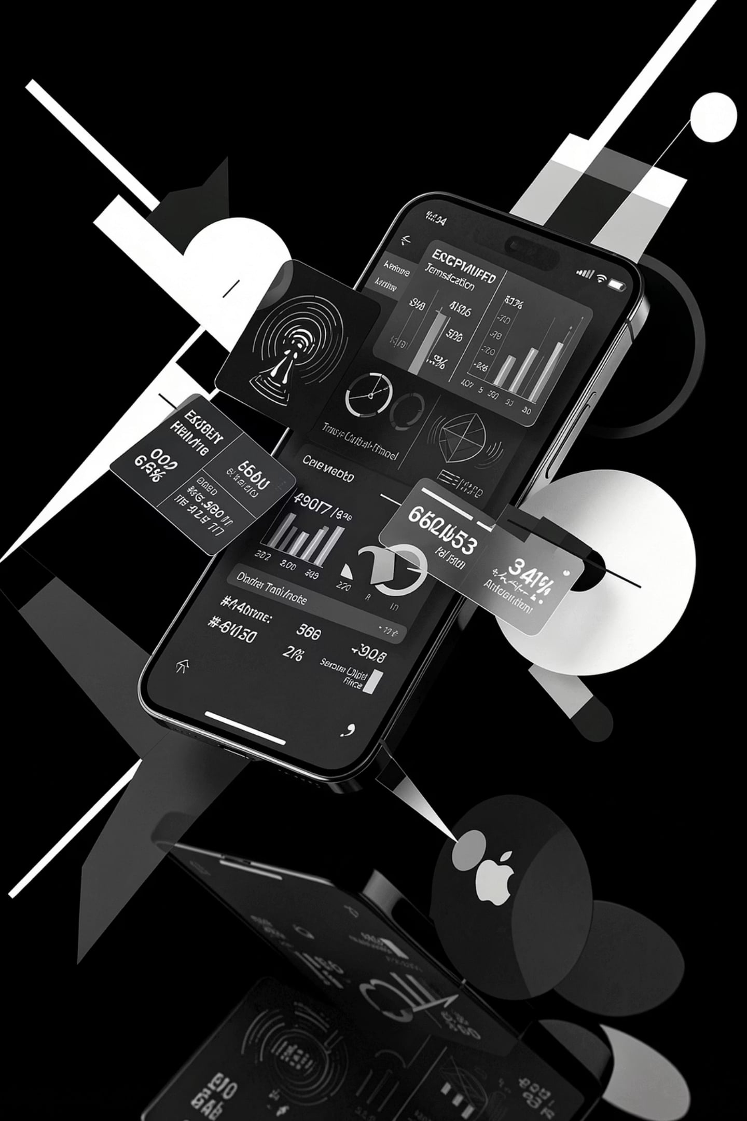
Spendly
Offline-First Zero-Knowledge Peer-to-Peer Finance Ecosystem
[Student Name] · [Enrollment Number] · Semester VII · Information Technology · [College Name]

Slide 2
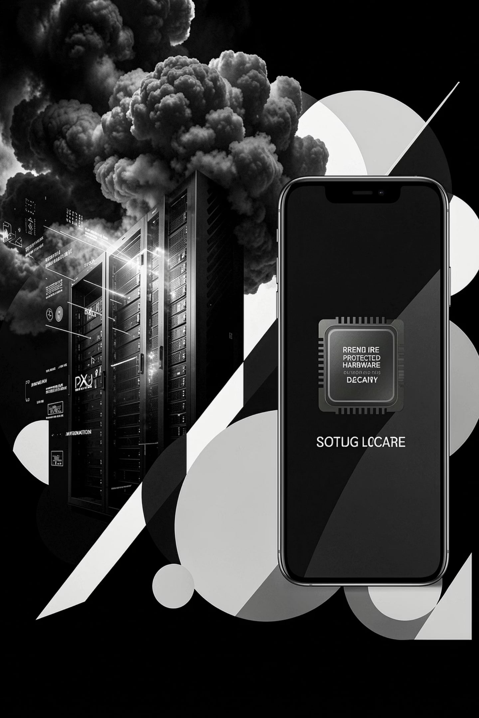

THE PROBLEM
Finance Today Is Broken
Modern payment systems are built on fragile assumptions — always-on internet, trusted third parties, and centralized data stores. Every transaction leaks metadata. Every POS terminal charges a premium. Every breach exposes everything.
Privacy Collapse
Every purchase is logged, tracked, and monetized. Centralized databases are single points of catastrophic failure.
Cloud Dependency
Offline environments render most fintech systems completely inoperable. Rural and low-connectivity markets are excluded.
POS Cost Burden
Monthly hardware and subscription fees make digital billing inaccessible for small merchants and micro-enterprises.
Data Breach Risk
A single server compromise exposes millions of users. Centralized architecture is structurally indefensible at scale.

Slide 3

THE SOLUTION
Introducing Spendly
Three interconnected applications — one unified ecosystem. Spendly reimagines peer-to-peer finance as a privacy-preserving, offline-capable, zero-infrastructure system built for the real world.
Spendly
Spendly Shop
The consumer wallet. Offline expense tracking, encrypted invoices, biometric authentication, and peer-to-peer settlement — all without a server.
The merchant POS. Barcode scanning, inventory management, QR invoicing, and cash wallet — zero monthly fees, zero internet required.
Spendly Radar
The discovery layer. Proximity-based offer detection, coupon claiming, and encrypted peer communication through WebRTC mesh networking.

Slide 4
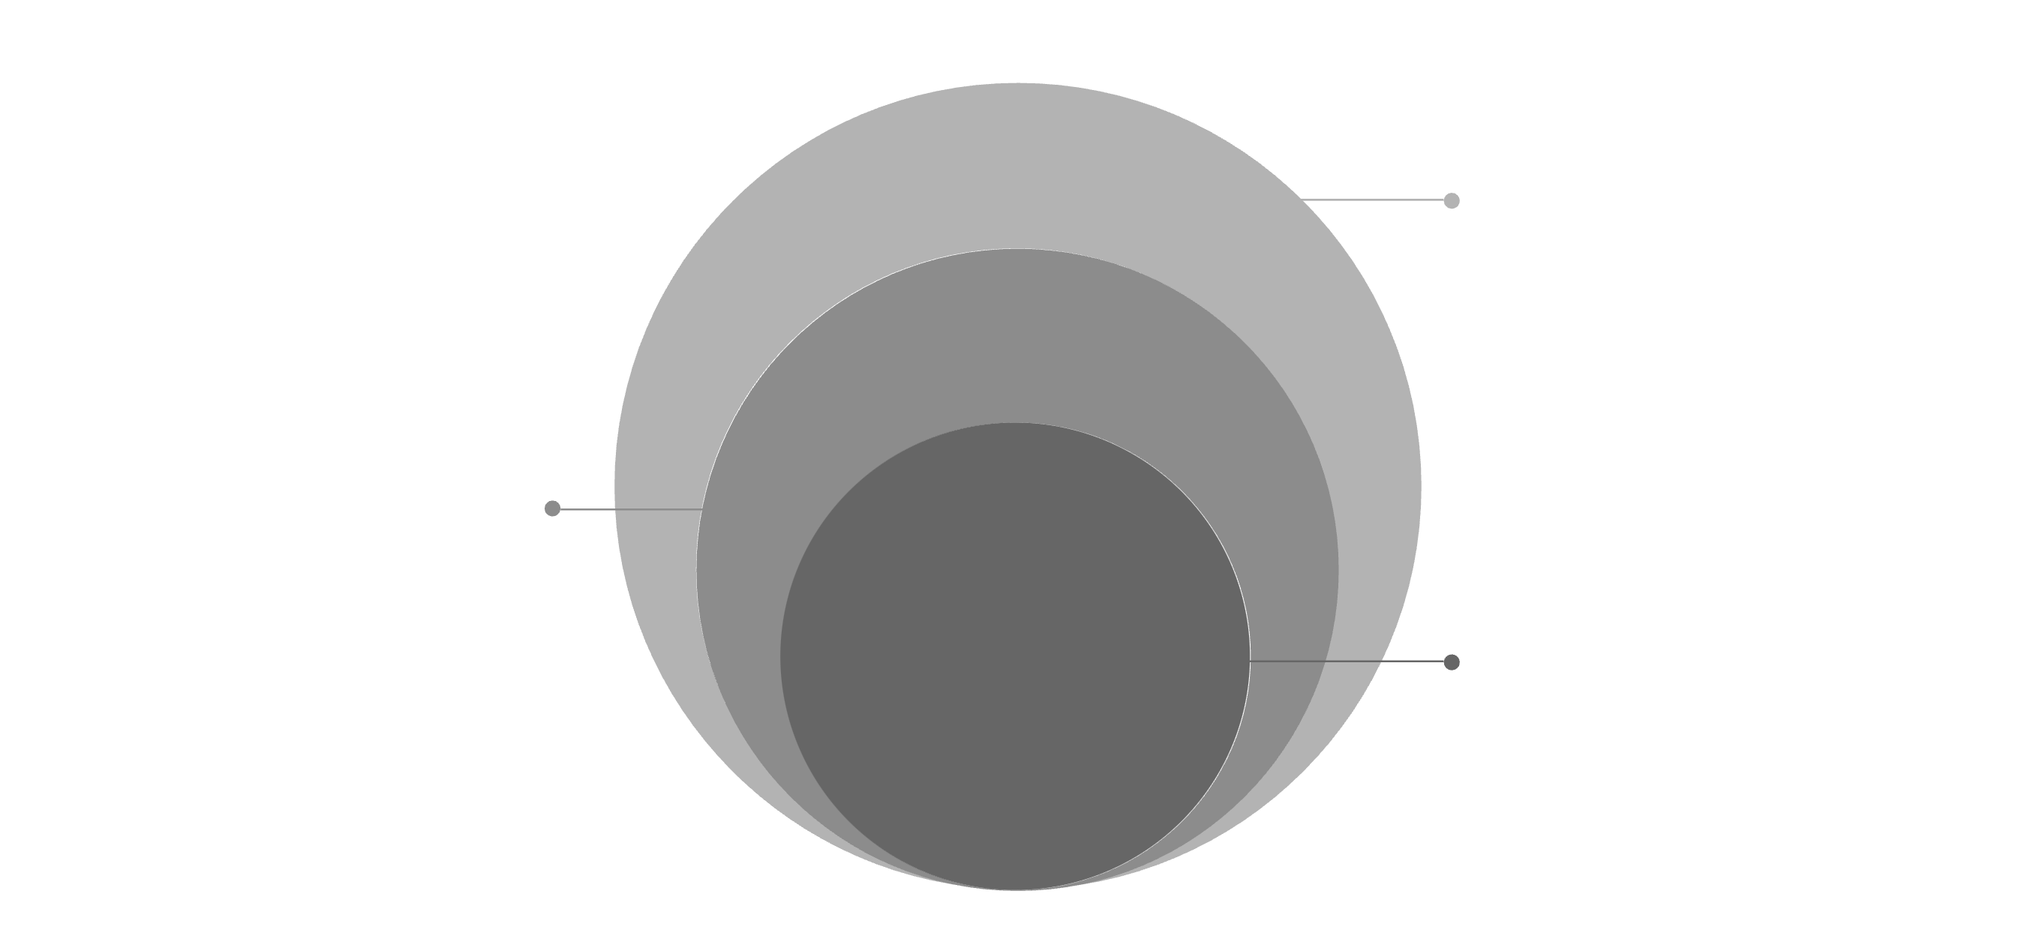
ARCHITECTURE
System Architecture
Spendly's architecture is an exploded layered stack — each technology occupies a precise stratum, from the reactive interface down to cryptographic storage. No layer depends on a central authority.
Application & Data
Dexie IndexedDB with AES-256-GCM encryption
Networking Layer
WebRTC, PeerJS, Cloudflare Workers KV
Core Infrastructure
Zero-server, offline-first, secure enclave
React and PWA deliver the interface. IndexedDB with Dexie.js provides structured local persistence. WebRTC and PeerJS enable direct device-to-device communication. Cloudflare Workers with KV offer optional edge caching. WebAuthn and AES-256-GCM secure every layer — all without a central database.

Slide 5

WORKING FLOW
From Discovery to Settlement
01
Offer Discovery
Spendly Radar detects proximity-based merchant offers through encrypted peer signaling.
02
Coupon Claim & Barcode Scan
User claims offer; merchant scans product barcode via Spendly Shop for instant lookup.
03
Offer Validation & Invoice Generation
System validates eligibility, applies discount, and generates a cryptographically signed invoice.
04
Invoice Sharing & Expense Analytics
Invoice transfers peer-to-peer via WebRTC; expense is logged locally with real-time savings analytics.

Slide 6
TECHNOLOGY
The Technology Stack
Every technology in Spendly was selected for a single reason: it must work without a server. The stack is lean, modern, and purpose-built for offline-first cryptography.
Frontend & UI
Networking & Edge
React — Component-driven reactive interface
PWA — Installable, offline-capable web app
WebAuthn — Biometric and hardware-key authentication
WebRTC — Direct peer-to-peer data channels
PeerJS — Simplified WebRTC signaling abstraction
Cloudflare Workers — Optional serverless edge functions
Worker KV — Distributed key-value edge storage
Database & Storage
IndexedDB — Browser-native structured local storage
Dexie.js — Ergonomic IndexedDB wrapper with schema versioning
Security
AES-256-GCM — Authenticated encryption for all stored data
Secure Enclave — Hardware-backed key isolation

Slide 7

SECURITY
Zero-Knowledge by Design
Spendly never transmits raw financial data. Every record is encrypted before storage. Every authentication is local. Every transaction is peer-to-peer. The server knows nothing — because there is no server.
Zero-Knowledge Architecture
No plaintext data ever leaves the device. The system proves validity without revealing content — mathematically, not trust-based.
Offline-First Encryption
AES-256-GCM encrypts all IndexedDB records at rest. Keys are derived from biometric credentials and never transmitted.
WebAuthn Biometric Unlock
FIDO2-compliant authentication binds access to hardware-backed biometrics. No passwords. No recovery emails. No attack surface.
Secure Enclave Isolation
Cryptographic keys are stored in hardware-isolated secure enclaves — inaccessible to the application layer or any remote adversary.

Slide 8





FEATURES
Everything a Modern Finance System Needs
Expense Tracking
Real-time local categorization with encrypted ledger history — fully operational without connectivity.
Merchant Billing
Instant QR invoice generation, barcode product lookup, and digital receipt delivery — zero hardware cost.
Inventory & Cash Wallet
Local stock management with cash balance tracking and EMI alert notifications for merchants.
Offline Sync & Analytics
Data syncs peer-to-peer when connectivity resumes. Spending insights are computed locally — never in the cloud.

Slide 9
ADVANTAGES & ROADMAP
What Spendly Delivers — and Where It Goes
Current Advantages
Future Scope
Offline-First — Fully functional without internet
Zero Server Cost — No infrastructure, no subscription
Privacy-Preserving — Zero-knowledge, local-only data
Fast Billing — Sub-second QR and barcode processing
P2P Communication — Direct device-to-device settlement
AI Insights — On-device spending pattern analysis
Voice Billing — Voice-command invoice generation
UPI & NFC — Native Indian payment rail integration
GST Compliance — Automated tax invoice formatting
Multi-Store — Chain merchant management layer

Slide 10

CONCLUSION
Spendly Is Not a Feature. It Is a Foundation.
Spendly demonstrates that privacy, offline capability, and peer-to-peer finance are not compromises — they are design imperatives. Built without a server, without a database, without a cloud. Built for the world as it actually exists.
Offline-First
Zero-Knowledge
Works everywhere, always
Your data stays yours
Peer-to-Peer
No middleman, ever
Thank you. Questions are welcome.

