Slide 1
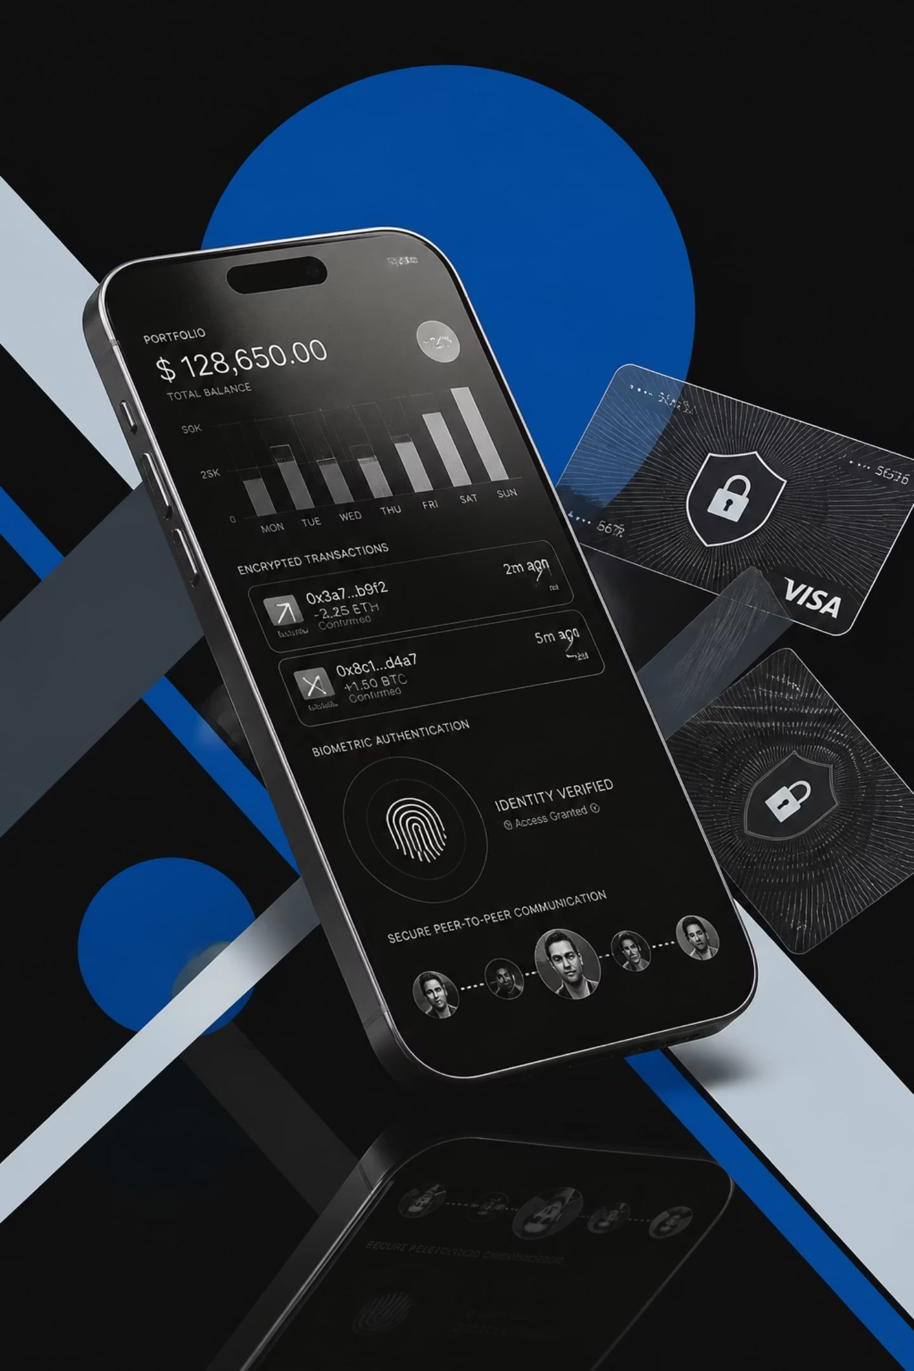
Spendly
Offline-First · Zero-Knowledge · Peer-to-Peer Finance Ecosystem
Student Name · Enrollment Number · Semester VII · Information Technology · College Name

Slide 2
The Problem
Finance today demands trust in systems designed to fail you.
Privacy Risks
Cloud Dependency
Internet Required
Your data is the product
Single points of failure
No connectivity, no finance
Centralized Databases
Monthly POS Costs
Breaches are inevitable
Hardware is a barrier

Slide 3



Introducing Spendly
Three applications. One ecosystem. Zero compromise.
Spendly
Personal finance & expense tracking — offline-first, zero-knowledge
Spendly Shop
Merchant billing, inventory & QR invoices — no POS hardware
Spendly Radar
Local offer discovery & peer-to-peer coupon sharing

Slide 4

System Architecture
01
React + PWA
Progressive Web App shell
02
IndexedDB + Dexie.js
Offline-first local database
03
WebRTC + PeerJS
Direct peer-to-peer networking
04
Cloudflare Workers + KV
Edge compute & key-value store
05
WebAuthn + AES-256-GCM
Biometric auth & end-to-end encryption

Slide 5
Working Flow
Discover Offers
Scan Product
Offer Validation
Invoice Sharing
Analytics
1
2
3
4
5
6
7
8
9
Claim Coupon
Product Lookup
Invoice Generation
Local Storage

Slide 6

Technology Stack
Frontend
Backend
React · Vite · Tailwind CSS · Zustand · Framer Motion
Cloudflare Workers · Worker KV
Networking
Security
WebRTC · PeerJS · ntfy.sh
WebAuthn · AES-256-GCM
Database
IndexedDB · Dexie.js

Slide 7






Security by Design
Your data never leaves your device. No exceptions.
Zero-Knowledge
Offline-First
Server knows nothing
Works without internet
WebAuthn
AES-256-GCM
Biometric unlock
Military-grade encryption
Secure Enclave
IndexedDB
Hardware-backed isolation
Encrypted local storage

Slide 8








Key Features
Expense Tracking
Merchant Billing
Inventory
Cash Wallet
EMI Reminder
QR Invoice
Offline Sync
Analytics

Slide 9

Advantages & Future Scope
TODAY
Advantages
Offline-first architecture
Zero server cost
Privacy by design
Fast billing
Secure communication
TOMORROW
Future Scope
AI analytics
Voice billing
NFC payments
UPI integration
GST & multi-store

Slide 10

Spendly
A privacy-first, offline financial ecosystem built on zero-knowledge architecture and peer-to-peer communication.
Thank You
Questions & Answers

