Slide 1

Spendly
Offline-First Zero-Knowledge Peer-to-Peer Finance Ecosystem
Semester VII · Information Technology · Major Project
[Student Name] · [Enrollment Number] · [College Name]

Slide 2
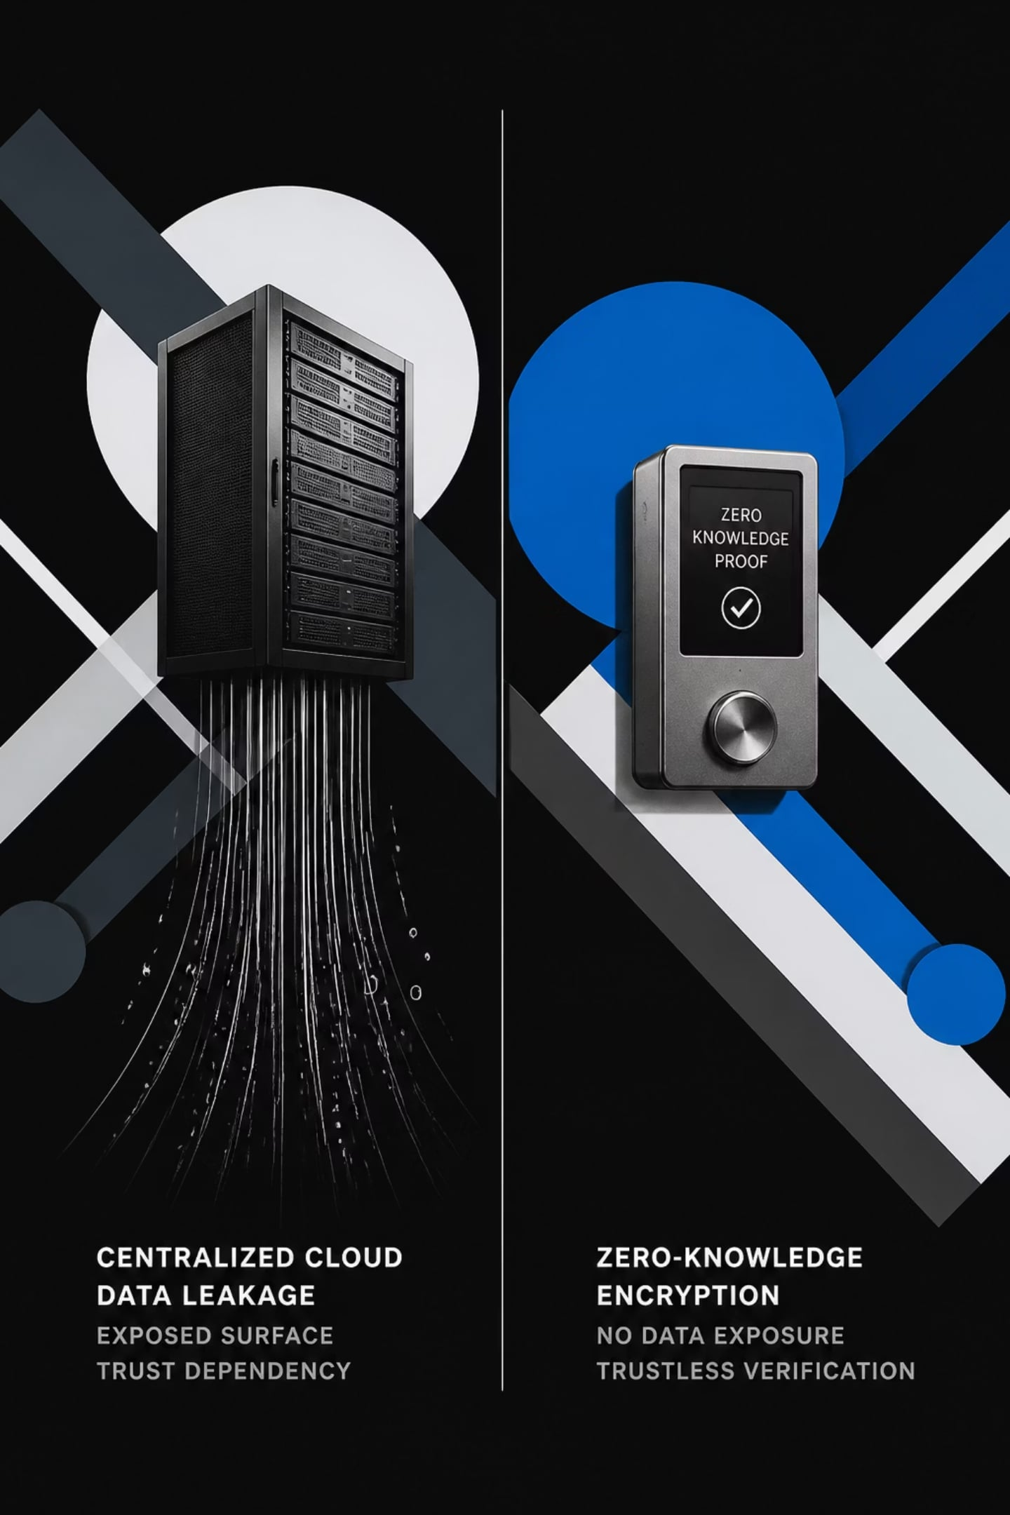
THE PROBLEM
The Financial World Is Broken
Every transaction today leaves a trace — stored on servers you don't control, exposed to breaches you can't prevent, and dependent on infrastructure you can't trust. The current model is fundamentally flawed.
Privacy at Risk
Centralized databases expose sensitive financial data to third parties, advertisers, and malicious actors.
Cloud Dependency
Offline environments render modern payment systems completely useless — a critical failure in emerging markets.
Data Breaches
Centralized storage is a single point of failure. One breach exposes millions of users simultaneously.
POS Costs
Traditional point-of-sale hardware demands monthly subscriptions and proprietary infrastructure.

Slide 3


THE SOLUTION
Introducing the Spendly Ecosystem
Three purpose-built applications working in concert — each designed for a distinct role, all unified by a shared zero-knowledge, offline-first architecture. Together, they redefine how money moves.
Spendly
The core personal finance application. Track expenses, manage wallets, generate invoices, and maintain complete financial sovereignty — entirely offline.
Spendly Shop
A merchant-facing point-of-sale interface. Accept payments, manage inventory, and issue QR invoices without any internet connection or monthly fees.
Spendly Radar
A peer-to-peer discovery and communication layer. Find nearby merchants, claim offers, and synchronize data securely over local networks.

Slide 4

ARCHITECTURE
System Architecture
Spendly is engineered as a layered, privacy-preserving stack — each component chosen for its ability to operate without a central server while maintaining cryptographic guarantees.
Application Edge
Cloudflare Workers, Worker KV, WebAuthn
Network Mesh
WebRTC, PeerJS, ntfy.sh
Core Data
IndexedDB, Dexie.js, AES-256-GCM
The architecture flows upward from persistent local storage through encrypted peer-to-peer networking, serverless edge compute, and finally a responsive React-based progressive web application — all operating without a traditional backend.

Slide 5
WORKFLOW
How Spendly Works
From discovery to settlement, every step in the Spendly workflow is designed to be fast, private, and fully offline-capable. No servers. No latency. No compromise.
Discover Offers
Claim Coupon
Scan Product
Offer Validation
Spendly Radar scans for nearby merchant promotions via local peer-to-peer discovery.
Offers are claimed and stored locally — encrypted and tied to your identity via WebAuthn.
Merchant scans product barcode or SKU. Inventory lookup happens entirely on-device.
Applicable coupons are validated against the cart in real time with zero server calls.
Invoice Generation
Invoice Sharing
Local Storage
Analytics
A signed QR invoice is generated locally and presented to the customer instantly.
Invoice is shared peer-to-peer via WebRTC and stored in IndexedDB for both parties.
All transaction records persist offline in encrypted IndexedDB with Dexie.js indexing.
Spending insights and merchant reports are computed locally — no data ever leaves the device.

Slide 6
TECHNOLOGY
Technology Stack
Every technology in the Spendly stack was selected for a single reason: the ability to deliver a premium, secure, and fully offline experience without a traditional server.
Frontend
Backend
Networking
React · Vite · Tailwind CSS · Zustand · Framer Motion
Cloudflare Workers · Worker KV
WebRTC · PeerJS · ntfy.sh
Security
Database
WebAuthn · AES-256-GCM
IndexedDB · Dexie.js

Slide 7





SECURITY
Zero-Knowledge by Design
Spendly's security model ensures that no party — not the developer, not the merchant, not the network — ever sees your financial data. Privacy is not a feature. It is the foundation.
Zero-Knowledge Architecture
Transactions are validated cryptographically without revealing any underlying data to any third party.
Offline-First Design
All core functionality operates without internet. Data never traverses an external network unless explicitly shared.
WebAuthn + Biometric Unlock
Device-level biometric authentication via WebAuthn ensures only the legitimate user can access financial data.
AES-256-GCM Encryption
All stored data is encrypted at rest using AES-256-GCM — the same standard used by governments and financial institutions.

Slide 8










FEATURES
Key Features
Spendly consolidates every financial interaction — personal and commercial — into a single, privacy-preserving ecosystem. No subscriptions. No cloud. No compromise.
Expense Tracking
Merchant Billing
Real-time categorization and visualization of all personal spending — computed entirely on-device.
Full point-of-sale functionality with QR invoice generation, no internet required.
Inventory Management
Cash Wallet
Track stock levels, SKUs, and product metadata locally with instant lookup.
Digital cash ledger for offline peer-to-peer transfers and balance tracking.
EMI Reminder
QR Invoice
Automated reminders for installment payments, managed without external notifications.
Cryptographically signed invoices shared via QR code — verifiable without a server.
Offline Synchronization
Analytics
Seamless peer-to-peer data sync when devices reconnect — no data loss, ever.
Privacy-safe spending insights and merchant reports generated locally from encrypted data.

Slide 9
ROADMAP
Advantages & Future Scope
Current Advantages
Future Scope
Offline-First: Fully functional without internet connectivity
Zero Server Cost: No infrastructure expenses for merchants or users
Privacy: Zero-knowledge architecture — no data ever leaves your device
Fast Billing: Instant invoice generation with no network latency
Secure Communication: Encrypted peer-to-peer channels via WebRTC
AI Analytics: On-device machine learning for spending pattern insights
Voice Billing: Voice-activated merchant commands for hands-free operation
NFC Payments: Contactless hardware-based peer-to-peer transactions
UPI Integration: Seamless bridge to India's Unified Payments Interface
GST Compliance: Automated tax invoice generation for registered merchants
Multi-Store: Centralized management for merchant chains and franchises

Slide 10
CONCLUSION
The Future of Private Finance
Spendly is more than a project — it is a statement. A declaration that financial privacy, offline resilience, and peer-to-peer trust are not luxuries reserved for the few, but rights owed to everyone. Built without servers. Protected by mathematics. Designed for the world as it is.
Privacy-First
Offline-Ready
Peer-to-Peer
Zero-knowledge architecture ensures your data is yours alone.
Works anywhere — no internet, no cloud, no compromise.
Direct, encrypted communication between users and merchants.
Thank You
Questions & Answers

