Slide 1

Spendly
Offline-First Zero-Knowledge Peer-to-Peer Finance Ecosystem
Student Name · Enrollment Number · Semester VII · Information Technology · College Name

Slide 2
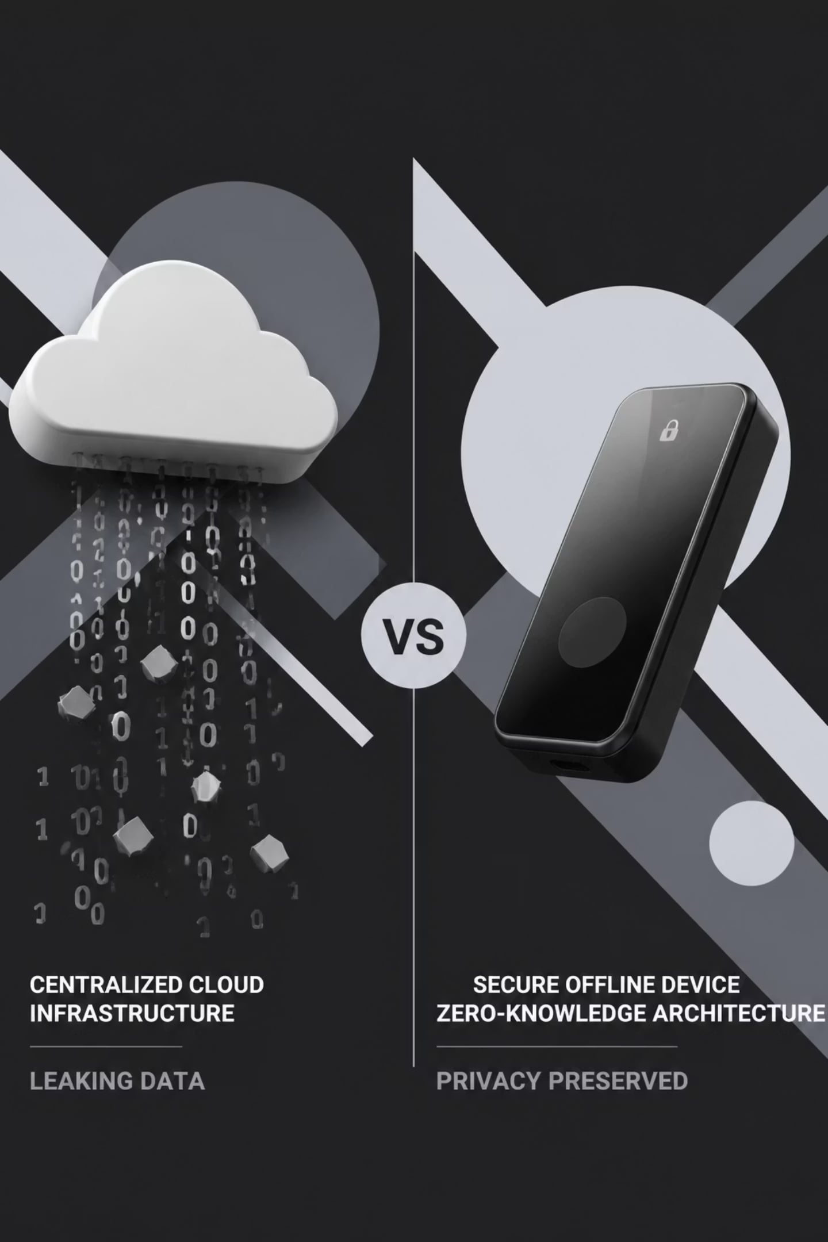
The Problem We're Solving
Modern finance is built on fragile assumptions — always-online, always-trusted, always-exposed.
Privacy at Risk
Cloud Dependency
Centralized servers store every transaction, creating permanent vulnerability to breaches and surveillance.
Offline scenarios break billing, inventory, and payments entirely — a critical failure for real-world commerce.
High POS Costs
Monthly SaaS fees for point-of-sale systems are prohibitive for small merchants and independent retailers.

Slide 3


Introducing the Spendly Ecosystem
Three applications. One unified vision. Zero compromise on privacy or performance.
Spendly
Personal finance and peer-to-peer payments — entirely offline-first, zero-knowledge architecture, biometric-secured.
Spendly Shop
Merchant billing, inventory management, and QR invoice generation — no internet, no monthly fees.
Spendly Radar
Proximity-based offer discovery and coupon claiming through encrypted local peer-to-peer communication.

Slide 4
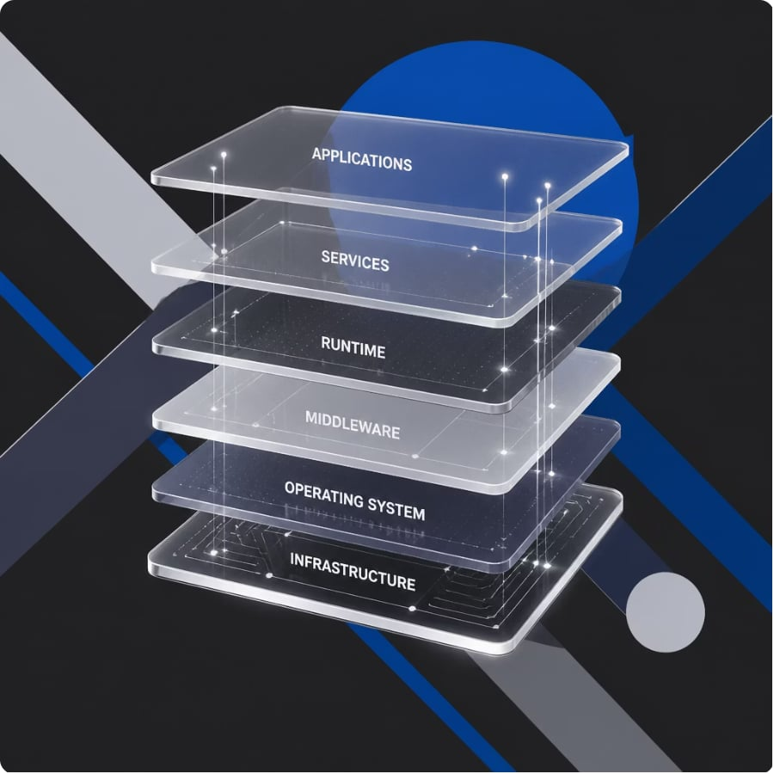

System Architecture
A layered, offline-first architecture where every component operates independently — and synchronizes only when trusted peers are present.
React + PWA
IndexedDB + Dexie.js
Responsive interface, installable on any device without app stores.
Encrypted local database — data never leaves the device without consent.
WebRTC + PeerJS
Cloudflare Workers + KV
Direct device-to-device communication, no relay server required.
Edge compute for lightweight sync — zero persistent server infrastructure.

Slide 5

How It Works
01
Discover Offers
Spendly Radar detects nearby merchant offers through encrypted local broadcast.
02
Claim Coupon · Scan Product
User claims offer; merchant scans product barcode or SKU for instant lookup.
03
Offer Validation · Invoice Generation
System validates eligibility offline; generates a signed QR invoice instantly.
04
Invoice Sharing · Local Storage · Analytics
Invoice shared peer-to-peer; stored locally; analytics updated in real time.

Slide 6

Technology Stack
Frontend
Backend
Networking
React · Vite · Tailwind CSS · Zustand · Framer Motion
Cloudflare Workers · Worker KV
WebRTC · PeerJS · ntfy.sh
Security
Database
WebAuthn · AES-256-GCM
IndexedDB · Dexie.js

Slide 7





Security by Design
Every layer of Spendly is engineered around a single principle: your data belongs to you, and only you.
Zero-Knowledge Architecture
No server ever sees your financial data. Not in transit. Not at rest.
WebAuthn + Biometric Unlock
Hardware-backed authentication via fingerprint or face — no passwords, ever.
AES-256-GCM Encryption
Military-grade encryption applied to every record stored in IndexedDB locally.
Offline-First by Default
Full functionality without internet. Sync occurs only when a trusted peer is in range.

Slide 8

Key Features
Expense Tracking
Real-time categorization with local analytics — no cloud required.
Merchant Billing
Instant QR invoice generation with offline inventory lookup.
Cash Wallet + EMI
Track cash flow and EMI reminders without any bank integration.
Offline Sync
Peer-to-peer synchronization resumes automatically when devices reconnect.

Slide 9



Advantages & Future Scope
CURRENT ADVANTAGES
Zero Server Cost
Privacy First
Fast Offline Billing
Edge-only infrastructure eliminates recurring hosting expenses entirely.
No telemetry, no tracking, no third-party data exposure — ever.
Transactions complete in milliseconds, independent of network state.
FUTURE ROADMAP
AI Analytics · Voice Billing
NFC · UPI · GST · Multi-Store
On-device intelligence for spending insights and hands-free merchant input.
Native payment rails, compliance tooling, and scalable merchant management.

Slide 10

Conclusion
Spendly redefines personal and merchant finance — built on zero-knowledge architecture, peer-to-peer communication, and an uncompromising commitment to privacy. No servers. No exposure. No compromise.
Privacy-First
Offline-First
Zero-knowledge by design
Works without internet
Peer-to-Peer
No central authority
Thank You
Questions & Answers

