Slide 1


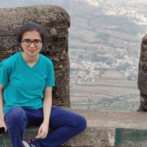


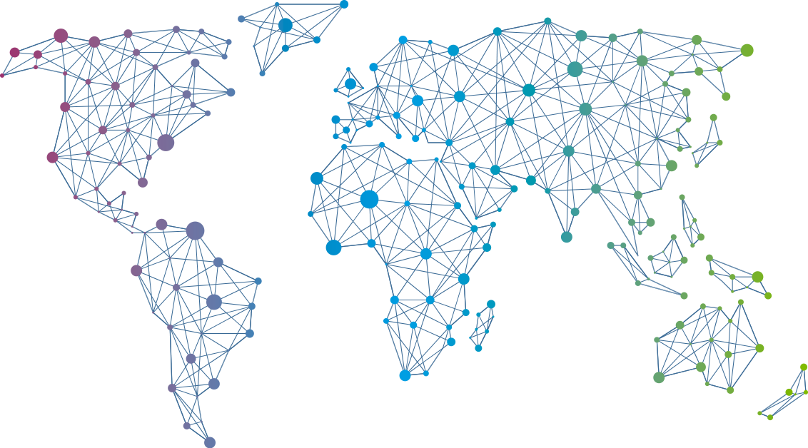

Speaker
Aditi Ahuja
Contributing to FOSS: Cloud Native Edition
Aditi Ahuja
AditiAhuja
September 16th & 17th
^{Online Event}
Powered By
International Conference

Slide 2
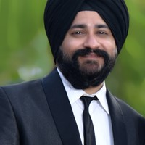
Speaker
Ajeet Raina
Delivering Container-based Apps to IoT Edge devices
Ajeet Raina
ajeetsraina
September 16th & 17th
^{Online Event}
Powered By
International Conference

Slide 3
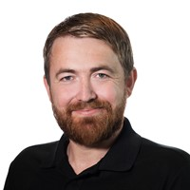
Speaker
Alexander Holmeset
What can be automated as a Teams administrator?
Alexander Holmeset
AlexHolmeset
September 16th & 17th
^{Online Event}
Powered By
International Conference

Slide 4
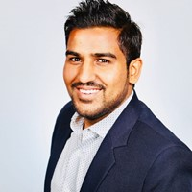
Speaker
Amit Malik
Multi Cloud Management with Azure Arc
Amit Malik
amit_malik99
September 16th & 17th
^{Online Event}
Powered By
International Conference

Slide 5
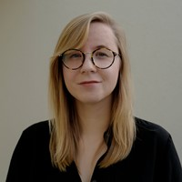
Speaker
Annie Talvasto
Top new CNCF projects to look out for
Kubernetes in the cloud - from zero to hero
Annie Talvasto
annietalvasto
September 16th & 17th
^{Online Event}
Powered By
International Conference

Slide 6
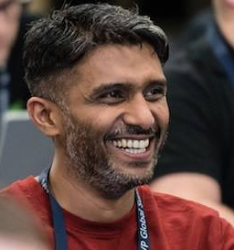
Speaker
Anoop C Nair
Azure Virtual Desktop & Windows 365 Modern Virtualization Solutions with Modern Management
Anoop C Nair
anoopmannur
September 16th & 17th
^{Online Event}
Powered By
International Conference

Slide 7
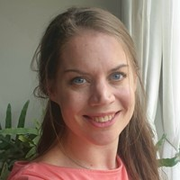
Speaker
Barbara Forbes
GitHub CoPilot and PowerShell
Barbara Forbes
Ba4bes
September 16th & 17th
^{Online Event}
Powered By
International Conference

Slide 8
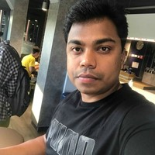
Speaker
Vignesh Ganesan
Securing your Azure Identity infrastructure
Vignesh Ganesan
cloudvignesh
September 16th & 17th
^{Online Event}
Powered By
International Conference

Slide 9
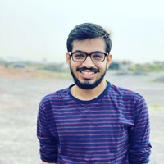
Speaker
Debabrata Panigrahi
New paradigm of resiliency testing: Cloud Native Chaos Engineering
Debabrata Panigrahi
debaelopedev
September 16th & 17th
^{Online Event}
Powered By
International Conference

Slide 10
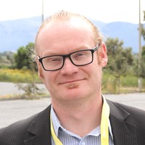
Speaker
Nestori Syynimaa
AADInternals: How did I built the ultimate Azure AD hacking tool from the scratch
Nestori Syynimaa
DrAzureAD
September 16th & 17th
^{Online Event}
Powered By
International Conference

Slide 11
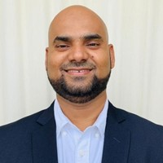
Speaker
Hasnain Shaikh
Zero Trust Approach to Secure Azure Workloads
Hasnain Shaikh
Hasnain__Shaikh
September 16th & 17th
^{Online Event}
Powered By
International Conference

Slide 12
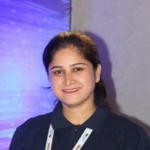
Speaker
Vandana Verma Sehgal
Embracing Developer-First Security for the Cloud Era
Embracing Developer friendly security with automation
Vandana Verma Sehgal
InfosecVandana
September 16th & 17th
^{Online Event}
Powered By
International Conference

Slide 13
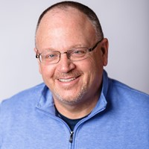
Speaker
Mike Nelson
Managing in Azure - The Portal, The Shell, The API, & the CLI
Practical and Un-Practical uses for the WSL
Mike Nelson
mikenelsonio
September 16th & 17th
^{Online Event}
Powered By
International Conference

Slide 14
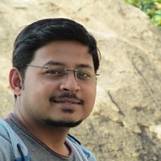
Speaker
Suman Chakraborty
Simplifying Deployment Pipelines from 'Build' to 'Release' using HashiCorp Waypoint
Suman Chakraborty
itsmesumanc
September 16th & 17th
^{Online Event}
Powered By
International Conference

Slide 15

Speaker
Jeff Wouters
Your own (advanced) PowerShell function template in 45 minutes
Jeff Wouters
jeffwouters
September 16th & 17th
^{Online Event}
Powered By
International Conference

Slide 16
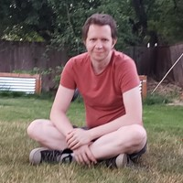
Speaker
Justin Grote
Presto Pester! Effective Powershell Testing with VSCode
Justin Grote
justinwgrote
September 16th & 17th
^{Online Event}
Powered By
International Conference

Slide 17
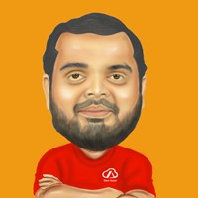
Speaker
Kasam Shaikh
Demystifying Azure AI with Azure IPaaS
Kasam Shaikh
KasamShaikh
September 16th & 17th
^{Online Event}
Powered By
International Conference

Slide 18
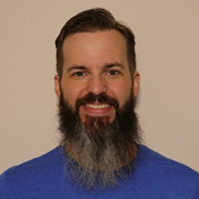
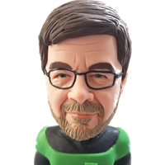
Speaker
Kyle Ruddy & Luc Dekens
Automation Showdown: Imperative vs Declarative
Kyle Ruddy
Luc Dekens
kmruddy
LucD22
September 16th & 17th
^{Online Event}
Powered By
International Conference

Slide 19
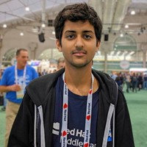
Speaker
Kunal Kushwaha
Scaling Communities to be more Inclusive
Kunal Kushwaha
kunalstwt
September 16th & 17th
^{Online Event}
Powered By
International Conference

Slide 20
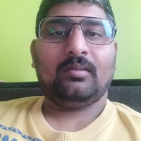
Speaker
Lalit Rawat
Microsoft Azure coolest and Feature
Lalit Rawat
lalit01rawat
September 16th & 17th
^{Online Event}
Powered By
International Conference

Slide 21

Speaker
Jakub Jareš
Profiling your PowerShell code with Profiler
Jakub Jareš
nohwnd
September 16th & 17th
^{Online Event}
Powered By
International Conference

Slide 22
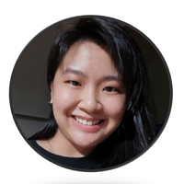
Speaker
Sabrina Kay
Explore the Integration of Conditional App Control
Sabrina Kay
oh_is_sabrina
September 16th & 17th
^{Online Event}
Powered By
International Conference

Slide 23
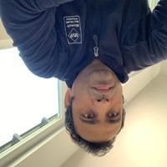
Speaker
Prabhat Nigam
PowerShell Automation: Human Building Machines
Remote Working with Azure Virtual Desktop
Prabhat Nigam
PrabhatNigamXHG
September 16th & 17th
^{Online Event}
Powered By
International Conference

Slide 24
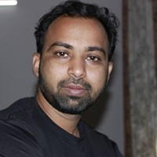

Speaker
Rahul Ambhore
Azure Cloud cost Optimization
Rahul Ambhore
Rahul Ambhore
September 16th & 17th
^{Online Event}
Powered By
International Conference

Slide 25
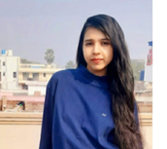
Speaker
Anamika Singh
Diving into Containers
Anamika Singh
reachtoana
September 16th & 17th
^{Online Event}
Powered By
International Conference

Slide 26
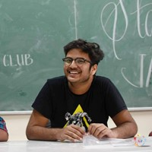
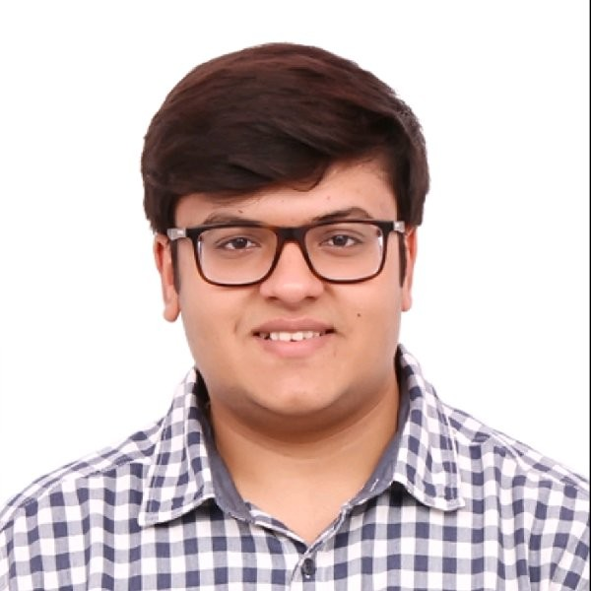
Speaker
Arsh Sharma & Madhav Jivrajani
Making Your Controllers Resilient: Workqueue To The Rescue
Arsh Sharma
Madhav Jivrajani
RinkiyaKeDad
MadhavJivrajani
September 16th & 17th
^{Online Event}
Powered By
International Conference

Slide 27
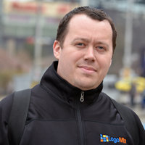
Speaker
Marton Kodok
Cloud Workflows - Automate your Cloud services
Marton Kodok
MartonKodok
September 16th & 17th
^{Online Event}
Powered By
International Conference

Slide 28
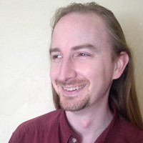
Speaker
Rob Richardson
Level-up Your DevOps with GitHub Actions and Kubernetes
Transition from a Build Script to a Dockerfile
Rob Richardson
rob_rich
September 16th & 17th
^{Online Event}
Powered By
International Conference

Slide 29
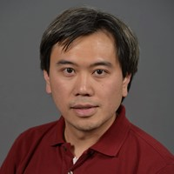
Speaker
Ron Dagdag
Serverless at the edge in Azure Percept
Ron Dagdag
RonDagdag
September 16th & 17th
^{Online Event}
Powered By
International Conference

Slide 30
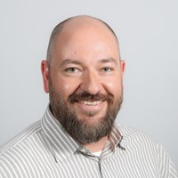
Speaker
Richard Toland
Advanced PowerShell for remote SharePoint administration & inspection
Richard Toland
rrtoland
September 16th & 17th
^{Online Event}
Powered By
International Conference

Slide 31
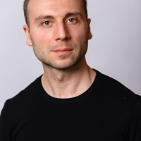
Speaker
Sergey Chubarov
Pentesting Azure Container Services
Sergey Chubarov
Sergey Chubarov
September 16th & 17th
^{Online Event}
Powered By
International Conference

Slide 32
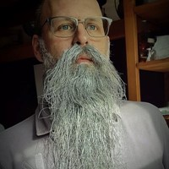
Speaker
Rob Sewell
Think PowerShell and SQL is meh? Meet dbatools!
Azure Arc-Enabled Data Services Introduction
Rob Sewell
sqldbawithbeard
September 16th & 17th
^{Online Event}
Powered By
International Conference

Slide 33
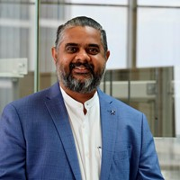
Speaker
Sriram Bhargav Madhav
Automation to Hyper-Automation Powered by AI and ML
Sriram Bhargav Madhav
Sriram Bhargav Madhav
September 16th & 17th
^{Online Event}
Powered By
International Conference

Slide 34
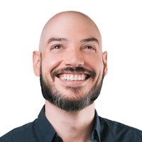
Speaker
Steve Pereira
Flow Engineering - Boost velocity, quality and happiness through your entire value stream
Steve Pereira
SteveElsewhere
September 16th & 17th
^{Online Event}
Powered By
International Conference

Slide 35
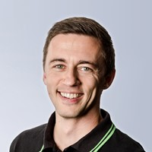
Speaker
Michael Seidl
PowerShell and MS Graph API demystified
Michael Seidl
techguyat
September 16th & 17th
^{Online Event}
Powered By
International Conference

Slide 36
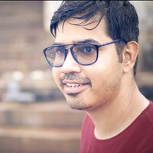
Speaker
Taha Baleegh Ansari
Audit VMs with Azure Guest Configuration Policy
Taha Baleegh Ansari
TechieTaha
September 16th & 17th
^{Online Event}
Powered By
International Conference

Slide 37
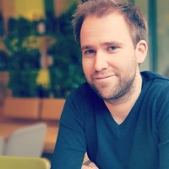
Speaker
Thomas Maurer
Azure Arc Overview -Learn about Hybrid and Multicloud Management with Azure
Thomas Maurer
thomasmaurer
September 16th & 17th
^{Online Event}
Powered By
International Conference

Slide 38

Speaker
Tim Davis
Pitfalls of Infrastructure as Code (And how to avoid them!)
Tim Davis
vtimd
September 16th & 17th
^{Online Event}
Powered By
International Conference

Slide 39
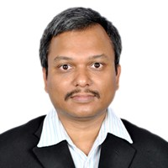
Speaker
Wriju Ghosh
Building Serverless Apps in Azure
Wriju Ghosh
wrijugh
September 16th & 17th
^{Online Event}
Powered By
International Conference

Slide 40
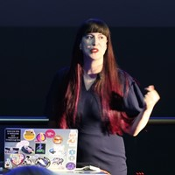
Speaker
Tanya Janca
More than just pipelines: DevSecOps
Security is everybody's job!
Tanya Janca
shehackspurple
September 16th & 17th
^{Online Event}
Powered By
International Conference

Slide 41
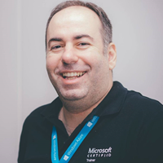
Speaker
André Melancia
Upgrade your grey cells and use Azure Synapse Analytics
André Melancia
AndyPT
September 16th & 17th
^{Online Event}
Powered By
International Conference

Slide 42
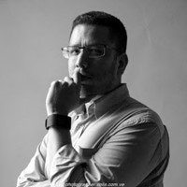
Speaker
Carlos Solís Salazar
Protecting your IT infrastructure with PowerShell
Carlos Solís Salazar
soysoliscarlos
September 16th & 17th
^{Online Event}
Powered By
International Conference

Slide 43
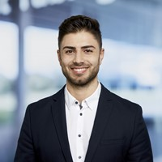
Speaker
Serkar Aydin
What to consider when setting up Business Process Automations
Serkar Aydin
serkar35857837
September 16th & 17th
^{Online Event}
Powered By
International Conference

Slide 44
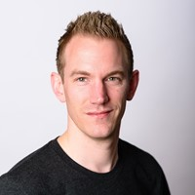
Speaker
Jaap Brasser
Azure Functions Unveiled
Jaap Brasser
jaap_brasser
September 16th & 17th
^{Online Event}
Powered By
International Conference

Slide 45
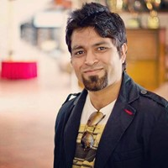
Speaker
Mohit Chhabra
Secure your Infrastructure with Azure Sentinel
Mohit Chhabra
mohit_techy
September 16th & 17th
^{Online Event}
Powered By
International Conference

Slide 46
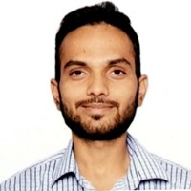
Speaker
Nitish Sharma
Application containerization and deployment
Nitish Sharma
September 16th & 17th
^{Online Event}
Powered By
International Conference

Slide 47
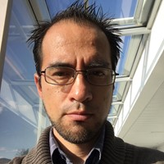
Speaker
Luis Beltran
Serverless Image Recognition in WhatsApp chatbot with Azure AI
Luis Beltran
darkicebeam
September 16th & 17th
^{Online Event}
Powered By
International Conference

