Slide 1


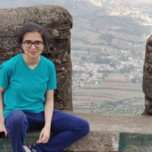


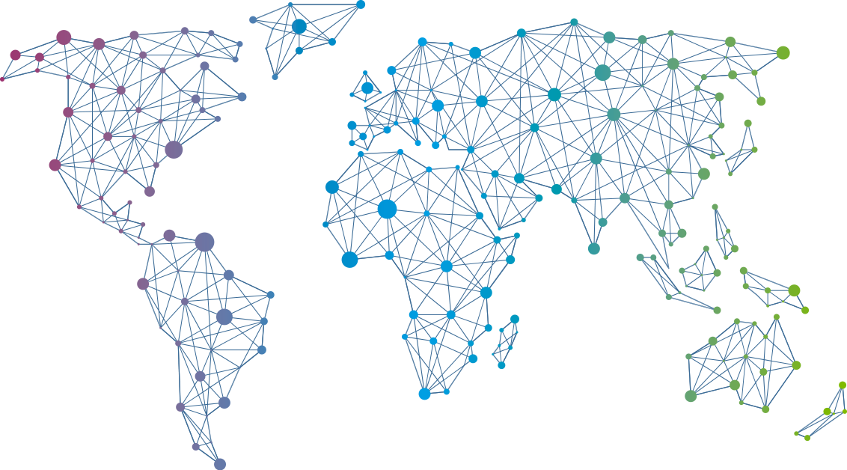

Speaker
Aditi Ahuja
Contributing to FOSS: Cloud Native Edition
Aditi Ahuja
AditiAhuja
September 16th & 17th
^{Online Event}
Powered By
International Conference

Slide 2
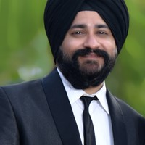
Speaker
Ajeet Raina
Delivering Container-based Apps to IoT Edge devices
Ajeet Raina
ajeetsraina
September 16th & 17th
^{Online Event}
Powered By
International Conference

Slide 3
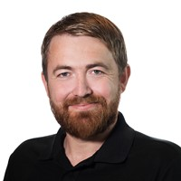
Speaker
Alexander Holmeset
What can be automated as a Teams administrator?
Alexander Holmeset
AlexHolmeset
September 16th & 17th
^{Online Event}
Powered By
International Conference

Slide 4
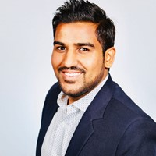
Speaker
Amit Malik
Multi Cloud Management with Azure Arc
Amit Malik
amit_malik99
September 16th & 17th
^{Online Event}
Powered By
International Conference

Slide 5
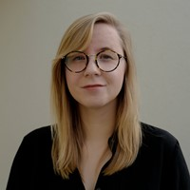
Speaker
Annie Talvasto
Top new CNCF projects to look out for
Kubernetes in the cloud - from zero to hero
Annie Talvasto
annietalvasto
September 16th & 17th
^{Online Event}
Powered By
International Conference

Slide 6
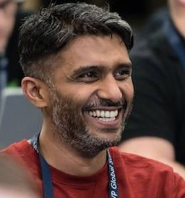
Speaker
Anoop C Nair
Azure Virtual Desktop & Windows 365 Modern Virtualization Solutions with Modern Management
Anoop C Nair
anoopmannur
September 16th & 17th
^{Online Event}
Powered By
International Conference

Slide 7
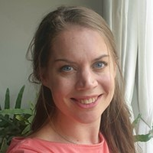
Speaker
Barbara Forbes
GitHub CoPilot and PowerShell
Barbara Forbes
Ba4bes
September 16th & 17th
^{Online Event}
Powered By
International Conference

Slide 8
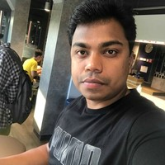
Speaker
Vignesh Ganesan
Securing your Azure Identity infrastructure
Vignesh Ganesan
cloudvignesh
September 16th & 17th
^{Online Event}
Powered By
International Conference

Slide 9
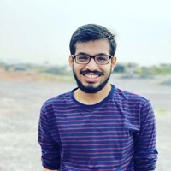
Speaker
Debabrata Panigrahi
New paradigm of resiliency testing: Cloud Native Chaos Engineering
Debabrata Panigrahi
debaelopedev
September 16th & 17th
^{Online Event}
Powered By
International Conference

Slide 10
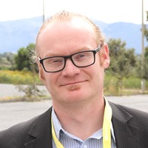
Speaker
Nestori Syynimaa
AADInternals: How did I built the ultimate Azure AD hacking tool from the scratch
Nestori Syynimaa
DrAzureAD
September 16th & 17th
^{Online Event}
Powered By
International Conference

Slide 11
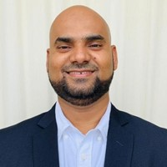
Speaker
Hasnain Shaikh
Zero Trust Approach to Secure Azure Workloads
Hasnain Shaikh
Hasnain__Shaikh
September 16th & 17th
^{Online Event}
Powered By
International Conference

Slide 12
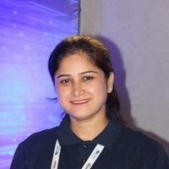
Speaker
Vandana Verma Sehgal
Embracing Developer-First Security for the Cloud Era
Vandana Verma Sehgal
InfosecVandana
September 16th & 17th
^{Online Event}
Powered By
International Conference

Slide 13
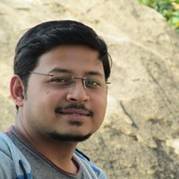
Speaker
Suman Chakraborty
Simplifying Deployment Pipelines from 'Build' to 'Release' using HashiCorp Waypoint
Suman Chakraborty
itsmesumanc
September 16th & 17th
^{Online Event}
Powered By
International Conference

Slide 14

Speaker
Jeff Wouters
Your own (advanced) PowerShell function template in 45 minutes
Jeff Wouters
jeffwouters
September 16th & 17th
^{Online Event}
Powered By
International Conference

Slide 15

Speaker
Justin Grote
Presto Pester! Effective Powershell Testing with VSCode
Justin Grote
justinwgrote
September 16th & 17th
^{Online Event}
Powered By
International Conference

Slide 16
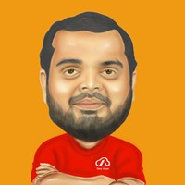
Speaker
Kasam Shaikh
Demystifying Azure AI with Azure IPaaS
Kasam Shaikh
KasamShaikh
September 16th & 17th
^{Online Event}
Powered By
International Conference

Slide 17
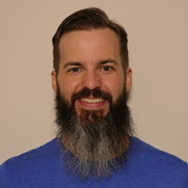
Speaker
Kyle Ruddy
Automation Showdown: Imperative vs Declarative
Kyle Ruddy
kmruddy
September 16th & 17th
^{Online Event}
Powered By
International Conference

Slide 18
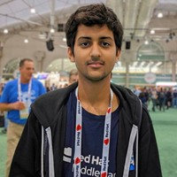
Speaker
Kunal Kushwaha
Scaling Communities to be more Inclusive
Kunal Kushwaha
kunalstwt
September 16th & 17th
^{Online Event}
Powered By
International Conference

Slide 19
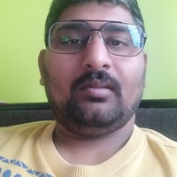
Speaker
Lalit Rawat
Microsoft Azure coolest and Feature
Lalit Rawat
lalit01rawat
September 16th & 17th
^{Online Event}
Powered By
International Conference

