Slide 1
Research Question: How does different social factors influence Crime Rate in Victoria
W08G6 Sheldon Liu (1455927), Zihan Dai (1488802), Jiahao Ni (1455828)
Phone Moe Thway (1342981)

Slide 2

Why this research question?
Insights from this research can aid government efficiently reduce crime rate
Foster a better quality of life and provide a safer community
Help Melbourne retain the most livable city in the world

Slide 3
Datasets Overview
Communities: 452 distinct suburbs and 34 distinct LGAs
House Price: 774 distinct suburbs
EGM: 57 distinct LGAs
LGA Offences: 79 distinct LGAs
Crime Rate
Crime Division

Slide 4
Methodologies
Data Preprocessing
Feature Engineering and Selection
Regression Modelling
Model Training and Evaluation

Slide 5
General data preprocessing
Handle null values(removal and imputation)
Data type conversion
Column value format cleaning
Drop empty rows
Remove irrelevant columns

Slide 6

Feature Engineering
Use average values of EGM loss and House Price over the years
Calculate Suburb Crime Rate and Suburb EGM losses using the below formulas

Slide 7
Imagine if house price of all these years are in the model.... we not going to do this
Using one single average price will reduce number of features to avoid overfitting and
smooth out short-term fluctuations.
Limitation:
We did not filter out "noise" / extreme values that will affect over average values
One Improvement might be :
If house price of "certain suburb" is larger than historic high price in real world
We detect a noise data => ignore it when calculating average

Slide 8
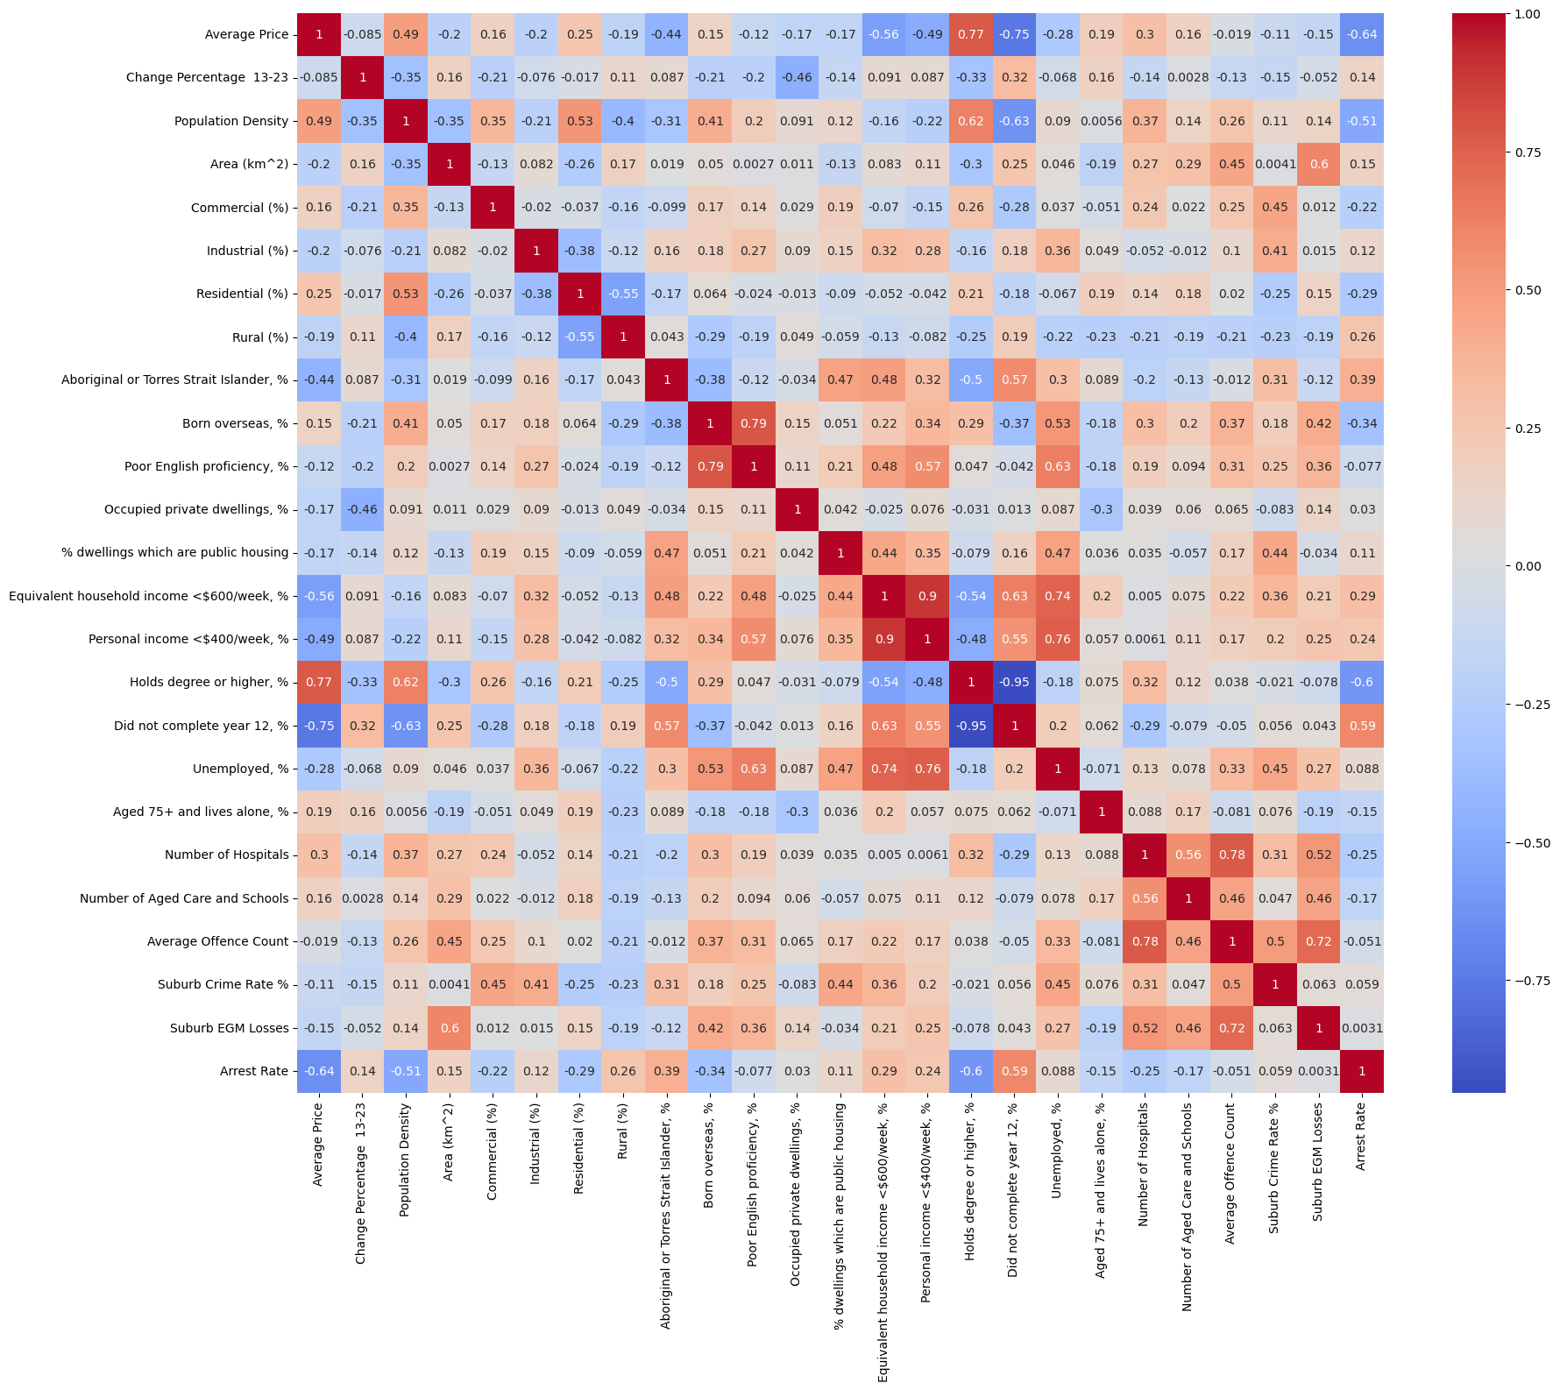
Feature Selection using Heatmap

Slide 9
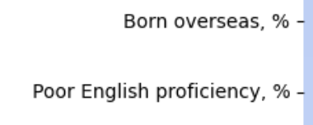

Why we do this:
01
Avoid multicollinearity (where 2 independent variables are very correlated )
2. Avoid overfitting (more likely to occur when have too much feature)
02
3. Select strongly correlated features to predict target variables
03
In example above, we choose to keep Born Overseas and remove Poor english proficiency.

Slide 10
Exploratory Data Analysis
The Victoria government wants city development, but they on a budget? Maybe it is best to choose a particular region as a starting point.
We recommend Melbourne, because :
Melbourne and surrounding regions are becoming more urbanised in modern era.
Victoria Government had established plans for managing urban expansion and guiding development to support growing population

Slide 11

Example plans include Plan Melbourne 2050

Slide 12

And urban control for regions around Melbourne
We want to align with government's planning visions
Study Melbourne => better deal with crimes in other regions that are also becoming more urbanised

Slide 13
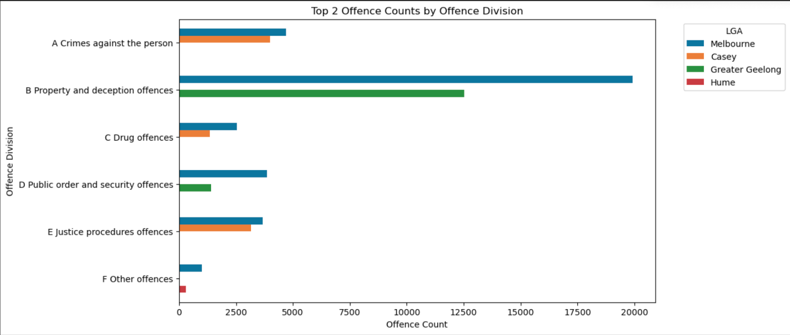
Furthermore, we believe Melbourne is quite representative in terms of all crime type.

Slide 14
Trend analysis
We include trends over the years for
EGM loss
Yearly average house price
property crime rate (include burglary/ theft)
Analyse how the two economic factors affect property crime rate in Melbourne

Slide 15
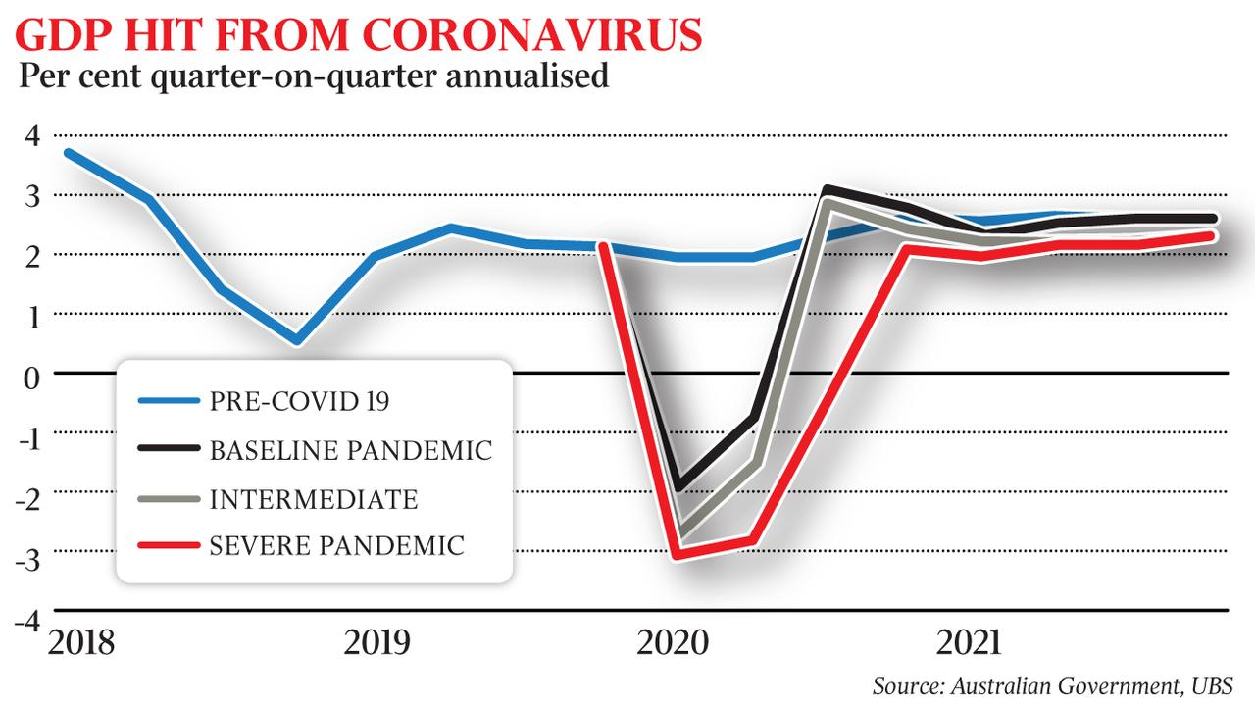
We will not analyse trend beyond 2019 since:
EGM loss has only data up to 2019
After 2019, there is covid
Major economic recessions can be a confounding variable for property crime

Slide 16
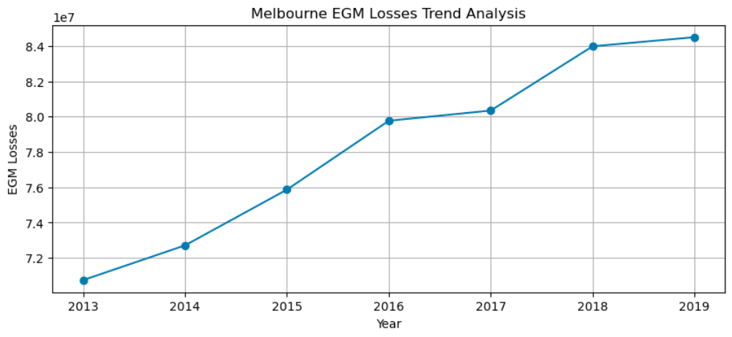
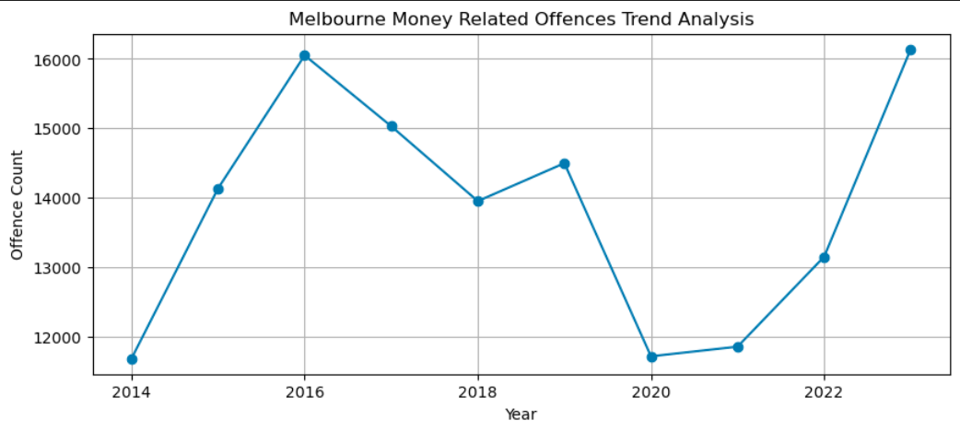
Both show greatest growth rate from 2014 – 2016 After 2016: EGM loss rate become slower Money Related offence sharply decrease

Slide 17

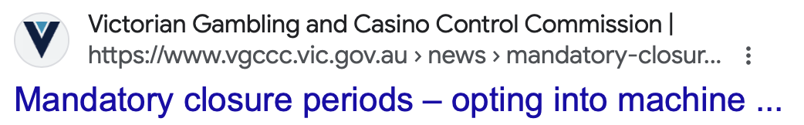
7.4\%
Why the difference after 2016
Mandatory pre-commit limit policy
New regulator VGCCC and relevant reforms
Lower case of theft in 2017 compare to previous year

Slide 18
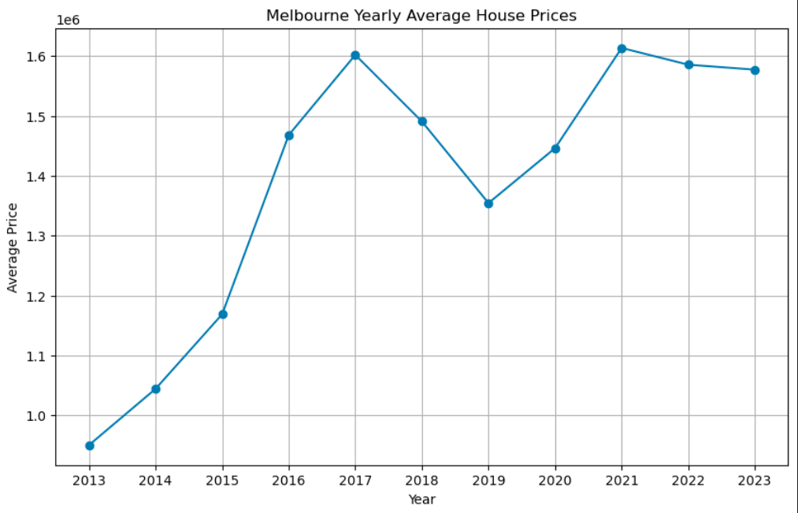
Both show greatest growth rate from 2014 – 2016
After 2016: Average house increase less slowly and decrease sharply in 2017
Money Related offence sharply decrease at the same time 2017

Slide 19
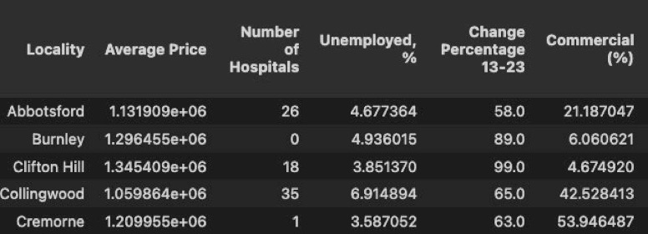
How Regression Model answer research question?
Sample training input: Government's control over social economic factors
Target Variable: Suburb Crime Rate

Slide 20
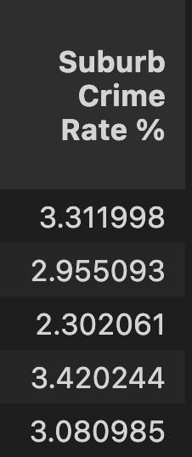
Sample Output base on Training set: What is the resulting suburb crime rate
Why we choose regression model over other model?
Intuitive comparison of independent variable Social Factors and dependent Variable Crime Rate
Linear regression predicts continuous variable suburb crime rate

Slide 21
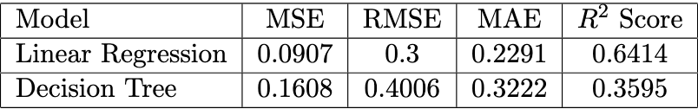
Model Performance
Interpretations and Reasonings:
Features and target variable are more linear related.
Decision Tree Regressor is a more complex model with several hyperparameters, it needs to be further finetuning. (0 – 0.35)

Slide 22




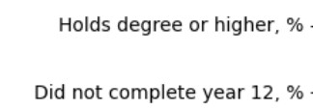

Key Findings – most relevant factors
Melbourne ---> EGM loss and House price are strongly related to property crime
Heat map shows otherwise
There is a low correlation between education background and tendency to commit crime.

Slide 23


Slide 24
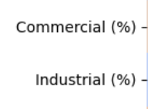





Commercial and industrial land usages are positively correlated to suburb crime Rate.
High aboriginal people portion and diverse cultural backgrounds can lead to high crime rate.

Slide 25
Limitations & Potential Improvements
Communities Dataset Recency (not just data for 2014)
Suburb EGM loss is approximated from LGA EGM loss(perhaps find data set)
Average value over the years, susceptible to extreme values
Feature definitions can be more specific
Target variable can focus on crime rate of different crime types

