Slide 1
COMP 1842
Coursework CRUD system part 2
Matt Prichard

Slide 2
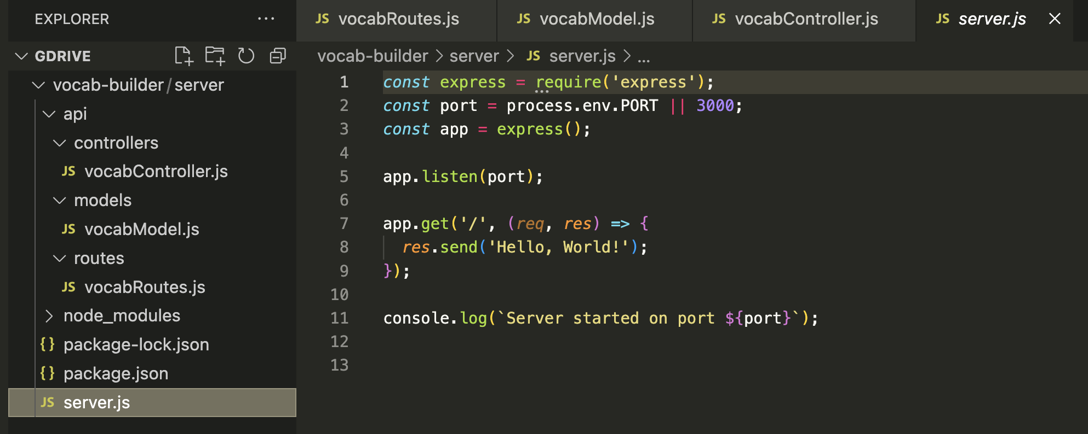
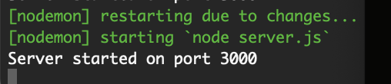
Recap
Last week we finished with this folder structure and a server running on port 3000
that restarts with nodemon each time we make a change.

Slide 3
Introduction
This week we will create a RESTful API for the Vue front end to consume and we will test it with Postcode.

Slide 4
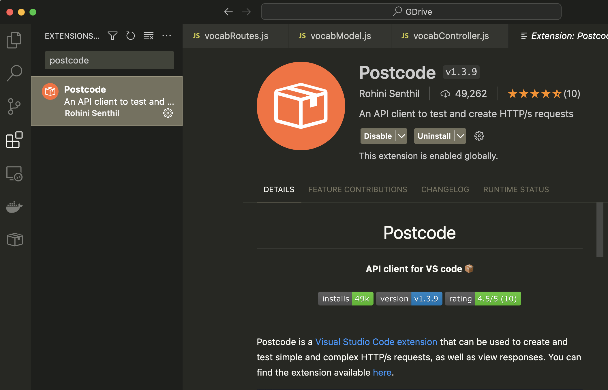
Install Postcode
Search for it in the VS code extension library

Slide 5
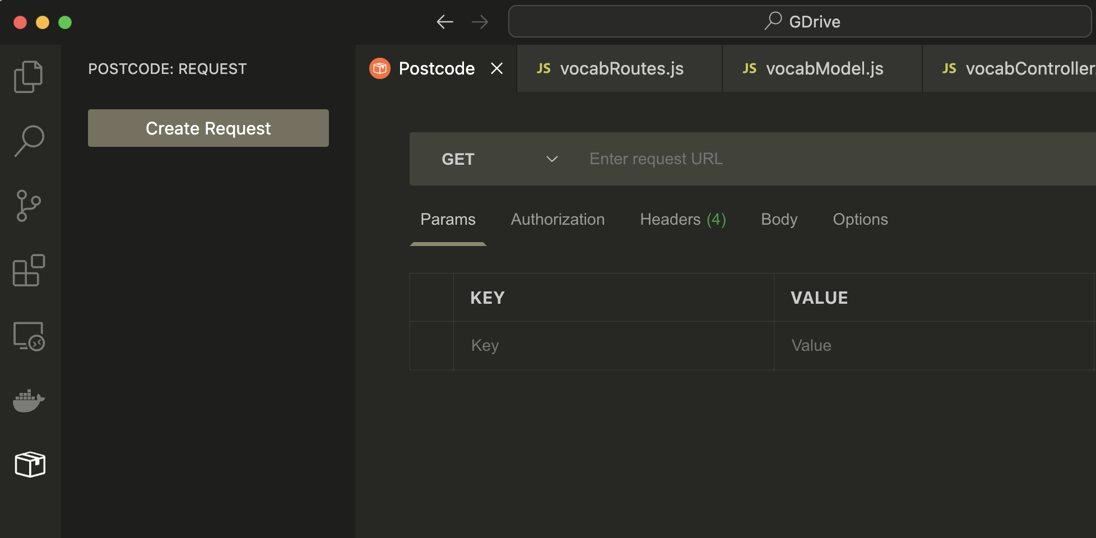
Postcode
Once installed you should see it’s icon on the left hand panel, click the icon and you will see the ‘Create Request’ button. We will come back to this.

Slide 6
vocabModel.js

Slide 7
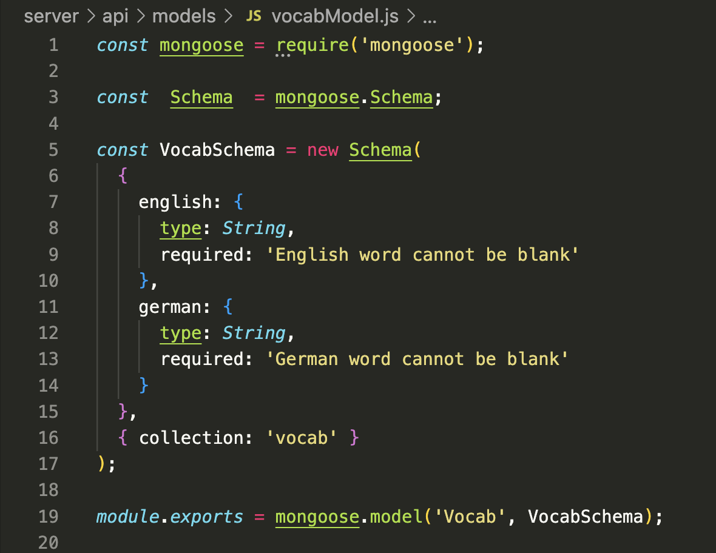
api/models/vocabModel.js. - full code

Slide 8
vocabModel.js. – detail pt1
This is where we will define the requirements of the data model that we intend to map to our database in MongoDB.
We are using the Mongoose library as the messenger between our app and our database.
The first thing to do inside of this file is require Mongoose and use the Schema class from the Mongoose library.

Slide 9
vocabModel.js. – detail pt2
Now we can begin to write the format for our model ‘VocabSchema’ by creating a new instance of the Schema class, line 5.
Our user model will have 2 attributes: english and german.
Each attribute will be defined using a key:value pair, with the key being the name of the attribute, and the value being its type, in this case ‘String’. We can also add some basic validation too.

Slide 10
vocabModel.js. – detail pt3
Line 16 we are specifying a name for our collection.
The last step is to solidify this Schema as a data model with mongoose and export it from this file for use in other areas of our project. Notice the different capitalisation, this is not a mistake.
Further reading:
https://dev.to/halented/part-2-creating-models-for-mongodb-with-mongoose-575d

Slide 11
vocabRoutes.js

Slide 12
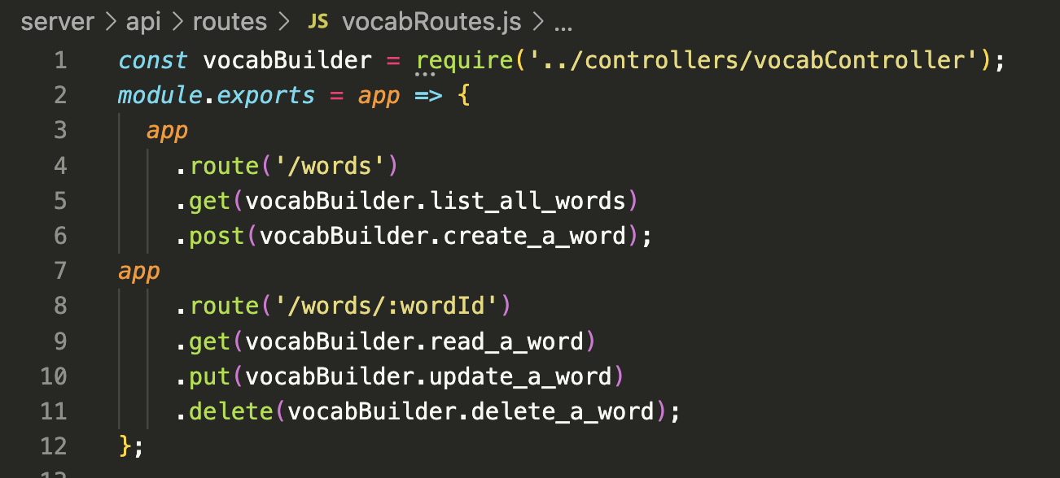
api/models/vocabRoutes.js. - full code

Slide 13
Setting up routes
Routing refers to determining how an application responds to a client request for a specific endpoint, which is a URI (or path) and a specific HTTP request method (GET, POST, and so on).
Each of our routes has different route handler functions, which are executed when the route is matched.
Above we have defined two basic routes(‘/words’, and ‘/words/wordId’) with different methods
‘/words’ has to methods(‘GET’ and ‘POST’), while ‘/words/wordId’ has GET, PUT and DELETE.
Also we require the controller so each of the routes methods can call it’s respective handler function.

Slide 14
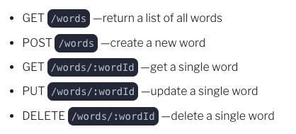
We are creating the following endpoints:

Slide 15
vocabController.js

Slide 16
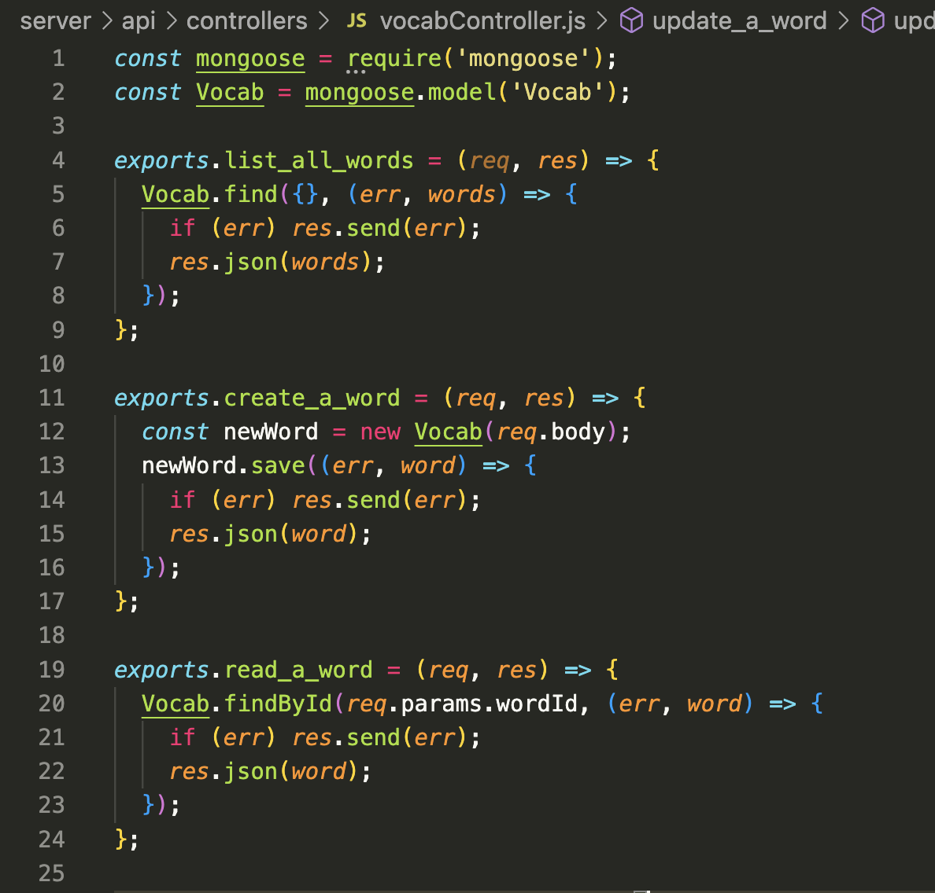
api/controllers/vocabController.js. – 1-24

Slide 17
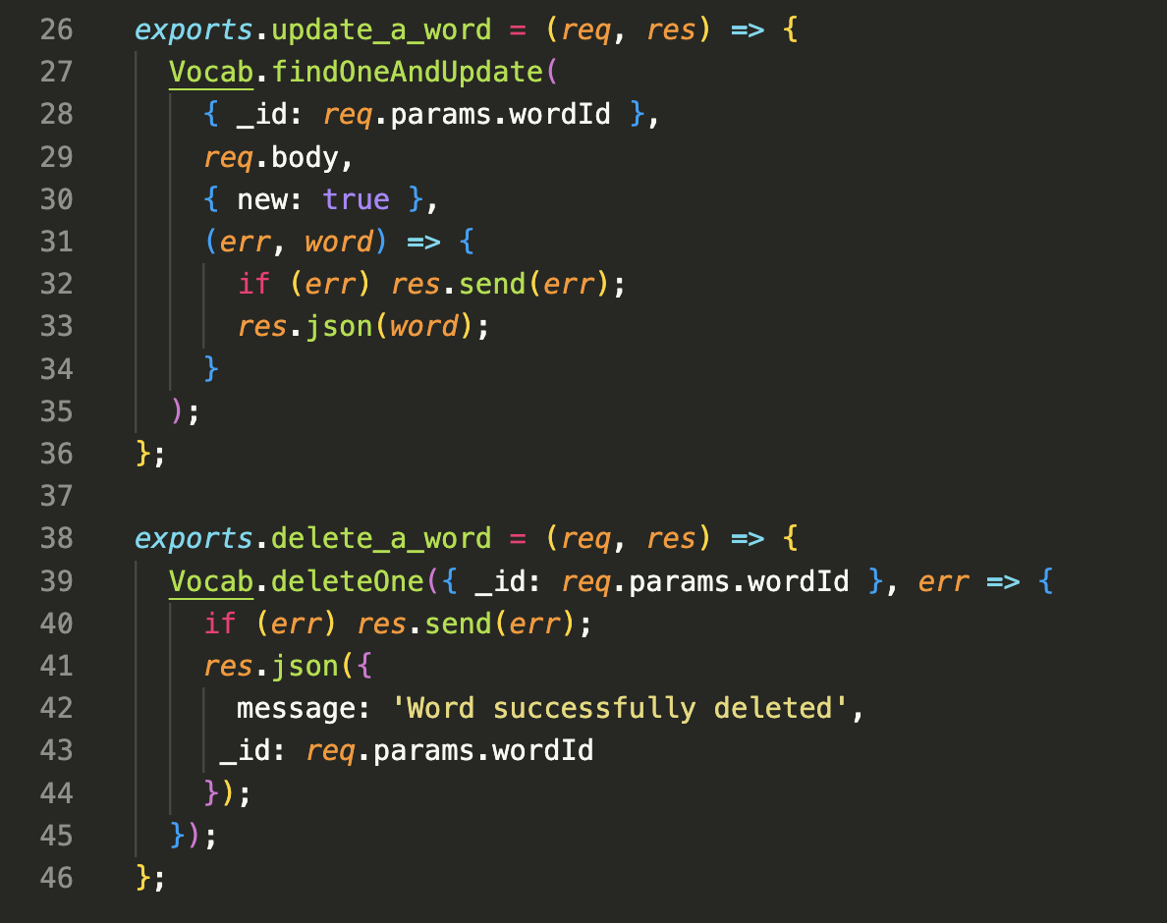
api/controllers/vocabCotroller.js. – 26 - 46

Slide 18
Setting up the controller
In this controller, we are writing five different functions namely:
list_all_words
create_a_word
read_a_word
update_a_word
delete_a_word
We will export each of the functions for us to use in our routes. Each of these functions uses different mongoose methods such as:
find, findById, findOneAndUpdate, save and remove.

Slide 19
Setting up the controller part 2
Don’t worry too much about the detail of each function but you should be able to get an idea of what is going on each time.
As you can see all the responses are in the json format
At the top of the file we are requiring the mongoose library and the model ‘Vocab’ that we made in vocabModel.js

Slide 20
server.js

Slide 21
Wiring it all together
Earlier on, we had a minimal code for our server to be up and running in the server.js file.
In this section we will be connecting our handlers(controllers), database, the created models, body parser and the created routes together.
Open the server.js file created a while ago and follow the following steps to put everything together.
Essentially, you will be replacing the code in your server.js with the code snippet from this section

Slide 22
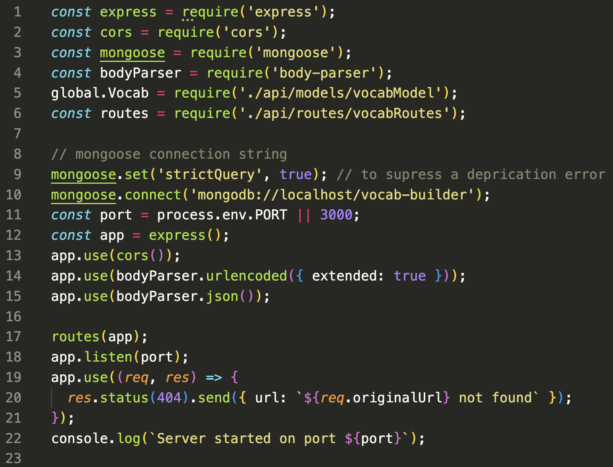
server/server.js. – full code

Slide 23
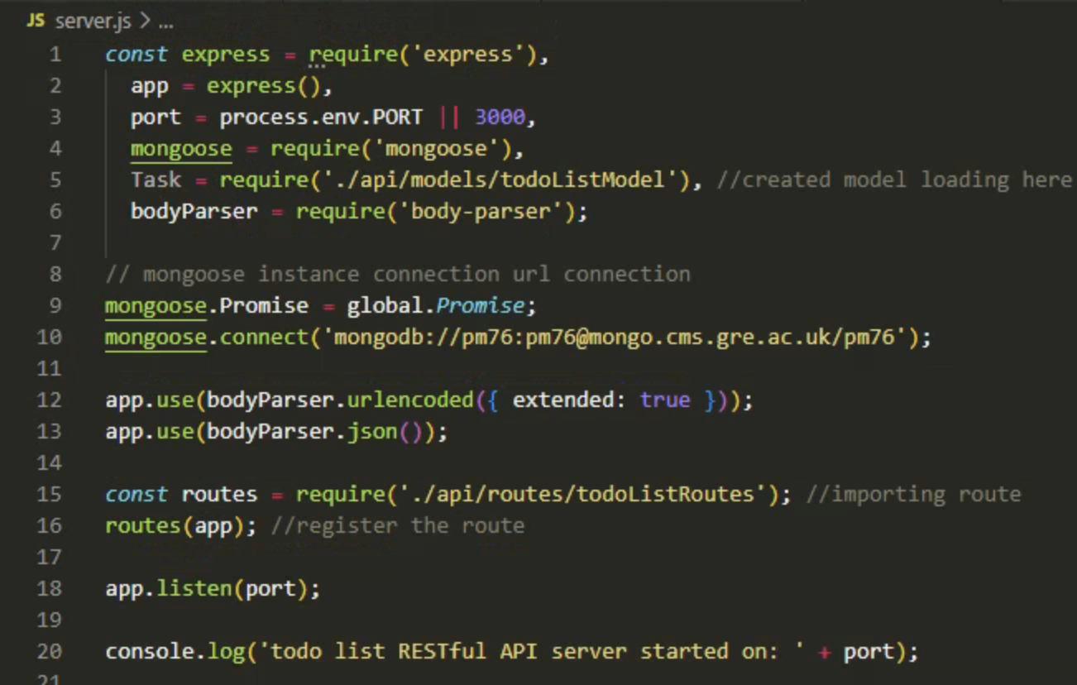
Important – line 10
If working with your University Mongo account use this line but change pm76 to your username in all 3 places !!
If working at home on your localhost use this connection string

Slide 24
server.js differences
Do not worry too much about the differences between the server file here and the one for the lab task. As I said this system is built from a book that is loosely based on the lab task tutorial and the author has made some additions to the code. Just copy it out and all should be fine.
CORS if you are interested, it’s quite complicated
https://developer.mozilla.org/en-US/docs/Web/HTTP/CORS

Slide 25
Body-parser
https://www.simplilearn.com/tutorials/nodejs-tutorial/body-parser-in-express-js
Body Parser is a middleware of Node JS used to handle HTTP POST request.
Body Parser can parse a string based client request body into JavaScript Object which we can use in our application.
Specifically in the context of a POST or PUT HTTP requests where the information you want is contained in the body.
Using body-parser allows you to access req.body from within routes and use that data.
For example: To create a user in a database.

Slide 26
Testing the API

Slide 27
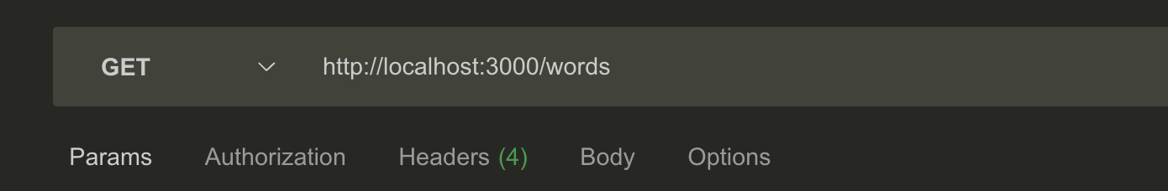
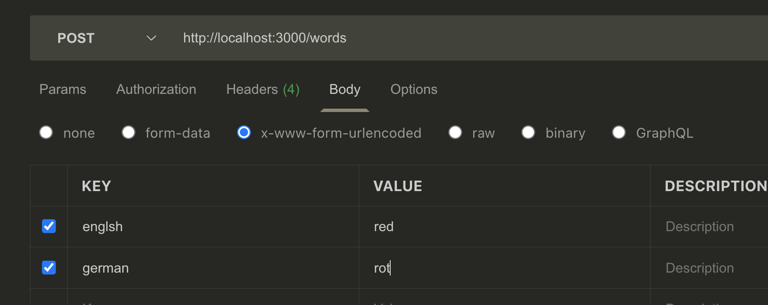
Testing the API with Postcode
Refer to slides 54 to 64 of the main lecture today

Slide 28
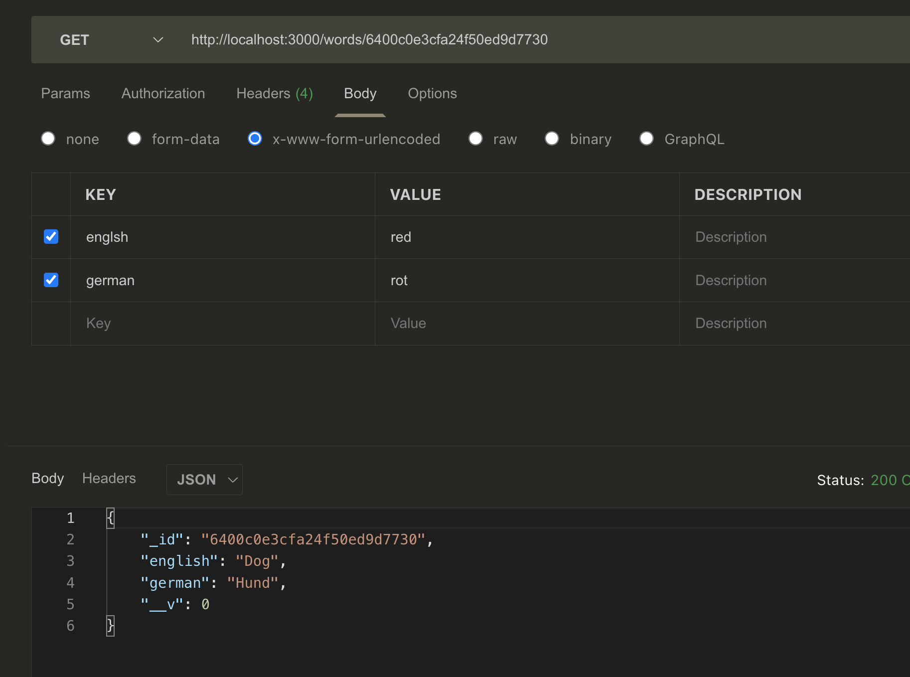
GET one word by ID

Slide 29
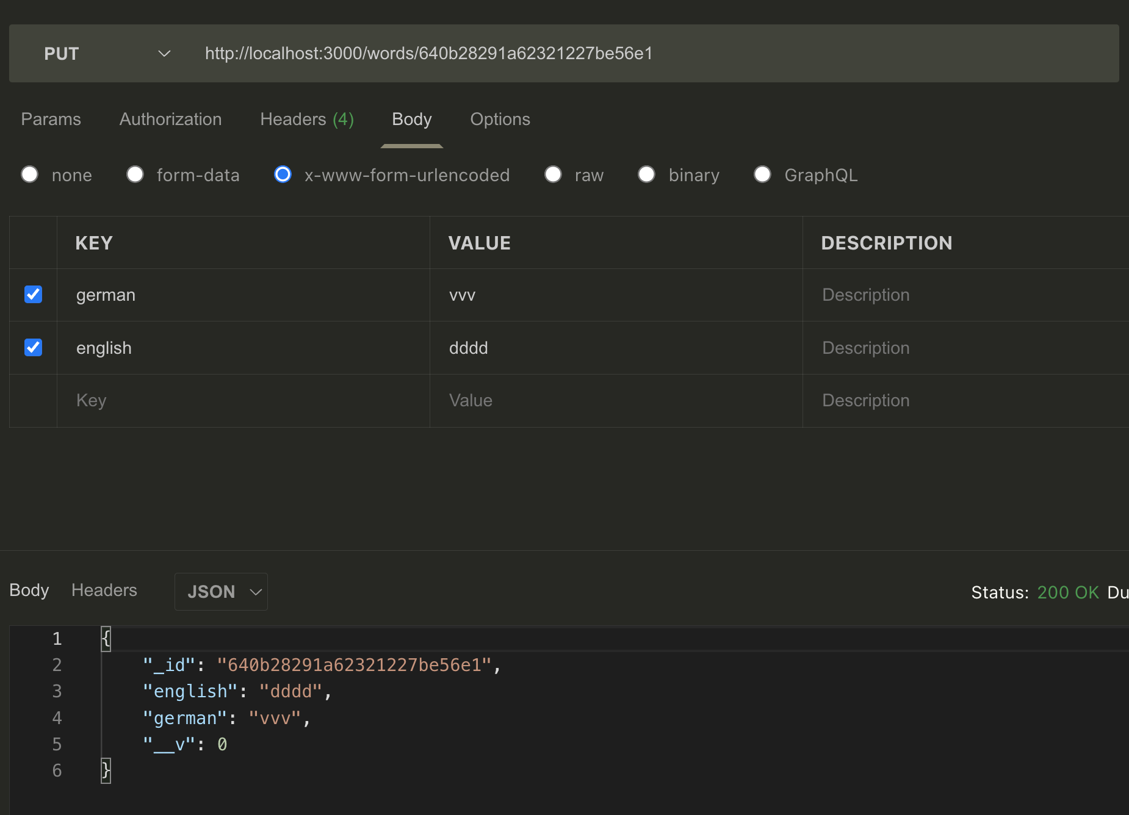
Update with PUT

Slide 30
?

