Slide 1
COMP 1842
Week11 – ExpressJS - The E
Matt Prichard

Slide 2

Introduction
What is it?
What's is for
How does it fit in the stack
Basic examples

Slide 3
MEVN stack
MongoDB (Database) – week 6
ExpressJS (Web Framework) – week 10
VueJS (Front-end Framework) – weeks 2-4
NodeJS (Application Server) – week 8

Slide 4
What is Express?
Express is a fast, unopinionated, minimalist web framework for Node.js.
Express is a "server-side" or "backend" framework that is very reliable in building APIs (Application Programming Interface).
https://expressjs.com/
The Express philosophy is to provide small, robust tooling for HTTP servers, making it a great solution for single page applications, web sites, hybrids, or public HTTP APIs.

Slide 5
Unopinionated? like Matt ☺
If a framework is opinionated, it lock or guides you into their way of doing things. Opinionated software means that there is basically one way (the right way™) to do things and trying to do it differently will be difficult and frustrating.
On the other hand, doing things the right way™ can make it very easy to develop with the software as the number of decisions that you have to make is reduced and the ability of the software designers to concentrate on making the software work is increased. Ruby on Rails is an example.

Slide 6
Unopinionated cont
Unopinionated software, on the other hand, leaves lots of flexibility to the user (developer). It doesn't proscribe one method of solving a problem, but provides flexible tools that can be used to solve the problem in many ways. The downside of this can be that because the tools are so flexible, it may be relatively hard to develop any solution.
PERL/PHP for example allows the developer and trusts the developer to make the right decisions and puts more control in their hands.
Vue is considered more opinionated than React with many issues having a clear answer in the docs.

Slide 7
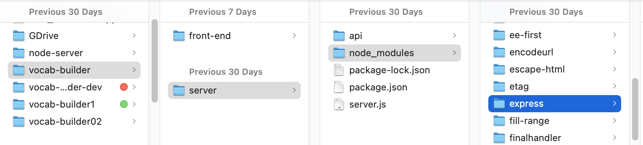
Installation
We installed it last week in our server folder

Slide 8
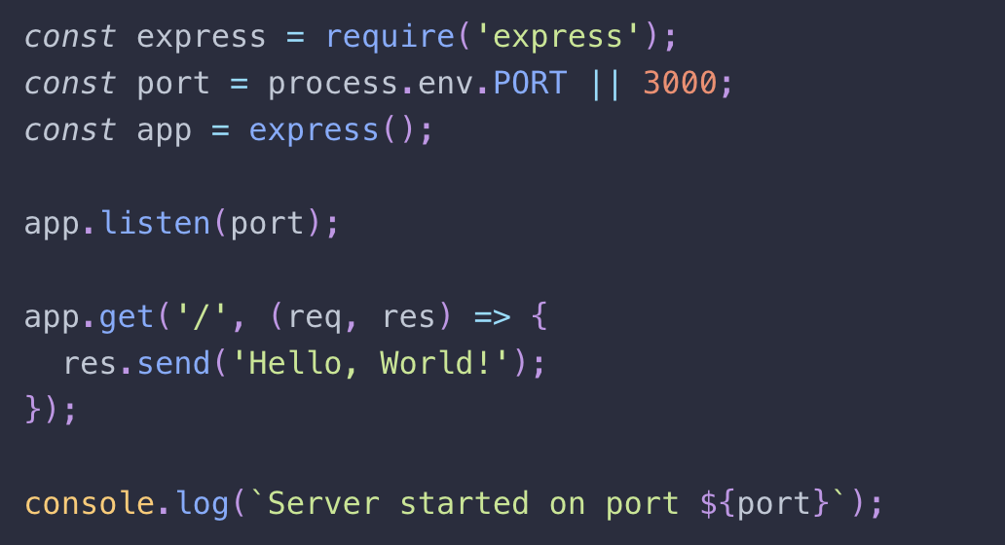
Beginning of week 8 – crud pt 1
Import the library
Set the port
Creates an Express application. The express( ) function is a top-level function exported by the express module.
Binds and listens for connections on the specified host and port. This method is identical to Node’s http.Server.listen(). –week 8 node server - slide 23

Slide 9
Beginning of last week
Routes HTTP GET requests to the specified path with the specified callback functions.
The req object represents the HTTP request and has properties for the request query string, parameters, body, HTTP headers, and so on.
The res object represents the HTTP response that an Express app sends when it gets an HTTP request.
res.send([body]) Sends the HTTP response.

Slide 10
Basic routing
Routing refers to determining how an application responds to a client request to a particular endpoint, which is a URI (or path) and a specific HTTP request method (GET, POST, PUT and DELETE ).
Each route can have one or more handler functions, which are executed when the route is matched.
Route definition takes the following structure:
app. METHOD (PATH, HANDLER)

Slide 11


Basic routing…cont
app is an instance of express.
METHOD is an HTTP request method, in lowercase.
PATH is a path on the server.
HANDLER is the function executed when the route is matched.

Slide 12
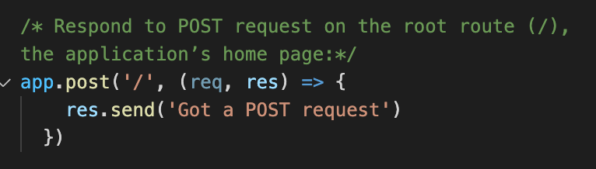
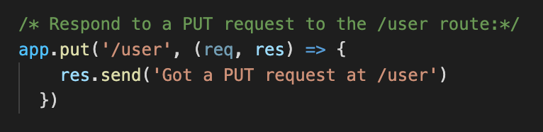
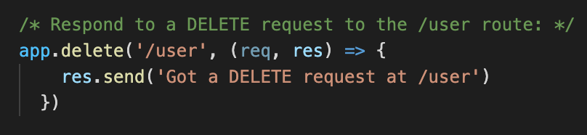

Slide 13

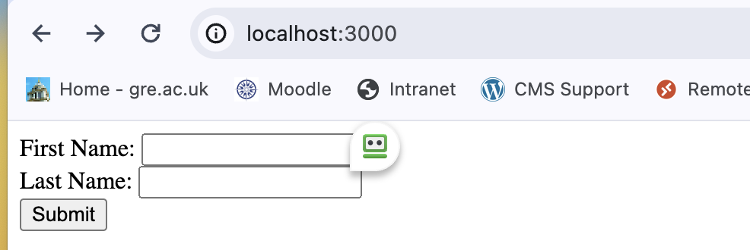

Slide 14
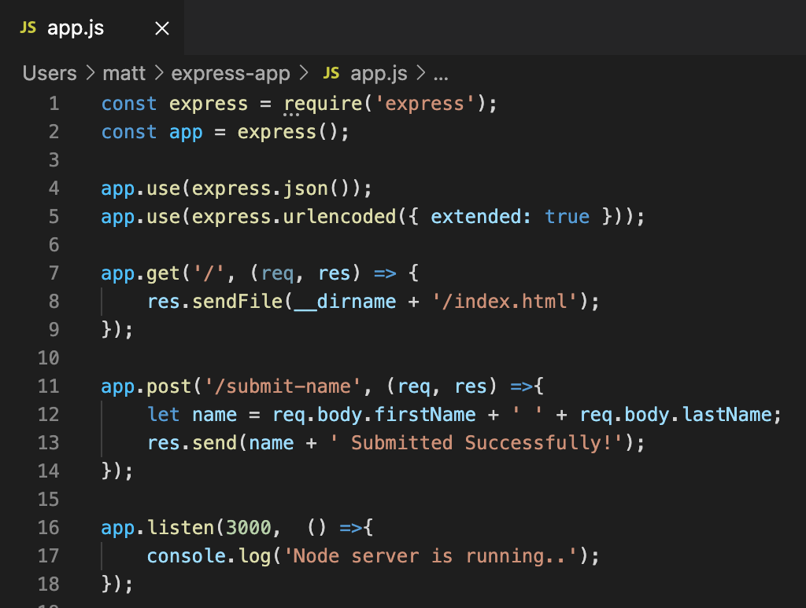
a basic express app

Slide 15
The express app – detail 1
1 - include or ‘require” the Express module
2 - Calls the express function "express()" and puts new Express application inside the app variable (to start a new Express application). It's something like you are creating an object of a class. Where "express()" is just like class and app is it's newly created object.

Slide 16
detail 2
3 - express.json() is a built in middleware function in Express starting from v4.16.0. It parses incoming JSON requests and puts the parsed data in req.body.
4 - express.urlencoded() is a method inbuilt in express to recognize the incoming Request Object as strings or arrays. This method is called as a middleware in your application using the code:
Needed for post and put requests

Slide 17
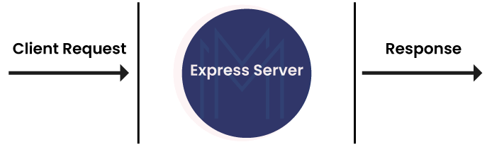
What is Middleware in Node.JS?
Middleware is nothing but a function that has access to response objects, request objects, and the next middleware function. It exists in between the request and response cycles of Node.JS execution. Generally, the request object is referred to by the variable ‘req', whereas the response object is referred to by the variable ‘res’..
https://www.scaler.com/topics/nodejs/middleware-in-nodejs/

Slide 18
detail 2 cont..
You NEED express.json() and express.urlencoded() for POST and PUT requests, because in both these requests you are sending data (in the form of some data object) to the server and you are asking the server to accept or store that data (object), which is enclosed in the body (i.e. req.body) of that (POST or PUT) Request.
In our CRUD app we are using bodyParser to do the same thing, but this deprecated depending on which version of Express is installed ( gets complicated)

Slide 19

detail 3
In Express you handle a GET request with the get ( ) method:
endpoint is the requested endpoint. It’s the value that comes after your domain name. callback tells the server what to do when the requested endpoint matches the endpoint stated. It takes two arguments: A request object and a response object.

Slide 20
detail 4
In the above block, POST data can be accessed using req.body. The req.body is an object that includes properties for each submitted form.
Index.html contains firstName and lastName input types, so you can access it using req.body.firstName and req.body.lastName.

Slide 21
detail 5
The app.listen() function creates the Node.js web server at the specified host and port. It is identical to Node's http.Server.listen() method.

Slide 22
server.js from last week

Slide 23
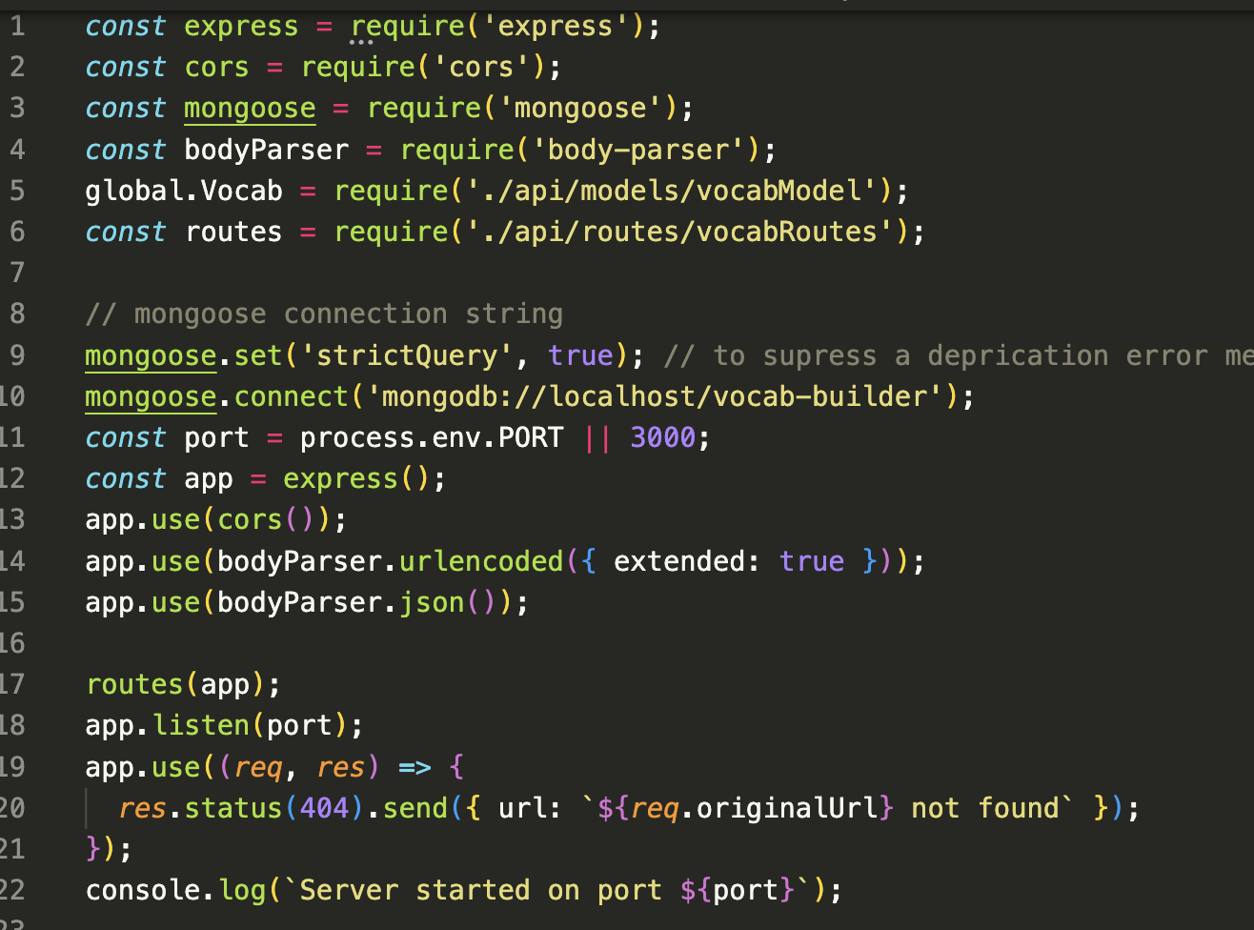
Our backend server from last week

Slide 24
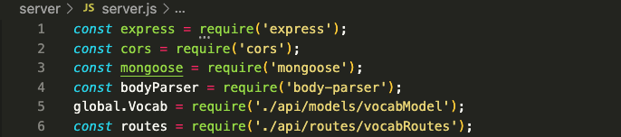
Our backend server detail 1
Import 4 libraries, express, cors, mongoose and body-parser
Include our vocabModle and declare it as global. To create a true global variable in Node.js, that is shared between multiple files, you should use the global object.
Include our vocabRoutes

Slide 25
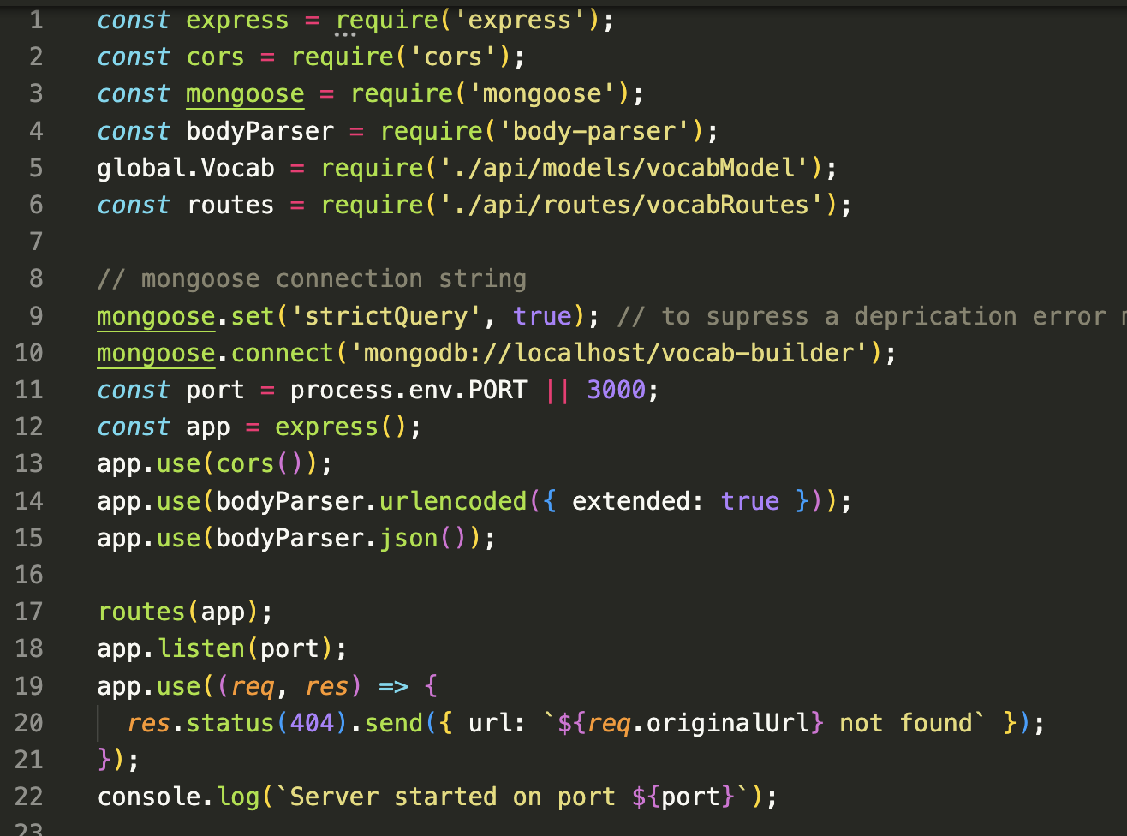
Our backend server detail 2
9/11 - Connect to our database, set the port to 3000
12/13 - Create our Express app. Use cors.
14/15 - Use bodyParser (seems to be deprecated in Express v4.16 and over, no harm in using it though.) https://stackoverflow.com/questions/55692084/what-is-the-difference-between-nodes-bodyparser-and-expresss-urlencoded-middle

Slide 26
Our backend server detail 3
17 – tell the Express app to use the routes we defined in vocabRoutes.js
18 - listen for connections on the specified host and port.
19/21 – dealing with 404 responses
https://expressjs.com/en/4x/api.html - app - list of Express methods

Slide 27
PARSE
To parse is to break up a sentence or group of words into separate components, including the definition of each part’s function or form.
Or….analyzing and converting a program into an internal format that a runtime environment can actually run, for example the JavaScript engine inside browsers.
Parsing is used in all high-level programming languages. Languages like C++ and Java are parsed by their respective compilers before being transformed into executable machine code. Scripting languages, like PHP and Perl, are parsed by a web server, allowing the correct HTML to be sent to a browser.
https://developer.mozilla.org/en-US/docs/Glossary/Parse

Slide 28
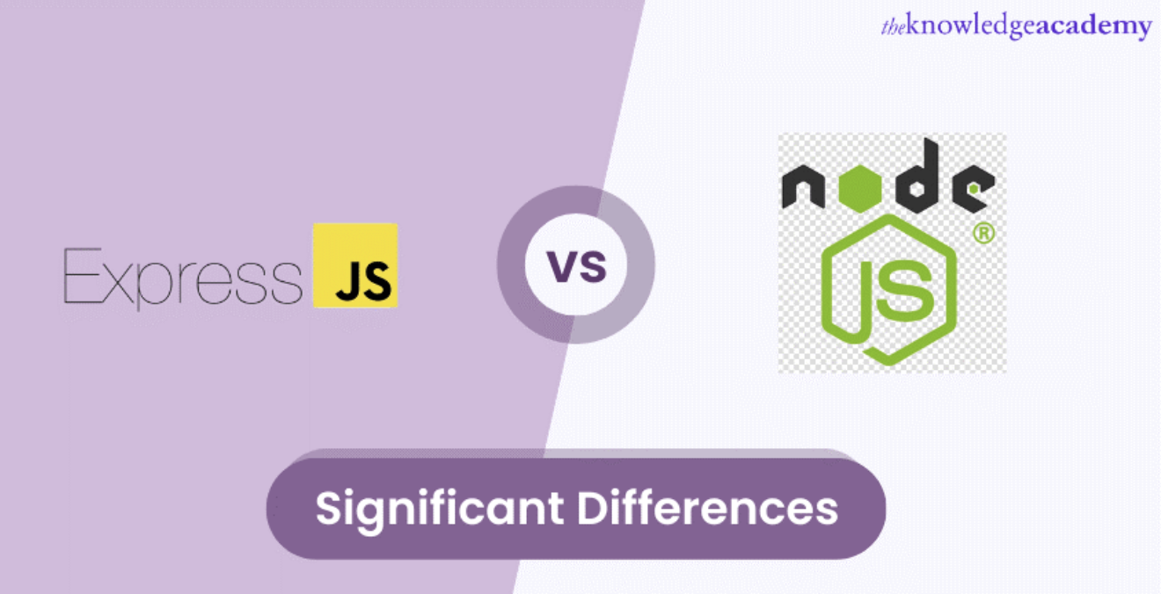
Express js vs Node js – read in own time !!
https://www.theknowledgeacademy.com/blog/express-js-vs-node-js/

Slide 29
?

Slide 30
Sources
https://www.tutorialsteacher.com/nodejs/expressjs-web-application
https://mfikri.com/en/blog/express-tutorial-beginners
https://expressjs.com/en/starter/hello-world.html
https://www.theknowledgeacademy.com/blog/express-js-vs-node-js/
https://expressjs.com/

