Slide 1
COMP 1842
Coursework CRUD system part 3 front end
Matt Prichard

Slide 2
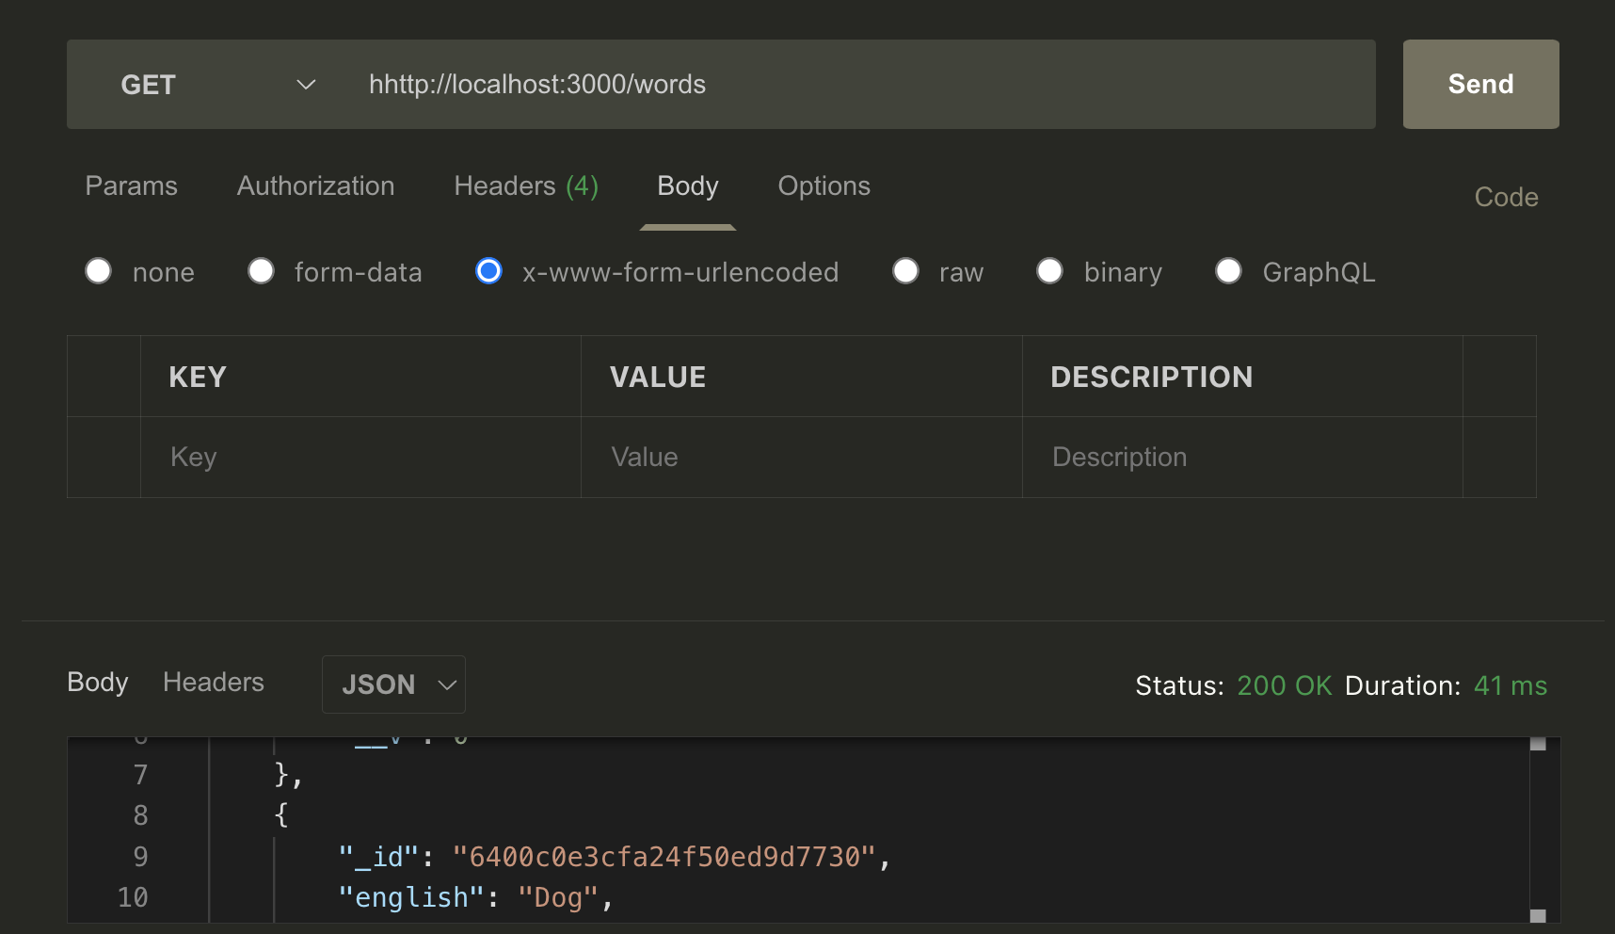
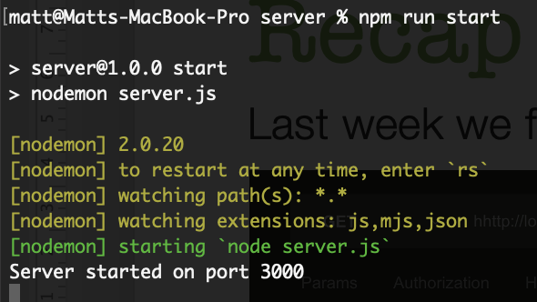
Recap
Last week we finished our RESTful API and tested it in Postcode

Slide 3


Introduction
This week we will create the first part of the Vue frontend.
We will install Vue cli globally to scaffold the project
https://cli.vuejs.org/ - Vue command line interface
We can check our install by typing. vue –-version Mine is 5.0.8

Slide 4

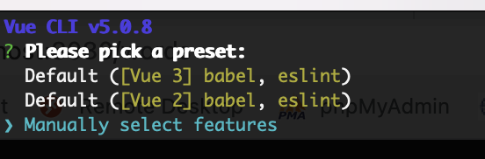
Basic set up
Make sure you’re in the root folder of the project (cd vocab-builder), then run the following:
When prompted use the arrow keys to select Manually select features and hit enter

Slide 5
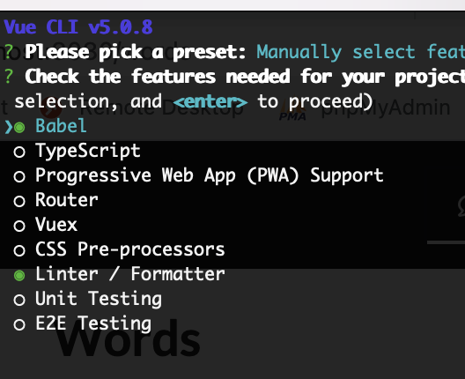
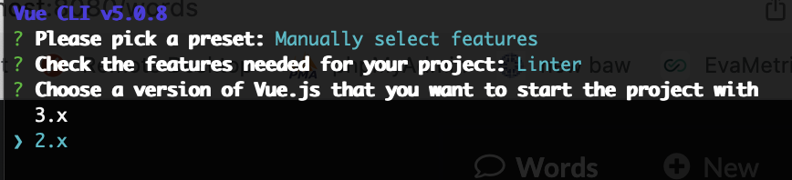
Basic set up pt 2
Click space to unselect Babel, use arrow key to go down and use space to unselect Linter,
Click enter and the select version 2 from the list and hit enter

Slide 6
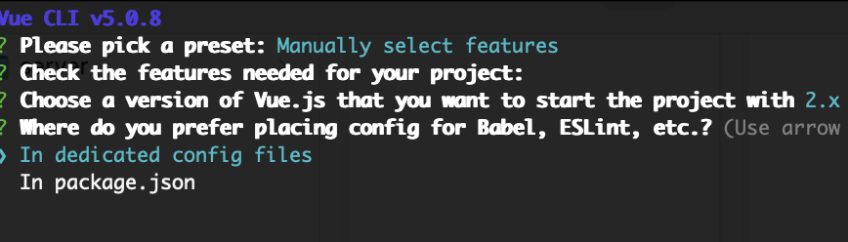
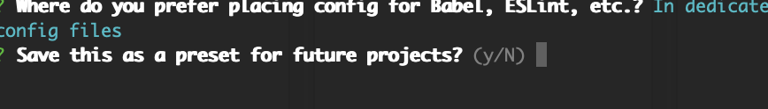
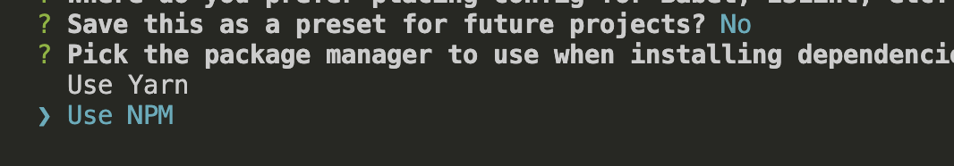
Basic set up pt 3
Leave – ‘In dedicated Config file’ hit Enter
Type N and Enter again
If using a Mac pick - Use NPM

Slide 7
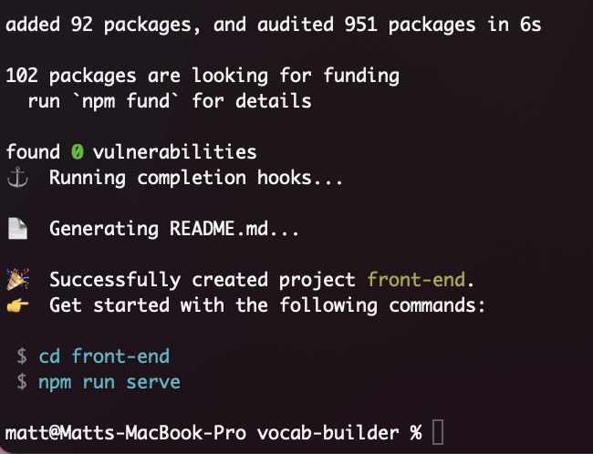
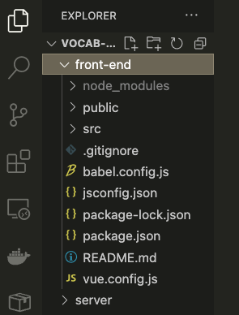
Basic set up pt 4
Eventually you should see something like this
VS code view

Slide 8
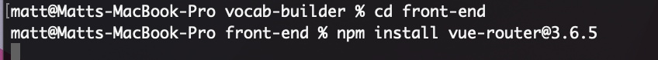
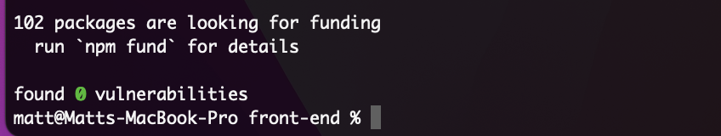
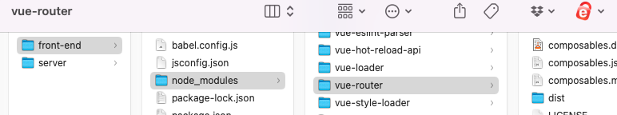
Install Vue router
cd front-end – make sure you are still in front-end
npm install vue-router@3.6.5

Slide 9
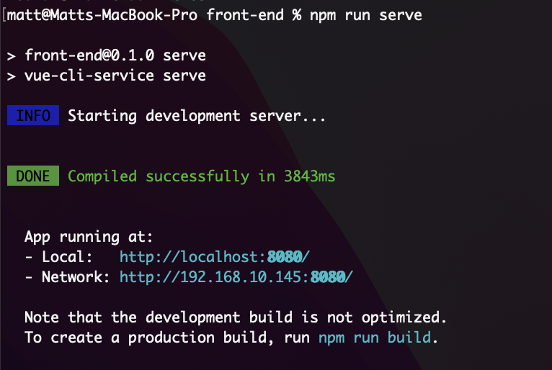
Test front end server
While still in front-end. npm run serve

Slide 10
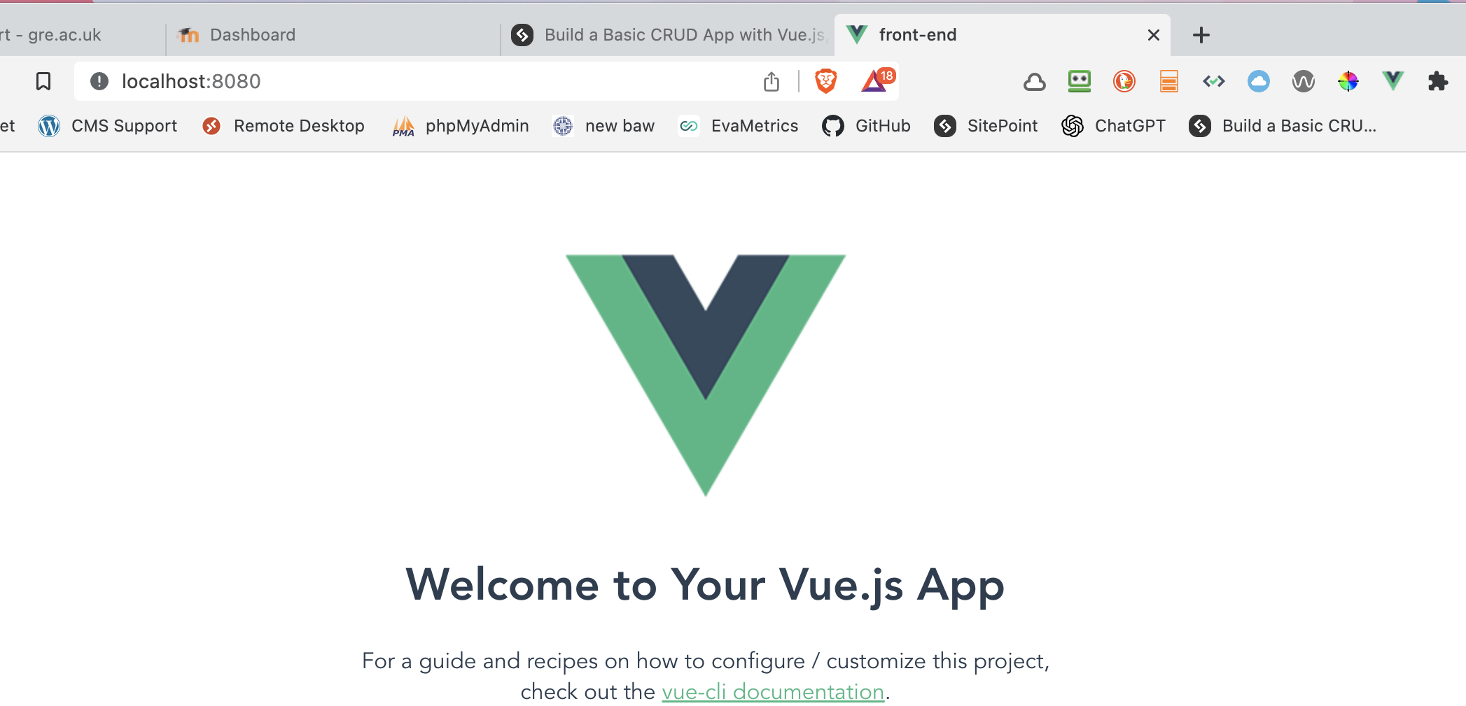
Check in browser
Localhost:8080

Slide 11
Control C stop the server
Delete helloWorld.vue from the src/components folder

Slide 12
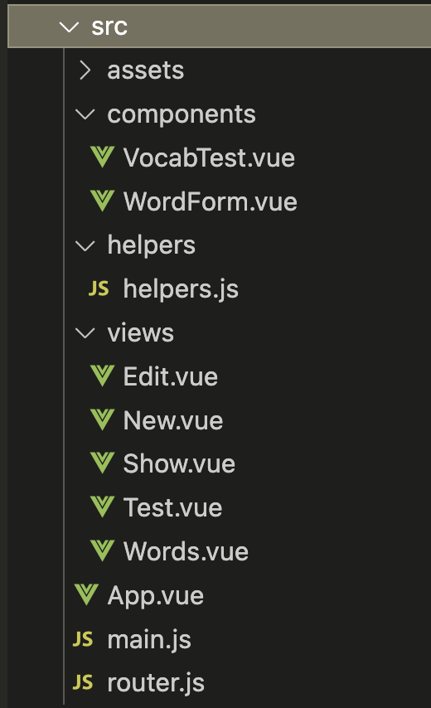
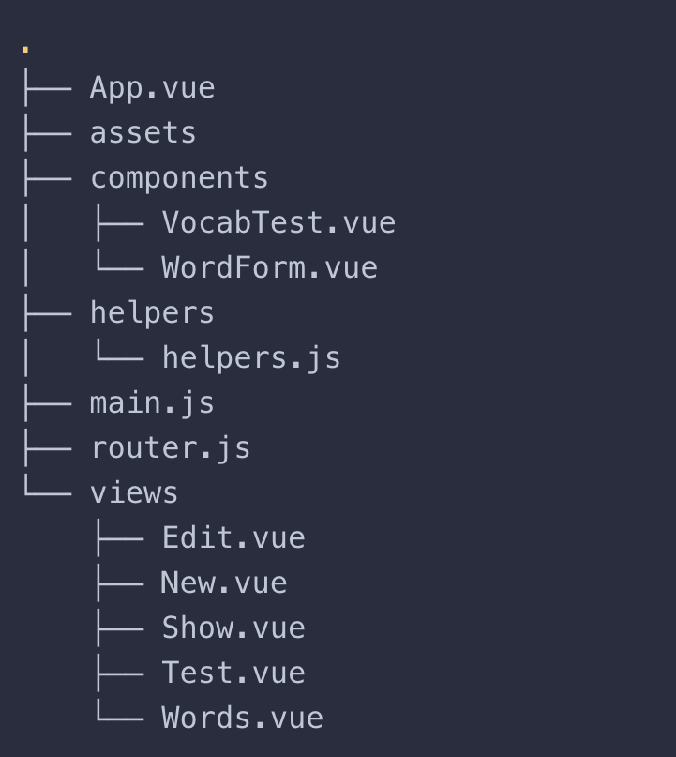
Finish structure
Carefully from within VS Code make the contents of the folder src look like this with all these folders and empty files

Slide 13
Front end dependencies
For the front end, we’ll be using the following libraries:
axios —a Promise-based HTTP client which will allow us to make Ajax requests from our front end to our back end.
semantic-ui-css —a lightweight, CSS-only version of Semantic UI.
vue-flash-message —a Vue flash message component which we will use to display information to the user.
While still in front-end run:
npm i axios semantic-ui-css vue-flash-message

Slide 14
src/router.js

Slide 15
Creating the Routes
Firstly, we need to consider which routes our application will have. We’ll need to perform all of the CRUD options we created in the back end.
/words —display all the words in the database
/words/new —create a new word
/words/:id —display a word
/words/:id/edit —edit a word
/test —test your knowledge
Deleting a word doesn’t require its own route. We’ll just fire off the appropriate request and redirect to /words.

Slide 16
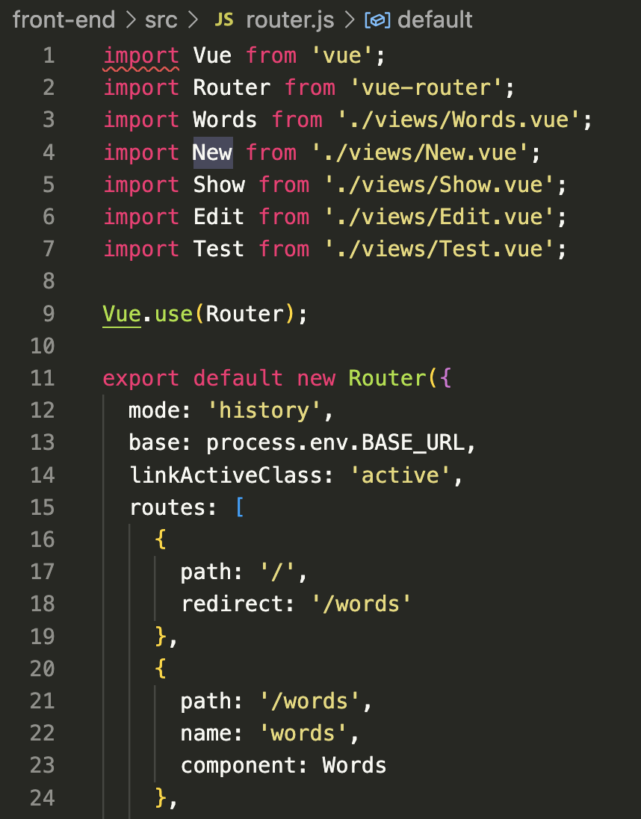
router.js pt1
Import vue, import vue-router, import the views.
Line12:https://v3.router.vuejs.org/guide/essentials/history-mode.html#example-server-configurations
Line 14 tells the router to apply a class of ’active’ to the currently activated navigation.
Create the various routes, the first one 17/18 redirects to a default route if just / is put in the URL

Slide 17
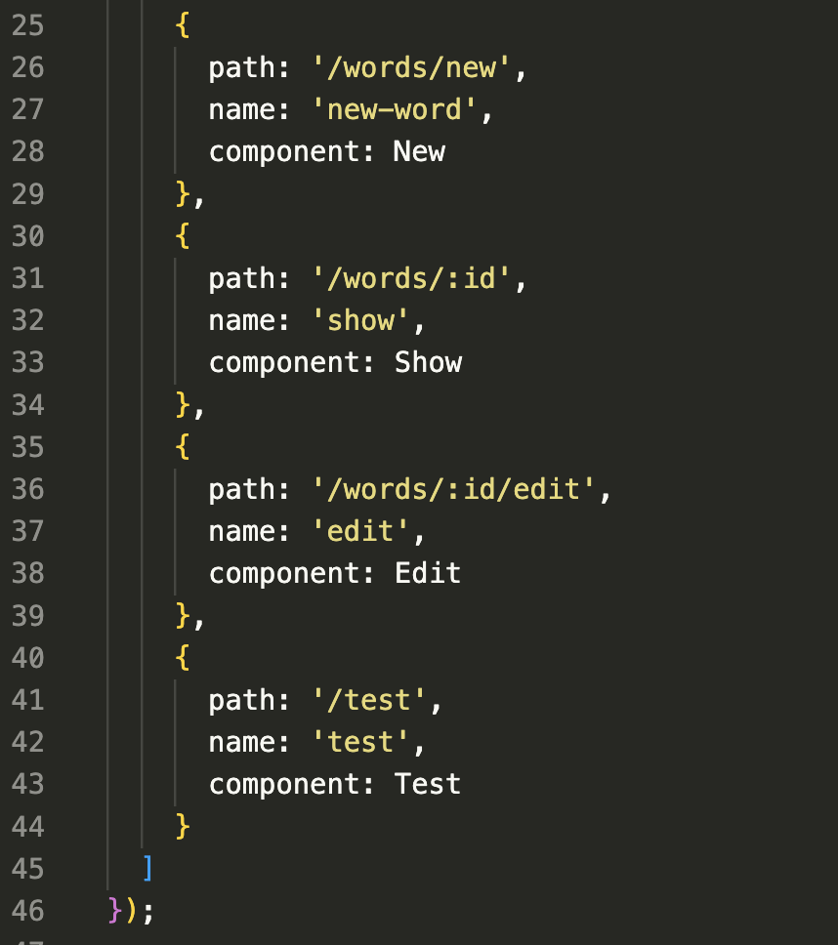
router.js pt2
Continue making the rest of the routes for our app

Slide 18
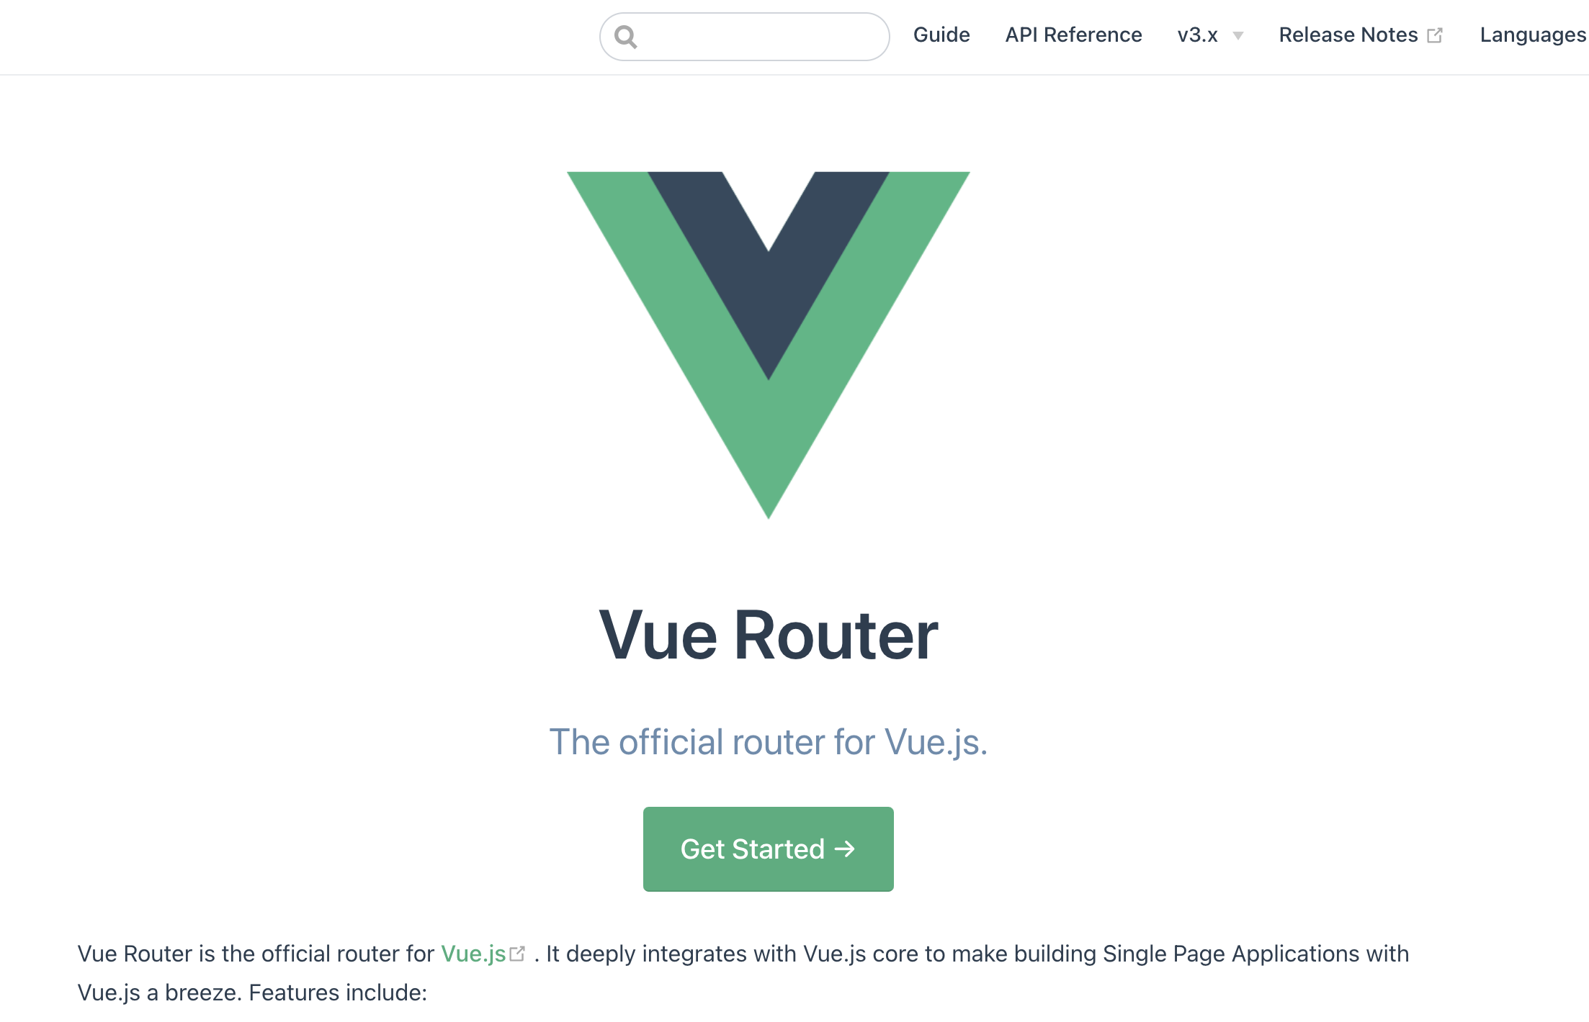
Vue router – further reading
https://v3.router.vuejs.org/

Slide 19
src/main.js

Slide 20
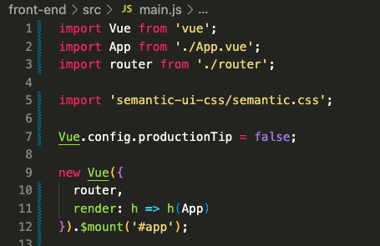
main.js – full code
We are adding lines 3 and 5 to main.js, importing router and our css
Line 7 turns off development mode warning message, don’t worry about it.
Line 9 -12 are are rendering and mounting the app in the element with id app in index.html
Further reading:
https://github.com/vuejs-templates/webpack-simple/issues/29

Slide 21
src/App.vue
File on moodle

Slide 22
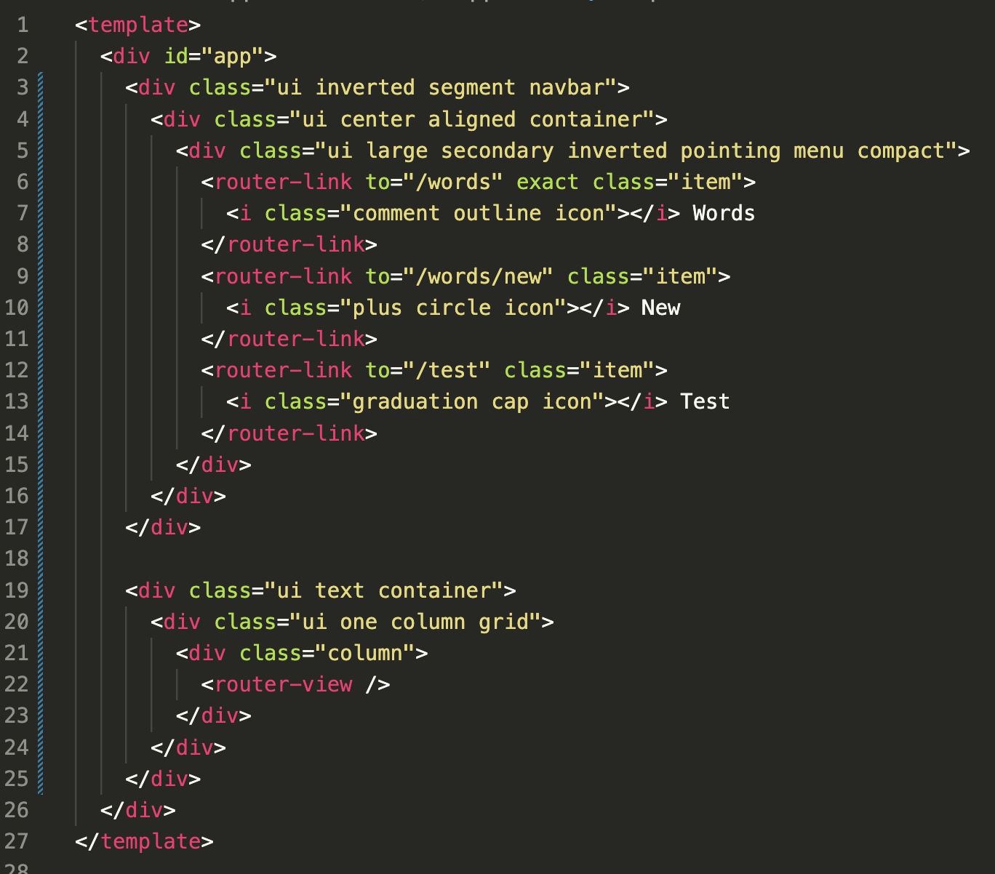
The template part
This is the HTML and Semantic UI CSS classes to make the main nav bar and includes the 3 Vue router links 6, 9 and 12. then declares an outlet (the <router-view /> component – line 22) for our views.

Slide 23
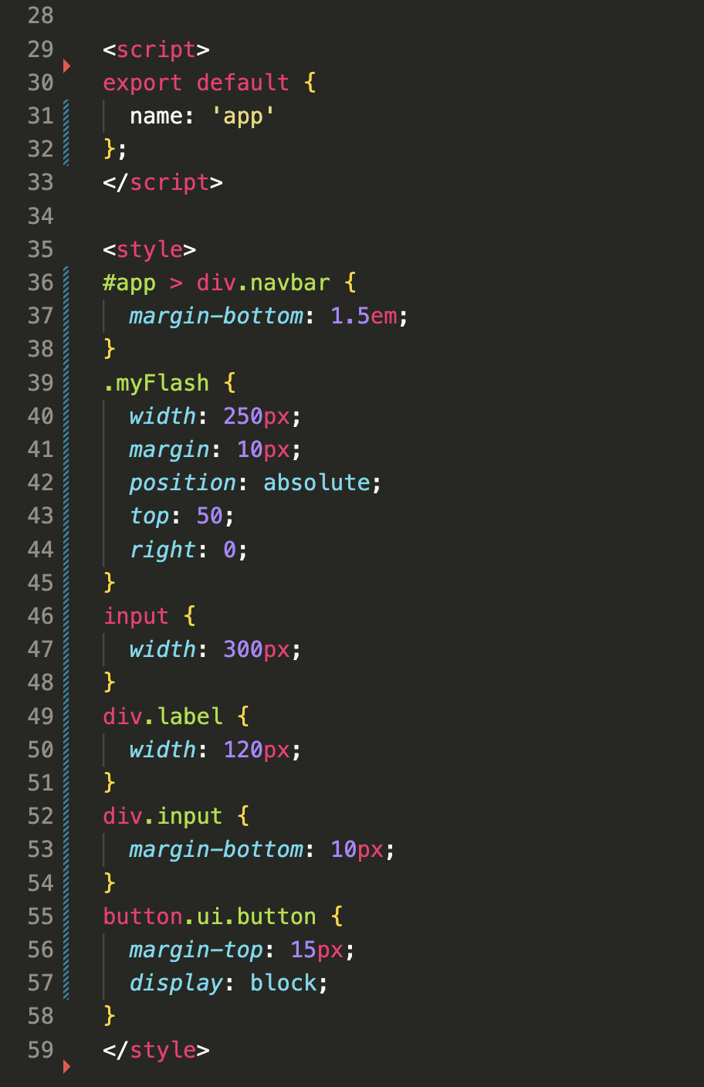
Script and css part
Using export default:
Another way is declaring a component. In Vue you can create a component and register it. You may also reuse it later if you needed.
https://codesource.io/vue-export-default-vs-vue-new/
Some additional CSS from line 35 onwards

Slide 24
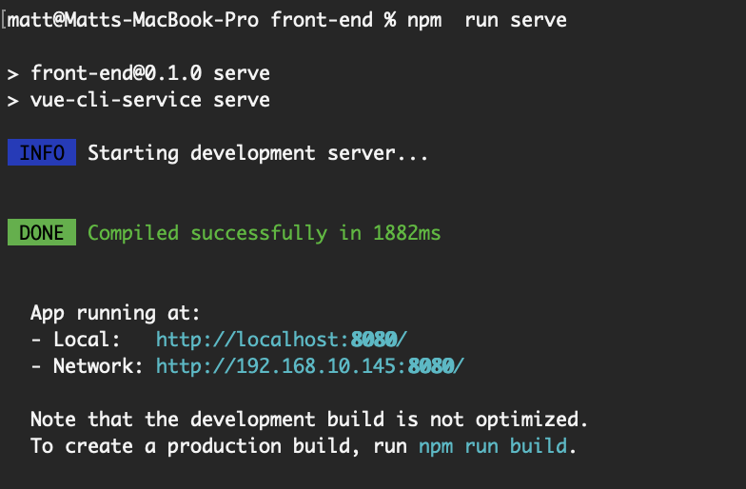
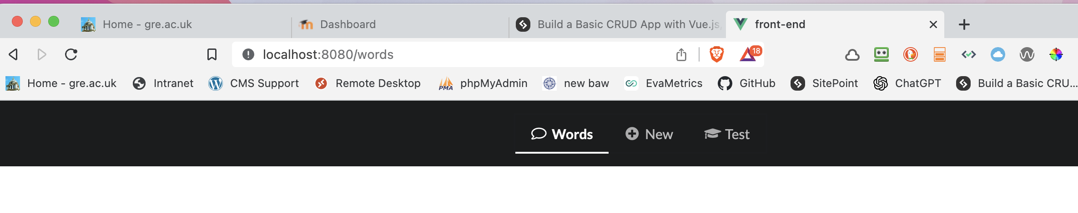
Test the front end
npm run serve
NB- end of week 9 part1 in my code - you carry on

Slide 25

YAY - coffee Beak

Slide 26
Back to work !
Communicating with the Back End
part 1

Slide 27
src/helpers/helpers.js

Slide 28
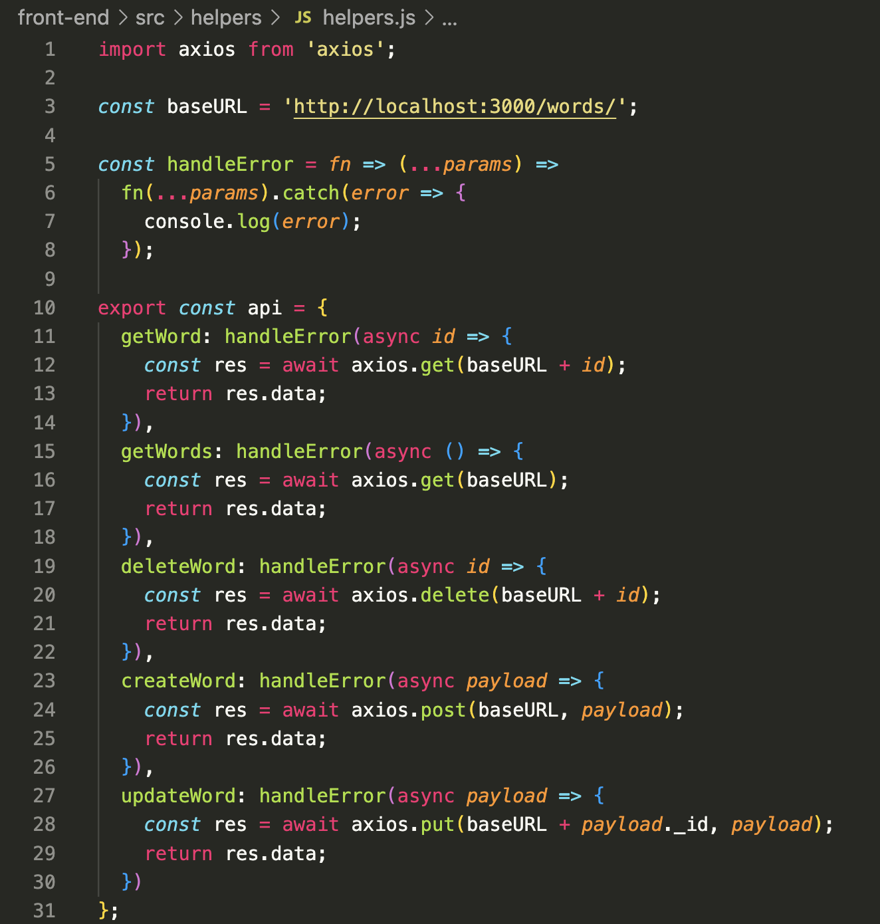
helpers.js full code
The next thing we need to do is establish a method of communicating with our Node back end. This is where the axios library comes in that we installed previously. To make our app flexible, we can add any axios-related code to a helper file which can be included in any component that needs it. Setting things up this way has the advantage of keeping all of our Ajax logic in one place.

Slide 29
helpers.js detail
We’re exporting an api object that exposes methods corresponding to the endpoints we created in the previous section. These methods will make Ajax calls to our back end, which will carry out the various CRUD operations.
https://www.sitepoint.com/flow-control-callbacks-promises-async-await/

Slide 30
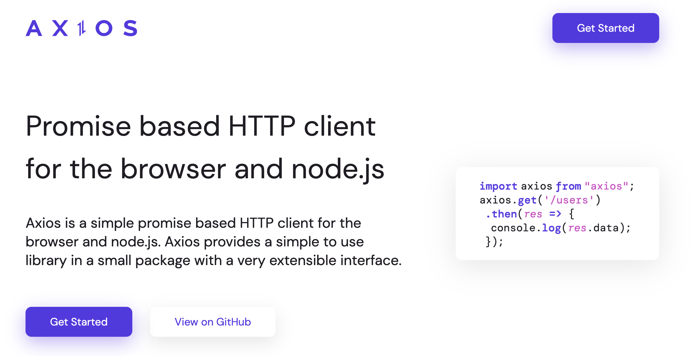
https://axios-http.com/

Slide 31
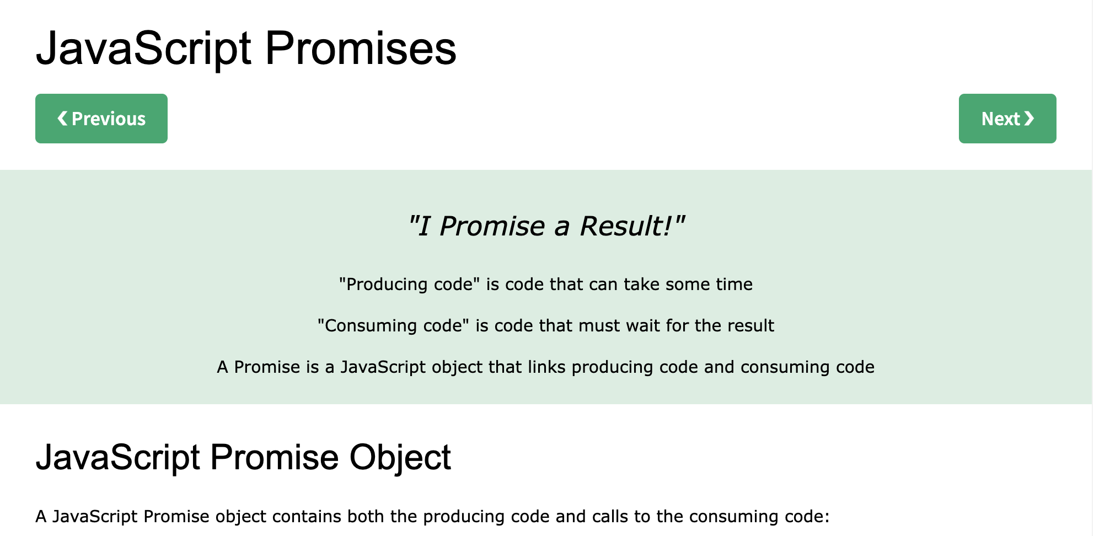
Beyond the scope of this module, but if you are interested
https://javascript.info/promise-basics
https://www.w3schools.com/js/js_promise.asp

Slide 32
src/views/Words.vue

Slide 33
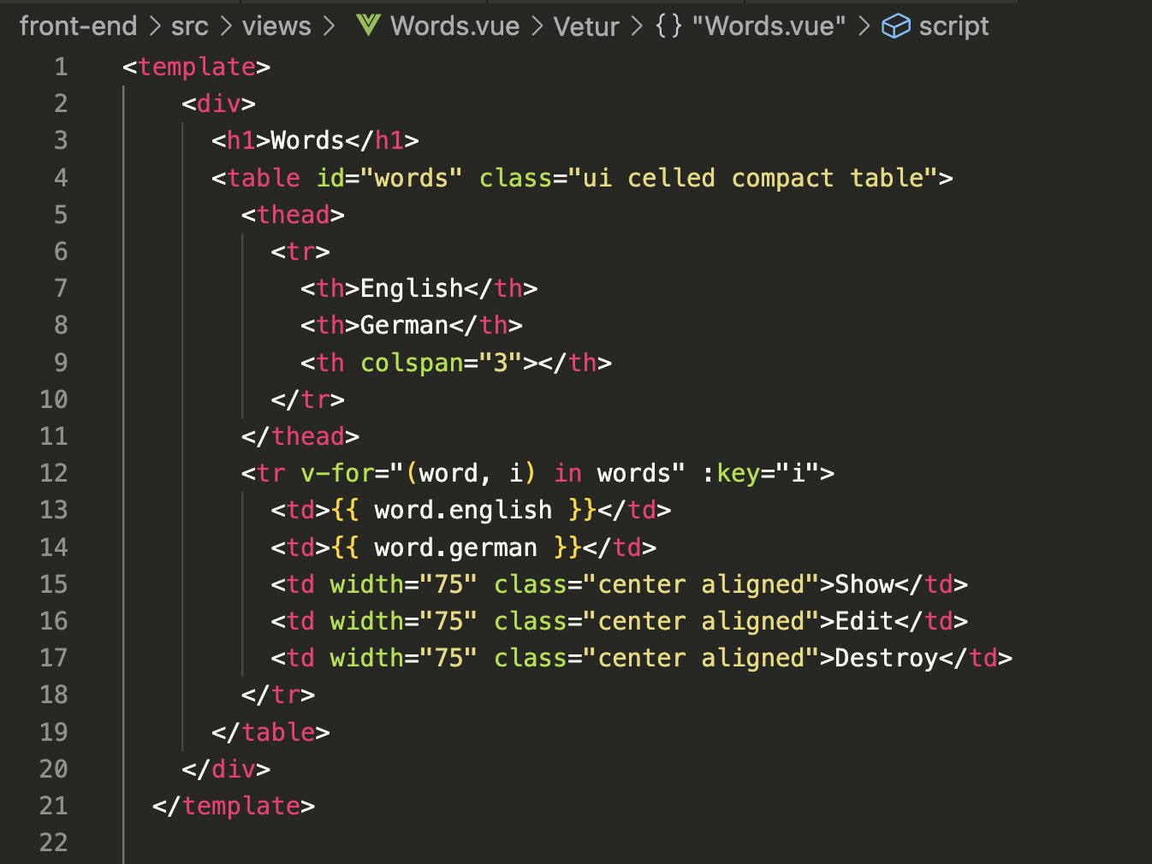
Words.vue pt1 – write this code
I’ll let you deduce what this code is more or less doing

Slide 34
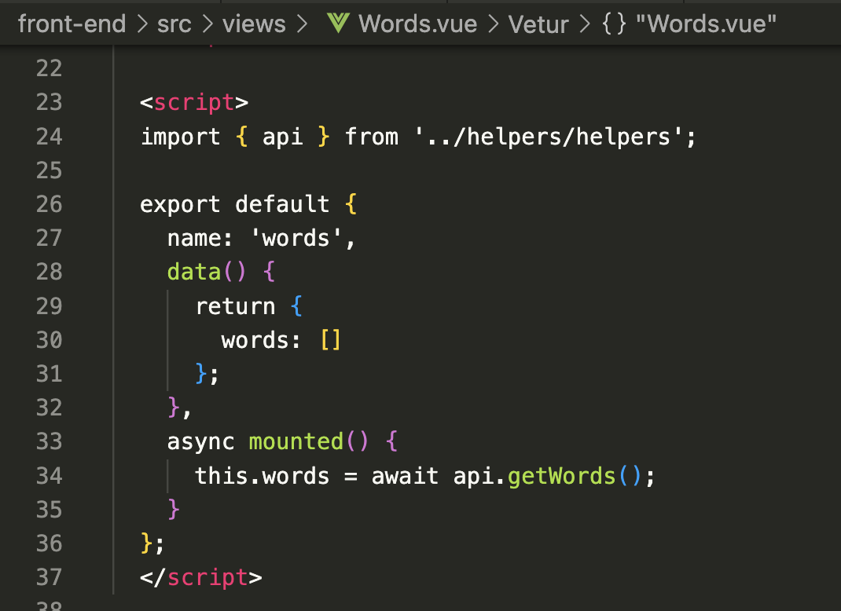
Words.vue pt2
We are importing our API (24) to perform operations against the back end, then in the component’s mounted lifecycle hook we’re calling its getWords method (34) to fetch all of the words from the database. As the component has a words property (30) on its data object, we can await the answer from the back end, then insert the response into this.words (34) and the component will update.

Slide 35
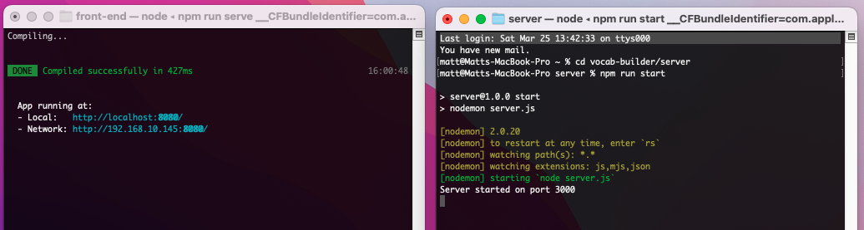
Test system so far
We need 2 instances of the terminal open at once. One for the back end on port 3000 and one for the front-end port 8080
Back-end cd uni/vocab/vocab-wk9-pt2/server then npm run start
Front-end cd uni/vocab/vocab-wk9-pt2/front-end then npm run serve

Slide 36
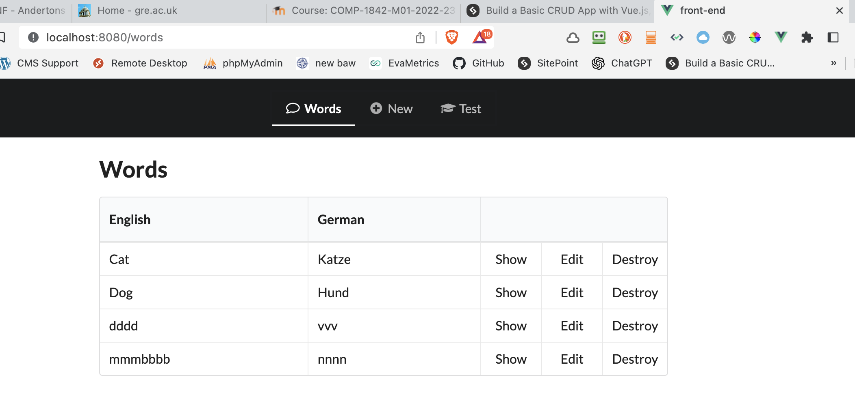
Localhost:8080/words
NB- end of week 9 part2 in my code - you carry on

Slide 37

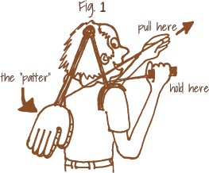
If you have got this far give yourself a…

Slide 38
Next…
displaying a single word

Slide 39
The theory
To show a single word we will need it’s ID from mongoDB, equivalent of the primary key from SQL.
We will need a link from the home page.
We will use the route /words/:id from routes.js
We will need a component to display the result as we did with the get all words.
week 9 part 3 in my code

Slide 40
The practice - firstly
In Words.vue overwrite line 15
With the following:
This creates a link to the show route which we defined in our src/router.js file. It uses the current word’s _id property to build the URL, resulting in something like:
http://localhost:8080/words/6400c0e3cfa24f50ed9d7730

Slide 41
src/views/Show.vue
Base file on Moodle

Slide 42
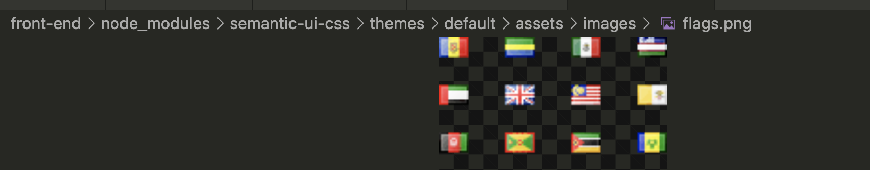
Show.vue
Copy the code from Show.vue from the zip file on Moodle to your Show.vue file in src/views.
The top part of the file is the HTML template and a router-link, read through this yourselves. This is where the flag icons from semantic UI are coming from too
Also take note of the scoped attribute on the <style> tag at the bottom. This means that any styles declared here are applied to this component only.

Slide 43
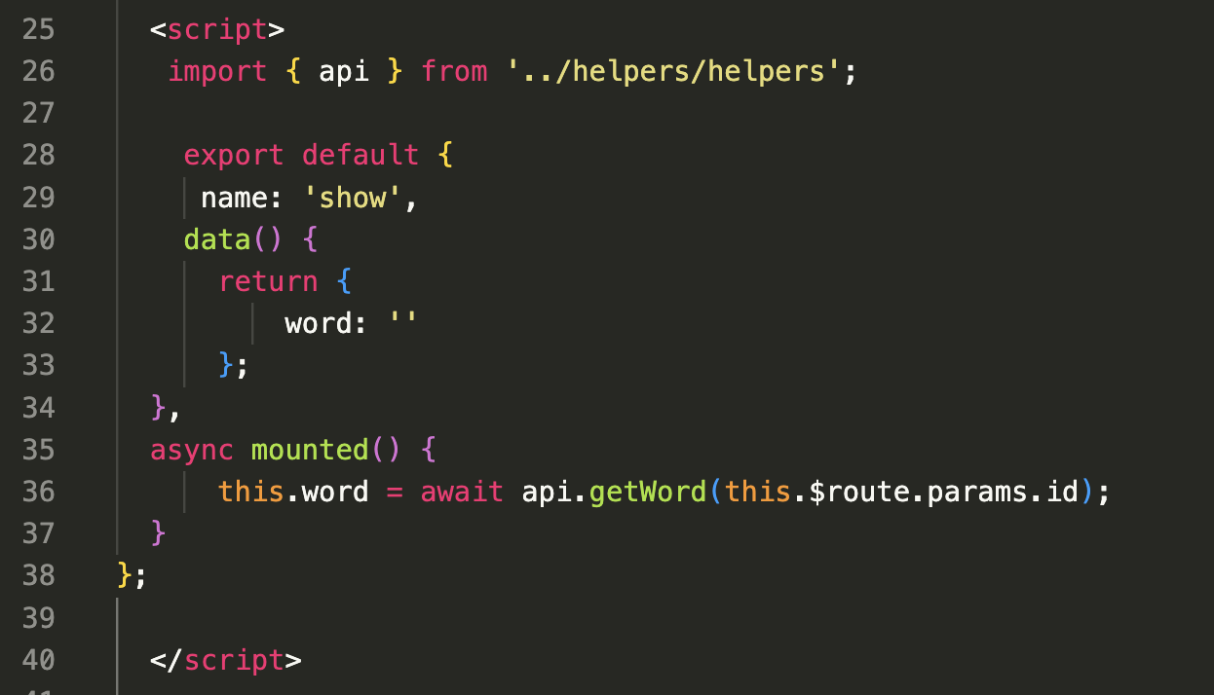
Show.vue pt2
Between the empty script tags add the following code, similar to slide 33.
When mounted, this component will use the same technique as before to get a single word from the database. It identifies the word in question by extracting its ID from the URL using this.$route.params.id. This is possible because of how we declared the route in src/router.js.
Here we used path: "/words/:id" which means that anything after /words/ should be available to us as $route.params.id.

Slide 44
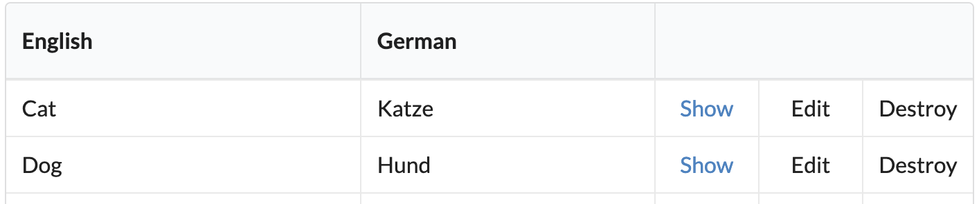
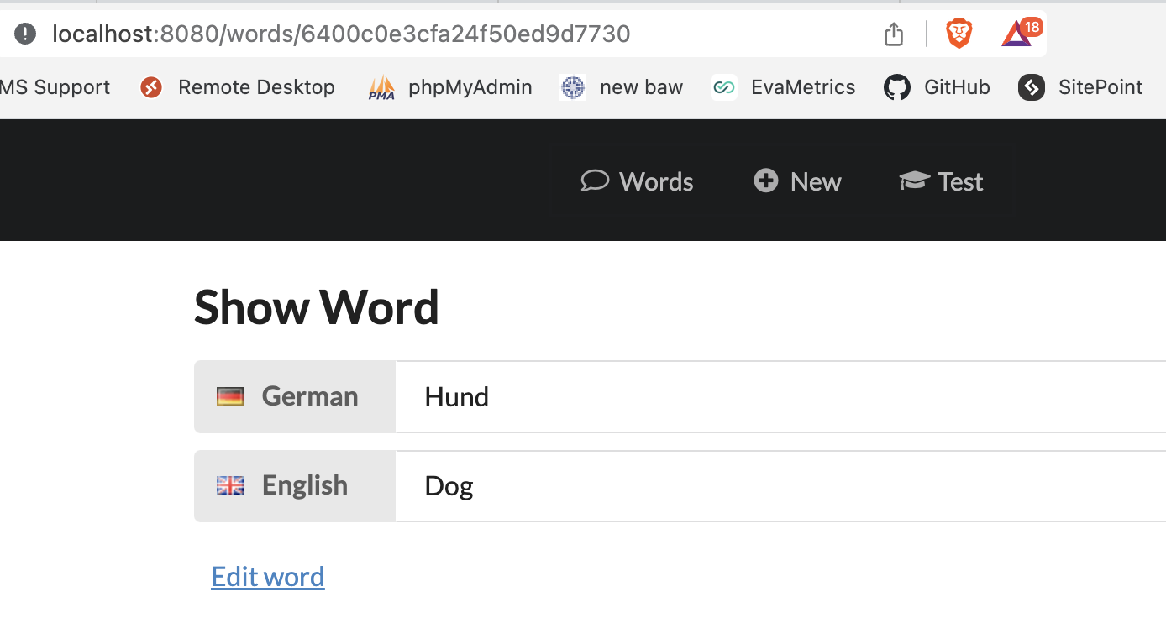
Test in browser
Back-end cd uni/vocab/vocab-wk9-pt3/server then npm run start
Front-end cd uni/vocab/vocab-wk9-pt3/front-end then npm run serve

Slide 45
Editing a word

Slide 46
src/views/Edit.vue

Slide 47
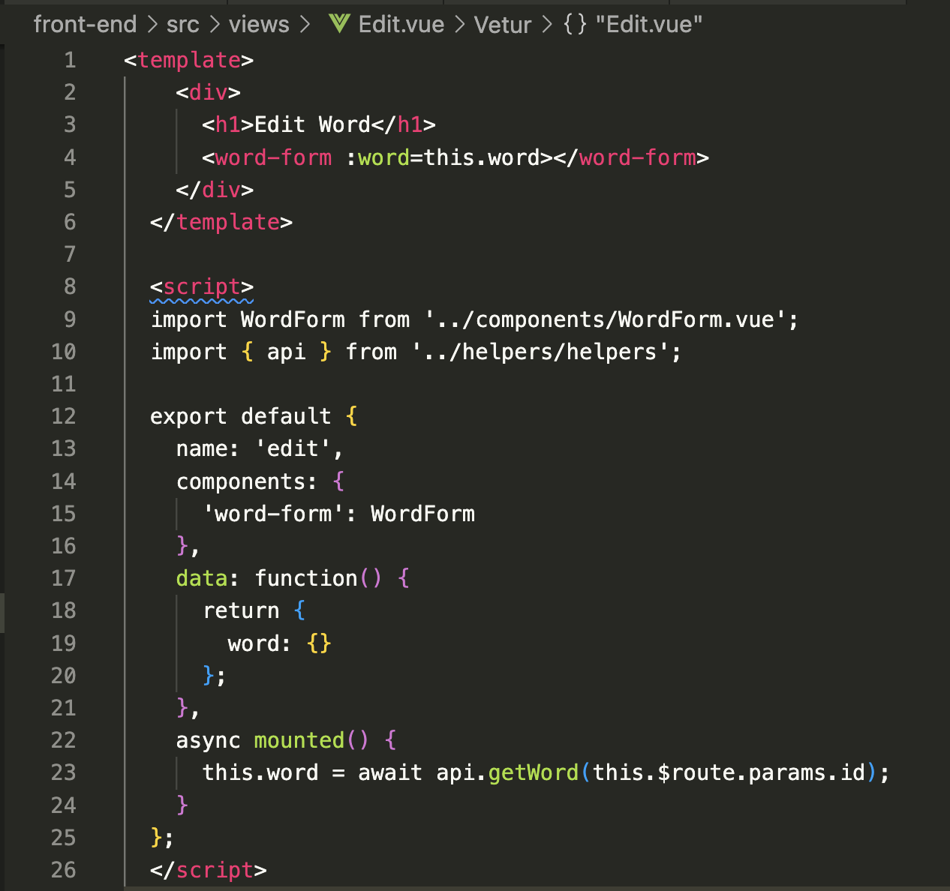
Edit.vue - full file
There’s something slightly different going on in this component. If you look within the <template> tag, you’ll notice that we’re including another component, WordForm, and passing it the value of this.word as a prop. The value of this.word is being retrieved within the mounted lifecycle hook, just as we’ve done in the other components.

Slide 48
Edit.vue - detail
Also notice that we’re declaring the child component that the Edit component requires, like so:
The reason is reusability. By structuring things this way, we’ll be able to use the same WordForm component in a little while when we come to implement the functionality to create a new word.

Slide 49
src/components/WordForm.vue
Full file on Moodle ☺

Slide 50
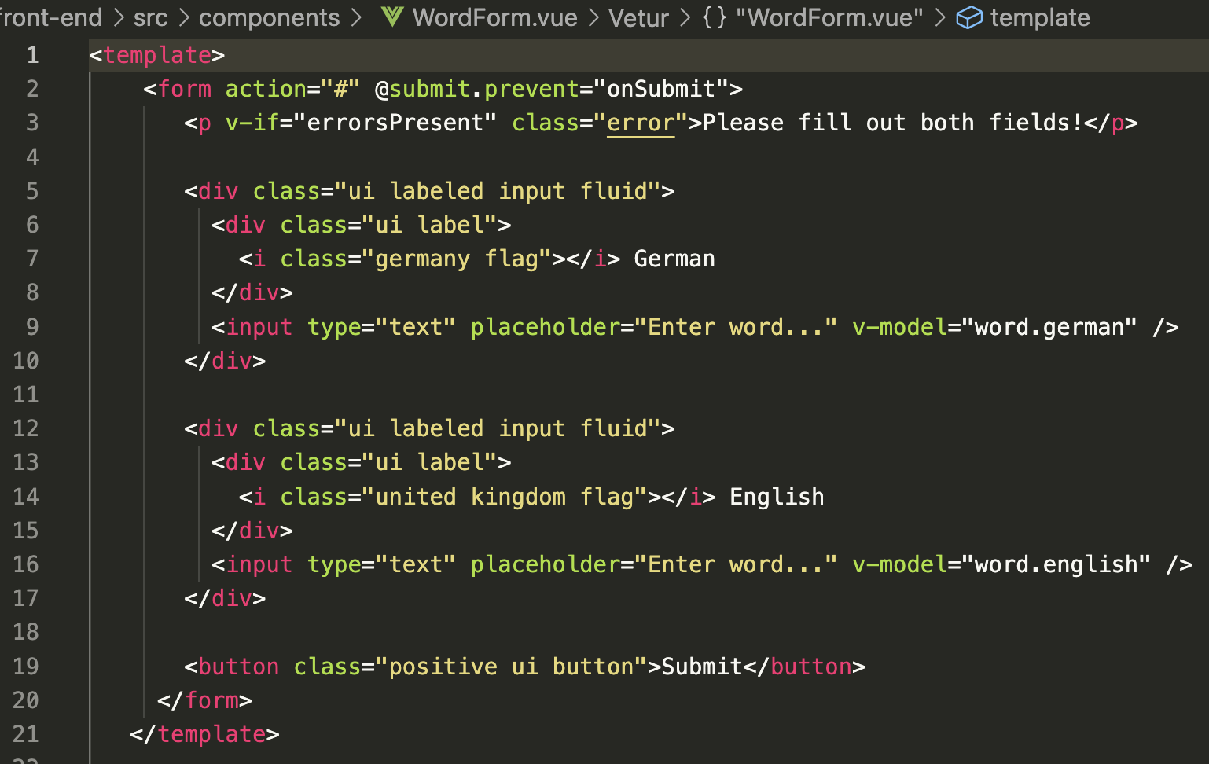
We have a form tag and we’ve bound the submit event to the onSubmit method we’ve defined in our methods object. We’re also using the prevent modifier to prevent the browser submitting the form.
Next a <p> tag to display an error message if either of the input fields is empty. We use v-if to only display this if the errorsPresent property is true.
Then we have our two input fields, one for the English word and one for German. We’re using v-model to set up two-way data binding between the english and german properties of the prop we’re passed.. Props were covered in ‘components’ - video 8 of the weekly Vue tasks

Slide 51
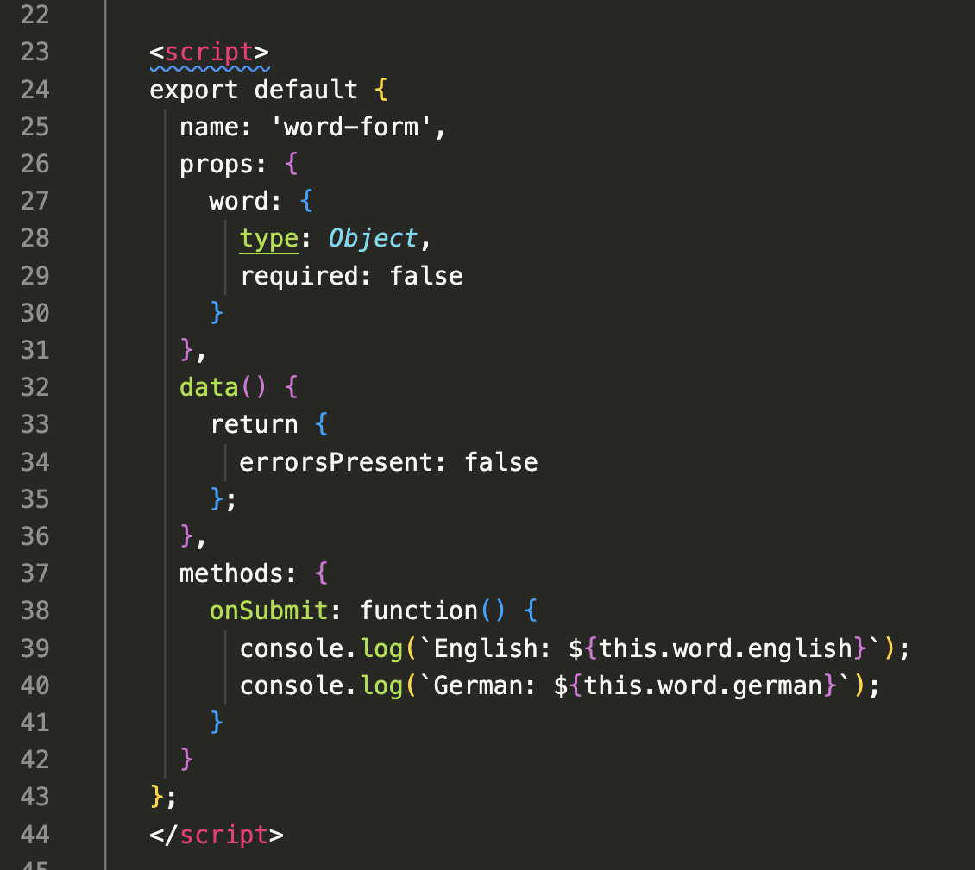
In the <script> section, we then declare that the word prop is of type Object, and that it isn’t required (because we’ll also use this form to create a new word).
The data object declares the aforementioned errorsPresent property and our method object, the onSubmit method.
All we’re doing in this method is logging out the value of whatever has been entered into the inputs.

Slide 52
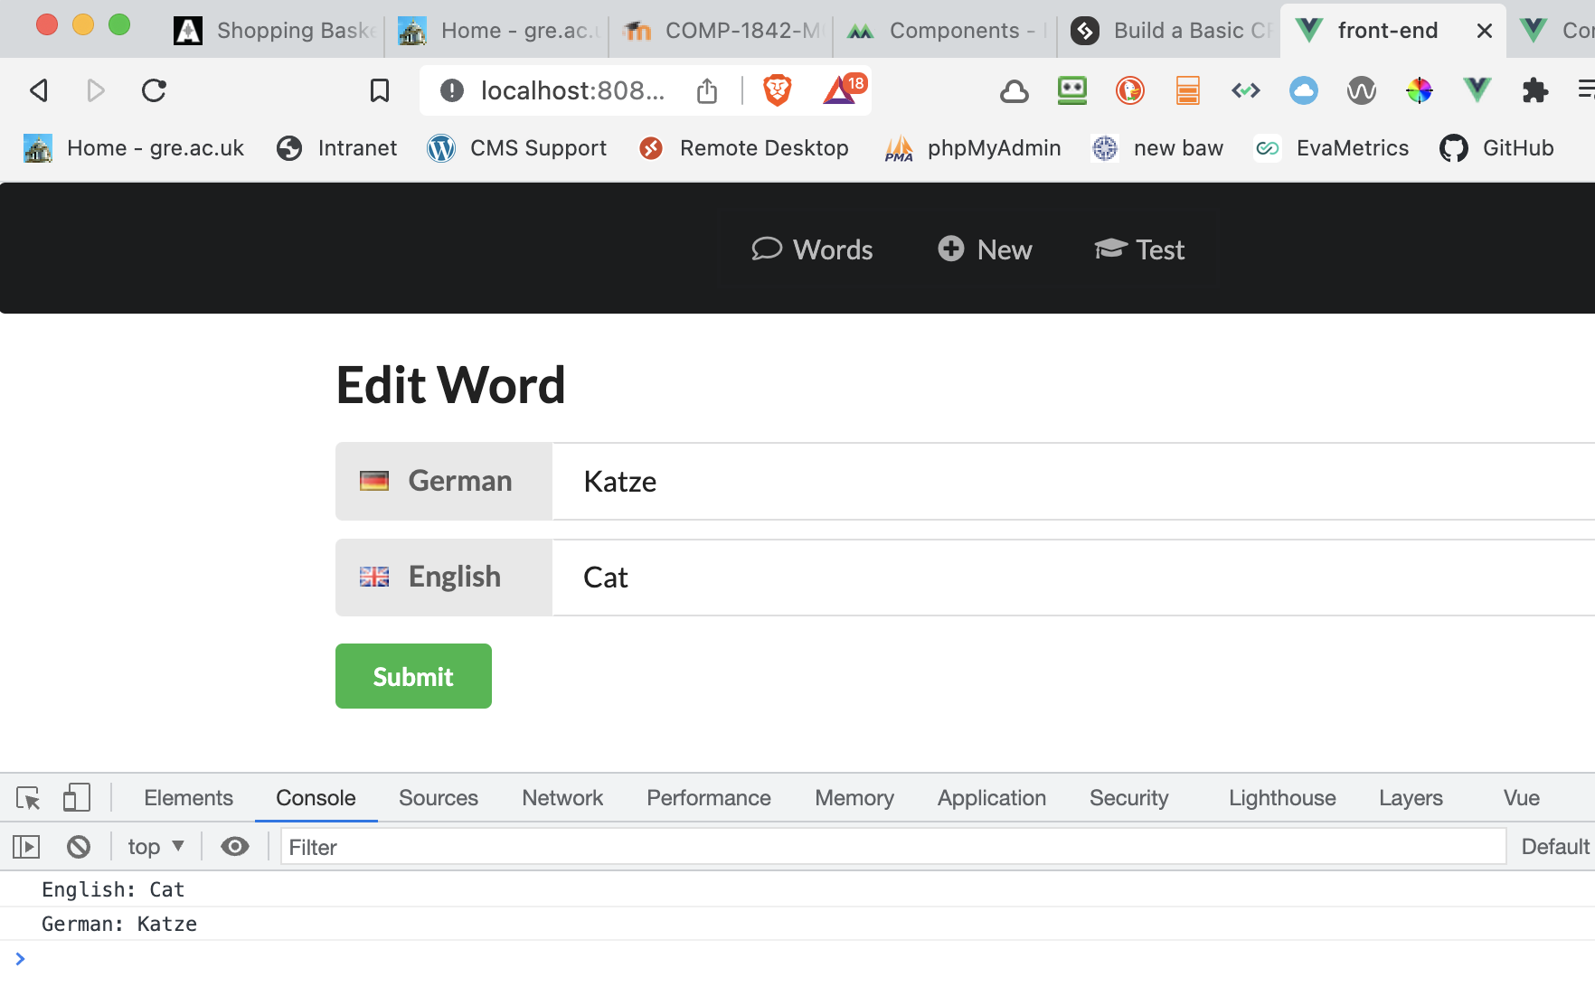
Now if you visit the Edit word view, you should see the correct word displayed in the fields.
And when you click Submit, you should see the value of both input fields logged in the console.

Slide 53
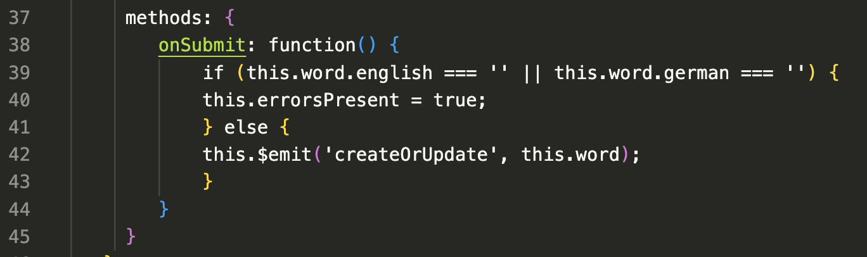
Finally in WordForm.vue
Finally, we need to expand our onSubmit method to do something other than log the values of the inputs to the console. Alter it to this:
This checks that both fields have a value. If not, it flags the error, otherwise it emits an event createOrUpdate which we can listen for in the parent component (in this case, Edit). It’s called it createOrUpdate, as the corresponding functionality in the parent component will be doing one of these two things.

Slide 54
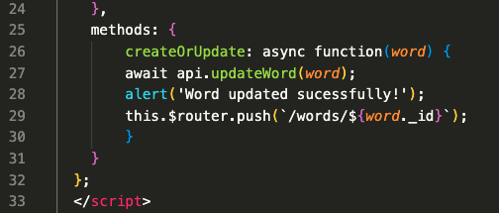
Back in Edit.vue
change
to
And implement the update functionality in the methods object:

Slide 55
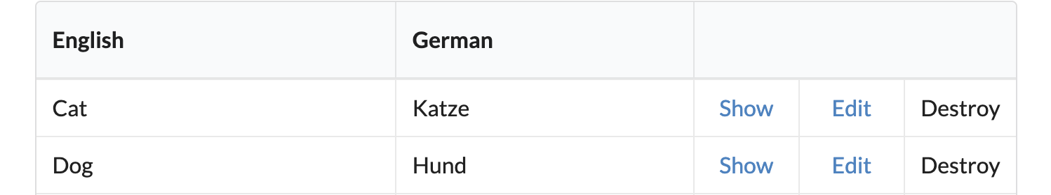
Final touch – Words.vue
change
to
Test the show and edit part of your system

Slide 56
Absolutely, positively, definitely
enough for now

Slide 57
?

