Slide 1
COMP 1842
Week 2 - Vue part 2
Matt Prichard

Slide 2
Introduction
Recap
Vue…next steps

Slide 3
Recap
We looked at the basic structure of a Vue app.
We need to load the Vue library into the header of our index.html
We have an external main.js file that holds the code for our Vue app, we load this file into the html document.
We mount the app into an HTML DOM object by it’s id #

Slide 4
Recap cont….
Using the {{moustache}} template syntax, The moustache tag will be replaced with the value of the property from the corresponding component instance.
We briefly looked at Vue Directives to perform conditional logic in the html with v-if etc.
We also looked at Binding properties with v-bind:href and the shorthand. :href

Slide 5
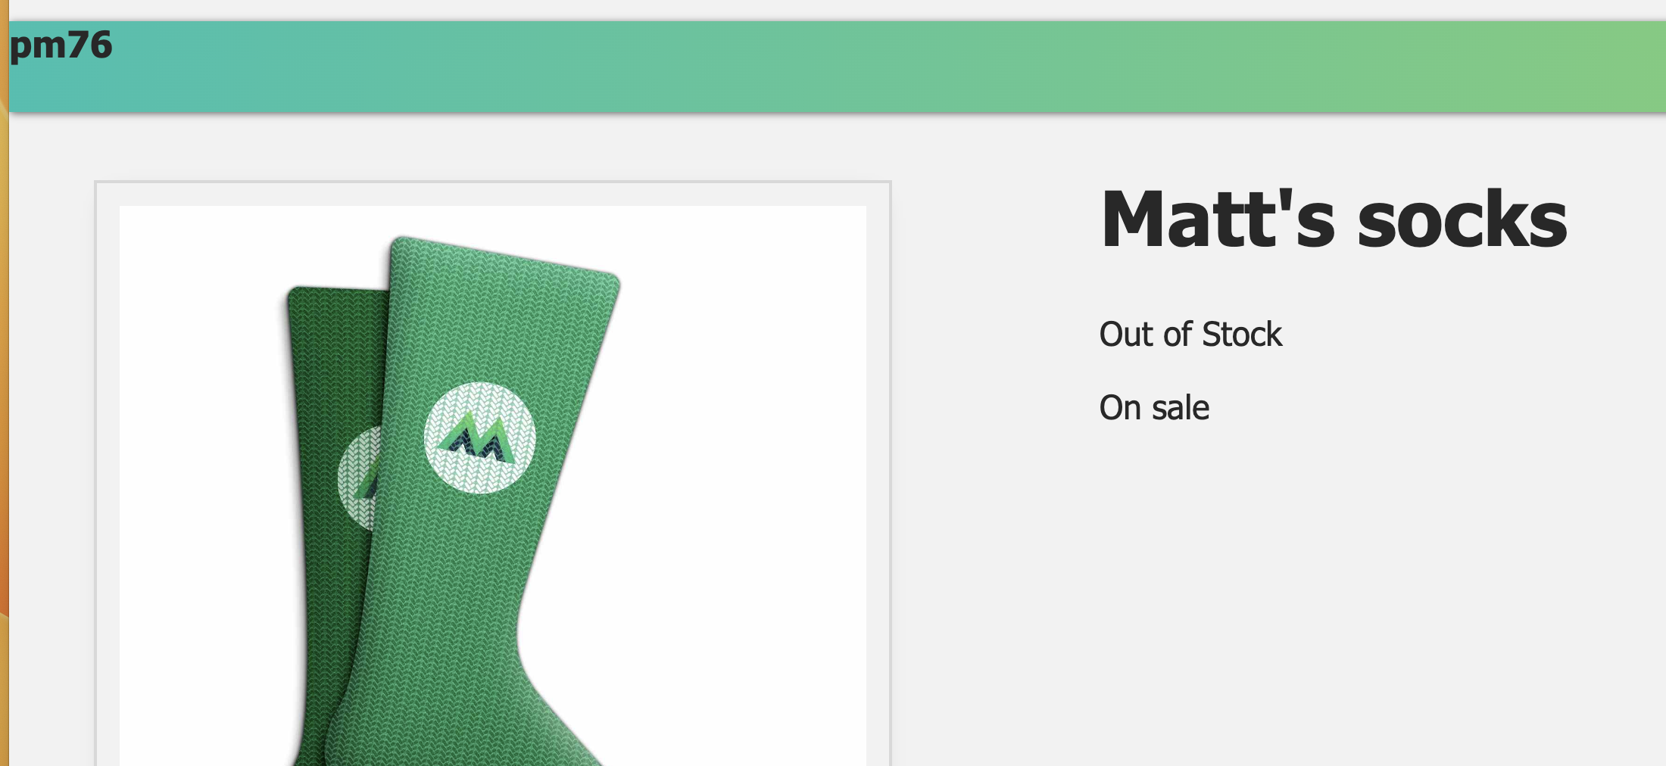
By the end of last week you should have had something like this

Slide 6
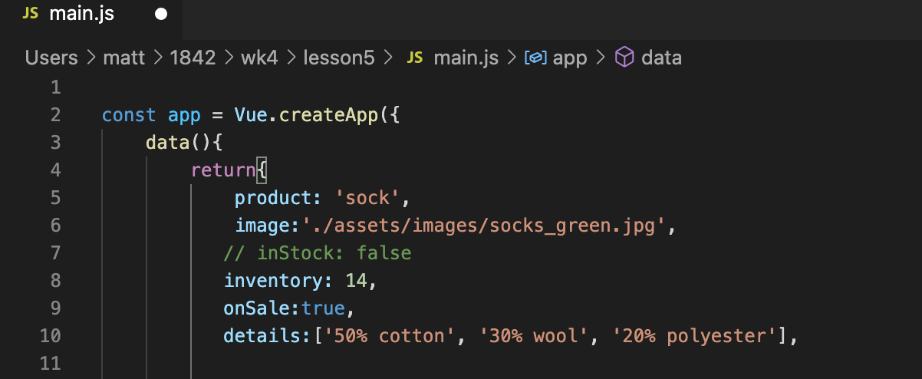
Lesson 5 main.js
Line 10: Adding an array of ‘details’ to the return object of the data function of our Vue app in main.js

Slide 7
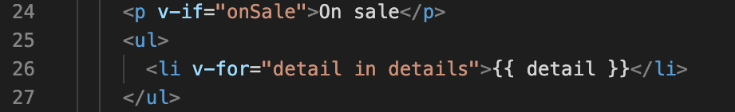
Lesson 5 index.html
Line 26: Using the ‘v-for’ directive in the list item tag of an Unordered list
We create an Alias “detail” as we iterate over the array “details”
Here, details refers to the details array in our data, and detail is the alias for the current element from that array, as we’re looping through it to print out a new li.
Very similar to what we were doing in our PHP templates last term.

Slide 8
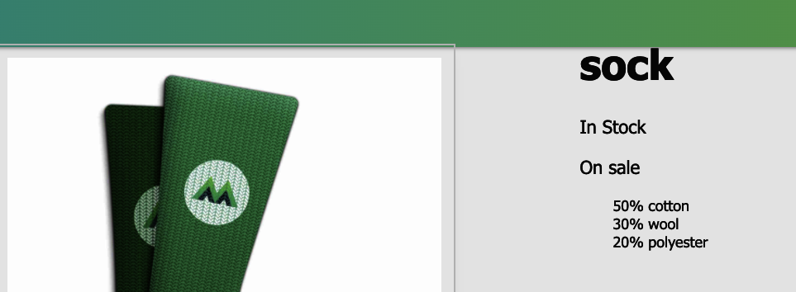
In the browser

Slide 9
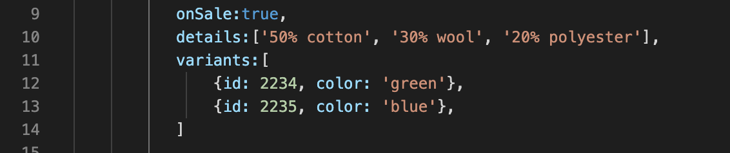
Lesson 5 variants
Next we can create an array of objects called variants.
Each product variant has an id, and a color, next task, we’ll print out each variant color. ( pick a spelling for color and stick to it)

Slide 10
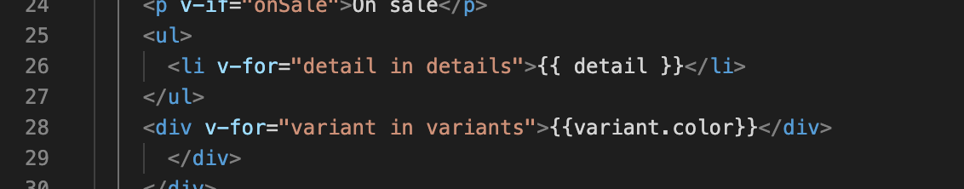
Lesson 5 variant in variants
Line 28: Notice how we’re using dot notation to print out each variant as we loop through the variants array.

Slide 11
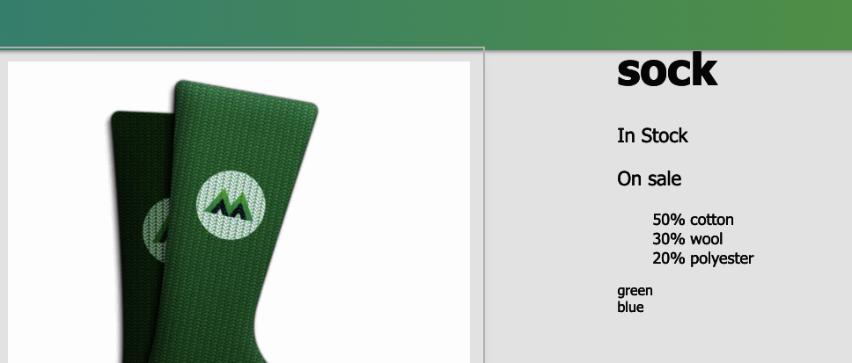
In the browser

Slide 12
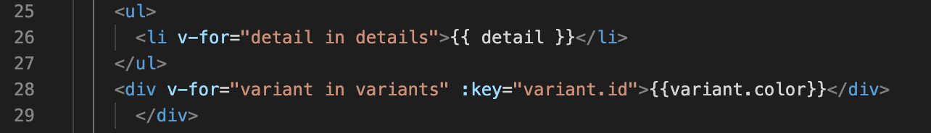
Lesson 5 key attribute
By saying :key="variant.id", we’re using the shorthand for v-bind to bind the variant’s id to the key attribute. This gives each DOM element a unique key so that Vue can grasp onto the element and not lose track of it as things update within the app. This provides some performance improvements.

Slide 13
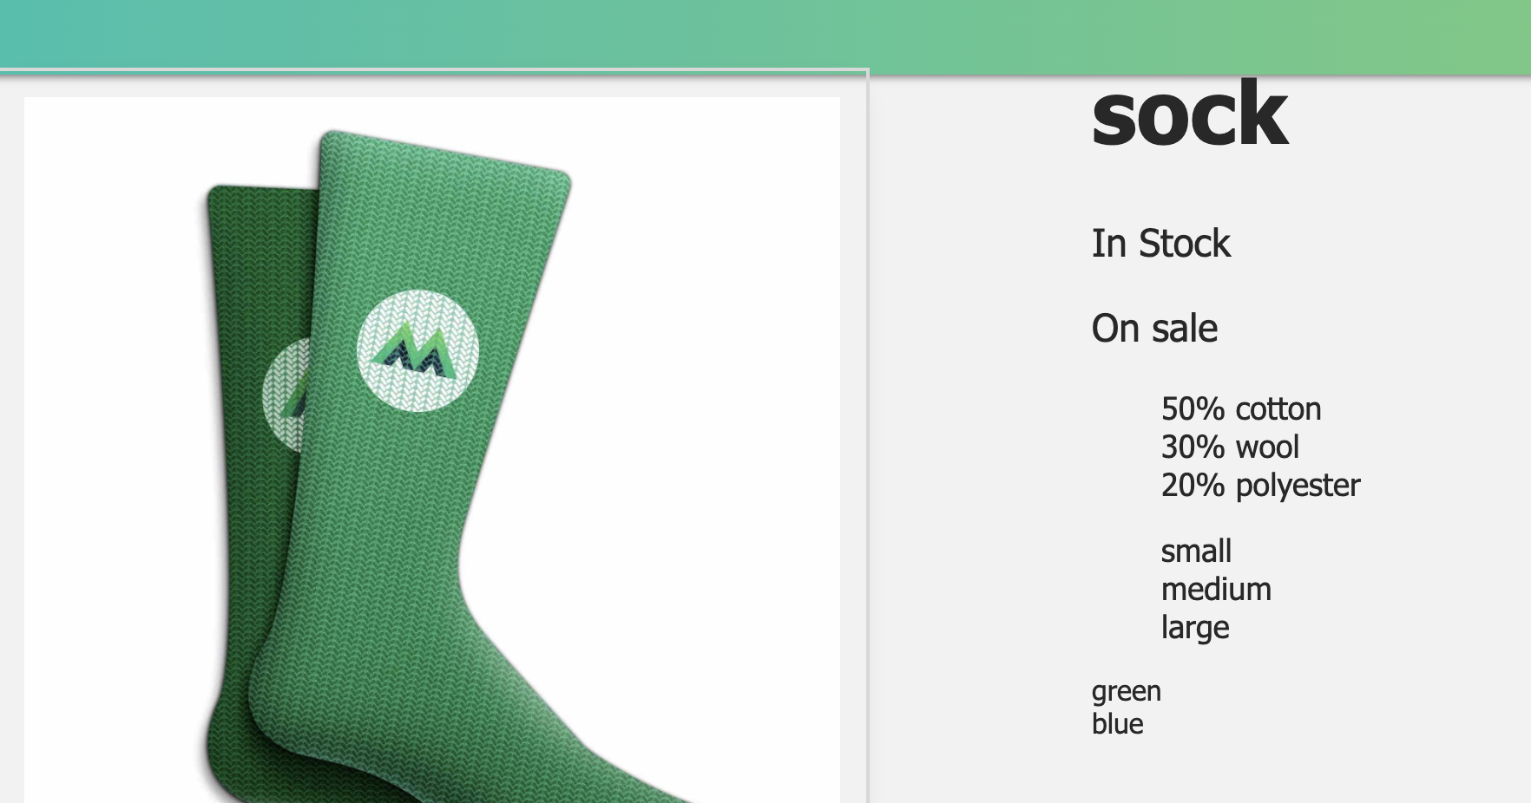
End of lesson 5 with coding challenge

Slide 14
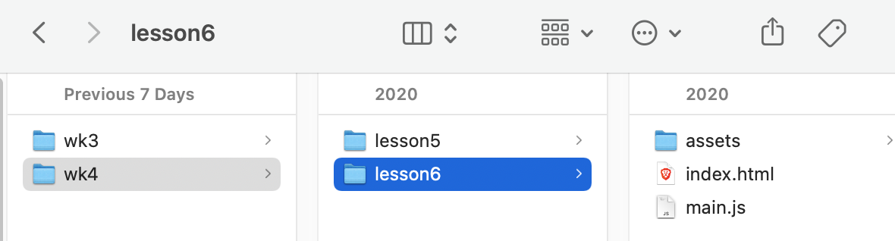
Lesson 6 - event handling
Duplicate and rename your completed lesson5 to lessson6

Slide 15
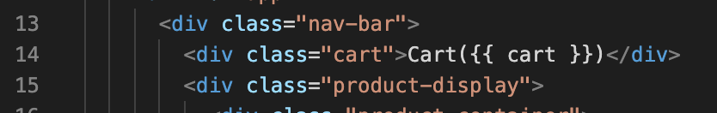
Lesson 6 - event handling
Line 14: a div with class cart which includes an expression to print out the value of our new cart data.
Line 33: a button

Slide 16
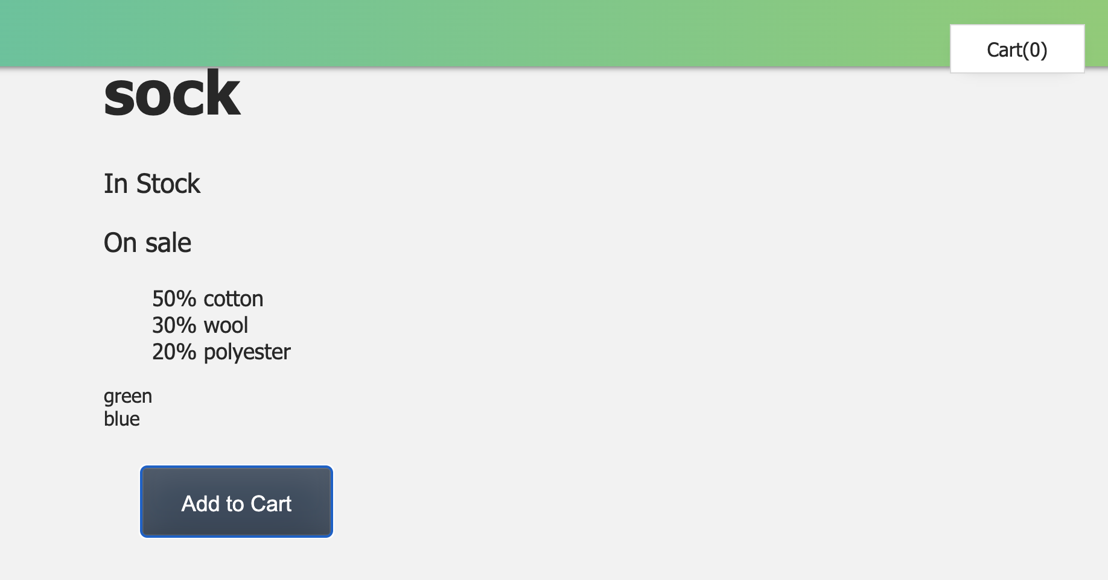
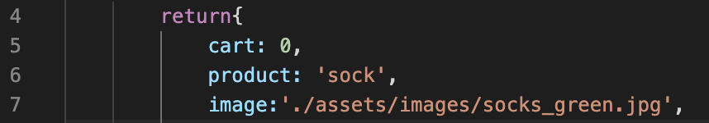
Lesson 6 – main.js
Line 5: The cart data set to 0

Slide 17
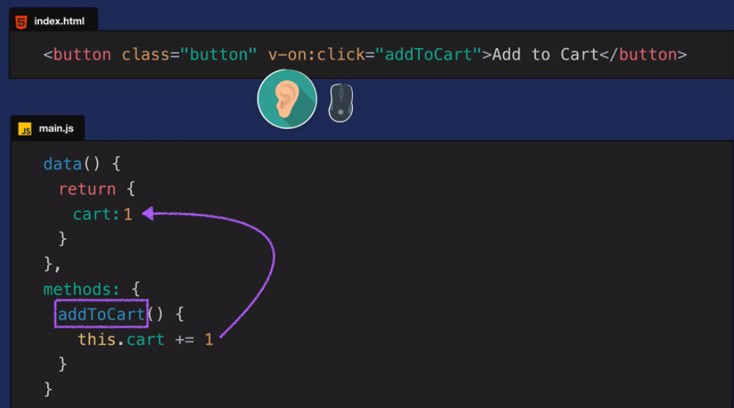
By adding v-on to an element, we’re essentially giving it an ear that can listen for events. In this case, we’ve specified that we’re listening for click events. When a click happens, the addToCart method runs, which takes the value of cart and increments it by one.

Slide 18
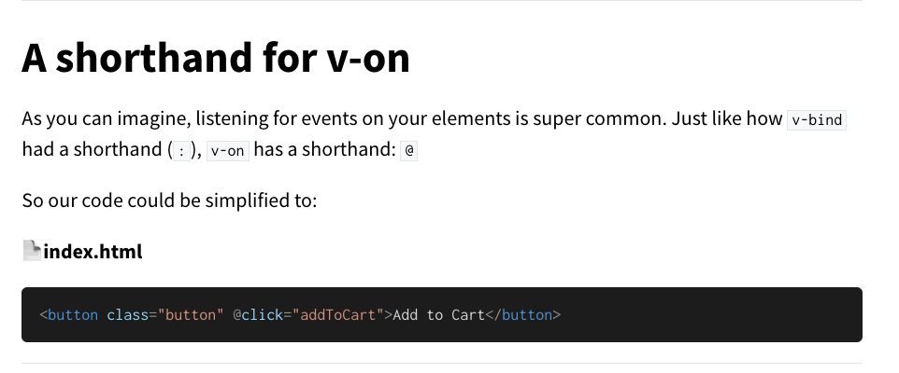

Slide 19
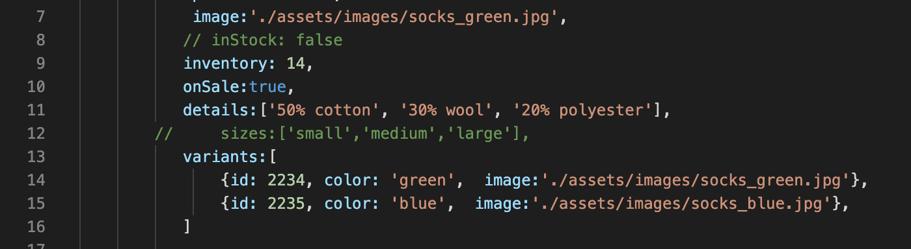
Lesson 6 Mouseover events
Lines 14 & 15: A new property is added to the variant objects, an image path for the green and blue socks image, this is basically the same as line 7

Slide 20
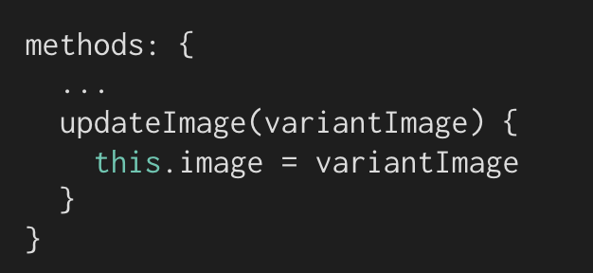
Lesson 6 @mouseover
Similar to @click there is @mouseover. When a mouseover event happens, we’re triggering the updateImage method, passing in the image path of each variant.
That method looks like this: It expects the variantImage as the parameter, and when it’s run, it sets this.image (in this Vue instance’s data) equal to the variant image that was passed in.

Slide 21
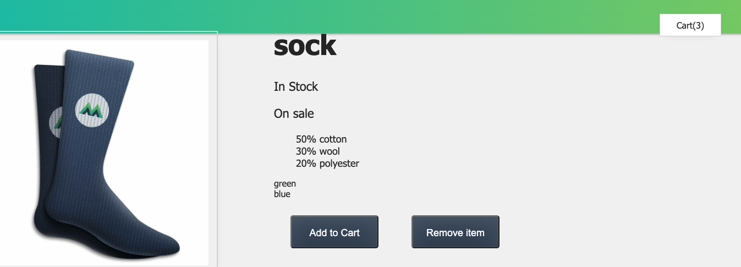
End of lesson 6 with coding challenge

Slide 22
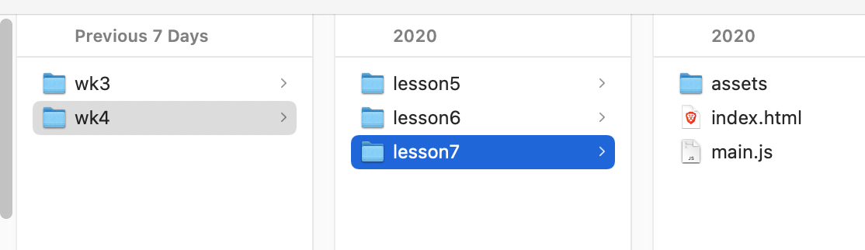
Lesson 7 – class & style binding
Duplicate and rename your completed lesson6 to lessson7

Slide 23
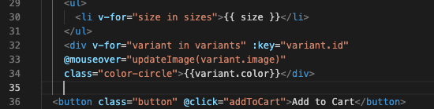
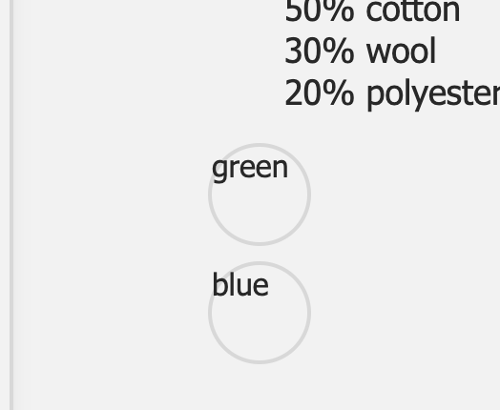
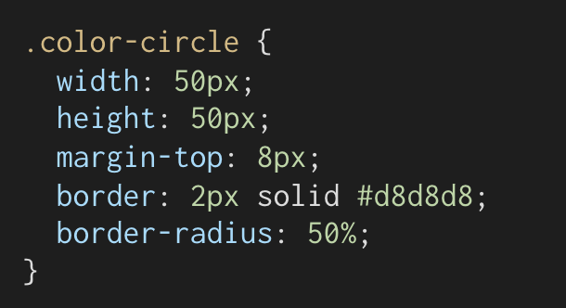
Add a new class to variants div called color-circle.
This already exists in the CSS

Slide 24
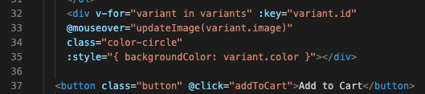
The style binding
Line 35: We do this by using v-bind (or its shorthand :) on the style attribute, and binding a style object to it. Here, we’re setting the divs’ backgroundColor equal to the variant.color. So instead of printing out the strings, “green” and “blue”, we’re using them to set the background color of our circles.

Slide 25
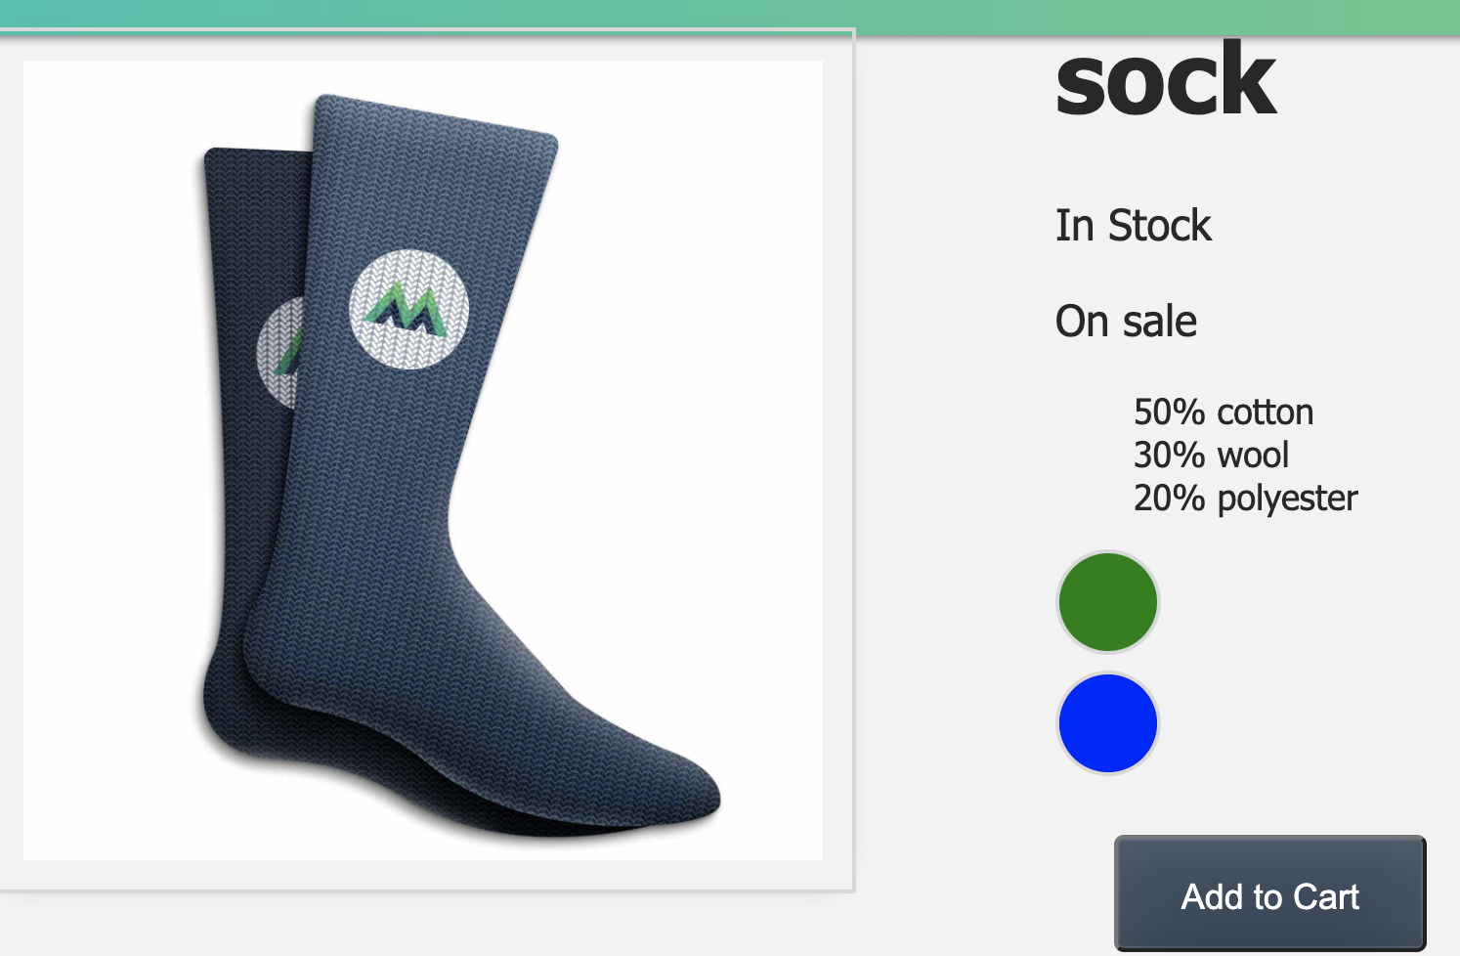

Slide 26

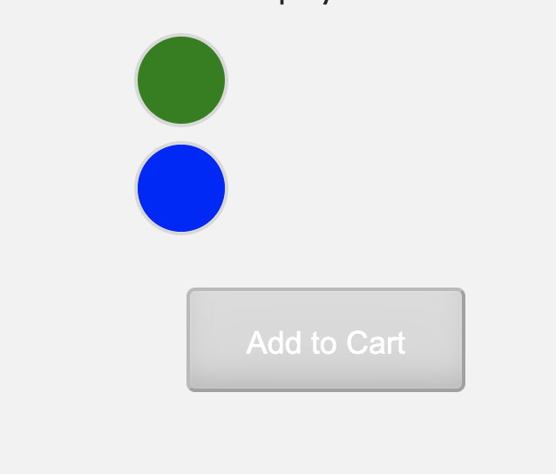
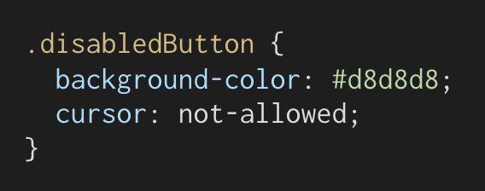
Out of stock
Follow the video for a deeper explanation

Slide 27
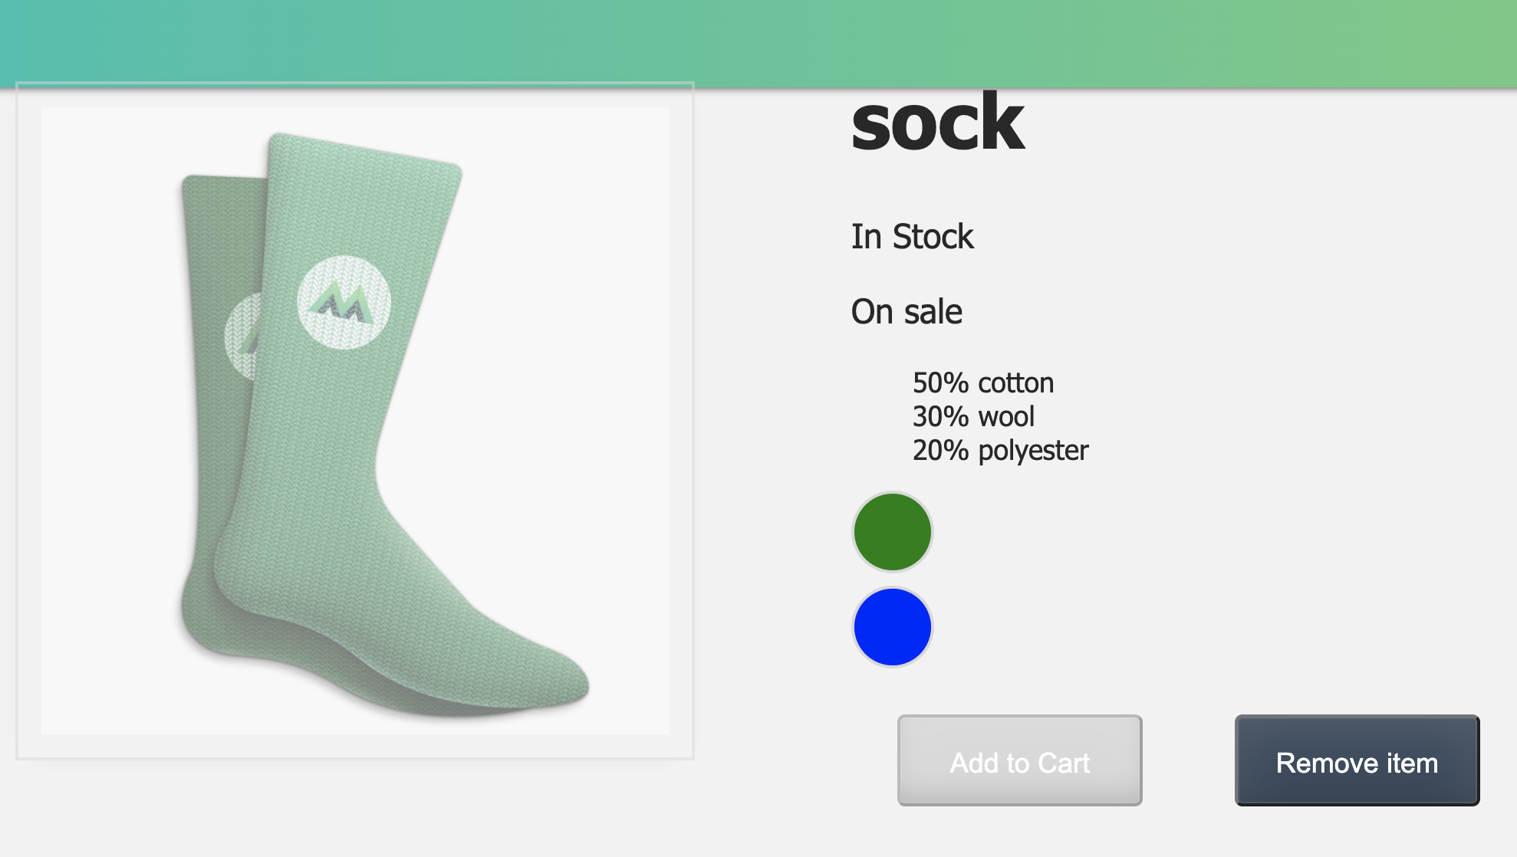
End of lesson 7 with coding challenge

Slide 28
Labs
Make sure you complete up to the end of lesson of 7 by next week.
Do as I have been doing, create a new version and folder for each lesson in case it all goes wrong !
By the end of this week you should have 6 lesson folders, each one built on the previous session.

Slide 29
?

