Slide 1
COMP 1842
Week 11
Matt Prichard

Slide 2
Introduction
Module recap
PHP API
Testing
Dunning-Kruger
Projects
Newsletters

Slide 3
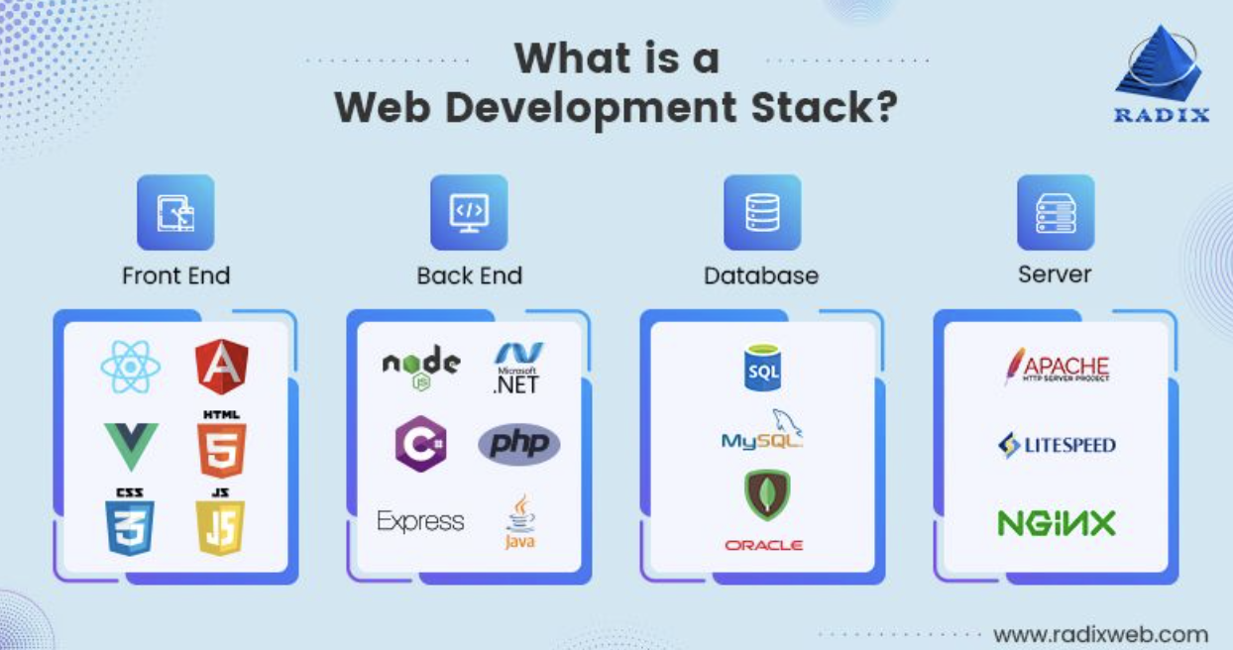
https://radixweb.com/blog/top-web-development-stacks

Slide 4
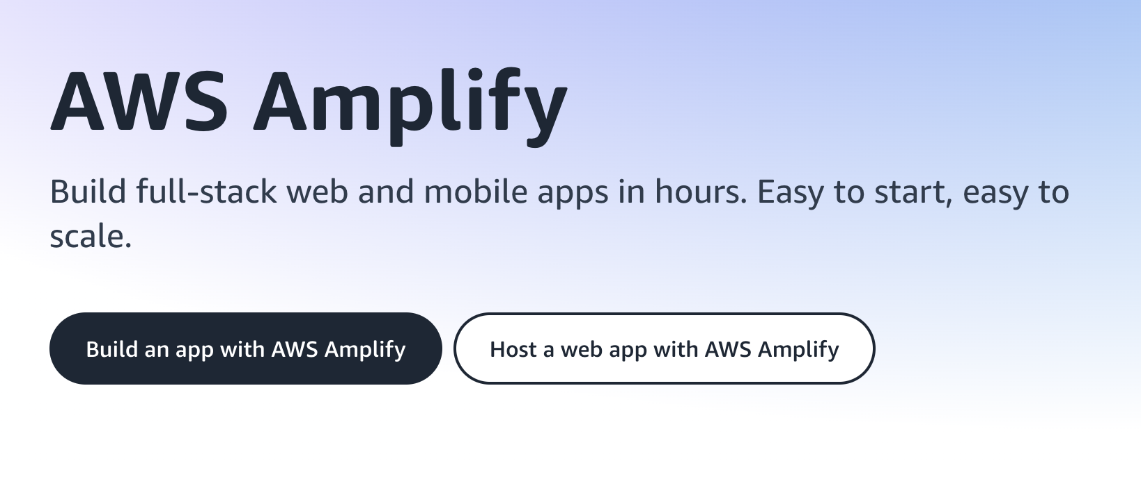
Other options
https://aws.amazon.com/amplify/

Slide 5
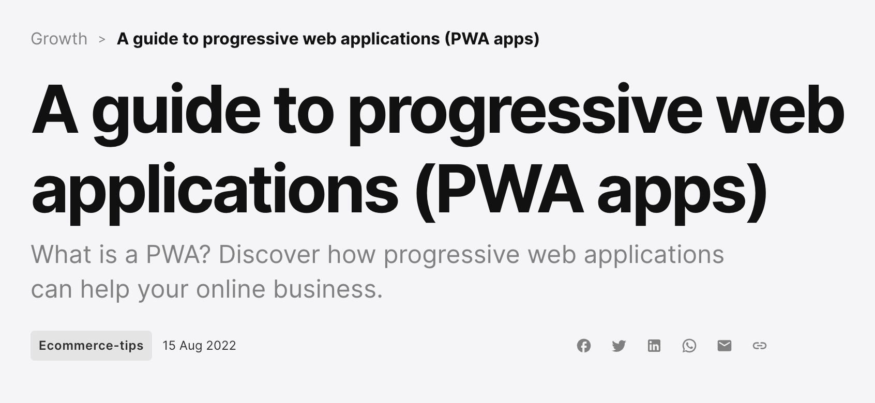
Consider mobile
Progressive Web Apps (PWAs) are built using HTML, CSS, and JavaScript code that's hosted on web servers and that runs in web browser engines. They can either be used directly in a web browser, like a website, or installed on a device from an app store, or by using the app installation feature of a supporting browser.
https://learn.microsoft.com/en-us/microsoft-edge/progressive-web-apps-chromium/
https://www.mollie.com/gb/growth/pwa-guide

Slide 6
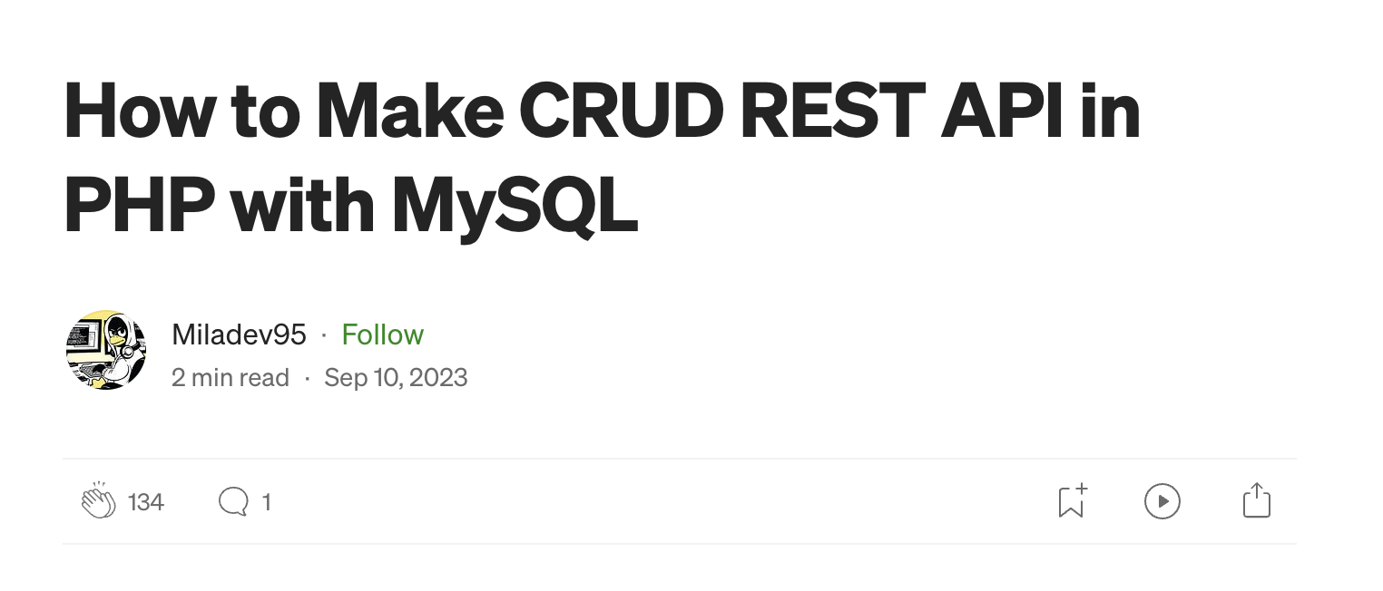

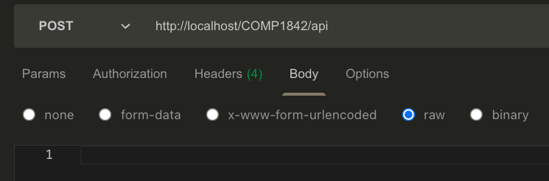
PHP RESTful API
{
"title": "matt3",
"author": "matt3",
"published_at": "london"
}
https://medium.com/@miladev95/how-to-make-crud-rest-api-in-php-with-mysql-5063ae4cc89

Slide 7
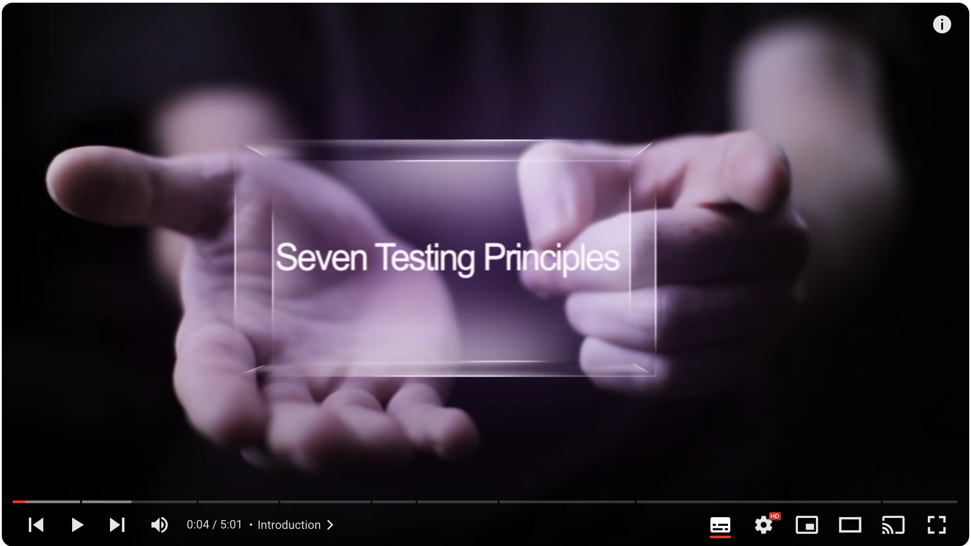
Seven testing principles
https://www.youtube.com/watch?v=rFaWOw8bIMM&list=PLDC2A0C8D2EC934C7&index=4

Slide 8
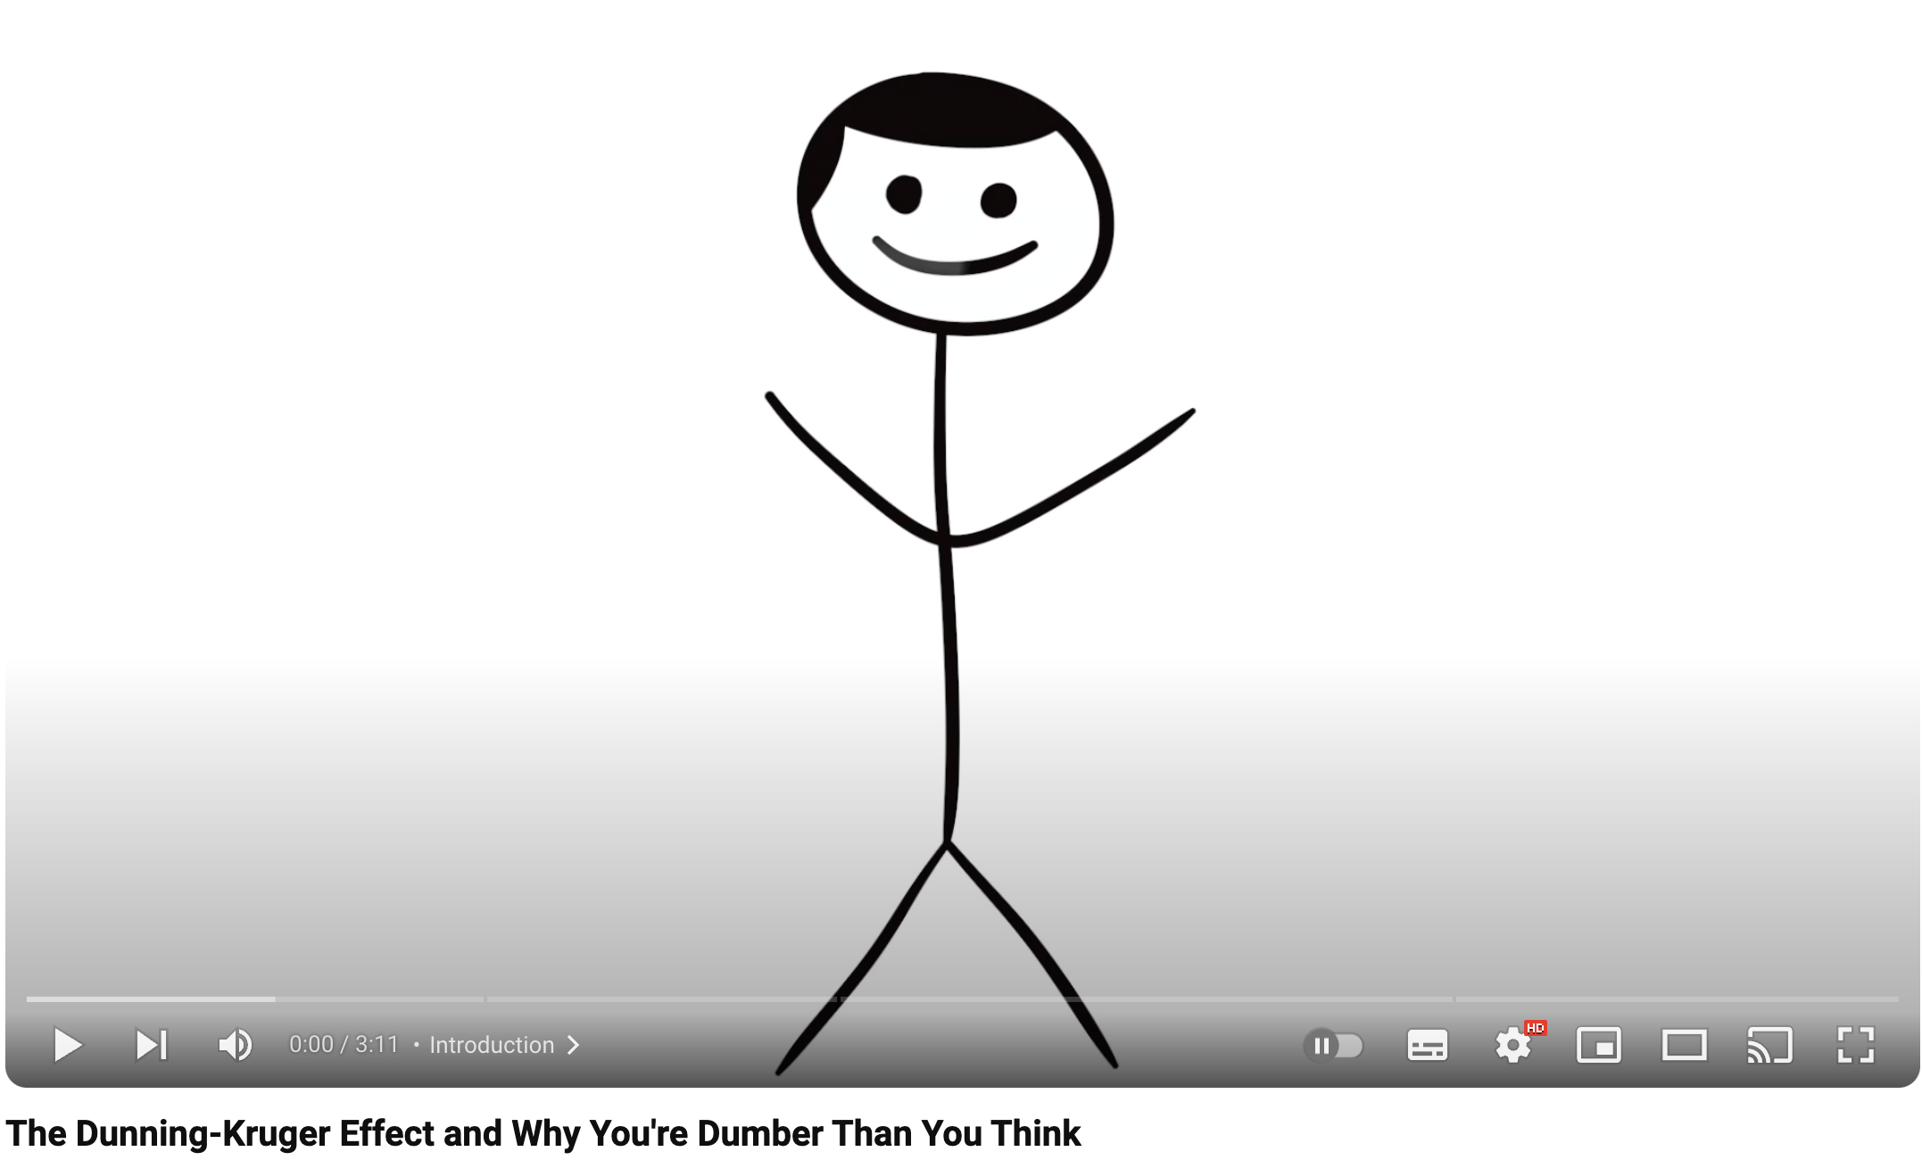
The Dunning-Kruger Effect
https://www.youtube.com/watch?v=HzyNXwF1vNg

Slide 9
Moving forward - year 3
PROJECTS

Slide 10
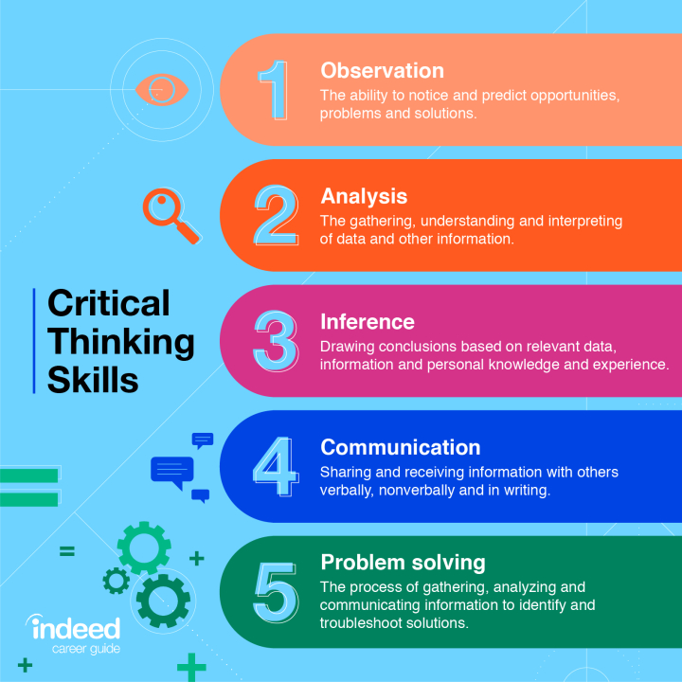
Remember this?

Slide 11
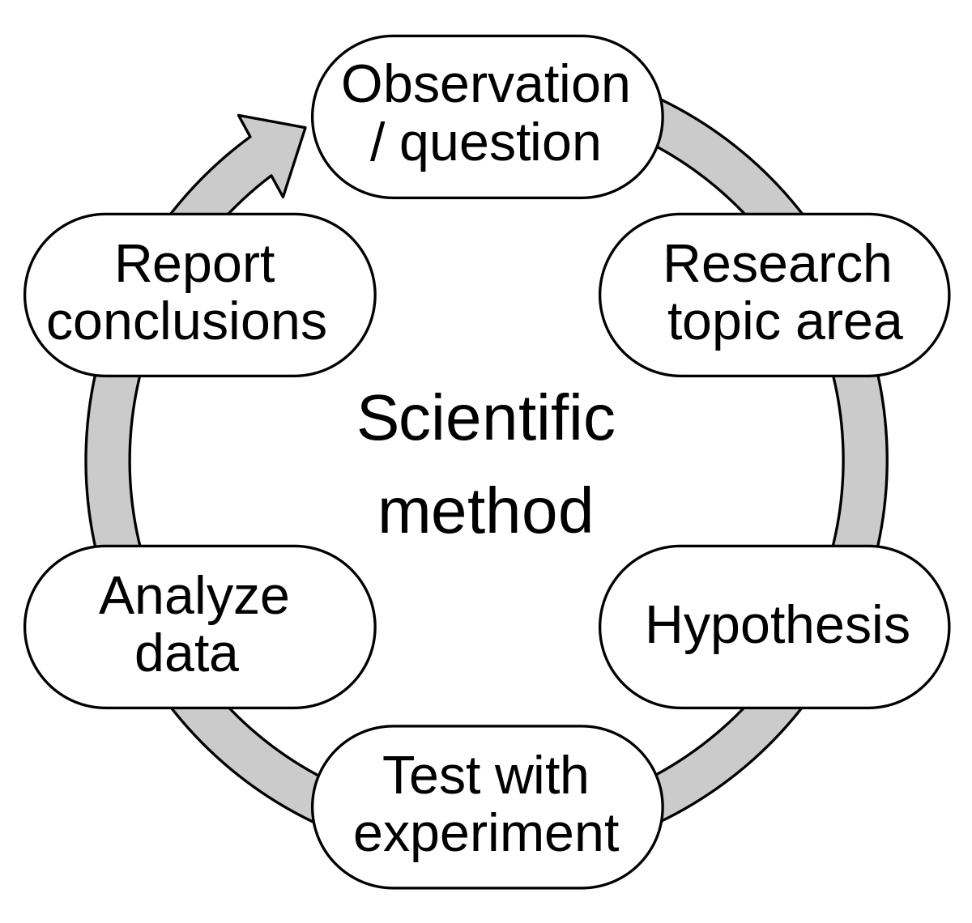
And this?

Slide 12
BSc Hons
The Sc bit means science…yes you need to “do a science”…so you will need to apply the scientific method.
The (Hons) bit stands for Honours. This generally means you study for 3 years, or 4 if the course is offered with an optional sandwich-placement year. You study 360 credits, including a major independent project or dissertation in your final year.

Slide 13
Project idea/title
Much better to come up with your own idea if you can.
Staff title can be a starting point to give a direction but be careful just following someone else’s idea, it really is better if it comes from you.
You need to be passionate about it, you’ll be living with it for 2 terms, 60 credits, if you lose interest, it will be hard to sustain yourself.
Perhaps an area you would like to work in in future?
Could end up as a portfolio piece?
It is not just a big Coursework !!!

Slide 14
Don’t focus on the product
Biggest mistake is to just focus of the product, this is not a coursework, we do not give you a specification to work towards.
Every project is different, every supervisor is different.
This is the product

Slide 15
The starting point
Observation, question, problem domain, reason for the project?
What are you trying to find out not “what do you want to make”.
This is the hardest part of the project and where lots of time can get chewed up resulting in a rushed decision if not careful.
Use the summer to think about this, ask for feedback on ideas.

Slide 16
Types of question
Comparison – is A better than B ?
Improvement – can this be made better ?
Gap in the market ? – Business related projects
Identify a problem with an existing system
Think big then narrow it down
An investigation into ….

Slide 17
Once you have your question / idea / rough title
Research Research Research.
Read Read Read.
Journals, books, blogs but firstly journals.
Google Scholar, Library databases.
What already exists in your domain, what are the leading experts in your field saying about it.
This is where all your references will live ( many pages of references)

Slide 18
Chapters in your report
Literature review ( maybe 2-3 k words)
Review of other products ( maybe 3 products or other systems in your area of interest).
What has gone before you ?
What can you deduce and imply from this information?

Slide 19
Hypothesis
I have found a problem. What happens if I do this ?
Or I wonder if x, y or z will produce a result I can measure to fix my problem or answer my question ?
OK, let’s build something….

Slide 20
Everything leads back to your reading
The previous research sections are meant to inform your decisions about the product. Your research may identify which technologies to use etc etc.
Everything in your project is evidence based and comes from the research.
If your research says .NET is better for this task than PHP then you need to learn .NET or have a very good justification for not using it other than “I don’t know it”.
In your project demo you will be asked to justify all of your choices and decisions

Slide 21
Methodology – what is it for ?
Part of the point of scientific research is that it is transparent and reproduceable.
Your methodology is basically you stating exactly how you did what you did so someone else can reproduce your experiment and hopefully get the same results. It’s nothing more complex than that
Don’t get hung up on adhering to fancy pre-existing methodologies unless they are a good fit for your work.
https://www.npr.org/sections/health-shots/2018/08/27/642218377/in-psychology-and-other-social-sciences-many-studies-fail-the-reproducibility-te

Slide 22
Methodology – pt 2
If you did the Scrum module you will have seen the waterfall methodology getting a good kicking.
In reality the waterfall method is the most applicable to the project dissertation and process at a high level with other methods nested inside.
This circle is basically a waterfall diagram
The “test with experiment” part can be broken out into a separate iterative stage if desired.
Here you can use, RAD, UCD or any suitable development method.

Slide 23
When being asked to document your project methodology it is not the dissertation we are talking about, but the “experiment”.

Slide 24
Requirements stage
You will have covered this by now on other modules
You can’t build something without some requirements.
You may be working iteratively with users where new requirements come in late etc like with with scrum, but you need something to get started
Your requirements should lead back to your literature review.
You produce your own requirements spec, it is not given to you.
You need to consider the testing stage now, how are you going to test against your requirements, did you meet them? etc etc.
You may use heuristics here?

Slide 25
The experiment – this is your product
You are building something to test your hypothesis.

Slide 26
The experiment – testing
Needs planning in advance.
User testing ?
Heuristic testing ?
Benchmarking ?
How will you know your experiment has succeeded or failed?

Slide 27
The success or failure of your experiment does not impact your mark. Failure to adhere to the scientific method will though.

Slide 28
Data analysis and report conclusions
These will be covered in the project lectures, but you can get the idea.
The testing, evaluation and conclusions are the MOST IMPORTANT part of the project.

Slide 29
Reading academic journals - 101
Journal articles can be very dry and hard going. Scientists and academics often don’t make the most interesting writers.
Do not read from start to finish
Read the abstract first then the results/conclusions.
If it seems interesting, you can read the rest of the paper otherwise move on.
Make a note of it for your references now !!!

Slide 30
Keep in contact with your supervisor, they are marking your project. Do what they say.
All projects are different, there is no marking scheme like for a coursework !
You need a product and a dissertation to pass.
You need to teach yourself the tech you need, we don’t teach coding for projects.

Slide 31
20 hours a week self-directed learning.
It adds up quick and it’s easy to fall behind.
This is an exercise in time management, self-reliance, independent learning problem solving and taking responsibility.
These are the qualities employers are looking for.
This is what defines a degree level education.

Slide 32
If you have a genuine interest in Web tech moving forward sign up for all the newsletters I have put on Moodle for this week and you will get all the latest updates for front end and JS. Otherwise good luck with your 3rd year

Slide 33
?

