Slide 1
COMP 1842
Coursework CRUD system part 4
Add and Delete
Matt Prichard

Slide 2
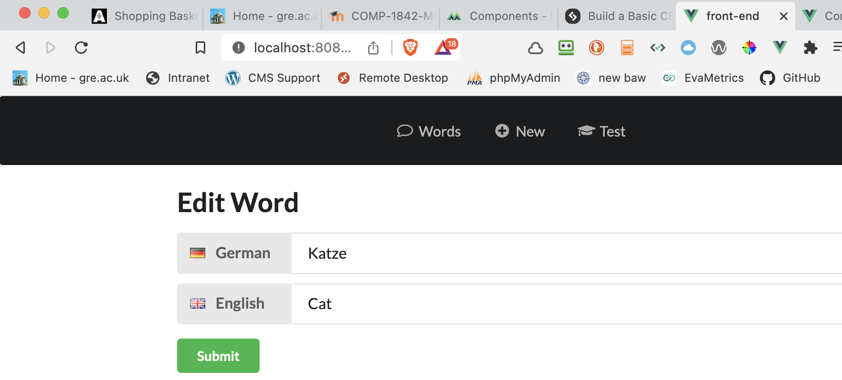
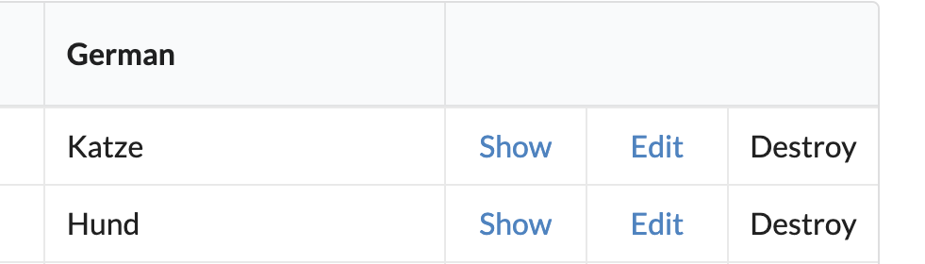
Recap
Last week we built the front and added read all, read one and edit functionality.

Slide 3
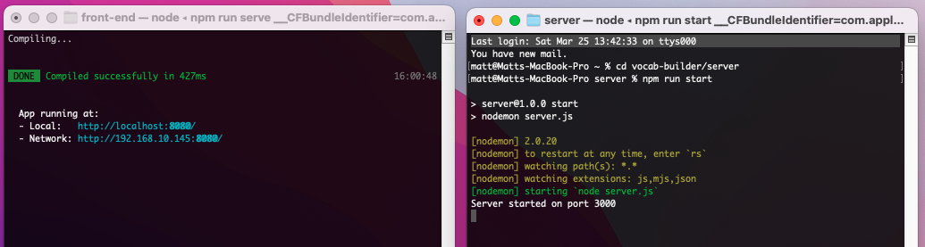
Recap 2
We needed 2 instances of the terminal open at once. One for the back end on port 3000 and one for the front-end port 8080
Back-end cd vocab-builder/server then npm run start
Front-end cd vocab-builder/front-end then npm run serve

Slide 4
This week
Use vue-flash-message to display info to the user
Add new words
Delete words

Slide 5
Adding Flash Messages

Slide 6
In place of alerts
Let’s use flash messages instead. These are nicely styled, configurable messages which won’t block the execution of JavaScript in the browser.
The first thing we’ll need to do is to tell our app to use them. To this end, go to src/helpers/helpers.js and make sure the top of the file reads like the following slide

Slide 7
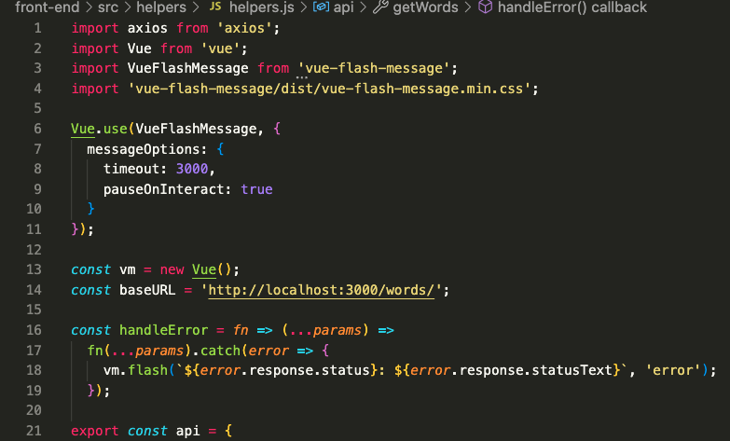
In place of alerts

Slide 8
helpers.js - lines 1-19
We start by importing Vue and VueFlashMessages and some CSS
We then tell Vue to use the VueFlashMessages plugin and pass it a couple of options. Such as timeout in milliseconds.
Finally, we create a new instance of Vue (line 13) as we also want to use the flash messages from within the helper file.
You can see this happening within our handleError function in the call to vm.flash() line 18.

Slide 9
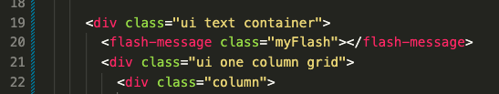
App.vue- add line 20
So that we can actually display the messages, add a FlashMessage component to src/App.vue:

Slide 10
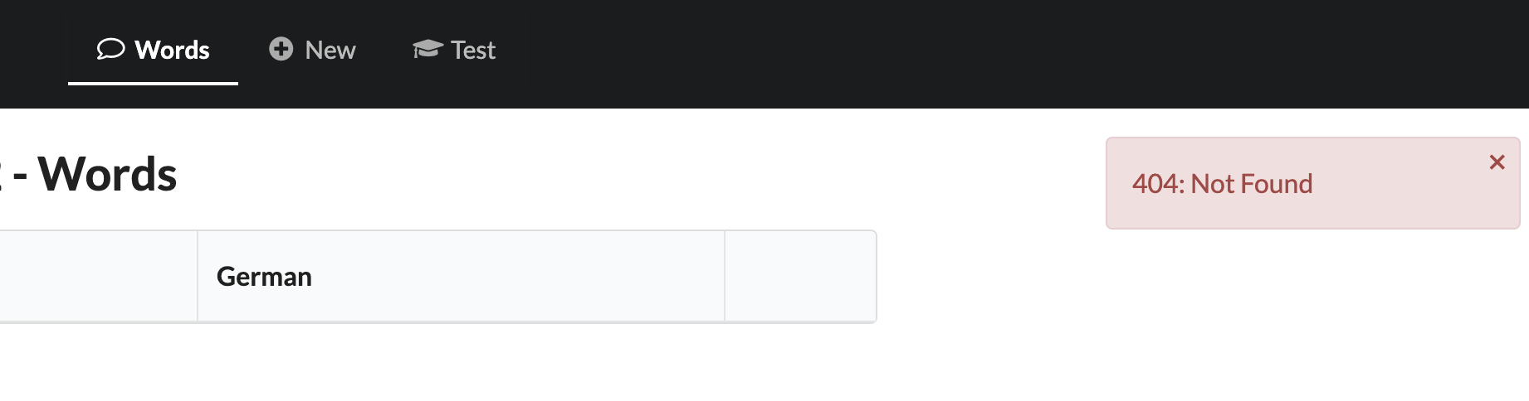
Test it
To test out whether it’s working, try changing the value of the baseURL variable in src/helpers/helpers.js to something non-existent. If all has gone according to plan, you should see a nicely formatted error message on the right hand of the screen when you reload the page

Slide 11


Finally…
To make a flash message appear when a word was successfully edited, go back to Edit.vue and change line 28 from:
To

Slide 12
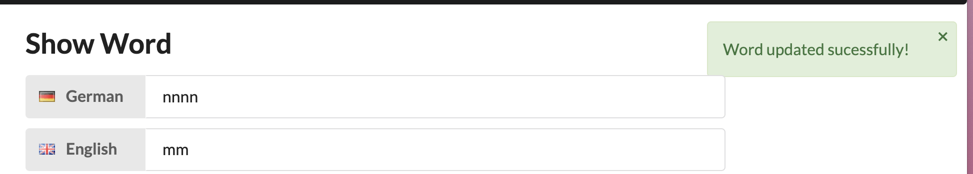
Test edit a word

Slide 13
Creating a new word

Slide 14
src/views/New.vue

Slide 15
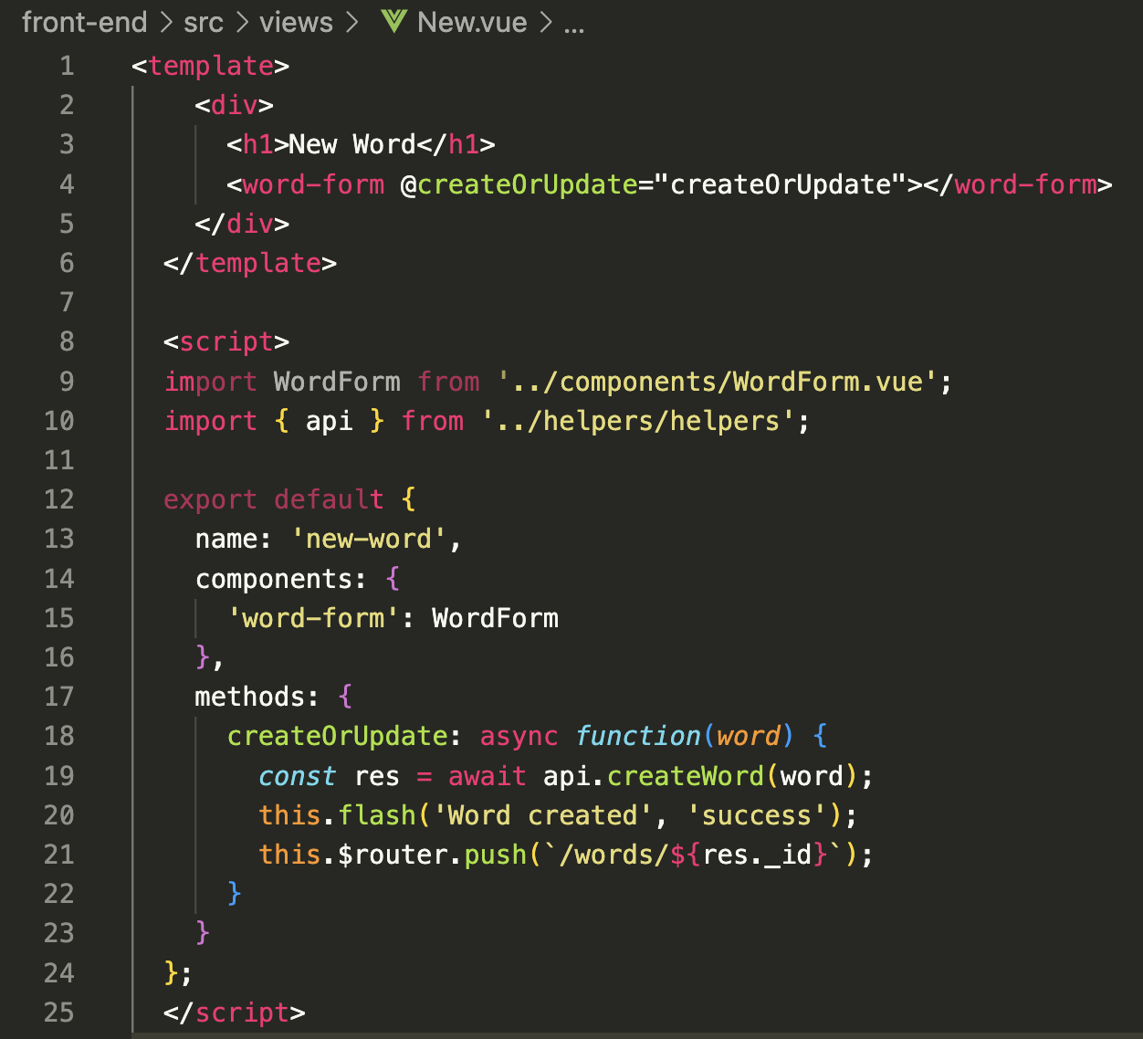
New.vue - full file
Copy this code.
This should hopefully look familiar as it’s quite similar to the Edit component. It also uses the WordForm child component. And, like the Edit component, it also listens for the createOrUpdate event. When it receives this event, it creates a new word with the given input and redirects to the newly created word.

Slide 16
Update WordForm.vue

Slide 17
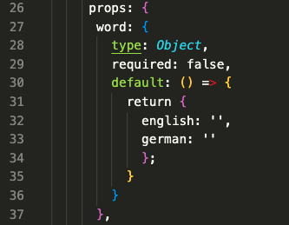
Before we can add words, however, there are a couple of changes that need to be made to the WordForm component. Head back to WordForm.vue and expand the props object like so:
Here, we’re initializing both values as empty strings.

Slide 18
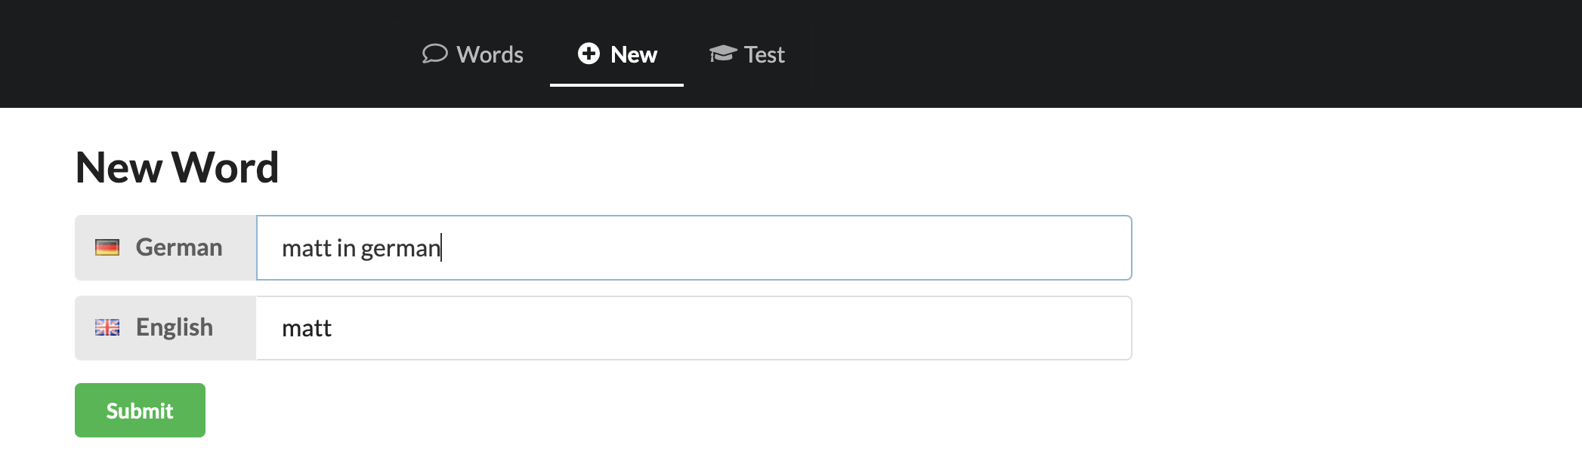
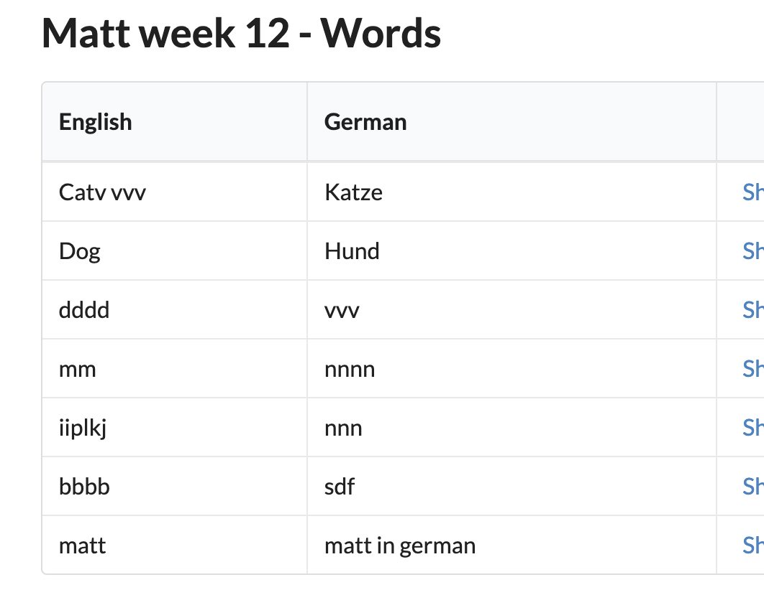
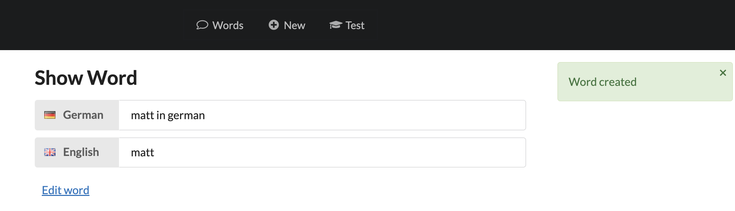
Test adding a word

Slide 19
Deleting a word – last part ☺

Slide 20

We won’t need a separate component to delete a word, as there’s no view involved. The action takes place in views/Words.vue
Change line 19 from:
To:19 and 20 below, this will prevent the browser’s default action, then call the onDestroy method.

Slide 21
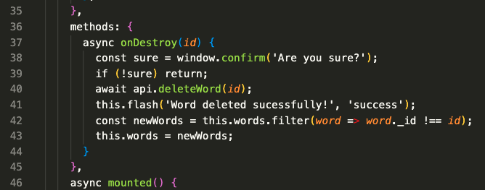
Next add this method to the script in Words.vue
To make sure the user really intended to delete a word, we use a dialogue to ask them to confirm the delete. If the user clicks OK, a request is sent to the API to delete the word

Slide 22
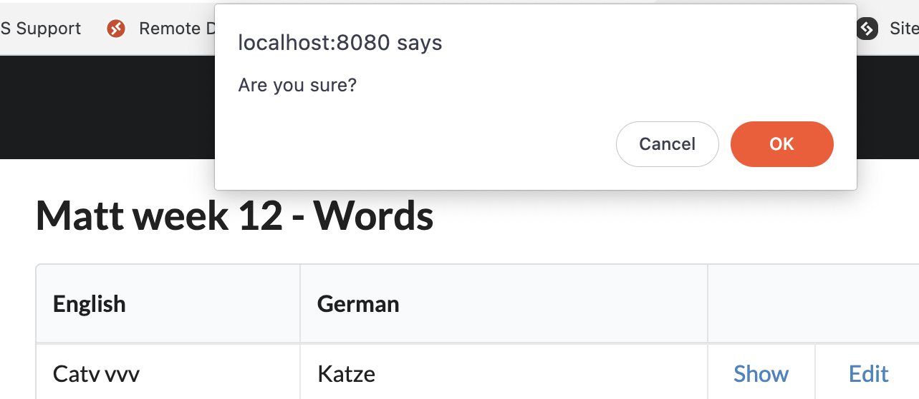
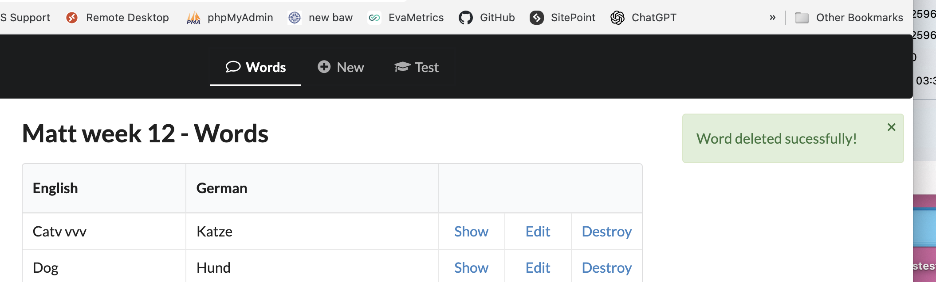
We then flash a message to let them know that the delete was successful before removing the word from the list of words in the data object.

Slide 23
We have now completed the CRUD system, getting all this working is worth 25%, see part 2 of the CW spec.
See the next set of slides for adding to this.

Slide 24
?

