Slide 1
COMP 1842
Additional tasks and deliverables.
Matt Prichard

Slide 2
CW part 2 – 60%
Developing a very basic MEVN stack CRUD system and providing a video walkthrough of the system and the code.
This is to be implemented on the University G-Drive. If you want to work on your own machine you will need to handle the installation process yourself.
We will develop a basic system in the labs, and you will be shown how to evidence this for your video. Higher marks will be awarded for:
Implementing the test page
Adding a new menu item and page.
Adding a new field to the crud system, the current system has 2, add a 3rd language.
Additional functionality of your own choice beyond the above three.

Slide 3
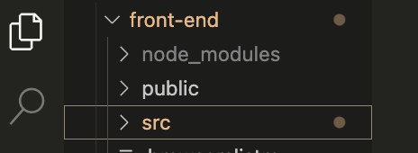
Deliverables
Upload a zipped copy of your SRC folder from the front-end folder. Only the SRC folder is required !
A 7-minute video walk through of your system in MP4 format. Details to follow. If you can’t create a video a PDF walkthrough will be acceptable, details to follow.

Slide 4
Additional tasks for extra marks

Slide 5
Carry out these tasks independently. They are not as hard as they may at first seem. If you want to back up / duplicate your system back up or rename the ‘src’ folder only, it is quite small (57kb). Do not back up the node-modules folder, it is huge (130 meg).

Slide 6
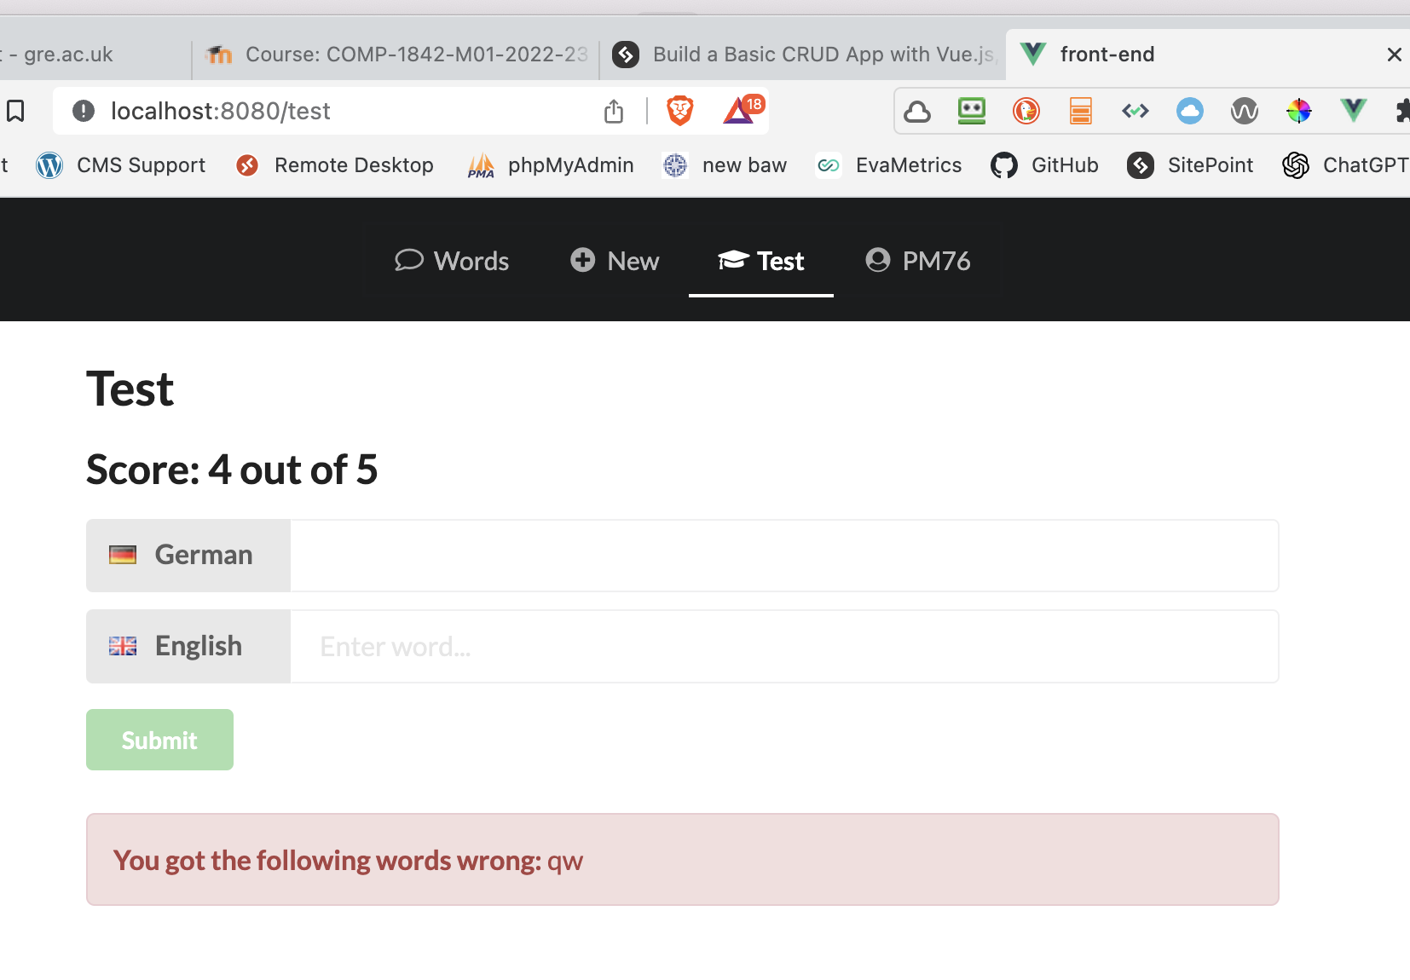
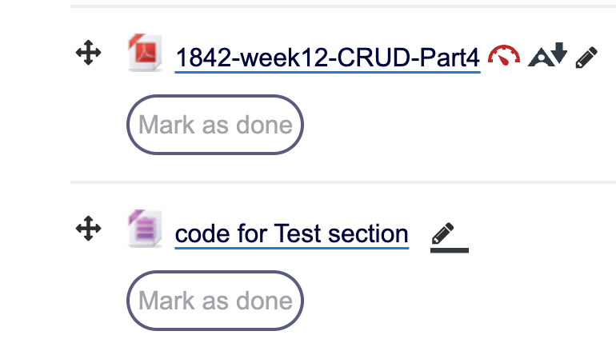
Additional task 1 – Nice easy one ☺
Notice we have had and extra link ‘test’ in the menu bar
There are 2 files in the zip on Moodle called
VocabTest.vue and Test.vue
All you need to do is download these files and put them in the right pace

Slide 7
Just plug the code in, here is a brief overview of what is happening
In a nutshell, we’re receiving the word list, words, as a prop (this is an array of objects). We then declare some data properties, mostly related to displaying the test. The randWords property makes use of the spread operator and an arrow function to sort the words into a random order.
We’re declaring currWord as a computed property, which will return the next word in the list of random words. We’ve used a computed property, as in the onSubmit method we’re removing the first item of the randWords array using shift() every time the user makes a guess. Mutating the array like this will cause currWord to be recalculated and the test will update.
Finally, the onSubmit method and the displayResults method handle form submission (when the user makes a guess) displaying the results.

Slide 8
Additional task 1 - working test

Slide 9
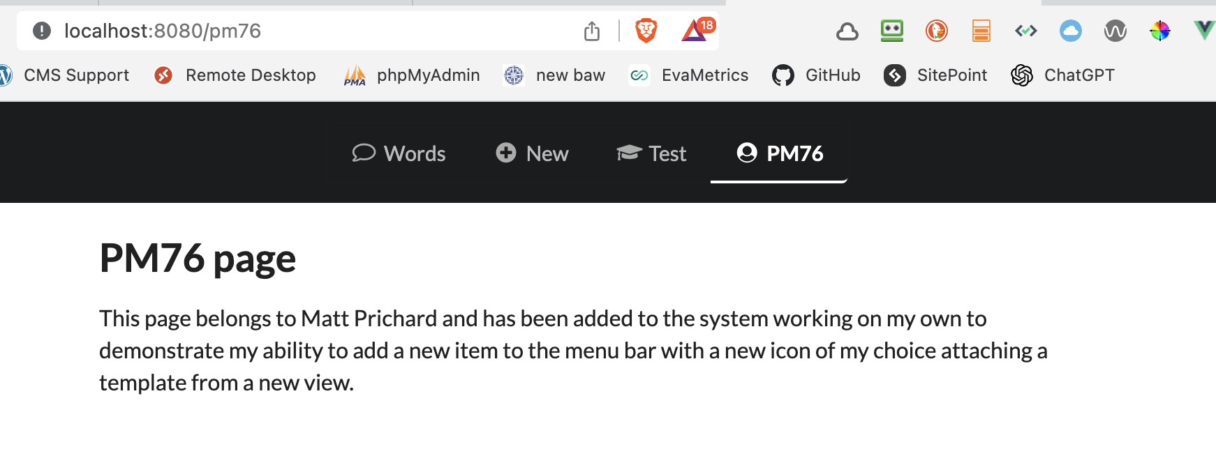
Additional task 2 - About me page
Use your username as a link in the menu and route it to a new template stating who you are and that you wrote this code.
Simple template containing an H1 and p tag

Slide 10
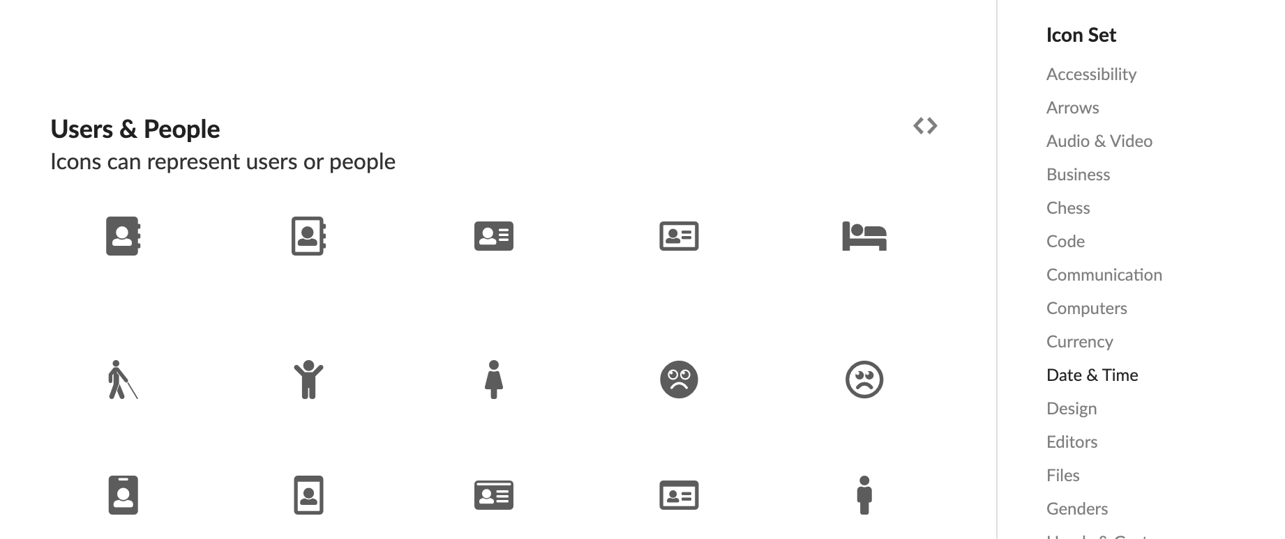
Semantic UI icons - implement any one you like
https://semantic-ui.com/elements/icon.html

Slide 11
Additional task 3 – slightly more involved
Adding a new field to the crud system, the current system has 2, add a 3rd language
Add an additional language to the system throughout. If you speak a 2nd language, perhaps use that one and use the appropriate flag.
You will need to think carefully about where to make changes and add additional code to both the server and the front-end.
You may be surprised about how few change you actually need to make!

Slide 12
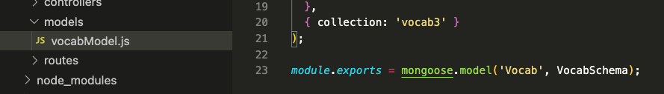
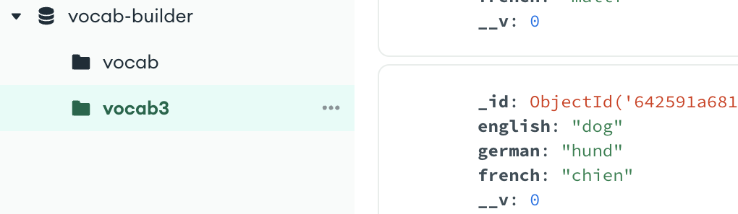
Free advice - Safety tip – server/api/models/vocabModel.js
Change the collection name
I called mine vocab3 (for 3 languages) this way your original collection will remain unchanged if it all goes wrong.

Slide 13
Additional task 4 suggestions
What do we do about the test now that we have 3 languages.
I have not done anything with this myself.
I will give extra marks if you come up with a solution.
This is not compulsory, finish everything else first !!

Slide 14
Additional task 4 suggestions part 2
Create a login system- this is one example https://auth0.com/docs/quickstart/spa/vuejs/interactive
Create a search functionality
Any other functionally you want to try and implement, just make sure you clearly identify what you have done and how.

Slide 15
Video requirements Please watch my video on Moodle

Slide 16
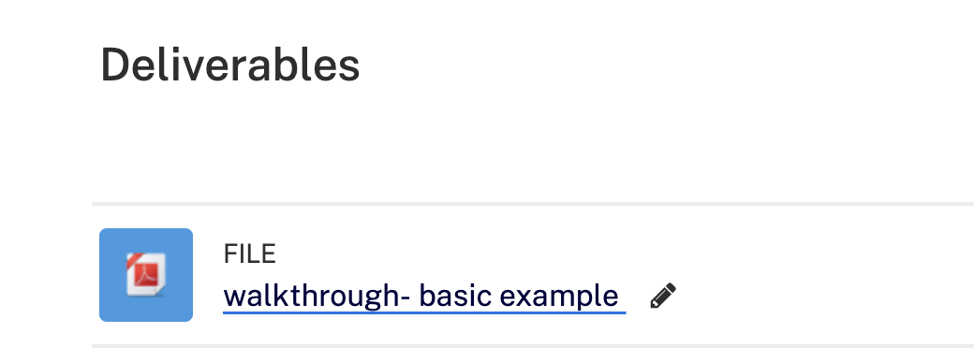
If for some reason it is not possible for you to make a video walkthrough you may provide a PDF instead. The following slides show the basic required screenshots. You will need to provide annotations explaining what is happening and if you implement new code you will need to show and discuss that too. There is an example on Moodle.

Slide 17
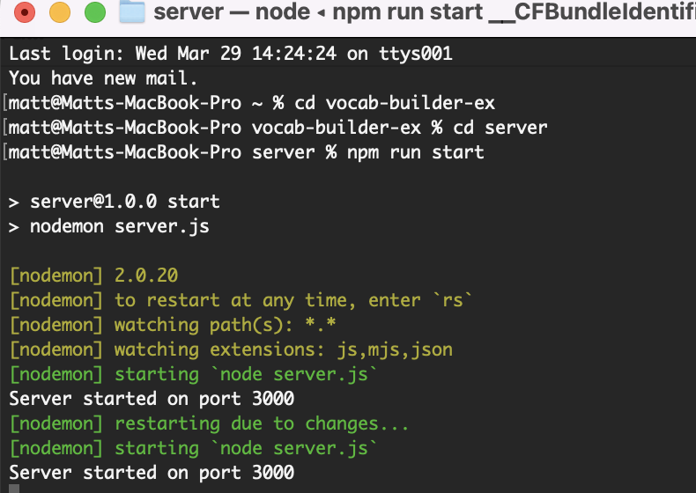
Evidence backend server is running on port 3000 from ‘server’

Slide 18
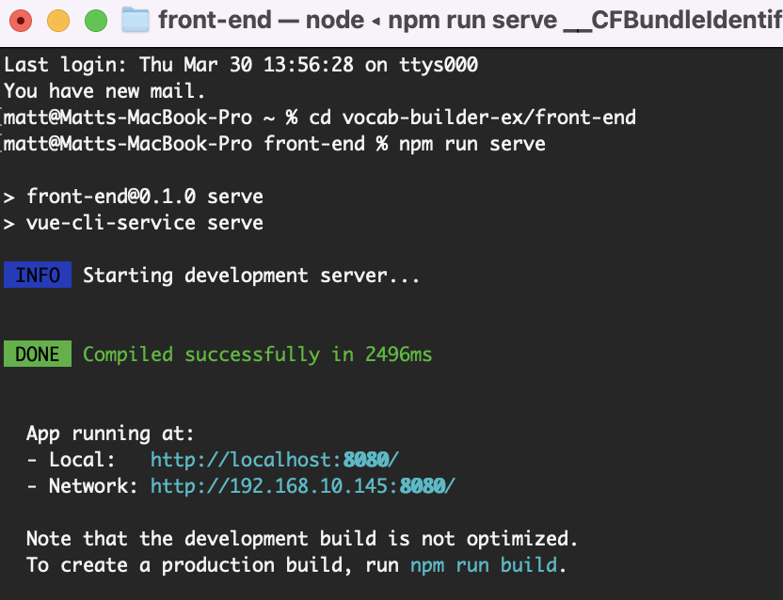
Evidence frontend server is running on port 8080 from ‘front-end’

Slide 19
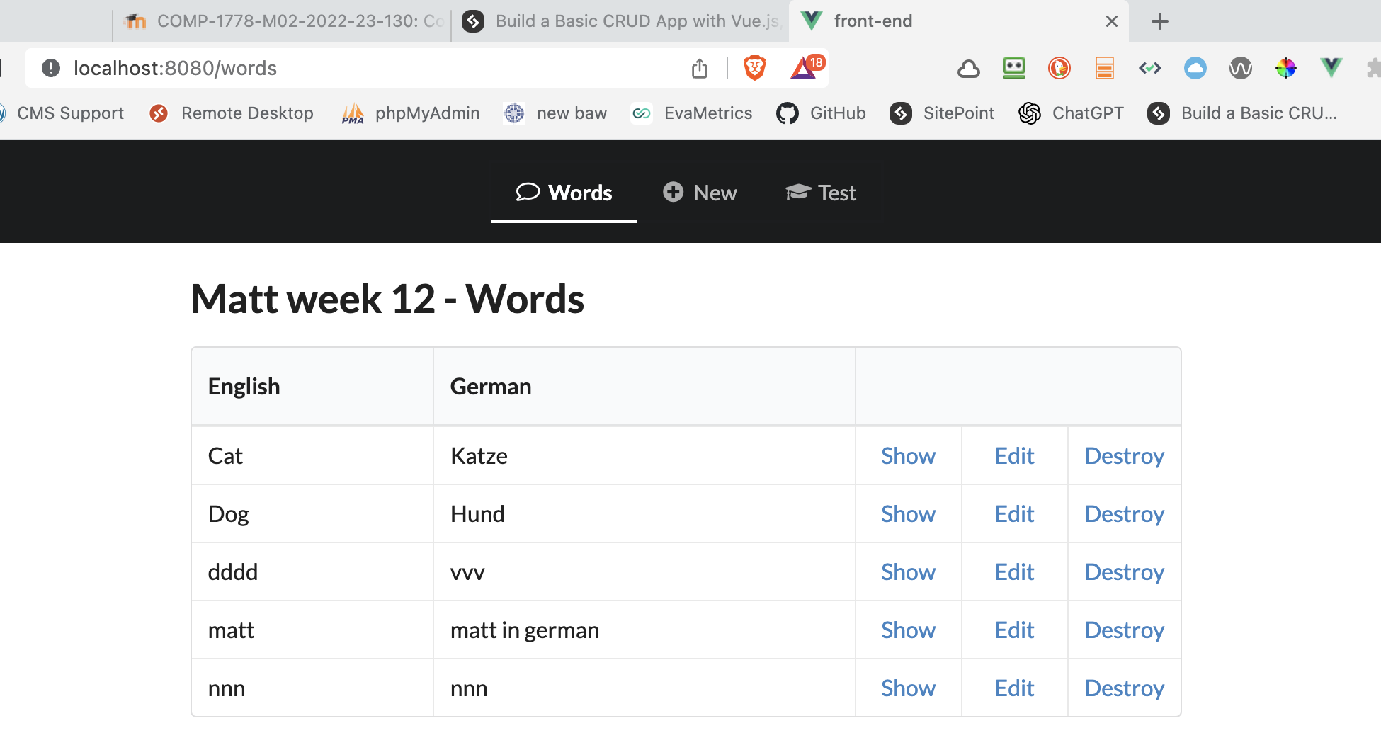
Evidence home page is running
Something to identify you

Slide 20
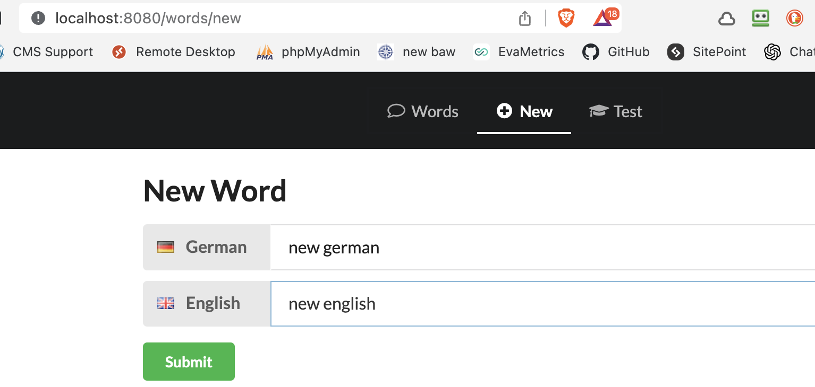
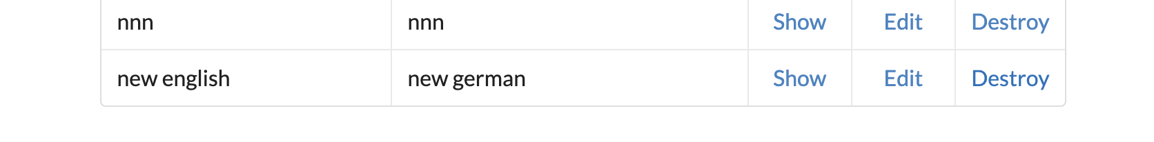
Evidence of add new

Slide 21
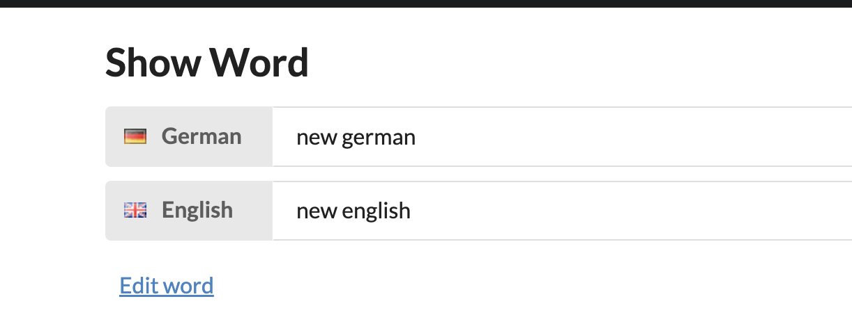
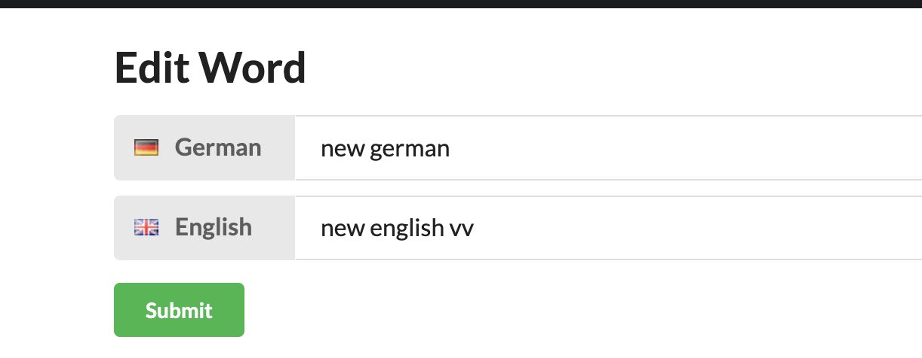
Evidence of show and edit etc…

Slide 22
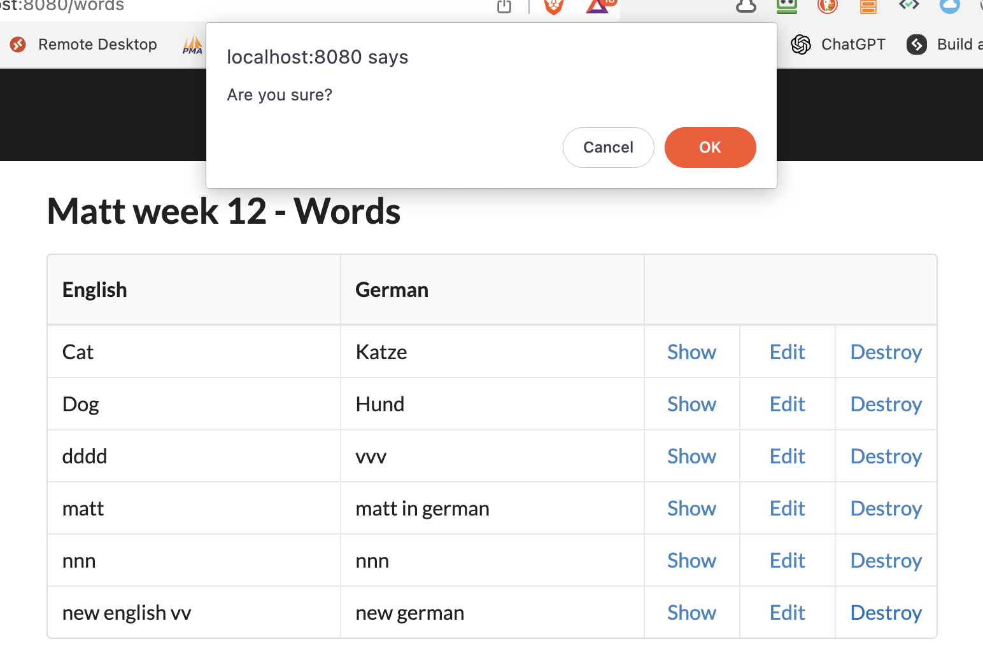
Evidence of delete

Slide 23
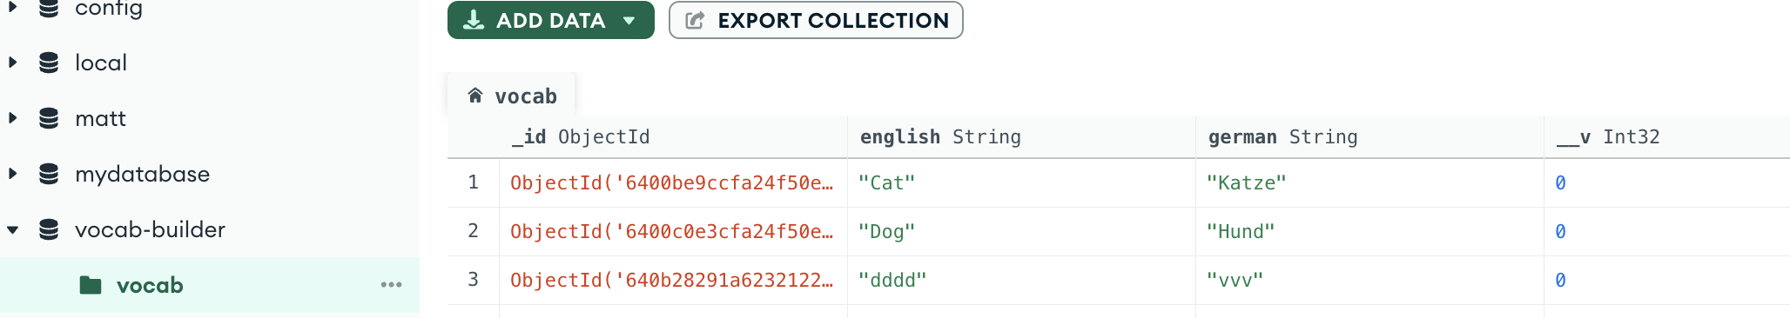
The data in my database

Slide 24
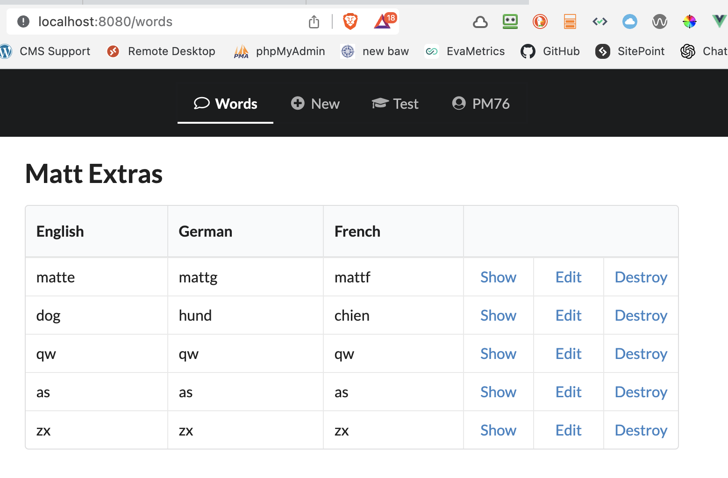
Additional task 3 – evidence 1

Slide 25
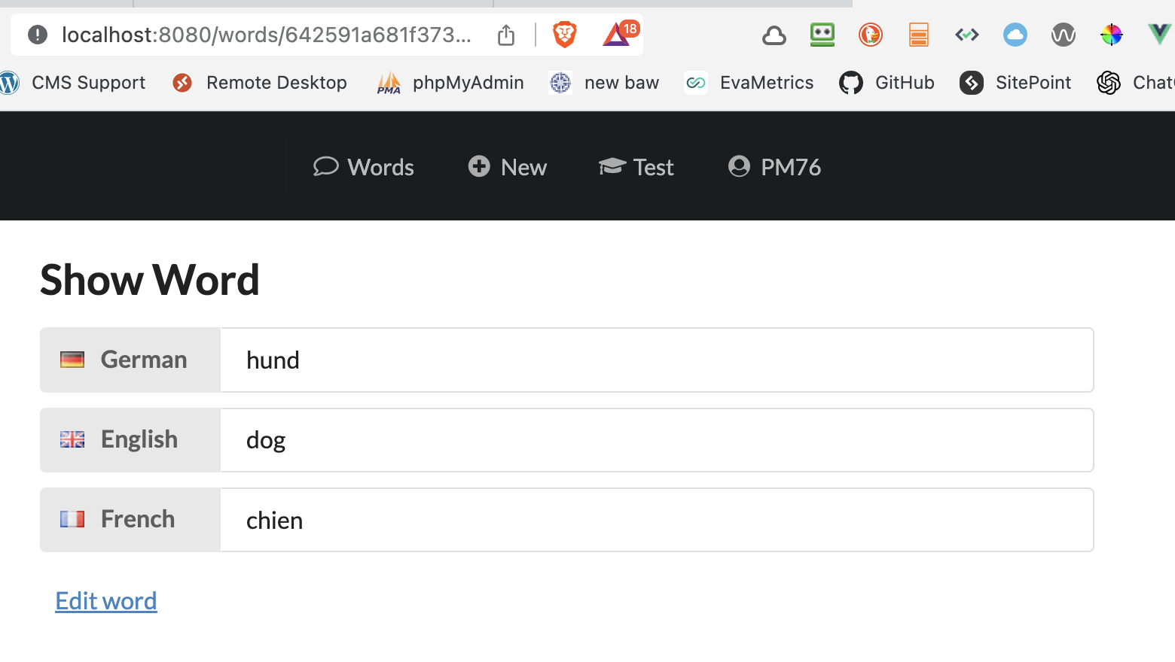
Additional task 3 – evidence 2

Slide 26
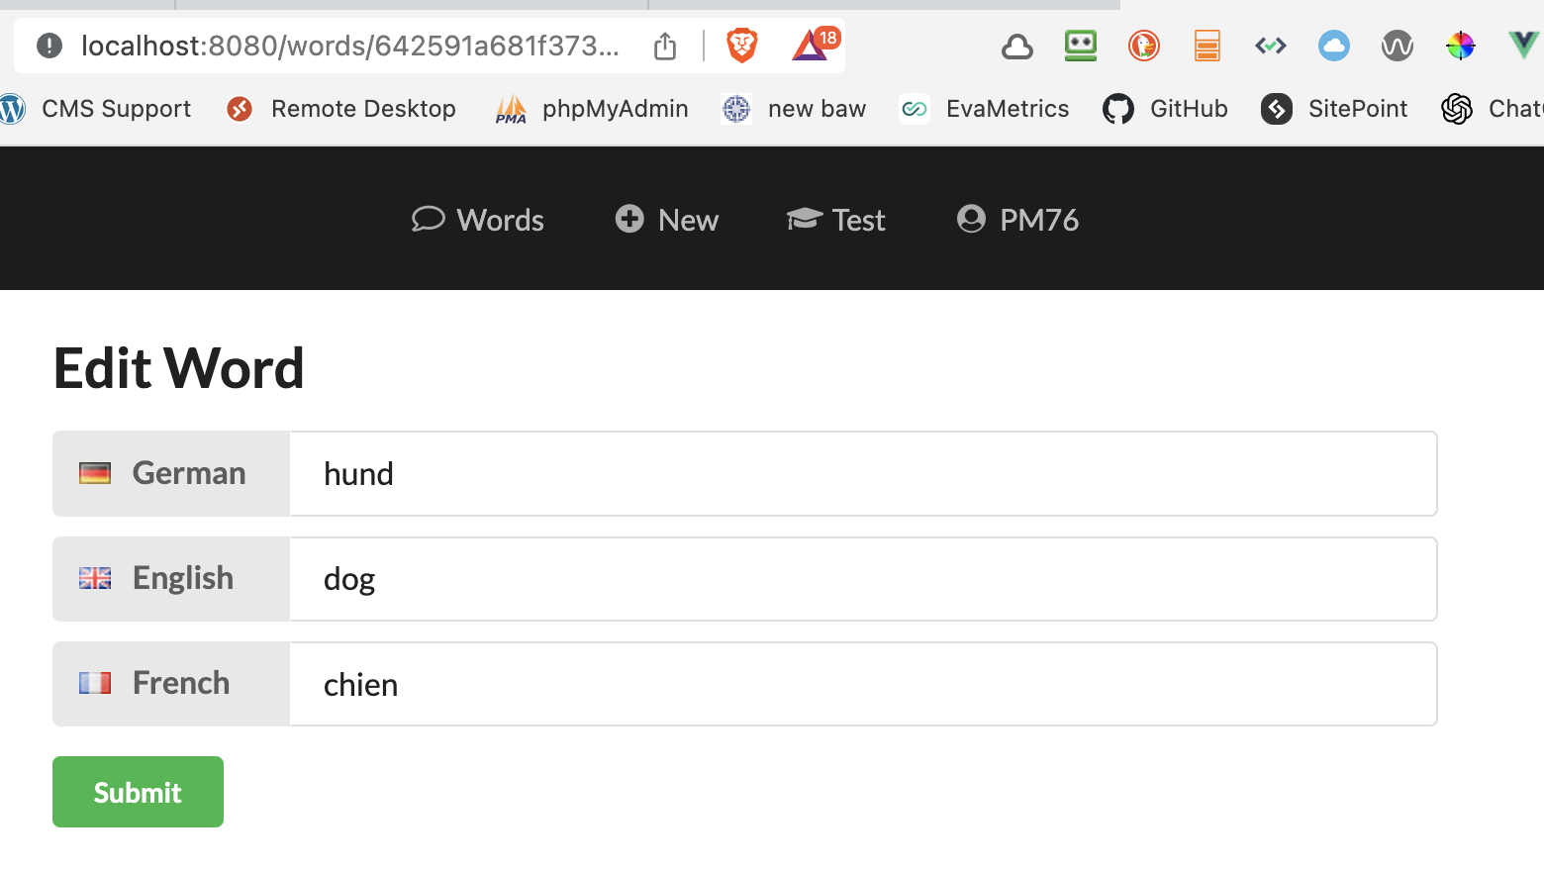
Additional task 3 – evidence 3

Slide 27
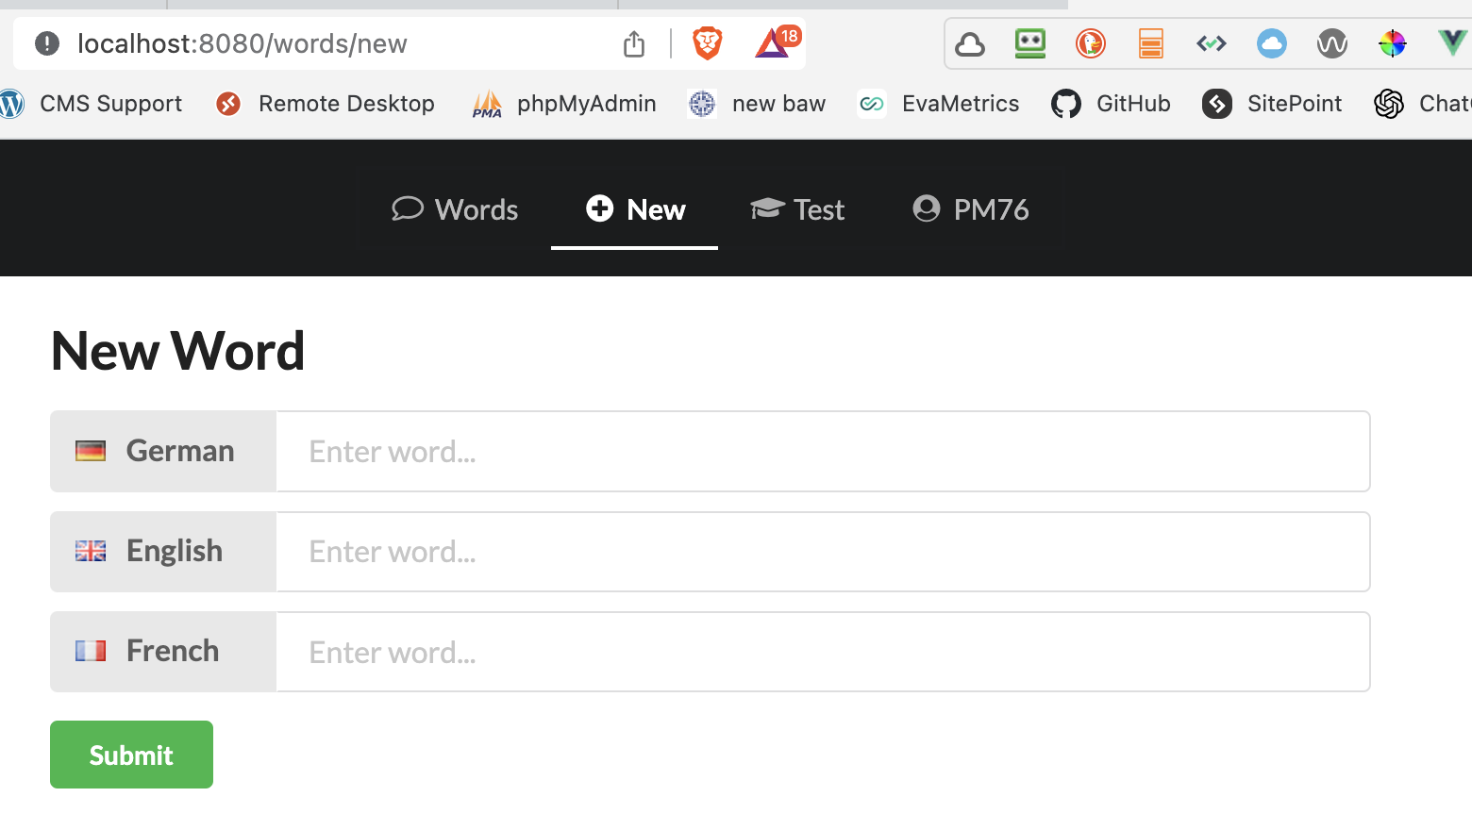
Additional task 3 – evidence 4 – you get the idea…

Slide 28
Code snippets may be used in your PDF if you are not making a video, to identify your new code.

Slide 29
Last time through the CW spec

Slide 30
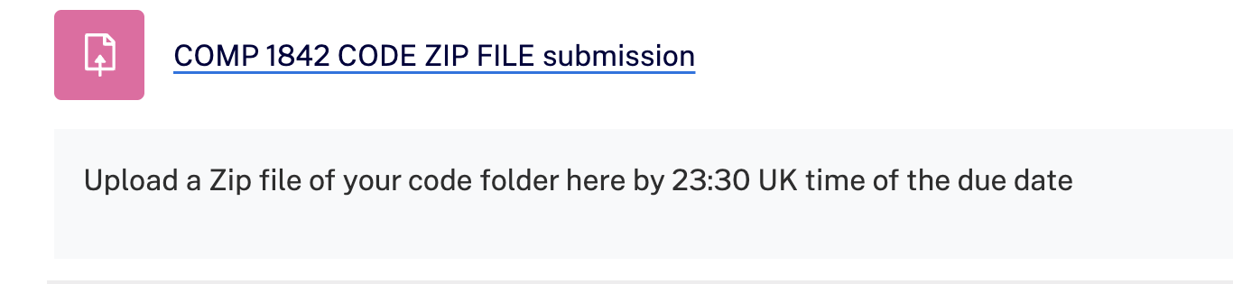

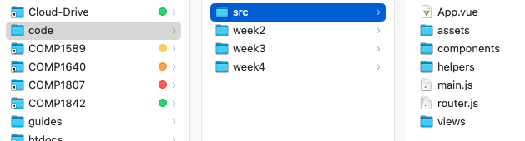
Final list of deliverables -code
Upload 1 zip file of all your code.
It will contain 3 folders for the Vue work, weeks 2, 3 and 4 each containing the relevant lessons. If you did not save each week separately just upload what you have.
In the same zip include a copy of the SRC folder from your vocab front-end. That is all, otherwise it will be too large.

Slide 31
If you don’t understand something, ask me or Alfie.

Slide 32
?

