Slide 1
COMP 1842
Week3 pt1 – SASS intro
Matt Prichard

Slide 2
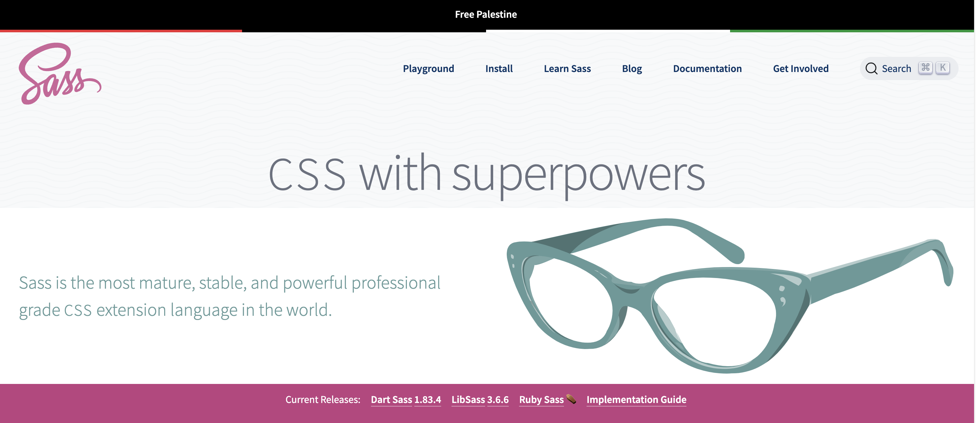
https://sass-lang.com

Slide 3
What’s it all about then ?
Sass stands for Syntactically Awesome Stylesheet
Sass is an extension to CSS
Sass is a CSS pre-processor
Sass is completely compatible with all versions of CSS
Sass reduces repetition of CSS and therefore saves time
Sass was designed by Hampton Catlin and developed by Natalie Weizenbaum in 2006
Sass is free to download and use

Slide 4
What’s it for?
Preprocessing
CSS stylesheets are getting larger, more complex, and harder to maintain. This is where a preprocessor can help. Sass has features that don’t exist in CSS yet like nested rules, mixins, imports, inheritance, built-in functions, and other stuff that help you write robust, maintainable CSS.

Slide 5
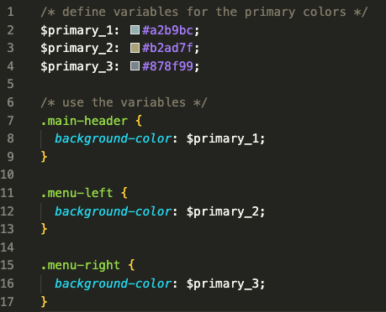
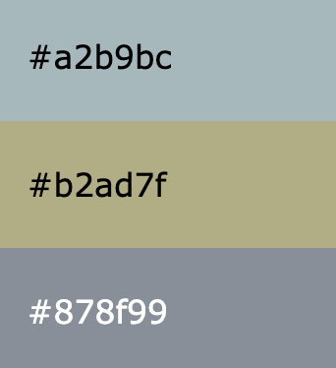
For example…
Instead of typing these values a lot of times, we can use Sass and write this:
If we have a site with 3 main colours, we may end up typing out these HEX values many times.
So, when using Sass, and the primary colour changes, you only need to change it in one place.

Slide 6
How dose it work?
A browser does not understand Sass code. Therefore, you will need a Sass pre-processor to convert Sass code into standard CSS.
This process is called transpiling.
So, you need to give a transpiler (some kind of program) some Sass code and then get some CSS code back.
Sass files have the ".scss" file extension.
Transpiling is a term for taking a source code written in one language and transform/translate it into another language

Slide 7
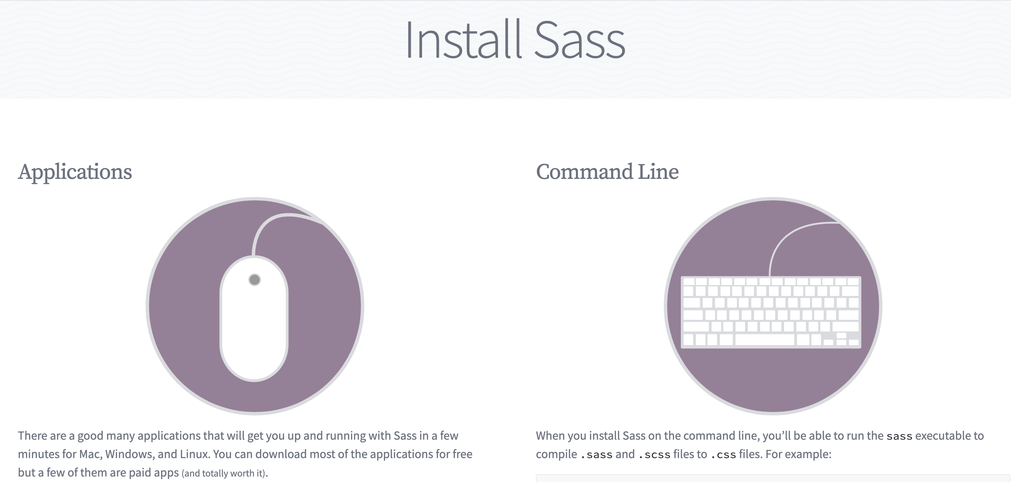
https://sass-lang.com/install/

Slide 8
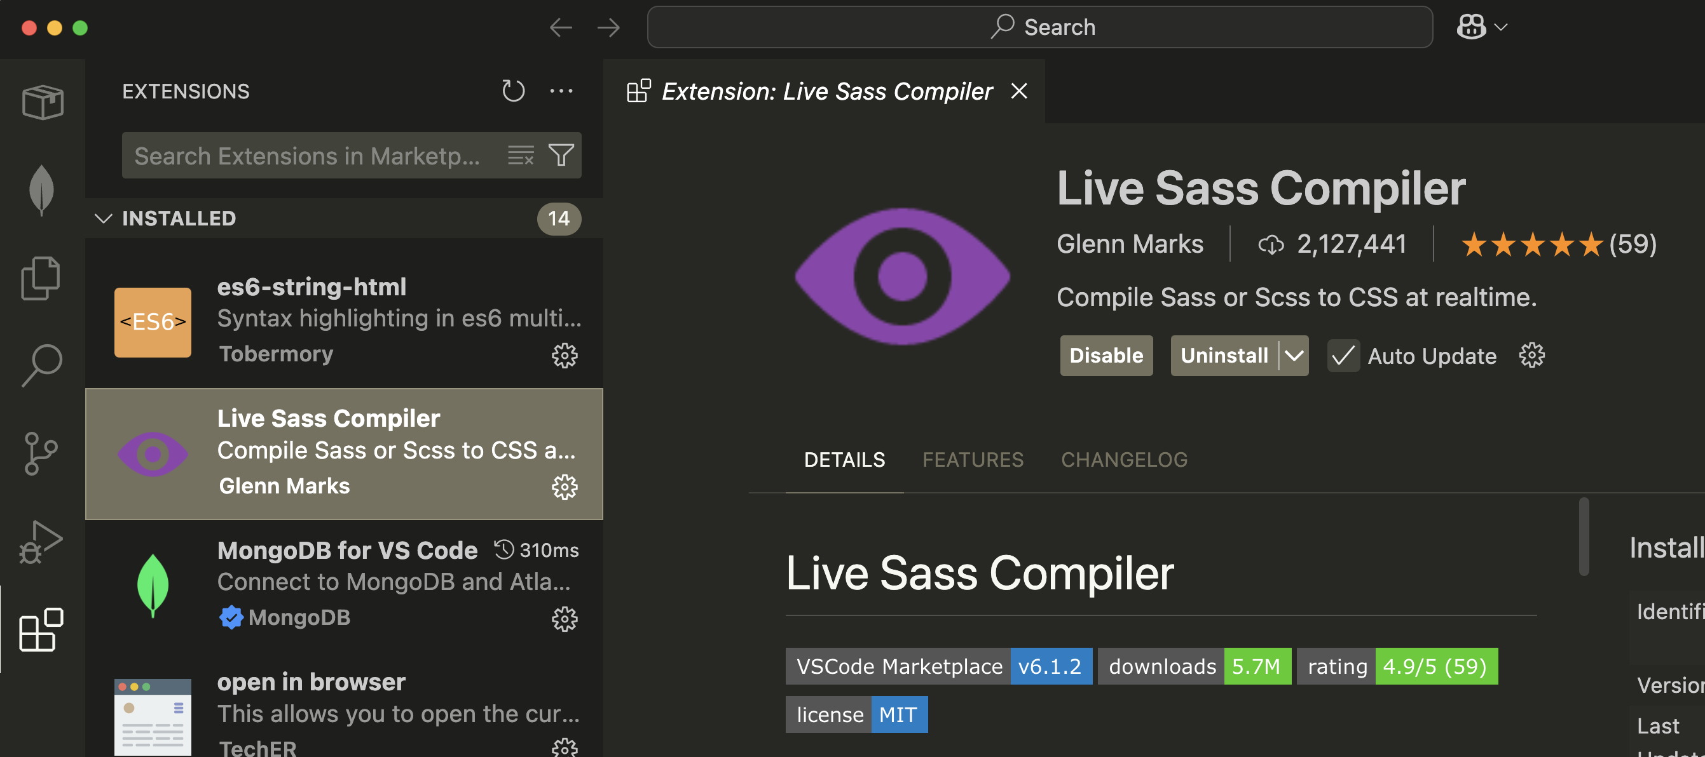
Later in this module we will look at using the command line and node npm to install and run Sass but for now we can also use this VS Code extension

Slide 9
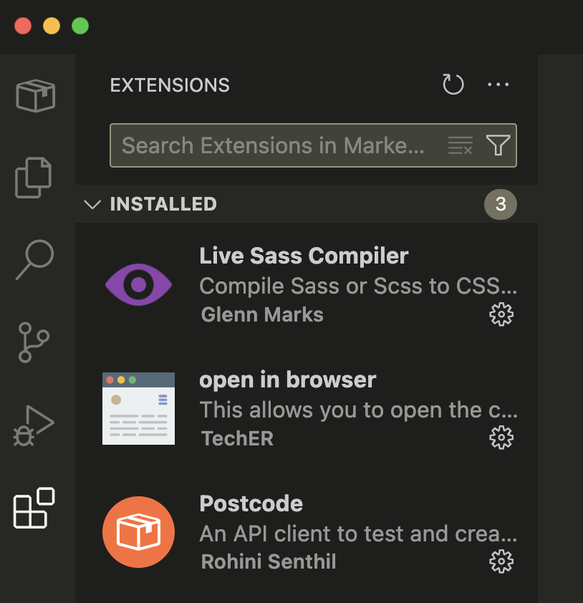
Click the Extensions icon in VS code
Search for Live Sass Complier and install it

Slide 10
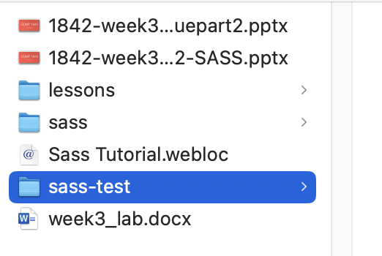
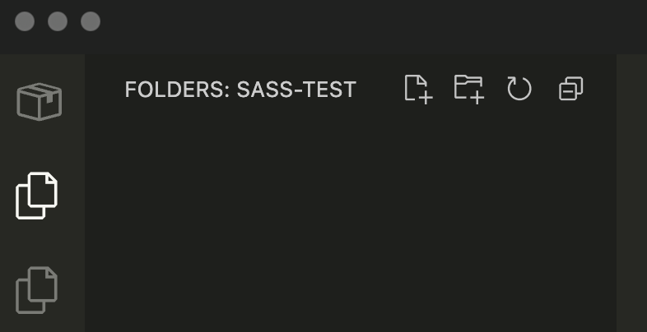
Setting up a project
On your G drive, perhaps in a COMP1842 / week 3 folder create a new empty directory called sass-test
From within VS Code open your new empty folder

Slide 11
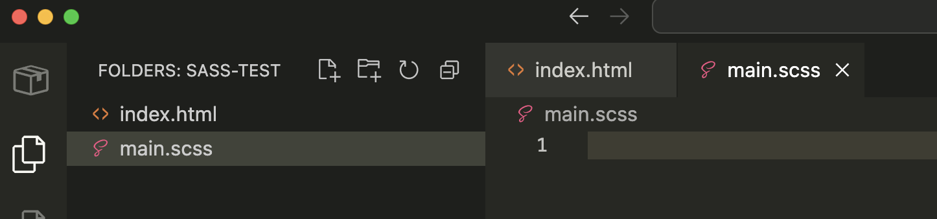
Creating our scss file
For our live sass complier extension to work we need an “scss” file and an html doc.
Create the following files from within VSCode into your new folder
index.html and main.scss
We are not creating a css file, the complier will do that for us.

Slide 12
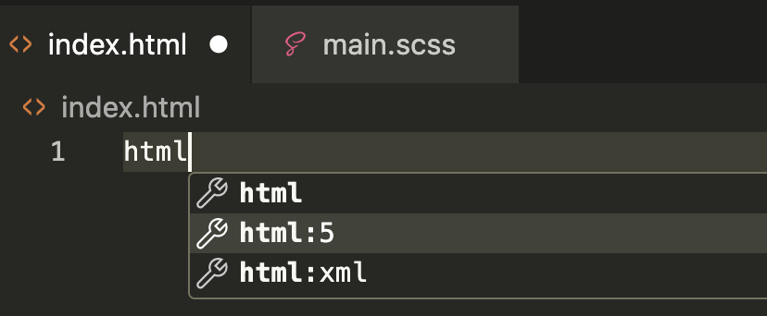
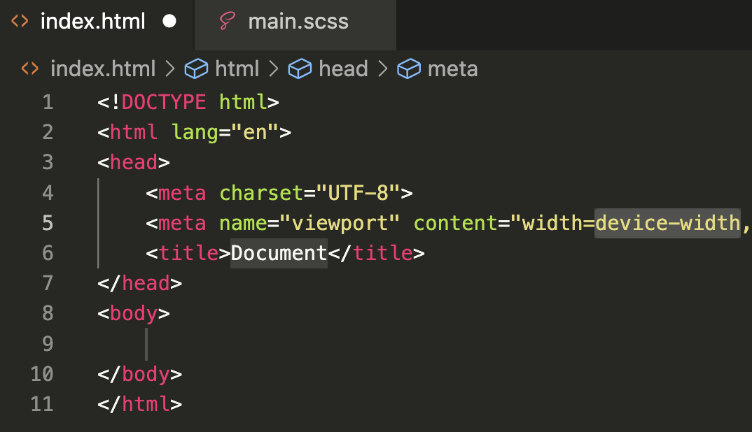
Basic index content
Begin typing html and select html:5 from the drop down to create our basic boiler plate

Slide 13
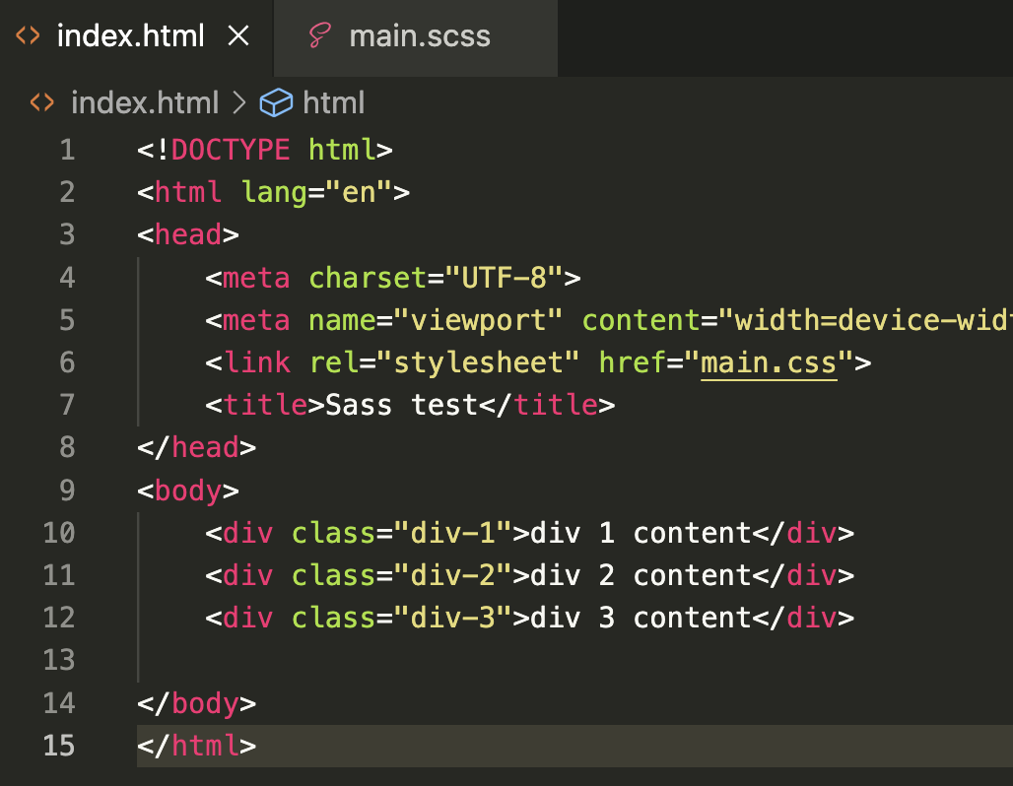
Basic index content cont…
Edit your index to match this
Notice line 6 is connecting to main.css which has not been created yet.
Lines 10-12 contain some placeholder divs with class names and some text content

Slide 14
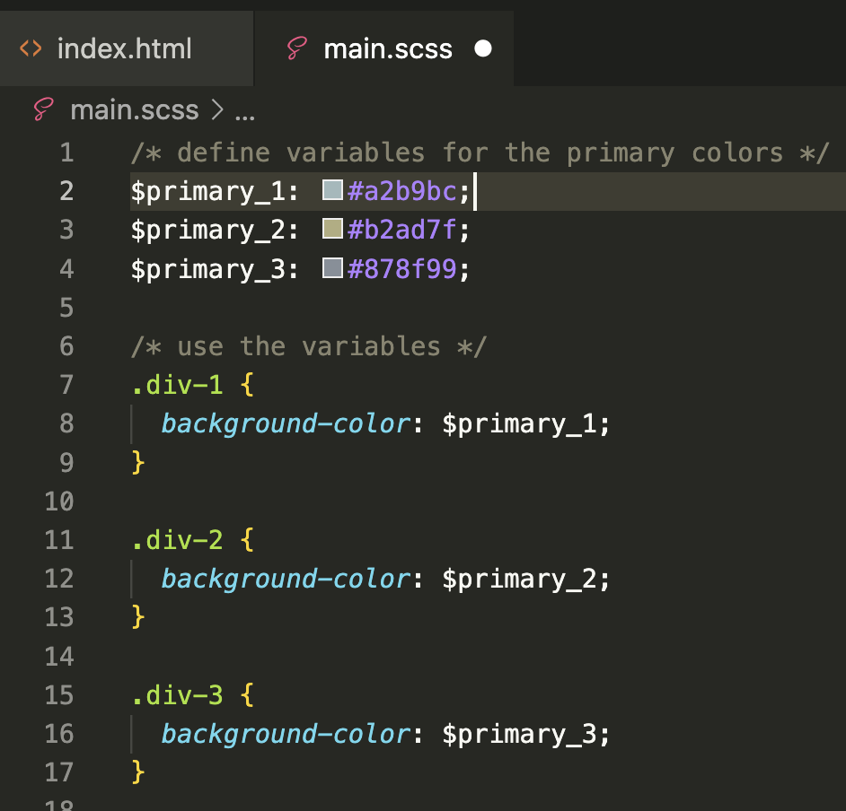
main.scss
You don’t need to copy the comments if you don’t want to
Line 2 - 4 we are setting our variables
Name value pairs, colon separated
$ sign to begin the variable
Lines 7 to 17. we are using the class names from the html page, a standard css selector such as background-color and then our newly created variables.

Slide 15
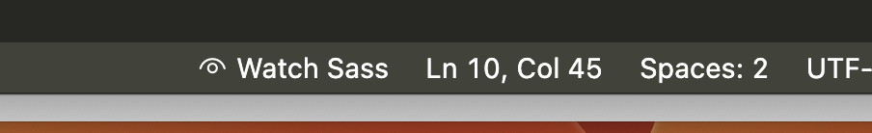
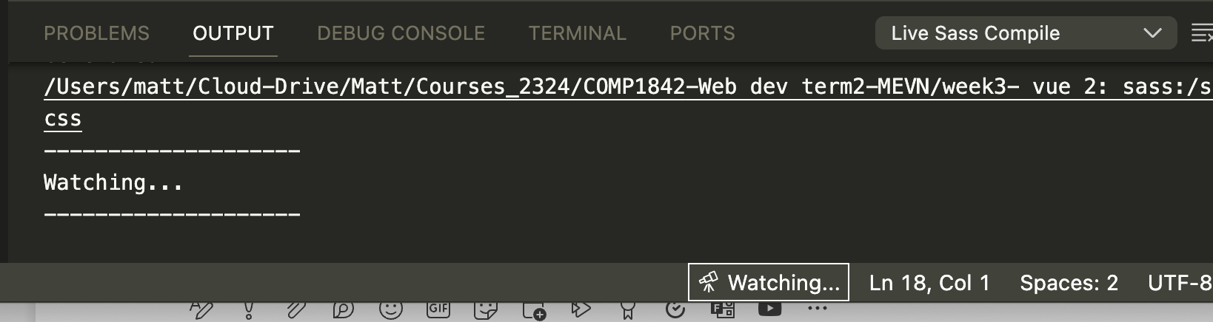
Watch and save the scss file
At the bottom of the screen is a watch sass button. Click this and you should get something like this. Save the scss file

Slide 16
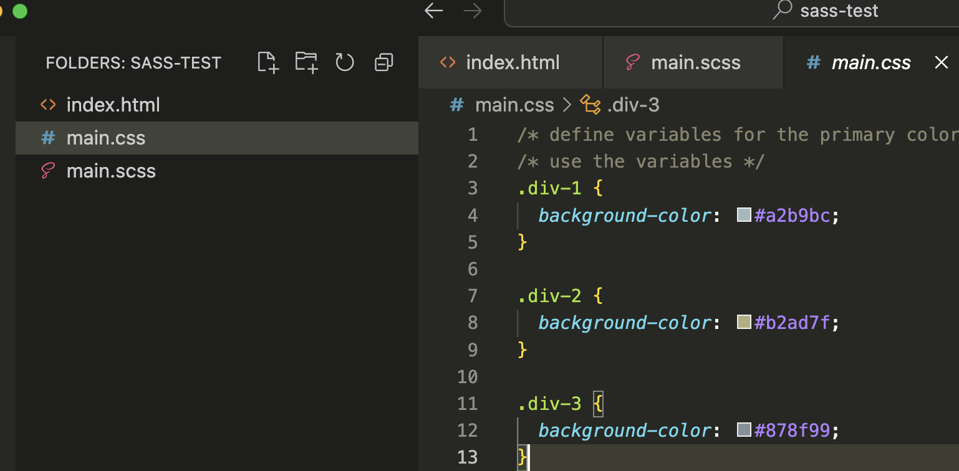
CSS file is compiled
If all has gone well a new css file called main.css should appear in your folder, we can see that the SASS code has been transpiled into pure CSS, no variables are present just the values we assigned.

Slide 17
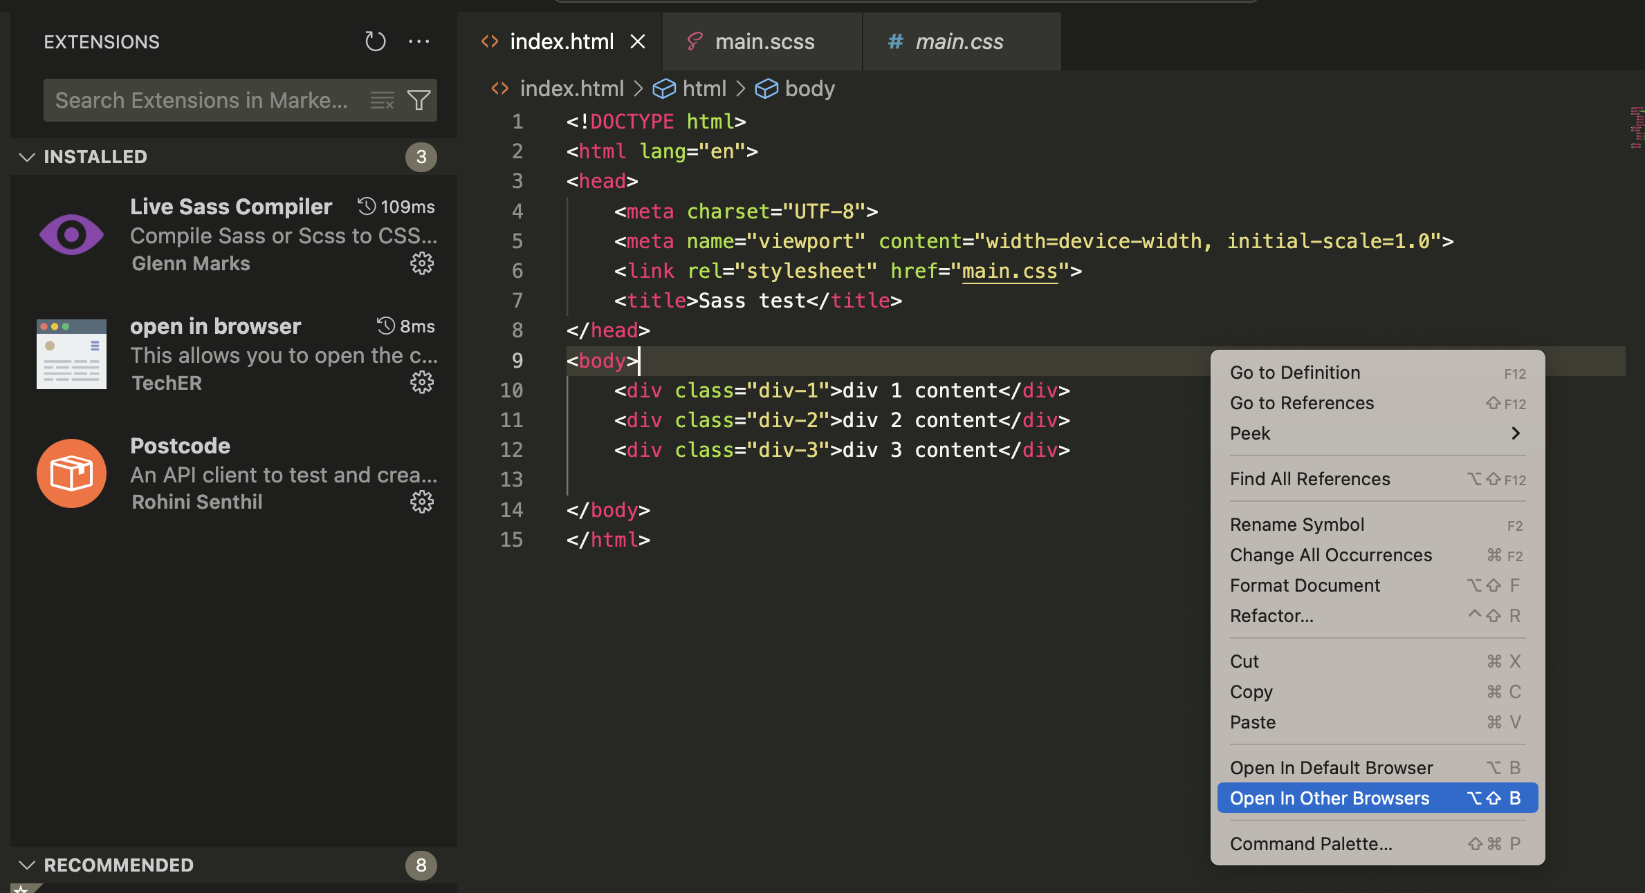
View in browser
If have also installed the ”open in bowser” extension, this gives me the option to right click in an html doc and open it in a browser.

Slide 18
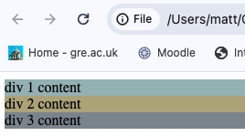
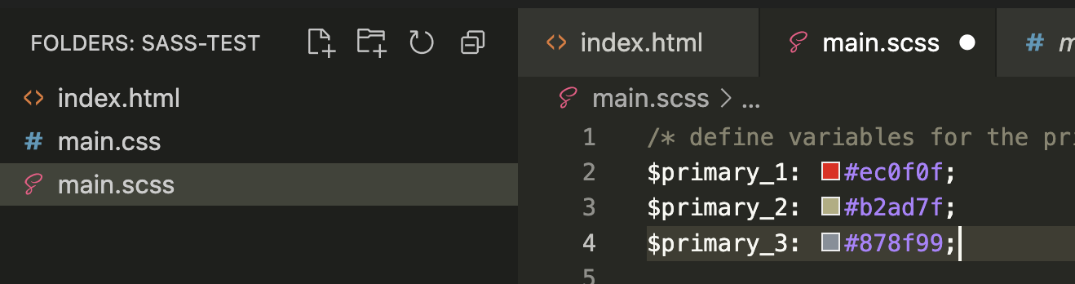

Our basic page
Now that we are ‘watching’ the scss file if I make a change to the colour in line 2 and simply save the scss file the css file auto updates

Slide 19
That was an absolute basic intro to SASS. What else can it do ?

Slide 20
MIXINS

Slide 21
The @mixin directive lets you make groups of CSS declarations that you want to reuse throughout your site. It helps keep your Sass very DRY.
The @include directive is created to let you use (include) the mixin.

Slide 22
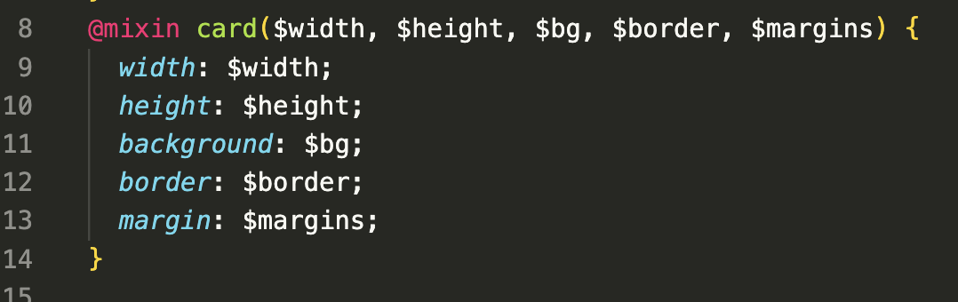
For example
We can create a mixin called “card” and assign various CSS properties to it
This acts a little like a very basic function. We can assign values to the parameters when we use it.

Slide 23
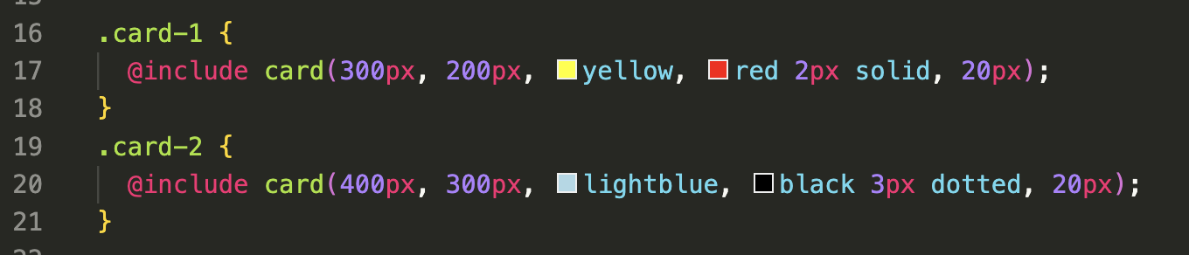
For example
Now we can make css classes and “include” the card mixin and pass in our arguments

Slide 24
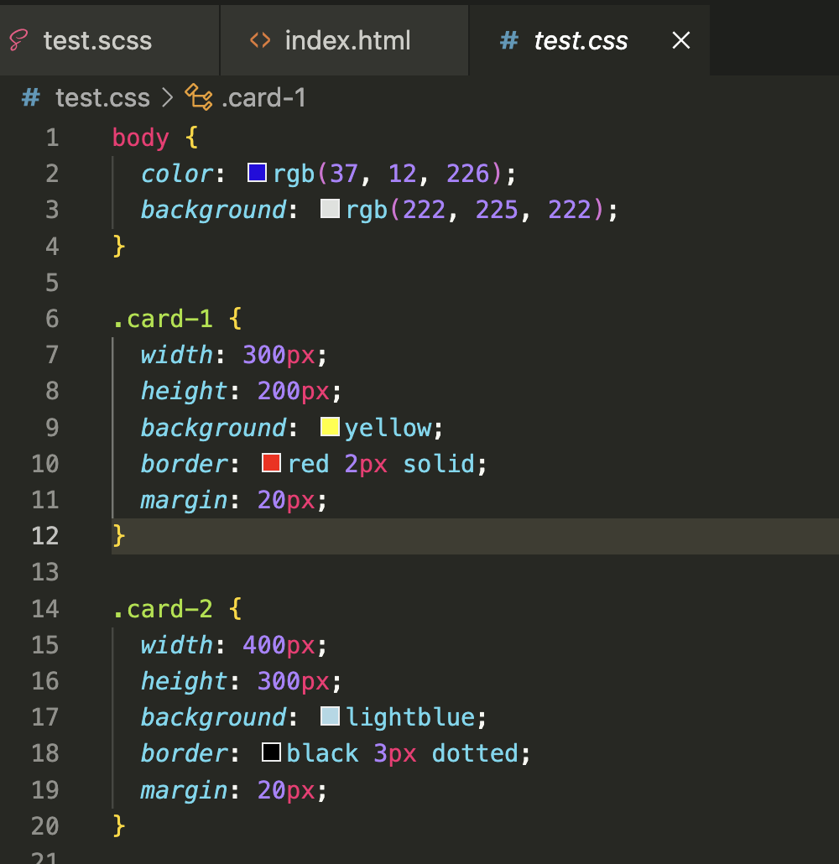
The transpiled CSS

Slide 25
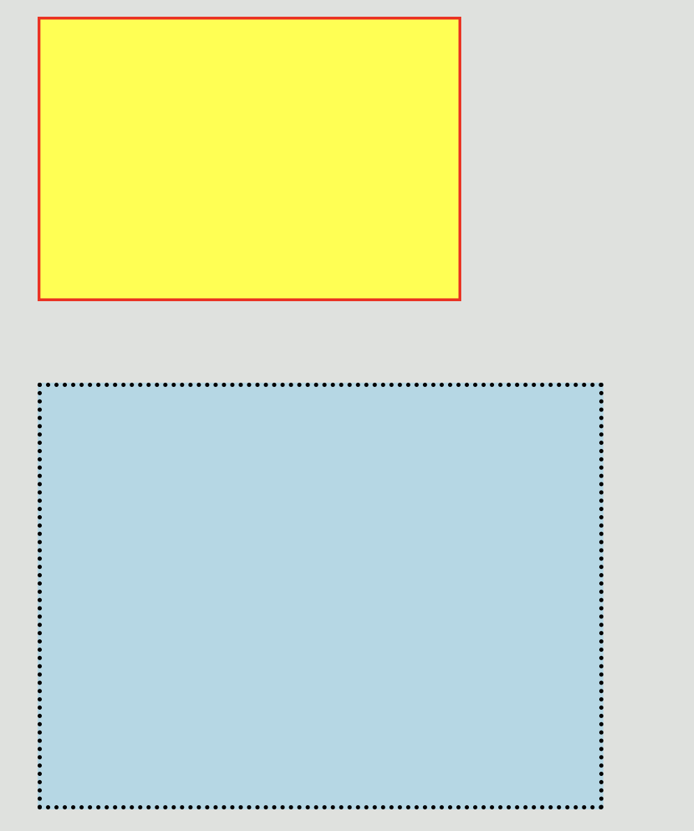
The html output

Slide 26
EXTEND
The @extend directive lets you share a set of CSS properties from one selector to another.
The @extend directive is useful if you have almost identically styled elements that only differ in some small details.

Slide 27
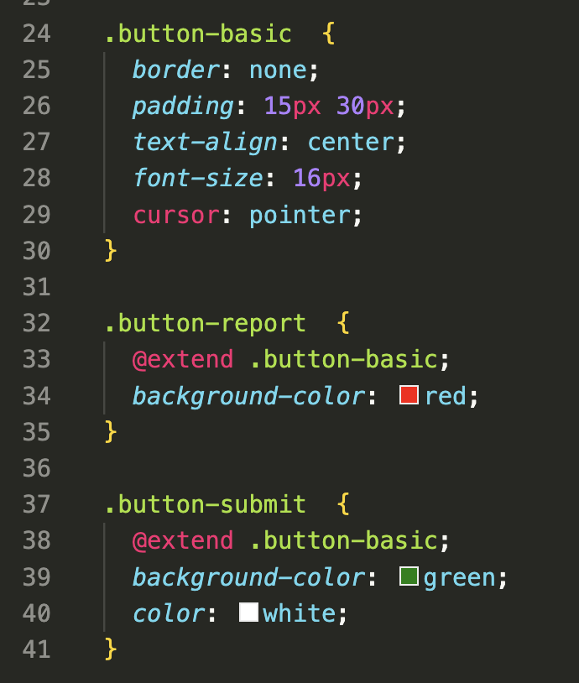
For example
We can create a class for a basic CSS button lines 24 - 30
Then we can create 2 versions of the button
That have minor changes. Button report EXTENDS button-basic.
This is a little like inheritance in programming where we get all the properties of the parent button and add some changes.

Slide 28
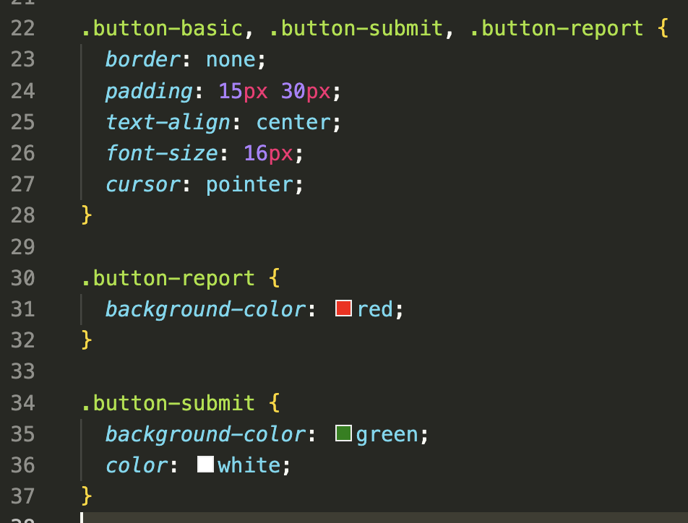
The transpiled CSS
We can see that all 3 classes have the basic button code lines 22-28.
Then we get our other 2 classes just with the additional CSS rules

Slide 29
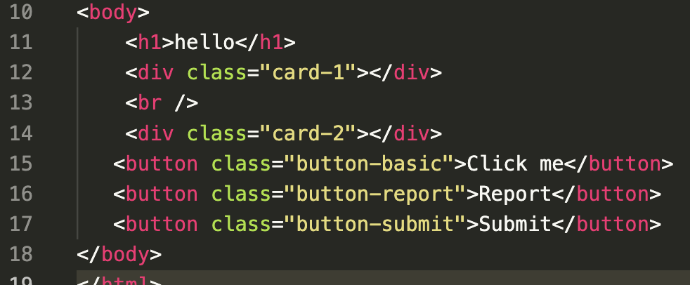
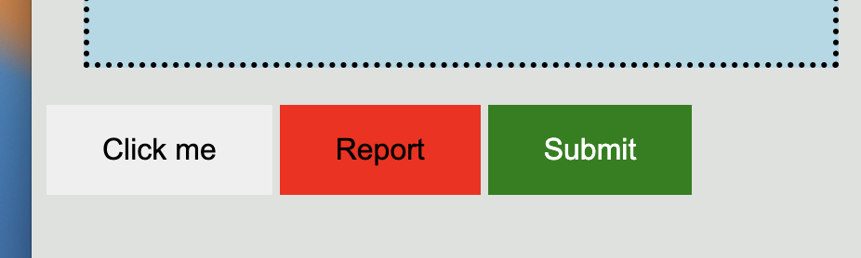
Add the classes to our html buttons

Slide 30
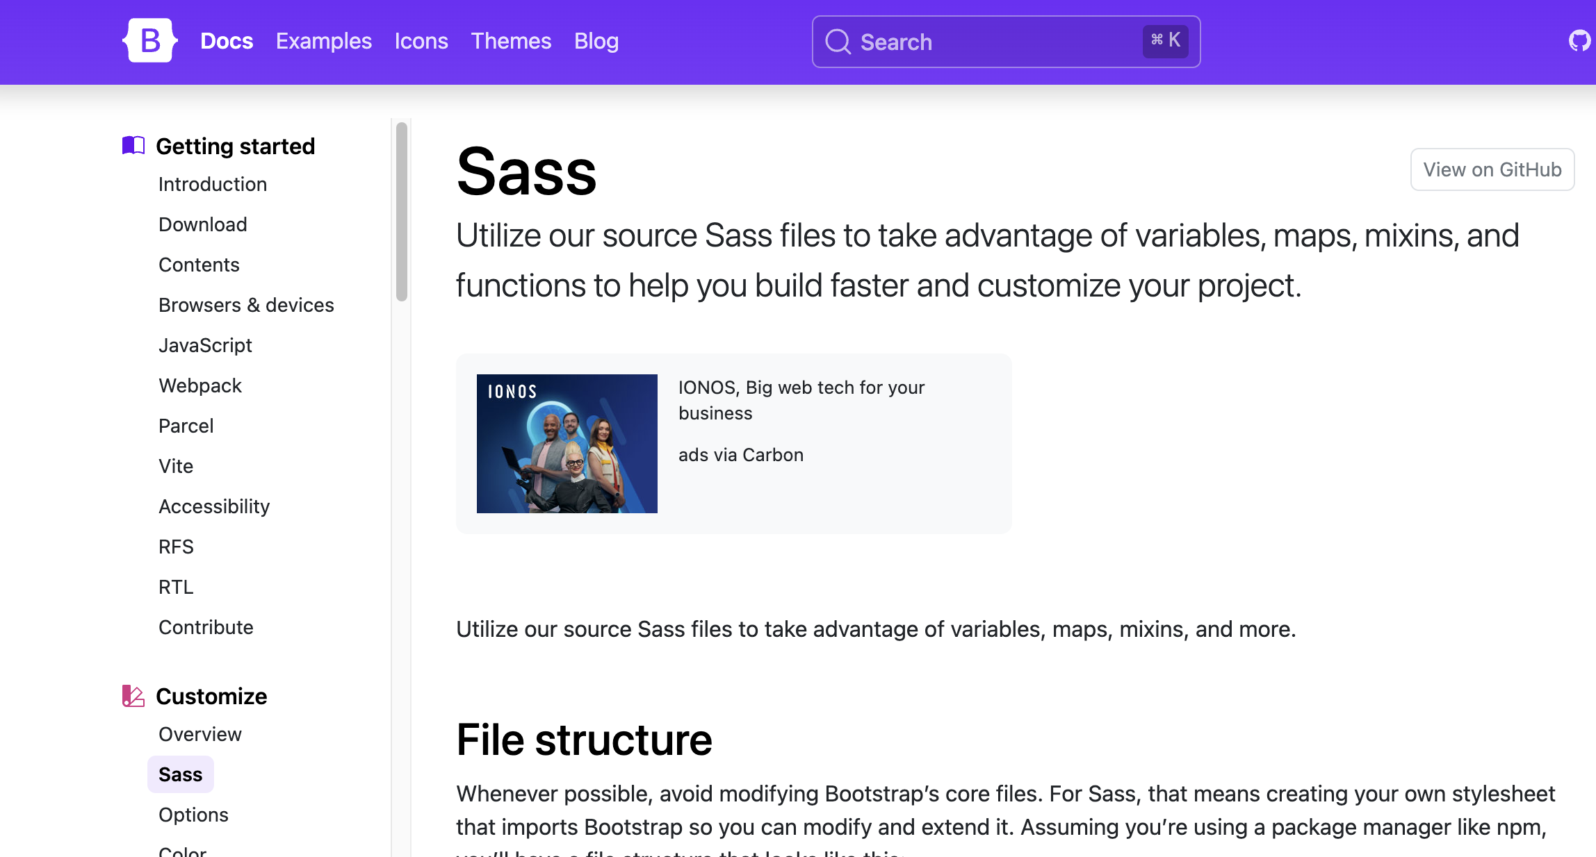
https://getbootstrap.com/docs/5.0/customize/overview/

Slide 31
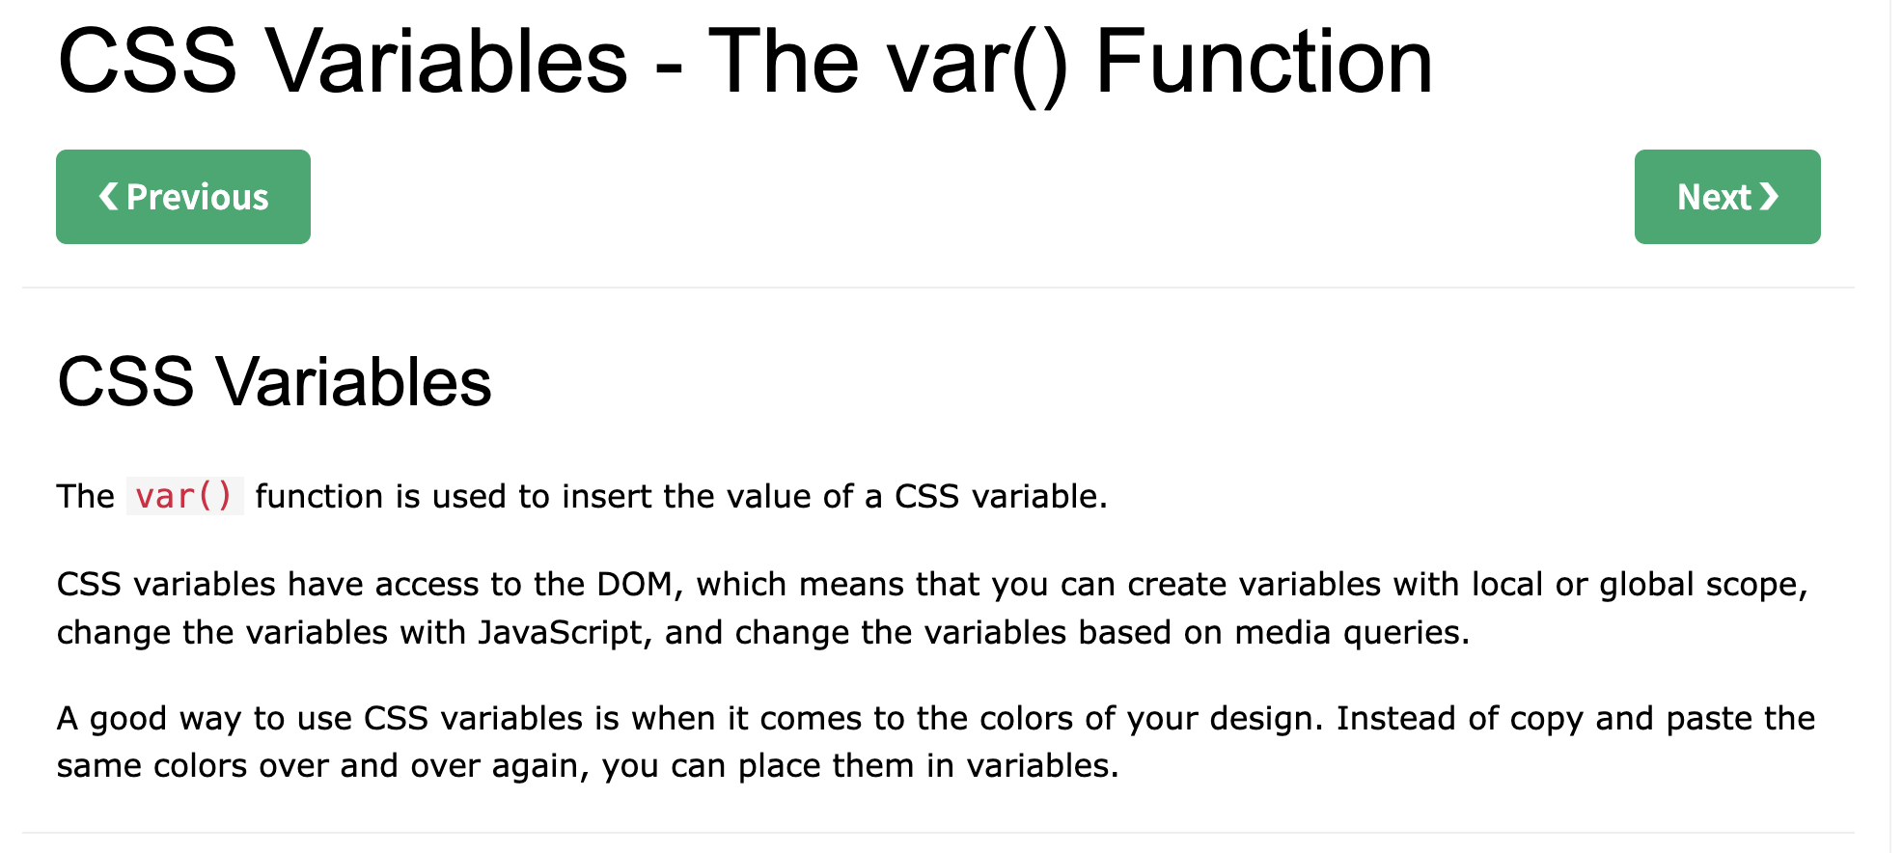
https://www.w3schools.com/css/css3_variables.asp
CSS var

Slide 32
https://www.w3schools.com/sass/default.php
Further SASS
https://sass-lang.com/guide/#inheritance
https://blog.logrocket.com/the-definitive-guide-to-scss/

Slide 33
?

