Slide 1
COMP 1842
Week 3 - Vue part 3
Matt Prichard

Slide 2
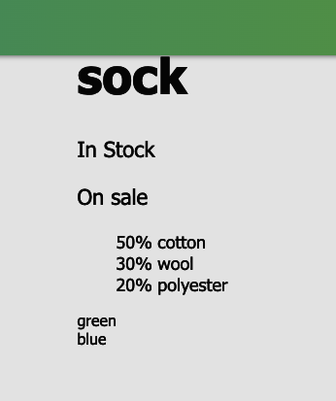
Recap
We looked at using v-for to loop over the contents of an array and dynamically generating list items in our HTML.
We saw how we can create an array of objects, in this case variants and using dot notation print out, for example the colour property of each variant

Slide 3
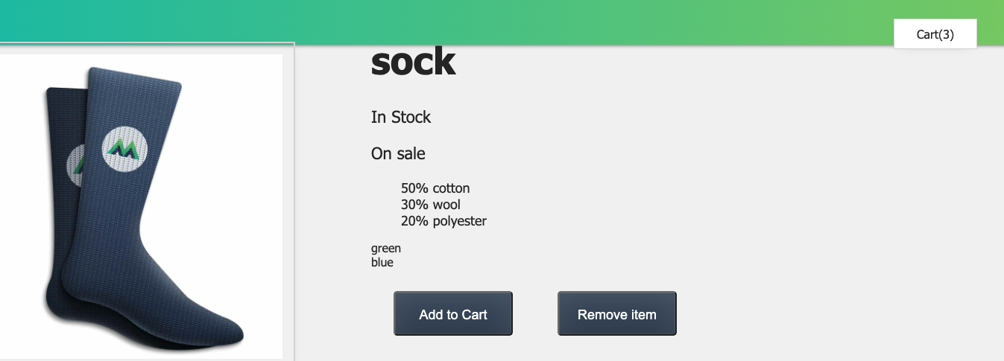
Recap cont…
We saw how to create mouse click and mouse over event listeners that in turn could be used to call a method or function from our App code.
We were able to use this to crate a basic interactive cart that updated on a button click or changed the image on mouseover

Slide 4
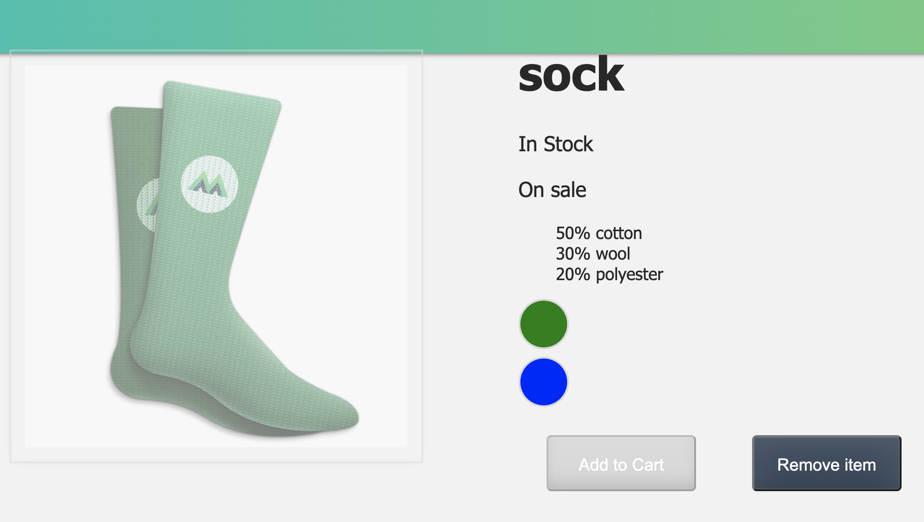
Recap cont…
Finally in lesson 7 we looked at style binding, allowing us to create the coloured circles and change the appearance and ‘disabled’ property of the add to cart button based on the inStock Boolean.

Slide 5
Sass
I introduced the concept of CSS pre processing with tools such as SASS. This allows better management of large scale CSS systems.
We can create variables, mixins (a bit like functions), conditional logic etc.
SASS files need to be complied out to CSS using either the command line as we will see next week, or one of many freely available SASS compliers.
VS Code has one you can install too via the extensions window.

Slide 6
This week lessons 8-11
I will quickly demo the last four lessons, but it is for you to complete these in your own time.
Remember to understand, not just copy.

Slide 7
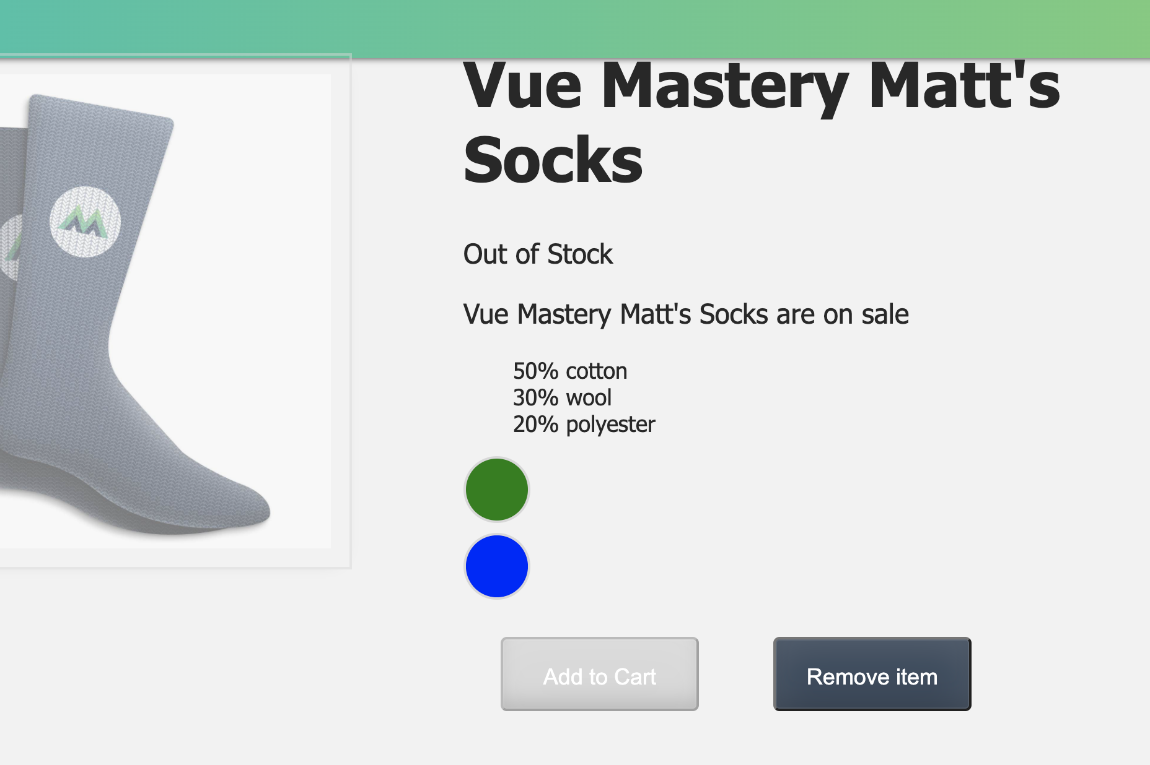
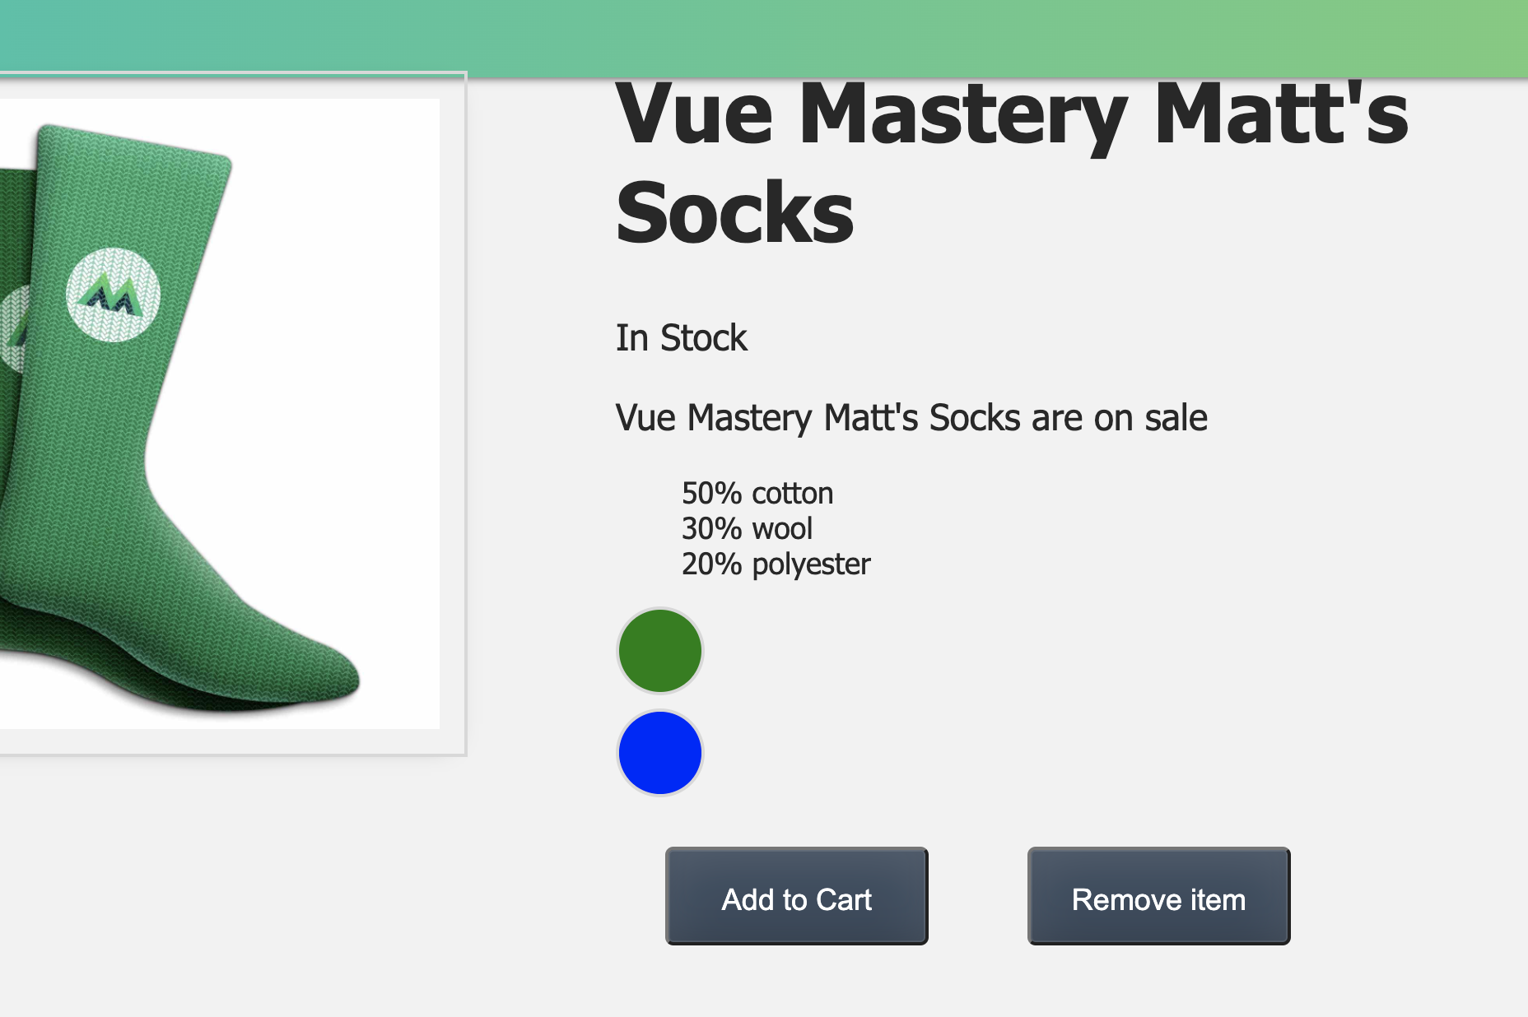
Lesson 8 demo
Computed properties – in stock / out of stock

Slide 8
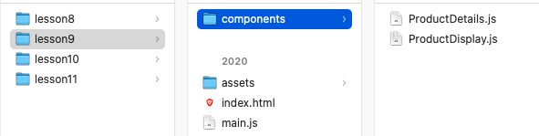
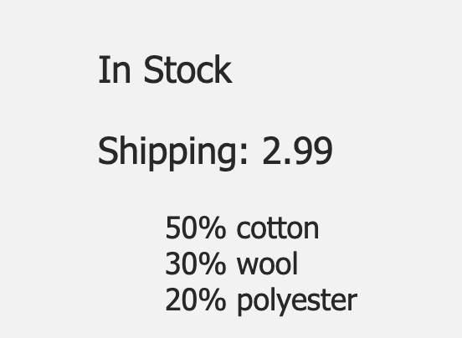
Lesson 9 demo
Components and props
Make sure you have es6-string-html extension in VS Code

Slide 9
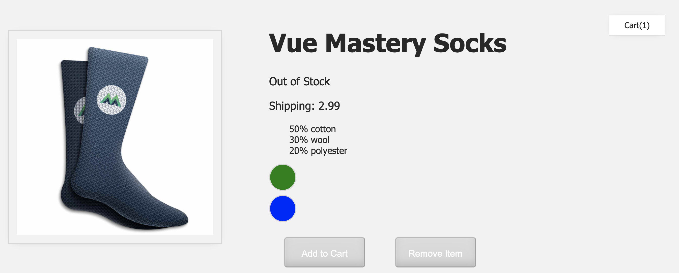
Lesson 10 demo
Communicating events – adding actual items to the cart
The coding challenge is quite hard on this one so don’t feel bad if you can’t manage it,

Slide 10
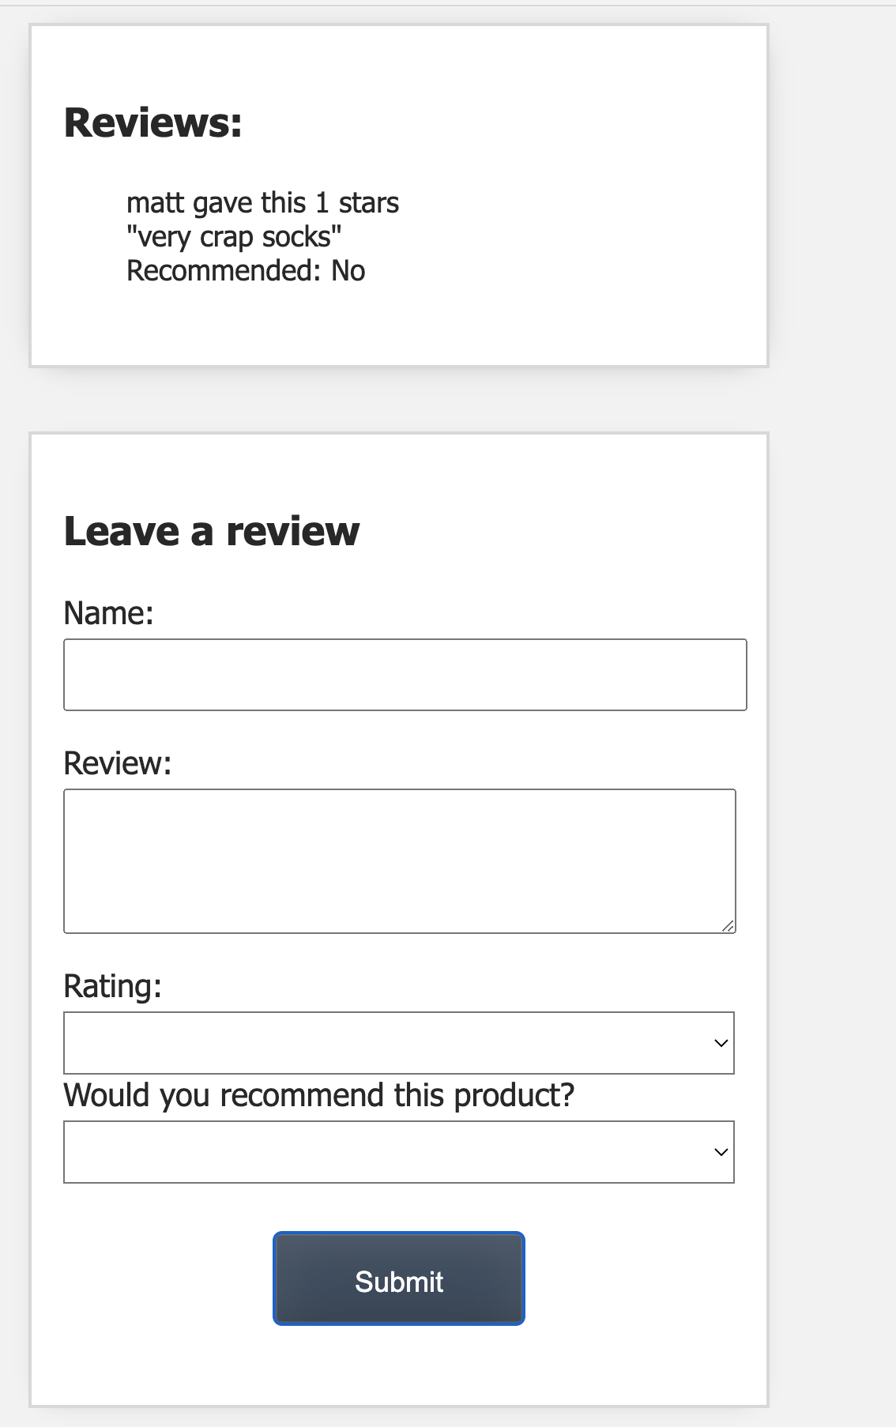
Lesson 11 - for the keen
Create a form for users to add product reviews.
This is challenging, but follow it slowly and you’ll get there.
Once you have completed all of these lessons I would recommend reviewing them a few times to consolidate understanding.
You may need to read up on JS arrays, push and slice and indexOf for example.
https://www.w3schools.com/js/js_array_methods.asp
https://www.w3schools.com/jsref/jsref_indexof.asp

Slide 11
Labs / homework
Make sure you complete up to the end of lesson of 10 by next week.
Do as I have been doing, create a new version and folder for each lesson in case it all goes wrong !
By the end of this week you should have 9 lesson folders over 3 weeks.

Slide 12
?

