Slide 1
COMP 1842
Critical Thinking
Matt Prichard

Slide 2
Intro
Critical thinking
Evidence, peer review
The scientific method
Hypothesis, Theory and Law
Cognitive dissonance
Confirmation bias
1st, 2nd and 3rd person

Slide 3
Critical thinking
Critical thinking is the art of making clear, reasoned judgements based on interpreting, understanding, applying and synthesising evidence gathered from observation, reading and experimentation.
Critical thinking is the ability to objectively analyze information and draw a rational conclusion.

Slide 4
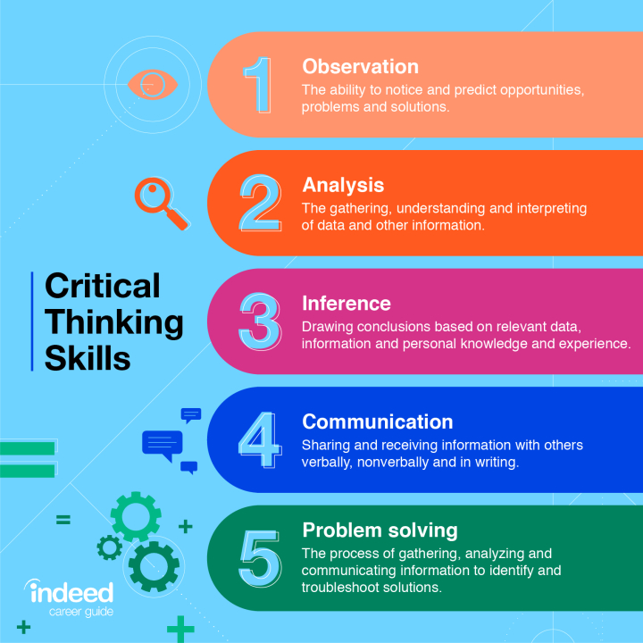

Slide 5
Evaluating a source's credibility
Currency: Does the source reflect recent research?
Relevance: Is the source related to your research topic?
Authority: Is it a respected publication?
Accuracy: Does the source support its arguments and conclusions with evidence?
Purpose: What is the author's intention?
https://www.gre.ac.uk/articles/ils/critical-thinking

Slide 6
Brexit
Brexit was a sobering example of the lack of critical thinking skills among the general population leading to a decision based on emotion and misleading information not evidence.

Slide 7
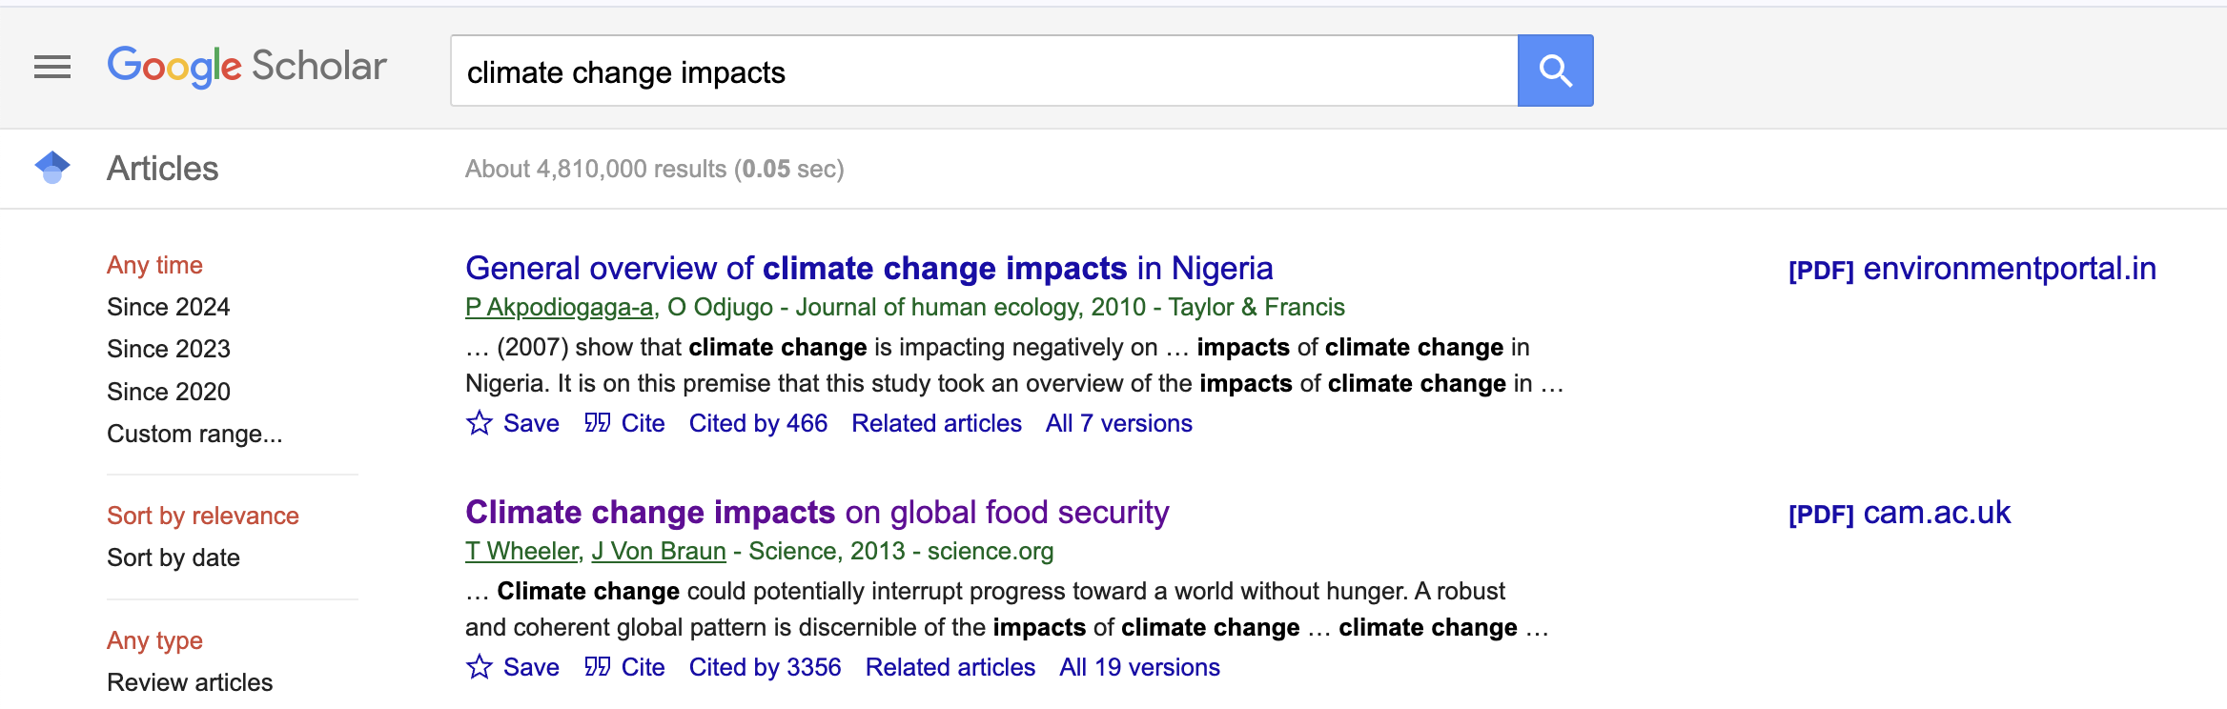
Google scholar vs Google or Twitter
https://scholar.google.com/
https://scholar.google.com/scholar?hl=en&as_sdt=0,5&qsp=3&q=climate+change+impacts&qst=bb
Vs
https://www.bigissue.com/news/environment/jacob-rees-mogg-climate-change-denial-energy-secretary/
Vs
https://www.theverge.com/2022/12/5/23494220/elon-musk-twitter-climate-misinformation-rise-analysis

Slide 8
Anecdotal evidence
Anecdotal evidence is information derived from personal experience or observation. Anecdotal evidence is used to learn about experiences, products, and to help prove a point.
It is not scientific evidence, which can be verified objectively.
Scientific evidence
“89% of lung cancer cases in the UK are preventable and 86% of these are linked to smoking.”
https://www.check4cancer.com/advice-and-awareness/blog/1683-what-are-the-12-things-you-can-do-to-reduce-your-cancer-risk#:~:text=Do%20not%20smoke,of%20cancer%20in%20the%20world.
Anecdotal evidence
“My gran smoked her whole life and never got cancer”

Slide 9
Peer review
Peer review is the evaluation of work by one or more people with similar competencies as the producers of the work (peers).
It functions as a form of self-regulation by qualified members of a profession within the relevant field.
Peer review methods are used to maintain quality standards, improve performance, and provide credibility.
In academia, scholarly peer review is often used to determine an academic paper's suitability for publication.

Slide 10
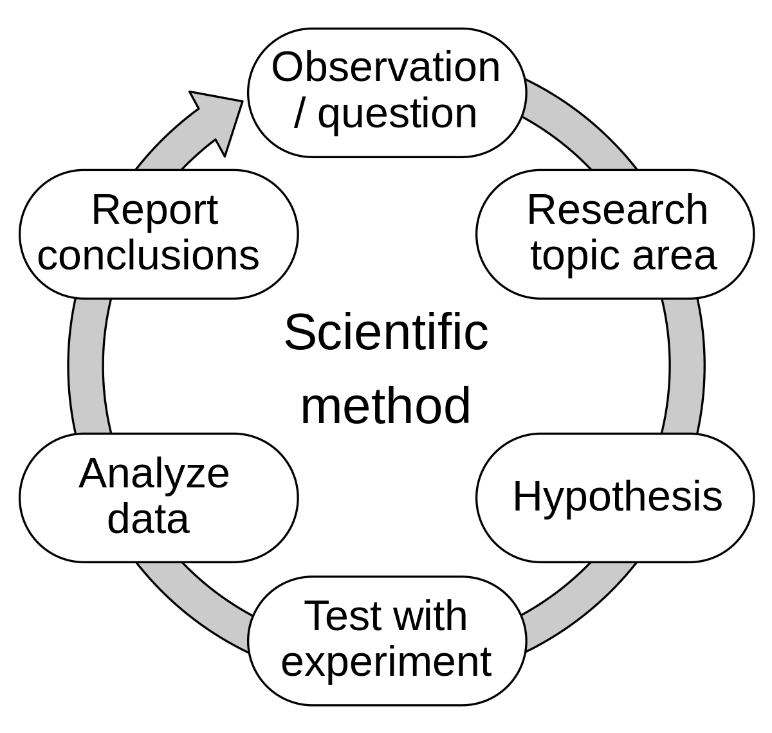
The scientific method

Slide 11
You are doing a BSc, your 3rd year project will be following and applying the scientific method.

Slide 12
Hypothesis, Theory and Law

Slide 13
Hypothesis
A hypothesis is a reasonable guess based on something that you observe in the natural world. Hypotheses are the foundation of the scientific method.
After making an observation and formulating a question, a scientist must create a hypothesis — a potential answer to the question.
They then make a testable prediction, test this prediction (over and over and over), and analyze the data.
Once this is done, they can then state whether or not their hypothesis was correct.

Slide 14
Hypothesis - example
You observe that, upon waking up each morning, your black bin is overturned, and rubbish is spread around the garden.
You form a hypothesis that foxes are responsible.
Through testing — maybe you stay up all night to watch for foxes — the results will either support or refute your hypothesis.

Slide 15
Theory
A scientific theory is a verifiable explanation of natural phenomenon. For example, the theory of gravity explains why an apple always falls to the ground when dropped.
A scientific theory consists of one or more hypotheses that have been supported by repeated testing. Theories are one of the pinnacles of science and are widely accepted in the scientific community as being true.
Theories can also evolve. This doesn't mean the old theory was wrong. It's just that new information was discovered.

Slide 16
Theory - example
When Sir Isaac Newton discovered the theory of gravity and wrote laws that explained the motions of objects, he was not wrong about how the world worked, but he wasn’t fully right either.
Albert Einstein later discovered the theories of special and general relativity — that the force of gravity exists due to the bending of spacetime, which is caused by massive objects.
This created a more complete theory of gravity, so Newton wasn't incorrect. He just had a partial answer.

Slide 17
Theory – examples 2
The greenhouse theory of climate change: The greenhouse effect is the process through which heat is trapped near Earth's surface by substances known as 'greenhouse gases’, helping to maintain a warmer temperature than it would have otherwise.
Evolutionary theory: Darwin proposed that species can change over time, that new species come from pre-existing species, and that all species share a common ancestor.

Slide 18
Law
Scientific laws are short and always true. They're often expressed in a single statement and generally rely on a concise mathematical equation.
Laws are accepted as being universal and are the cornerstones of science. They must never be wrong (that is why there are many theories and few laws). If a law were ever to be shown false, any science built on that law would also be wrong.
Examples of scientific laws (also called "laws of nature") include the laws of thermodynamics, Boyle’s law of gasses, the laws of gravitation.

Slide 19
Law
The characteristics of scientific law are - they are based in physics, observed by anyone, occur in the natural world without any intervention by people, explains the how of what was observed under specific conditions, is expressed by a mathematical formula or equation, can be used to predict outcomes, and can be proven.
The difference between a scientific theory and law is that a theory is used to explain why something is observed. Scientific law is used to explain how the thing that is observed happened.
https://en.wikipedia.org/wiki/Scientific_law#Laws_of_classical_mechanics

Slide 20
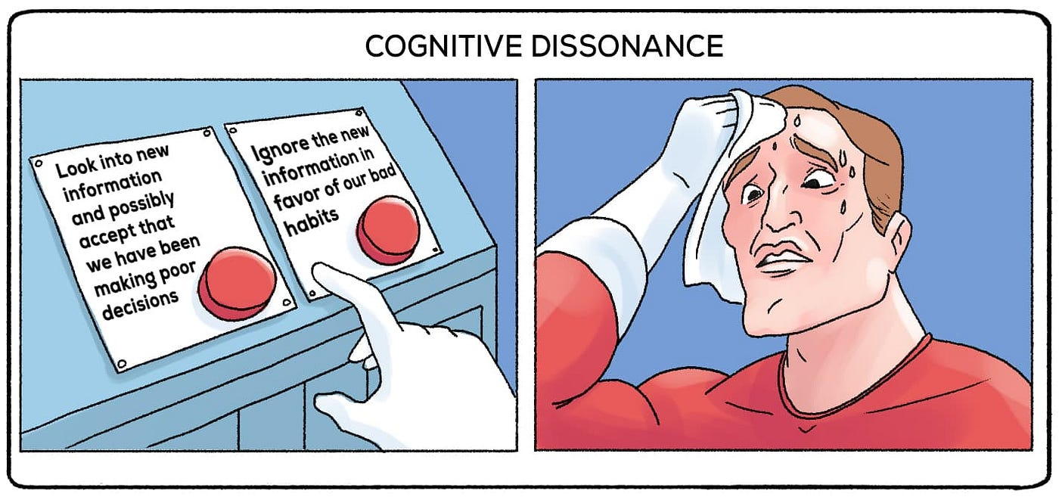
Cognitive dissonance
Cognitive dissonance is the discomfort a person feels when their behaviour does not align with their values or beliefs. Cognitive dissonance is a psychological phenomenon that occurs when a person holds two contradictory beliefs at the same time.

Slide 21
examples
People often experience cognitive dissonance when what they know (e.g. that burning fossil fuels contributes to climate change) conflicts with what they do (driving, flying, etc).
You want to be healthy, but you don't exercise regularly or eat a nutritious diet. You feel guilty as a result.
COVID-19 risk perception, cognitive dissonance, and vaccine hesitancy
https://www.ncbi.nlm.nih.gov/pmc/articles/PMC10026885/
2011 end times prediction
https://en.wikipedia.org/wiki/2011_end_times_prediction

Slide 22
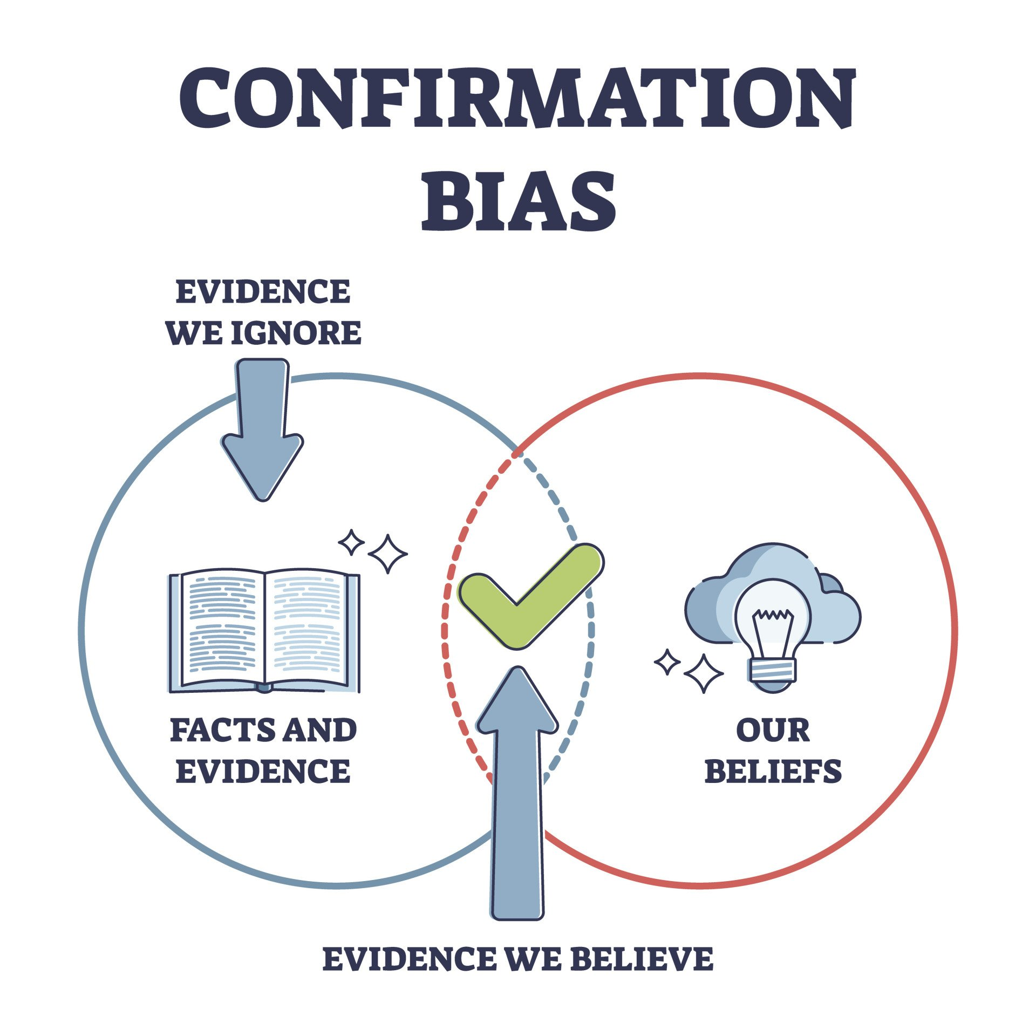
Confirmation bias
Confirmation bias is the tendency to search for, interpret, favour, and recall information in a way that confirms or supports one's prior beliefs or values.
People display this bias when they select information that supports their views, ignoring contrary information, or when they interpret ambiguous evidence as supporting their existing attitudes

Slide 23
Examples – social media
Information we are presented on social media is not only reflective of what the users want to see but also of the designers’ beliefs and values. Today, people are exposed to an overwhelming number of news sources, each varying in their credibility.
To form conclusions, people tend to read the news that aligns with their perspectives. For instance, new channels provide information (even the same news) differently from each other on complex issues (i.e., racism, political parties, etc.), with some using sensational headlines/pictures and one-sided information.
Due to the biased coverage of topics, people only utilize certain channels/sites to obtain their information to make biased conclusions.

Slide 24
Examples
People also tend to search for and interpret evidence with respect to their religious beliefs (if any).
For instance, on the topics of abortion and transgender rights, people whose religions are against such things will interpret this information differently than others and will look for evidence to validate what they believe.
Similarly, those who religiously reject the theory of evolution will either gather information disproving evolution or hold no official stance on the topic.

Slide 25
1st, 2nd and 3rd person

Slide 26
First person
First person is the I / We perspective.
I, we, me, us, my, mine, our, and ours.
I think I lost my wallet! I can’t find it anywhere! Oh, I could just kick myself!
We could do ourselves a favour and make a reservation for our group.

Slide 27
Second person
This is the “you” perspective. The biggest indicator of the second person is the use of second-person pronouns: you, your, yours, yourself, yourselves.
You can wait in here and make yourself at home.
You should be proud of yourselves for finishing this enormous project!
Can be used for manuals ,walkthroughs, instructions etc…

Slide 28
Third person
The third-person pronouns include he, him, his, himself, she, her, hers, herself, it, its, itself, they, them, their, theirs, and themselves.
Sarah used her prize money from the science fair to buy herself a new microscope.
The concertgoers roared their approval when they realized they’d be getting an encore.

Slide 29
Academic writing
Most academic papers should generally be written in the third person, referring to other authors and researchers from credible and academic sources to support your argument rather than stating your own personal experiences.
In their research Jones (2023) notes that PHP….
PHP, a very popular server-side language (Jones, 2023)…

Slide 30
To Summerise
First person acceptable in personal evaluations or reflections.
“I learned x, y or z from doing…”
Second person for instructional material.
“Firstly, you need to create an account…”
Third person for the bulk of other academic writing
“Matt (2025) was very clear in his slides…”

Slide 31

https://www.gre.ac.uk/articles/ils/articles-academic-skills

Slide 32
?

