Slide 1
COMP 1842
Week1 - JS refresher
Matt Prichard

Slide 2
What is JavaScript?
JavaScript was designed to add interactivity and to provide client-side programming to HTML pages
JavaScript is a scripting language or a lightweight programming language .
Executable JavaScript may be included into an HTML page as either...
External - a separate file containing JavaScript
Embedded - as the content of a <script> element
Inline - as the value of an HTML event attribute
Everyone can use JavaScript without purchasing a license

Slide 3


If you only remember one thing from today… JavaScript is not Java

Slide 4
JavaScript
Refresher
demonstrations

Slide 5
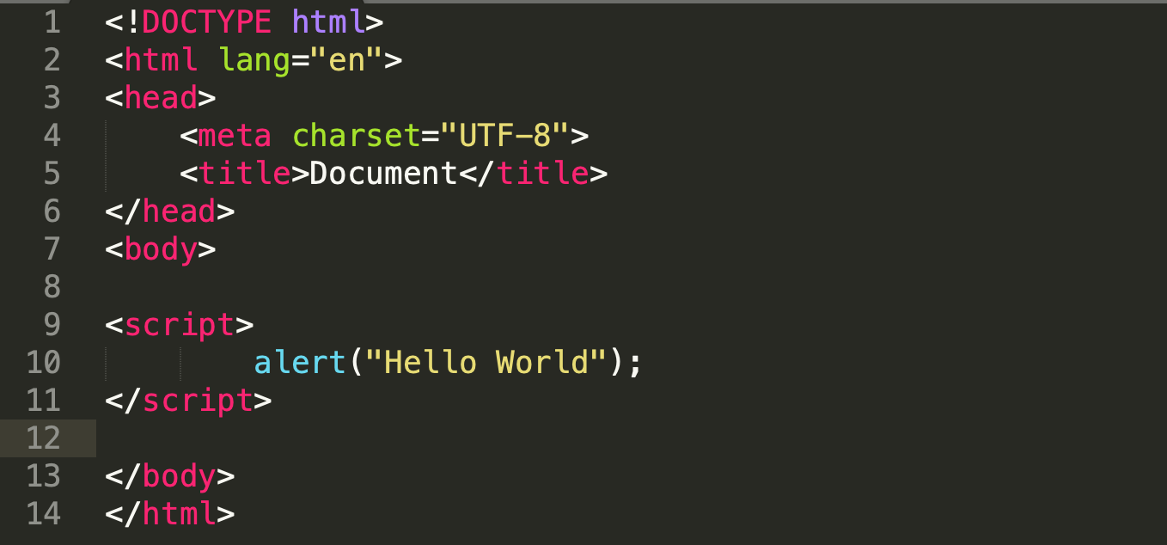
To insert a JavaScript into an HTML page, use the <script> tag. The <script> and </script> tells where the JavaScript starts and ends. The lines between the <script> and </script> contain the JavaScript.

Slide 6
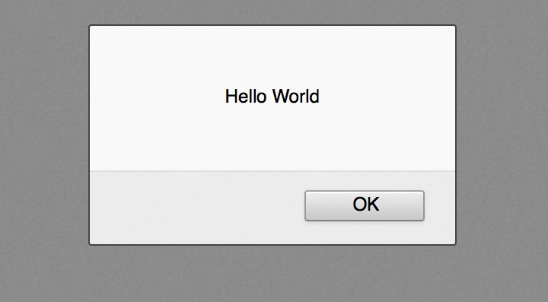
Alert box in FireFox

Slide 7
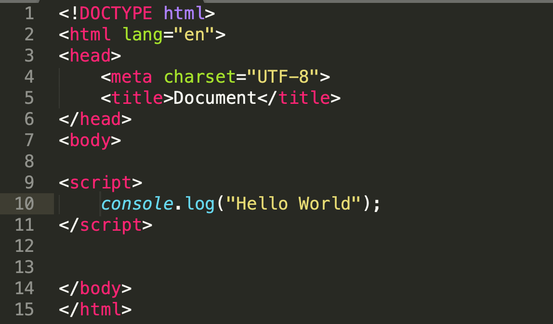

Slide 8



console.log(expression);
evaluates the expression and displays the result in the JavaScript Console

Slide 9
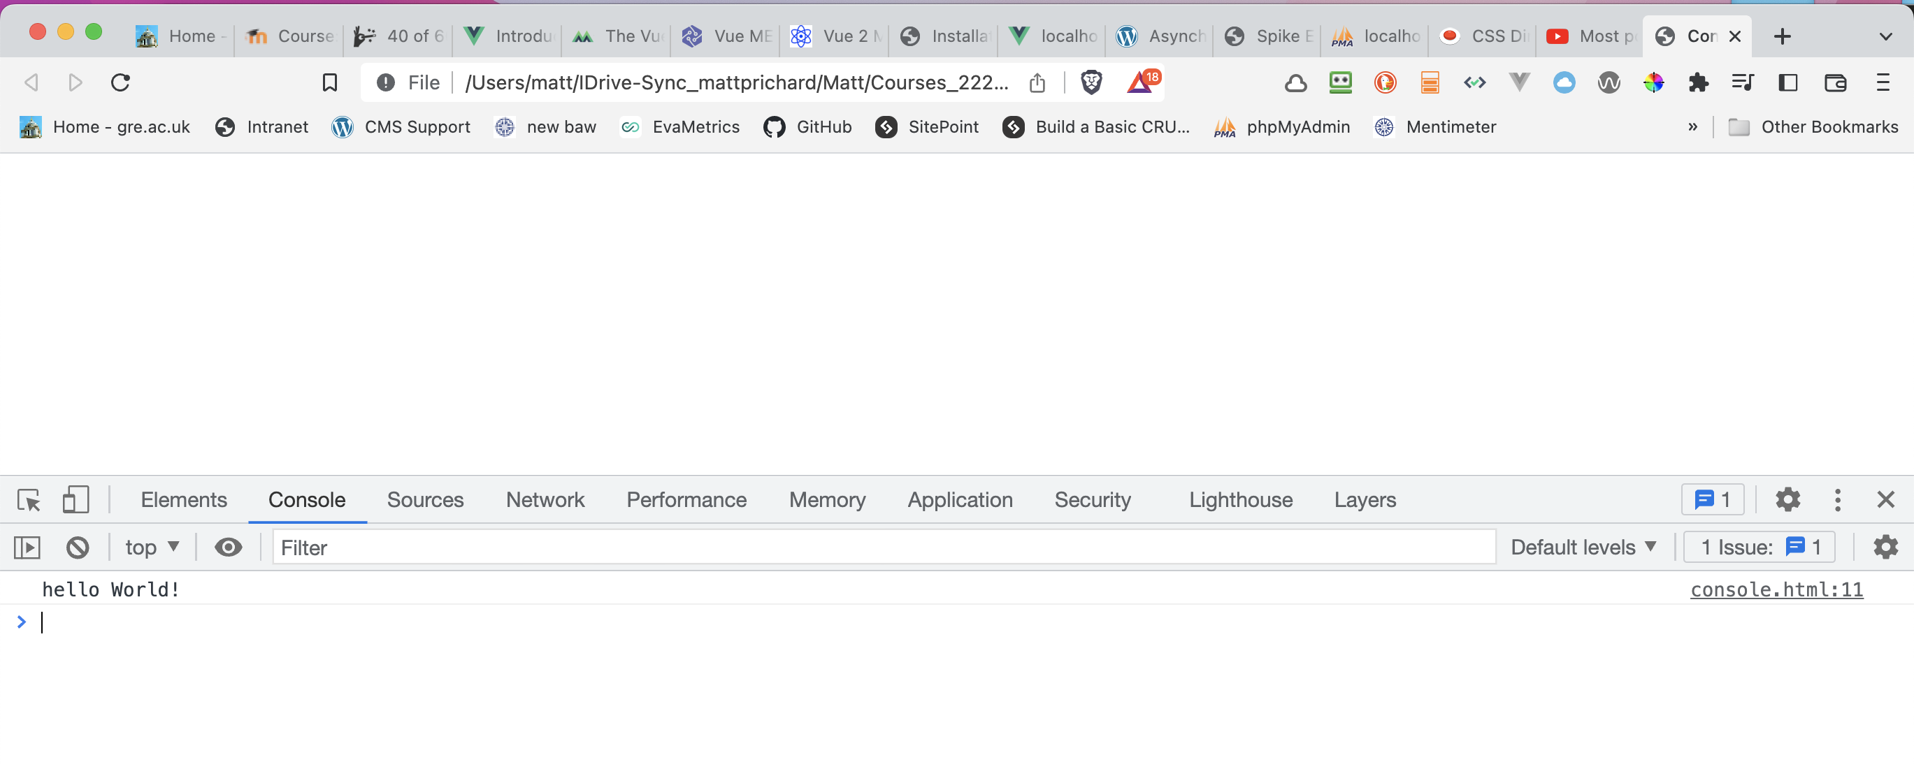

Slide 10

innerHTML
Another way to get output to the screen is using innerHTML
This allows us to output to any HTML element we know the ‘id’ of.
We create an HTML element and give it an ID.

Slide 11




innerHTML cont.
The getElementById() method accesses the first element with the specified id.
Then access the inner HTML property of that element and assign it a value

Slide 12
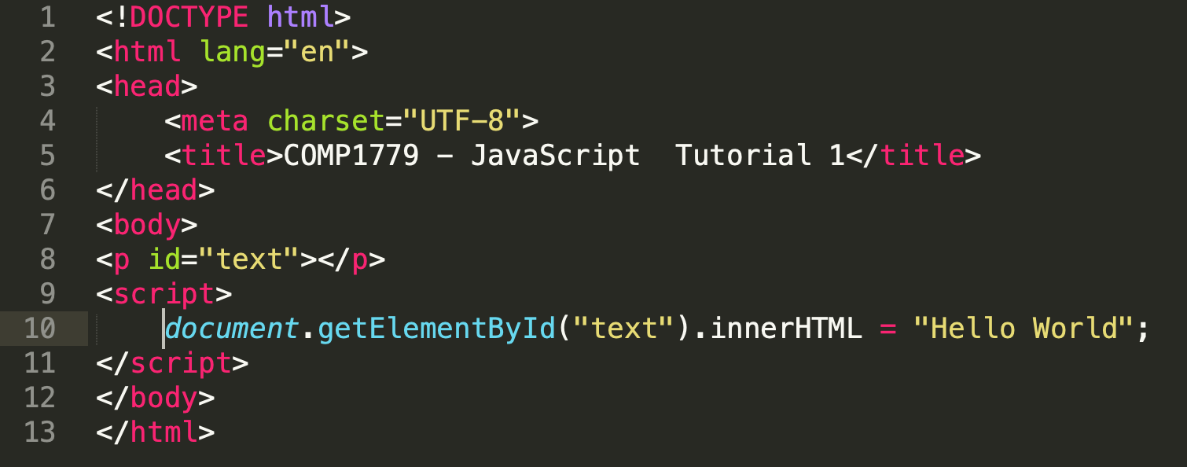

Slide 13
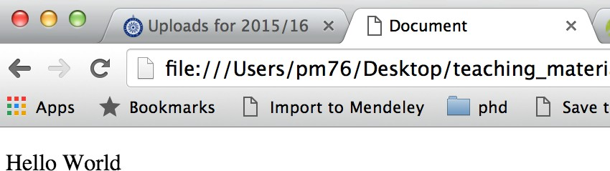
Inner html in a browser

Slide 14
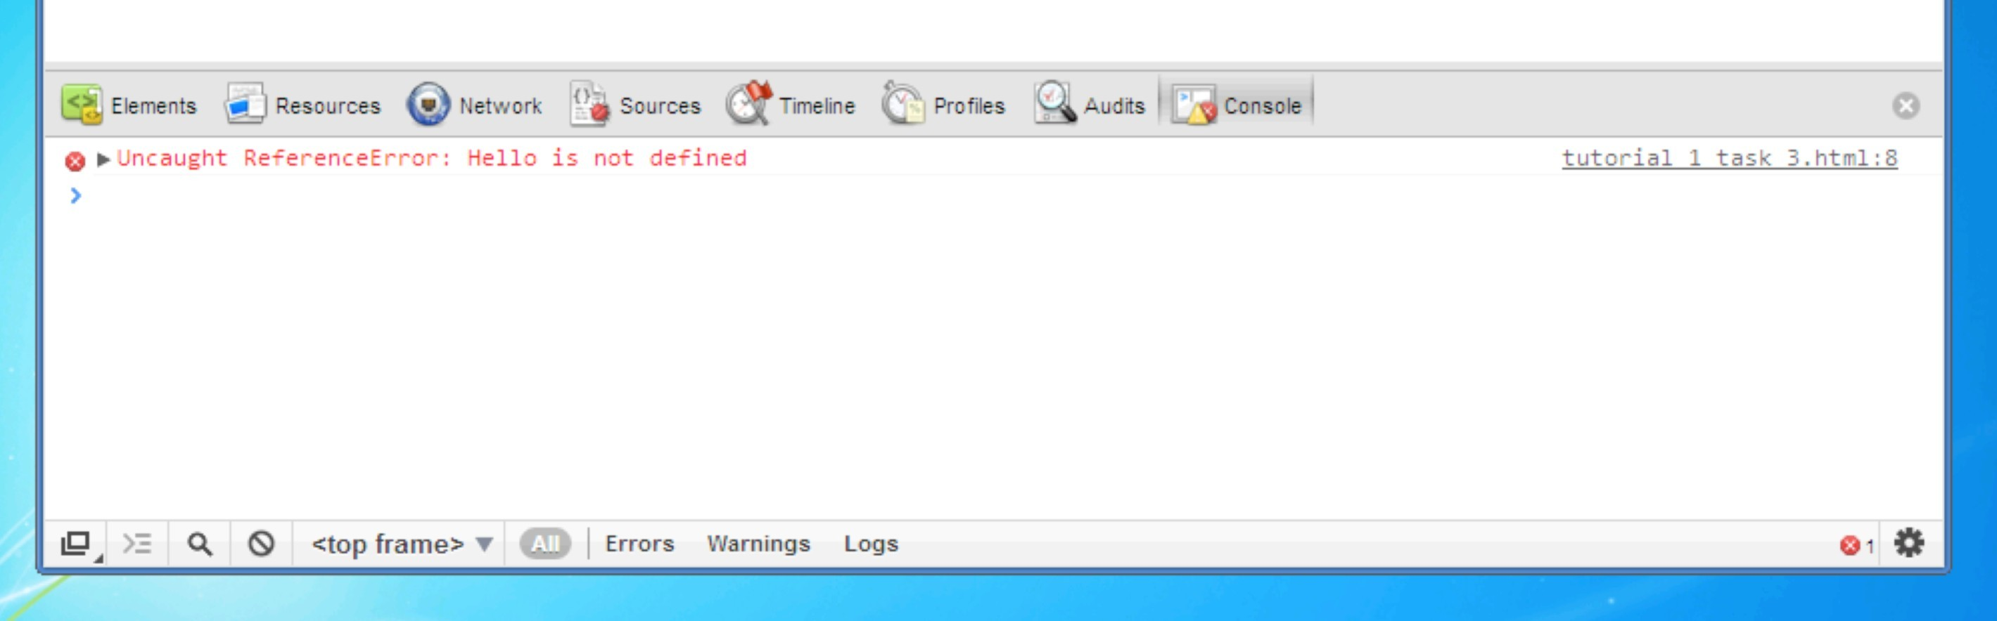
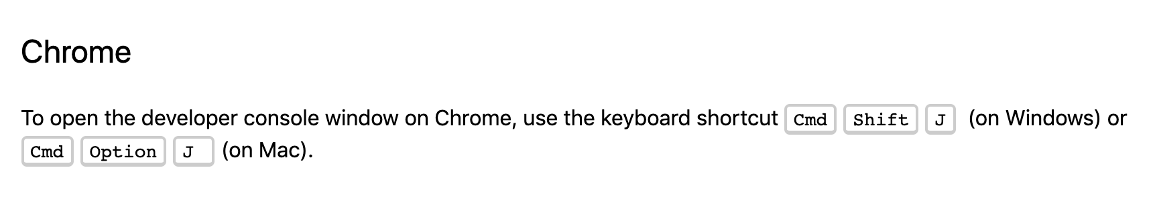
Debugging
Access the Console in your browser

Slide 15
Variables

Slide 16
Tells JavaScript this is a variable
Variable name (Some are reserved).
Variable names in lowercase
var message = “Hello”; console.log(message);
Outputs the contents of the variable message
Puts the word Hello into the variable message

Slide 17
Numbers don’t have quotes
Puts the number 29 into the variable age
var age = 29;
console.log(age);

Slide 18
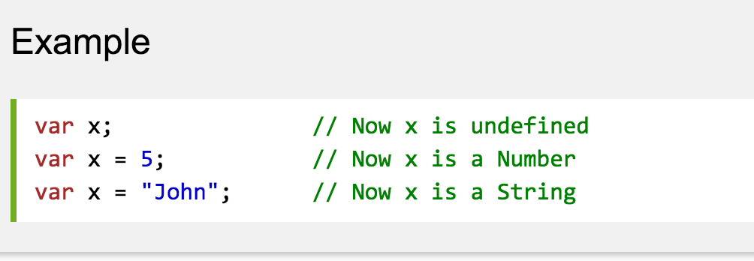
“JavaScript has dynamic data types, This means the same variable can be used as different types.”
http://www.w3schools.com/js/js_datatypes.asp

Slide 19
Variable names - summary
Must begin with a letter, $ or _ Can’t start with a number.
Can contain letters, numbers, $ and _ Can’t contain a hyphen (-) or full stop (.)
Cannot use reserved words as they ‘do something’ in the language – full list:
http://www.w3schools.com/js/js_reserved.asp
Variable names are case sensitive ‘dog’ and Dog’ are different.
Use names that describe the information the variable stores.
If using more than one word use a Capital letter for each word after the first ( camelCase – camelCaps ) or use underscores (not hyphens) to join words.

Slide 20
Concatenation
“Concatenation (from Latin concatenare, to link together) is taking two or more separately located things and placing them side-by-side next to each other so that they can now be treated as one thing.
In computer programming two or more character strings can be concatenated for the purpose of saving space or so that they can be addressed as a single item.”
In JavaScript you use the + symbol
“string1” + “string2” + variable3 + “ ”

Slide 21

Comments
// ………

Slide 22
Crash course continues
As I have said this module will be focused on JavaScript, but when we begin using Vue.js (which is clearly written in JavaScript), I will discuss the code as we get to it.
I can’t stress enough the importance of working through some W3schools tutorials in your own time.

Slide 23
let vs const vs var
I highly recommend you read this section
https://www.w3schools.com/js/js_variables.asp
Always declare JavaScript variables with var, let, or const.
The var keyword is used in all JavaScript code from 1995 to 2015.
The let and const keywords were added to JavaScript in 2015.
If you want your code to run in an older browser, you must use var.

Slide 24
const
The const keyword was introduced in ES6 (2015).
Variables defined with const cannot be Redeclared.
Variables defined with const cannot be Reassigned.
Variables defined with const have Block Scope.
As a general rule, always declare a variable with const unless you know that the value will change. Use const when you declare:
A new Array, a new Object or a new Function

Slide 25
let
The let keyword was introduced in ES6 (2015).
Variables defined with let cannot be Redeclared.
Variables defined with let must be Declared before use.
Variables defined with let have Block Scope.
https://www.freecodecamp.org/news/understanding-let-const-and-var-keywords/

Slide 26
?

