Slide 1
COMP 1842
Week1 - Part 1 – Introduction
Matt Prichard

Slide 2
Introduction
Module overview
JS frameworks?
HTML5 + CSS
The DOM

Slide 3
Welcome back
What have we (you) all learned from term 1?
Time / stress management
Attendance / punctuality
Multitasking
Little and often / time boxing
Pomodoro Technique

Slide 4

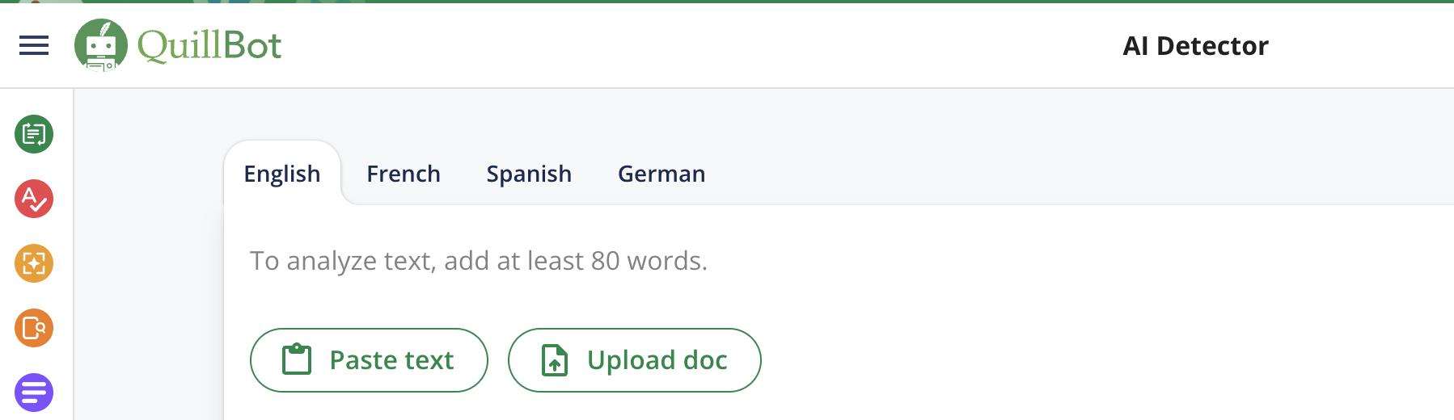
https://gptzero.me/
https://quillbot.com/ai-content-detector

Slide 5
Module overview
We are not using the I Drive – work on the G Drive now.
Will be looking at JS stacks (more on this later in the module).
1 coursework worth 100% in two main parts
I will go through the CW spec in due course
There will be no report but a video instead - yay

Slide 6
Module aims
This module provides students with an introduction to the MEVN Stack. It is one of the modern free open-source JavaScript based stacks used to build single page, multi-page as well as complex dynamic web applications. The stack consists of MongoDB, Express.js, Vue.js and Node.js Students will gain an introduction to these technologies while developing a very simple CRUD web application (much more basic than the PHP one)

Slide 7

Bit of a warning
Although initially this all looks manageable as essentially we are using one language, JavaScript, I can assure you that this is tricky stuff.
As we go through the module I will try and contextualise it to last terms PHP work although this is really quite different.
Also, I have been a full-time lecturer now for around 18 years and gave up doing live client work some time ago, long before these technologies took hold.
Therefore, I have less of a real-world background here than with PHP

Slide 8
Some background

Slide 9
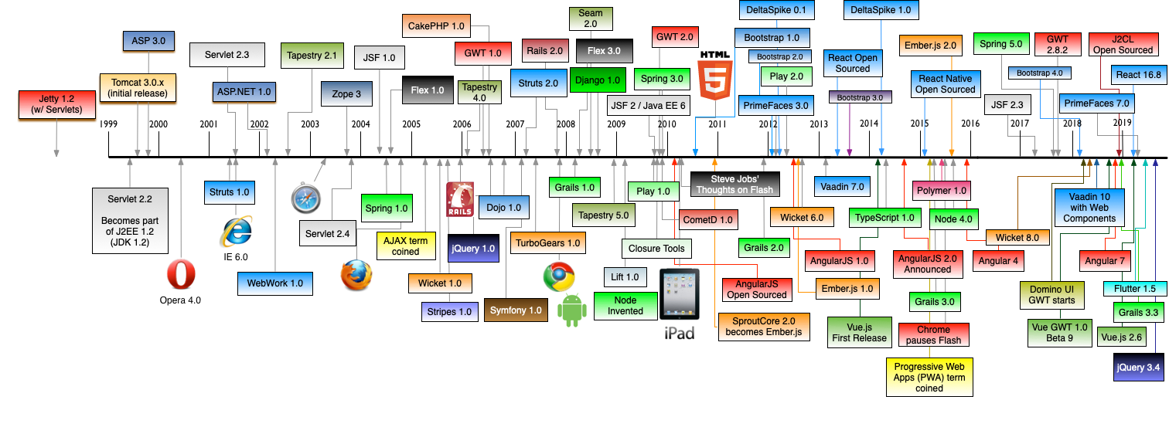
A history of web frameworks
https://raw.githubusercontent.com/mraible/history-of-web-frameworks-timeline/master/history-of-web-frameworks-timeline.png

Slide 10

https://www.youtube.com/watch?v=VbvMJUpY0a4

Slide 11
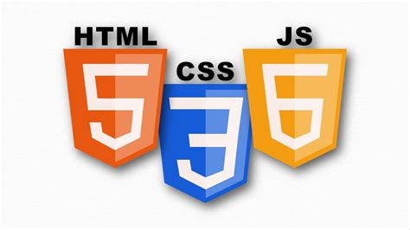
The big 3

Slide 12
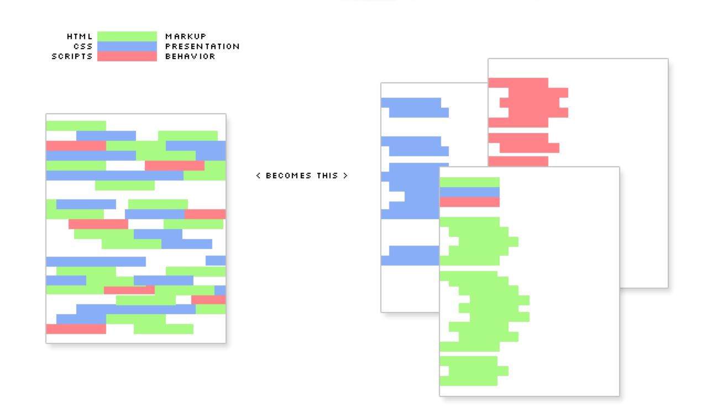
Recap – html, css, js
index.html
mystyle.css
myscript.js

Slide 13
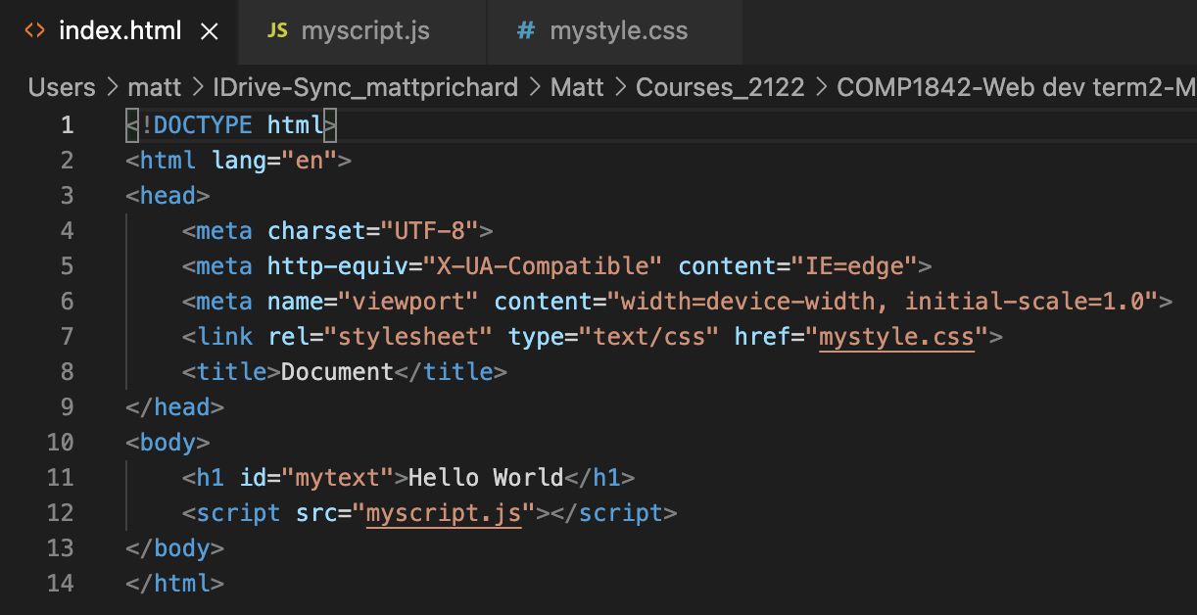
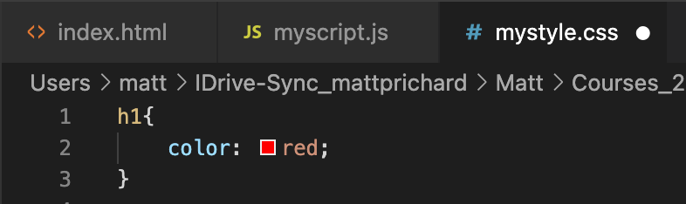
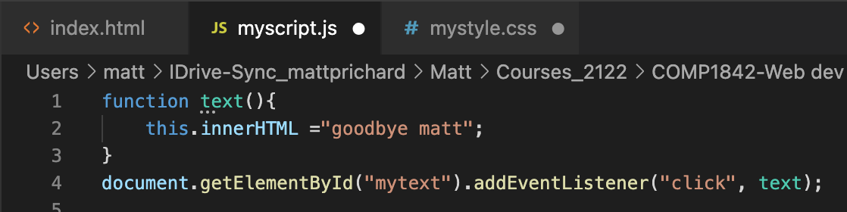
week1/index.html

Slide 14
Remember
HTML is a combination of approaches that gives us the ability to:
Describe the structure of pages/text. This is the markup part
Link to and from other documents using the text of the page itself. This is the hypertext part.
CSS is the language we use to style an HTML document.
CSS describes how HTML elements should be displayed.

Slide 15
Document Object Model
When a web page is loaded, the browser creates a Document Object Model of the page.
The HTML DOM model is constructed as a tree of Objects:
With the object model
JavaScript can change all the HTML elements in the page
JavaScript can change all the CSS styles in the page
JavaScript can remove existing HTML elements and attributes
JavaScript can add new HTML elements and attributes

Slide 16
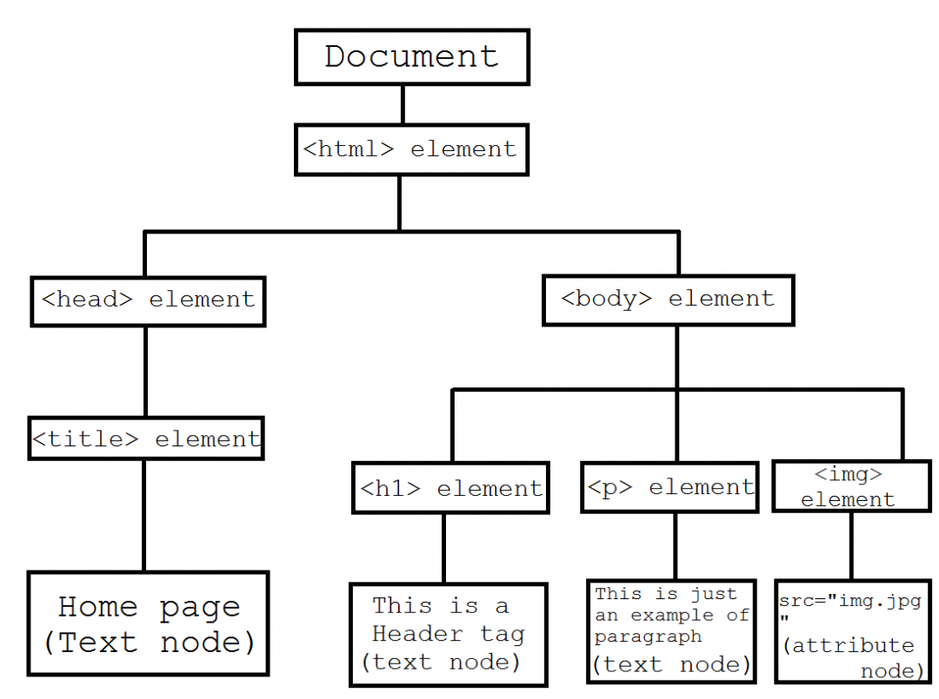

Slide 17
What is the HTML DOM?
The HTML DOM is a standard object model and programming interface for HTML. It defines:
The HTML elements as objects
The properties of all HTML elements
The methods to access all HTML elements
The events for all HTML elements
In other words: The HTML DOM is a standard for how to get, change, add, or delete HTML elements.

Slide 18
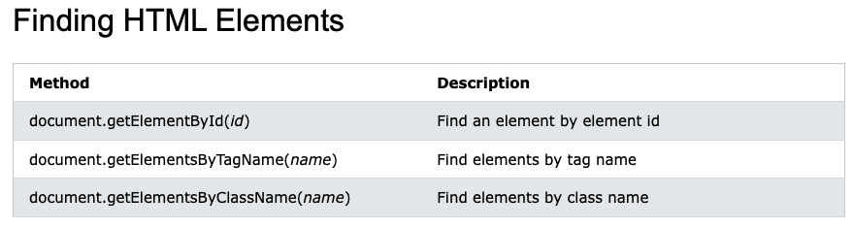
The HTML DOM document object
The document object represents your web page.
If you want to access any element in an HTML page, you always start with accessing the document object.
Below are some examples of how you can use the document object to access HTML

Slide 19
?

