Slide 1
COMP 1842
Introduction to NoSQL
Matt Prichard

Slide 2
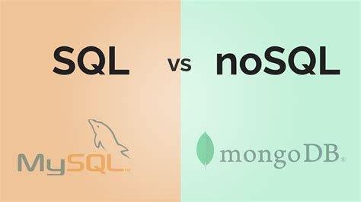
Introduction
SQL vs NoSQL
Scaling
MongoDB

Slide 3
SQL recap
It is a query language that allows retrieving specific data from databases.
A relational database is a type of database (usually organized into tables) that enables the recognition and access of data in relation to another piece of data within the same database.
In other words, it stores related data across multiple tables, which are organized into columns and rows, and allow the user to query data (or information) from various tables simultaneously.

Slide 4
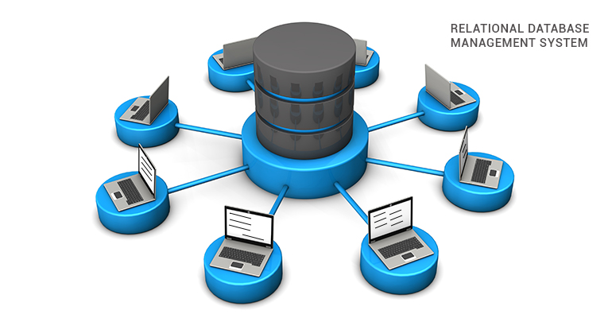
RDBMS
A relational database is a database that follows
the relational model of data. To maintain a relational
database, a Relational Database Management System (RDBMS) is used.
SQL is a language that allows for communication with data in an RDBMS.
An important clarification is that SQL is not a database system itself. When comparing SQL vs NoSQL, the main differences being assessed are relational databases vs non-relational databases

Slide 5
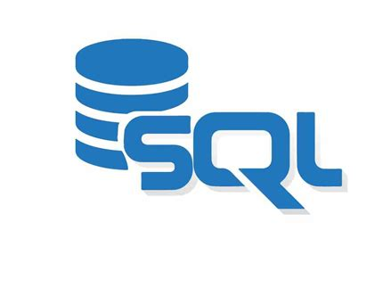
SQL
Another aspect to consider is that SQL is not the only programming language able to query relational databases, but it is definitely the most popular one.
Therefore, the terms "SQL databases" and "relational databases" are often interchangeably used. MySQL, PostgreSQL, Microsoft SQLServer
and Oracle Database are among the most well-known RDBMS using SQL.

Slide 6
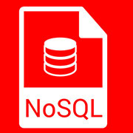
What is NoSQL ?
NoSQL refers to non-relational databases and to distributed databases. NoSQL can also stand for "Not Only SQL" to highlight that some NoSQL systems may also support SQL query language.
In fact, before moving on it is important to keep in mind that NoSQL does not necessarily mean that a database does not support SQL.
Instead, it means that the database is not an RDBMS or in other words a non-relational database.

Slide 7
Brief history
NoSQL databases emerged in the late 2000s as the cost of storage dramatically decreased, removing the need to create a complex, difficult-to-manage data models in order to avoid data duplication.
Cloud computing also rose in popularity, and developers began using public clouds to host their applications and data. They wanted the ability to distribute data across multiple servers and regions to make their applications resilient, to scale out instead of scale up.

Slide 8
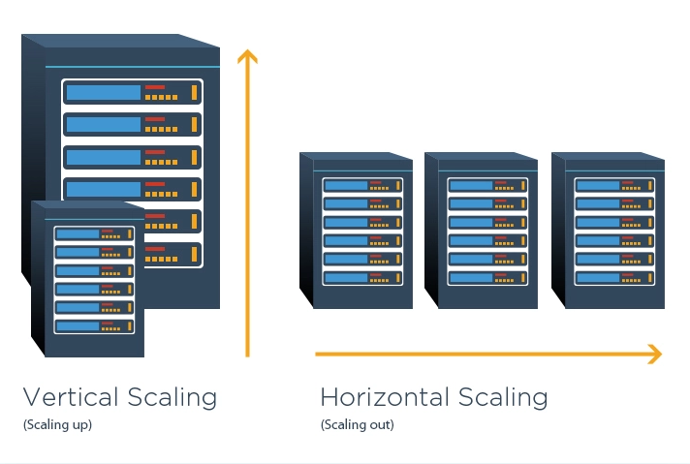
Scaling

Slide 9
What is scaling
If an application can handle a maximum of 'x' requests simultaneously. As soon as this number exceeds x ( say, x+1), critical hardware resources are exhausted, and the application cannot process further requests. Scaling refers to the adjustments made to system hardware resources to handle increased traffic and requests. This could be in the form of:
Adjustments to network bandwidth
Upgrades to CPU capacity and physical memory
Basic hard drive alterations

Slide 10
Vertical scaling
It is defined as the process of increasing the capacity of a single machine by adding more resources such as memory, storage, etc. to increase the throughput of the system. No new resource is added, rather the capability of the existing resources is made more efficient. This is called Vertical scaling. Vertical Scaling is also called the Scale-up approach.
Example: MySQL

Slide 11
Advantages of Vertical Scaling
It is easy to implement
Reduced software costs as no new resources are added
Fewer efforts required to maintain this single system
Disadvantages of Vertical Scaling
Single-point failure
Since when the system (server) fails, the downtime is high because we only have a single server
High risk of hardware failures

Slide 12
Horizontal scaling
The process of adding more instances of the same type to the existing pool of resources and not increasing the capacity of existing resources like in vertical scaling. Horizontal Scaling is also called the Scale-out approach.
In this process, the number of servers is increased and not the individual capacity of the server. A Load Balancer routes the user requests to different servers according to the availability of the server. Thereby, increasing the overall performance of the system. In this way, the entire process is distributed among all servers rather than just depending on a single server. Example: NoSQL, Cassandra, and MongoDB

Slide 13
Advantages of Horizontal Scaling
There is no single point of failure in this kind of scale because there are multiple servers. So if any one fails then there will be other servers for backup.
Low Latency: Latency refers to how late or delayed our request is being processed.
Built-in backup
Disadvantages of Horizontal Scaling
Not easy to implement as there are a number of components needed
Cost is high
Networking components like, routers and load balancer are required

Slide 14
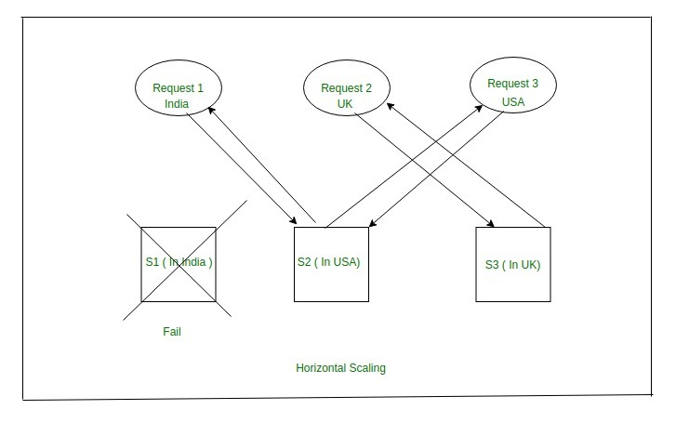
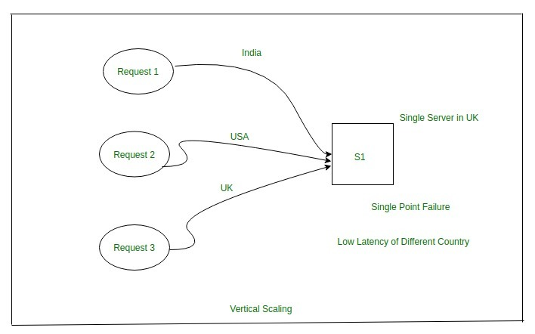

Slide 15
Back to NoSQL
Each NoSQL database has its own unique features. At a high level, many NoSQL databases have the following features:
Flexible schemas – next slide
Horizontal scaling
Fast queries due to the data model – next slide but one
Ease of use for developers

Slide 16
Flexible Schema
Unlike SQL databases, where you must determine and declare a table's schema before inserting data, MongoDB's collections, by default, do not require their documents to have the same schema. That is:
The documents in a single collection do not need to have the same set of fields and the data type for a field can differ across documents within a collection.
Ability to change the structure of the documents in a collection, such as add new fields, remove existing fields, or change the field values to a new type, update the documents to the new structure.

Slide 17
Fast Queries
Queries in NoSQL databases can be faster than SQL databases. Why?
Data in SQL databases is typically normalized, so queries for a single object or entity require you to join data from multiple tables. As your tables grow in size, the joins can become expensive. However, data in NoSQL databases is typically stored in a way that is optimized for queries.
The rule of thumb when you use MongoDB is Data that is accessed together should be stored together. Queries typically do not require joins, so the queries are very fast.

Slide 18
Types of NoSQL databases
Over time, four major types of NoSQL databases emerged:
Document databases - store data in documents similar to JSON (JavaScript Object Notation) objects. Each document contains pairs of fields and values. The values can typically be a variety of types including things like strings, numbers, booleans, arrays, or objects.
Key-value databases - are a simpler type of database where each item contains keys and values.
Wide-column stores - store data in tables, rows, and dynamic columns.
Graph databases - store data in nodes and edges. Nodes typically store information about people, places, and things, while edges store information about the relationships between the nodes. Neo4j seems to be a big player.

Slide 19
RDBMS vs NoSQL: Data Modelling Example
Let's consider an example of storing information about a user and their hobbies. We need to store a user's first name, last name, phone number, city, and hobbies.
In a relational database, we'd likely create two tables: one for Users and one for Hobbies.

Slide 20
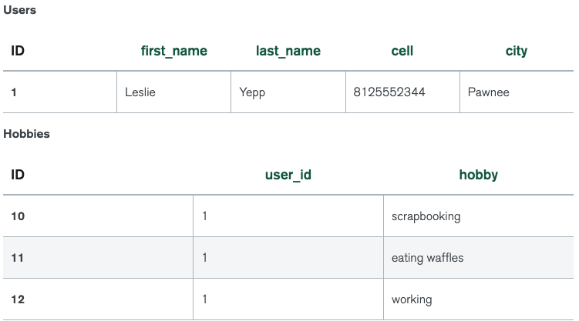
In order to retrieve all of the information about a user and their hobbies, information from the Users table and Hobbies table will need to be joined together.

Slide 21
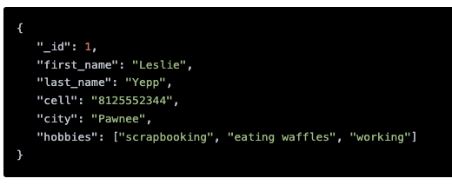
How to store the same information about a user and their hobbies in a document database like MongoDB. – look familiar ?
In order to retrieve all of the information about a user and their hobbies, a single document can be retrieved from the database. No joins are required, resulting in faster queries.

Slide 22
When should NoSQL be used?
When deciding which database to use, decision-makers typically find one or more of the following factors lead them to selecting a NoSQL database:
Fast-paced Agile development
Storage of structured and semi-structured data
Huge volumes of data
Requirements for scale-out architecture
Modern application paradigms like microservices and real-time streaming

Slide 23

https://www.mongodb.com/
https://docs.mongodb.com/guides/
MongoDB is a source-available, cross-platform, document-oriented database program. Classified as a NoSQL database program, MongoDB uses JSON-like documents with optional schemas. MongoDB is developed by MongoDB Inc.

Slide 24
Basic terminology

Slide 25
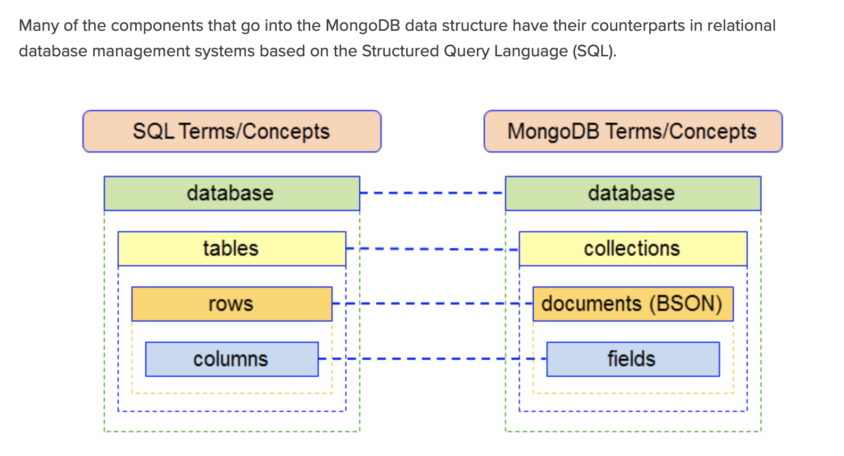

Slide 26
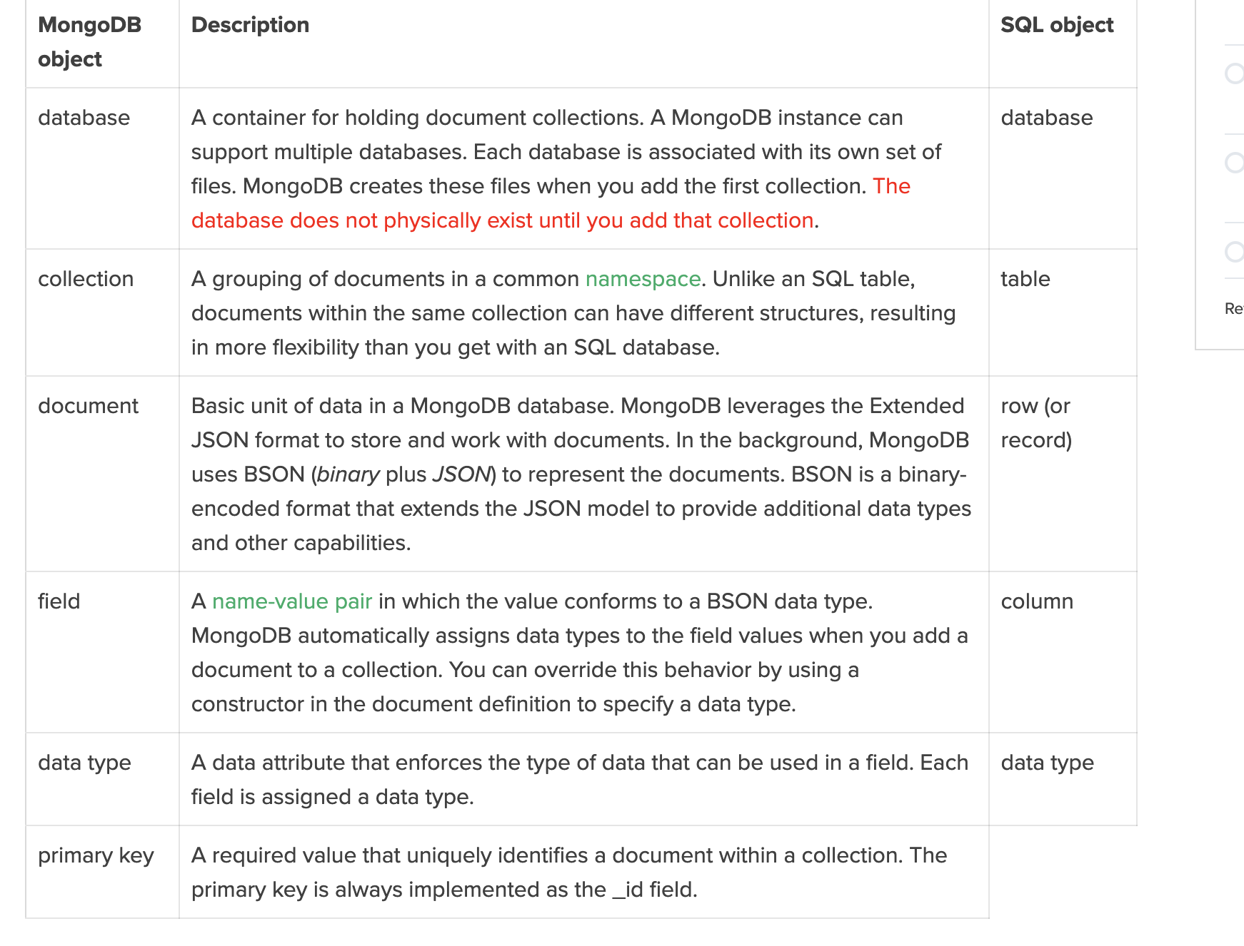

Slide 28
Mapping terms and concepts
The document model – Instead of tables, MongoDB stores data in documents, BSON documents which are a binary representations of JSON documents.
Documents typically store information about one object as well as any information related to that object. Related documents are grouped together in collections. Related collections are grouped together and stored in a database.
https://www.mongodb.com/developer/article/map-terms-concepts-sql-mongodb/

Slide 29
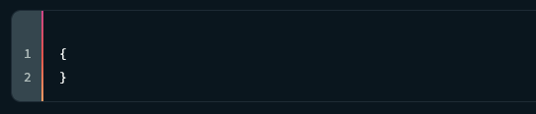
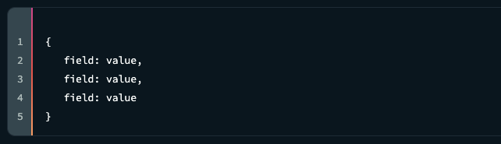
Every document begins and ends with curly braces.
Inside the curly braces, you'll find an unordered set of field/value pairs that are separated by commas..

Slide 30
Field / Values
The fields are strings that describe the pieces of data being stored.
The values can be any of the BSON data types. BSON has a variety of data types including Double, String, Object, Array, Binary Data, ObjectId, Boolean, Date, Null, Regular Expression, JavaScript, JavaScript (with scope), 32-bit Integer, Timestamp, 64-bit Integer, Decimal128, Min Key, and Max Key.
Every document is required to have a field named _id. The value of _id must be unique for each document in a collection and is immutable,

Slide 31
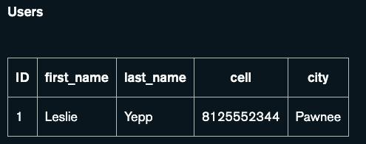
Example Documents
Let's say we need to store information about a user named Leslie. We'll store her contact information including her first name, last name, cell phone number, and city. We'll also store some extra information about her including her location, hobbies, and job history.
Storing Contact Information
Let's begin with Leslie's contact information. When using SQL, we'll create a table named Users. We can create columns
for each piece of contact information
and we'll include an ID column.

Slide 32
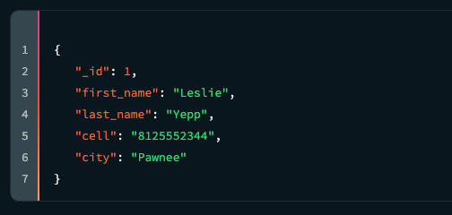
MongoDB version
We create a new document for Leslie where we'll add field/value pairs for each piece of contact information we need to store. We'll use _id to uniquely identify each document. We'll store this document in a collection named Users.

Slide 33
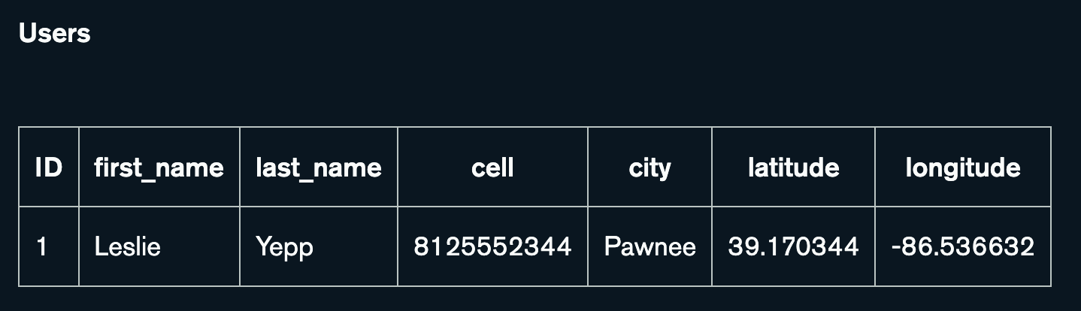
Storing Latitude and Longitude
Now that we've stored Leslie's contact information, let's store the coordinates of her current location.
When using SQL, we'll need to split the latitude and longitude between two columns.

Slide 34
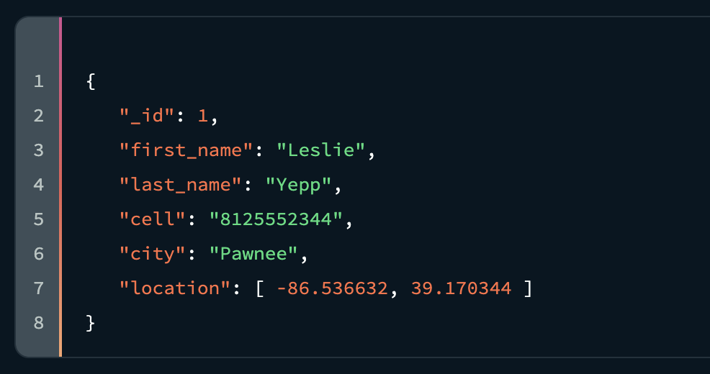
MongoDB version
MongoDB has an array data type, so we can store the latitude and longitude together in a single field.

Slide 35
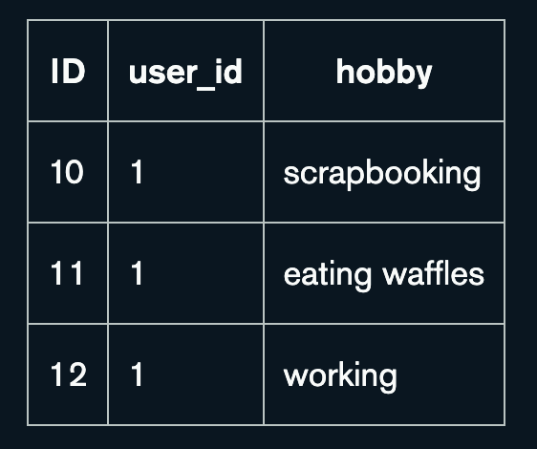
Storing lists of information
Now let's store her hobbies. Since a single user could have many hobbies (meaning we need to represent a one-to-many relationship), we’d create a separate table just for hobbies. Each row in the table will contain information about one hobby for one user. When we need to retrieve Leslie's hobbies, we'll join the Users table and our new Hobbies table.

Slide 36
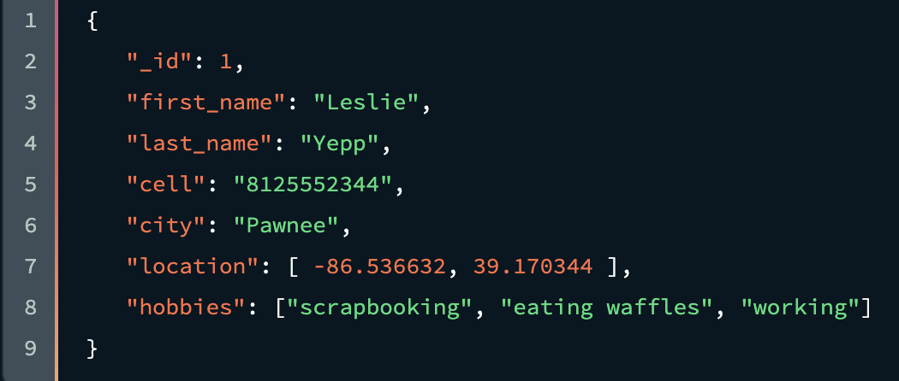
MongoDB version
Since MongoDB supports arrays, we can simply add a new field named "hobbies" to our existing document. The array can contain as many or as few hobbies as we need (assuming we don't exceed the 16 megabyte document size limit). When we need to retrieve Leslie's hobbies, we don't need to do an expensive join to bring the data together; we can simply retrieve her document in the Users collection.

Slide 37
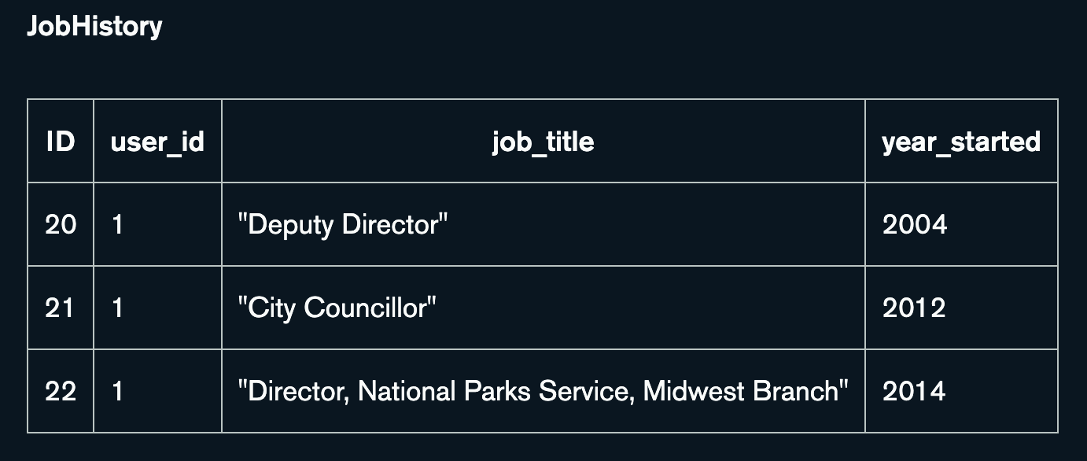
Storing groups of related information
Let's say we also need to store Leslie's job history.
Just as we did with hobbies, we create a separate table just for job history information. Each row in the table will contain information about one job for one user.

Slide 38
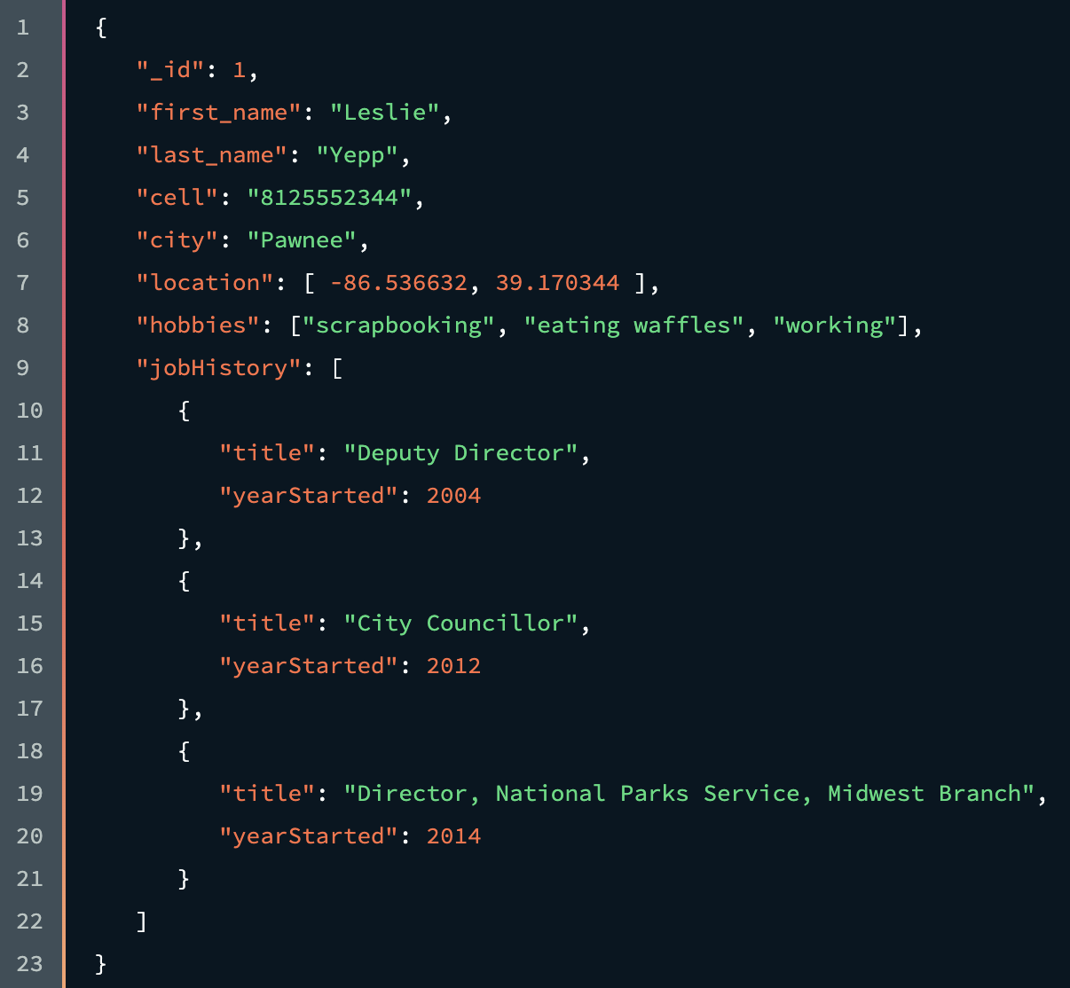
MongoDB version
So far we've used arrays in MongoDB to store geolocation data and a list of Strings. Arrays can contain values of any type, including objects. Let's create a document for each job Leslie has held and store those documents in an array.

Slide 39
Skipping data and adding new info
We find we need to store information about a new user: Lauren. We need to store a lot of the same information about Lauren as we did with Leslie : her first name, last name, city, and hobbies. However, Lauren doesn't have a phone, location data, or job history. We also discover that we need to store a new piece of information: her school.

Slide 40
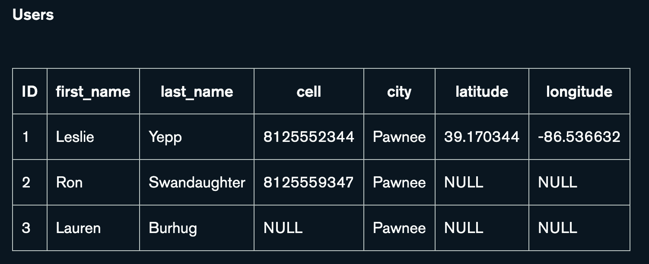
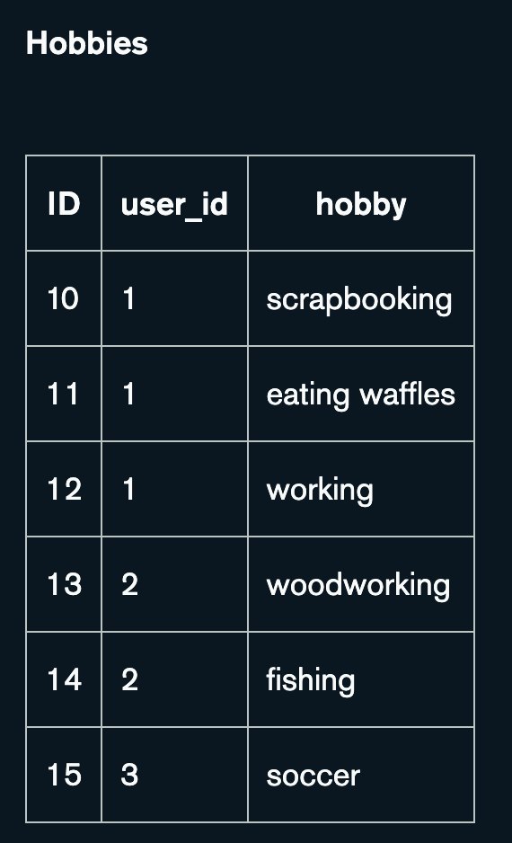
In SQL

Slide 41
Skipping data and adding new info cont
We have two options for storing information about Lauren's school. We can choose to add a column to the existing Users table, or we can create a new table.
Let's say we choose to add a column named "school" to the Users table. Depending on our access rights to the database, we may need to talk to the DBA and convince them to add the field.
Most likely, the database will need to be taken down, the "school" column will need to be added, NULL values will be stored in every row in the Users table where a user does not have a school, and the database will need to be brought back up.

Slide 42
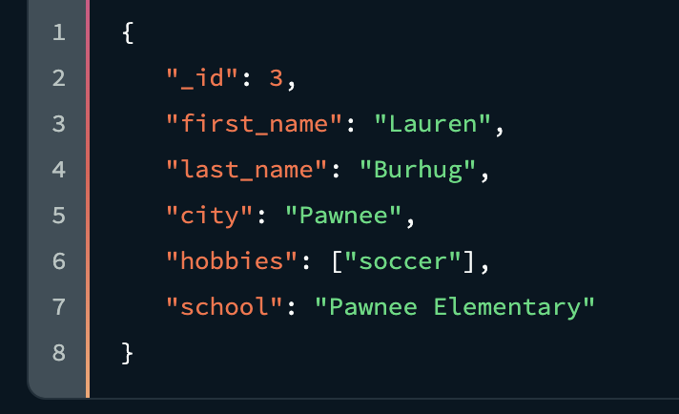
MongoDB version
As you can see below, we've added a new field named "school" to Lauren's document. We do not need to make any modifications to Leslie's document when we add the new "school" field to Lauren's document. MongoDB has a flexible schema, so every document in a collection does not need to have the same fields.
This can be an unsettling idea coming from a strict SQL background where the schema is locked down.

Slide 43
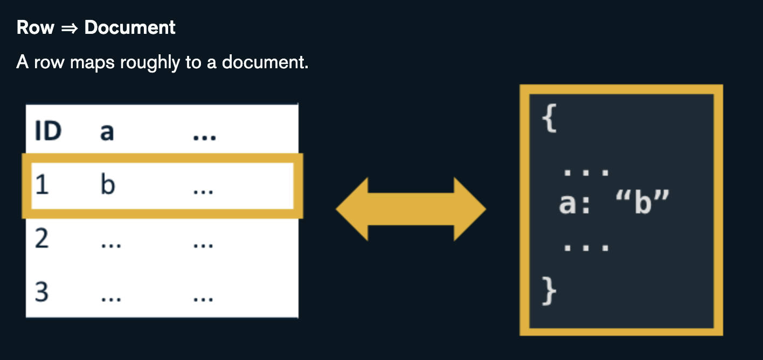
To re-enforce

Slide 44
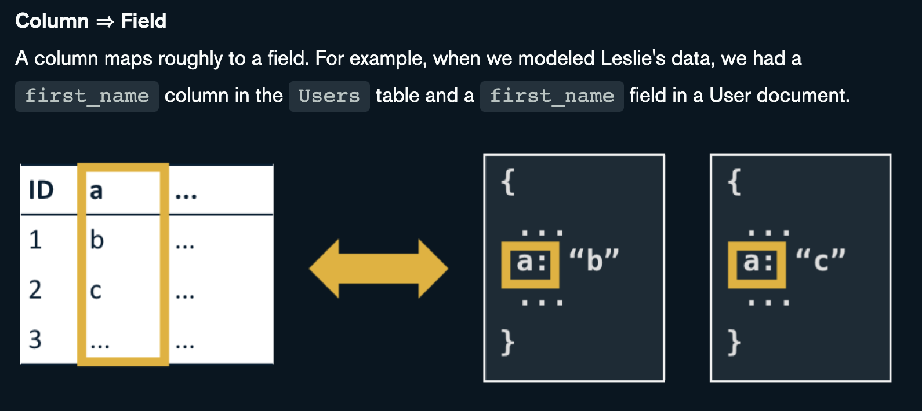
To re-enforce

Slide 45
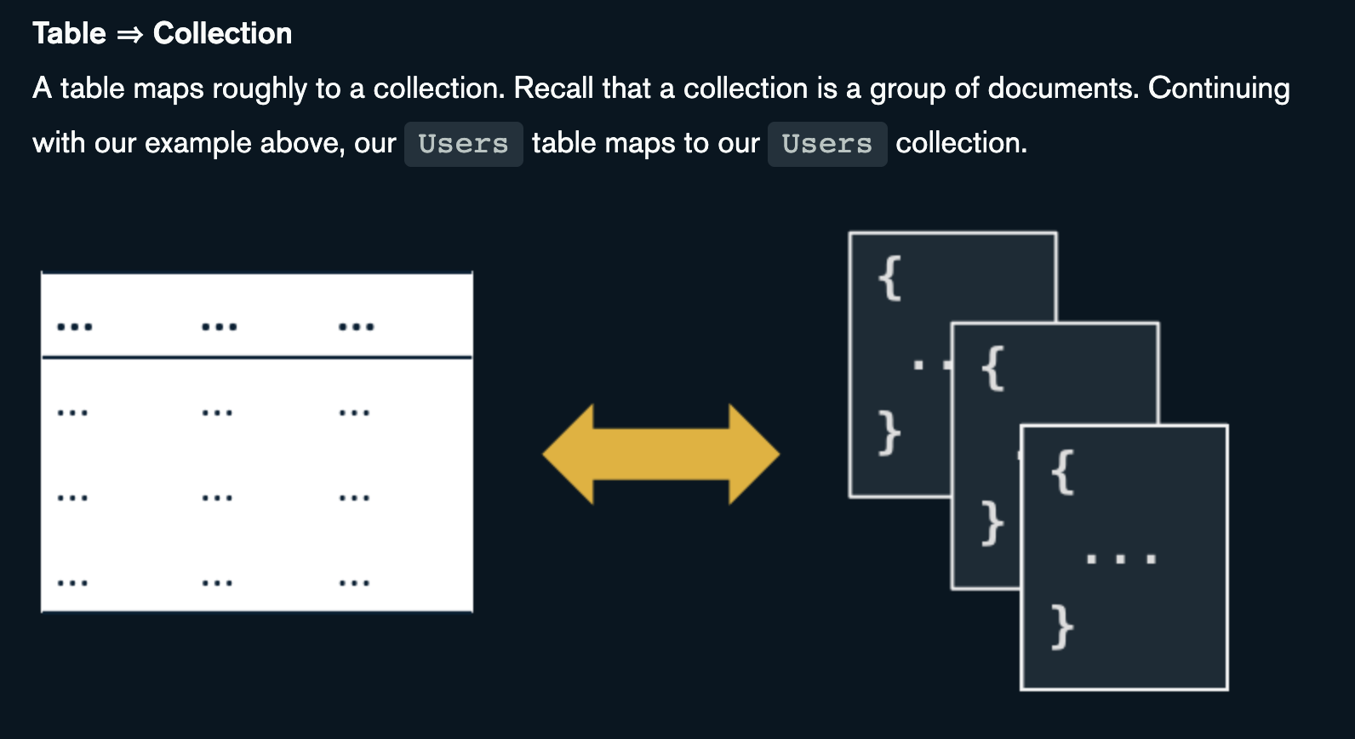
To re-enforce

Slide 46
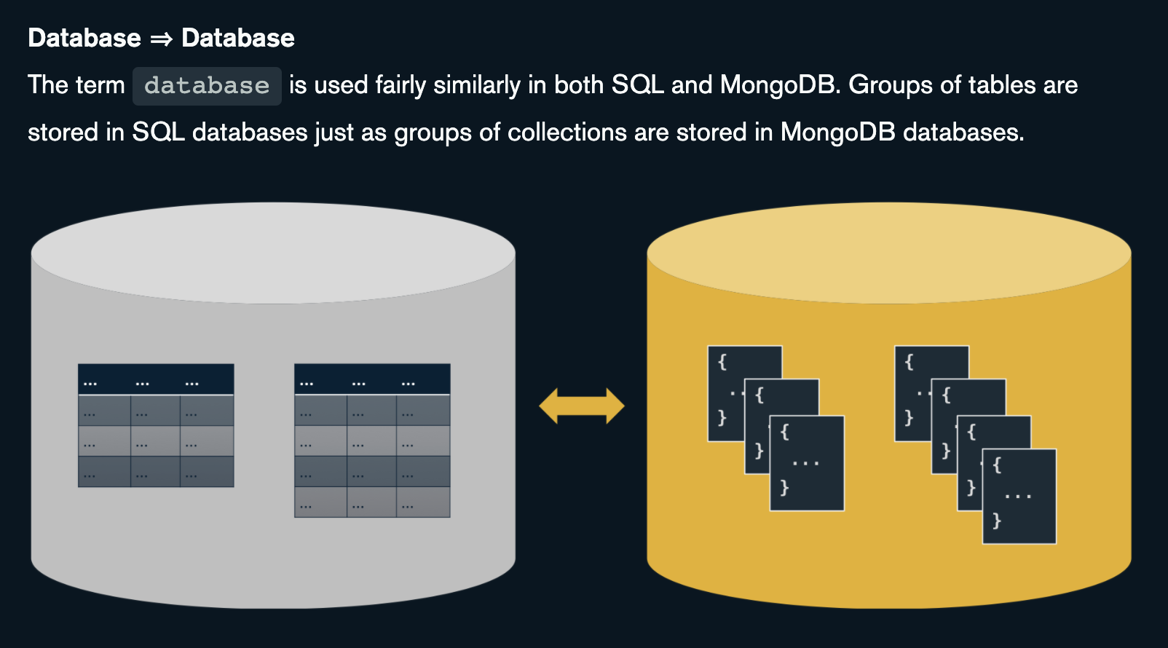
To re-enforce

Slide 47
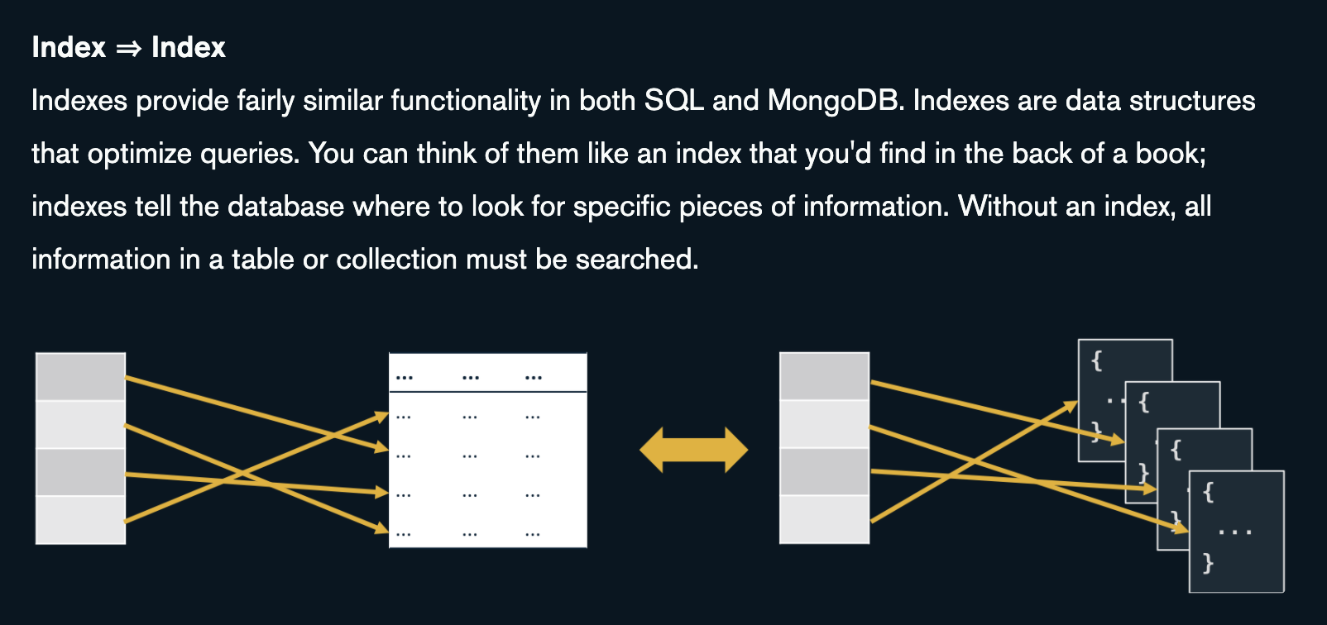
To re-enforce

Slide 48
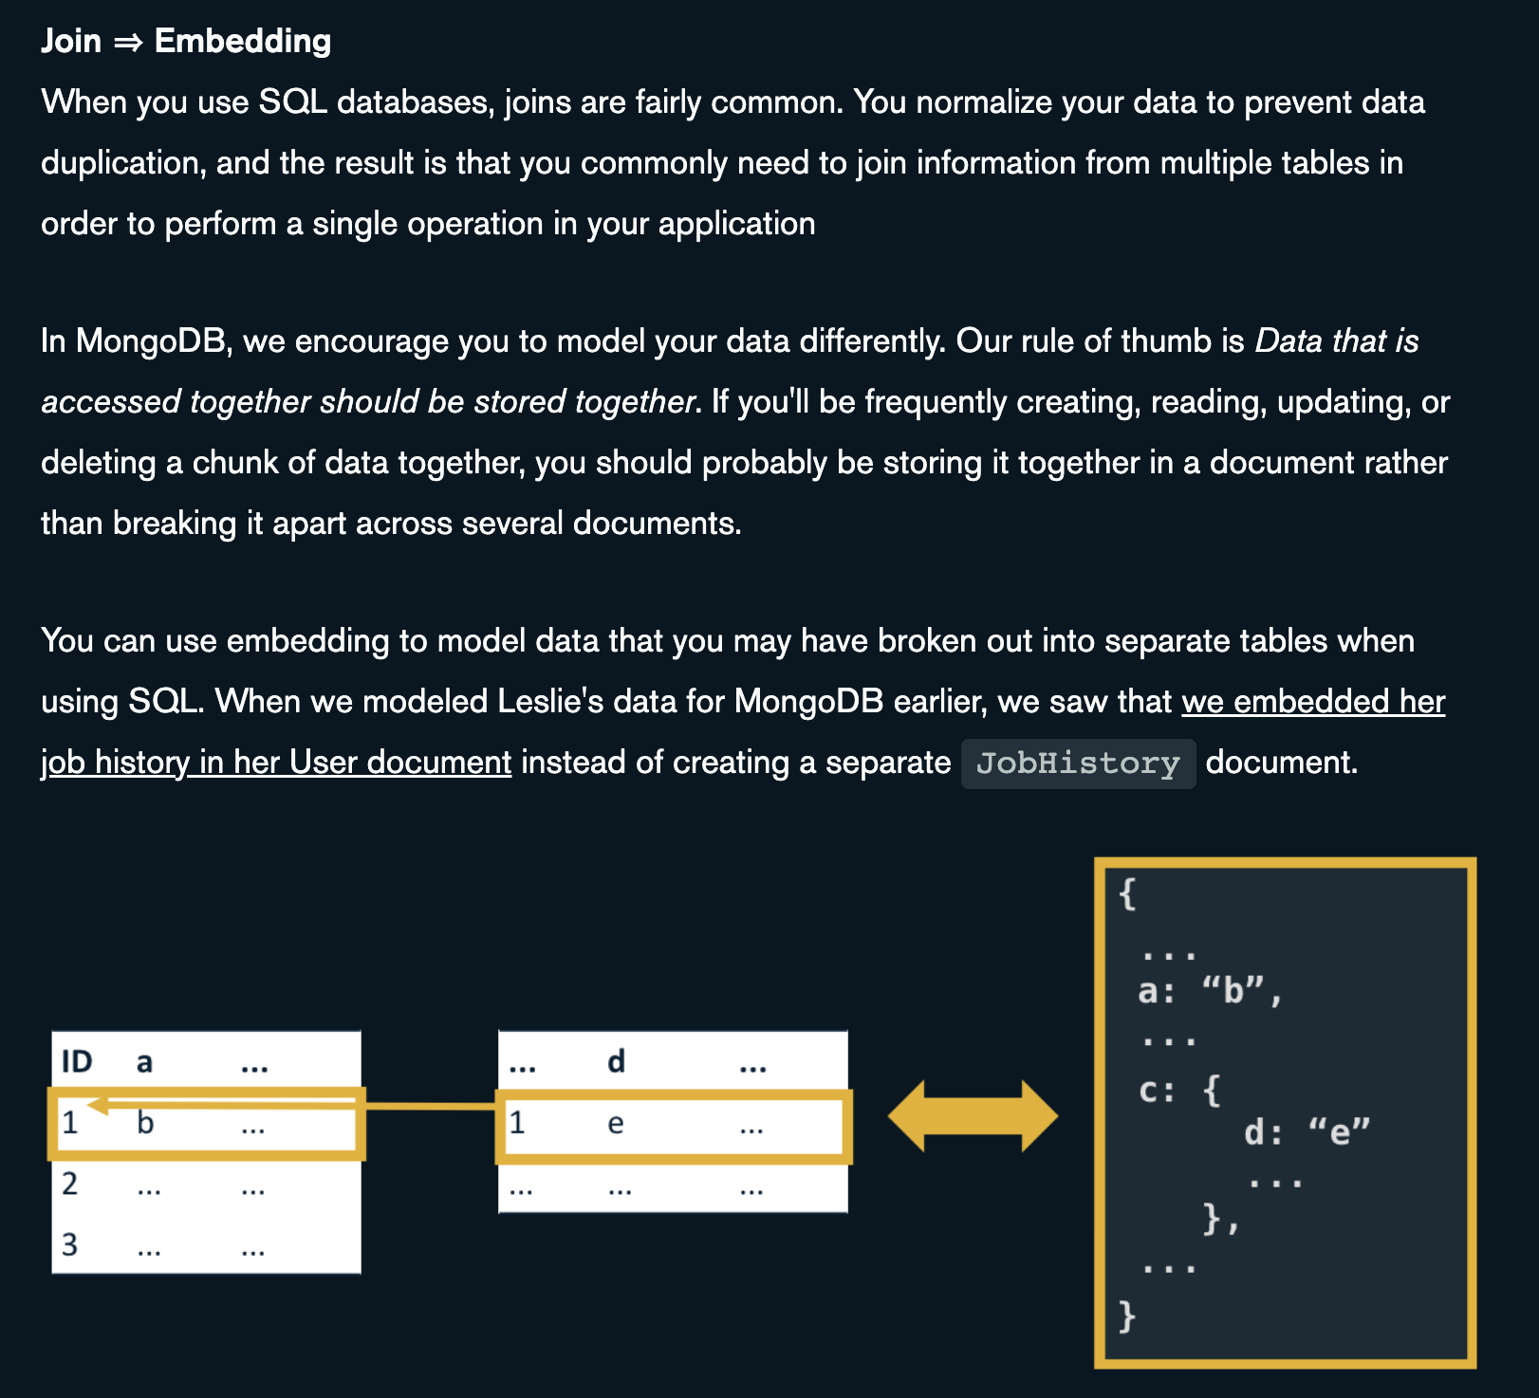

Slide 49
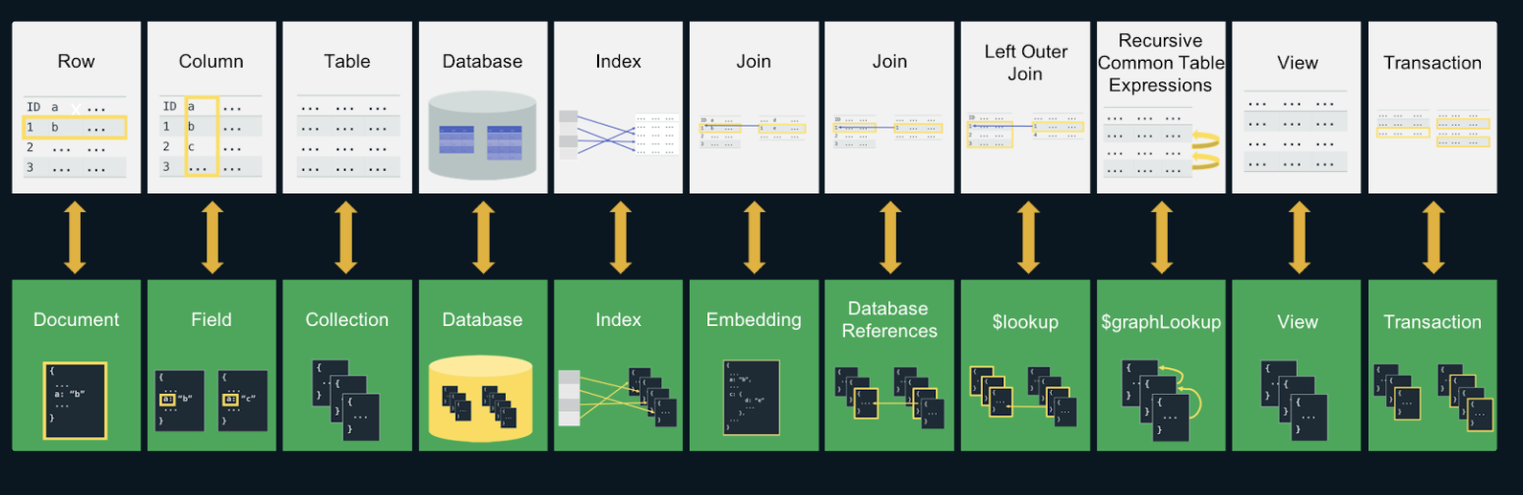
Full article can be found below – I suggest you read it !!
https://www.mongodb.com/developer/article/map-terms-concepts-sql-mongodb/

Slide 50
?

Slide 51
Sources
https://www.imaginarycloud.com/blog/sql-vs-nosql/
https://www.mongodb.com/nosql-explained/nosql-vs-sql
https://www.mongodb.com/nosql-explained
https://www.geeksforgeeks.org/overview-of-scaling-vertical-and-horizontal-scaling/
https://middleware.io/blog/vertical-vs-horizontal-scaling/

