Slide 1
COMP 1842
MongoDB in the labs and Home
Matt Prichard

Slide 2

Introduction
Compass
Demos
Tutorials
Labs

Slide 3
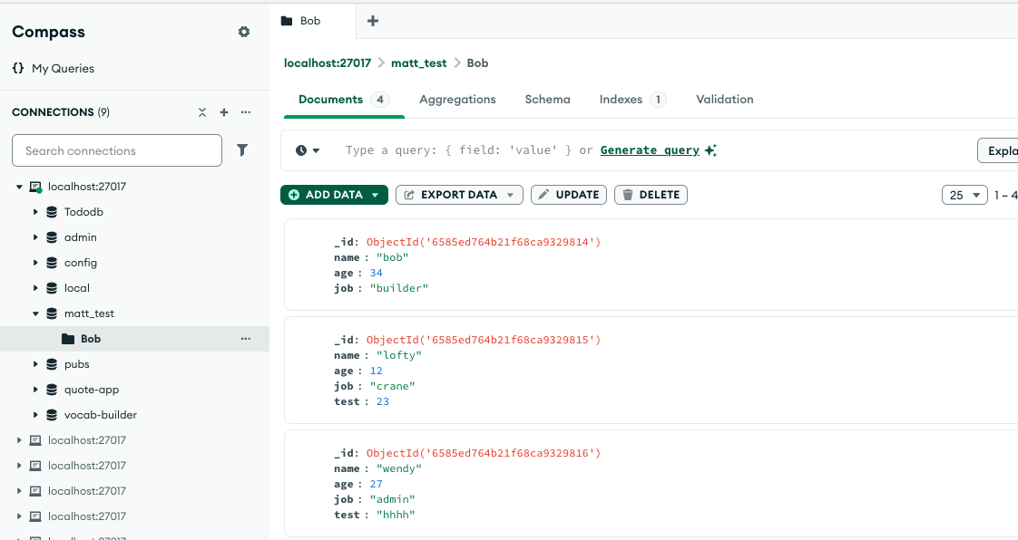
Think…phpMyAdmin for MongoDB

Slide 4
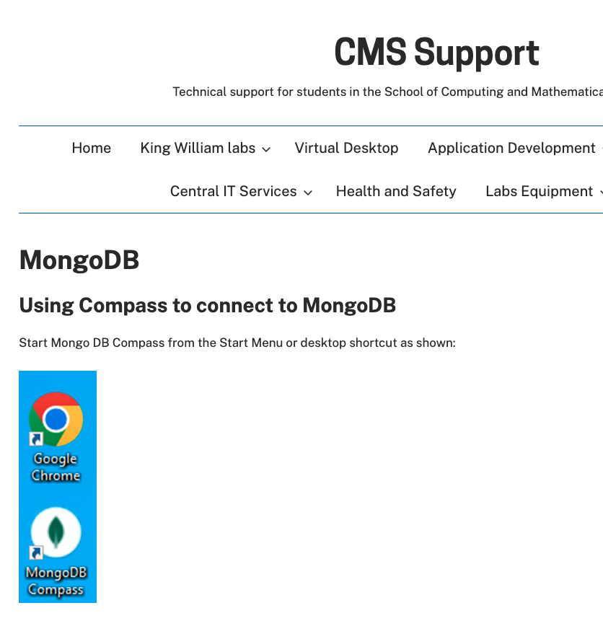
https://blogs.gre.ac.uk/cmssupport/application-development/databases/mongodb/
Follow these CMS instructions for accessing your student MongoDB database
Follow the instructions carefully.
Your student ‘username’ is used for all 3 parts of the authentication.
Do this straight away, Alfie and I will help if needed.
Connection string is:
mongodb://vmp1lstumdb01:27017/

Slide 5
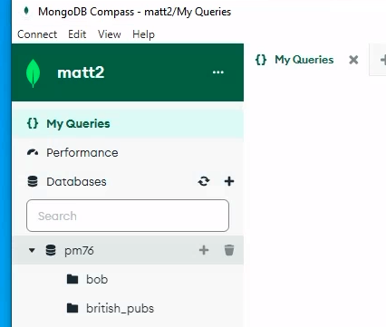
When connected you should see a database with your name on the left, very much like PHPMyAdmin. Mine already has some collections (tables) in it, yours will be empty.

Slide 6
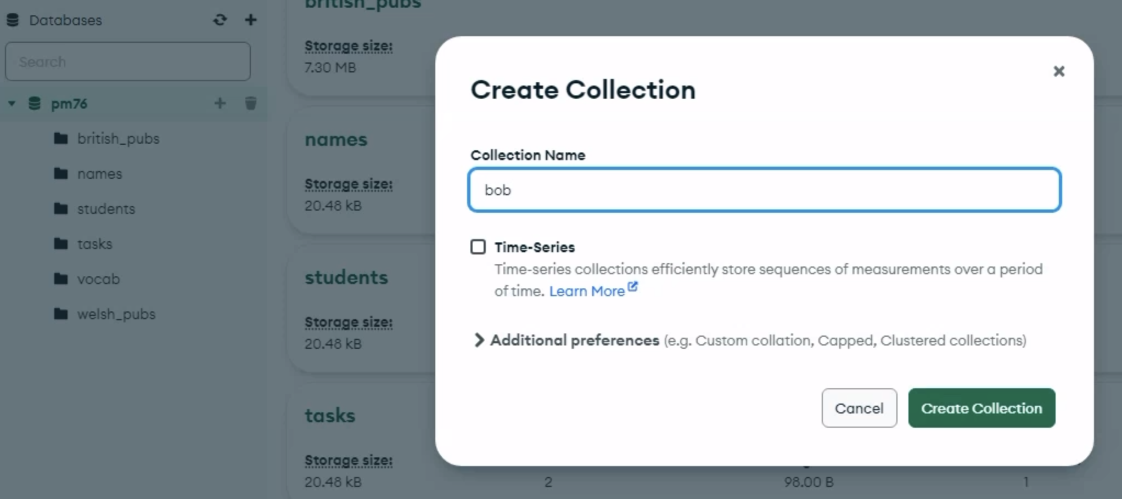
Click the little plus sign next to your database name and name your new collection ‘bob’

Slide 7
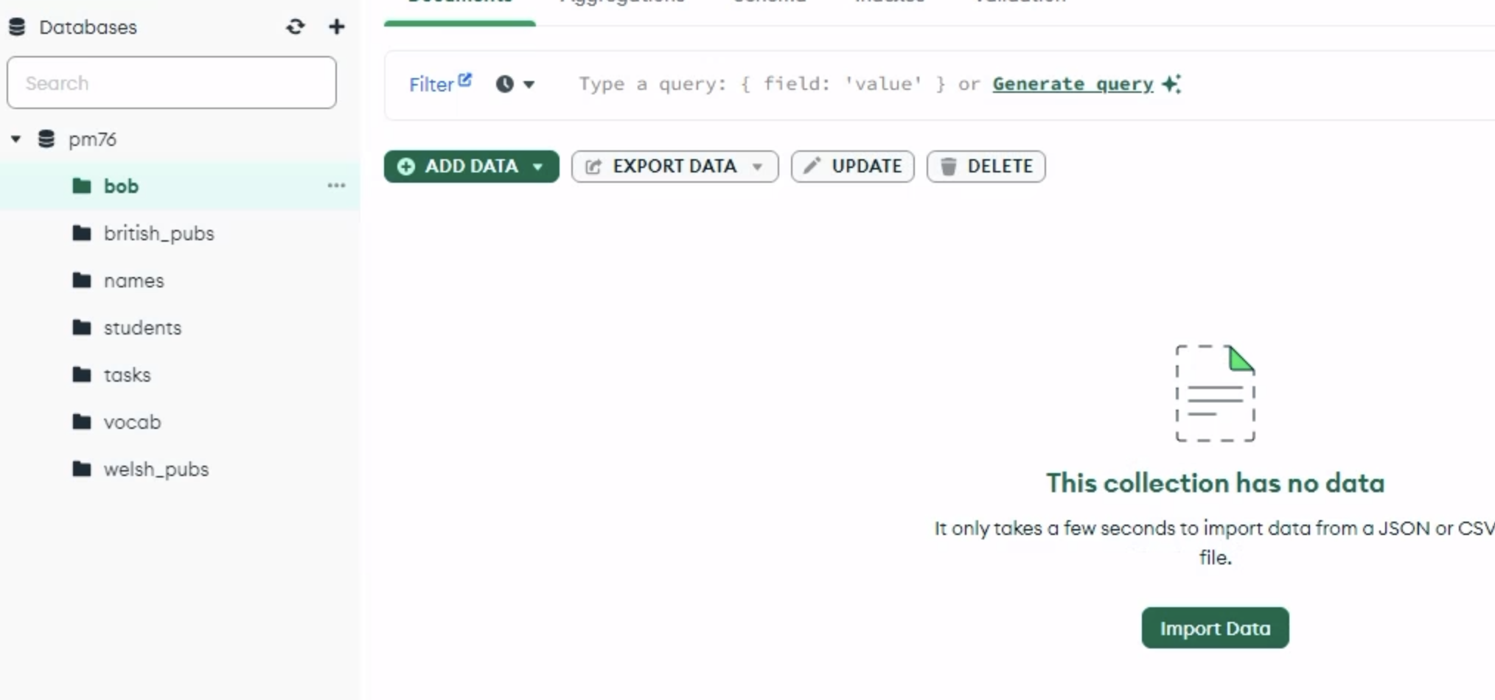
You should now see an import data button, find the bob the builder json file from the bob buikder zip on moodle and import it.

Slide 8
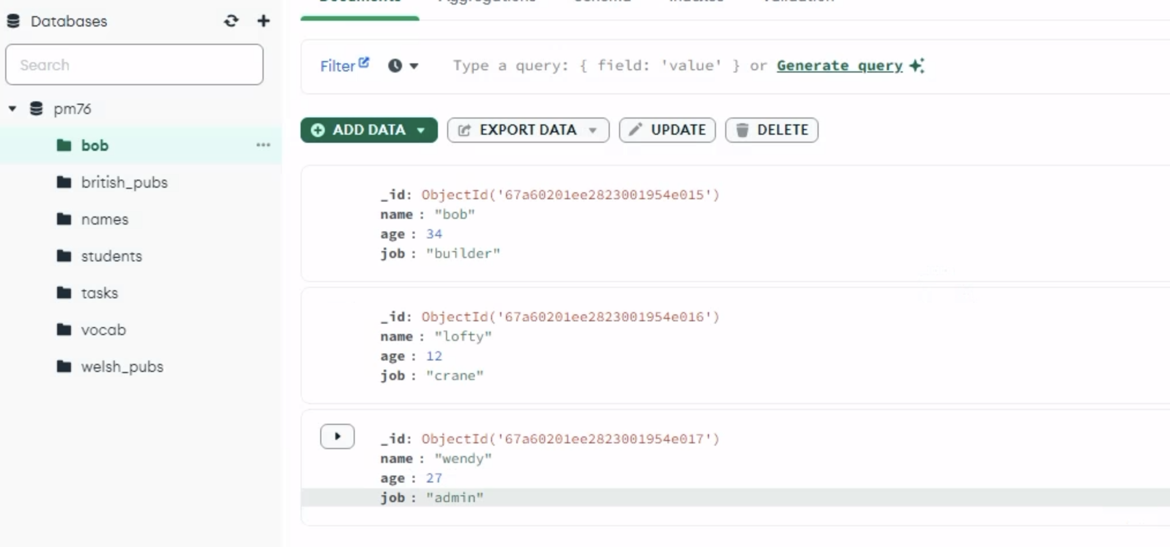
Your imported data – notice a unique _id (or primary key) is generated for you

Slide 9

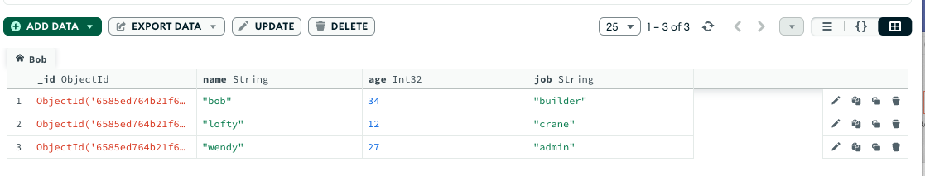
Notice the 3 buttons at the top right of your data window.
They are, List view, JSON view and Table view. Click on them all and see how the view of your data changes.
You will probably feel most comfortable in Table view coming from a MySQL background

Slide 10
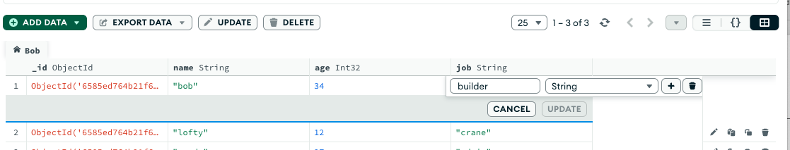
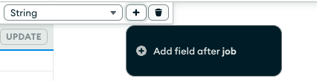

Double click on the word ”builder” and the edit/delete options open. Here we can edit the content or change the data type from the down menu etc. Notice the little plus sign. Click it and click ”Add field after job” call it hourly pay, data type decimal, put a value in

Slide 11
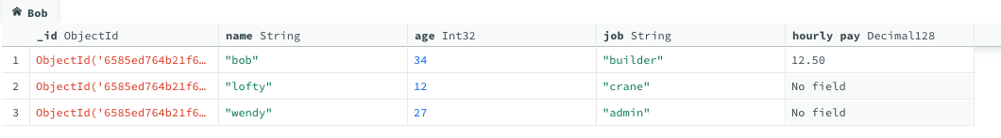
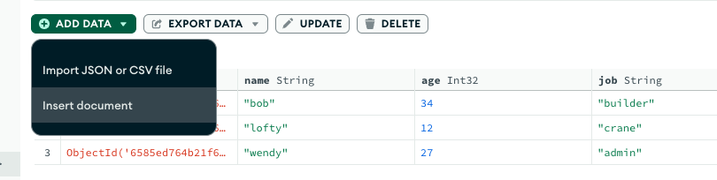
You could now double click “No field” for lofty and add a value. Simple yes… very like PHP MyAdmin
To add a new “row” or document click the green “ADD DATA” button and choose Insert document

Slide 12
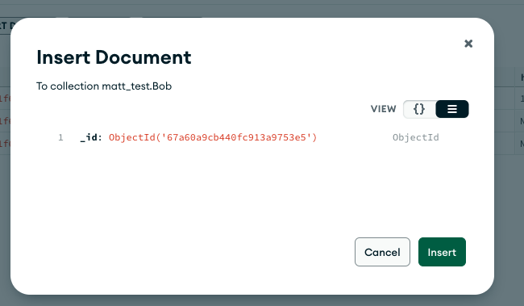
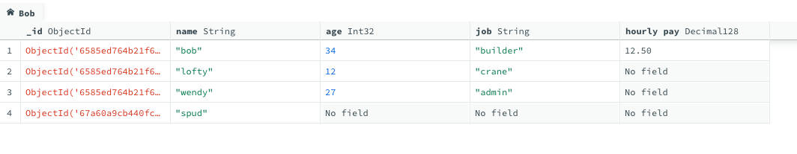
Select the list view button and click insert
A new document is added with a primary key and you could now enter some data as before.

Slide 13
That is the absolute basics of adding, editing and deleting fields, documents and collections. Play around with it for a while, if it goes wrong dump the collection and re import it.
Compass has help files at:
https://www.mongodb.com/docs/compass/current/documents/view/
We don’t need to go into great depth for this module, but get to feel comfortable with the basics and make sure your student account works.

Slide 14
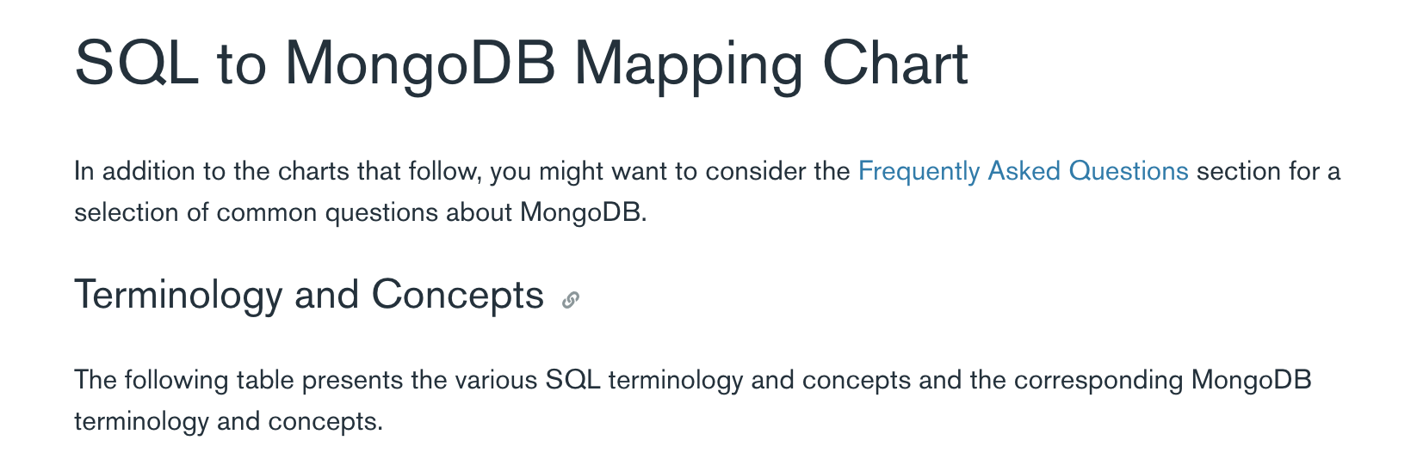
https://docs.mongodb.com/manual/reference/sql-comparison/

Slide 15


Slide 16
MongoDB on localhost at home

Slide 17
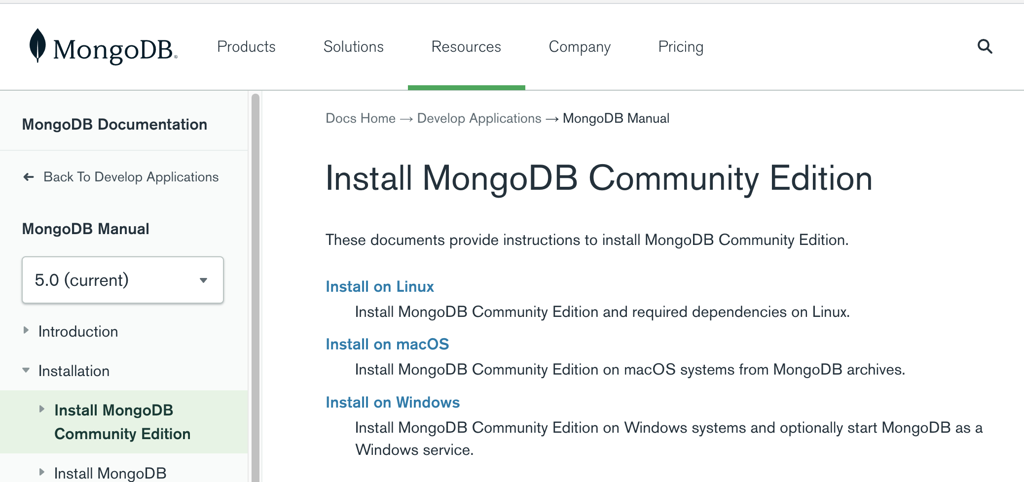
Install the free community edition of MongoDB
https://docs.mongodb.com/manual/administration/install-community/

Slide 18
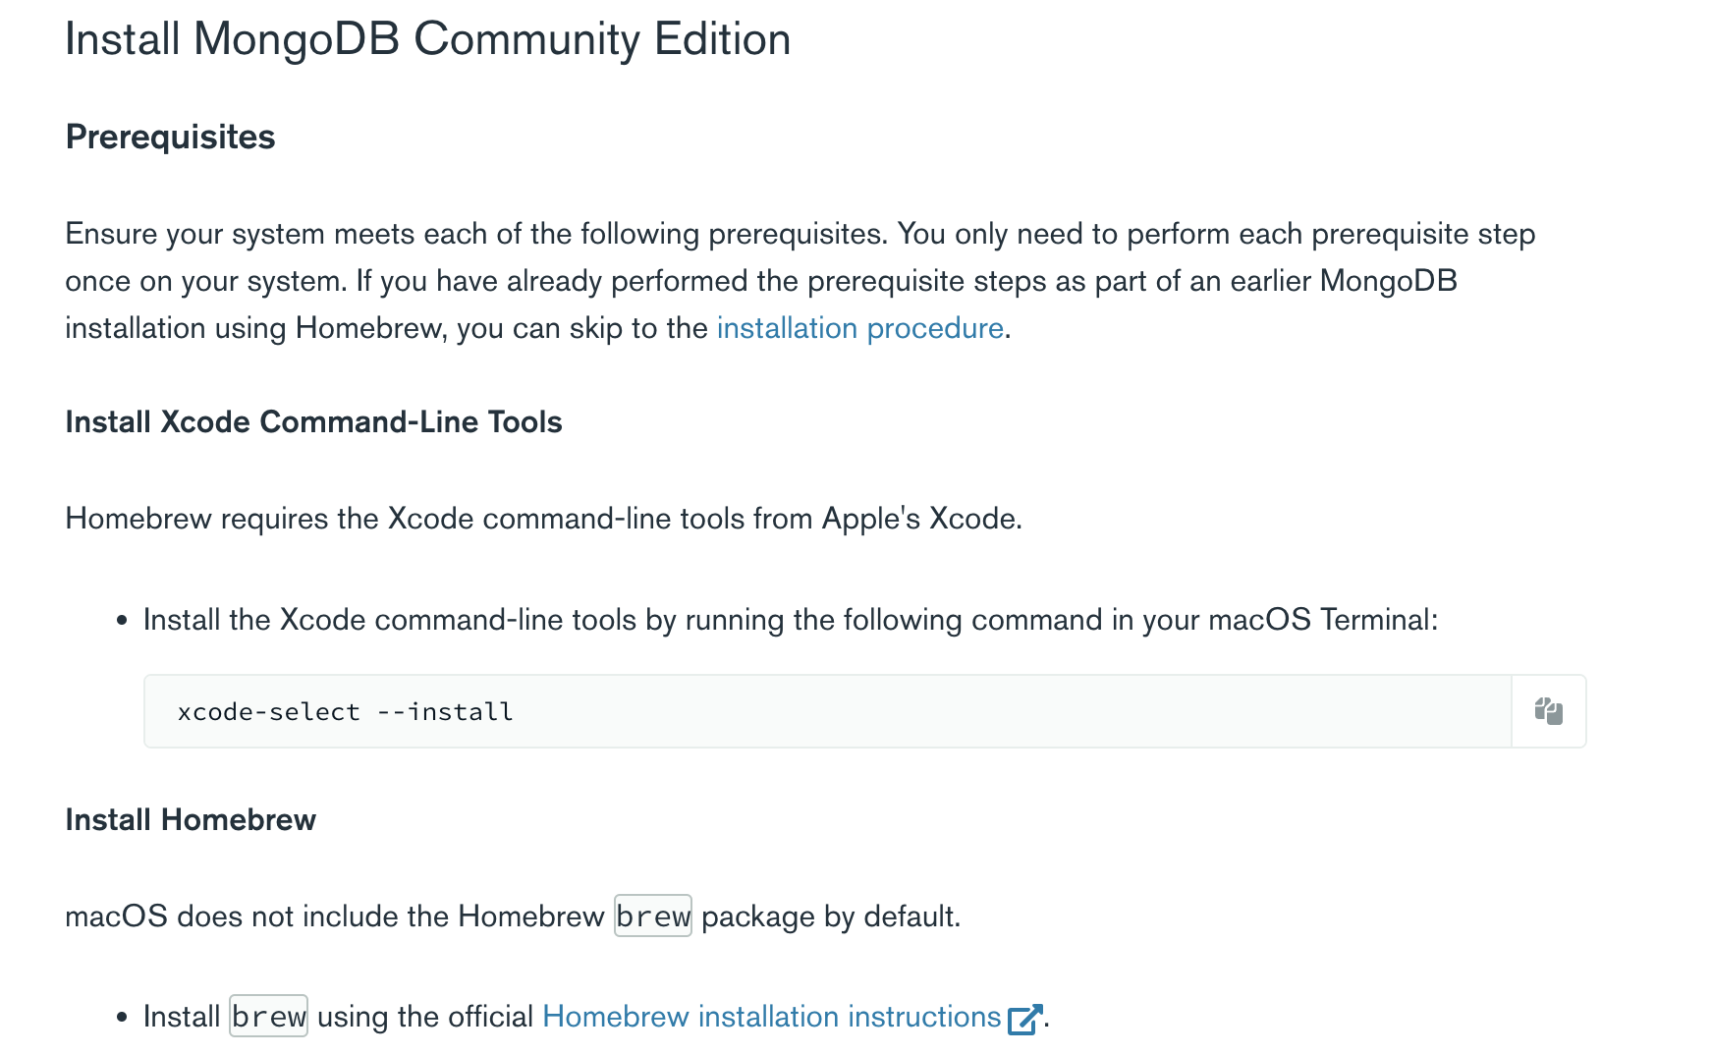
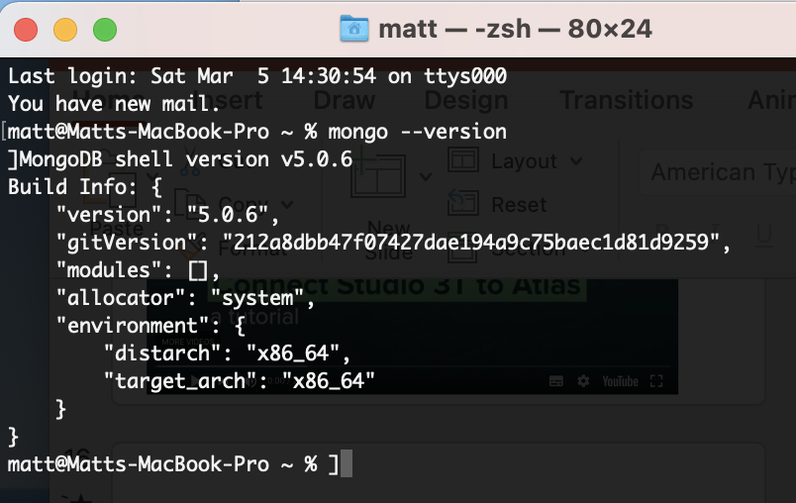
On my Mac I had to install various prerequisites from the command line.
Good luck windows users ☺ About an hour later it was all done !! ☹

Slide 19
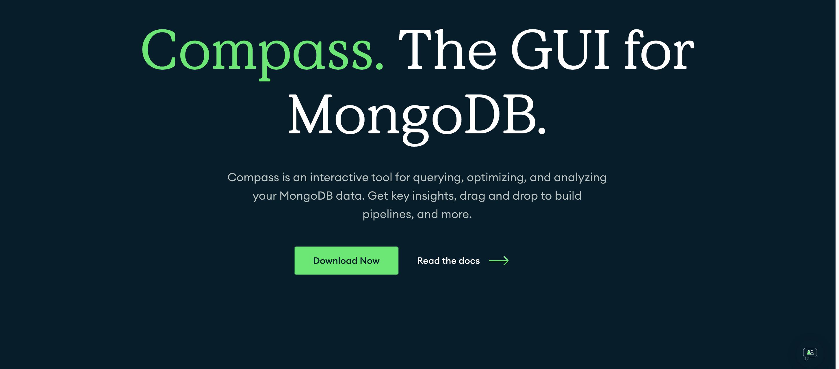
Compass - free GUI
https://www.mongodb.com/products/compass

Slide 20


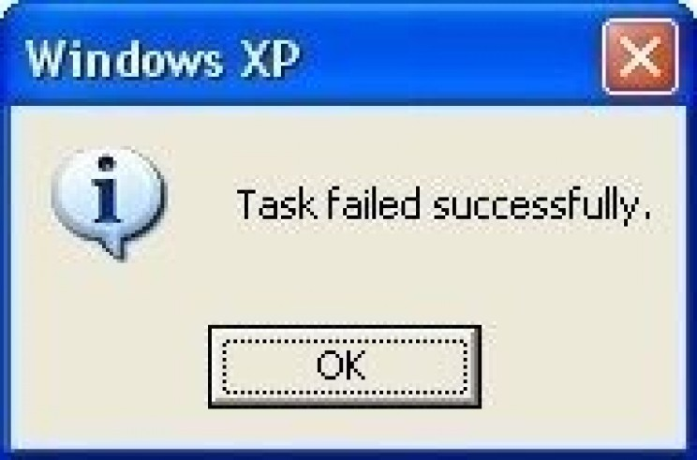
In the end it might just be easier to work on Virtual desktop.

Slide 21
Labs
Work through slides 4 -13.

Slide 22
?

