Slide 1
COMP 1842
Coursework CRUD system part 1
Matt Prichard

Slide 2
This is for the coursework
These notes form the first part of the CRUD system you are making for your coursework.
Just getting all this working is no small achievement so go slow.

Slide 3
Introduction
This week we will create our server folder/file structure
Install the necessary dependencies
Set up our basic Node server.
Follow very carefully, if it all goes wrong you can just bin it and start again.
My materials will be based on me working on Virtual Desktop or my Mac. This code should be the same wherever you run it!

Slide 4
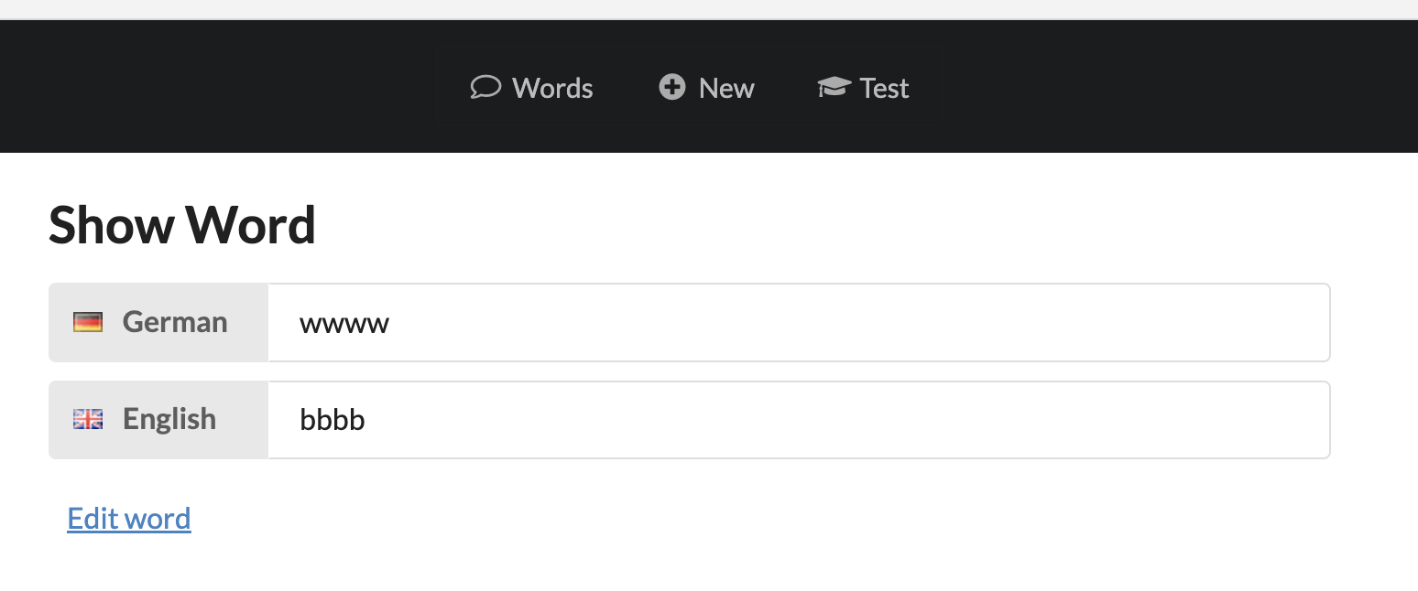
Finished system demo
http://localhost:8080/words/
Back-end cd uni/vocab/vocab-wk10-pt2/server then npm run start
Front-end cd uni/vocab/vocab-wk10-pt2/front-end then npm run serve

Slide 5
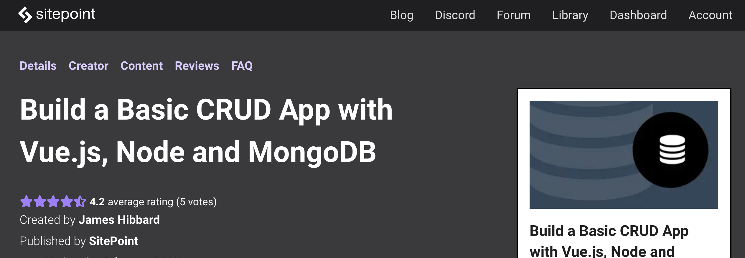
Based on sitepoint book

Slide 6
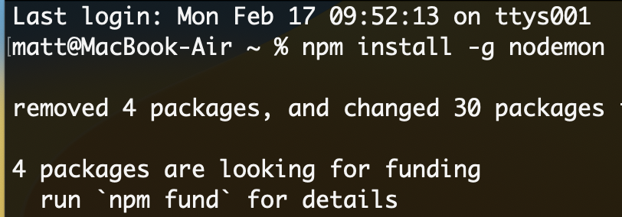

Install nodemon globally
Run this command in the node command prompt in the labs
npm install –g nodemon
We can check it has installed
nodemon -v

Slide 7
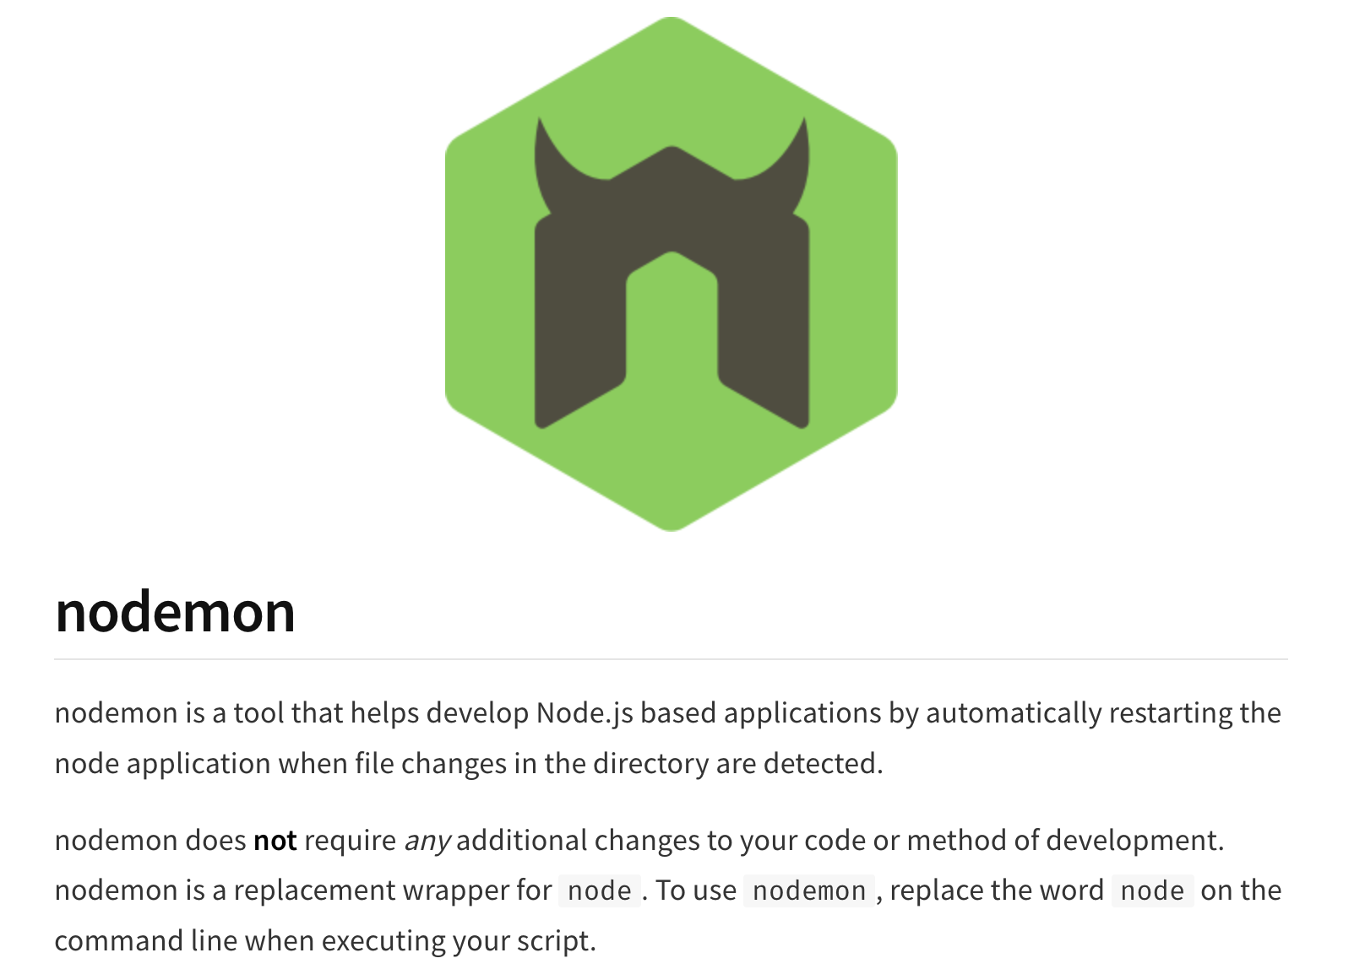
https://www.npmjs.com/package/nodemon

Slide 8
Creating the Node Back End
This week and next week we’ll create a RESTful API for our Vue front end to consume and test it using PostCode, a VS code plugin for testing APIs
We won’t want to go into too much detail on how a RESTful API works this week.

Slide 9
Directory structure pt 1
On your G Drive (or at home) create folder ‘vocab-builder’
Please follow the naming conventions and structure exactly.
Inside this folder create folder ‘server’

Slide 10
Directory structure pt2
Inside ‘server’ create ‘api’
Inside ‘api’ create ’controllers’, ‘models’, ‘routes’

Slide 11
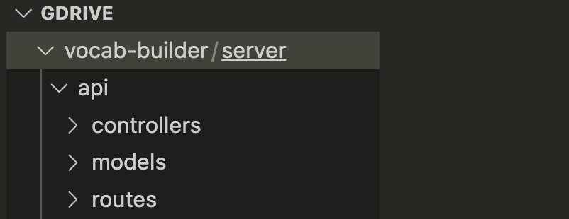
Directory structure pt3
Now open folder ‘vocab-builder’ from within VS code

Slide 12
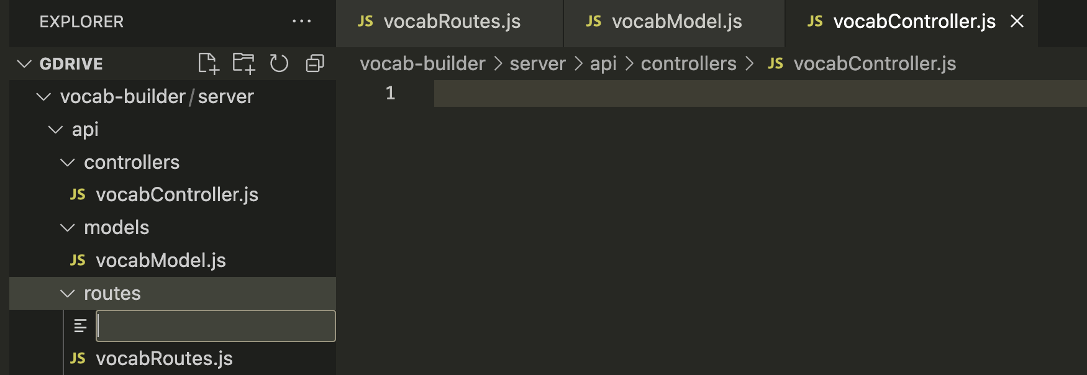
Create files
Using the new file icon create the following 3 js files in their corresponding folders. Be very careful with spelling and Caps

Slide 13
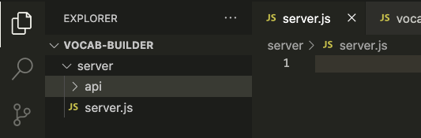
Create files pt2
Making sure you are now in the server folder, create server.js file
Leaving VS code open go to the node js command prompt

Slide 14
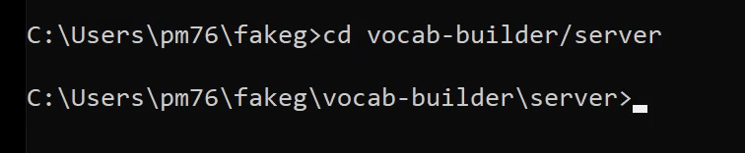
Node command prompt
Using cd navigate to vocab-builder/server in the command prompt

Slide 15
Node command prompt
Once in the server directory run
npm init -y
npm init initialises the project and creates our package.json file

Slide 16
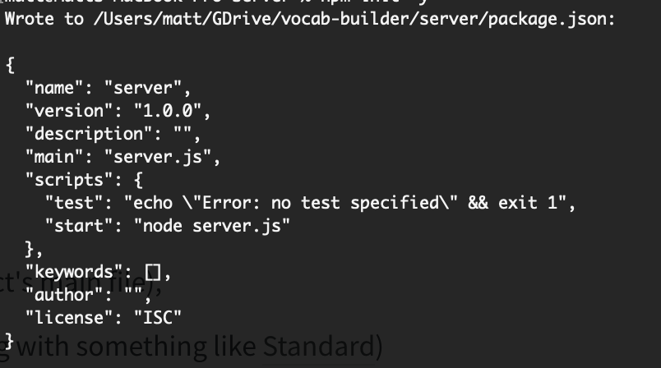
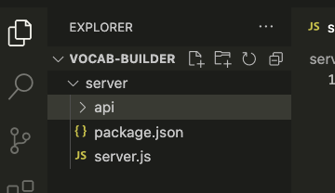
npm init
When you run the command you should see something like this, with the package file appearing in your VS code window

Slide 17
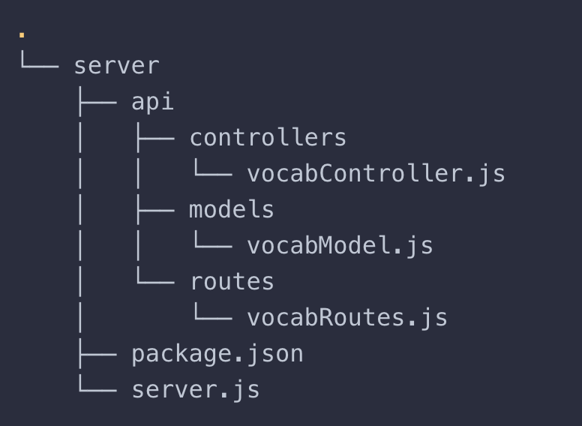
Structure at this point
Your folder and file structure should match this, if not go no further!!

Slide 18
Install the dependencies
For our API, we’ll be using the following libraries:
express —a small framework for Node that provides many useful features, such as routing and middleware.
cors —Express middleware that can be used to enable CORS in our project.
body-parser —Express middleware to parse the body of incoming requests.
mongoose —a MongoDB ODM (the NoSQL equivalent of an ORM) for Node. It provides a simple validation and query API to help you interact with your MongoDB database. (ORM and ODM explained).

Slide 19
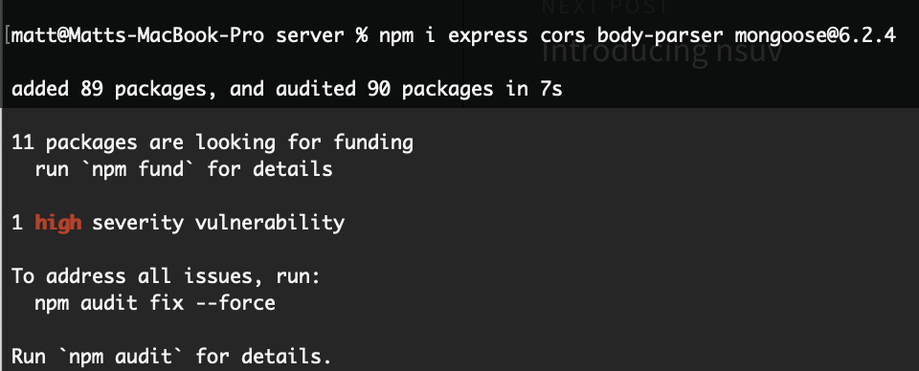
Install the dependencies
Making sure you are still in the server directory run this command in the node command prompt – notice we are specifying an exact version of mongoose
npm i express cors body-parser mongoose@6.2.4
NB - I chose to fix the severe vulnerabilities when prompted.

Slide 20
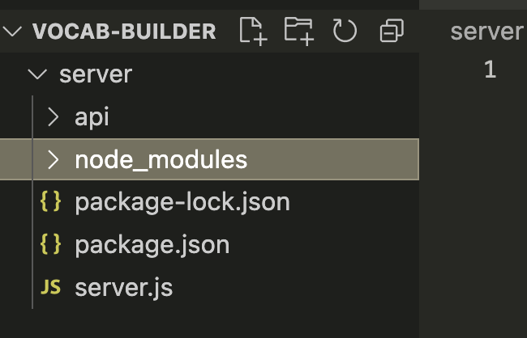
In VS code
You should now see a new folder called node_modules that contains many folders including the ones we just asked to install.

Slide 21
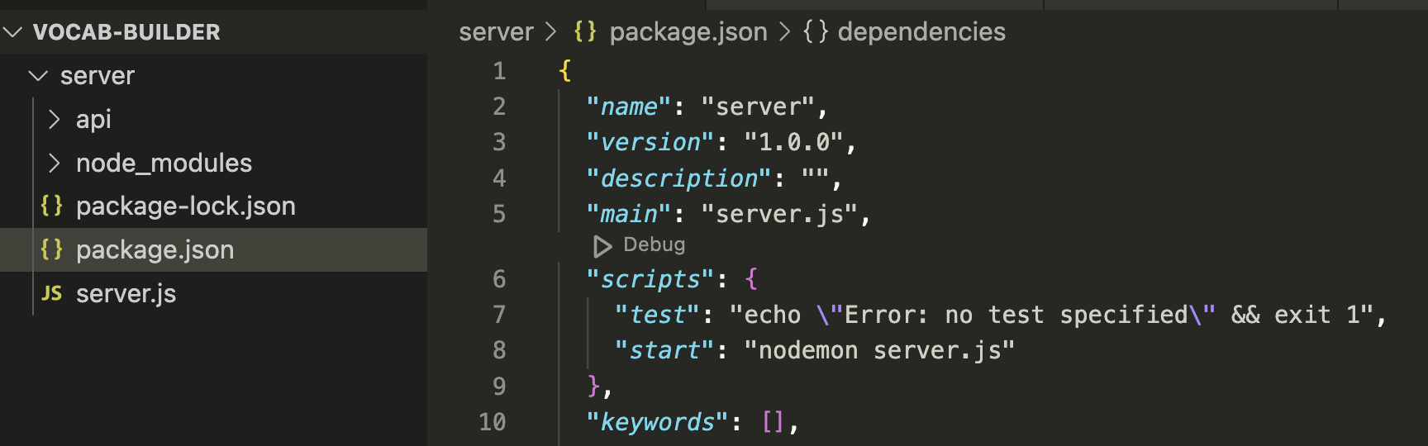
package.json
Open the main package.json file in the server folder and change line 8 to read
"start": "nodemon server.js” now save changes

Slide 22
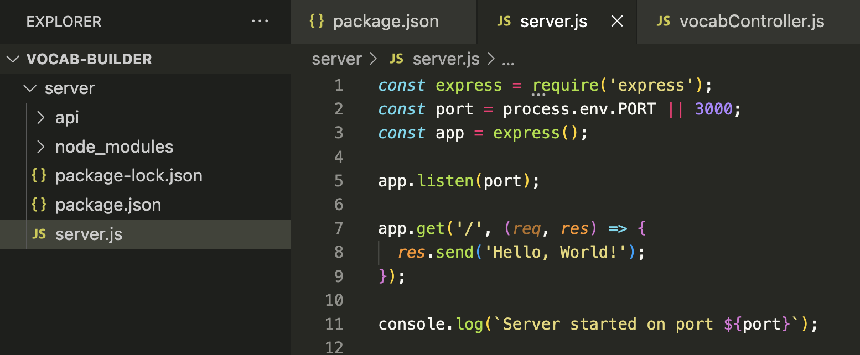
Create the server
Copy this code carefully into the server.js file and save.
Notice the use of back ticks not single quotes on line 11

Slide 23
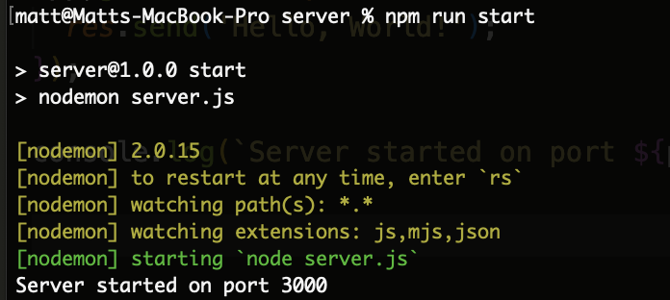
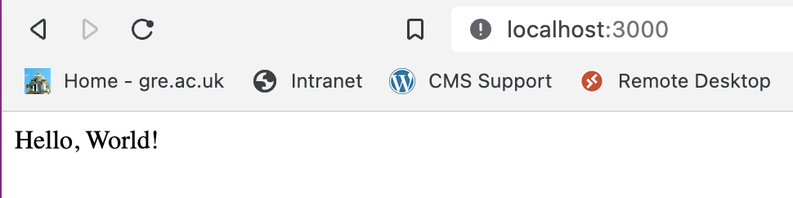
run the server
Go into the terminal and type npm run start You should see a message that the server has started on port 3000. If you visit http://localhost:3000/ you should see “Hello, World!” displayed.

Slide 24
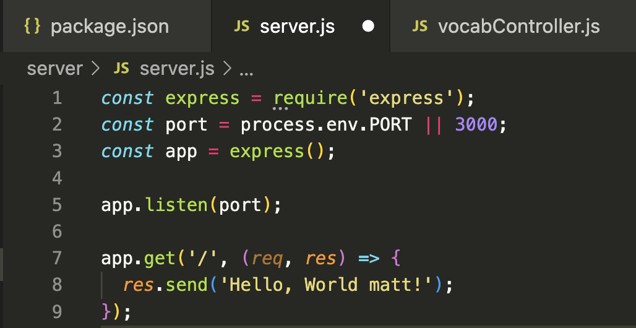
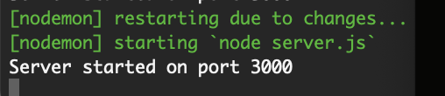
nodemon working
Leave the server running, go back to VS code and change the message to include your name, when you save the file. nodemon automatically restarts the server for you without having to run the command again. Control C to stop

Slide 25
Enough for one day.
There is a great deal that can go wrong getting this far, I’ve had all sorts of difficulties with version control and constantly updated dependencies etc.
If it all goes horribly wrong just bin it all and start again, you won't break anything.

Slide 26
?

