Slide 1
COMP 1842
Node.js server
Matt Prichard

Slide 2
Introduction
NoSQL recap from week 5
Npm recap from week 4
Node js server

Slide 3
Recap – NoSQL Please read these articles in your own time!
https://www.sitepoint.com/sql-vs-nosql-differences/
https://www.sitepoint.com/sql-vs-nosql-choose/

Slide 4
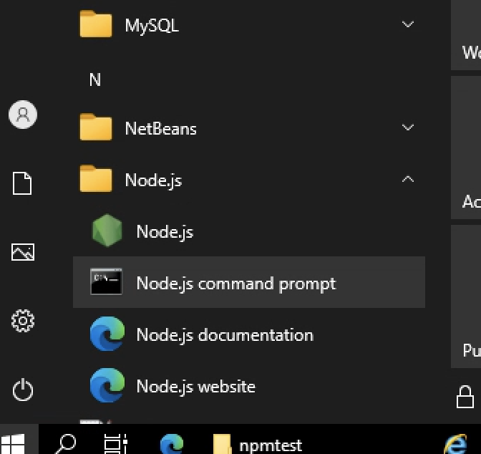
Recap -Running Node locally
For these examples I am running the files from my G Drive
You can install Node and npm on your own machines, but I can’t directly support that.
In the labs locate and open the Node.js command prompt

Slide 5
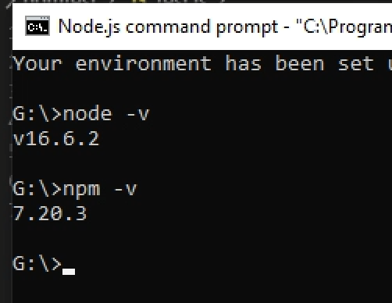
Install check
Type node –v and press enter, this will give the current version of node that is installed, do the same with
npm –v

Slide 6
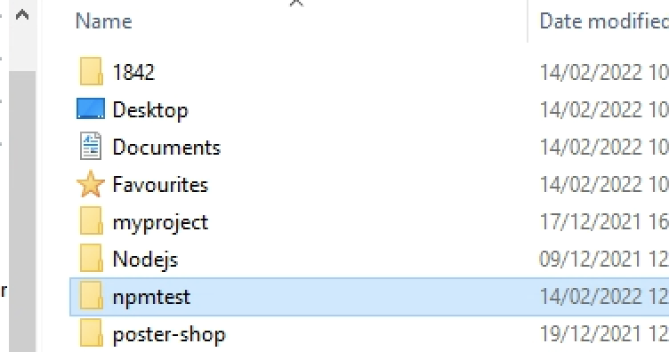
G Drive – new folder npmtest

Slide 7
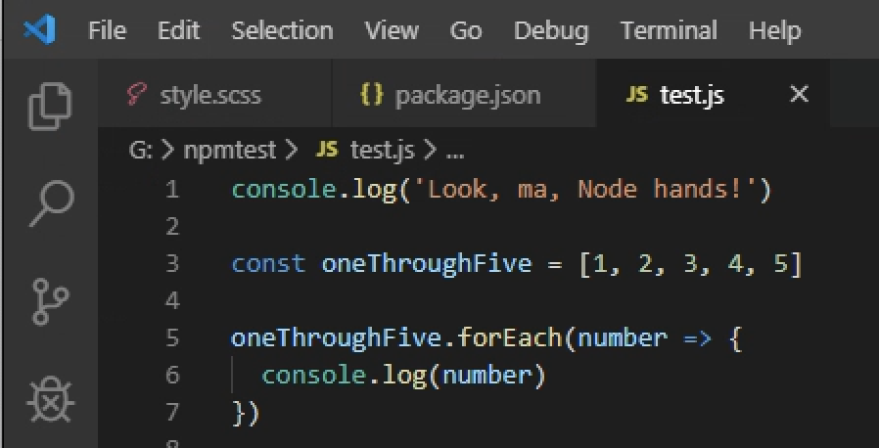
Create test.js and save to the new folder

Slide 8
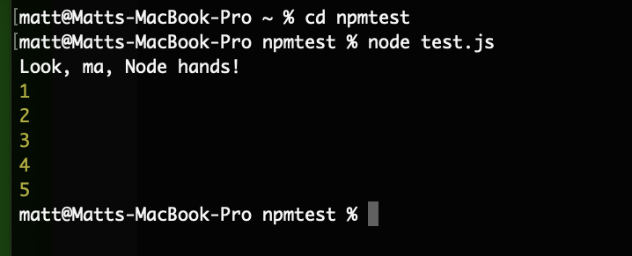
Run node
Open the Node command prompt, navigate to where the file is
(using cd npmtest or “change directory to npmtest ”) and type node test.js
to get the following output.

Slide 9
Navigating folders
cd folder_name/ change directory
cd ../ back up a directory
Can chain together
cd folder1/folder2/folder3/
cd ../../../
cd / takes you to the root directory

Slide 10
Node
Node.js can be used to build different types of applications such as command line applications, web applications, real-time chat application, REST API server etc.
However, it is mainly used to build network programs like web servers, similar to PHP, Java, or ASP.NET.

Slide 11
Cont…
A common task for a web server can be to open a file on the server and return the content to the client.
Here is how PHP or ASP handles a file request:
Sends the task to the computer's file system.
Waits while the file system opens and reads the file.
Returns the content to the client.
Ready to handle the next request.

Slide 12
Cont…
Here is how Node.js handles a file request:
Sends the task to the computer's file system.
Ready to handle the next request.
When the file system has opened and read the file, the server returns the content to the client.
Node.js eliminates the waiting, and simply continues with the next request.
Node.js runs single-threaded, non-blocking, asynchronous programming, which is very memory efficient.
https://medium.com/@monuchaudhary/single-threaded-non-blocking-asynchronous-and-concurrent-nature-of-javascript-a0d5483bcf4c

Slide 13
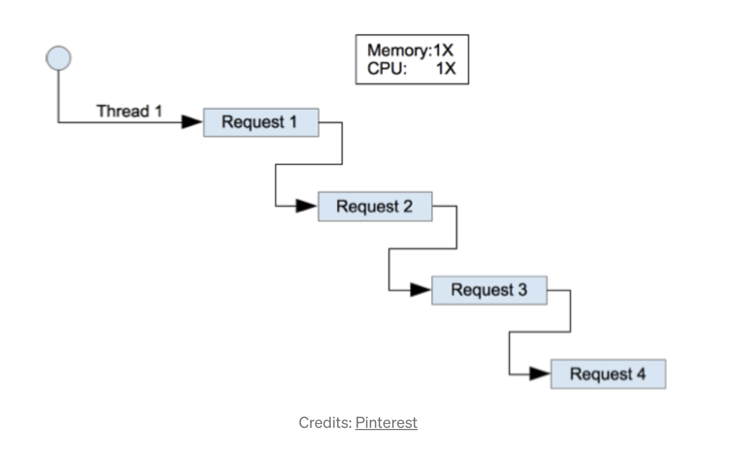
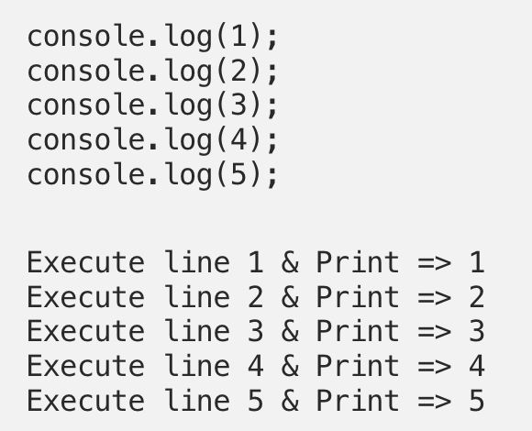
single-threaded, non-blocking, asynchronous programming ☹
JavaScript is a single-threaded language. This means it has one call stack and one memory heap. It executes code in order and must finish executing a piece code before moving onto the next. So if we print from 1 to 5 it will execute every line one by one and can’t execute all console logs at once.

Slide 14
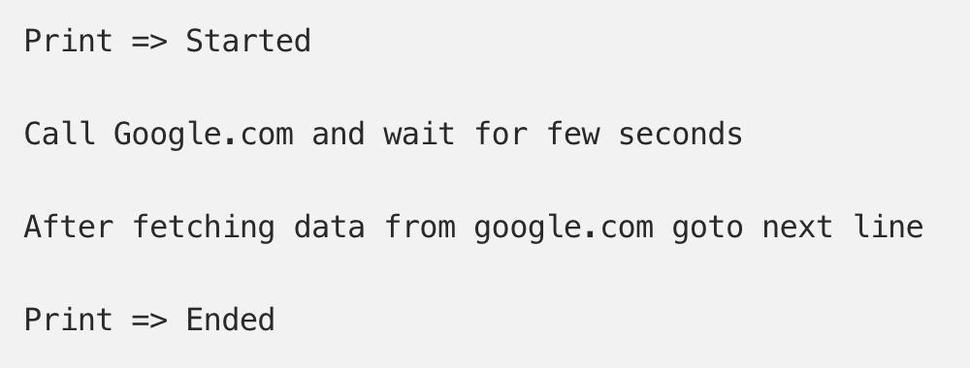
Here a function is making an ajax request to google.com, which is blocking the process. If we execute this code in C, PHP or any other language it will execute like this.

Slide 15
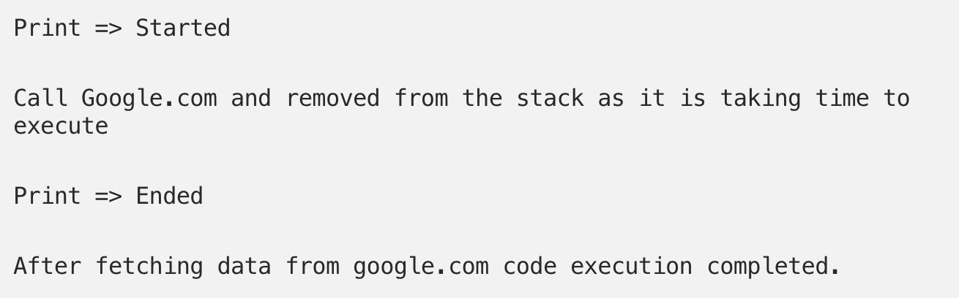
JavaScript is a non-blocking language, the Call Google function call doesn’t stop our rest of the code executing and printing “Ended” before fetching data from google.com, like this.
But how is JavaScript non-blocking when it only has one thread? The answer is that these requests are performed by web APIs (C++ library in case of node) which has its own thread. This makes concurrency possible in JavaScript.
https://medium.com/@monuchaudhary/single-threaded-non-blocking-asynchronous-and-concurrent-nature-of-javascript-a0d5483bcf4c

Slide 16
What Can Node.js Do?
Node.js can generate dynamic page content
Node.js can collect form data
Node.js can add, delete, modify data in your database
Node.js files contain tasks that will be executed on certain events
A typical event is someone trying to access a port on the server
Node.js files must be initiated on the server before having any effect
Node.js files have extension ".js"

Slide 17
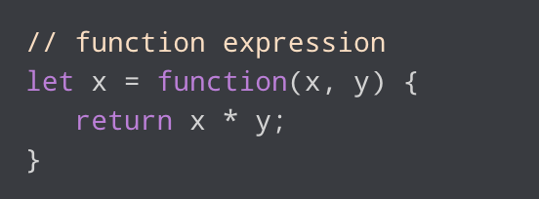
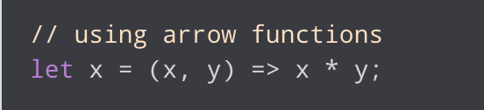
An aside => Arrow functions
Arrow functions are one of the features introduced in the ES6 version of JavaScript. It allows you to create functions in a cleaner way compared to regular functions. For example:

Slide 18
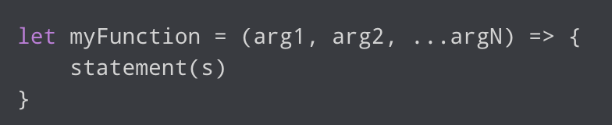
Arrow function syntax
myFunction is the name of the function
arg1, arg2, ...argN are the function arguments
statement(s) is the function body
If the body has single statement or expression, you can write arrow function as:

Slide 19

Further reading
https://www.w3schools.com/Js/js_arrow_function.asp
https://www.freecodecamp.org/news/arrow-function-javascript-tutorial-how-to-declare-a-js-function-with-the-new-es6-syntax/

Slide 20
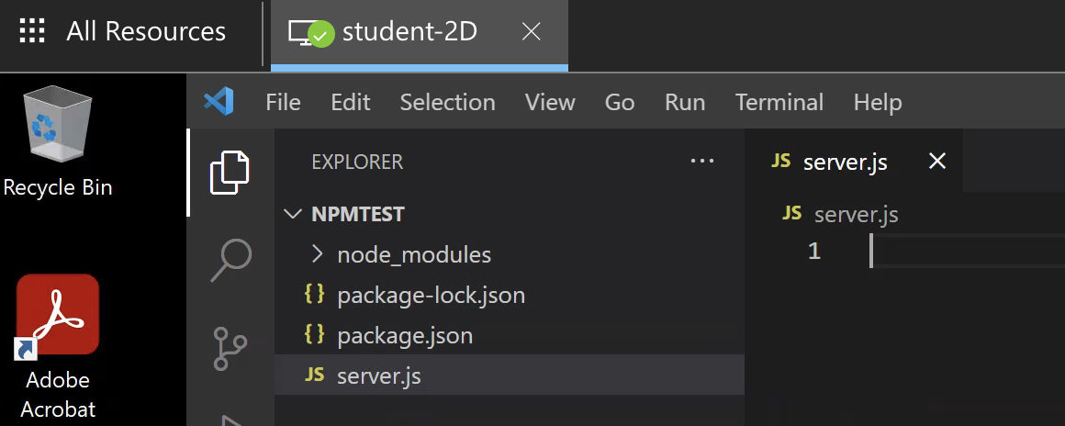
Create new file
In the ‘npmtest’ folder from week 5 create a new file > server.js

Slide 21
Node.js web server
To access web pages of any web application, you need a web server. The web server will handle all the http requests for the web application e.g
IIS is a web server for ASP.NET web applications.
Apache is a web server for PHP or Java web applications.
Node.js provides capabilities to create your own web server which will handle HTTP requests asynchronously. You can use IIS or Apache to run Node.js web applications but it is recommended to use Node.js web server.

Slide 22
Create Node.js web server
Node.js has a built-in module called HTTP, which allows Node.js to transfer data over the Hyper-Text Transfer Protocol (HTTP).
To include the HTTP module, use the require( ) method:
const http = require(‘http’);
The HTTP module can create an HTTP server that listens to server ports and gives a response back to the client.
Use the createServer() method to create an HTTP server:

Slide 23
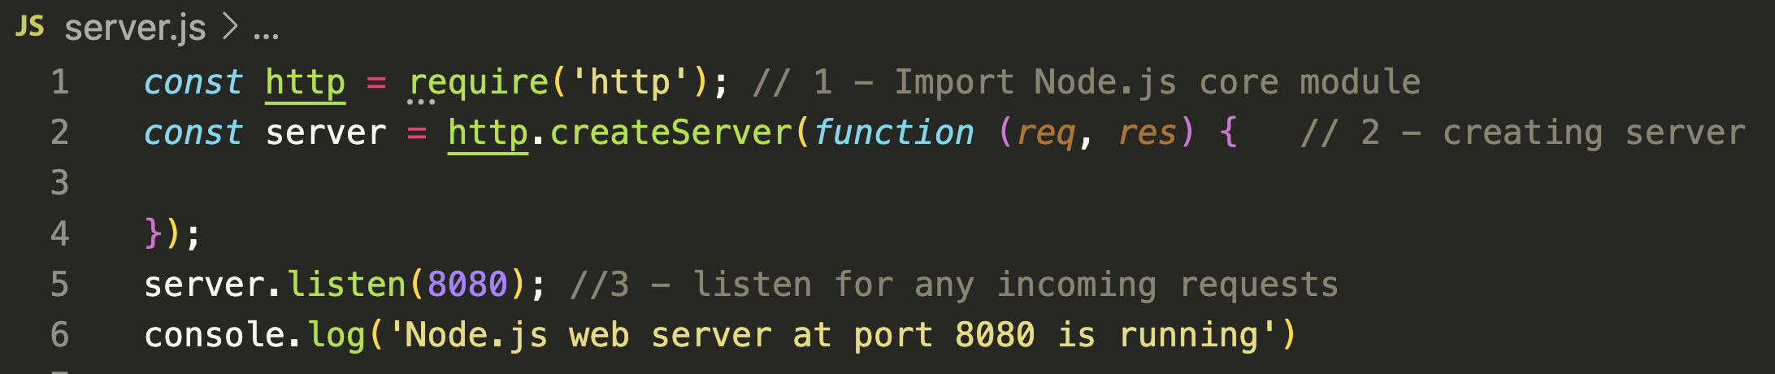
Create Node.js web server 2
The function passed into the http.createServer() method, will be executed when someone tries to access the computer on port 8080.

Slide 24
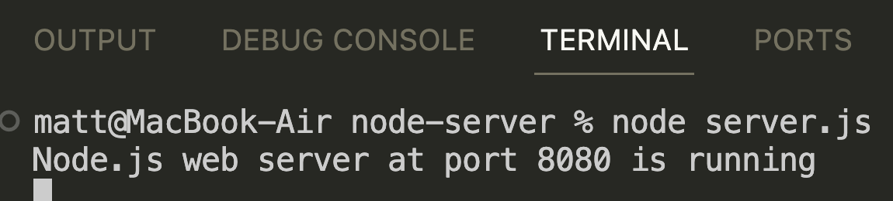
Run the server
cd to the directory containing your new file if not already there.
Then type node server.js
Control C to stop the server

Slide 25
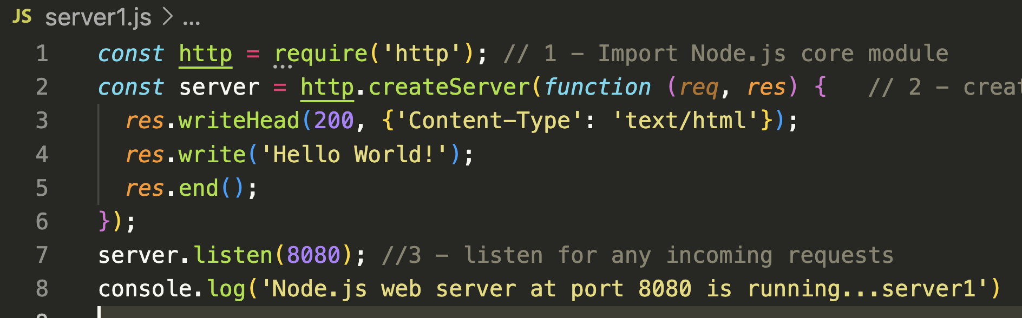
Add an HTTP Header
If the response from the HTTP server is supposed to be displayed as HTML, you should include an HTTP header with the correct content type: Line 3 set response header, Line 4 set response content.

Slide 26
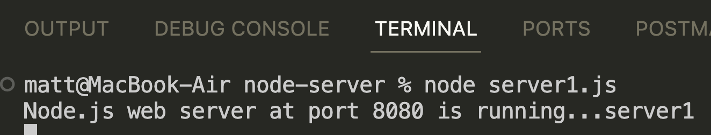
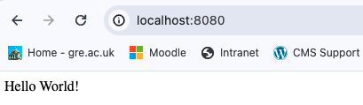
Restart the server
Restart the server node server.js
Note I have a new file server1, yours can still be the same file
In your browser go to localhost:8080

Slide 27
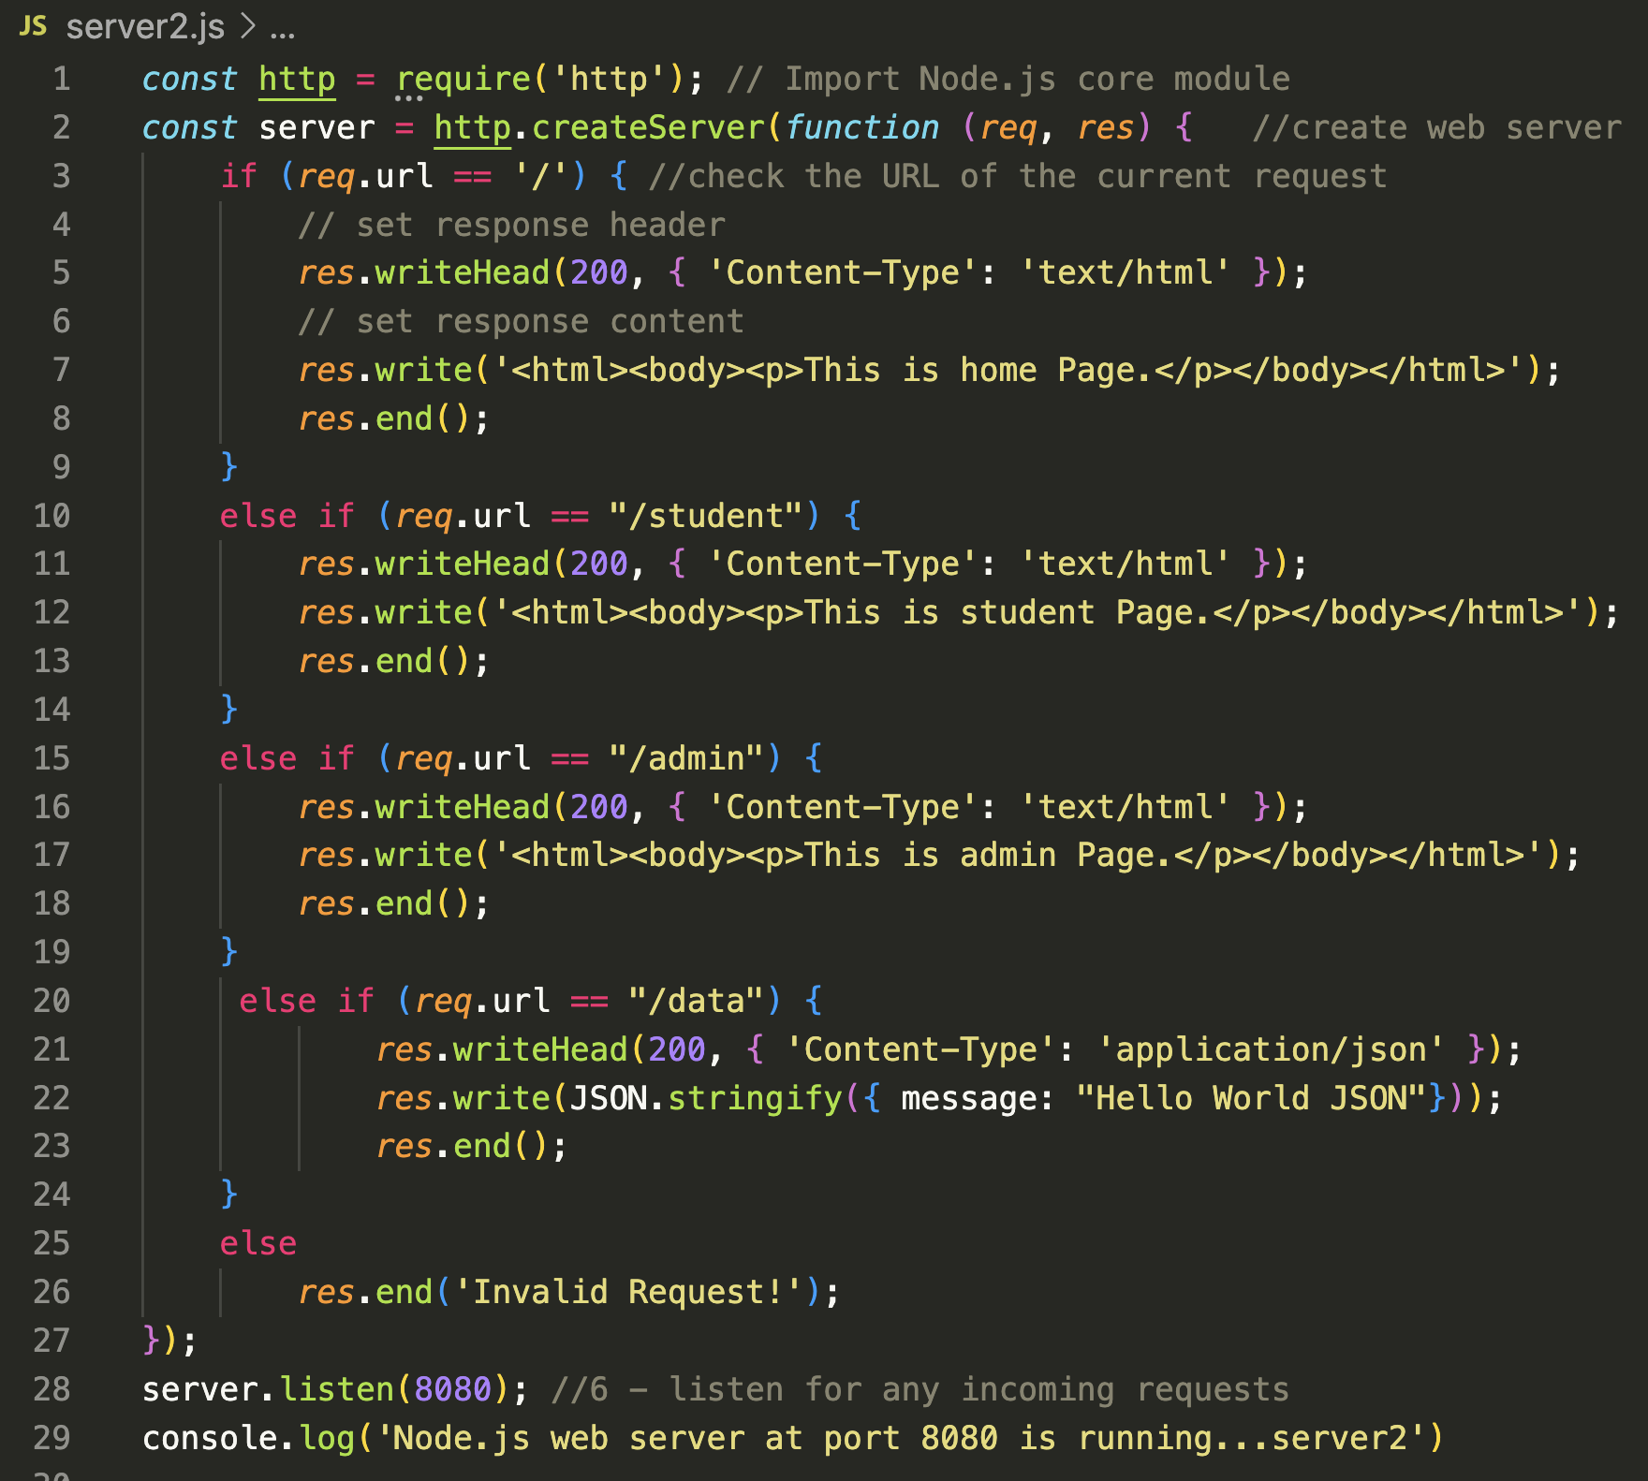
Fuller example node-server/server2.js

Slide 28
Handle HTTP Requests
The http.createServer() method includes request and response parameters which are supplied by Node.js.
The request object can be used to get information about the current HTTP request e.g., url, request header, and data.
The response object can be used to send a response for a current HTTP request.

Slide 29
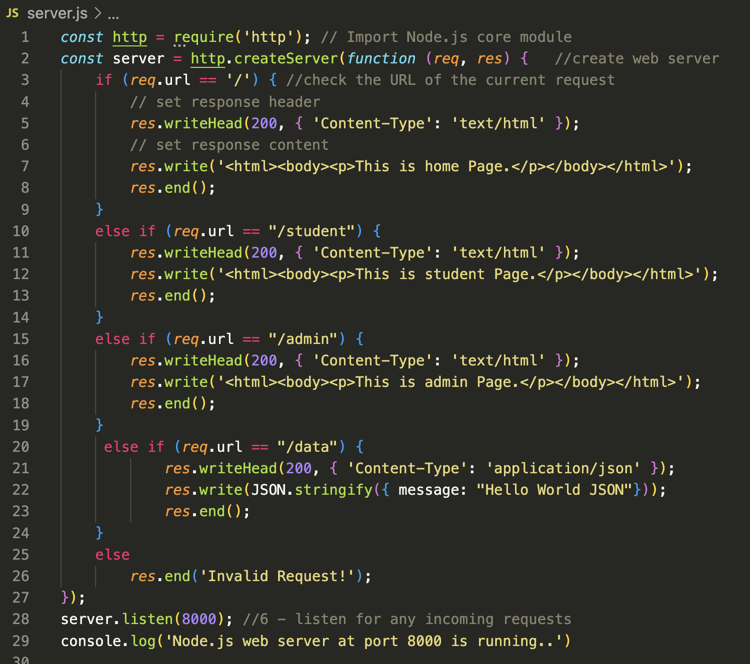
Detail view
Using if and else if. We can use the ‘url’ property of the request object to check the url of the current request lines 3 and 10

Slide 30
Detail view 2
Again, req.url is used to check the url of the current request and based on that it sends the response. To send a response, first it sets the response header using writeHead() method and then writes a string as a response body using write() method. Finally, Node.js web server sends the response using end() method.

Slide 31
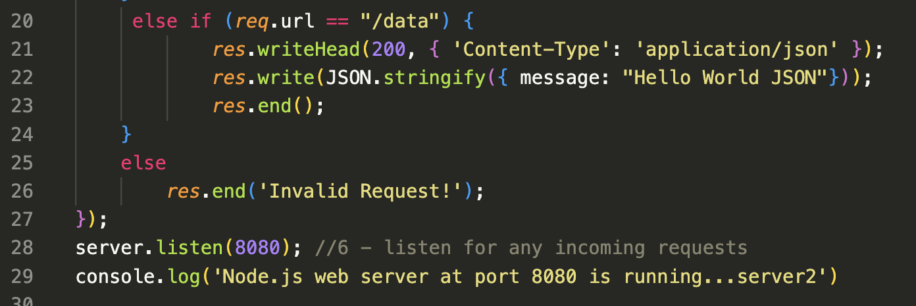
Sending JSON response
Inserting lines 20-24 shows how to serve a JSON response from the Node.js web server. this way we can create a simple web server that serves different responses. (see: JSON.stringify)

Slide 32
Lab task for this week (#4 of 5)
Implement the code from slide 20 onwards from this lecture on your G Drive or on your own machine.
Submit a screen shot of the server running in the command line on port 8080
Show the different responses in the browser via localhost:8080
Home, student, admin, data (the JSON response) and the invalid request error.
Annotate the screenshots explaining your understanding of today’s work.

Slide 33
?

Slide 34
sources
https://www.tutorialsteacher.com/nodejs/create-nodejs-web-server
https://www.tutorialspoint.com/nodejs/nodejs_response_object.htm
https://nodejs.org/en/docs/guides/anatomy-of-an-http-transaction/
https://www.w3schools.com/nodejs/nodejs_http.asp

