Slide 1
Reinforcement learning
show
Q_Learning_demo4
Q_Learning_demo5

Slide 2
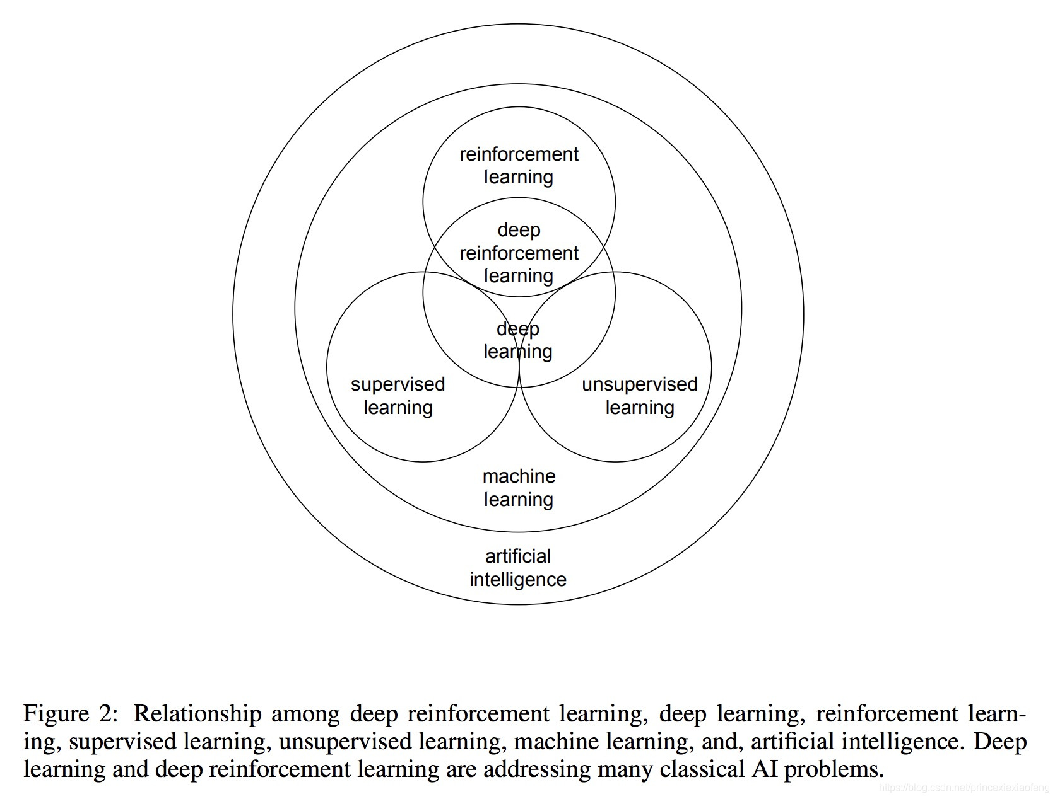

Slide 3
马尔可夫决策过程 (Markov Decision Process，MDP)

Slide 4
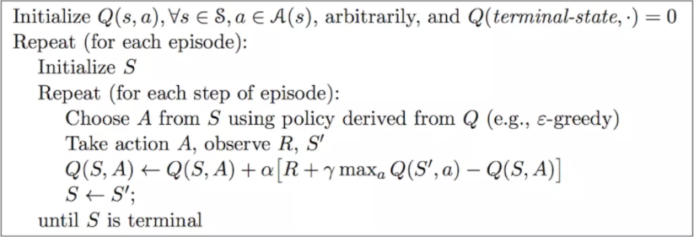
Q-Learning 伪代码

Slide 5
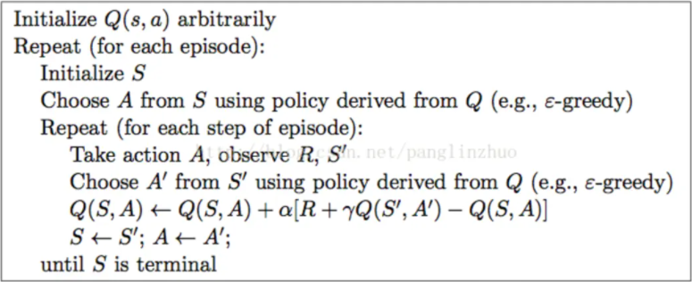
Sarsa 伪代码

