Slide 1
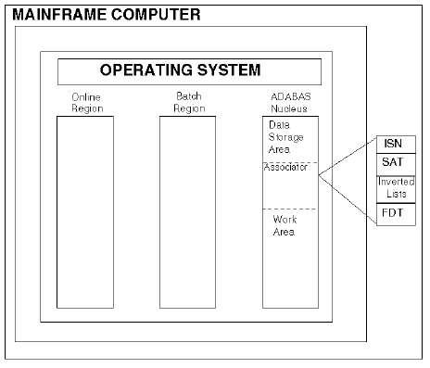
ADABAS

Slide 2
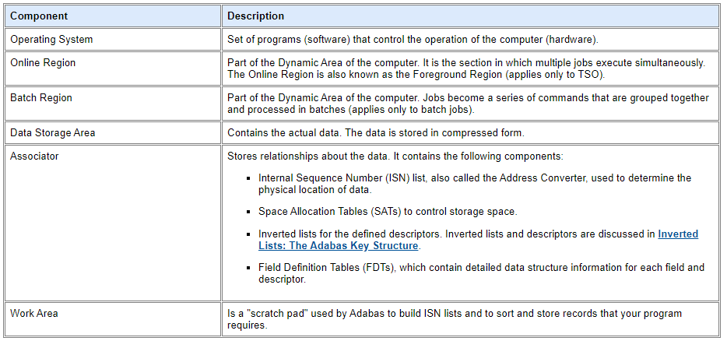
ADABAS

Slide 3
Inverted List
Value: Value of the Descriptor.
Count: No of count matches with Descriptor value.
ISN: List of ISN matches with Descriptor value.

Slide 4
Inverted List
The Inverted list is used to resolve ADABAS search commands and read records in logical sequence built and maintained for each field in an ADABAS file that is designated as a key field or “descriptor”.
It is called an “inverted” list because it is organized by descriptor value rather than by ISN.

Slide 5
Address Converter
RABN
ISN
Address Converter contains RABN in ISN sequence.

Slide 6
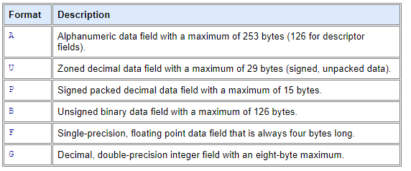
Standard format for ADABAS fields

Slide 7
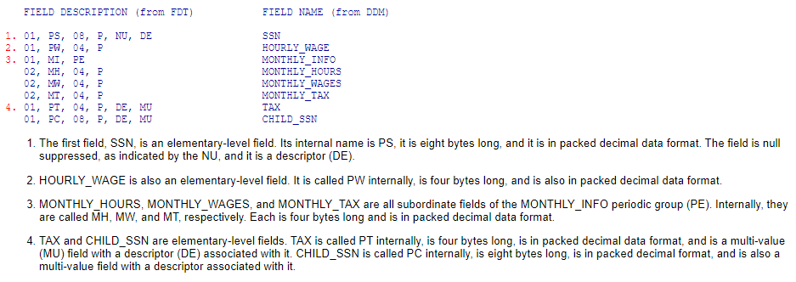
Standard format for ADABAS fields

Slide 8
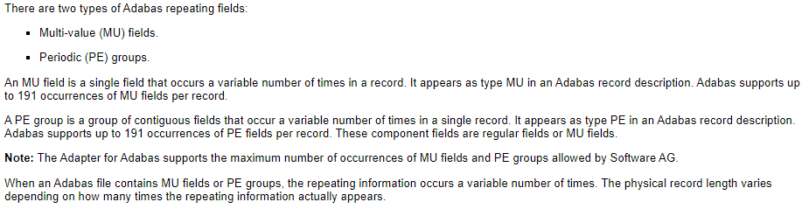
Standard format for ADABAS fields

Slide 9
Data Storage
Data storage contains the actual data records of ADABAS files in the database.
Data Storage block divides the data in the blocks.
Each block is having a number called RABN – Relative ADABAS Block Number.
RABN
1
3
2
4
5
7
9
10
6

Slide 10
Data Storage
The compression technique is a major strength of ADABAS.
Data compression significantly reduces the amount of storage required. It also permits the transmission of more information per physical transfer, resulting in greater I/O efficiency.
Normal Suppression
Fixed Suppression
Null Suppression

Slide 11
Normal Compression
Normal Compression : It will delete trailing spaces and leading zeros before Storing.
An inclusive length byte (ILB) at the beginning of the field indicates the total number of stored bytes, including the ILB.
e.g. “ADABAS” entered in SUBJECT field of A20 with default/normal compression, it’s stored size will be 7. 6 bytes of field “ADABAS” plus one byte of ILB.
An empty field will be replaced by a one-byte empty field counter (EFC).
ADABAS can store up to 63 contiguous empty fields in a single hexadecimal byte.

Slide 12
Fixed Compression
Fixed Compression : ADABAS will store the value in the field without deleting trailing spaces and leading zeros.
Use fixed compression for fields that are always be fully populated. e.g. SSN
It do not include a length byte and are not compressed. This option saves storage space for 1 byte that are nearly full.

Slide 13
NULL Compression
NULL Compression : ADABAS will delete the trailing spaces and leading zeros.
It string together the null fields.
For the complete blank field stored with NULL compression, ADABAS will store only 2 bytes for all the null fields. 1 byte to indicate the field is NULL and 1 byte to indicate the number of NULL fields.
The field that will be frequently empty should be ordered together in FDT and stored with NULL compression.
It is different from default suppression in searches on descriptors. ADABAS do not return records if the descriptor is blank.

Slide 14
ADABAS Descriptors
Descriptors are predefined access path to the database which could be fields, partial fields, or groups of complete and partial fields used by ADABAS to select records in a file. ADABAS descriptors correspond to indexed fields.
There are five types of descriptors supported by the Adapter for ADABAS:
Descriptors (DE), which have a value associated with a single field.
Superdescriptors (SPR), which have a key value associated with all or part of two to twenty fields (see your Software AG documentation for current limitations on superdescriptors).
Subdescriptors (NOP), which have a key value associated with part of a single field.
Phonetic Descriptors (PDS), which have a similar phonetic value associated with a single field. The phonetic value of a descriptor is based on the first 20 bytes of the field value. Only alphabetic values are considered: numeric values, special characters, and blanks are ignored. Lowercase and uppercase alphanumeric characters are internally identical.
Hyperdescriptors (HDS), which have a value generated, based on a user-supplied algorithm. Up to 31 Hyperdescriptors can be defined in single physical ADABAS.

Slide 15
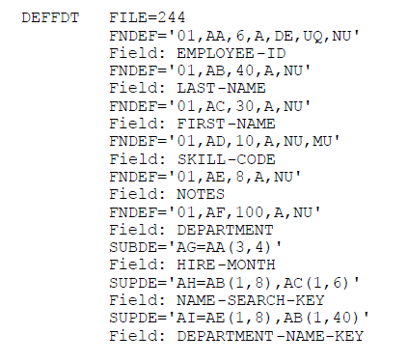
FDT
The File Definition Table (FDT) describe the physical structure of data.

Slide 16
FDT
Field Information | Description
Field Level Indicator | Denotes a hierarchical relationship between fields. In an ADABAS record description the levels are 1, 2, 3, and so on.
ADABAS Field Name | Two-character name used by ADABAS to identify the field. This name is unique to the file. The first character must be alphabetic, and the second character can be alphabetic or numeric. Field names E0 through E9 are reserved for internal ADABAS use.
Standard Length | Length of the field in bytes.
Standard Format | Format of the field.
Field Properties | Indicates whether the field value is null suppressed (NU), the field is of fixed or variable length (FI), or if the field (which exists on a mainframe platform) is long alphanumeric (LA).
Descriptor Status | Indicates if the field is a descriptor, subdescriptor, superdescriptor, phonetic descriptor, hyperdescriptor, subfield, or superfield.
Field Type | Indicates if a field is a group (GR), multi-value (MU), or periodic group (PE). Multi-value fields and periodic groups are examples of multiply occurring fields.

Slide 17
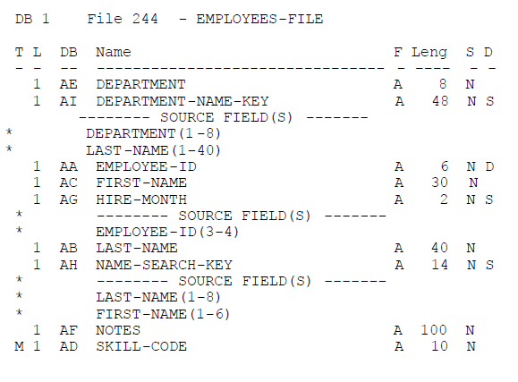
DDM
The DDM is the link between FDT and natural environment.

Slide 18
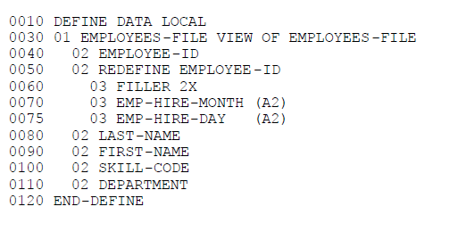
VIEW
The programmatic view is the link between DDM and Natural program.

Slide 19
How ADABAS finds the data
Need to find data having Descriptor – ‘ABC’
Value Count ISN
ABC
2
7,4
Inverted List
1
2
3
4
5
6
ISN RABN
7
8
9
2
1
10
11
12
4
2
5
3
Database
6
4
7
5
Address Converter

Slide 20
How ADABAS uses FIND
Need to find data having Descriptor – ‘ABC’
Value Count ISN
FIND process each ISN one by one and create it’s own list in working storage to get the data from the physical location.
FIND creates ISN list for each descriptor value..
ABC
2
7,4
Inverted List
1
2
3
4
5
6
4,7
4
Working Storage
ISN RABN
7
8
9
2
1
10
11
12
4
2
ADABAS returns in order as they appear in ISN list. So if Order is important, don’t use a FIND.
5
3
Database
6
4
7
5
Address Converter

Slide 21
ADABAS system variable
ADABAS returns the information in following system variables:
*Number : Contains the number of ISN in the set.
*Counter : Number of FIND loops in the program.
*ISN : ISN of the current record

Slide 22
How ADABAS FIND NUMBER works
Need to find data having Descriptor – ‘ABC’
Value Count ISN
FIND NUMBER is not a loop. It is more effective when the expected count is less than 40%. For criteria greater than 40%, one should use HISTOGRAM.
ABC
2
7,4
Inverted List
Gives the number of records that match the selection criteria.

Slide 23
How ADABAS HISTOGRAM works
Need to find data having starting value/descriptor – ‘ABC’
Value Count ISN
HISTOGRAM is a loop and generate RC command.
If the descriptor values are unique, use FIND NUMBER, otherwise use HISTOGRAM/TO.
ABC
2
7,4
Inverted List
Gives the number of records that match the selection criteria.

Slide 24
IMP points for HISTOGRAM
If STARTING FROM value is not specified, ADABAS will start from the beginning of the inverted list.
HISTOGRAM can be used with ASCENDING and DESCENDING keywords to ready the inverted list in the specific order.
HISTOGRAM view an contains only descriptor values. Natural will not allow any other fields in the view.
HISTOGRAM does have access to key fields (DESC, SD) to be displayed etc. in the Histogram loop

Slide 25
How ADABAS READ LOGICAL works
Need to find data having starting from and thru value – ‘ABC’
Value Count ISN
ABC
2
4,7
Inverted List
1
2
3
4
5
6
7
8
9
ISN RABN
10
11
12
4
2
Database
7
5
Address Converter

Slide 26
How ADABAS READ PHYSICAL works
1…………
2…………
3…………
4…………
5…………
6…………
7…………
8…………
9…………
10………
11………
12………
1
2
3
4
5
6
7
8
9
10
11
12
Database
Output

Slide 27
How ADABAS READ ISN works
ISN RABN
1
2
3
4
2
4
5
6
7
5
7
8
9
Address Converter
10
11
12
Database
This READ BY ISN will not cause execution error if the ISN is not valid unlike GET.

Slide 28
How ADABAS STORE works
Need to store data – ‘ABC’
Value Count ISN
ABC
2
4,7
1
2
4,7,11
Inverted List
3
4
5
6
7
8
9
ISN RABN
10
11
12
4
2
Database
7
5
11
12
Address Converter

Slide 29
How ADABAS UPDATE works
UPDATE will hold the record till it updates and release.
Data has been identified to update.
Need to update the data – ‘ABC’
Value Count ISN
ABC
2
4
Inverted List
1
2
3
4
5
6
Get the RABN corresponding to ISN
7
8
9
ISN RABN
10
11
12
4
2
Database
7
5
11
12
Address Converter

Slide 30
How ADABAS DELETE works
DELETE will hold the record till it transaction end and release.
Inverted list updated
Data has been identified to update.
Need to delete the data – ‘ABC’
2
4,7
1
2
7
Inverted List
3
4
5
6
Get the RABN corresponding to ISN
Update the address converter.
7
8
9
ISN RABN
10
11
12
4
2
Database
7
5
11
12
Address Converter

Slide 31
END TRANSACTION
END TRANSACTION is a logical transaction consists of one or more STORE, UDPATE or DELETE.
It holds the records in the hold queue called “Buffer” where all the records will be there with pending transaction.
END TRANSACTION in batch perform the same task for bunch of records similar individual.
GET TRANSACTION DATA is used to retrieve the last transaction data, used for restart data.

Slide 32
BACKOUT TRANSACTION
BACKOUT TRANSACTION is a logical transaction which tell ADABAS to stop all the commits.
ADABAS release all held record from held queue once it receives the BT command.
It generally uses when program detects any error and the data should not be commit to the database.

Slide 33
IN LIMBO
In LIMBO is time between ETs.
Between the time to STORE, UPDATE and DELETE, ADABAS keeps database updates in the held queue.
This time limit is set by DBA.
If system crashes/waiting time is over, ADABAS backs out all the pending transactions.

