Slide 1
wxWidgets and Qt
A Comparison
Multi-Platform C++ GUI Toolkits:
You Have Options

Slide 2
Supported Platforms
* = Challenging to Use
WxWidgets
Windows
Linux
BSD/Solaris
OSX*
Qt
Windows
Linux
BSD/Solaris*
OSX
Android*
iOS*
Tizen*

Slide 3
License
wxWidgets
LGPL with closed - source commercial - friendly clause.
Qt
GNU LGPL
Previous versions somewhat problematic.

Slide 4
IDEs and Tools
WxWidgets
Visual Studio and gcc are first-class citizens.
Code::Blocks and DialogBlocks are commonly-used tools.
Qt
Has own tools, including the Qt Creator IDE.
Builds with Visual Studio and GCC.
Reported to work well with Eclipse.

Slide 5
Major Users
WxWidgets
Audacity
BOINC
Kirix Strata
BitTorrent
FileZilla
Qt
KDE
Kindle
Spotify
VLC Player

Slide 6
Build Process
wxWidgets
Regular makefiles with wx-config utility for library and include paths
Qt
qmake projects, generates meta-objects and makefiles.

Slide 7
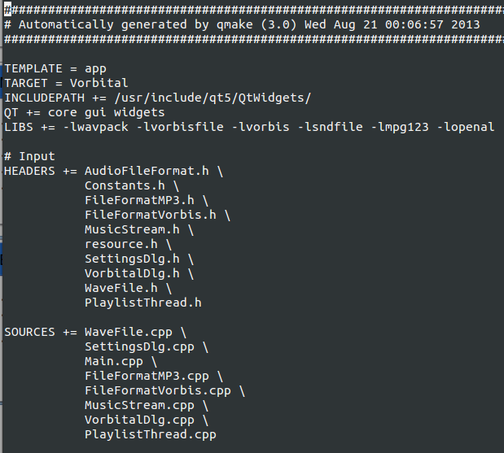
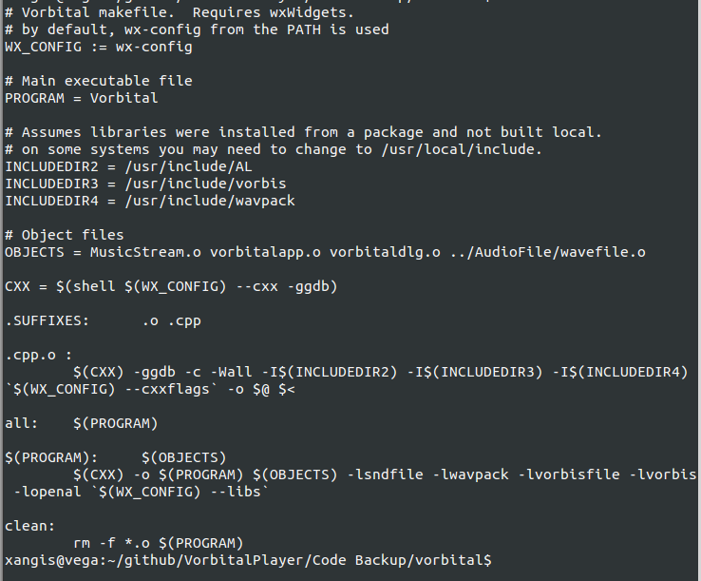
Project File Example

Slide 8
wxWidgets
class HelloWorldApp : public wxApp
{
public:
virtual bool OnInit();
};
DECLARE_APP(HelloWorldApp)
–---
#include "wx/wx.h"
IMPLEMENT_APP(HelloWorldApp)
bool HelloWorldApp::OnInit()
{
wxFrame *frame = new wxFrame((wxFrame*) NULL, -1, _T("Hello wxWidgets World"));
frame->CreateStatusBar();
frame->SetStatusText(_T("Hello World"));
frame->Show(true);
SetTopWindow(frame);
return true;
}
Qt
#include <QApplication>
#include <QPushButton>
int main(int argc, char **argv)
{
QApplication app (argc, argv);
QPushButton button ("Hello world !");
button.show();
return app.exec();
}

Slide 9
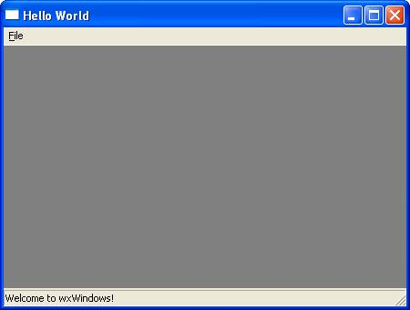

Hello World

Slide 10
Native Look and Feel
wxWidgets
Very good. SDK is primarily a wrapper around native libraries.
Qt
Good. More focus on consistency across platforms.

Slide 11
Included Batteries
wxWidgets
OpenGL Support
Audio and Video Support
Rich Text
HTML Controls
Qt
OpenGL Support
Audio and Video Support
Rich Text
Full WebKit Integration

Slide 12
Books and Resources
wxWidgets
wiki.wxwidgets.org
forum.wxwidgets.org
One book, by Julian Smart, 7 years ago.
Qt
qt-project.org
10+ books. Everything by Mark Summerfield is excellent.

Slide 13
Recommendation
Use Qt For New Projects
Why?
Documentation, community, activity, support, convenience, tools, resources.

