Slide 1
Floating-Point Representations 17.5 Rounding Schemes
周晰朗
22112020068
2023.12.13

Slide 2
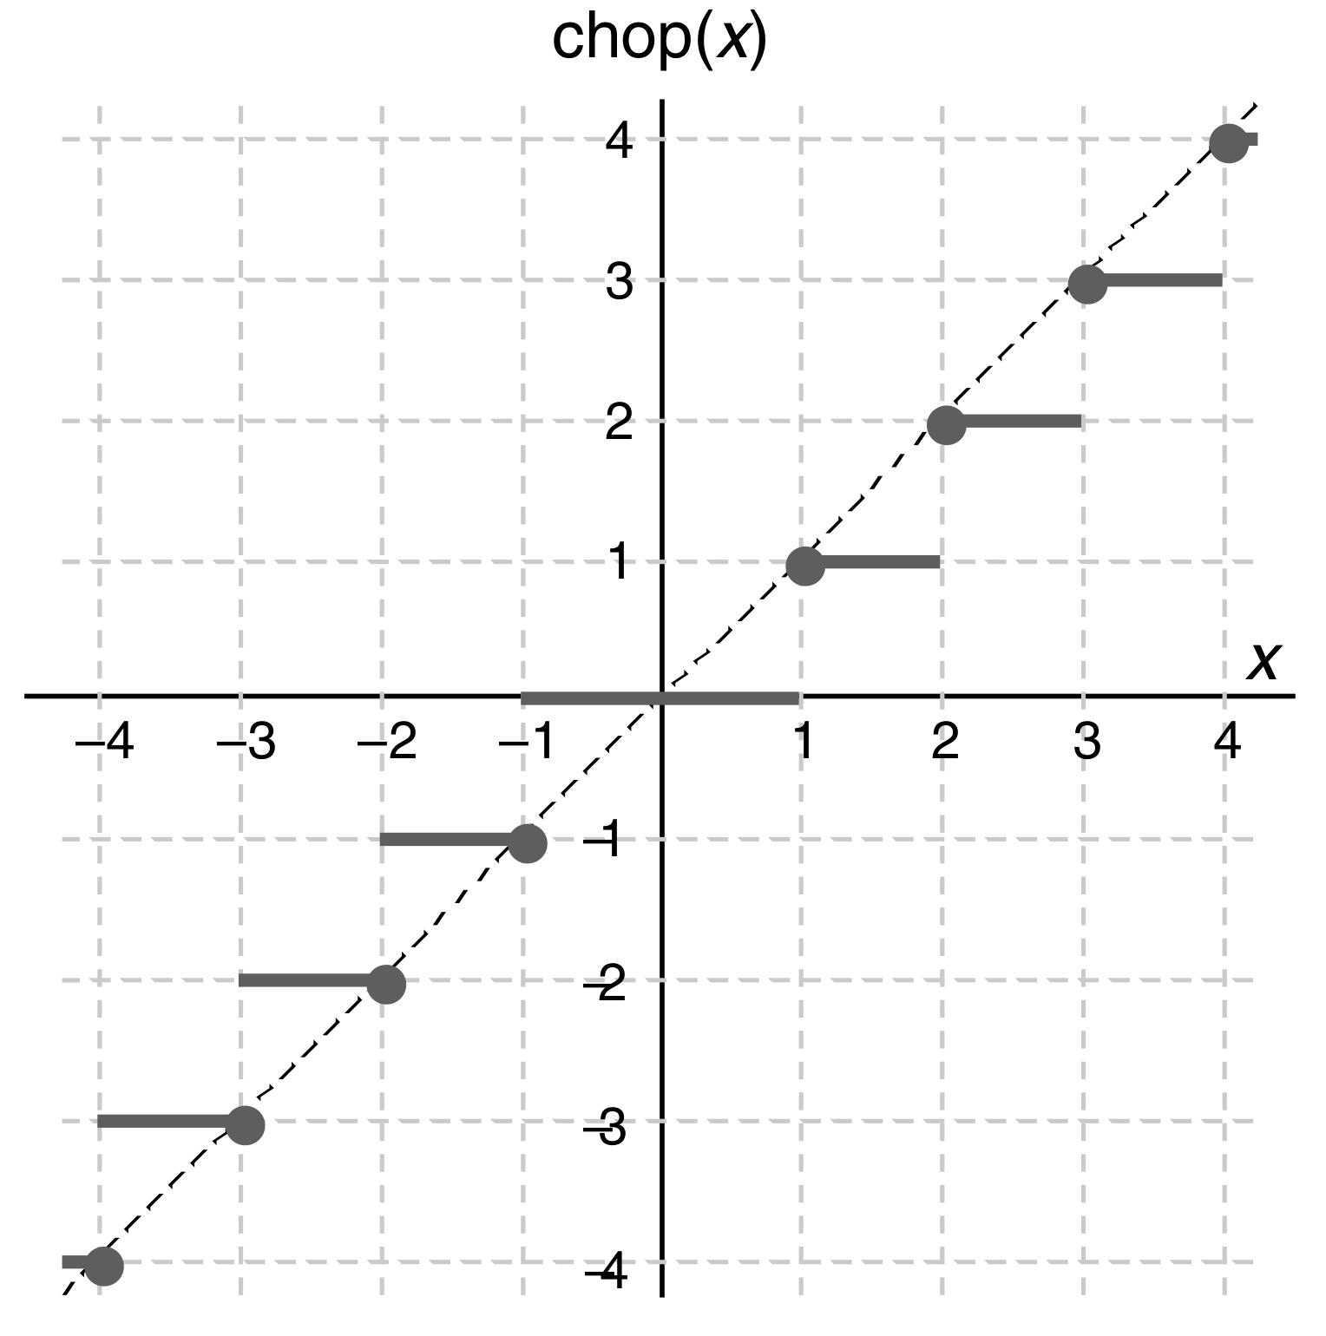
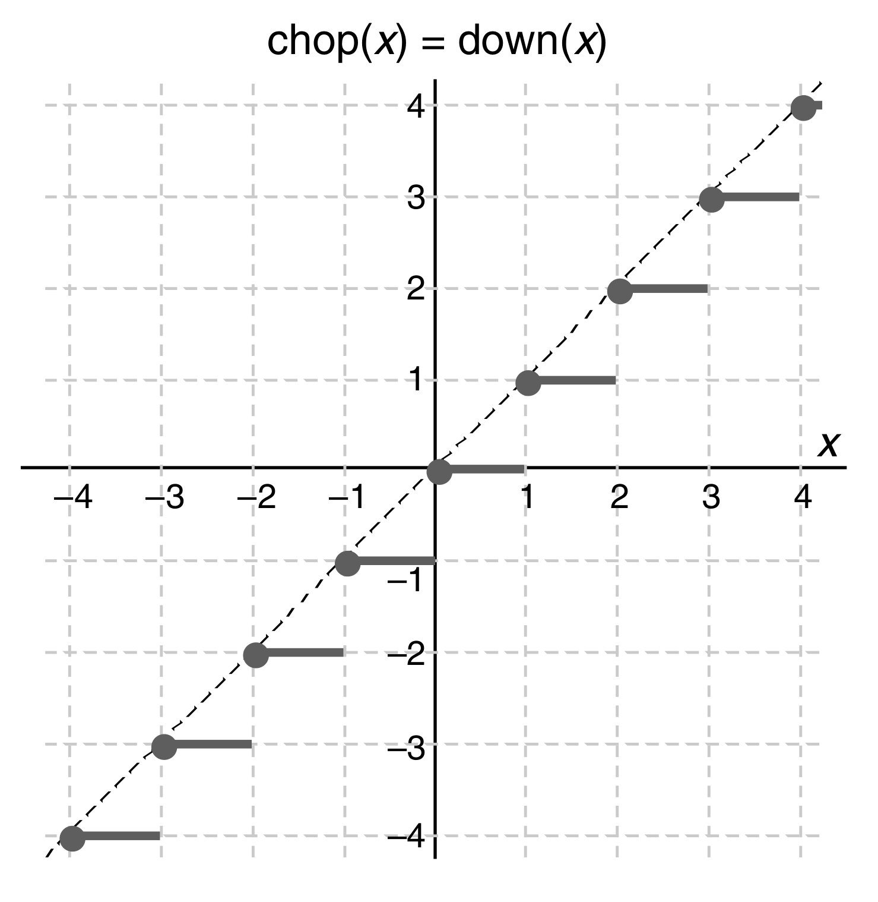
Chop
Fig1. Truncation or chopping of a signed-magnitude number (same as round toward 0).
Fig2. Truncation or chopping of a 2’s-complement number (same as downward-directed rounding,or rounding toward −∞).

Slide 3
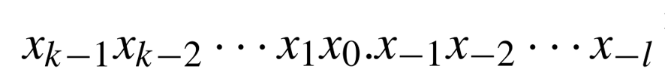

Chop
补码
原码
1110.11
1001.01(-1.25)
1110
1010(-2)
反码+1
Fig2. Truncation or chopping of a 2’s-complement number (same as downward-directed rounding,or rounding toward −∞).

Slide 4
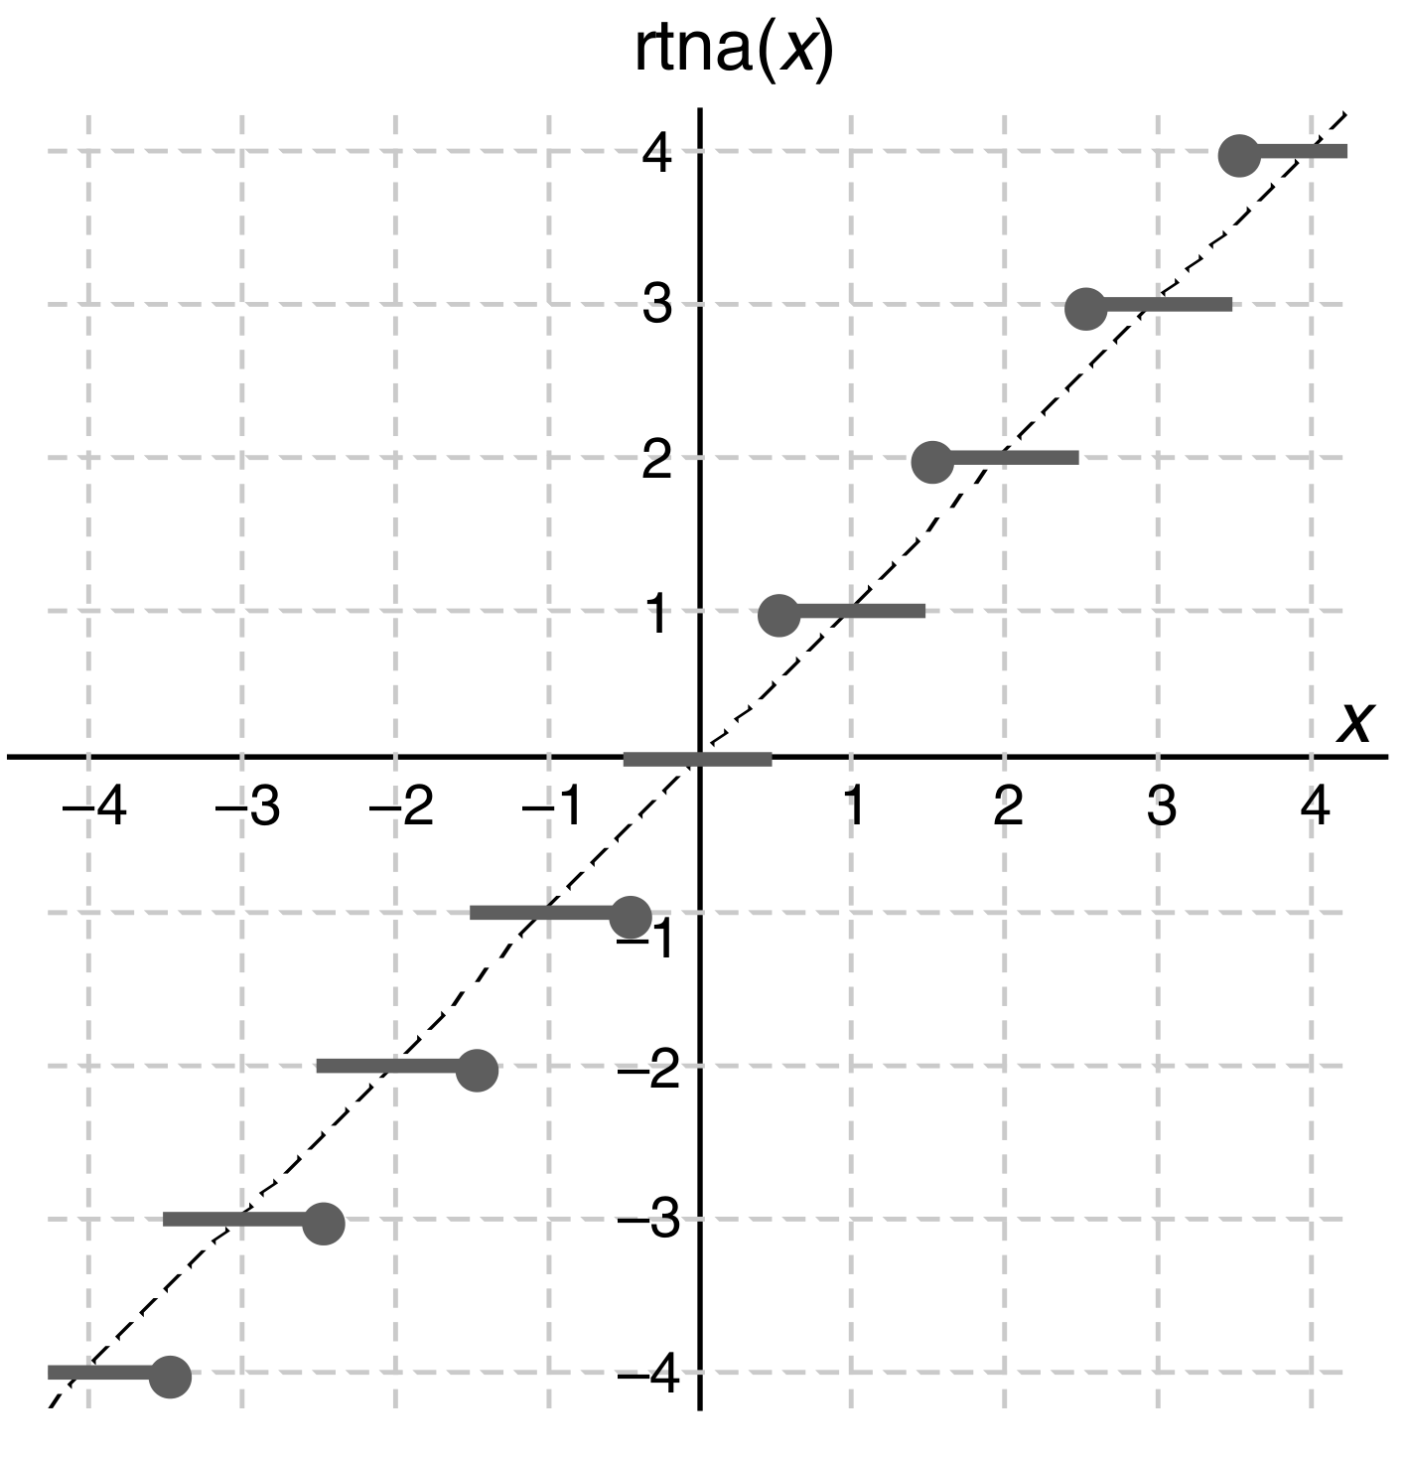
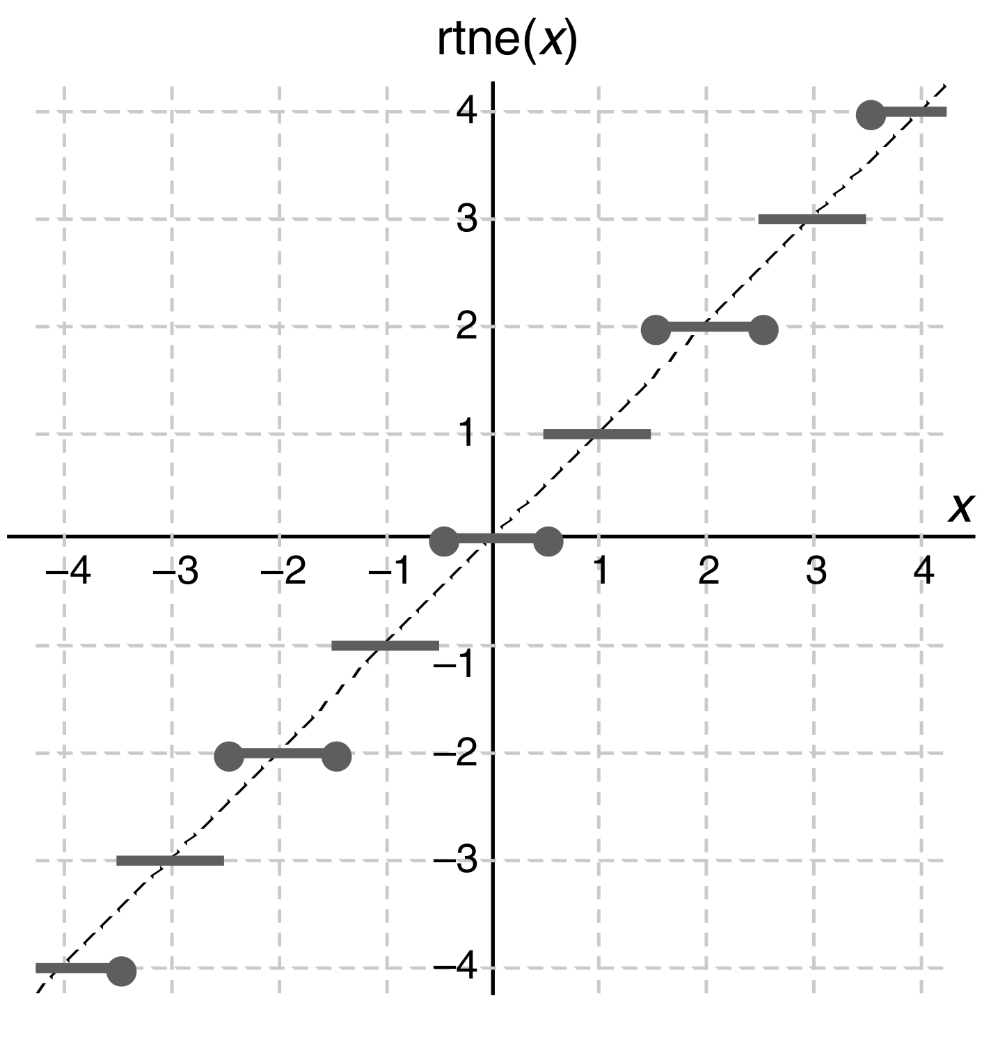
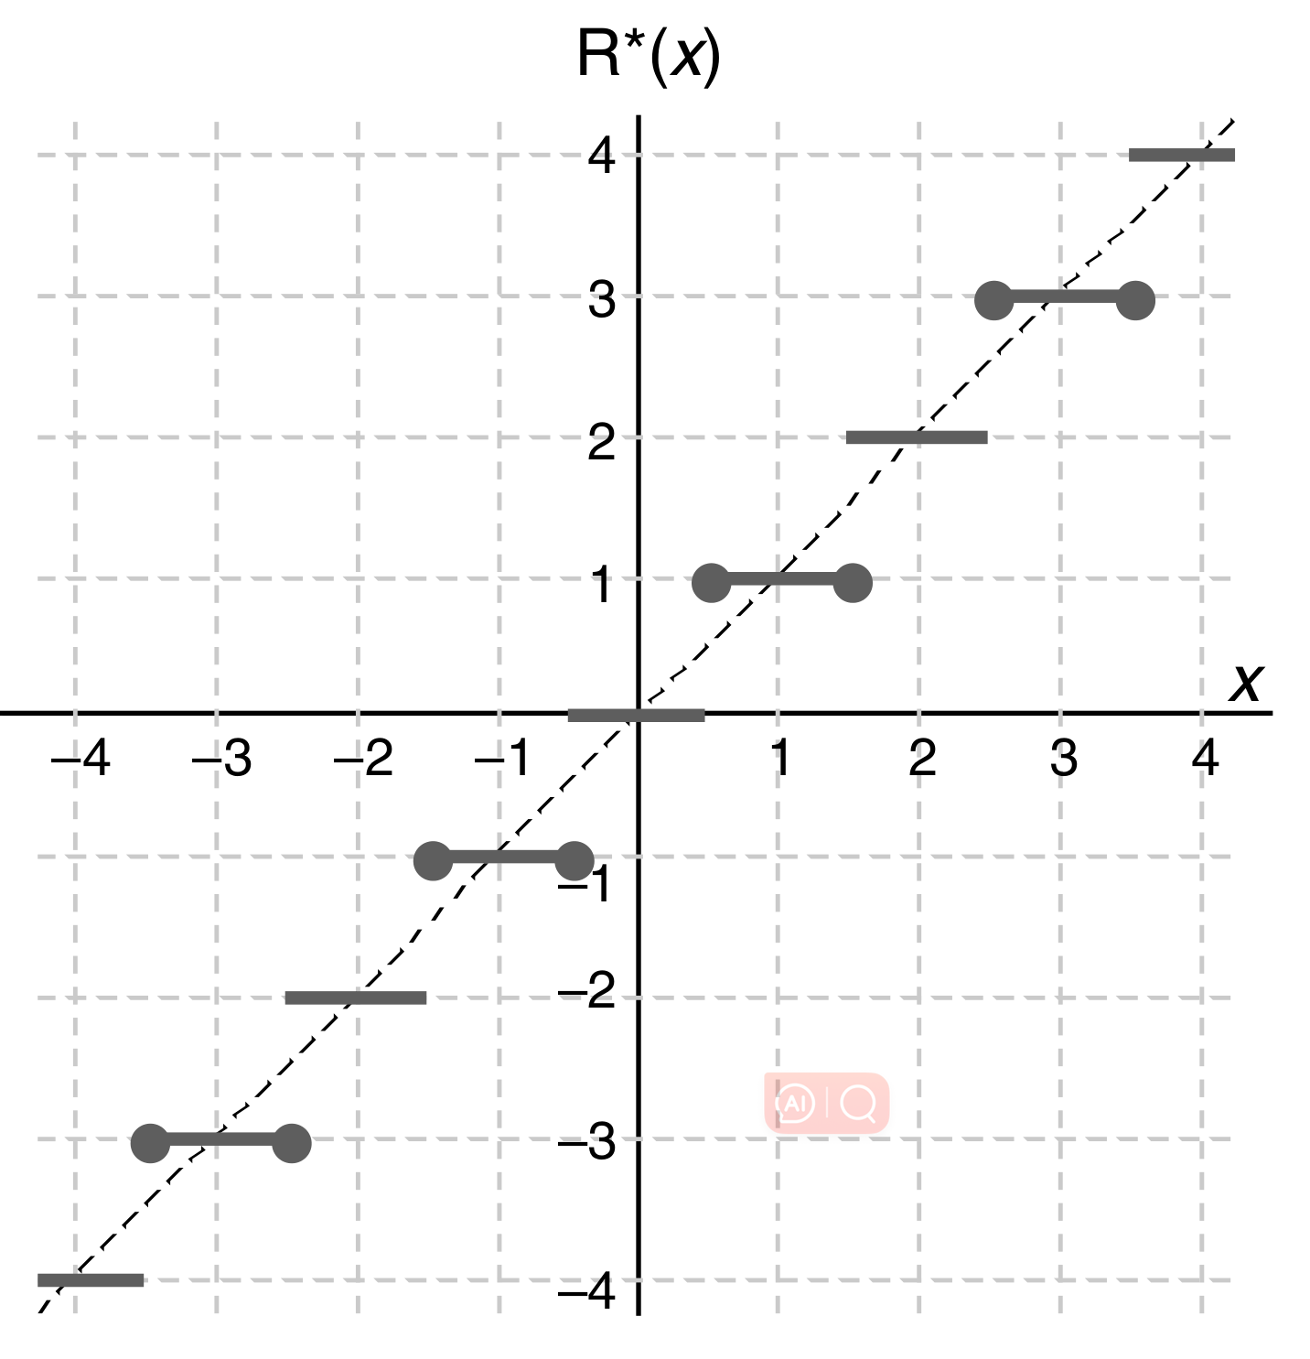
Rtna/Rtne/Rtno
1.5(2) + 2.5(3) = 5
1.5(2) + 2.5(2) = 4
1.5(1) +2.5(3) = 4

Slide 5
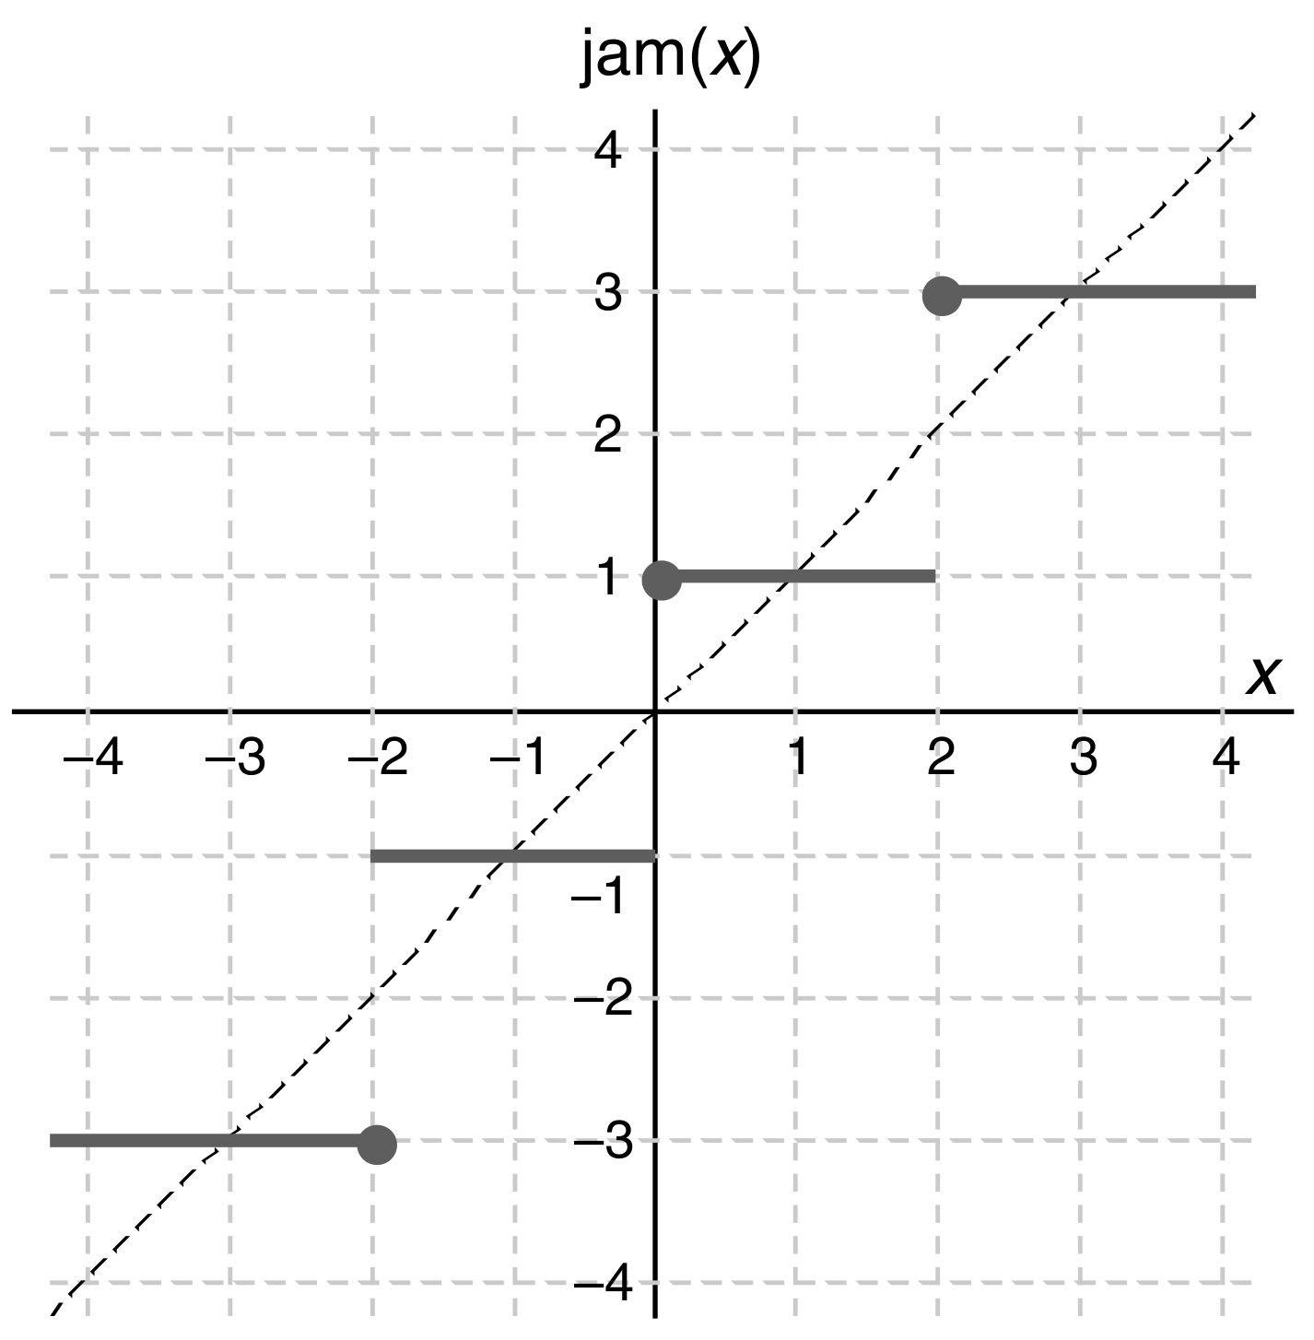
Jamming/von Neumann rounding
1.5(1) + 2.5(3) = 4
0.1(1) + 2.1(3) = 4

Slide 6
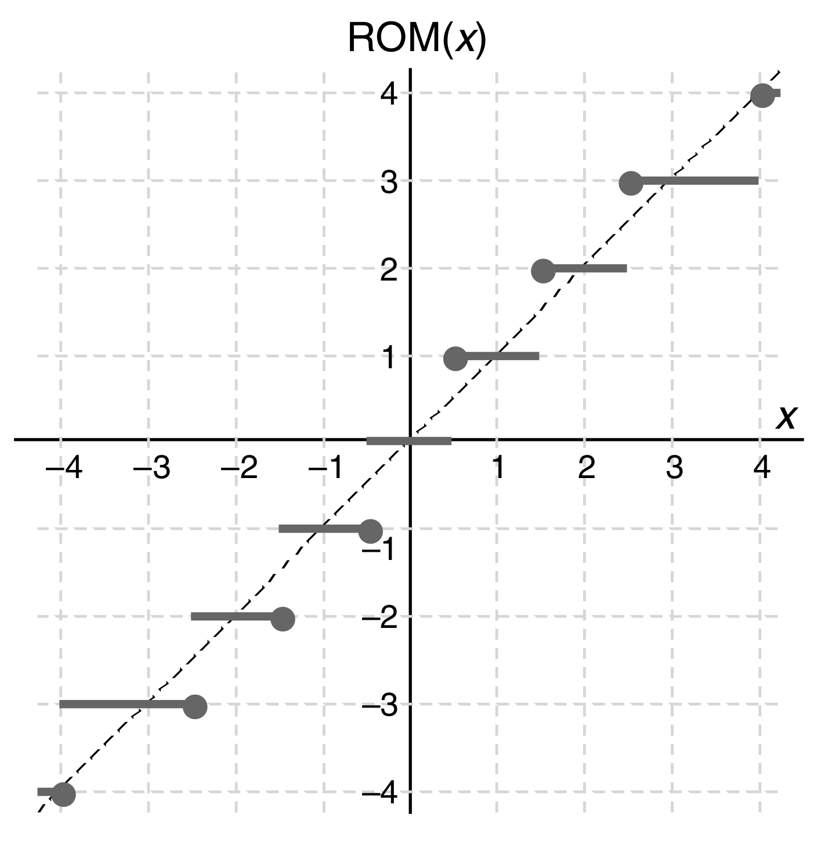
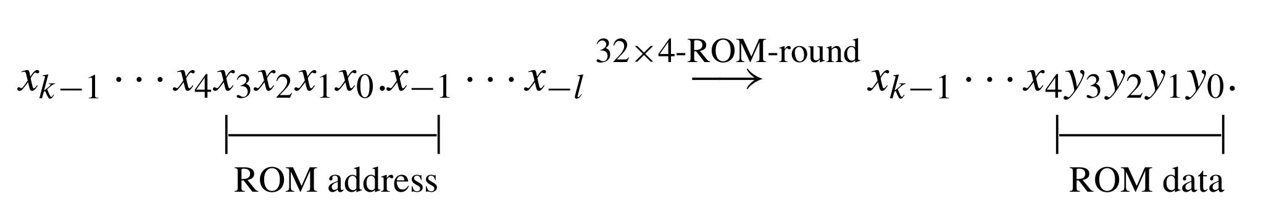
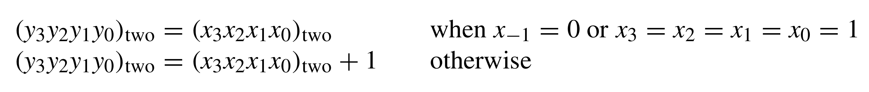
ROM

Slide 7
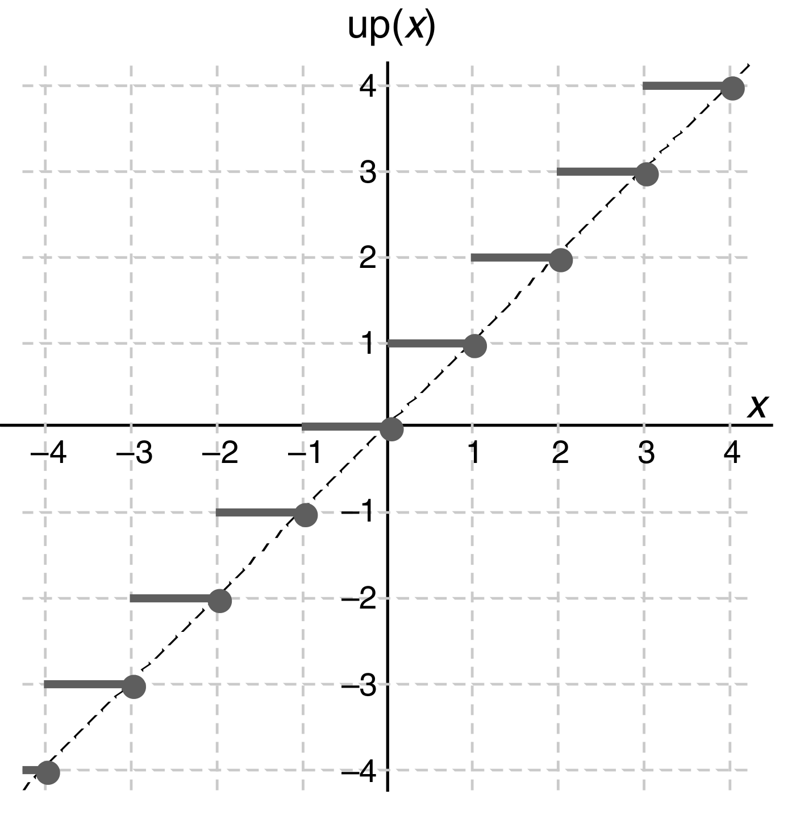
Up/Down

Slide 8
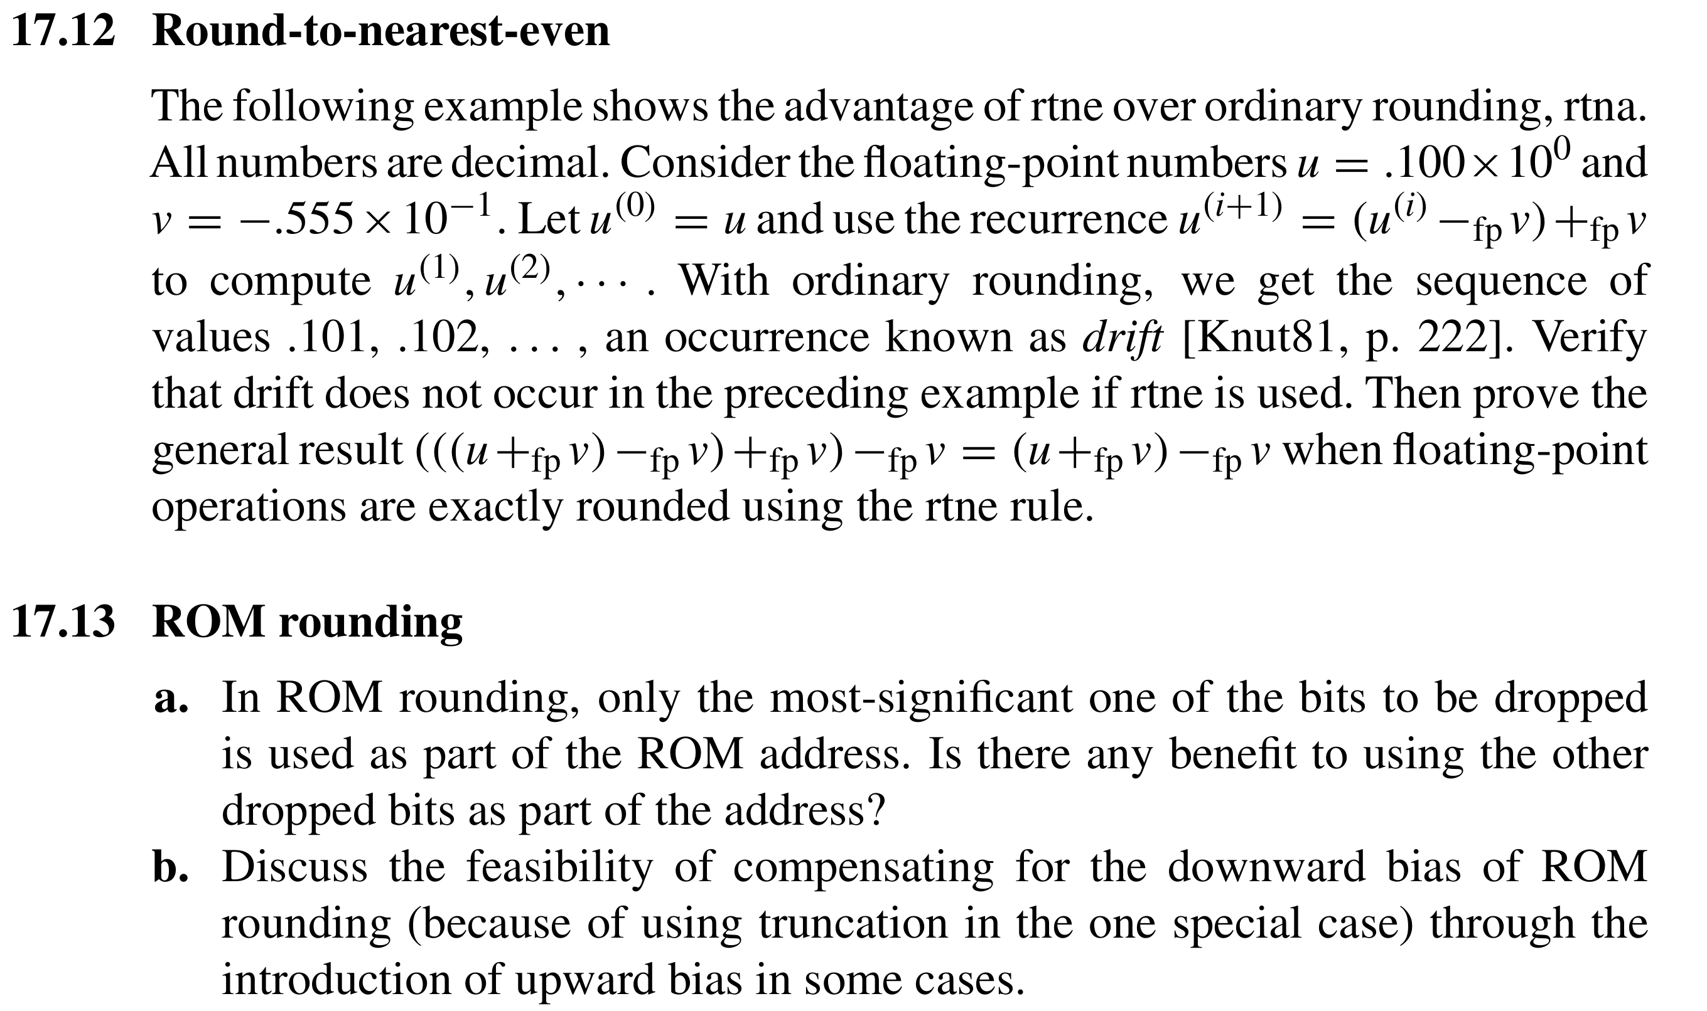

Problem
Rtna
Rtne
.100 + .0555 = .1555
= .156
.100 + .0555 = .1555
= .156
.156 - .0555 = .1005
= .101
.156 - .0555 = .1005
= .100

Slide 9
Why rounding ？

Slide 10
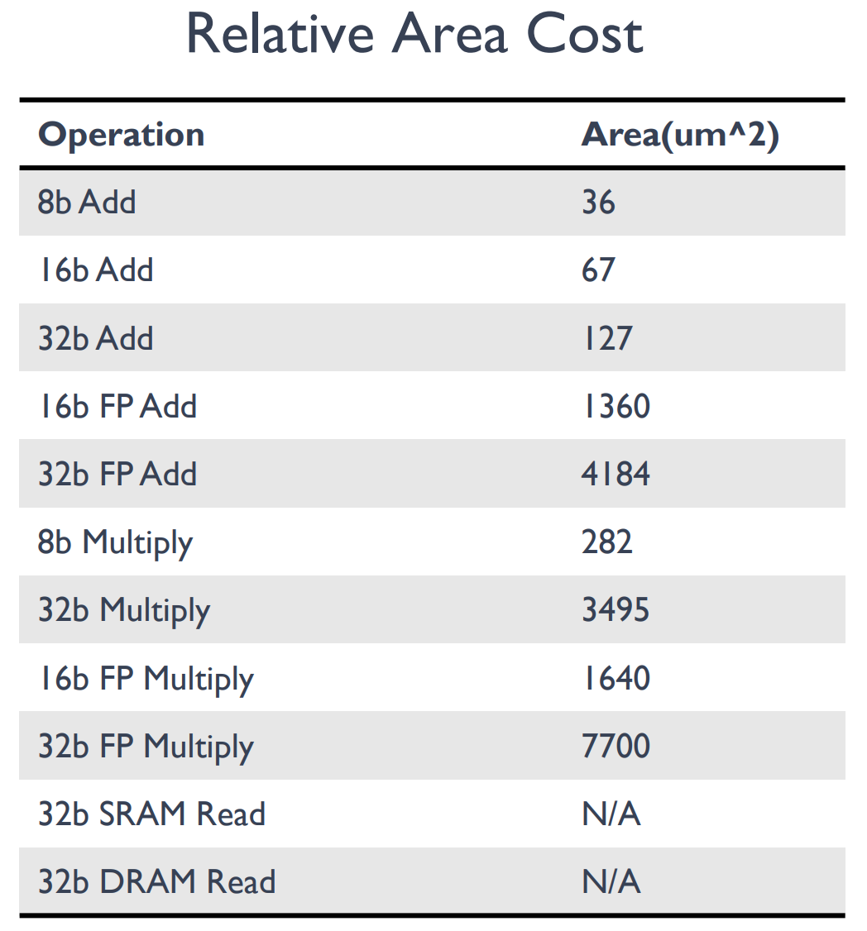
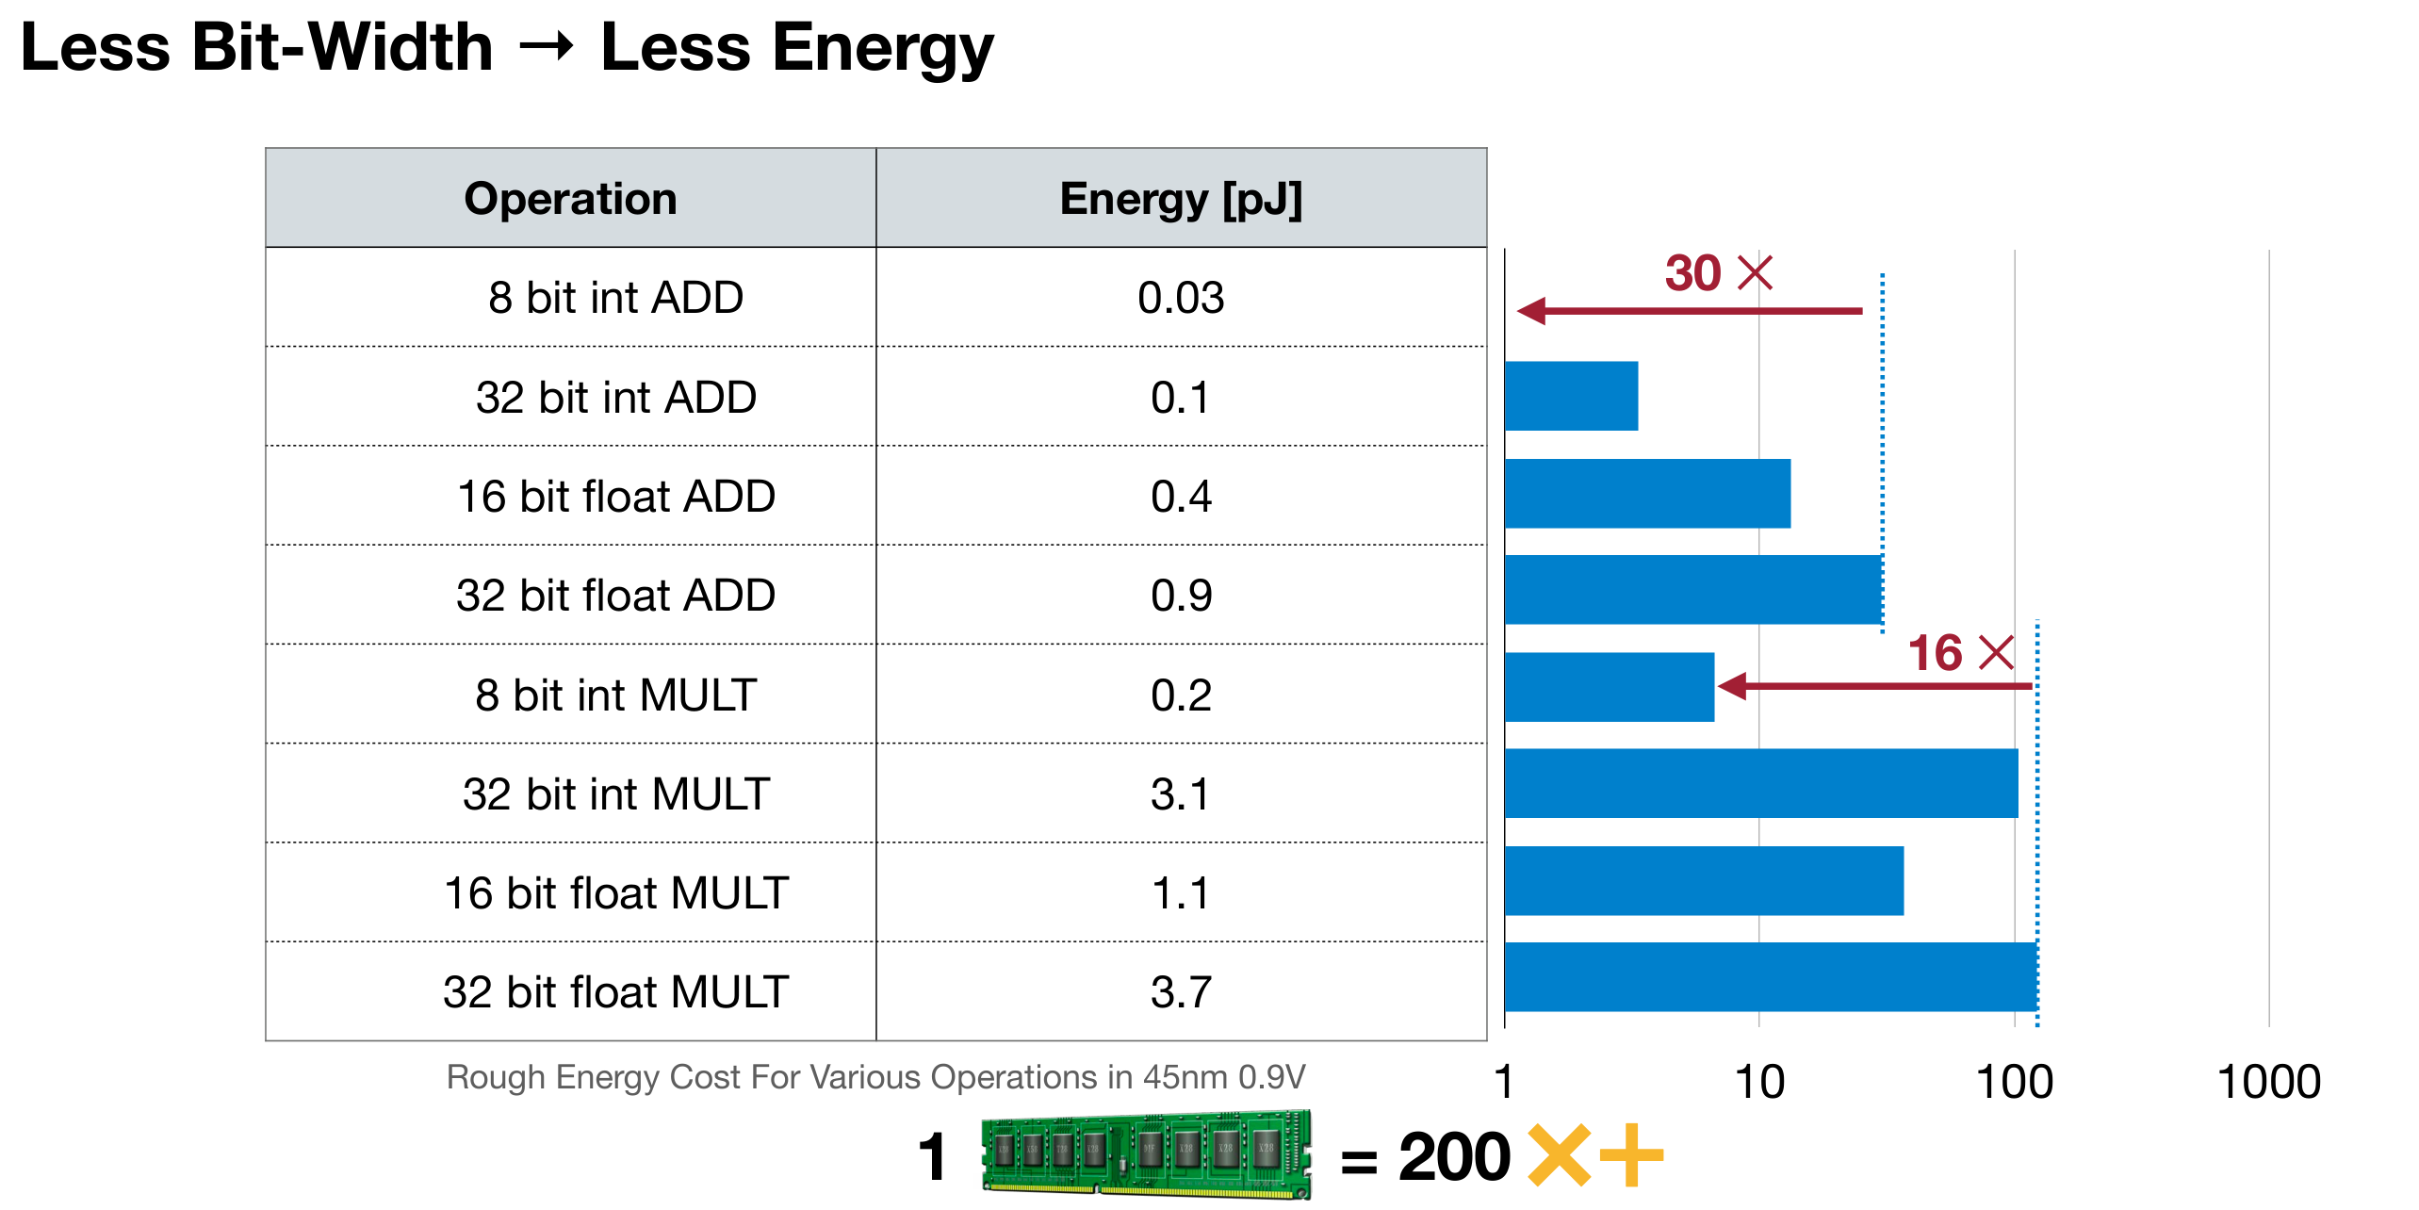
Low Bit-Width Operations are Cheap

Slide 11
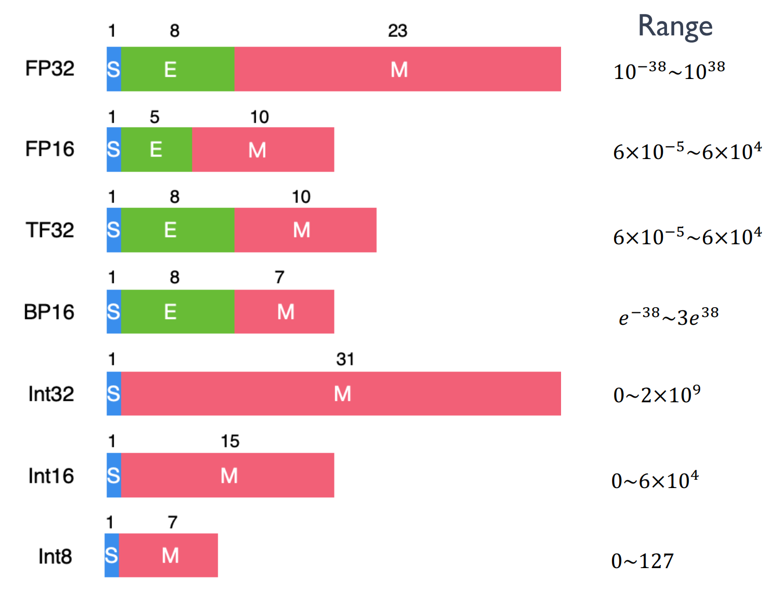
Bit-width in Neural Network

Slide 12
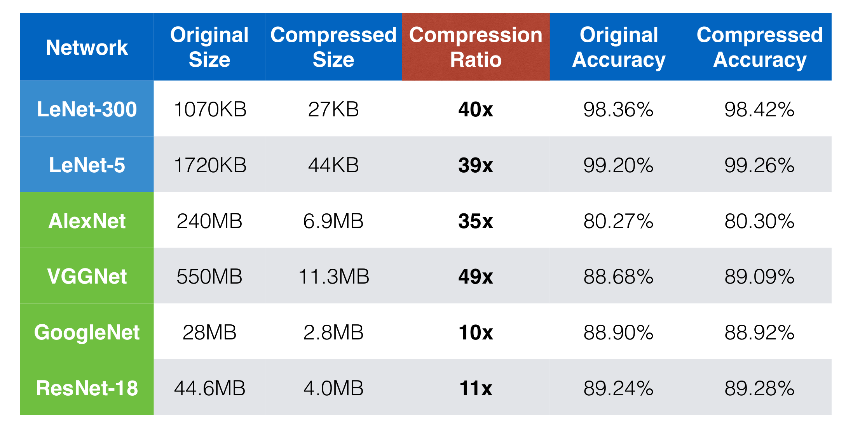
Quantization

Slide 13
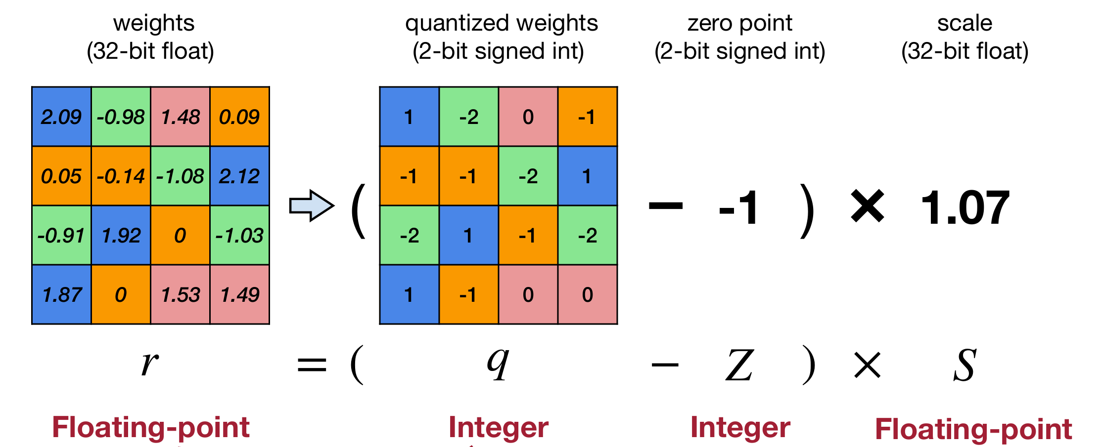
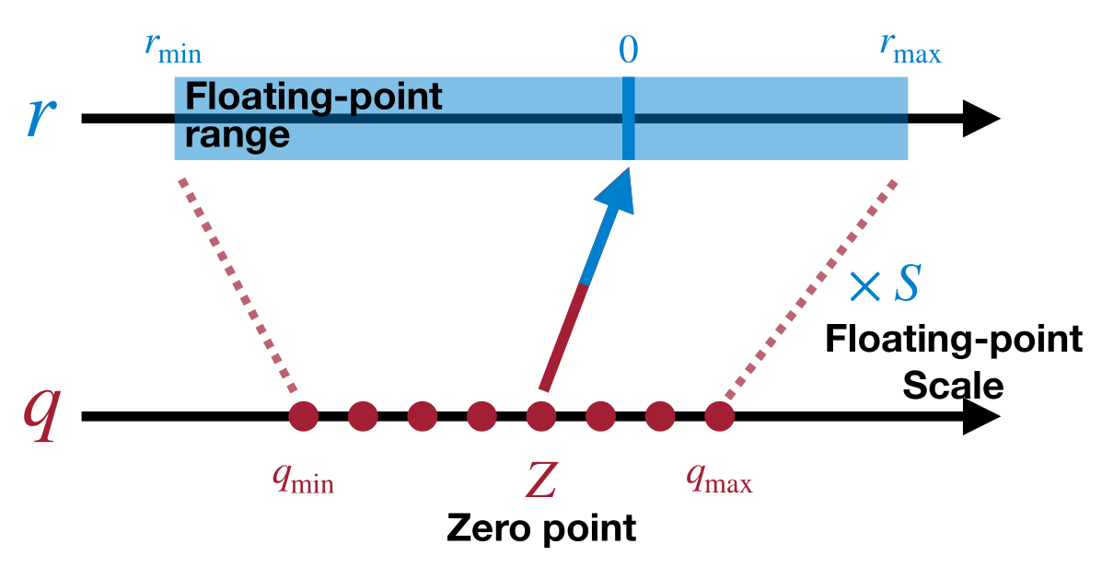
Quantization

Slide 14
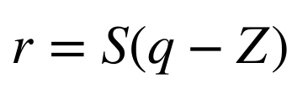
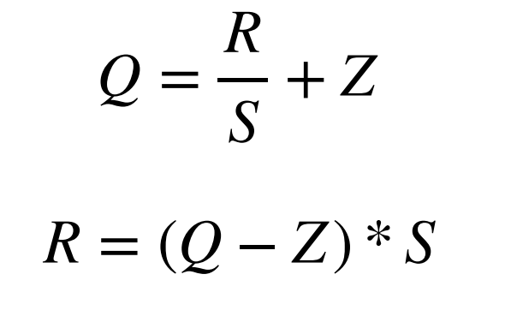
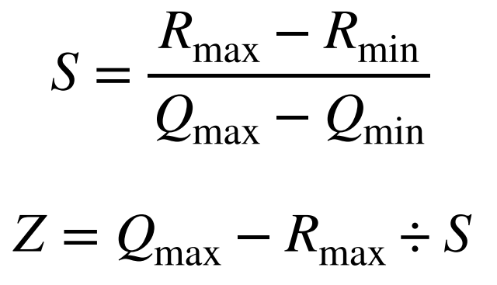
Quantization
R 表示输入的浮点数据
Q 表示量化之后的定点数据
Z 表示零点（Zero Point）的数值
S 表示缩放因子（Scale）的数值
Rmax 表示输入浮点数据中的最大值
Rmin 表示输入浮点数据中的最小值
Qmax 表示最大的定点值（127 / 255)
Qmin 表示最小的定点值（-128 / 0）

Slide 15
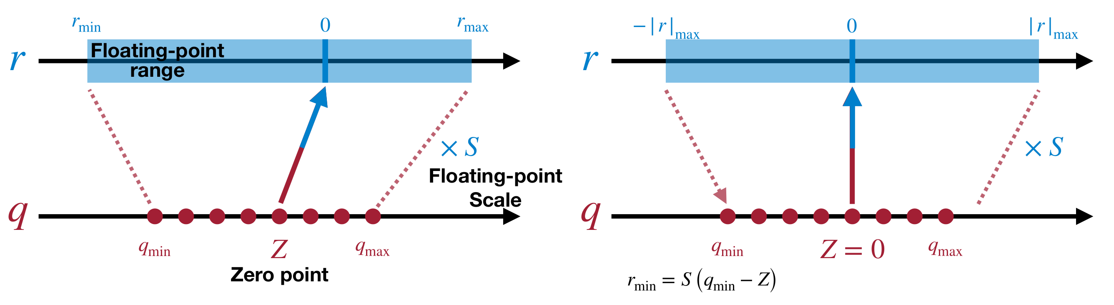
Linear Quantization

Slide 16
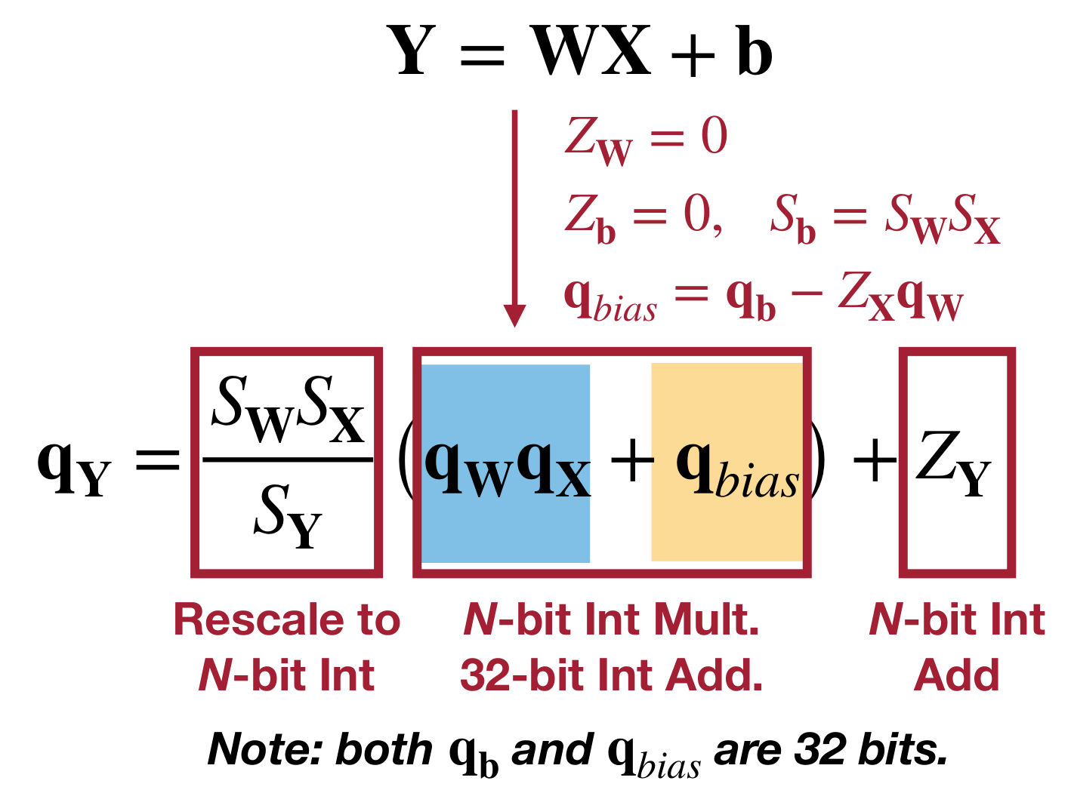
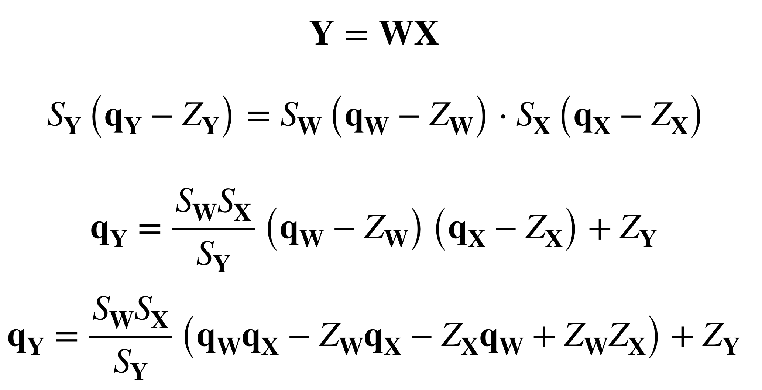
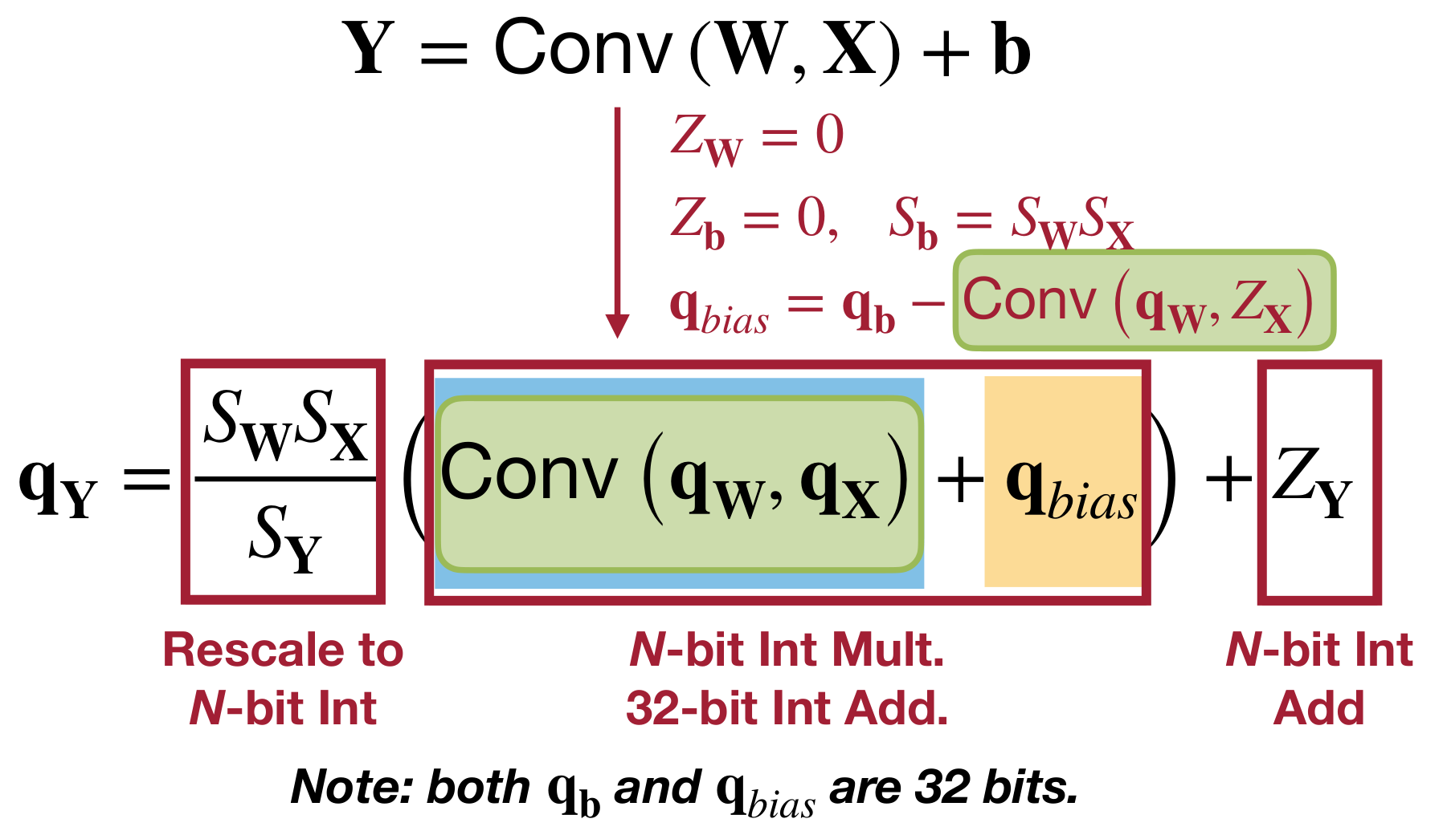
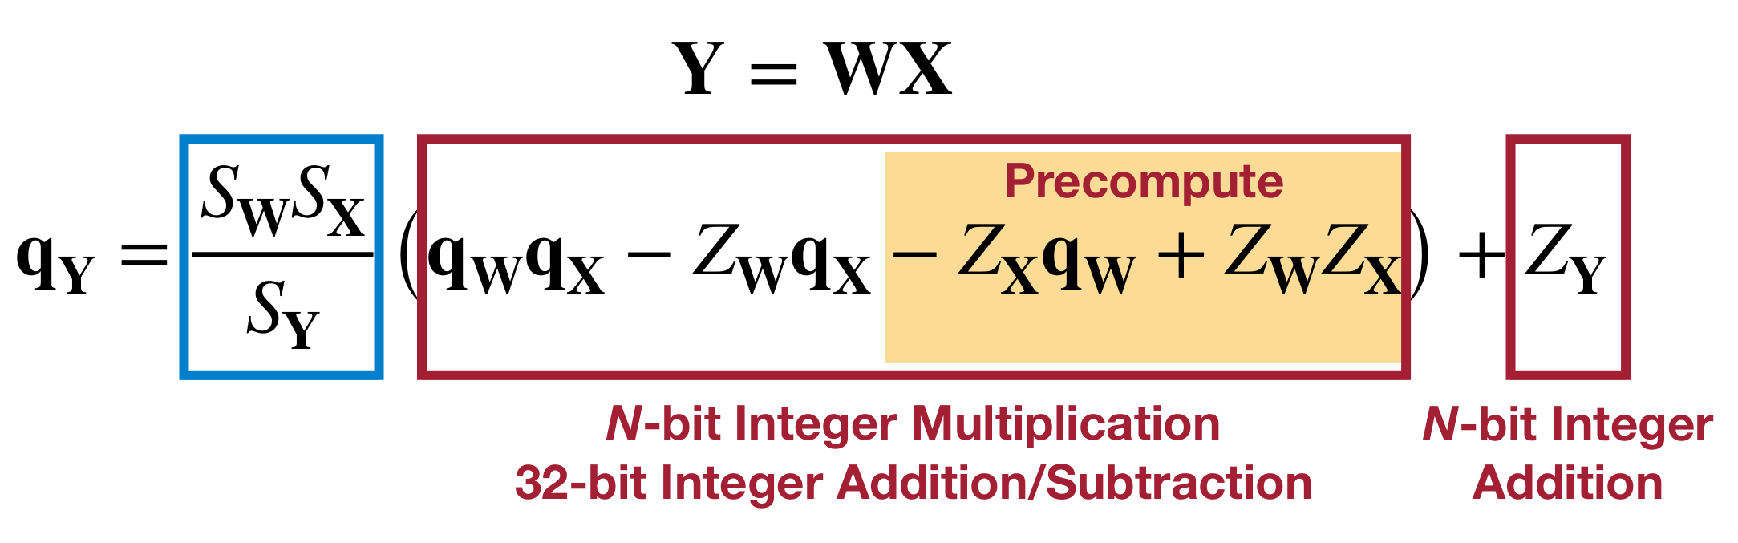
Quantization

Slide 17
References
MIT 6.5940 TinyML and Efficient Deep Learning Computing https://efficientml.ai
https://github.com/chenzomi12/DeepLearningSystem/tree/main
Jacob B, Kligys S, Chen B, et al. Quantization and training of neural networks for efficient integer-arithmetic-only inference[C]//Proceedings of the IEEE conference on computer vision and pattern recognition. 2018: 2704-2713.

