Slide 1

CMR COLLEGE OF ENGINEERING & TECHNOLOGY
(UGC AUTONOMOUS)
KANDLAKOYA, MEDCHAL ROAD, HYDERABAD-501401
DEPARTMENT OF
COMPUTER SCIENCE AND ENGINEERING
MULTILINGUAL MACHINE TRANSLATION
Team Members
Gouher Naaz -17H51A0524
Kondi Saikiran -17H51A05E6
Porika Dhanrajnath -17H51A05G4
Guide – Dr. N. SWAPNA
Batch-46

Slide 2
OUTLINE
INTRODUCTION
EXISTING SYSTEM
PROPOSED SYSTEM
OBJECTIVE
REQUIREMENTS
DESIGN
RESULT
CONCLUSION

Slide 3
INTRODUCTION
This project Multilingual Machine Translation is a computerized system that is designed to translate source text from various natural languages into target text of another natural languages.
Translation is needed because it enables communication between people from different regions. It provides meaningful communication from one language to another language.
MMT is a courier for the transmission of knowledge, a protector of culture heritage and boost in tourism. India is a multilingual country with millions of people speaking variety of languages.

Slide 4
EXISTING SYSTEM
There are many translators online, that provide functionality to translate the language into target language.
Some of the translators like ‘Bablyon Online translator’ and ‘Reverso’ in the market just provide a single text input function to translate the language and doesn’t accept image file and voice as input.
All these existing systems have similar and single feature(typing-text). To overcome this type of issues MMT is introduced.

Slide 5
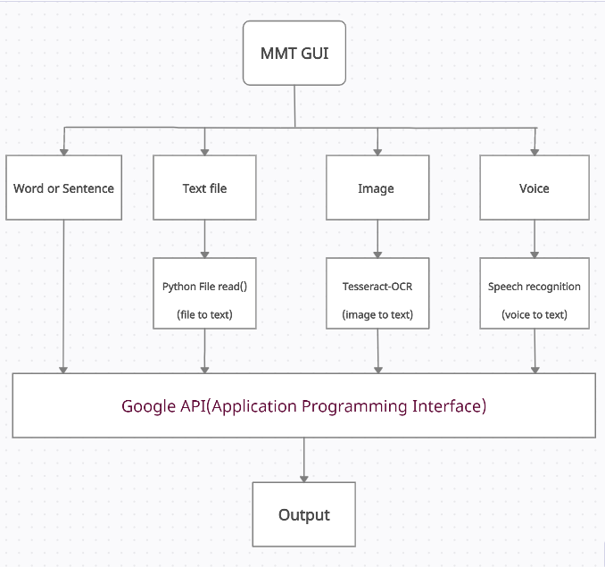
Proposed system

Slide 6
PROPOSED SYSTEM
The system which proposed is used to translate source language into target language, here Source language is detected automatically and the target language code should be given by the user which is provided.
This Multilingual machine translator is a tool to translate text, words, phrases from one language to any other language by using Google API i.e., google_trans_new which is python library.
This system supports all Indian regional languages. We are checking telugu, hindi and urdu languages for translation accuracy.
This proposed system has additional features like Image text translation and voice input translation.

Slide 7
OBJECTIVE
To develop a model which is used to translate the source language into target language by providing various features.
The ultimate goal of Multilingual Machine Translation (MMT) project is to develop one model for translation between as many Indian languages as possible by effective use of available linguistic resources.

Slide 8
REQUIREMENTS
SOFTWARE REQUIREMENTS
OPERATING SYSTEM : Windows or Mac OS.
GOOGLE COLAB or Jupyter Notebook (ANACONDA) for developing the system.
Stable Internet
HARDWARE REQUIREMENTS
HARD DISK: minimum 20GB, recommended 100GB or more
RAM: Minimum 4GB or more
PROCESSOR: intel i5 or more latest versions

Slide 9
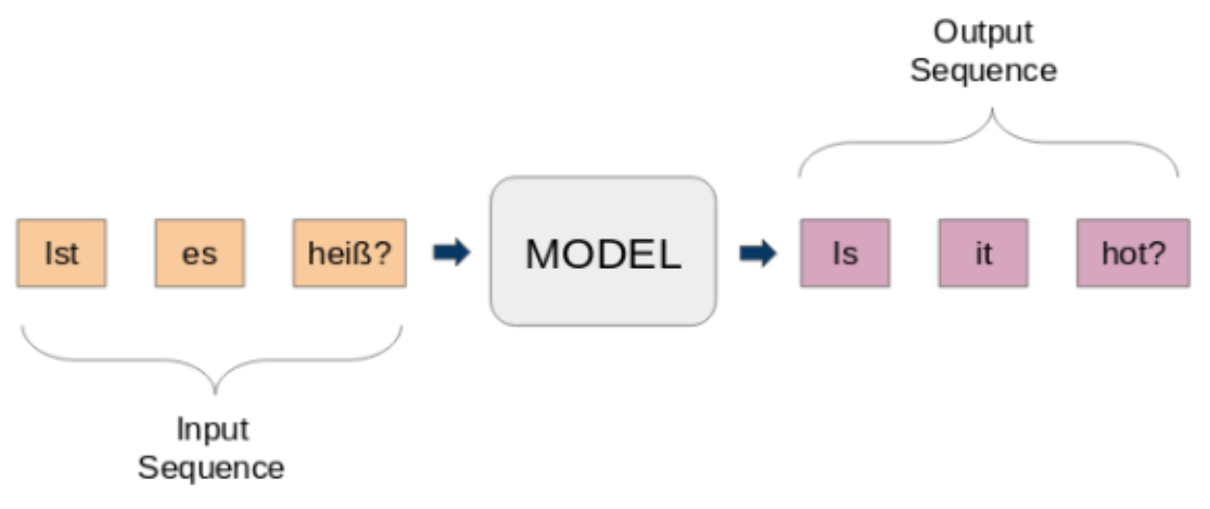
Model
MMT

Slide 10
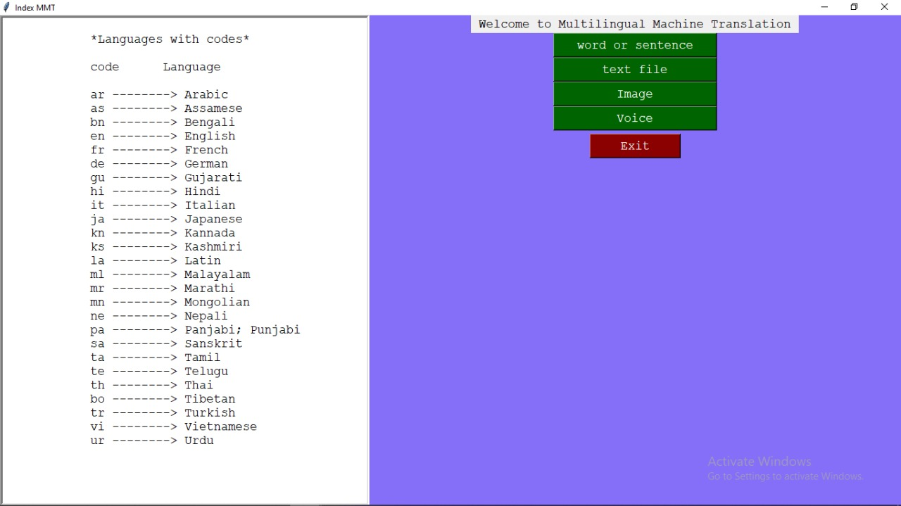
DESIGN
To implement this project, we will use the concepts of Python, Tkinter, and google_trans_new libraries.
In this project, the user will be able to select various kinds of input like text, text file, image and voice to translate any language by selecting the target output language.

Slide 11
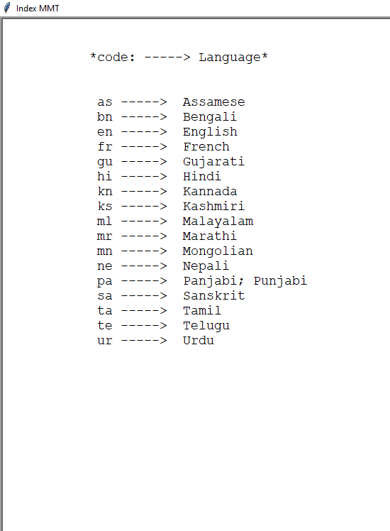
Googletrans
Google_trans_new is a python library. We import the Translator from google_trans_new, which is used to do translations.
We also import LANGUAGES from google_trans_new which support various languages but we only involved Indian regional languages.
Langdetect is python library which is used to detect source text language automatically.

Slide 12
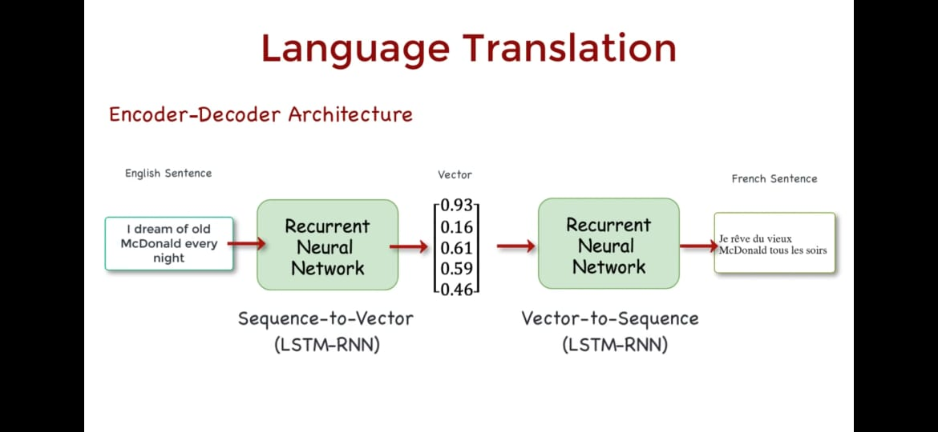
Neural Machine Translation

Slide 13
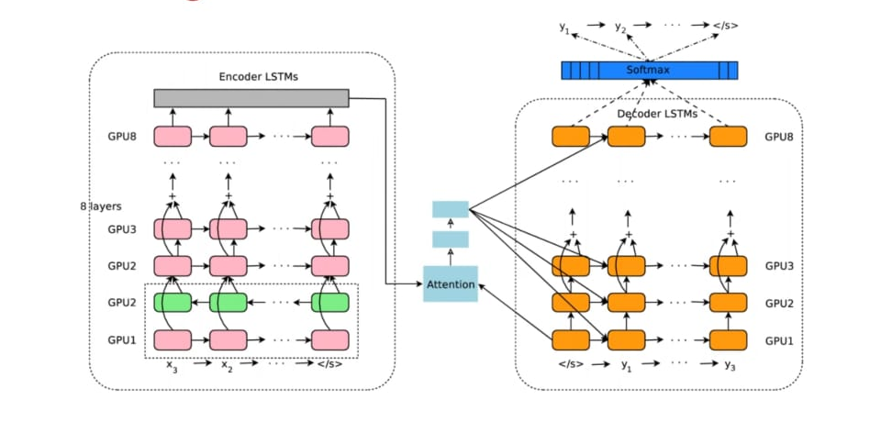
LSTM-RNN Architecture

Slide 14
Neural machine translation (NMT) is an approach to machine translation that uses an artificial neural network to predict the likelihood of a sequence of words, typically modelling entire sentences in a single integrated model.
The word sequence modeling was at first typically done using a recurrent neural network (RNN). RNN captures the sequential information present in the input data i.e. dependency between the words in the text while making predictions.
A bidirectional recurrent neural network, known as encoder, is used by the neural network to encode a source sentence for a second RNN, known as decoder, that is used to predict words in target language.

Slide 15
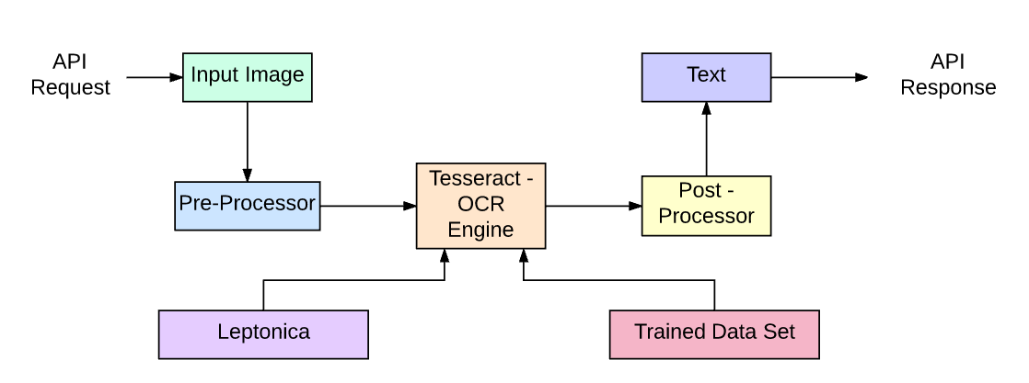
OCR process flow

Slide 16
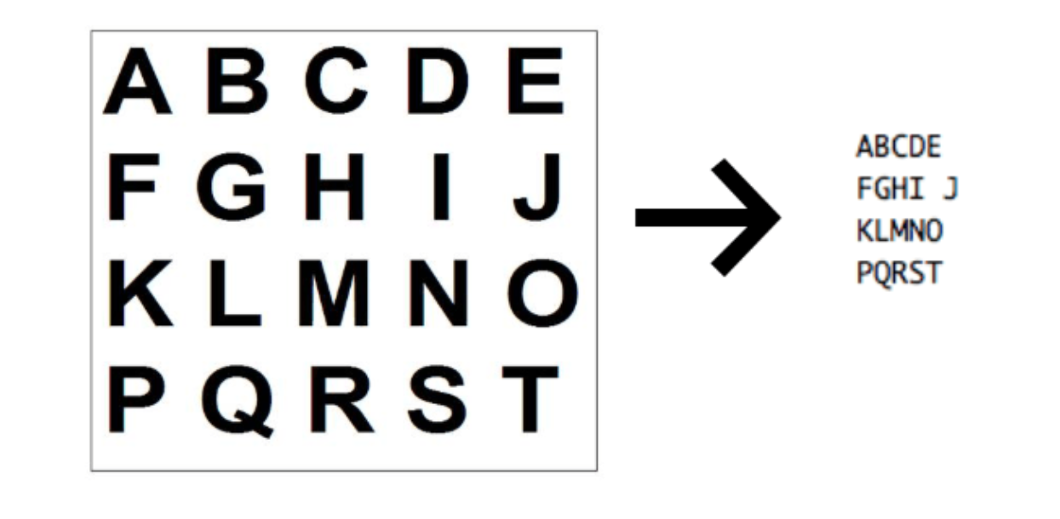
Tesseract
It is an optical character recognition engine with open-source code, this is the most popular and qualitative OCR-library.
OCR uses Leptonica and Trained data set for image processing and it recognize text.

Slide 17
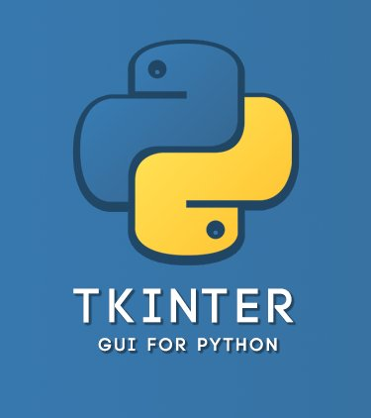
TKINTER
Tkinter is the standard GUI library for Python.
Python when combined with Tkinter provides a fast and easy way to create GUI applications. Tkinter provides a powerful object-oriented interface to the Tk GUI toolkit.

Slide 18
TECHNOLOGY
Integrated development editor:
Jupyter Notebook
Tech framework used to develop this system are:
Python 3.6
Python Libraries.
Tesseract-OCR
Speech Recognition
Tkinter

Slide 19
RESULTS
This model consists of four different input methods to take input from the users. They are:-
word or sentence 3. image
text document 4. voice
Language | Dataset length
telugu | 400 documents
hindi | 250 documents
english | 800 documents
urdu | 4797 words

Slide 20
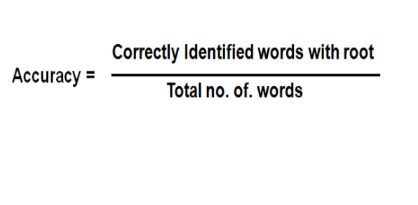
Accuracy formula :

Slide 21
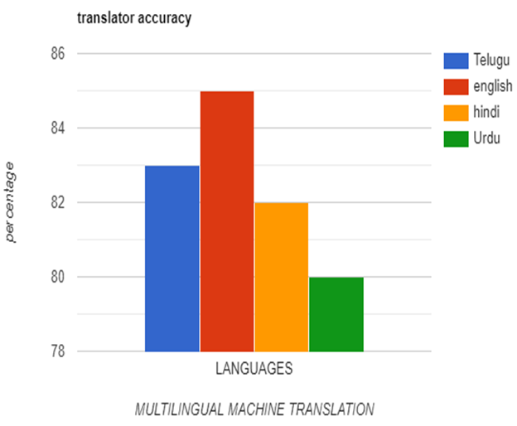
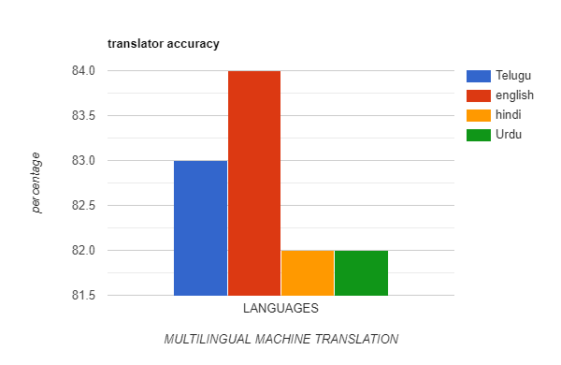

Slide 22
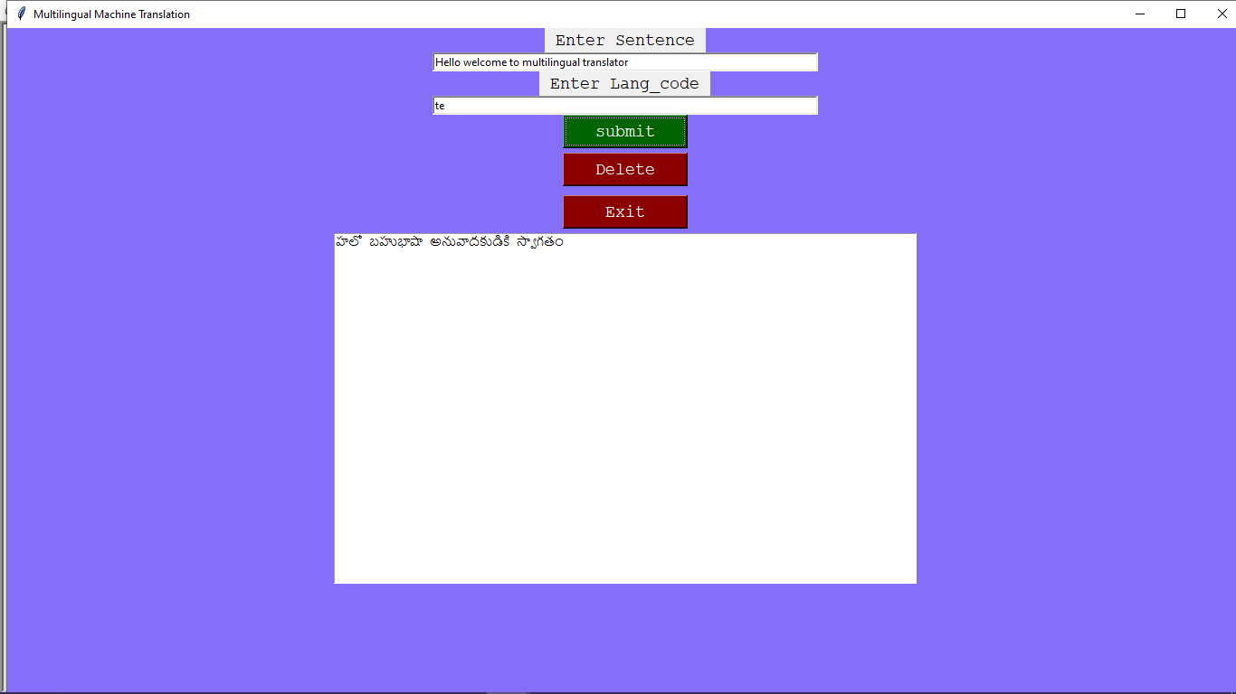
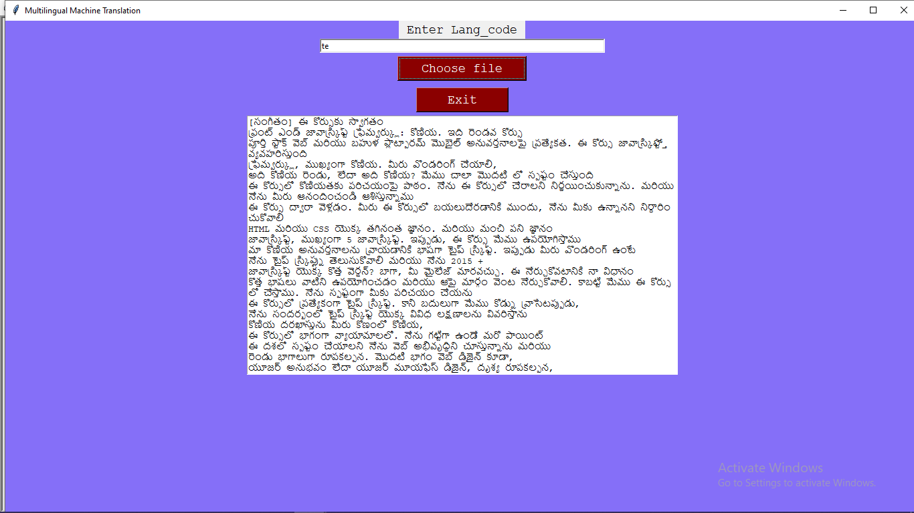
RESULTS
word or sentence
text document

Slide 23
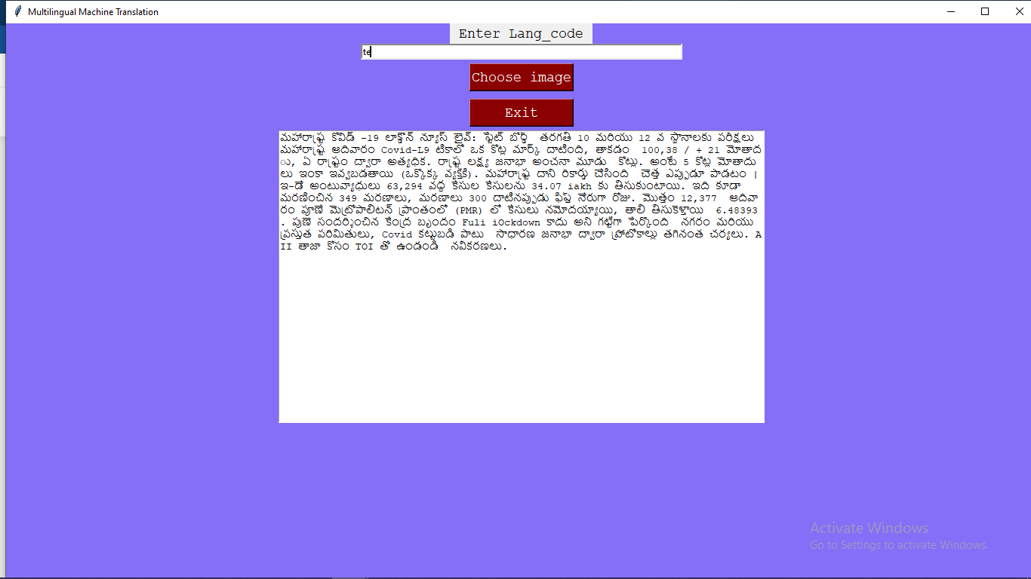
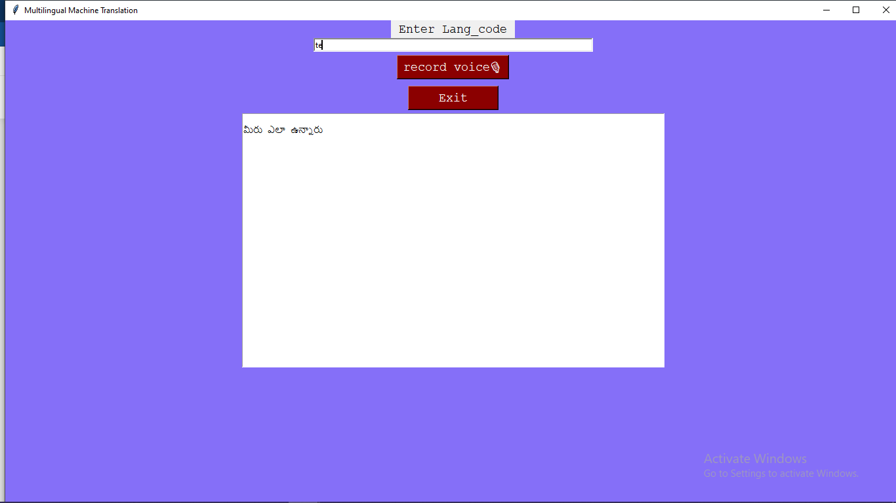
RESULTS
image
voice

Slide 24
CONCLUSION
Machine translation is challenging given the inherent ambiguity and flexibility of human language.
The work presented in this project is also promising, because it demonstrates an effective translation.
In the future this project can be upgrade by implementing the text to speech of target language, accepting noisy images and can increase accuracy of the project.

Slide 25
THANK YOU !!

