Slide 1
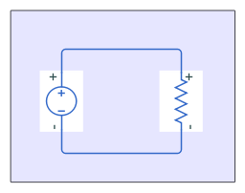

Water Wheel
Modeling of electrical system
Rolling resistance is

