Slide 1
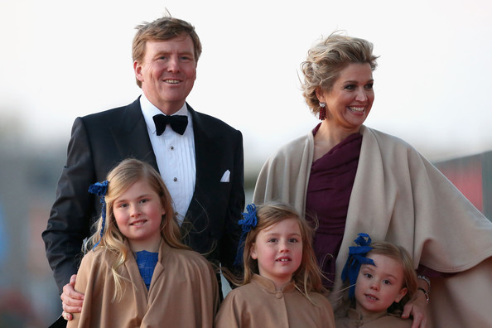
C++ Inheritance⁽¹⁾
(1) and Object Oriented Programming
Notes:
Inherit titles, land, money, biological traits and 'class'.

Slide 2
Object Oriented Programming
Topics these lectures
  Prototypical problems
  OOP
  Inheritance
  Polymorphism
  Two Design Patterns
Notes:
OOP needs much thinking
C++ already programming without training wheels
Classes look different from various perspectives
Who knows what about whom
Honderd gevangenen en een gloeilamp.

Slide 3
Prototypical problems
Several problem statements:
  given an algorithm, of which some parts can not yet be specified, how can we implement such an algorithm?
Notes:
Find/sort by as yet unknown criteria.

Slide 4
Prototypical problems
Several problem statements:
  given facilities as offered by, e.g., the stream classes, how can we make them available for new devices, as yet unknown and non-existing?
Notes:
How to talk to an EKP (Entangled KeyPair)
How to talk to a smartphone (in 1990)
K&R: everything is a file

Slide 5
Prototypical problems
Several problem statements:
  given facilities as offered by callback functions like qsort's (*compare)() parameter, how can we enforce type-safety and pass context-information to those functions?
Notes:
Compare takes const void* parameters.
compare may be nullptr.
What if compare needs more information beyond those void *

Slide 6
Prototypical problems
General approach:
  define an interface
  implement that interface in a class
  problem: only one class implements the interface
class offering
an interface
time
class using
that interface
Notes:
Interface is like a contract between caller and called:
- what functions should exist, and
- what parameters should be present.

Slide 7
Prototypical problems
Problem: only one class implements the interface
Solution: create a reusable interface
  Any class offering that interface may be used by software expecting that interface
  The interface does not exist to be used (by other classes offering/expanding the interface) but to be reused (through the `reusable' class)
Notes:
However, C++ is not duck-typed.
And templates are Not Covered.
User of stream cannot use EKPstream if it has to call particular member functions.

Slide 8
Prototypical problems
solution:
  The reusable interface may be implemented by multiple classes.
class offering
an interface
class expecting
that interface
time
class
implements
the interface
class
implements
the interface
class
implements
the interface
Notes:
Time may be long, in decades

Slide 9
Object Oriented Programming
OOP is commonly associated with
  Inheritance
    create new classes from existing ones
  Polymorphism
    reimplement the interface of a basic class
OOP disadvantage:
  Almost the strongest possible coupling
    never use stronger coupling than required
    alternatives?
Notes:
Objects – how we perceive the world
Inheritance – A human has some traits a big ape has.
Polymorphism – A human is a specific kind of animal.
Combined: a kind of fool implemented as a big ape
Strong coupling in humans → lifelong responsibilities

Slide 10

Class Diagrams

Slide 11
Simplest Public Inheritance
class Base{
double d_data
public:
double value();
};
class Derived: public Base{
};
int main()
{
Derived di;
cout << di.value();
// Wrong, but allowed
Base *bp = &di;
}
Derived
Base

Slide 12
Class access control recap
class Base{
double d_data;
public: // Available to users of Base
double value() const;
protected: // Available to Base and Derived
void halve();
private: // Available to Base only
recompute();
};

Slide 13
Inheritance
Inheritance:
  What is inherited?
  How to inherit?
class Derived: keyword Base
Base class
public
Derived class
Keyword:
protected
private

Slide 14
Public inheritance
Base |  | Derived | DDerived/User
public |  | public | use/use
protected |  | protected | use/-
private |  | - | -
Base *bp = new Derived; //ok
Base *bp = new Derived; //ok
Notes:
Only with Public inheritance:
Derived now is a kind of Base.

Slide 15
Protected inheritance
Base |  | Derived | DDerived/User
public |  | protected | use/-
protected |  |  | use/-
private |  | - | -
Base *bp = new Derived; //not ok!
Notes:
Nothing happens except private not usable to Derived
Nothing private in Base (then no reason for separate Base)

Slide 16
Private inheritance
Base |  | Derived | DDerived/User
public |  | private | -
protected |  |  | -
private |  | - | -
Base *bp = new Derived; //not ok!
Notes:
So a class derived from Derived won't see any of the Base members.

Slide 17
Construction/Destruction
When inherited class objects are constructed:
  the base class constructor is called first
  the code of the derived class's constructor is executed next (including its member initializers).
Destruction proceeds comparably, stack-wise:
  the derived class destructor is executed first
  the base class destructor is executed next
  base class destructors are never explicitly called
Notes:
So there is a difference between a single class and a base/derived pair.

Slide 18
Construction
By default derived class constructors call default base class constructors
  Can't use data members to initialize base classes as base classes are constructed first.
MyString::MyString(size_t size) // e.g. from std::string
{
resize(size); // BS: inefficient
}
MyString::MyString(size_t size) // e.g. from string
:
string(size) // OK
{}
Notes:
Base class constructed first
Don't want default ctor? Use base class initializer.

Slide 19
Construction
Copy construction:
  A copy constructor is a constructor; So:
  The base class copy constructor must explicitly be called by the copy constructor.
  What about move constructors? or other constructors?
MyString::MyString(MyString const &other)
:
string(other) // OK: MyString is a string
data member initializers go here
{
...
}
Notes:
The move constructor is defined analogously, but uses std::move when initializing base classes (and members, where applicable. It grabs the temporary's value and only needs to take care of its own pointers to avoid destruction of data of a temporary whose data was grabbed.
MyString::MyString(MyString const &other)
:
string(std::move(other))
(etc)
{
...
}

Slide 20
Hiding
Members in the interface hide base class members having identical names
  normally avoid identically named derived members
  call base class members as obj.Base::member() or apply a using declaration (watch for ambiguity!)
class Derived: public Base
{
public:
using Base::insert;
void insert(double d);
};
Base class
(insert(int))
Derived class
(insert(double))
using obeys access rights!
Notes:
!!! Which function is called is determined by the type of the pointer, not of the pointee !!!

Slide 21
Slicing
Slicing: assignment of derived class objects to base class objects causes slicing:
  Slicing: all additional data members of the derived class are silently ignored.
    How could this happen accidentally?
int main()
{
MyString iv(12) // MyString is a string!!
string intv;
intv = iv; // slicing!
}
Notes:
A base class value parameter (or return type) will cause slicing.
Constructing an object from a Base class pointer (or reference) causes slicing.
In general: be cautious when assigning derived classes to base class objects.
“Uses” is all-or-nothing

Slide 22
When Use Inheritance?
Registrable
With concepts shown so far, don't.
Public inheritance so far is BS.
Private inheritance might save a
few lines of code, ...
... but that's for lazy programmers.
Unless the base class has protected members that you must use, there is nothing you cannot do with composition.
Biont
Notes:
Biont is any living thing.
Registrable registers the object into a global array of things to evaluate during simulation. Like Bionts, or rock dissolving in water.

Slide 23
OOP
for (Biont *bi = abiont; *bi != 0;
++bi)
bi->live(1_day);
Biont *abiont;
&Plant beech
&Animal woodpecker
&Plant birch
&Animal ladybird
nullptr
Wouldn't it be nice if Biont::live() knew about Plant::live() ?
So far it's hard. Biont.hh would have to #include Plant.hh
Circular dependencies conceptually create (big) single classes.
Biont
Plant

Slide 24
Polymorphism
Is about reusing code. C++ offers this dynamically and statically.
Base classes use implementations defined in derived classes.
Late or dynamic binding: it is compile-time unknown what function is called*. The actual function to call is determined run-time.
Polymorphism: next week's lecture
  * if it is known, it's called static or early binding
Notes:
All access to derived functionality is through the facilities of the base class.
Dynamic binding:
the type of the object we refer to determines
which function is called, rather than the
type of the pointer or reference we're using.

Slide 25
Inheritance??
Want to use inheritance? Think twice!
  It results in almost the
  strongest possible coupling
  It quickly results in deep class hierarchies
    it complicates maintenance
    it complicates use
  Why should you use OOP anyway?
    Learn the reasons for using inheritance, e.g. polymorphism: next week
    Prefer loosely coupled classes / composition
Notes:
Single-class is an even stronger coupling.
Friends are not even marginally better.
Utrecht MRI anecdote.
Forging of the sampo

Slide 26
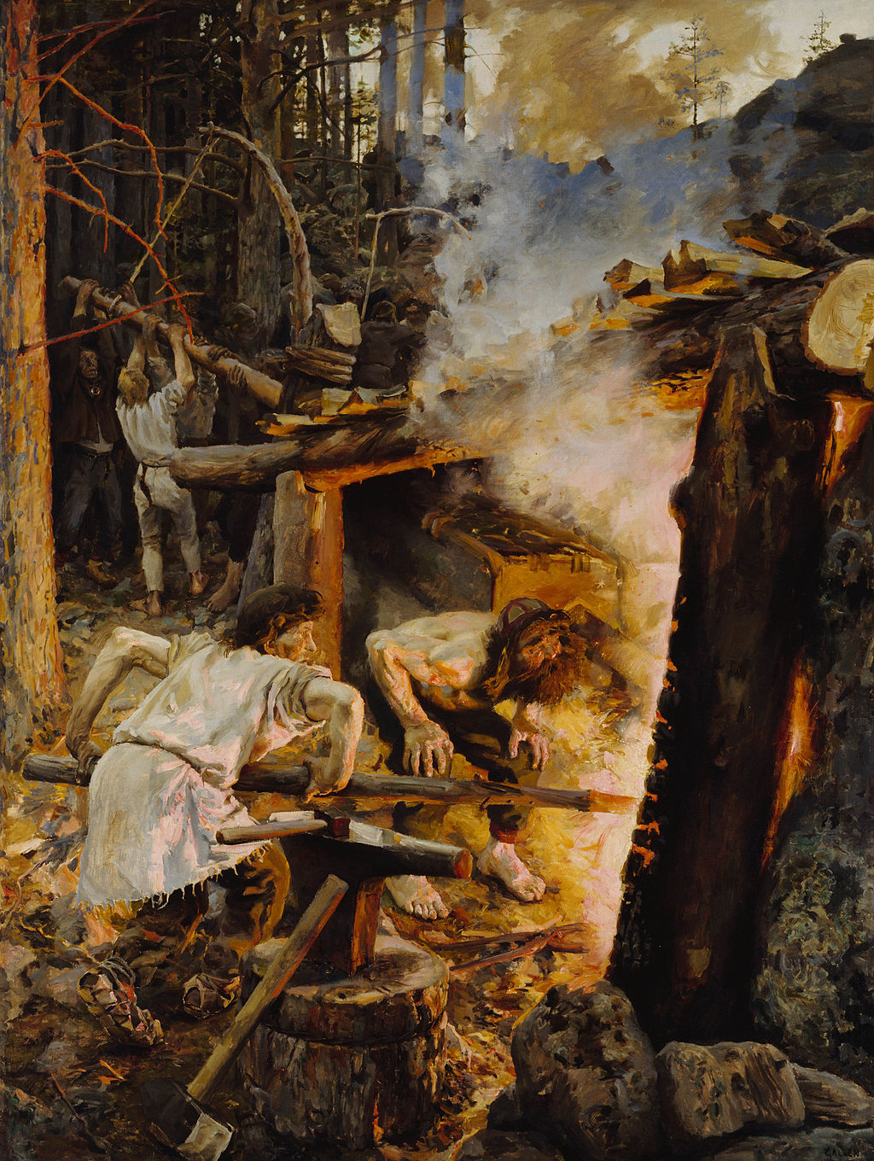
Notes:
Grain/flour, salt and gold out of thin air

Slide 27
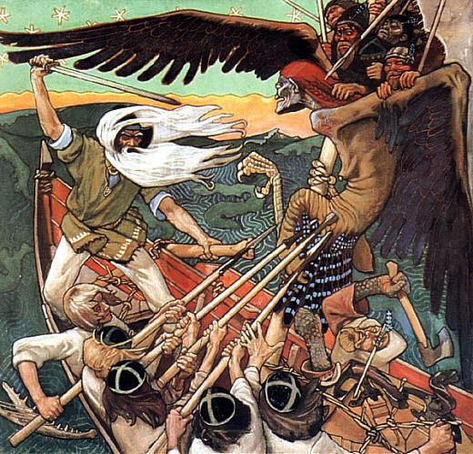

Slide 28
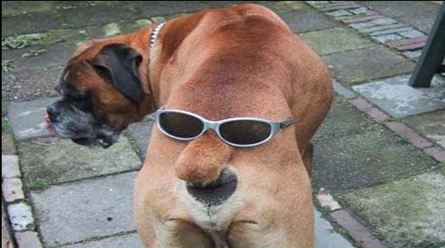
Composition
Composition refers to:
  has a, is-implemented-in-terms-of
Composition has desirable characteristics:
  Clear, complete interfaces
  Multiple data members of the same class can co-exist
  Composed objects may completely be decoupled from classes using them (using composition)
    Data organization of composed objects may be decoupled from classes that use them

Slide 29
Composition
Composition
  The composed object(s) can be decoupled from the composing class
  What if we don't?
Composing class
Before:
original
class object
original
class object
more data
Notes:
PIMPL can be used
Offering base class facilities to the Derived class users can be quite a bit of work.

Slide 30
Composition
Composition
  The composed object(s) can be decoupled from the composing class
  the class is modified...
Composing class
After:
modified
class object
original
class object
more data
Doesn't fit
anymore

Slide 31
Inheritance
Private inheritance if
  a protected member must be used
  Examples:
    A streambuf class can only be constructed as a derived class, as its constructor is protected.
    An ifstream needs to use a protected istream constructor
class streambuf
{
protected:
streambuf();
};
Notes:
You are being forced here by the author of streambuf.
Private inheritance to build a thin layer over an existing type. E.g.
Class GrowingString: private std::string;

Slide 32
Inheritance
Private inheritance if
  controlled polymorphism is used (next week: members of derived classes use the base class's polymorphic features)
class Derived: private Base, public NeedsBase
{
Derived(x, y, z, ...)
:
Base(x, y, z),
NeedsBase(*this)
{}
};
Notes:
The three reasons for using inheritance are not the only reasons. Some more will follow later on

Slide 33
Multiple Inheritance
Cyanobacterium
Fungus
Lichen is both a fungus
and a bacterium
So it inherits from two bases
(not that unusual in programming)
Lichen
Notes:
Not that usual in Biology either

Slide 34
Inheritance
Multiple inheritance:
  If a class must be available before the next base class can be defined
  If multiple classes must share a common base class
    The common base class could merely define an enum, which is now available to all derived classes.
Notes:
A common base class: e.g., Bobcat's class SharedEnum__

Slide 35
Inheritance
Multiple inheritance (I): mixed
  Both private and public inheritance
  Controls the construction order
    a streambuf is required to create a stream
    the stream must be destroyed before the streambuf is destroyed
streambuf
definition
time scale
istream
RandomBuffer
construction time scale
randstream
Notes:
Randstream inherits from istream publicly, because it is a kind of istream,
And from randombuffer privately, because it isimplemented as a randombuffer.
This is also a trick: randombuffer is now constructed before randstream, so it can be presented to the istream constructor.

Slide 36
Public Inheritance
Summarizing:
Public inheritance should
only be used
in the context of
Polymorphism
Notes:
The three reasons for using inheritance are not the only reasons. Some more will follow later on

Slide 37
Inheritance
Inheritance is OK when gaining substantially from the
  empty base class optimization
class Base
{
// functions only
};
class Composer
{
Base d_base;
int d_x;
};
class Derived: public Base
{
int d_x;
};
typically 4 bytes
typically 8 bytes
Notes:
The three reasons for using inheritance are not the only reasons. Some more will follow later on

Slide 38
Inheritance Rules
No protected members, no
private virtual members?
  Don't inherit
Base class without virtual members?
  Don't inherit publicly from this base class
    use composition, or private-inheritance

Slide 39
Object Oriented Programming
Topics these lectures
  Prototypical problems
  OOP
  Inheritance
  Polymorphism
  Two Design Patterns

Slide 40
C++ Inheritance
That's All, Folks
about
Inheritance

