Slide 2

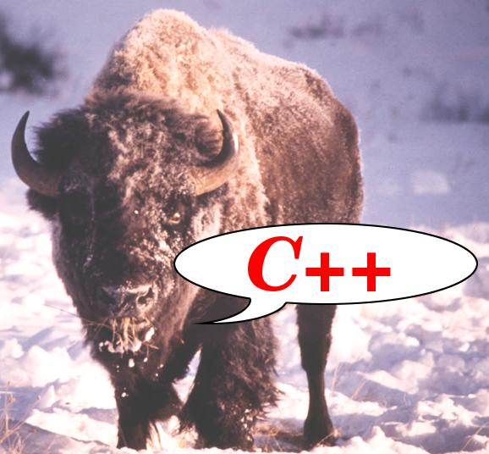
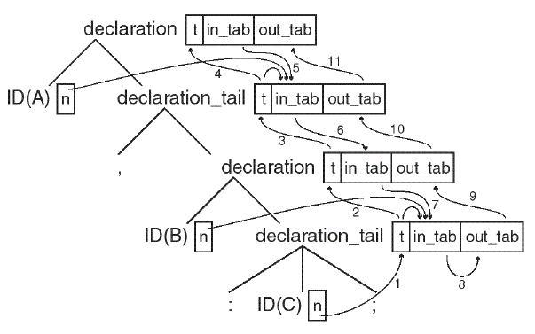
C++ Parsers (II)

Slide 3
C++ Parsers (II):
Decorating the Parser
Bisonc++ specification file
Actions
Error handling
Debugging
Notes:
Decorating the parser consists of adding actions to the rules.

Slide 4
Perspective
Grammar
Language
Rules
Sentences
Parser
bisonc++
Input:
|
Expr
;
Expr:
|
Expr ‘+’ Expr
|
Expr ‘*’ Expr
|
int
;
0
1
.
.
312354
.
.
2 + 17
.
.
2 + 3 * 422
.
.
.
.
Tree of Reductions
Expr → Input
Expr ‘+’ Expr → Expr
int→ Expr
int→ Expr
Notes:
Besides rules, a grammar has
an alphabet,
terminal and nonterminal tokens,
a start symbol.
The grammar is finite. But there are infinitely many sentences in the language. (See the empty string?)
The parser tells whether or not a sentence is in the language. It does so by giving the sequence of rules that produced the sentence.
The parser (so far) does not attach any meaning to the sentence. But we can...

Slide 5
Parsing
Rules: 1 + 2 * 3
expr: '1','+','2','*','3'
INT
|
expr '+' expr
|
expr '*' expr
;
push INT = stoi(matched())
pop INT=1; push expr=1
push ‘+’ = ~
push INT = 2
pop INT=2; push expr=2
push ‘*’ = ~
push INT = 3
pop INT=3; push expr=3
pop expr=3,’*’,expr=3; push expr=6
pop expr=1,’+’,expr=6; push expr=7
Notes:
LALR Parsing involves a stack (in addition to the state machine of regex parsing).
Actions useful even w/o attributes: demo refix.
To attach meaning, we associate an attribute with the token: the semantic value.
For terminals, semval is closely related to matched text. But nonterminal also have semantic values.
Implementation: in addition to token stack, parser keeps a stack of semantic values. At reduction, it pops one or more items from the stack, computes a new semantic value, and pushes it (along with the token).

Slide 6
Bisonc++ operation
Bisonc++ highlights:
  Generates a base class defining the parser tokens
    Uses escalation to prevent
    circular dependencies
  Generates a parser class defining
  the essential class members
  Generates a parsing function
  performing the parsing
  No virtual or other public
  members (but see the Notes).
  Supports namespaces.
Parser Base
class
(defines Tokens)
Scanner class
Parser class
Program
Notes:
Well... there is the constructor, of course. And a public member setDebug().

Slide 7
Bisonc++ use
Bisonc++ usage summary:
  Define a grammar
  Use declarations to disambiguate
  Use declarations or options to configure
  int lex() must be implemented (default implementation provided by bisonc++ itself).
  Use the parser in a program.
Notes:
%token
%left, %right, %nonassoc, %prec
%debug, %x, %filenames
Default lex() returns d_scanner.lex()

Slide 8
Bisonc++ main() example
Bisonc++ usage:
  Use the parser in a program.
    E.g., assuming the parser's grammar defines an interactive calculator, then the required program is:
int main()
{
Parser calc;
return calc.parse();
}

Slide 9
Bisonc++ - files involved
Bisonc++ usage:
  bisonc+ generates:
    parse.cc - contains the parsing function parse()
    rewritten at each bisonc++ run.
    Parserbase.h - defines the parser's base class, in which the tokens are defined
    rewritten at each bisconc++ run.
    Parser.h - defines the parser class: additional
    members should be defined here.
    Parser.ih - defines the implementation header.
Notes:
parser.ih contains e.g.
Parser::error()
Parser::lex()
Parser::exceptionHandler()
Those are none of the user's business, no not I the header file. But they can be used in the Parser implementation.
parse.cc can be viewed for educational purposes. Parserbase.h will show a stack, because a LALR-parser needs one.

Slide 10
Bisonc++ options
Bisonc++ usage:
  All names may be altered using options or declarations. E.g.,
    %filenames pathname
    %class-name ClassName
    %parsefun-source source.cc
    %scanner ../scanner/scanner.h
  Important predefined types:
    ClassName::Tokens__ - token enumeration
    STYPE__ - type of the parser's semantic value stack
Notes:
To turn any *.bc++ into a parser, Makefile uses:
--target-directory=
--baseclass-header=
--class-header=
--implementation-header=
--parsefun-source=
--verbose

Slide 11
Bisonc++ member functions
Bisonc++ usage:
  Important predefined functions:
    parse() - public member: the parsing-function itself
    error(char const *msg) - defined inline, redefinable
    int lex() - declared, or defined by using %scanner.
    ERROR() - may be called to generate an error,
    recovered by the parser's error recovery
    system
    ACCEPT() - terminates parsing, returning 0
    ABORT() - terminates parsing, returning 1

Slide 12
Bisonc++ data members
Bisonc++ usage:
  Important predefined data members:
    These data members are directly accessible from the parser's members
  All accessible types, enumerations, data members and internal use only member functions end in two underscores: __.
int d_token__;
bool d_debug__;
STYPE d_val__;
size_t d_nErrors__;
Notes:
d_token__: current token. Hands Off!
d_debug__: whether debug info actually is output
d_val__: current semantic value.
May be offered to scanner by pointer
(at construction time)
d_nErrors__: error count total so far

Slide 13
Bisonc++ Parser Specification
Specification File
  Specification files consist of two sections:
    tokens
    rules
declarations,
all starting
with
%directive
%%
rules,all
starting with
name:

Slide 14
Union Token Type
Specification File: important declarations
  Parser actions usually return values: it is possible to define multiple value types using an old-style union:
%union
{
int i;
unsigned u;
std::string *sp;
}
Notes:
A better alternative for unions is the Semantic value base class. The Bisonc++ user manual and the C++ Annotations describe this in more detail.
Another alternative: use unrestricted unions
The %union specification refers to a classic, C-style union.

Slide 15
Rule→Value
Specification File: important declarations
  Rule-value associations used with old-style unions:
%type <d> expr
%type <sp> string
Notes:
Scanner tokens can be associated with types as well, but that is discouraged.
See the Annotations for details.

Slide 16
Custom STYPE__
Specification File: important declarations
  Alternatively: use STYPE__ to define your own type (define %stype in the header section):
class RuleValue
{
Type d_type;
unsigned d_idx;
double d_value;
public:
// members
};
%stype RuleValue
Notes:
baseclass_preinclude is included by the baseclass header. If only needed for parser members, just include through the parser.ih header.
STYPE__ can also be a wrapper (proxy) around a base class pointer when subclassing is used to define various return type classes. See the Annotations for details
Also, it could be a shared_ptr<Type>, with Type the name of the semantic value type.

Slide 17
Polymorphic!
Specification File: important declarations
  Preferred Approach: use bisonc++'s %polymorphic directive
    Semantic values are coupled to tags:
      %polymorphic INT: int; STRING: std::string
    Non-terminals may be associated with polymorphic semantic values using the %type directive:
      %type <INT> expr
    The non-terminals receiving scanner-tokens initialize the correctly typed semantic value (next)
Note: tags are
not tokens!
Notes:
Tags are not tokens, but you can name them the same.
So when '13' is scanned, matched() holds “13”, and scanner returns a Parser::INT.
The parser associates an expr with a Tag__<INT>,
...

Slide 18
Polymorphic: actions
Specification File: important declarations
  Preferred Approach: bisonc++'s
  %polymorphic directive
    The non-terminals receiving scanner-tokens initialize the correctly typed semantic value:
    Typed non-terminals keep their TAG-types (next)
expr: // assume: %type <INT> expr
NR
{
$$ = stoll(d_scanner.matched());
}
|...
Notes:
Assume %type <FLOAT> floatexpr
So floatexpr gets
$$ = stold(d_scanner.matched());
Here you can be sure that matched() is still available.

Slide 19
Polymorphic: rules (II)
Specification File: important declarations
  Preferred Approach: bisonc++'s %polymorphic directive
    Typed non-terminals keep their TAG-types
expr: // assume: %type <INT> expr
expr '+' expr
{
$$ = $1 + $3; // this adds two int values
}
|
...
Notes:
This goodness ends when you need to promote both an intexpr and a floatexpr to an expr.
The parser then needs to decide at runtime. You need a run-time polymorphic semantic type. (Or a switch function.)

Slide 20
Polymorphic: internals
Additional type(s) defined with %polymorphic
  Entities are defined in the namespace Meta__
  Herein:
    class Base is the polymorphic base class
    For each TAG: Semantic<TAG>: public Base
    class SType: public std::unique_ptr<Base> becomes the Parser's semantic value type STYPE__

Slide 21
Getting to the Values
SType offers:
  Constructors and assignment operators
  Tag__ tag()
  DataType &get<Tag__>() returns a reference to the data member of the semantic value.
Semantic conversion operators for easy access

Slide 22
Old School Actions
Specification File: rules and actions
  Consider the string rule: what's happening here?
    This and the next slides assume that the old-style %union approach was used
string:
string STRING
{
$$ = appendText($1);
}
|
STRING
{
$$ = saveText();
}
;

Slide 23
OSA: using values
Specification File: rules and actions
  Example: the string rule
string:
string STRING
{
$$ = appendText($1);
}
|
STRING
{
$$ = saveText();
}
;
Notes:
Note: text matched at `STRING' is only availabe until the next token. Save the text in a %union field when the next token would overwrite the text (as in `string STRING').
The rule's 2nd alternative shows this saving process.

Slide 24
Keep actions small
Specification File: rules and actions
  Implementing a parser's (private) member:
string:
string STRING
{
$$ = appendText($1);
}
...
string *Parser::appendText(string *sp)
{
*sp += d_scanner.matched();
return sp;
}
Notes:
The parser's member may access all accessible elements of the scanner. Here d_scanner.matched() is called.

Slide 25
Memory management
Specification File: rules and actions
  A rule referring to two strings:
  The function appendString:
strings:
strings string
{
$$ = appendString($1, $2);
}
;
string *Parser::appendString(string *l, string *r)
{
*l += *r;
delete r; // not used anymore!!
return l;
}
Notes:
Do we have alternatives?
Maybe....: The parser stores string ptrs on its value stack.
We could use a stack of strings, and then push and pop strings on a stack of our own:
appendString()
{
string tmp(d_str.top());
d_str.pop();
d_str.top() += tmp;
}
(no leaks, no args, no string *sp union fields)

Slide 26
Polymorphic Ease
Reconsider the same string rule, now using
  %polymorphic STRING: std::string; ...
string:
string STRING
{
$$ += d_scanner.matched();
}
|
STRING
{
$$ = d_scanner.matched();
}
;
By default: $1 is $$

Slide 27
Negative Indices
Specification File: rules and actions
  Use negative $-indices to, e.g., inherit attributes:
variable_definition:
type variable_list ';'
variable_list:
variable_list ',' IDENT
{
d_symtab.insert($-1, $3);
}
|
IDENT
{
d_symtab.insert($-1);
}
;
NOTE: semantic value
associations (also polymorphic
tags) are ignored and cannot be
used with negative $-indices.
But explicit typing is OK (e.g.,
$<INT>-1)
we know the
previous semantic
value is a type
(note: no blanks
in the $-1 expr.)
Notes:
$i, i>0 refers to the semantic value of rule element i
$0: refers to the rule's own semantic value (but use $$)
$-i: refers to the semantic value of rule `i' elements before the current rule's positition in the production rule using the current rule
Use negative indices with caution.
Consider using %negative-dollar-indices to prevent warnings.

Slide 28
Example
Program Construction Summary
  1. construct the grammar and related files:
    define members, rules, actions, etc.
    define the scanner as a data member of the parser
  2. create the parser: call bisonc++ -V -l grammar
  3. construct the scanner: call flexc++ lexer
  4. ...

Slide 29
Example
Program Construction Summary
  1. construct the grammar and related files
  2. create the parser
  3. construct the scanner
  4. write the main program.
    Define `Parser parser',
    call parser.parse() to parse the input.
  5. build the final program from its sources.

Slide 30
Example
Example:
  Expressions accepting assignments and variables (one per line), using double arithmetic.
  In this example:
  STYPE is used:
    %stype RuleValue
struct RuleValue
{
enum Type
{
VALUE,
VARIABLE
};
Type d_type;
double d_number;
unsigned d_idx;
}
Notes:
The struct has three constructors.
These are not shown here.

Slide 31
Example
Grammar:
lines:
lines line
|
line
;
expr:
NUMBER
|
IDENT
|
expr '-' expr
|
expr '+' expr
|
expr '=' expr
|
'(' expr ')'
|
'-' expr %prec uMinus
;
line:
expr '\n'
|
error '\n'
|
'\n'
;
Notes:
Note that without terminating newline, there is no line.
Note that the grammar allows '3 = 4'

Slide 32
Example
Grammar: line actions:
lines:
lines line
|
line
;
line:
expr '\n'
{
display($1);
}
|
'\n'
{
done();
}
;
Notes:
See? No newline => No result displayed at EOF

Slide 33
Example
Grammar: expression actions:
expr:
NUMBER
{
$$ = value();
}
|
IDENT
{
$$ = variable();
}
|
expr '-' expr
{
$$ = sub($1, $3);
}
|
expr '=' expr
{
$$ = assign($1, $3);
}
|
'(' expr ')'
{
$$ = $2;
}
|
'-' expr %prec uMinus
{
$$ = negate($2);
}
;
Notes:
see demo

Slide 34
Example Action
Implementing members, e.g., assign();
RuleValue &Parser::assign(RuleValue &left,
RuleValue &right)
{
if (left.d_type == RuleValue::VARIABLE)
d_value[left.d_idx] = rvalue(right);
else if (d_display)
{
error("Non-lvalue in assignment");
++d_nErrors__;
}
return left;
}
lvalue must be
a name
at error d_display
was set to false
keep parse() happy:
return a value

Slide 35
Example Action
Implementing members, e.g., rvalue();
double Parser::rvalue(RuleValue const &rv)
{
return rv.d_type == RuleValue::VALUE ?
rv.d_number
:
d_value[rv.d_idx];
}
Notes:
rvalue is on the rhs of an ‘=’ (duh)

Slide 36
Example
The lexical scanner specification:
digits [0-9]+
ident0 [a-zA-Z_]
identx [a-zA-Z_0-9]*
%%
[ \t]+
{digits} |
{digits}.{digits} return Parser::NUMBER;
{ident0}{identx} return Parser::IDENT;
\n|. return matched()[0];
Notes:
see demo

Slide 37
Errors
Error handling
  the error rule matches all input up to the next mentioned or implied token.
  flag/count errors when they occur.
  when errors were detected, end the program after completing parse().
Notes:
see demo

Slide 38
error
Using the error rule:
line:
expr '\n'
{
display($1);
}
|
error '\n'
{
prompt();
}
|
'\n'
{
prompt();
}
;
Notes:
demo parserdemo2 (branch master)

Slide 39
Getting Rid of Bugs
Grammar: Debugging
  Parser:
    Use -V when calling bisonc++
    compile the parser using %debug
    use setDebug(true) to activate debugging
  Scanner:
    compile the scanner using %debug
    call setDebug(true) to activate, setDebug(false) to suppress.
  The program shown in these slides is at
  https://www.icce.rug.nl/edu/3/restricted/parsers2/download/parser.tar.gz

Slide 40
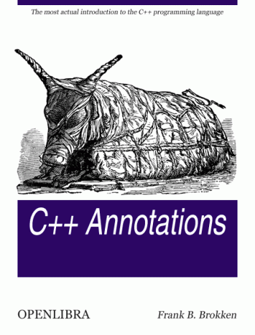

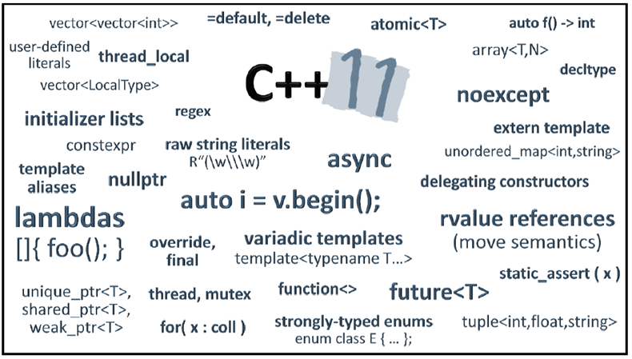
C++
2a!!
7!
requires
4
concept

Slide 41



C++
That's All, Folks.
(you've come a long way...)
Notes:
StripeSpotter

