Slide 2
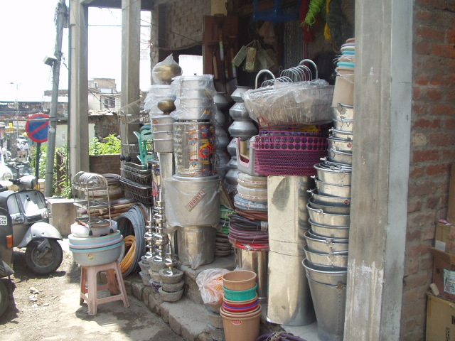
Containers

Slide 3
Containers
Containers? What containers?
Why vectors, not arrays?
What about C?
What to put into containers?
Adding? Erasing? Shrinking?
Associative arrays

Slide 4
Containers
Introduction to Containers
Containers:
  store information
  make life easy
  are implemented using templates
  allow complex data organizations
  promote correctness and clarity
  mix well with generic algorithms
  already encountered: std::string.

Slide 5
Containers
Very important:
  vector
Also used:
  deque
  map / unordered_map (hashtable)
  set
  stack
Little used:
  list, array

Slide 6
Containers
Common Features:
  Containers are classes: no user memory management required
  Containers may contain containers
  Containers offer value semantics
    copy construction
    assignment
    comparisons
  Special header file per container type
  (e.g., #include<vector>)

Slide 7
Containers
Vector
  Expandable, extensible, abstract array
  Some characteristics and uses:
#include <vector>
vector<int> vi; // vi(4, 2), vi = {4, 2}, vi{1,2,3}
vi[idx]
vi.resize(x), vi.reserve(x)
vi.insert(iterator, value)
vector<vector<int>> dim2;
difference?

Slide 8
Containers
Vector
  Iterators:
    Common to many containers
    Objects acting like pointers
    Type: vector<Type>::const_iterator
vector<int> vi(30);
vi.begin()
vi.end()

Slide 9
Containers
Why vectors, not arrays?
  Follow the standard: use vector as your sequence of choice
  The vector offers:
    0 bytes overhead per stored object
    fastest access of its elements
    locality of reference: consecutive elements are next to each other in memory
    C array layout compatibility
    random access iterators, at least as fast as any other container's iterator type.

Slide 10
Containers
Why vectors?
  Vectors vs. Lists: generally prefer the vector
  Mid-insertion into a vector is usually faster than into a list.
    Vector element access is extremely fast
    Accessing an element in a list is slow
a vector
a list

Slide 11
Containers
Why vectors, not arrays?
  Vectors encapsulate all memory management
  No fixed array boundaries
  Rich interface (size(), insert(), erase(), resize(), operators)
  vectors can be used in combination with C functions
    strings often too, but they offer no guaranteed locality of reference.
      use its c_str() member to pass its value to C functions having a char const * parameter.

Slide 12
Containers
What about strings? A well-known container
  std::string
    in fact: basic_string<char>
  What happens if we do: basic_string<int>?
    this defines a string of ints
Example:
int main()
{
basic_string<int> bi(4, 12);
bi.insert(bi.begin(), 5);
cout << bi[0] << ' ' << bi[1] << '\n';
}

Slide 13
Containers
C knows about arrays
Arrays: sequences of values (same types)
Vectors:
  Guaranteed to have locality of reference.
    Elements with adjacent indices are also physically next to each other.
  Use established idiom to acces an element's address; what about iterators?
    An iterator is not a pointer: can't pass an iterator to a C function

Slide 14
Containers
C knows about arrays
Vectors and strings:
  Idiom accessing an element's address:
    &*iterator
      begin() returns iterator, front() a reference to its 1st element.
    &object[idx]
    Reading four binary int values into a vector:
int main()
{
vector<int> vi(4);
cin.read(&vi.front(), 4 * sizeof(int));
}

Slide 15
Containers
What to put into containers?
  In general: types supporting value semantics
    primitive types (built-ins and pointers)
    objects of classes doing as the ints do.
    Be careful when putting pointers to data owned by the container into the container
      Why?
      Solution: turn them into objects by wrapping them in a class

Slide 16
Containers
What to put into containers?
  In general: types supporting value semantics
    primitive types (built-ins and pointers)
      vector<int>, vector<double>
      but also: vector<DataContainer::iterator> for, e.g., indirect sorting.
typedef vector<Data> DataContainer;
typedef DataContainer::iterator Iter;
DataContainer dc;
populate(&dc);
vector<Iter> indirectDc;
populate(&indirectDc, dc);

Slide 17
Containers
What to put into containers?
  Vectors with iterators for fast operations:
vector<BigData> vbd; vector<BigData::iterator> vi;
but pointers could
also be used here
operations are
performed on this
vector, leaving vbd
intact

Slide 18
Containers
What to put into containers?
  In general: types supporting value semantics
    objects of classes that do as the ints do.
      Vectors of strings: vector<string>
      But also 2-dimensional vectors: vector<vector<string>>
    In general: classes supporting
      copy construction
      assignment operation
    What about other classes?
      May often be wrapped in wrapping classes (wrappers)

Slide 19
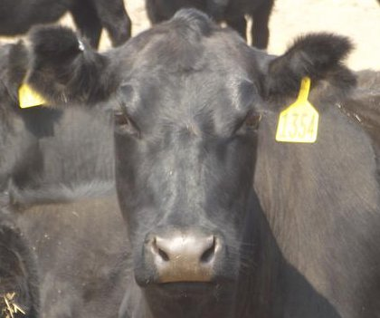
Containers
What to put into containers?
    Be careful when putting pointers to data owned by the container into containers
      Solution: turn them into objects by wrapping them in a class
    One great solution: shared_ptr.
      requires #include <memory>
      Any number of copies can be made, the shared_ptr deleted last will also delete the object managed by the shared pointer.
      Shared_ptr and Copy-On-Write (COW): DIY!
      Example: next slide
Notes:
Why careful? Think about object destruction: the memory isn't automatically destroyed.

Slide 20
Containers
What to put into containers?
    Be careful when putting pointers to data owned by the container into containers
      Great solution: shared_ptr.
      This displays twice Hello C++ world
      Shared_ptr: ideal for wrapping pointers to store in containers
int main()
{
shared_ptr<string> sp(new string("Hello world"));
shared_ptr<string> sp2(sp);
sp->insert(strlen("Hello "), "C++ ");
cout << *sp << '\n' <<
*sp2 << endl;
}

Slide 21
Containers
What about COW?
  Wrapping data and reference counting in a class
  Modifications should apply to deep copies
  Class setup:
class DataWrap
{
std::shared_ptr<Data>
d_data;
public:
DataWrap(...);
SharedData's
public interface
};
Data::Data(Data const &other)
default implementation
is OK here

Slide 22
Containers
What about COW?
  Destructor (default) and a modifier (COW):
class DataWrap
{
std::shared_ptr<Data>
d_data;
};
DataWrap::~DataWrap()
not required
void DataWrap::setValue(Value value)
{
DataWrap tmp;
tmp.d_data = new Data{value};
swap(tmp);
}

Slide 23
Containers
What about COW?
  A modifier
    First create a temporary DataWrap object
void DataWrap::setValue(Value value)
{
Data tmp;
tmp.d_data = new Data{value};
swap(tmp);
}

Slide 24
Containers
What about COW?
  A modifier
    First create a temporary DataWrap object
    Next let tmp.d_data point to a Data object containing value (tmp's d_data refcount is set to 1)
void DataWrap::setValue(Value value)
{
Data tmp;
tmp.d_data = new Data{value};
swap(tmp);
}

Slide 25
Containers
What about COW?
  A modifier
    First create a temporary DataWrap object
    tmp.d_data points to Data containing value
    Swap to exchange *this and tmp
void DataWrap::setValue(Value value)
{
Data tmp;
tmp.d_data = new Data{value};
swap(tmp);
}

Slide 26
Containers
What about COW?
  A modifier
    First create a temporary DataWrap object
    tmp.d_data points to a copy of the Data object
    Swap to exchange *this and tmp
    Shared refcount is reduced by tmp's destructor
void DataWrap::setValue(Value value)
{
Data tmp;
tmp.d_data = new Data{value};
swap(tmp);
}

Slide 27
Containers
What about COW?
  Why this way?
    Commit or roll-back
    We either are able to keep the integrity of the Data object, as its data don't change at all
    or (eventually)
    we modify the data in an unfailing way.
void Data::setValue(Value value)
{
Data tmp;
tmp.d_data = new Data{value};
swap(tmp);
}

Slide 28
Containers
Adding elements to containers
  Don't think for the container
  Use push_back (with std::stack: push)
    push_back: performed in (limiting case) constant time.
      Realized by exponential capacity enlargement.
      Alternative methods don't guarantee this. E.g.,
      resize(size() + 1, value)
      insert(vs.end(), value)
int main()
{
vector<string> vs;
string s;
while (cin >> s)
vs.push_back(s);
}

Slide 29
Containers
Adding elements to containers
  When not to use push_back?
    when ranges must be inserted
      A range provides context to the inserting function allowing it to optimize its bookkeeping work.
      Only one resize operation is required, rather than
      end - begin resize operations
int main()
{
vector<string> vs1(filler(1));
vector<string> vs2(filler(2));
vs1.insert(vs1.begin() + vs1.size() / 2,
vs2.begin(), vs2.end());
}

Slide 30
Containers
Reducing the size of containers
  Problem: the capacity is not reduced by:
    container.resize(smallerSize)
    container.reserve(smallerCapacity)
  Solved by a well-known idiom, using swap.
    to shed excess capacity
    to shed contents and capacity
{
vector<int> vi;
vi.reserve(300); // capacity now 300
...
vi = vector<int>(); // capacity still 300
} // (same for clear())

Slide 31
Containers
Reducing the size of containers
  Problem: the capacity is not reduced by
    container.resize(smallerSize)
    container.reserve(smallerCapacity)
  Solved by a well-known idiom, using swap.
    Constructors only allocate what's required
swapping
tmp vi
{
vector<int> vi;
vector<int>(vi).swap(vi); // sheds excess capacity
vector<int>().swap(vi); // sheds contents and cap.
}

Slide 32
Containers
Reducing container size
  Problem: the capacity is not reduced by
    container.resize(smallerSize)
    container.reserve(smallerCapacity)
  Solved by a well-known idiom, using swap.
    Creates anonymous vector, initialized by vi's contents,
    Swaps this anonymous vector with vi.
vector<int>(vi).swap(vi); // sheds excess capacity

Slide 33
Containers
Subtleties with containers: will this work?
  Containers are part of the Standard Template Library.
  Consider the following example:
  The green part is OK.
deque<double> ddeq(fill());
vector<double> vd(fill());
auto next = ddeq.begin();
... (more to follow)

Slide 34
Containers
Will it work?
  Containers are part of the Standard Template Library.
  Consider the following example:
  The green part is OK.
  What about the rest: OK? Not OK? Why?
deque<double> ddeq(fill());
vector<double> vd(fill());
auto next = ddeq.begin();
for (size_t idx = 0; idx != vd.size(); ++idx, ++next)
ddeq.insert(next, vd[idx] / 60);

Slide 35
Containers
Will it work?
  Containers are part of the Standard Template Library.
  Consider the following example:
  Time's UP...
  OK? Not OK? Why?

Slide 36
Containers
Will it work?
  Containers are part of the Standard Template Library.
  Consider the following example:
  OK? Not OK? Why?
    Hard to see?
    When developing, check STL-based code.
    With g++ maybe add the compiler option -D_GLIBCXX_DEBUG
auto next = ddeq.begin();
for (size_t idx = 0; idx != vd.size(); ++idx, ++next)
ddeq.insert(next, vd[idx] / 60);

Slide 37
Containers
(Un)ordered containers
  (Multi-dimensional) arrays using indices of up to 1,000,000,000?
  Building a dictionary?
Comparable problems
  Not every index is used
    Sparse matrices
    Associative arrays
Sparse 2-dim matrix

Slide 38
Containers
(Un)ordered containers
  (Multi-dimensional) arrays using indices of up to 1,000,000,000?
    Can't use a vector<vector<Data>> resizing it to 1,000,000,000 rows and columns
  Building a dictionary?
    The index is not numeric
  Options:
    ordered associative array (map)
    unordered associative array (unordered_map)[hashtable])

Slide 39
Containers
Table Key Lookup Summary:
  Simple linear lookup: on average k/2 attempts
  Binary lookup: on average ²log k attempts:
        ²log 64 = 6
        top half? top 2 lines? top line?
        left half? leftmost 2 lines? leftmost line?
  Hashing: f(arg) in [0..N): on average slightly over 1 attempt.
  But there is also overhead...
k elements

Slide 40
Containers
Ordered map:
  Map: ordered, uses binary lookup
  Defining a map: map<keytype, valuetype> mkv;
  Some characteristics:
    mkv[key] always exists, inserts if not yet available
    mkv.find(key) returns iterator or mkv.end()
    Iterators return map<keytype, valuetype>::value_type
      or: pair<keytype, valuetype>
  Example:
map<string, size_t> monthDay;
monthDay["january"] = 31;

Slide 41
Containers
Unordered map (unordered_map):
  Unordered (hashtable): not ordered, uses hashing
  Usually textual keys
    Provided hashing and comparison functions can be used
    Comparison is required to handle collisions
Assume: hash(key1) == hash(key2)
hashTable[key1] = data1;
hashTable[key2] = data2;
data1
key1
May not overwrite
key1's data1

Slide 42
Containers
Unordered map:
  Unordered (hashtable): not ordered, uses hashing
  Full definition:
    HashType and ComparisonType: predefined types exist for std::string, std::complex, and the basic types (do not (yet) define your own types).
    Example:
unordered_map<keyType, valueType, HashType, ComparisonType>
#include <unordered_map>
using namespace std;
int main()
{
unordered_map<string, size_t> month;

Slide 43
Containers
Containers? What containers?
Why vectors, not arrays?
What about C?
What to put into containers?
Adding? Erasing? Shrinking?
Associative arrays

Slide 44
Containers
That's All, Folks,
about Containers.

