Slide 1
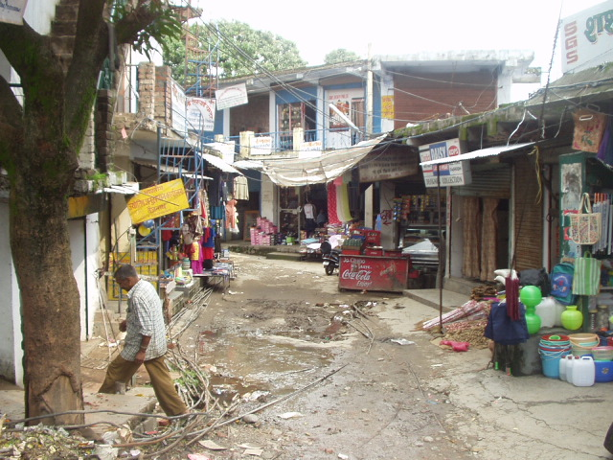
Multi threading II

Slide 2
Multi Threading II
Today's Topics:
  The future
  Tasks: async, packages, and promises
  Semaphores

Slide 3

  Doing things only once
Problem:
  threads 1 and 2 must initialize a shared variable unless it has already been initialized
  thread 1 inspects the variable
    not initialized, so ... (context switch) ...
    initialize the variable
  at the context switch thread 2 performs the initialization.
Consequently: the variable is initialized twice.

Slide 4
  Doing things only once
Consequently: the variable is initialized twice.
This can be solved using mutexes, but less complex using the once_flag, and call_once.
Example:
std::once_flag Data::s_once;
Data *Data::data() // e.g., a static member
{
std::call_once(s_once, iniData()); // initialize s_data
return s_data;
}

Slide 5
Starting Threads
Consider the following
prototypical program:
void task1()
{ ... }
void task2()
{ ... }
void task3()
{ ... }
int main()
{
thread t1(task1);
thread t2(task2);
thread t3(task3);
t1.join();
t2.join();
t3.join();
}

Slide 6


The Future
Did you notice the return
values of the functions
implementing the threads?
well..., eh, ...

Slide 7

The Future
Did you notice the return values of functions implementing threads?
What if we want to return a value from a thread?
  Why isn't RBA a good idea?
Return values of thread-functions are available in the future.
void task1()
void task2()
void task3()
Notes:
RBA:
maybe the thread is a factory: it creates a result that previously wasn't available yet.
because of the multithreaded nature of the program, the result might not be available when we need it. This requires additional synchronization safeguards
The thread might throw an exception

Slide 8

The Future
std::future objects contain:
  return values from threads
  exceptions thrown by threads
Future objects may be shared among threads, (through std::shared_future objects)
  std::shared_future objects are
  constructed from std::future
  objects
Requires #include<future>

Slide 9
The Future
Characteristics of std::future objects:
  The future's value type is provided in the future's type specification:
  future<std::string>
  shared_future<ReturnType> share() &&
  ReturnType get()
  bool valid()
    returns false after using share() or get()
  void wait()
You cannot assign a value to a future object, you can only retrieve its value
NOTE!
Notes:
The r-value reference indicates that whenever you obtain a future from a (factory) function, you should immediately call its share member to obtain the corresponding shared_future.

Slide 10
The Future
How to obtain the future?
  The future is prepared (parlance: is made ready) in a separate thread
    The thread starts
    The thread finishes; at that point the future is ready for us to use
    The main program uses the result, available from the future
  We cannot assign values to future objects
So, how do future objects receives values?

Slide 11
Returning values from threads
Method 1: futures via std::async
  Async is a function running
  an asynchronous task
  It immediately returns
  a std::future object
  Processing continues, but the
  future might not yet
  have been made ready
  Eventually obtain the task's
  result once we need it.
  No join required.
Program ...
async(...)
do
whatever
needs
to
be
done
use the
result from
the future
task
running
asyn-
chronous-
ly
Notes:
Using RBA you also need a mutex and a mechanism (condition_variable?) to wait until the result is available.

Slide 12
Returning values from threads
std::async
  requires #include <future>
  the returned std::future contains
    the value returned by the thread's function, or
    an exception thrown by the thread's function
  you could return a value using RBA, but
    the returned object must already exist: so assignment must be available...
    and what about exceptions?
Notes:
Using RBA you also need a mutex and a mechanism (condition_variable?) to wait until the result is available.

Slide 13
Returning values from threads
Using exceptions the intuitive way:
  This program terminates...
void task()
{
throw SomeException;
}
int main()
try
{
thread thr(task);
thr.join();
}
catch (...)
{}

Slide 14
Returning values from threads
std::async enables us to return exceptions from threads
  This program properly terminates
void task(); // throws an exception
int main()
try
{
auto fut = async(launch::async, task);
... any code here ...
fut.get();
... more code here ...
}
catch (...)
{}
enum class launch
{
async,
deferred
};
optional
1st argument

Slide 15
Returning values from threads
Consider the following program
  Let's analyze the (likely) output of this program...
string task()
{
cout << "task starts" << endl;
return string{"the future has arrived!"};
}
int main()
{
auto fut = async(task);
this_thread::sleep_for(seconds(2));
cout << "main running" << endl;
string str = fut.get();
cout << str << endl;
}
future<string>

Slide 16
Returning values from threads
Consider this program
Nothing happens
because of the default
std::launch::deferred
flag
string task();
int main()
{
auto fut = async(task);
this_thread::sleep_for(seconds(2));
cout << "main running" << endl;
string str = fut.get();
cout << str << endl;
}

Slide 17
Returning values from threads
Consider this program
Nothing happens
because of the default
std::launch::deferred
flag
string task();
int main()
{
auto fut = async(task);
this_thread::sleep_for(seconds(2));
cout << "main running" << endl;
string str = fut.get();
cout << str << endl;
}
After 2 seconds this
line is displayed

Slide 18
Returning values from threads
Consider this program
Nothing happens
because of the default
std::launch::deferred
flag
string task();
int main()
{
auto fut = async(task);
this_thread::sleep_for(seconds(2));
cout << "main running" << endl;
string str = fut.get();
cout << str << endl;
}
After 2 seconds this
line is displayed
At this point task is
run, showing:
task starts

Slide 19
Returning values from threads
Consider this program
Nothing happens
because of the default
std::launch::deferred
flag
string task();
int main()
{
auto fut = async(task);
this_thread::sleep_for(seconds(2));
cout << "main running" << endl;
string str = fut.get();
cout << str << endl;
}
After 2 seconds this
line is displayed
At this point task is
run, showing:
task starts
Finally
the future has arrived
is shown.

Slide 20

Returning values from threads
std::async: implications:
  The task is asynchronously performed
    is that always what we want?
  We have:
    no control over the task's execution:
      default: std::launch::deferred
    or the task runs asynchronously right now:
      explicit: std::launch::async
      overpopulation?
A std::packaged_task
gives us full control.

Slide 21
Decoupling tasks and threads
So, method 2 for obtaining futures: via std::packaged_task
  requires #include <future>
  is configured with a function
  the function may (a)synchronously be called
  the result is retrieved from a future.
  (a packaged_task connects a function to a future but (unlike async) it isn't automatically called)

Slide 22
Decoupling tasks and threads
Prototype of
the called
function
std::packaged_task: specification
usage:
typedef packaged_task<string (string const &)> Task;
string encrypt(string const &text);
string line = lineToProcess();
Task task{encrypt};
auto fut = task.get_future();
if (line.length() < 10)
task(line);
else
{
thread{ move(task), ref(line) };
// do something while encrypting
}
cout << fut.get() << '\n';
function to call
line to process

Slide 23
Decoupling tasks and threads
std::packaged_task: specification
usage:
typedef packaged_task<string (string const &)> Task;
string encrypt(string const &text);
string line = lineToProcess();
Task task{encrypt};
auto fut = task.get_future();
if (line.length() < 10)
task(line);
else
{
thread{move(task), ref(line)};
// do something while encrypting
}
cout << fut.get() << '\n';
provide the
packaged_task
with a function

Slide 24
Decoupling tasks and threads
std::packaged_task: specification
use:
typedef packaged_task<string (string const &)> Task;
string encrypt(string const &text);
string line = lineToProcess();
Task task{encrypt};
auto fut = task.get_future();
if (line.length() < 10)
task(line);
else
{
thread{move(task), ref(line)};
// do something while encrypting
}
cout << fut.get() << '\n';
get the future
(not yet ready!)

Slide 25
Decoupling tasks and threads
std::packaged_task: specification
use:
typedef packaged_task<string (string const &)> Task;
string encrypt(string const &text);
string line = lineToProcess();
Task task{encrypt};
auto fut = task.get_future();
if (line.length() < 10)
task(line);
else
{
thread{move(task), ref(line)};
// do something while encrypting
}
cout << fut.get() << '\n';
directly perform
the task if it's
quickly done

Slide 26
Decoupling tasks and threads
std::packaged_task: specification
use:
typedef packaged_task<string (string const &)> Task;
string encrypt(string const &text);
string line = lineToProcess();
Task task{encrypt};
auto fut = task.get_future();
if (line.length() < 10)
task(line);
else
{
thread{move(task), ref(line)};
// do something while encrypting
}
cout << fut.get() << '\n';
or asynchronously
perform the task,
and in between do
something useful
(detaching is OK!)

Slide 27
Decoupling tasks and threads
std::packaged_task: specification
use:
typedef packaged_task<string (string const &)> Task;
string encrypt(string const &text);
string line = lineToProcess();
Task task{encrypt};
auto fut = task.get_future();
if (line.length() < 10)
task(line);
else
{
thread{move(task), ref(line)};
// do something while encrypting
}
cout << fut.get() << '\n';
handle the result
when done.

Slide 28
Decoupling tasks and threads
Packaged_tasks hold task specifications
  it could be part of a larger task: it then resembles the Template Method Design Pattern
Example:
void run(Task &&task)
{
string line;
getline(cin, line);
task(line);
}
string encrypt(string const &text);
int main()
{
Task task{encrypt};
auto result = task.get_future();
thread{run, move(ptask)}.detach();
cout << result.get() << '\n';
}
Could be configured
with any matching
function
Could also
directly call run

Slide 29
Decoupling tasks and threads
Decoupling??
  Assume we have many tasks
    maybe known beforehand
    may require different function signatures
  But we only have a limited number of cores
    that's the reality
How to decouple tasks and threads?
Packaged_tasks may come to the rescue!

Slide 30
Decoupling tasks and threads
Perform these steps:
  Prepare a vector of packaged tasks
    hm.... different function signatures?
    OK, so
      embed the packaged tasks in classes,
      defining a private run member,
      derive these classes from an abstract base class (ABC)
      fill the vector with pointers to ABCs
ABC
Task 1
Task 2
vector of ptrs (unique_ptr?)
to ABC

Slide 31
Decoupling tasks and threads
Perform these steps:
  Prepare a vector of packaged tasks
  Define a producer, that knows how many cpus we have (thread::hardware_concurrency())
    until all tasks have been performed, push indices of tasks to perform on a queue
      but never more than the #available threads
while (true)
{
taskQueue.push(idx);
if (idx++ == taskVector.size())
break;
waitForAvailableThread();
}

Slide 32
Decoupling tasks and threads
Perform these steps:
  Prepare a vector of packaged tasks
  Define a producer, that knows how many cpus we have (thread::hardware_concurrency())
  Define a consumer, that starts a task whenever possible
while (true)
{
size_t idx = taskIndex();
if (idx == taskVector.size())
break;
taskVector[idx].execute();
waitForTask();
}

Slide 33
Decoupling tasks and threads
Perform these steps:
  Prepare a vector of packaged tasks
  Define a producer, that knows how many cpus we have (thread::hardware_concurrency())
  Define a consumer, that starts a task whenever possible
  The Task's execute() function informs the producer once its task has been completed

Slide 34
Decoupling tasks and threads
Perform these steps:
  Prepare a vector of packaged tasks
  Define a producer, that knows how many cpus we have (thread::hardware_concurrency())
  Define a consumer, that starts a task whenever possible
  The Task's execute() function informs the producer once its task has been completed
  The big question: how to synchronize the producer's and consumer's actions...

Slide 35
Promising futures
Passing return values between threads: std::promise.
  Requires #include <future>
  Remember: exceptions could be generated!
A packaged_task could be used, but it needs a function
  The promise merely contains a return value in its future.
  This time we assign the return value (or the exception)

Slide 36
Promising futures
The previous packaged_task example, now using std::promise
Code snippet:
(put this in a
while (true) loop
to process multiple
lines; maybe add a
catch (exception &ex)
clause)
function declarations:
string encrypt(string const &text);
void run(promise<string> &);
promise<string> ret;
auto result = ret.get_future();
if (line.length() < 10)
run(move(ret));
else
{
thread{run, move(ret)}.detach();
// do something while encrypting
}
cout << result.get() << '\n';

Slide 37
Promising futures
The void run() function using std::promise
void run(promise<string> &prom)
try
{
string line;
cout << "? ";
if (!getline(cin, line))
throw runtime_error("end of input");
prom.set_value(encrypt(line));
}
catch (...)
{
prom.set_exception( current_exception() );
}

Slide 38
Any Problems?
Assume we have multiple things to do....
  How many threads are we going to start?
  Starting threads takes time: do we need to create them over and over again?
  What about overpopulation?
  What if one future.get() blocks, how long are we going to wait?
  Is busy waiting the only viable alternative?
Let's consult good old Edsger...
Notes:
And maybe a bit of Bobcat?
Brokken's Own Base Classes And Templates
Check your apt-get / aptitude programs...

Slide 39

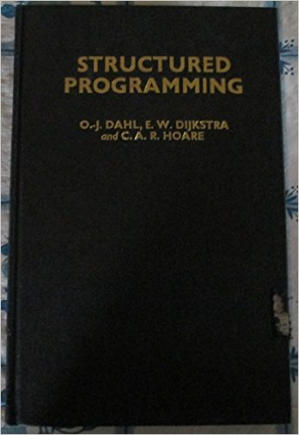
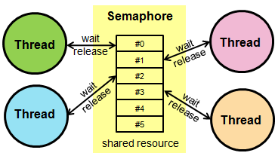

Edsger Dijkstra
Edsger Dykstra (1930-2002)
  One of the founders of Structured Programming
  Creator of the Semaphore
  data type.

Slide 40
Semaphore
Constructor
  Initializes the semaphore with an initial count
wait member:
  Waits until notified, then checks whether the initial count exceeds 0, if so the count is reduced and wait returns
notify(one, all) member:
  Increments the count, notifies one or all of its wait-ing members
For their implementations: see, e.g., the Annotations
Notes:
Overloaded wait members include
wait_for
wait_until
and wait members calling a function when they are being notified

Slide 41
Semaphore
Common use:
Initially:
Client (consumer):
available.wait();
retrieve item
storage.notify();
process item
Server (producer):
produce item
storage.wait();
store item
available.notify();
Semaphore storage(10); // as an example
Semaphore available(0);
Notes:
Overloaded wait members include
wait_for
wait_until
and wait members calling a function when they are being notified

Slide 42
Semaphore Example
Using two task threads and an output thread
  Data structures:
Semaphore available(0); // # available results
Semaphore workers(2); // # task threads
Semaphore job(0); // # available jobs for the
// workers
mutex lineMutex;
queue<string> lineQueue; // Queue holding lines to process
mutex outMutex;
queue<string> outQueue; // Queue with produced results
Notes:
Overloaded wait members include
wait_for
wait_until
and wait members calling a function when they are being notified

Slide 43
Semaphore Example
Using two task threads and an output thread
  Output function (runs in a thread):
void output()
{
while (true)
{
string line;
available.wait(); // wait for available result
{
lock_guard<mutex> lg(outMutex);
if (outQueue.empty())
return; // retrieve the result
line = outQueue.front();
outQueue.pop();
}
cout << line << '\n';
}
}
Notes:
Overloaded wait members include
wait_for
wait_until
and wait members calling a function when they are being notified

Slide 44
Semaphore Example
Two task threads and
an output thread:
  Task function:
bool next(string &line)
{
lock_guard<mutex> lg(lineMutex);
if (lineQueue.empty())
{
job.notify_all();
return false;
}
line = lineQueue.front();
lineQueue.pop();
return true;
}
void task()
{
while (true)
{
job.wait();
string line;
if (not next(line))
return;
send(process(line);
available.notify();
workers.notify();
}
}
void send(string const &line)
{
lock_guard<mutex> lg(outMutex);
outQueue.push(line);
}
Notes:
Overloaded wait members include
wait_for
wait_until
and wait members calling a function when they are being notified

Slide 45
Semaphore Example
Two task threads and an output thread:
  main():
int main()
{
thread out(output);
thread worker1(task);
thread worker2(task);
process();
job.notify();
worker1.join();
worker2.join();
available.notify();
out.join();
}
void process()
{
string line;
while (getline(cin, line))
{
workers.wait();
{
lock_guard<mutex> lg(lineMutex);
lineQueue.push(line);
}
job.notify();
}
}
Notes:
Overloaded wait members include
wait_for
wait_until
and wait members calling a function when they are being notified

Slide 46
Semaphore Example II
Sometimes it can be realized simpler:
  We want to compile sources in parallel (e-mail submission?)
  All the source's file names are available or can easily be made available
  We define a pool of workers
  The program ends once a file doesn't compile or when all sources have been compiled.
Notes:
Overloaded wait members include
wait_for
wait_until
and wait members calling a function when they are being notified

Slide 47
Semaphore Example II
A Compiler object receives the names of all files to compile
  Its compile function starts a pool of workers and returns true if compilation was successful.
  The workers do the hard work; compile waits until notified.
bool Compiler::compile()
{
workForce();
d_ready.wait();
return d_activeWorkers = 0;
}
Semaphore
atomic<size_t>
Notes:
Overloaded wait members include
wait_for
wait_until
and wait members calling a function when they are being notified

Slide 48
Semaphore Example II
The workForce member merely starts as many worker-threads as necessary.
  The workers are self-supporting: they operate detached:
void Compiler::workForce()
{
for (size_t count = 0; count != N_WORKERS; ++count)
thread{ worker, ref(*this)}.detach();
}
Notes:
Overloaded wait members include
wait_for
wait_until
and wait members calling a function when they are being notified

Slide 49
Semaphore Example II
Workers handle the sources to compile
  If none: done (1), otherwise (2) compile it.
void Compiler::compileOne()
{
while (true)
{
string source = nextSource();
if (source.empty() // (1) {
maybeReady();
return;
}
// (2)
if (not compile(source))
return;
}
}
string Compiler::nextSource()
{
string ret;
lock_guard<mutex> lk(d_srcMutex);
if (not d_sources.empty())
{
ret = d_sources.back();
d_sources.pop_back();
}
return ret;
}
Notes:
Overloaded wait members include
wait_for
wait_until
and wait members calling a function when they are being notified

Slide 50
Semaphore Example II
maybeReady() notifies compile when all's done:
(in which case the
program ends)
compile(source) compiles source as child process
using a Fork-
derived class.
void Compiler::maybeReady()
{
if (--d_activeWorkers == 0)
d_ready.notify();
}
bool Compiler::compile(string const &source)
{
CompileFork cf(source);
cf.fork();
if (cf.ret() != 0)
{
cerr << cf.rdbuf();
d_ready.notify();
return cf.ret();
}
Caveat: not shown: protection
against two failing compilations
running in parallel, both writing
to cerr.
Notes:
Overloaded wait members include
wait_for
wait_until
and wait members calling a function when they are being notified

Slide 51
Multi threading II
Today's topics:
  The future
  Tasks: async, packages, and promises
  Semaphores

Slide 52



That's All, Folks,
for Part II
the Prelude is next...

Slide 53
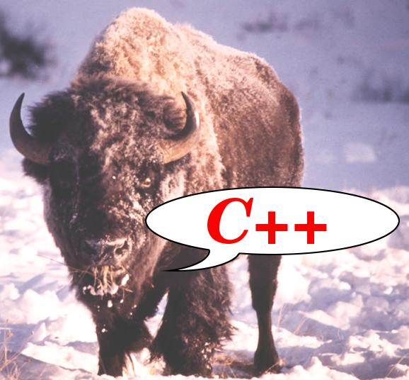

C++ Part III preview
Templates:
  What's more? How do we use our own in our programs? How to design advanced templates?
Grammars:
  What is a grammar? How do we design our own grammars? How do we use them to process (very) complex input?
Software generators:
  Bisonc++ (generates grammar parsers),
  Flexc++ (generates scanners (tokenizers).

