Slide 1
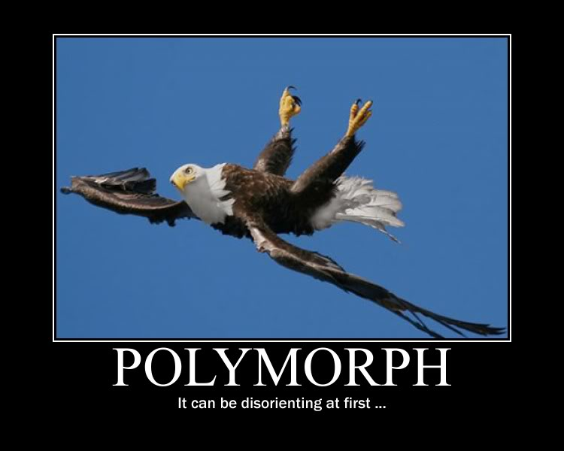
C++ Polymorphism
Notes:
Inherit titles, land, money, biological traits and 'class'.

Slide 2
Object Oriented Programming
Topics these lectures
  Prototypical problems
  OOP
  Inheritance
  Polymorphism
  Two Design Patterns
Notes:
OOP needs much thinking
C++ already programming without training wheels
Classes look different from various perspectives
Who knows what about whom
Honderd gevangenen en een gloeilamp.

Slide 3
Prototypical problems
Several problem statements:
  given an algorithm, of which some parts can not yet be specified, how can we implement such an algorithm?
Notes:
Find/sort by as yet unknown criteria.

Slide 4
Prototypical problems
Several problem statements:
  given facilities as offered by, e.g., the stream classes, how can we make them available for new devices, as yet unknown and non-existing?
Notes:
How to talk to an EKP (Entangled KeyPair)
How to talk to a smartphone (in 1990)
K&R: everything is a file

Slide 5

Composition
Composition refers to:
  has a, is-implemented-in-terms-of
Composition has desirable characteristics:
  Clear, complete interfaces
  Multiple data members of the same class can
  co-exist
  Composed objects may completely be decoupled from classes using them (using composition)
    Data organization of composed objects may be decoupled from classes that use them
Notes:
Wrt decoupling: think of pimpl implementations

Slide 6
Composition
Composition
  The composed object(s) can be decoupled from the composing class
  What if we don't?
Composing class
Before:
original
class object
original
class object
more data
Notes:
PIMPL can be used
Offering base class facilities to the Derived class users can be quite a bit of work.

Slide 7
Composition
Composition
  The composed object(s) can be decoupled from the composing class
  the class is modified...
Composing class
After:
modified
class object
original
class object
more data
Doesn't fit
anymore
Notes:
This problem is completely solved by pimpl:
whatever the new data organization, the composing class can be used as-is.

Slide 8

Inheritance
So, why (and how) should you inherit?
  Public inheritance (class Derived: public Base)
    use it only to realize
    Liskov's Substitution Principle (LSP):
      the Derived class is-a
      (or works-like-a) Base class
  Private inheritance (class Derived: private Base)
    to realize is-implemented-in-terms-of
      if composition is not an option
      if the protected interface must be used.
composition: has-a
Notes:
is-implemented-in-terms-of: is implemented using
Protected: we dunno. Perhaps if you have multiple layers of inheritance to avoid the intermediate layers from being used by the end user.
Private: derive a streambuf with EKP-facilities from std::streambuf

Slide 9
Inheritance
Multiple inheritance:
  If a class must be available before the next base class can be defined
  If multiple classes must share a common base class
    A.k.a. escalation
    The common base class could merely define an enum, which is now available to all derived classes
Notes:
A common base class: e.g., Bobcat's class SharedEnum__

Slide 10
Inheritance
Private inheritance if
  a protected member must be used
  Examples:
    A streambuf class can only be constructed as a derived class, as its constructor is protected.
    An ifstream needs to use a protected istream constructor
class streambuf
{
protected:
streambuf();
};
Notes:
You are being forced here by the author of streambuf.
Private inheritance to build a thin layer over an existing type. E.g.
Class GrowingString: private std::string;

Slide 11
Inheritance
Private inheritance if
  controlled polymorphism is used
  (polymorphism is only used by members of the derived class)
class Derived: private Base, public NeedsBase
{
Derived(x, y, z, ...)
:
Base(x, y, z),
NeedsBase(*this)
{}
};
Notes:
The three reasons for using inheritance are not the only reasons. Some more will follow later on

Slide 12
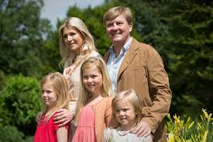
Multiple Inheritance
A SocketStream is both a
(special kind of) streambuf
and an istream
So it inherits from two bases
(not that unusual in real life, but
also not in programming)
std::streambuf
std::istream
SocketStream
Notes:
Not that usual in Biology either

Slide 13
Inheritance
Multiple inheritance (I): mixed
  Both private and public inheritance
  Controls the construction order
    a streambuf is required to create a stream
    the stream must be destroyed before the streambuf is destroyed
streambuf
definition
time scale
istream
RandomBuffer
construction time scale
randstream
Notes:
Randstream inherits from istream publicly, because it is a kind of istream,
And from randombuffer privately, because it isimplemented as a randombuffer.
This is also a trick: randombuffer is now constructed before randstream, so it can be presented to the istream constructor.

Slide 14
Inheritance
Virtual multiple inheritance (II): sharing
  sharing a common virtual base class
Virtual derivation:
ios
ios
ios
istream
ostream
istream
ostream
istream: public
virtual ios
fstream
What ios are we
talking to?
fstream
When designing istream and ostream a common
base class must already be kept in mind.

Slide 15
Inheritance
Virtual multiple inheritance (II): overriding
  When overriding the construction of a virtual base class...
Base
Base();
Base(int);
Base has several constructors
Derived()
{...}
Derived (: public virtual Base) may use
any Base constructor
Derived
Final
Final(int x)
:
Base(x)
{}
Final needs to use another Base constructor:
explicitly calls Base(x), overriding Derived's
construction
Notes:
Final will use Base's default constructor, unless otherwise specified

Slide 16
Inheritance
Summarizing: use public inheritance
  to override a virtual member function
  to implement Liskov's Substitution Principle (LSP):
    the derived class is-a (works-like-a) base class.
  to derive from classes designed as Base classes only.
    such classes have virtual destructors.
Notes:
The three reasons for using inheritance are not the only reasons. Some more will follow later on

Slide 17
Inheritance
Inheritance is OK when gaining substantially from the
  empty base class optimization
class Base
{
// functions only
};
class Composer
{
Base d_base;
int d_x;
};
class Derived: public Base
{
int d_x;
};
typically 8 bytes
typically 16 bytes
Notes:
The three reasons for using inheritance are not the only reasons. Some more will follow later on

Slide 18
Inheritance
Virtual members:
  should be private
  overriding members redefine the behavior of the Base class (not of the derived class!)
    don't inherit to reuse, inherit to be reused!
  are called from public base class members:
    the Base class is in control
    the Base class is robust: the interface does not confuse Derived and Base class facilities
    redefinition- and user-interfaces are separated
(by the
Base class)
Notes:
Inherit not to reuse the base class, but to let the base class be reused.
With inheritance the focus should be on the base class and programs should, except when constructing the derived class object only use facilities offered by the base class.

Slide 19
A Design Pattern
The Template Method Design Pattern:
  consider an algorithm, of which some parts can not yet be specified, how can we implement such an algorithm?

Slide 20
Template Method D.P.
The Template Method Design Pattern:
  given an algorithm, of which some parts can not yet be specified, how can we implement this algorithm?
  Starting point:
  a function that must
  execute the algorithm
    The algoritm is defined by Base::execute.
void fun(Base &base)
{
preamble();
base.execute();
postamble();
}
Notes:
Like a Boss: declare that a general solution exists
Let others figure out the particular cases.
Fermat did it this way.

Slide 21
Template Method D.P.
The Template Method Design Pattern:
  given an algorithm, of which some parts can not yet be specified, how to implement this algorithm?
  the class Base offers an interface to the algorithm, leaving part(s) of its implementation to action()
class Base
{
public:
void execute();
private:
virtual void action();
};
void fun(Base &base)
{
preamble();
base.execute();
postamble();
}
interface
execute frequently performs tasks before and/or after action

Slide 22

Template Method D.P.
The Template Method Design Pattern:
  given an algorithm, of which some parts can not yet be specified, how do we implement this algorithm?
  A derived class provides a concrete implementation
class Base
{
public:
void execute();
private:
virtual void action();
};
class Derived1: public Base
{
void action() override;
void fun(Base &base)
{
preamble();
base.execute();
postamble();
}
interface
implementation hook
implementation detail
Notes:
Users cannot access the derived class' private functions!

Slide 23
Template Method D.P.
The Template Method Design Pattern:
  given an algorithm, of which some parts can not yet be specified, how to implement this algorithm?
  Different derived classes may implement different variants of the algorithm's
  redefinable element(s):
Derived1 d1; Derived2 d2;
fun(d1); fun(d2);

Slide 24
Designing Base classes
How to recognize base-classes?
  they support
    public, virtual destructors
    or protected, non-virtual destructors;
  they have non-public
    copy constructors and assignment operators (i.e., these are private or protected);
  they define private virtual members
    Implementation hooks for derived classes
Notes:
CC and op= should be non-public:
Copying the base class causes slicing, and should therefore be avoided
Derived classes know what they are doing and might need/want to copy their Base part.

Slide 25
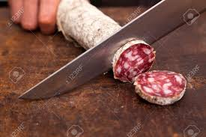
Designing Base classes - problem
Wrapping a base-class
  how to implement Wrapper's Copy Constructor?
class Wrapper
{
Base *d_base;
public:
Wrapper(Base *base);
Wrapper(Wrapper const &other);
Polymorphic base class
Wrapper::Wrapper(Wrapper const &other)
:
d_base(new Base(*other.d_base)) // Ouch!!
Wtf are we doing here???
Notes:
Since we don't know what the *d_base is actually pointing at, how can we copy its object?
Slicing must be avoided

Slide 26
Designing Base classes
How to copy Base-class objects?
  We can't copy a Derived class object through a Base object: there is
  no virtual copy constructor.
Notes:
How could there be? A virtual constrcuctor would have to have a v_pointer. But we can't set the v_pointer until we know the type.

Slide 27
Designing Base classes
How to copy Base-class objects?
  We can't copy a Base object: there is
  no virtual copy constructor.
In cases like this: define a protocol.
  The protocol is defined using an
  Abstract Base Class

Slide 28
Abstract Base classes
Abstract Base Classes (ABCs)
  ABCs define at least one pure virtual function.
    these functions show = 0; in their interface
  derived classes must override pure virtual functions (or object construction is impossible)
    the overridden functions are called from base class pointers or references (as usual).

Slide 29
Designing Base classes
How to copy Base-class objects?
  We can't copy a Base object: there is
  no virtual copy constructor.
In cases like this: define a protocol.
  The protocol is defined using an
  Abstract Base Class
A Wrapper class is/can be used to encapsulate Base class pointer manipulations

Slide 30
A Design Pattern (II)
Example: Prototype Design Pattern
The Base class once again, showing some more details:
class Base
{
public:
Base(Base const &other) = delete;
Base &operator=(Base const &rhs) = delete;
virtual ~Base();
Base *clone() const; // calls copy
private:
virtual Base *copy() = 0;
};

Slide 31
The Prototype D.P.
The Wrapper class:
inline for brevity
class Wrapper
{
Base *d_base;
public:
Wrapper(Wrapper const &other)
:
d_base(other.d_base->clone()) // obtain Derived obj.
{}
Wrapper(Base const &base); // calls base.copy()
// destructor, op= and move-members are standard
// consider: duplicate Base's interface
// or offer members returning Base & and
// Base const & objects,
// or let Wrapper be a Proxy, supporting
// operator Base(), op=(Base const &)
};
Notes:
Often Wrapper will need a default constructor. It should initialize d_base to 0. Members may need to check d_base's value
Is Wrapper's destructor virtual?
Wrapper is meant to offer Base's functionality
But with copy construction and operator=

Slide 32
Inheritance Rules
Your class has
  no protected members,
  no private virtual members?
  then don't inherit from it.
Your base class doesn't have virtual members?
  then don't inherit publicly from this class
    use composition, or private-inheritance

Slide 33
Object Oriented Programming
Topics these lectures
  Prototypical problems
  OOP
  Inheritance
  Polymorphism
  Two Design Patterns

Slide 34
C++ Inheritance
That's All, Folks
about
Inheritance and Polymorphism

