Slide 1







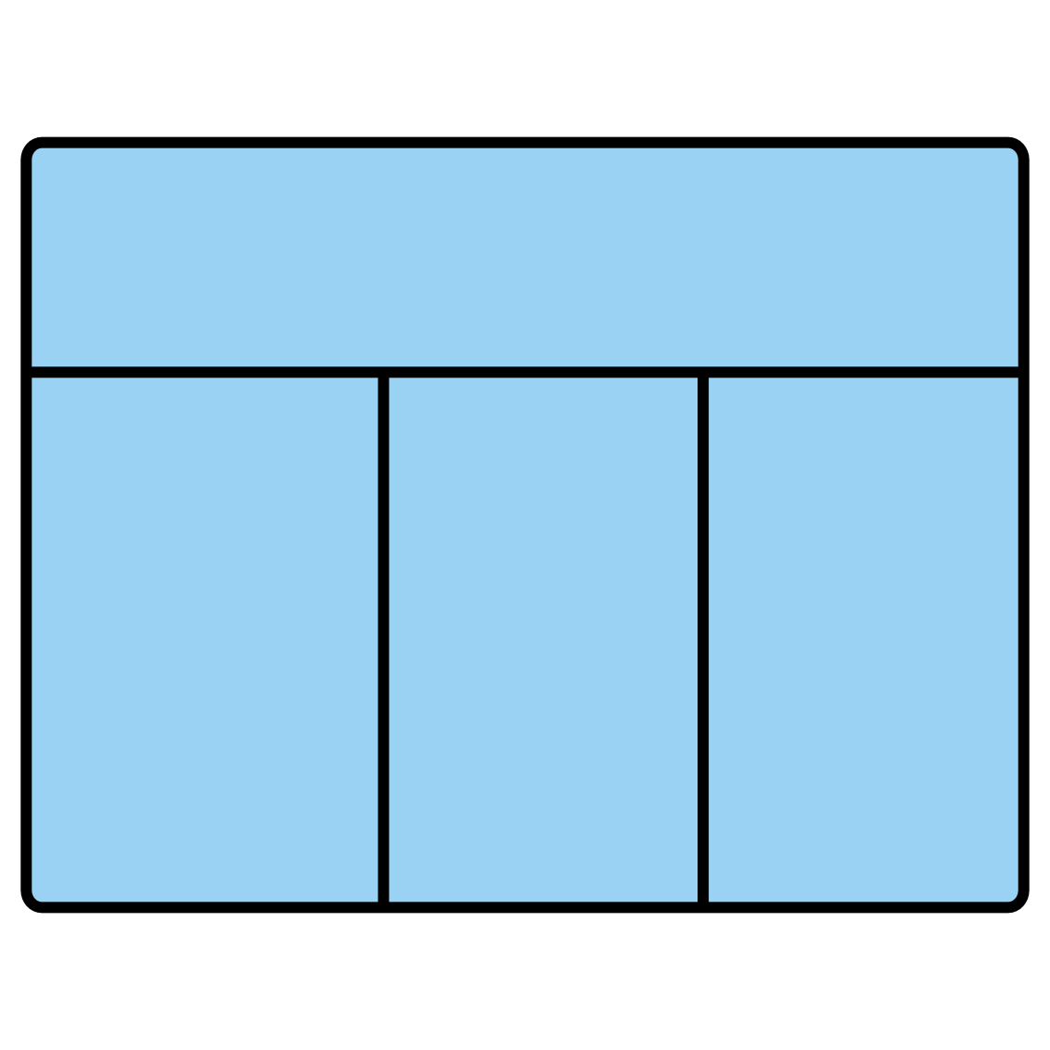




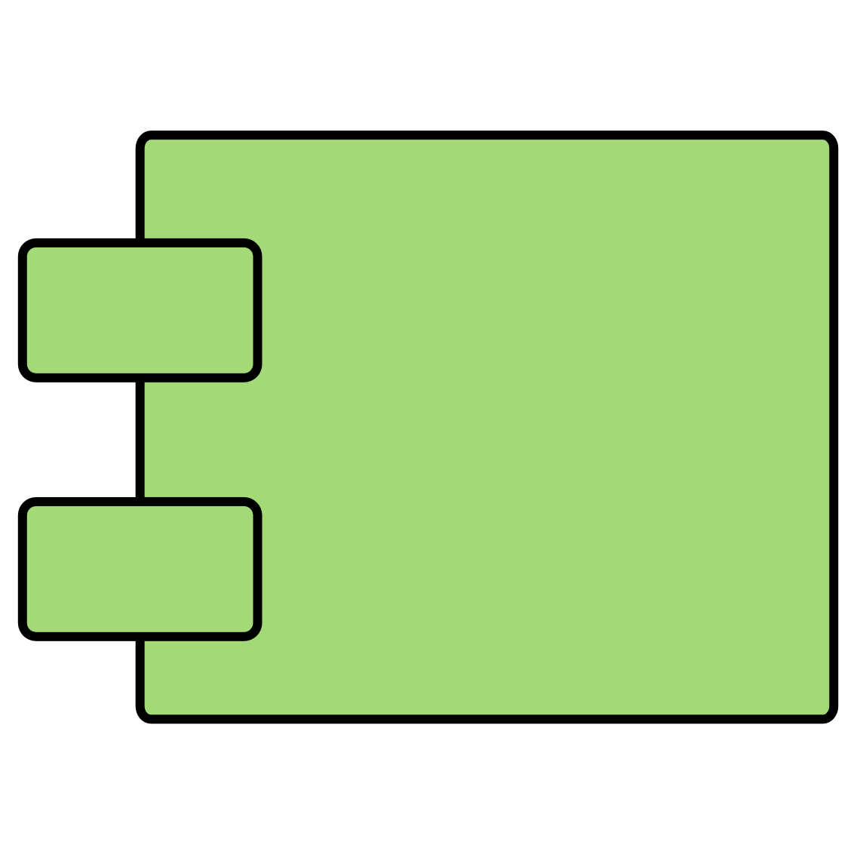




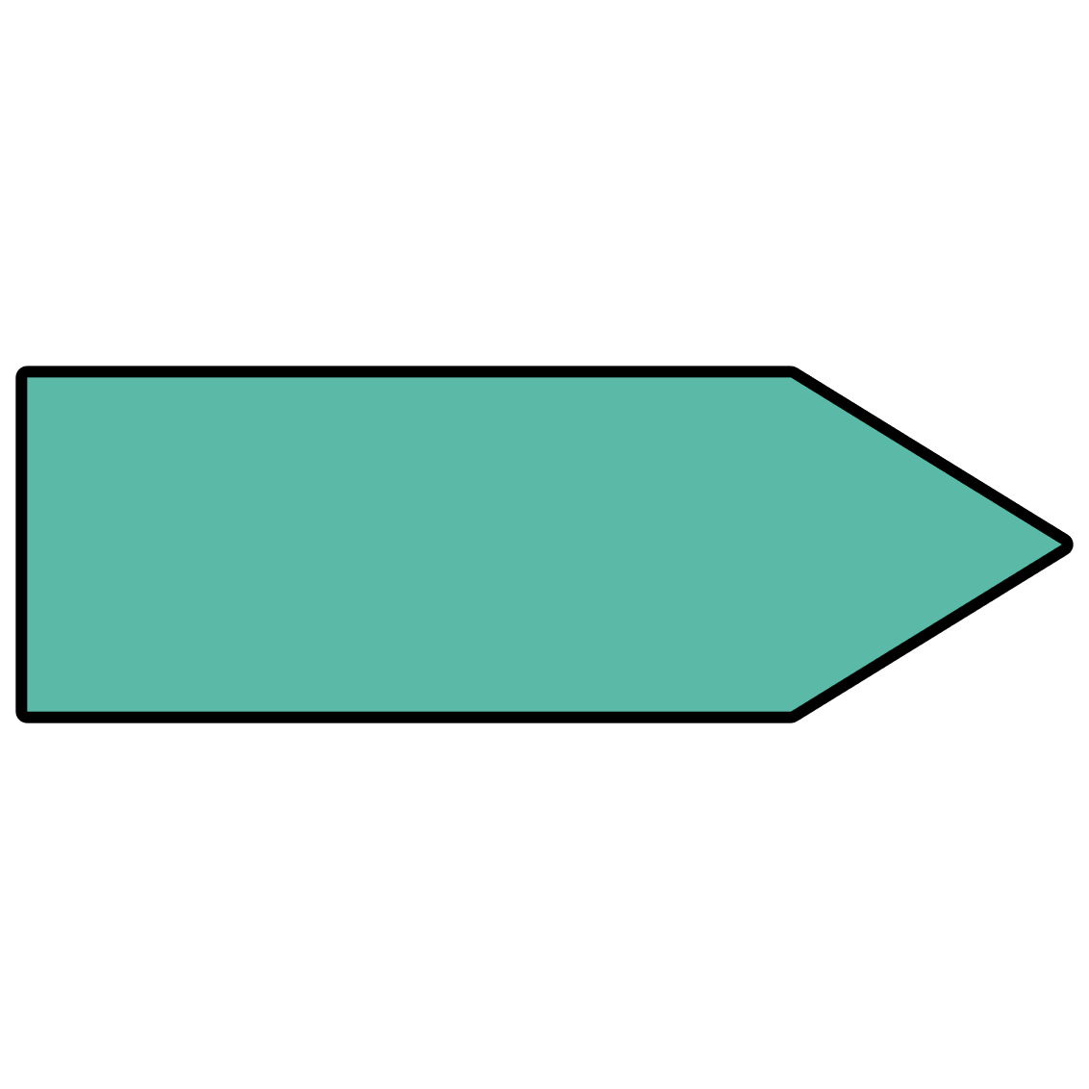







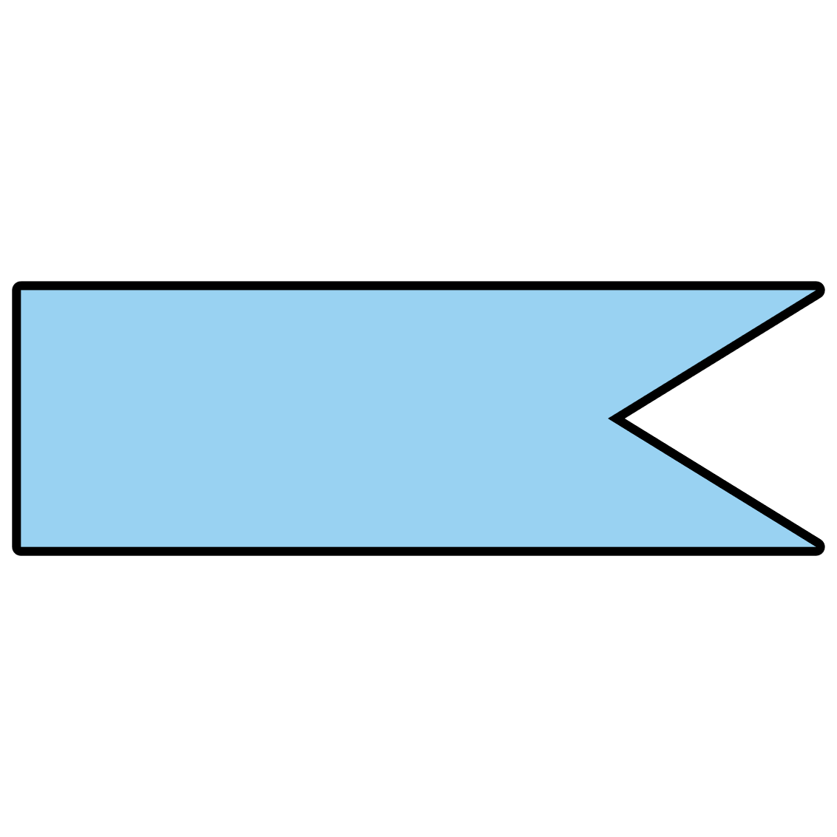





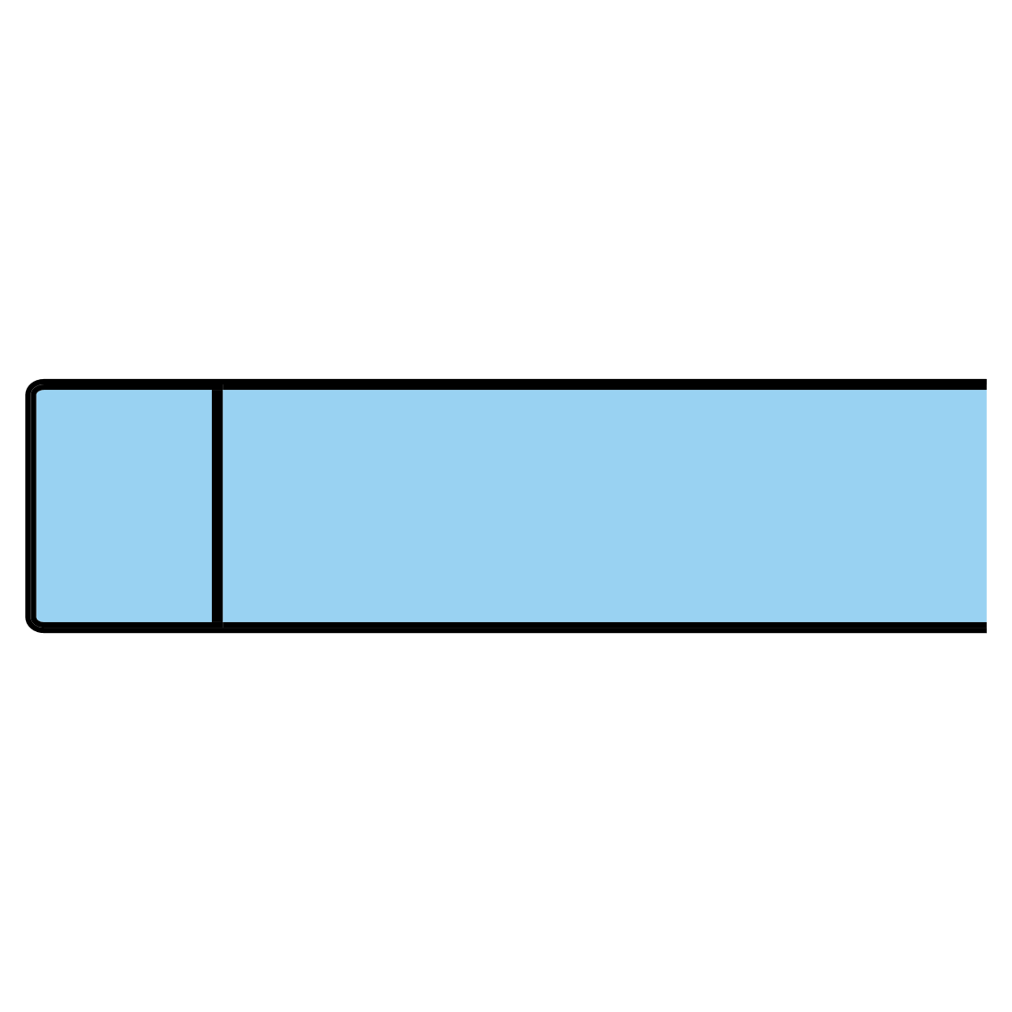










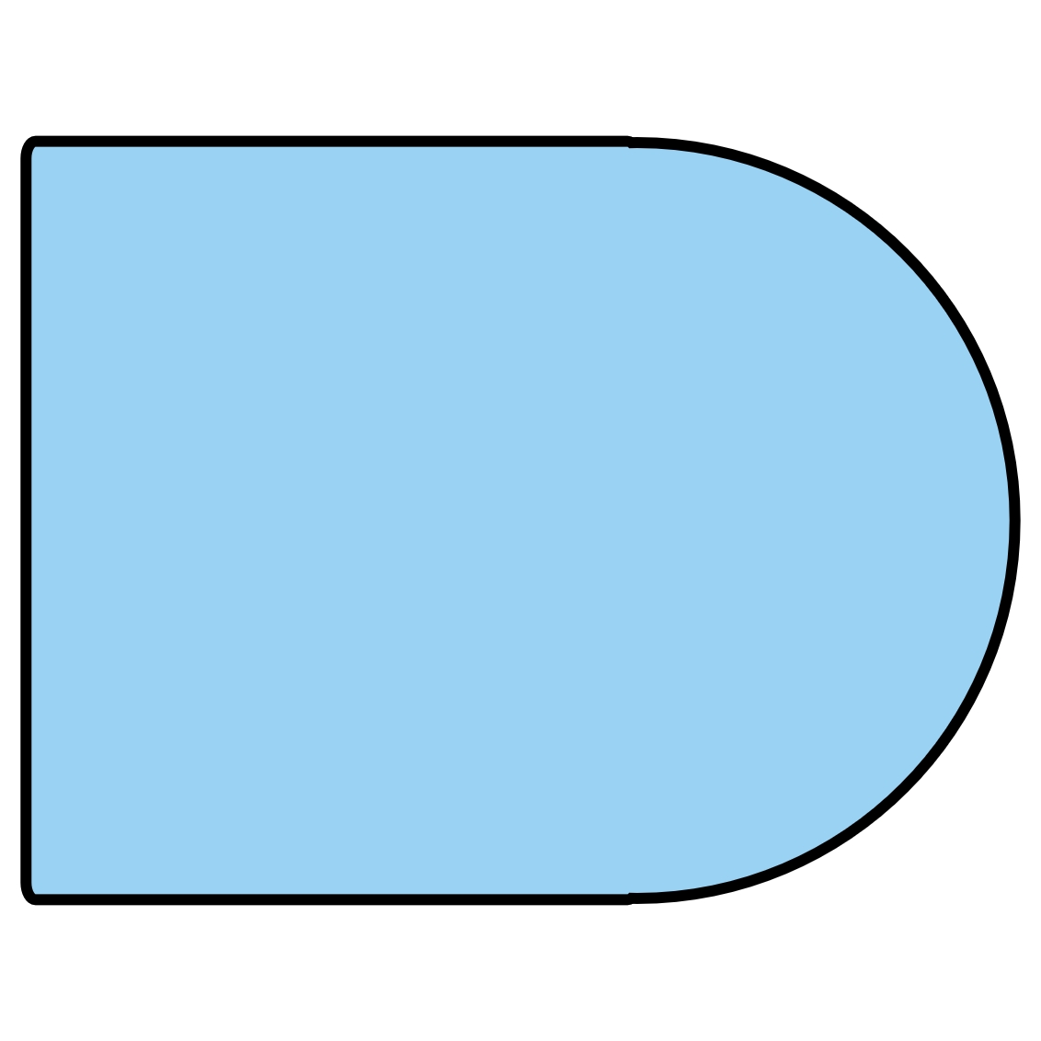





Flowchart
UML
Data Flow
BPMN
ERD
External Entity
Entity
Data
Merge
Entity
Note
Field
Field
Field
Process
Task
Key
Key
Key
Type
Type
Type
Decision
Database
A
Weak Entity
Component
1.0
Transaction
Process
Connector
1.0
Start
Terminator
Hard Disk
Attribute
Send Signal
Process
Event
Or
Predefined Process
Internal Storage
Multivalued Attribute
Recv Signal
Data Store
Event
Summing Junction
Document
Relationship
Data Store
Paper Tape
Display
Event
Manual Operation
Weak Relationship
Data Store
Multiple Documents
Off-Page Link
End
Gateway
Start
Manual Input
Delay
Note
End
Stored Data
Comment
Branch / Merge
Preparation

