Slide 1

INSURANCE FRAUD DETECTION
GROUP-01
P.PRIYANKA
M.SONIKA
B.NAVEEN
P.MANIKANTA
V.MANOJ KUMAR
A.RAGHU
ABDUL SABOOR

Slide 2
OVERVIEW
Fraud claims affect not only the companies financial aspect, but also of the innocent people seeking effective claim coverage. Fraud claims are serious financial burden to the company.
Here we predict the claim is genuine or fraud by analyzing and manipulating the data collected .This will help the company to reject the fraud claims and accept only the genuine claim requests.

Slide 3
DATA FACTS AND EDA
Here the data consist of many attributes such as area service, hospital county, hospital id , age, gender, abortion, result, payment typology etc. We use only required columns for our data visualization and model building.
Here we perform initial analysis, filtering and sorting of data, data visualization etc.,

Slide 4
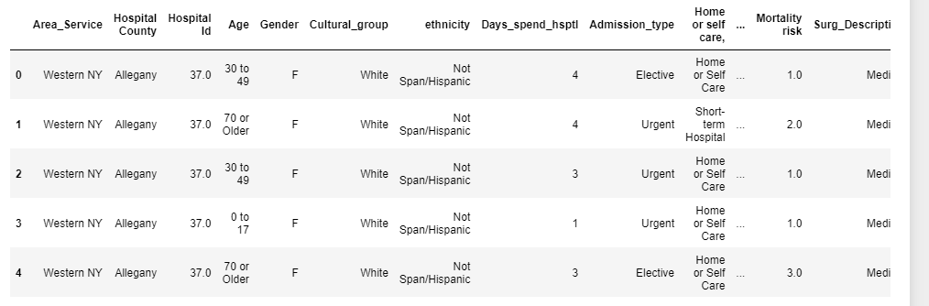
INSURANCE DATA SET

Slide 5
MODEL BUILDING OUTPUT

Slide 6
FINAL MODEL BUILDING AND DEPLOYMENT
We use random forest model for our deployment as it is giving highest testing accuracy when compared to all the other model building techniques.
We use STREAMLIT for building our web application.

Slide 7
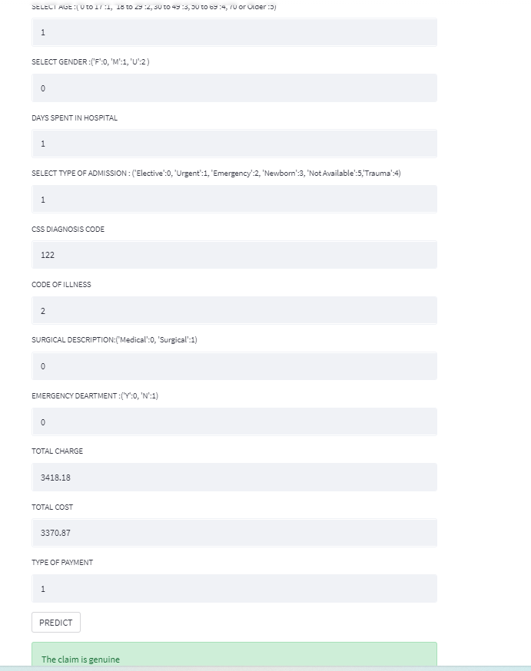
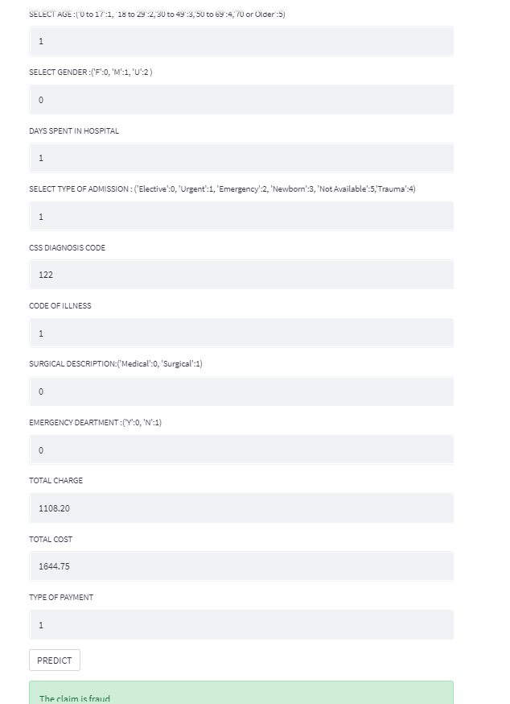
STREAMLIT OUTPUT

Slide 8
LINKS
Link 01: https://colab.research.google.com/drive/1tZlxJFVocshMyRSMq16RfObPC0oldVPb
Link 02: https://colab.research.google.com/drive/1c9E9unaYE4wZ1VQ51jNnMKsh0S3UKn0s
Link 03: https://colab.research.google.com/drive/1KqH_cELeUjISkNqVRReIyQFS-ODSNHww

Slide 9
THANK YOU!!!!

