Slide 1
PROBLEM STATEMENT 04
PrivacyLens
Name
Email
Building a Privacy-Preserving AI Browser Agent
Card
OTP
Compute what is sensitive locally. Reason globally only on sanitized data.
The cloud model gets realistic synthetic values instead
Team name The Marlbros Team ID EGVJH7
2 Problem
3 Idea
4 Architecture
5 Pipeline
6 Different
7 Proof
8 Roadmap
Notes:
PrivacyLens is a privacy-preserving AI browser agent. The idea in one line: compute what is sensitive locally, and let the cloud model reason only on sanitized data. The redacted form on the right is what the model never sees. Use the topic chips at the bottom to jump anywhere in the deck.

Slide 2
PS-004: the problem, and our answer
AI agents shop, fill forms and manage accounts, but they send screenshots and page data to cloud models, exposing Aadhaar, PAN, passwords, OTPs, cards and API keys. The brief has four tasks plus evaluation.
Task | The problem asks | Our answer
A Detect | Find Aadhaar, PAN, cards, emails, passwords, OTPs, keys, faces | Regex + Luhn/Verhoeff, DOM and accessibility rules, OCR, NER and face detection, merged
B Sanitize | Redact screenshots and text; originals must not be recoverable | Solid blackout in screenshots; realistic synthetic values in text; [REDACTED:TYPE] as fail-safe fallback
C Reason | AI acts on sanitized data; validate actions; user approval | LLM sees synthetic values only; every action validated; real value restored locally into the approved field
D Validate | Block unsafe outgoing data, fail closed, injection defense, preview, local mode | Egress firewall on the full payload, injection rules, before/after X-Ray, Ollama offline mode
Evaluate | Recall, precision, leakage, context, task success, latency, security | Annotated synthetic pages, canary values, scripts that reproduce every number
⌂ Home
‹
1
2
3
4
5
6
7
8
›
Notes:
The problem in one breath: agents send screenshots and page data to a cloud model, and that data contains Aadhaar, PAN, passwords, OTPs and keys. PS-004 asks for four things: detect, sanitize, reason safely, validate. Read down the right-hand column: each task maps to one concrete mechanism we built. Stack: Python 3.11 and Playwright for the browser, regex with Luhn and Verhoeff plus DOM rules, OCR, spaCy and OpenCV for detection, Pydantic contracts, Claude API in cloud mode or an Ollama VLM in local mode, FastAPI for the X-Ray interface.

Slide 3
Our idea: the Undercover Agent
ON YOUR MACHINE
SENT TO THE LLM
BACK ON YOUR MACHINE
john.doe@company.com
alex.smith_482@example.com
john.doe@company.com
The real value stays in the browser.
A realistic synthetic identity. The page still makes sense.
The executor types the real value into the approved field only.
Why not just redact?
Three rules
A tag like [REDACTED:EMAIL] strips meaning; the agent cannot tell what the field expects. A synthetic email keeps format and context, while the real value never leaves the trusted side.
Compute what is sensitive locally.
Reason only on synthetic data.
Restore the original only at the executor, only when authorized.
⌂ Home
‹
1
2
3
4
5
6
7
8
›
Notes:
Why not just redact? A tag like [REDACTED:EMAIL] strips meaning, so the agent can not tell what the field expects. A realistic synthetic email keeps format and context. The real value stays local and is typed back only into the approved field by the executor.

Slide 4
Architecture: one trusted gateway
TRUSTED · YOUR MACHINE
UNTRUSTED
CLOUD
P1
P2
P2 · P3
P3
LLM
P4
payload
1 Browser & Snapshot
2 Detection Engine
3 Swap & Sanitize
4 Egress Firewall
Private map · local only
P1
approved action
P1 · P4
action
6 Executor & Vault
5 Validate & Approve
types real value
Sees synthetic data only
Real data
Synthetic data
Action
⌂ Home
‹
1
2
3
4
5
6
7
8
›
Notes:
One trusted gateway sits between the browser and the model. Everything on the left is trusted and local; the cloud model sees synthetic data only. The private map never enters the model-bound payload, risky actions need approval, and any failure blocks sending. Modules P1 to P4 own the four boxes, with shared typed contracts.

Slide 5
Pipeline: follow the data
REAL DATA · LOCAL
SYNTHETIC · SAFE TO SEND
REAL
1
2
3
4
5
6
7
Snapshot
Detect
Swap & sanitize
Egress firewall
Reason
Validate
Restore & execute
P1
P2
P2 · P3
P3
P4
P1 · P4
P1
Secret found? BLOCK + LOG. Nothing is sent.
FOLLOW ONE VALUE
john.doe@company.com
alex.smith_482@example.com
type it into “Email”
john.doe@company.com
on the page
sent to the LLM
LLM action
typed locally
⌂ Home
‹
1
2
3
4
5
6
7
8
›
Notes:
Follow one email through seven steps. Snapshot, detect, swap and sanitize, then the egress firewall as the last gate. The model returns an action, we validate it, and the real value is restored locally. If a secret is found in the outgoing payload we block, log, and send nothing.

Slide 6
What makes PrivacyLens different
FIVE SIGNATURE FEATURES
VERSUS OTHER APPROACHES
1
Privacy Firewall
Capability | Typical agent | Redaction only | PrivacyLens
Hides real data from the LLM | No | Yes | Yes
Page stays understandable to AI | Yes | No | Yes
Fail-closed outgoing check | No | No | Yes
Live leak-attack demo | No | No | Yes
Intent-aware disclosure | No | No | Yes
Prompt-injection defense | No | Partial | Yes
Inject a canary secret live and watch the gateway block it.
2
Intent-Aware Filtering
Reveal only what the task needs; keep the rest local.
3
Privacy Time Machine
Replay every decision. Stores categories, never values.
4
Prompt-Injection Trap
A malicious page versus the action validator, with reasons.
5
Privacy X-Ray
Original, scan and AI-visible views side by side.
Capability categories, not named products.
⌂ Home
‹
1
2
3
4
5
6
7
8
›
Notes:
Five visible controls make the prototype demonstrable, not just claimed: the firewall blocks a canary live, intent-aware filtering reveals the minimum, the time machine replays decisions without storing values, the injection trap rejects off-domain navigation, and the X-Ray shows what the AI actually sees. Against redaction-only tools we keep the page understandable; against typical agents we actually hide the data and check the outgoing payload. Mosaic Shield (risk score R = sum of w_i s_i + lambda C) is proposed, not yet calibrated.

Slide 7
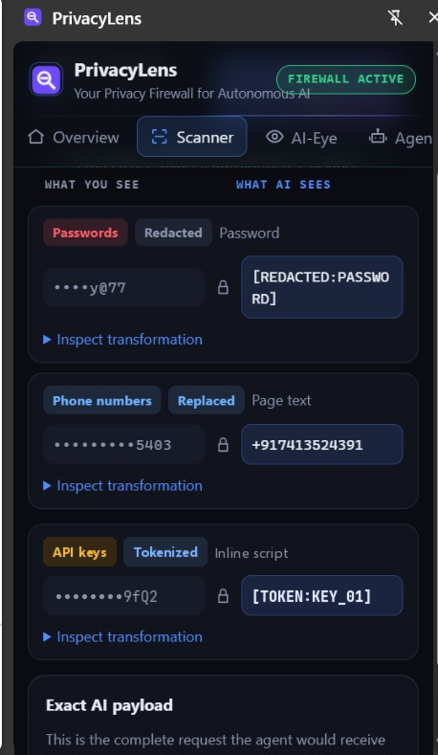
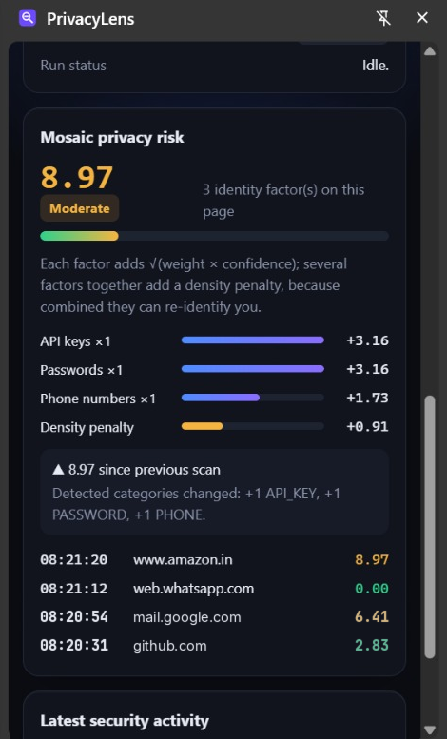
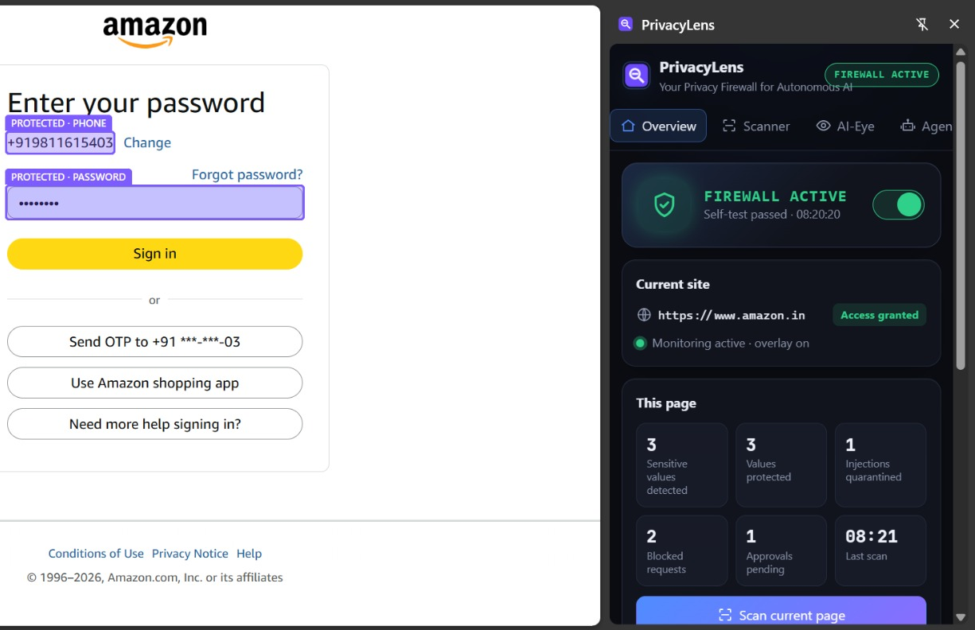
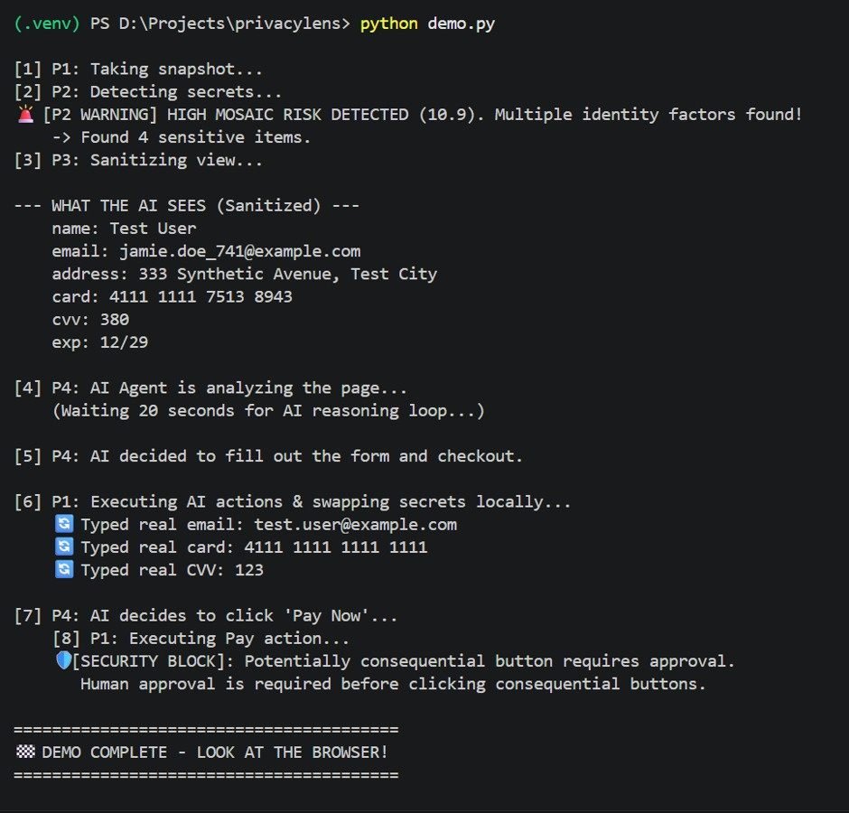
Proof: measured, not promised
19/19
0
5/5
secrets
detected
originals
leaked
payloads
blocked
Field | Original (local only) | Text sent to LLM (synthetic)
Email | priya.nair@mailtest.in | alex.smith_481@example.com
Aadhaar | 2345 1860 9173 | 9999 0000 0016
⌂ Home
‹
1
2
3
4
5
6
7
8
›
Notes:
Left: the same checkout page twice. The real one stays local; the screenshot that leaves the machine has every sensitive field blacked out. Middle: we deliberately disabled the sanitizer and the egress firewall still blocked the payload because it found the original email, phone, card and Aadhaar. Right: 19 of 19 planted secrets detected, zero originals in outgoing payloads, 5 of 5 sabotaged payloads blocked. Be upfront about scope: this is the text and DOM pathway on five synthetic pages. Our first run missed a phone number inside a tel: link, the firewall blocked that payload, and we fixed the regex. Screenshots, OCR, names and faces are not yet measured. Everything reproduces with python run_proof.py.

Slide 8
Secrets stay local.
Agents stay smart.
19/19
0
5/5
secrets
detected
originals
leaked
payloads
blocked
Synthetic substitution and a fail-closed firewall let an AI agent work on real interfaces without ever seeing real data.
FUTURE SCOPE
NOW
NEXT
LATER
Mosaic Shield
Fully local mode
Policy and audit
Flag combinations of low-risk details that identify a person; swap in one coherent synthetic persona.
On-device vision model and OCR so no byte leaves the machine, plus a browser extension and desktop agents.
User and enterprise rules, exportable replay logs, richer media: PDFs, video calls, faces.
⌂ Home
‹
1
2
3
4
5
6
7
8
Notes:
Close on the roadmap: Mosaic Shield is next, catching combinations of harmless-looking details that identify a person; then a fully local mode where nothing leaves the machine; then policy and audit for enterprises. Land the tagline: secrets stay local, agents stay smart. 19 of 19 detected, 0 leaked, 5 of 5 sabotaged payloads blocked. Then take questions.

