Slide 1
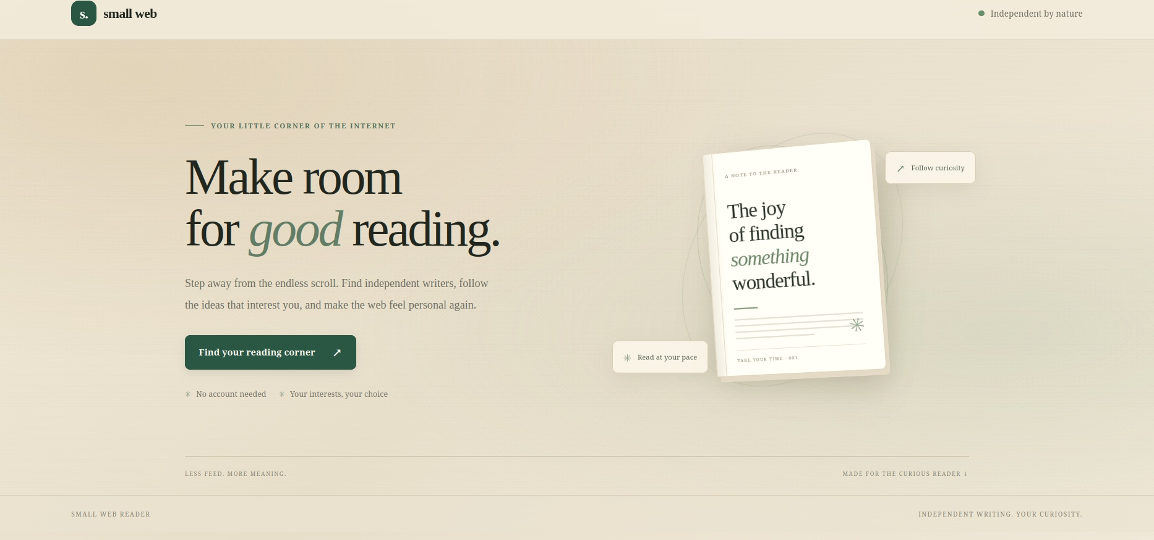
S. SMALL WEB
01
PS-003 / PRODUCT STORY
The web is still
worth wandering.
A reader for independent writing.
Find it. Follow it. Make time for it.
INDEPENDENT BY NATURE
A SMALL WEB READER
DISCOVER FOLLOW READ RETURN

Slide 2
S. / SMALL WEB
THE IDEA
Independent writing
deserves a better home.
Small Web Reader brings the publications you choose into one calm reading space.
01
02
03
04
FIND
→
FOLLOW
→
READ
→
RETURN
Start with topics and independent publications.
Keep the writers you want to hear from.
See new posts together in one timeline.
Save articles and pick up where you stopped.
NO ACCOUNT REQUIRED / NO ENDLESS FEED / YOUR READING, YOUR CHOICE
PS-003 · 16HOLYCOLOURS
02 / 08

Slide 3
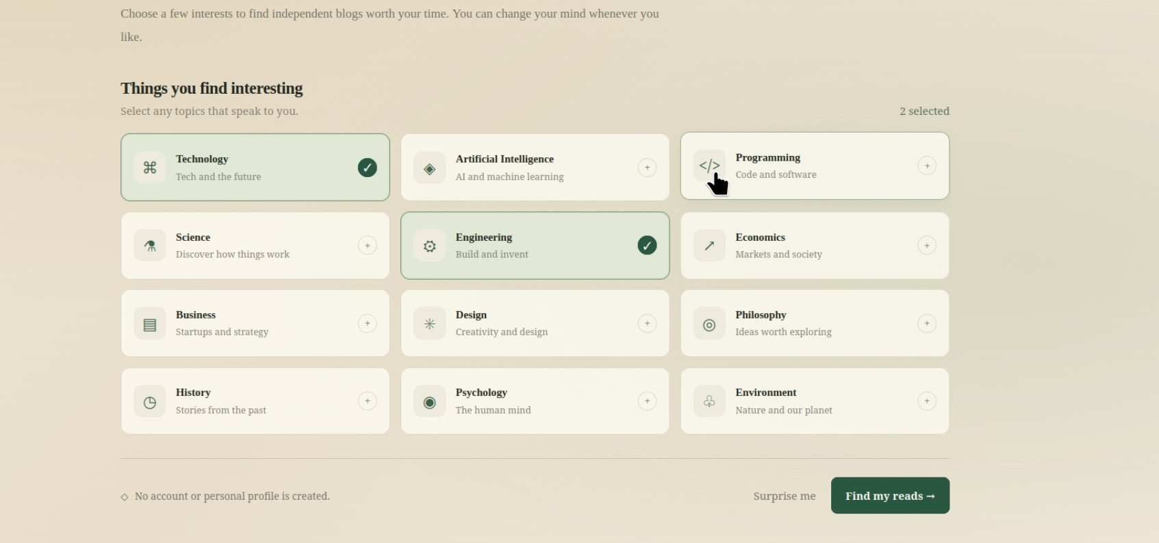
S. / SMALL WEB
01 / FIRST RUN
Start with interests.
Not identity.
The first screen asks what you like to read—not who you are.
01
Pick a few subjects
Technology, engineering, science, design and more.
02
Change them anytime
Interests shape the starting point, not a permanent profile.
03
No sign-up step
No account or personal profile is created.
INTERESTS FIRST / NO ACCOUNT
PS-003 · 16HOLYCOLOURS
03 / 08

Slide 4
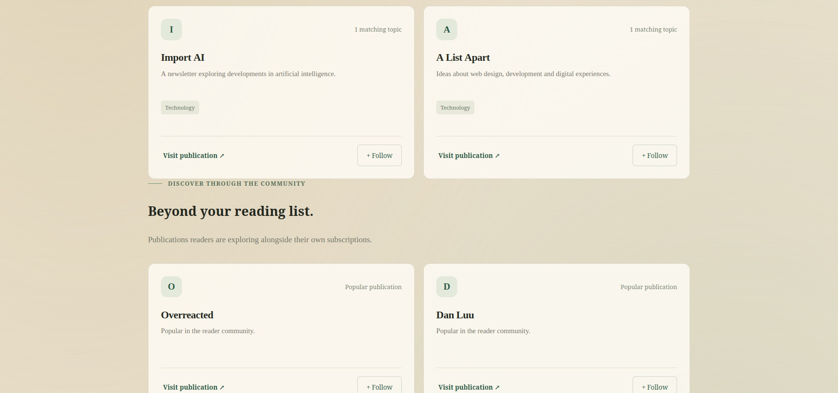
S. / SMALL WEB
02 / DISCOVERY
Find the next blog
to follow.
Two paths surface publications worth exploring.
01 TOPIC MATCH
Find publications around the subjects you picked.
02 RELATED READING
Aggregate co-subscription patterns suggest what to read next.
Suggestions, not a prescribed feed. You decide what to follow.
TOPIC MATCH + RELATED PUBLICATIONS
PS-003 · 16HOLYCOLOURS
04 / 08

Slide 5
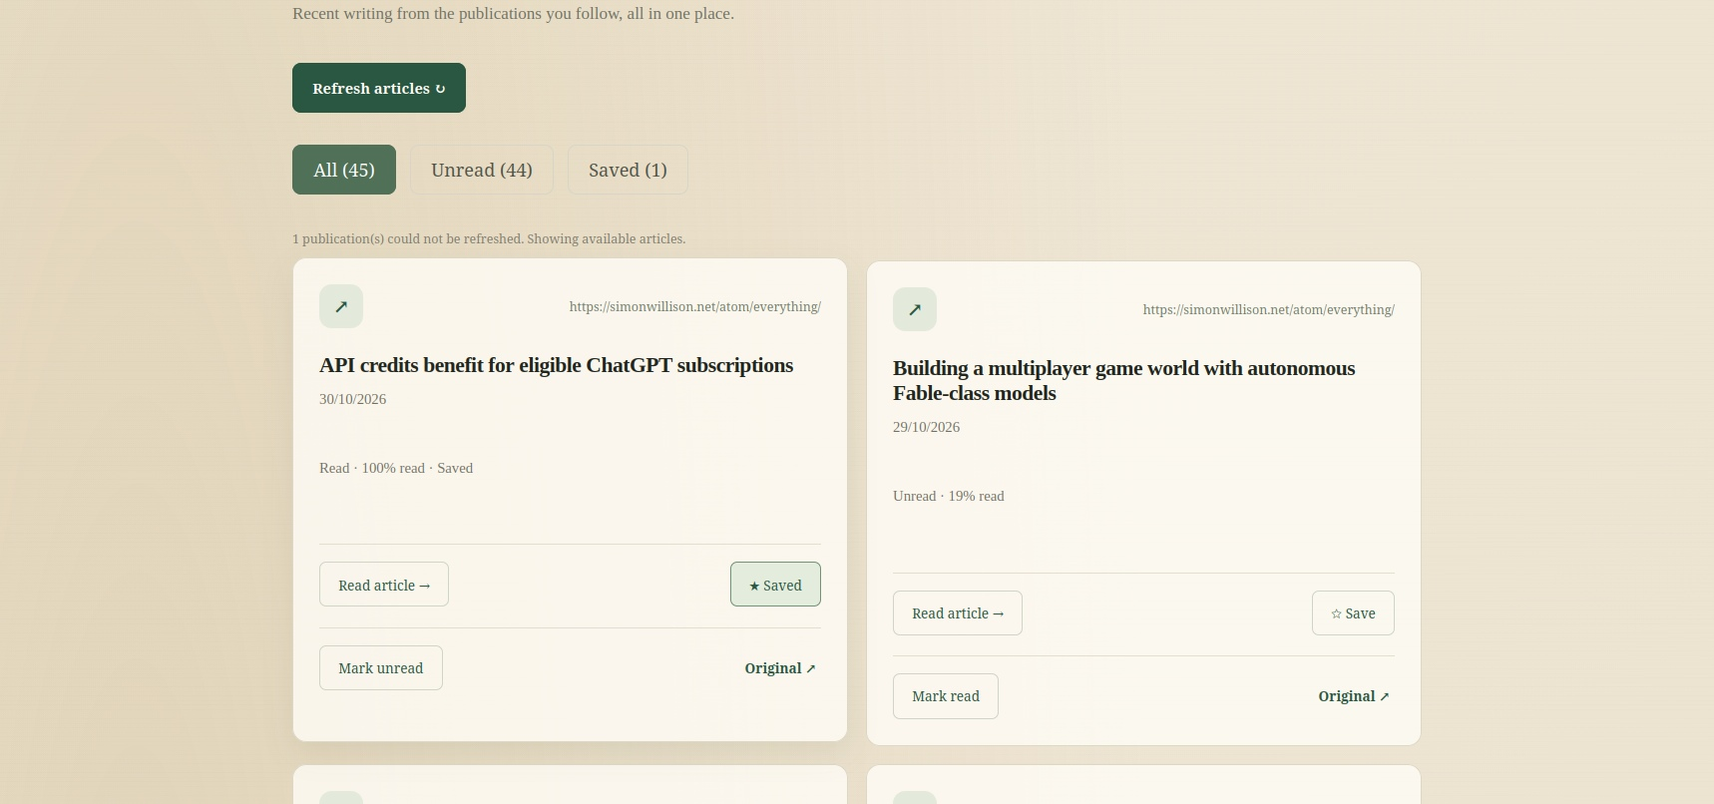
S. / SMALL WEB
03 / TIMELINE
Blogs you follow.
One fresh timeline.
New posts from the publications you follow, gathered in one place.
ALL
UNREAD
SAVED
↻
Refresh when you're ready
Check followed feeds for new writing, on your terms.
PS-003 · 16HOLYCOLOURS
05 / 08

Slide 6
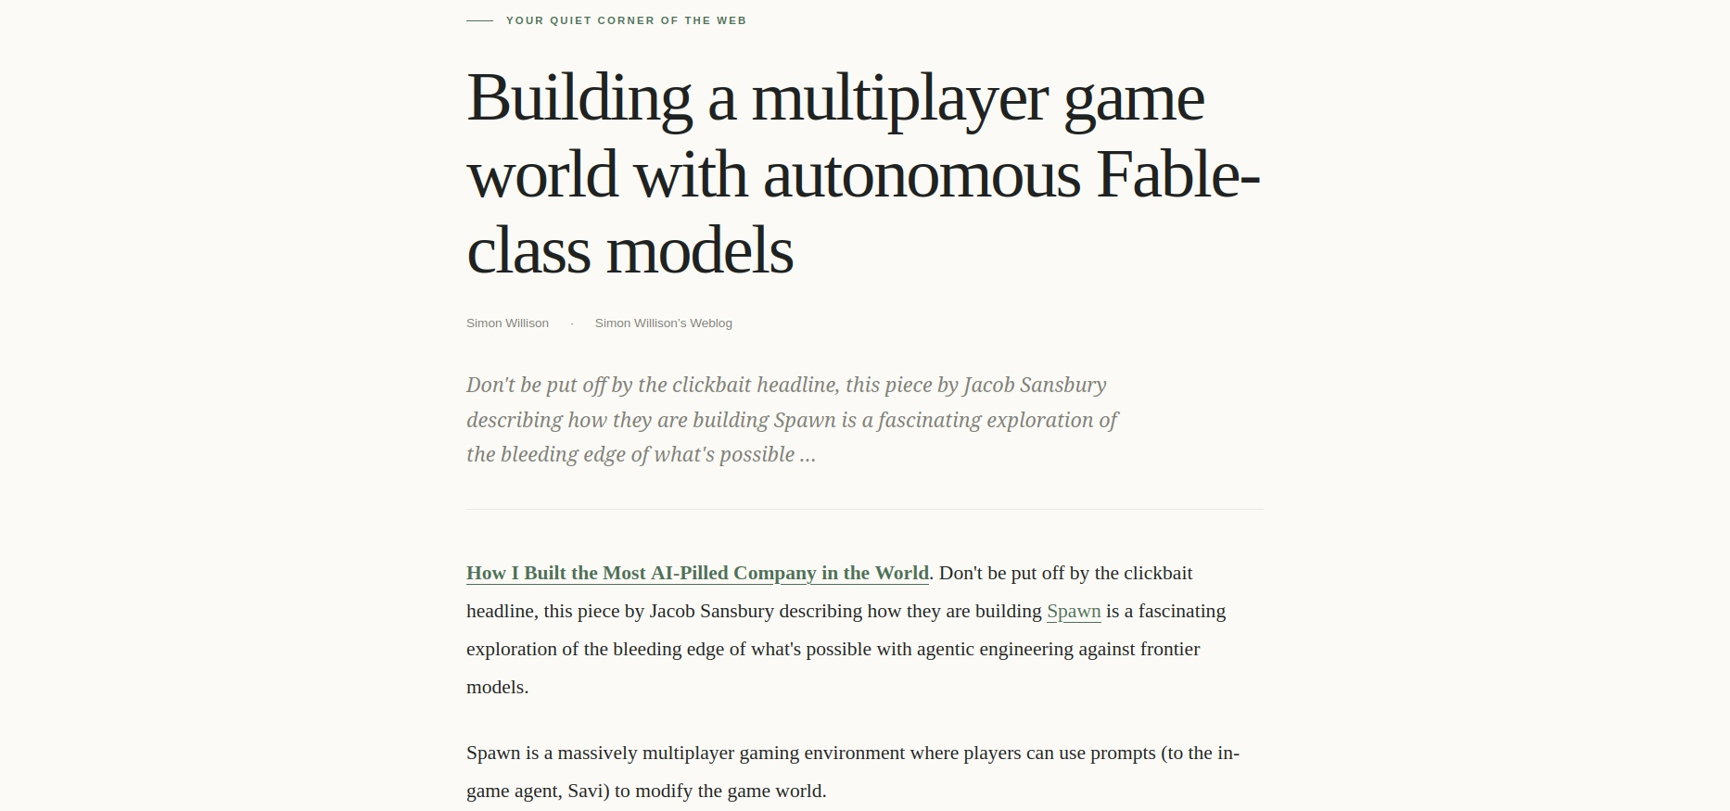
S. / SMALL WEB
04 / READING
Open the post.
Keep the writing.
The reader extracts the article into a clean view, away from the clutter of the original page.
FEED ITEM
→
READING VIEW
The original publication stays one click away.
READ AT YOUR PACE
Article content, without the detour.
PS-003 · 16HOLYCOLOURS
06 / 08

Slide 7
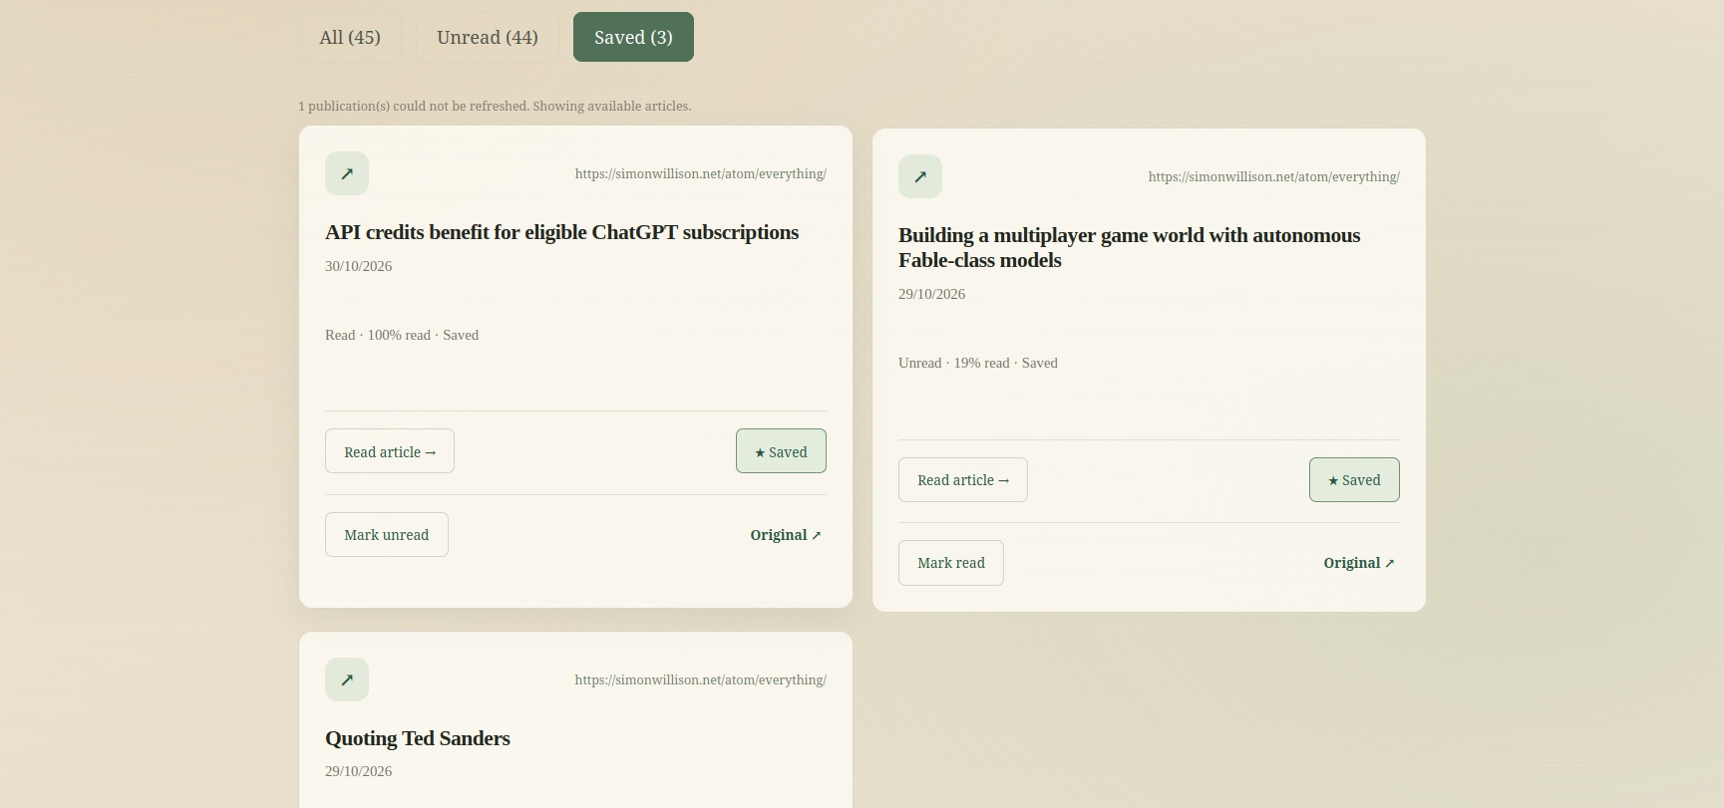
S. / SMALL WEB
05 / READING MEMORY
Keep the article.
Keep your place.
A reading list should remember what matters, without asking you to manage it.
SAVED
For later
READ / UNREAD
Know what's done
PROGRESS
Return where you stopped
A small memory for a long reading list.
PS-003 · 16HOLYCOLOURS
07 / 08

Slide 8
S. / SMALL WEB
UNDER THE SURFACE
Simple on the surface.
Deliberate underneath.
A reader-first frontend, with a small service for retrieval and anonymous discovery signals.
IN THE BROWSER
BACKEND + DATABASE
RSS / Atom parsing · Article extraction
API
Public feed retrieval
Saved articles · Read state · Progress
Aggregate popularity + co-subscription signals
Local browser storage supports the reading experience.
No reader account or personal profile.
Less feed. More reading.
Prototype note: discovery popularity values are seeded demo data.
PS-003 · 16HOLYCOLOURS
08 / 08

