Slide 1
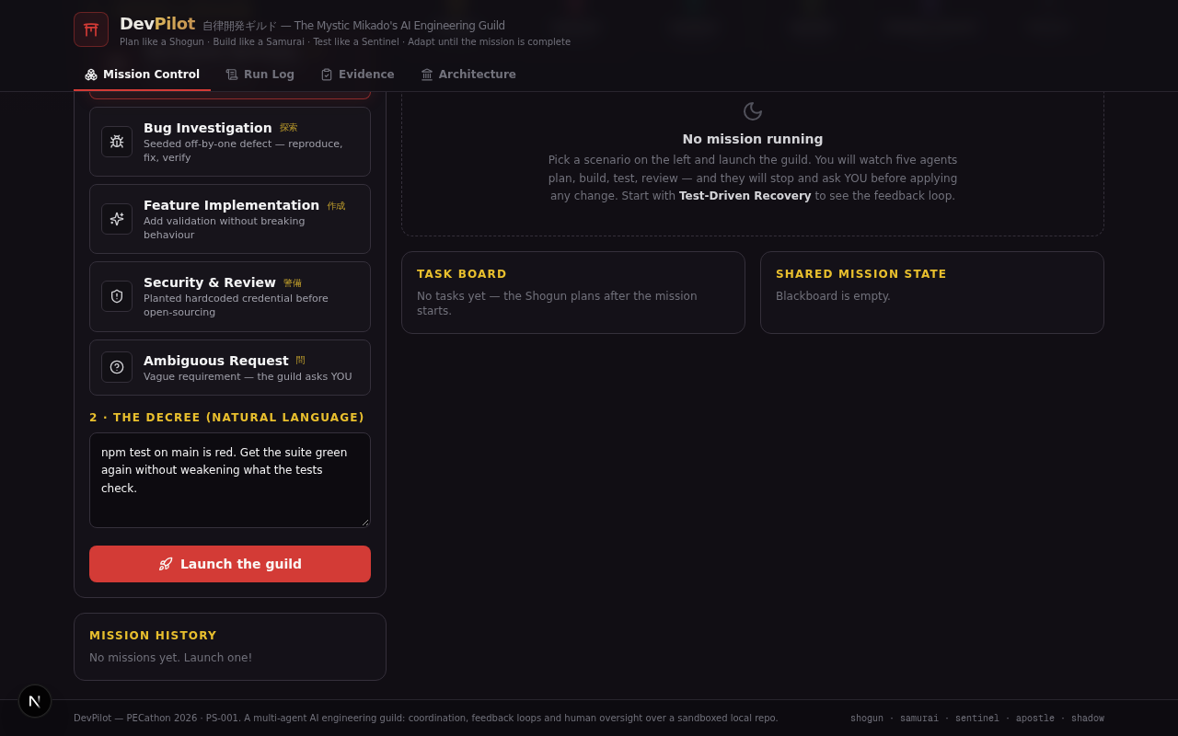
PROJECT OVERVIEW
DevPilot
The Mystic Mikado’s Autonomous AI Engineering Guild
Plan like a Shogun.
Build like a Samurai.
Test like a Sentinel.
An event-driven multi-agent workspace that turns natural-language software requests into planned, implemented, tested and reviewed changes.
MISSION CONTROL • RUN LOG • EVIDENCE • ARCHITECTURE
DEVPILOT | SOFTWARE ENGINEERING, WITH HUMAN OVERSIGHT
01/08

Slide 2
01 — THE CHALLENGE
From vague request to verified code
Software changes need more than code generation: they need context, coordination, testing and accountable decisions.
THE PROBLEM
THE DEVPILOT APPROACH
A developer request often starts as plain language—but delivering it safely requires a chain of work:
• Understand the intent and acceptance criteria
• Find the right files and project conventions
• Implement without breaking existing behaviour
• Run checks, investigate failures and review risks
• Decide when to proceed, retry or ask a human
DevPilot organizes the work as a coordinated engineering mission.
A planning agent decomposes the request; specialist agents build, test and review; a shared mission state carries findings between them; and a human approval gate keeps consequential actions under control.
COORDINATED AGENTS
REAL EVIDENCE
BOUNDED AUTONOMY
02/08

Slide 3
02 — PRODUCT EXPERIENCE
One mission. A visible engineering workflow.
The interface is organized around four views that make progress and decisions inspectable.
01
02
03
04
MISSION CONTROL
LIVE RUN LOG
EVIDENCE
ARCHITECTURE
Choose a scenario, write a natural-language decree and launch the guild.
Follow agent messages, tool calls, task updates and mission events as they happen.
Inspect file edits, test outcomes, verification criteria and review findings.
Understand agent responsibilities, shared state, tools and safety boundaries.
A command center, not a chat window
Mission status, task board, shared state, agent activity and mission history stay in view—while deeper logs and evidence remain one click away.
03/08

Slide 4
03 — THE GUILD
Specialists collaborate through shared context
Five roles divide the engineering mission; their findings influence the next action rather than running as isolated personas.
SHOGUN
SAMURAI
SENTINEL
Planner & orchestrator
Developer
Tester
Turns the request into objectives, acceptance criteria and a task graph; replans when blockers appear.
Inspects the repository, selects tools and implements context-aware code changes.
Runs tests, diagnoses failures and sends actionable evidence back to the developer.
APOSTLE
SHADOW COUNCIL
Independent verifier
Review & security
Checks acceptance criteria separately and records pass/fail evidence.
Reviews correctness, consistency and security risks; challenges changes before approval.
SHARED MISSION STATE • TASKS • FINDINGS • DECISIONS • OPEN ISSUES
04/08

Slide 5
04 — SYSTEM DESIGN
Event-driven orchestration with a shared blackboard
Agents read and write mission state; new evidence can change the plan, trigger a retry or request clarification.
USER REQUEST + REPOSITORY
SUPPORTED TOOL SET
↓
read_file
Repo-scoped operations
Tool results are added to the event stream and made visible in the UI.
SHOGUN | PLAN & DELEGATE
search_repo
↓
edit_file
SPECIALISTS | BUILD • TEST • VERIFY • REVIEW
write_file
↓
run_tests
SHARED MISSION STATE | EVENTS & FINDINGS
security_scan
↓
HUMAN APPROVAL / ESCALATION
Boundary: no writes outside the mission repository; destructive operations and network calls are blocked in the described tool layer.
05/08

Slide 6
05 — TRUST & CONTROL
Autonomy with explicit limits
The system is designed to make its work inspectable and to stop when confidence or permission is insufficient.
REPOSITORY SCOPE
File and command operations are restricted to the mission repository.
DESTRUCTIVE ACTION BLOCKS
Dangerous operations (such as recursive deletion) are blocked.
HUMAN APPROVAL GATE
Consequential changes pause for a human decision before proceeding.
BOUNDED RETRIES
A rejection allows one revision retry; repeated failure escalates instead of looping forever.
EVIDENCE-BASED COMPLETION
A mission is not declared successful solely from an agent's claim—tests and verification are recorded.
DESIGN PRINCIPLE: THE HUMAN REMAINS THE FINAL AUTHORITY FOR CONSEQUENTIAL DECISIONS.
06/08

Slide 7
06 — DEMONSTRATION PATHS
Five scenarios show how the guild adapts
Scenario-based missions exercise implementation, recovery, security review and clarification—not just happy-path code generation.
FEATURE
BUG
RECOVERY
Add validation while preserving existing behaviour.
Reproduce a defect, create a regression check and fix the cause.
Investigate a failing test suite and iterate toward green.
SECURITY
AMBIGUITY
Detect and remediate a planted credential before release.
Pause on a vague request and ask the human to clarify.
FAILURE / REVIEW FINDING → SHARED STATE UPDATE → REPLAN OR REVISE → RERUN CHECKS → VERIFY
07/08

Slide 8
07 — CLOSING
A transparent engineering guild—not a black box
DevPilot brings planning, implementation, feedback and human control into one visible mission.
LIVE DEMO WALKTHROUGH
WHAT DEVPILOT DEMONSTRATES
1. Select Test-Driven Recovery or Custom Mission.
• Multi-agent task coordination
• Context-aware repository work
• Test and review feedback loops
• Independent acceptance checks
• Human oversight and bounded autonomy
• Inspectable mission history and evidence
2. Enter a plain-language engineering request.
3. Watch agent activity, task state and tool events.
4. Inspect file edits, test results and independent verification.
5. Review the proposed outcome and make the approval decision.
DEVPILOT | PLAN. BUILD. TEST. REVIEW. ADAPT.
08/08
08/08

