Slide 1
PRIVACYLENS
Your face.
Your card.
Your OTP.
Not the AI's.
PECATHON'26 | PS-004 | Team code PF-A73PXS
Notes:
Open with the four lines. The point of the project is that your private details stay on your computer. The AI gets a cleaned view, and still finishes the task.

Slide 2
AI agents see your whole screen
1
Pages and screenshots go to cloud models
So the model can read the page and click for you.
2
They carry your private details
Aadhaar, PAN, card numbers, passwords, OTPs, API keys, faces.
3
One hidden instruction can steer the agent
A page can try to make it paste your card somewhere else.
Compute what is sensitive locally. Reason globally only on sanitized data.
Every orange tile is something private that leaves your device.
Notes:
AI browser agents work by reading the page and a screenshot. Those go to a cloud model. A checkout page or a support chat is full of things you never meant to share. The fix is a rule: decide what is sensitive on your own computer, and only send what has been cleaned.

Slide 3
Every step is cleaned before the AI
1
2
3
4
5
6
Look
Detect
Hide
Check
Decide
Act
Reads the page, form fields and a screenshot
Checksums, page structure, context rules, faces
Placeholders in text, solid black in images
A guard blocks anything unhidden. Fails closed
The AI picks one action from the clean view
We validate, ask you, then type real values locally
Stays on your computer
What the AI receives
Real values, held in memory only. The real screenshot. Your saved card, typed in locally.
Placeholders like [REDACTED:CARD#1], page structure and labels. Text only. Never the screenshot.
Notes:
Each step of a task goes through the same pipeline. Everything in dark runs on your computer. Only step five talks to the AI, and it only sees the cleaned view. The guard is fail closed: if anything in steps one to four goes wrong, nothing is sent.

Slide 4
Six things that make it different
1
2
3
Defense in depth
Your card stays local
Fails closed
Checksums (Luhn, Verhoeff), page structure, context and faces work together.
It names a placeholder. Your computer types the real value, after you approve.
A guard checks every message. Any error means nothing is sent.
4
5
6
Hide, Ask or Reveal
Resists injection
See what the AI sees
Set it for each kind of data. Ask permission is the default, one task at a time.
A hidden page instruction cannot paste your card. The validator rejects it.
One switch shows the exact blacked-out view the AI receives.
Notes:
These are the six things that set this apart. Pick two to talk about: the AI never sees your card because our code types it locally, and the guard fails closed so an error means nothing is sent.

Slide 5
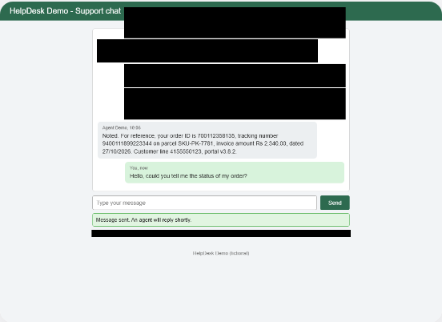
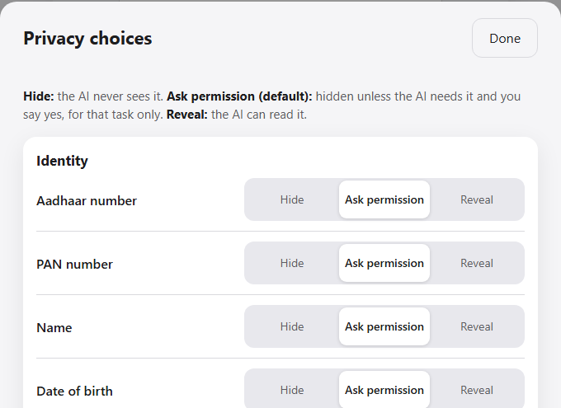
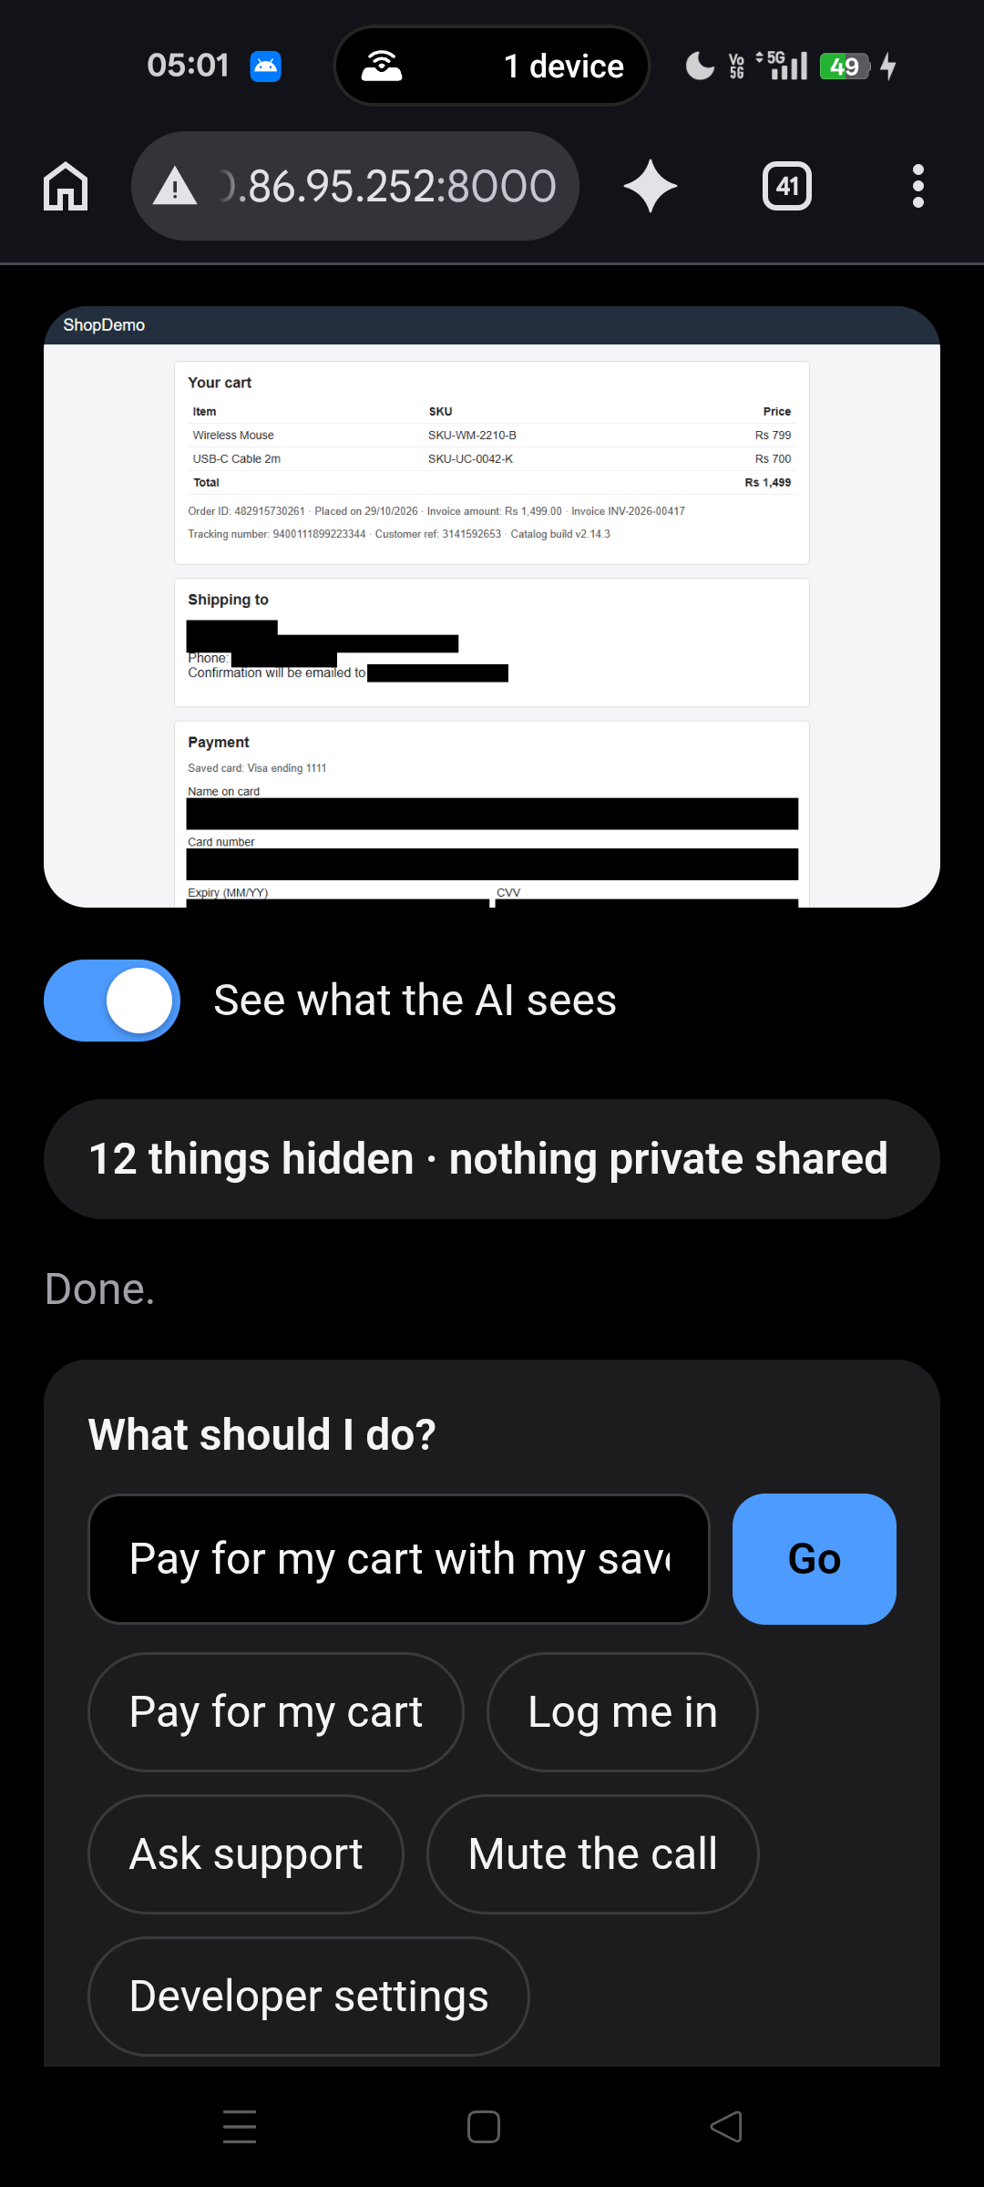
See it working
What the AI sees
Names, address and card details are solid black.
Privacy choices
A choice for each kind of data.
Right: a real phone, over Wi-Fi. It shows the same AI view and gets the approval sheet, so tapping Approve on the phone lets the task finish.
Notes:
These are real screenshots of the running app. The first is the AI view: names, address and card are solid black. The second is the Privacy choices table. On the right is a real phone approving a payment over Wi-Fi.

Slide 6
You stay in control
1
Approve from your phone
Hide
Ask permission
Reveal
The sheet also appears on your phone. Tap Approve there. Tested on a real phone.
Aadhaar number
Ask permission
PAN number
Hide
2
Hidden items get a notice
A pill drops in from the top: Card number hidden. Kept on this device.
Card number
Reveal
Ask permission is the default. The AI has to ask, you say yes, and it lasts for one task.
3
A one-click Windows app
Unzip, double-click, no Python. It works offline with the built-in planner.
Notes:
This is the idea we added after our first sketch: one row per kind of data, three choices. The default is Ask permission, so the AI has to ask and you say yes for that one task. The same approval sheet shows up on your phone. The Windows app needs no Python.

Slide 7
Measured, not claimed
29 → 0
100%
100%
secrets exposed without PrivacyLens, versus with it
recall on 29 annotated private values
precision: 0 of 44 lookalikes wrongly hidden
20 / 20
94.4%
212
adversarial cases pass: disguised data, hostile AI replies, forced failure
task success with Gemini, 17 of 18 runs, 0 leaks
automated tests passed in the last full run
Measured on our six controlled test pages with the default settings (eval/results.json). The leak counts cover those pages and two paths: the message to the AI and the browser's network traffic.
Notes:
Every number here comes from one evaluation file that anyone can rerun. The headline is twenty nine private values exposed without the system and none with it. Be clear that this is on our six controlled pages with default settings. The Gemini number is from the official run, before we added the model fallback.

Slide 8
The whole problem statement, covered
A
Detect
Patterns with checksums, page structure, context rules, faces
What it is, honestly
A working prototype on controlled test pages
Not a layer for every website, yet
Next: a real-sites mode and a browser extension
B
Sanitize
Placeholders in text, solid black in screenshots, structure kept
C
Reason and act
Gemini or the offline planner, validated actions, approval for risky steps
D
Validate and prove
Fail-closed guard, injection defence, before and after preview, tests
Questions?
Bonuses: 7 of 9 fully covered, 2 partly. Fully local AI uses the offline planner only, and cross-browser covers Chromium and WebKit.
Notes:
This slide maps straight onto the four tasks in the problem statement. Say the honest part out loud: it is a working prototype on controlled pages, not a layer for every website yet. The next step would be a real-sites mode and a browser extension.

