Slide 1

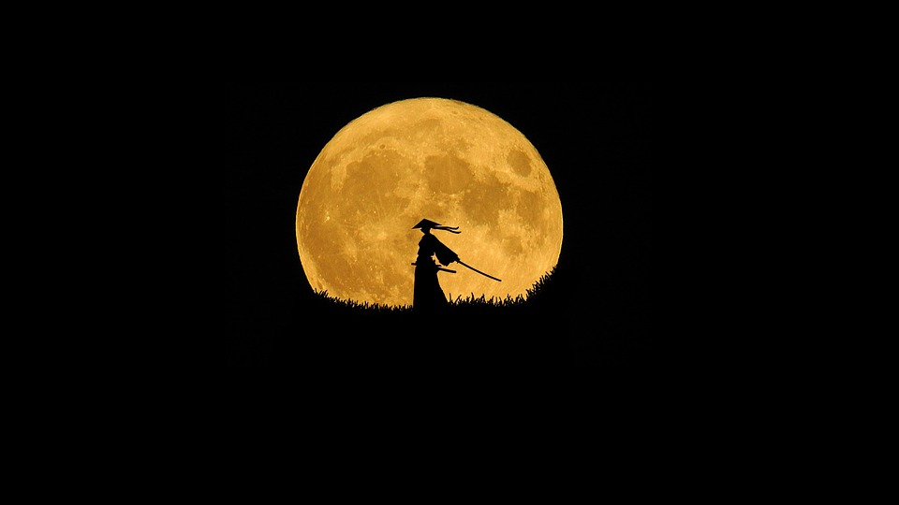
PECATHON 2026 / OFFICIAL SUBMISSION DECK / TOP 40 QUALIFIER
TSUKUYOMI
WATCH
月読見張
The Samurai's Celestial Guide
Stargazing Intelligence, Live Stellarium Sky, Orbital Ephemeris & Faithful AI Astro-Restoration
PROBLEM STATEMENT ID
PS-002
PROBLEM STATEMENT TITLE
Tsukuyomi Watch: The Samurai's Celestial Guide
THEME / DOMAIN
Space Technology, Astronomy, Scientific AI & Geo-Telemetry
PS CATEGORY
Software (Full-Stack Web Platform & Deconvolution Engine)
TEAM ID / NAME
PF-KV5WKX | The roadsters
REPOSITORY & LIVE PROTOTYPE
Working Full-Stack Prototype Ready (Express + React 19 + Sharp + SGP4 + Stellarium Web) [https://team-pf-kv5wkx.onrender.com/]
月読見張

Slide 2
TSUKUYOMI WATCH / IDEA OVERVIEW
02 / 08
Problem, solution & core differentiators
Addressing real-world observational bottlenecks with physics-grounded AI, live topocentric telemetry & an interactive Stellarium sky
01 / THE REAL-WORLD PROBLEM (STORY & BOTTLENECKS)
02 / PROPOSED SOLUTION: TSUKUYOMI WATCH
▫ Fragmented Night-Sky Intelligence: Stargazers juggle 4+ separate tools for cloud cover, particulate AQI haze, lunar glare, and dark-sky topography.
▫ Inaccurate Event Tracking: Generic calendars list global meteor/ISS events without computing topocentric solar depression or local horizon visibility.
▫ AI Hallucination in Astrophotography: Standard generative AI enhancers invent fake stars and nebulae, destroying scientific and photometric truth.
▫ High Barrier to Entry: Raw telescope captures (Hubble/JWST/ground) are obscured by Poisson sensor noise and atmospheric PSF blur.
▫ No Sky Context: Knowing a site is dark is not enough — observers cannot preview what will actually be overhead at that place and time.
▫ The Watchtower (Spot Finder): Computes a unified 0-100 'Night Honor Score' fusing Open-Meteo cloud cover, visibility, humidity, and US AQI particulate haze on an Edo scroll map.
▫ The Celestial Scroll (Event Tracker): Live SGP4 orbital propagation (NORAD 25544) for visible ISS passes + US Naval Observatory (USNO) & SunCalc lunar ephemeris with horizon alerts.
▫ The Star Gazer (Stellarium Sky): Embedded Stellarium Web planetarium opened at the exact location, date & field of view of any spot or event.
▫ The Spirit Lens (Faithful AI Restoration): Non-hallucinatory Wavelet/NLM denoising + Richardson-Lucy PSF deconvolution with automated DAOStarFinder/SEP star & galaxy cataloging.
▫ The Dojo Dashboard: Interactive before/after split comparator, deep zoom, and astrometric overlays.
03 / CORE DIFFERENTIATORS (USPs vs. 500+ OTHER SUBMISSIONS)
04 / KEY VALUE PROPOSITIONS
▫ Zero-Hallucination Photometric Guarantee: Unlike LLM/diffusion wrappers that fabricate stars, our Richardson-Lucy deconvolution strictly recovers optical point-spread signals, with flux-conservation and object-count checks reported per restoration.
▫ 3-Tier Resilient Orbital & Geo Fallbacks: Automatic failover across 3 TLE mirrors (wheretheiss.at -> CelesTrak -> IvanStanojevic) and Overpass -> Curated Shivalik Sanctuaries.
▫ One Observer, Every Module: Watchtower spots and Scroll events deep-link (lat, lng, date) into the Star Gazer, and one saved observer location is shared across pages.
▫ Live Local Sidereal Time (LST) D3 Dome: Real-time stereographic sky projection with Edo-period samurai star lore (Hokuto Shichisei, Subaru).
▫ Sensory & Accessible Craft: Procedural Web Audio Koto/Suzu synthesis paired with a 1-click WCAG 'Calm Mode' that disables animations and glows.
▫ Photometrically Faithful: Flux-conserving restoration that adds no new objects.
▫ Zero-API-Key Core: Runs out-of-the-box using open scientific endpoints.
▫ Offline-Ready Persistence: IndexedDB caching (`imageStore.ts`) preserves restorations.
▫ Sub-Second Ephemeris: In-memory TTL caching (15m weather, 3h TLE) prevents rate-limiting during live demos.
▫ Gamified Observation: Honor Points & ranks (Ashigaru to Shogun) reward real sky-watching.
PECATHON 2026 • OFFICIAL SUBMISSION
月読見張 • THE SAMURAI'S CELESTIAL GUIDE

Slide 3
TSUKUYOMI WATCH / TECHNICAL APPROACH
03 / 08
System architecture & process flow
End-to-end layered architecture, scientific deconvolution / ephemeris pipeline & Stellarium sky-view flow
01 / CLIENT UI LAYER
02 / EXPRESS API GATEWAY
03 / SCIENTIFIC & AI ENGINES
04 / EXTERNAL DATA MIRRORS
▫ React 19 + TypeScript SPA
▫ Watchtower (Leaflet Scroll Map)
▫ D3.js Stereographic Sky Dome
▫ Celestial Scroll (Lunar/ISS UI)
▫ Star Gazer (Stellarium Web frame)
▫ Spirit Lens & Dojo Comparator
▫ IndexedDB (`imageStore.ts`)
▫ Node.js + Express (`server.ts`)
▫ In-Memory TTL Caching Layer
▫ Multer 25MB Buffer Ingestion
▫ 60s Deconvolution Watchdog
▫ Graceful Stale-Cache Failover
▫ REST JSON Telemetry Routes
▫ SGP4 Propagator (`satellite.js`)
▫ Topocentric Horizon (`suncalc`)
▫ Wavelet / NLM Denoising Engine
▫ Richardson-Lucy Deconvolution
▫ DAOStarFinder / SEP Contour
▫ Night Honor Score Calculator
▫ Stellarium URL Builder
▫ Open-Meteo Weather & US AQI
▫ US Naval Observatory (USNO)
▫ WhereTheISS / CelesTrak TLEs
▫ OSM Overpass + Nominatim
▫ Stellarium Web (stellarium-web.org)
▫ NASA/ESA STScI Sample Archive
▫ Curated Shivalik Sanctuaries
FLOW A / SPIRIT LENS & DOJO ASTROPHOTOGRAPHY PIPELINE
STEP 1: INGEST
Upload raw space image (or NASA Hubble/JWST preset) via Multer memory buffer & normalize via Sharp.
STEP 2: DENOISE
Apply multi-scale Wavelet & Non-Local Means (NLM) filtering to suppress Poisson & read noise.
STEP 3: DECONVOLVE
Iterative Richardson-Lucy PSF deconvolution sharpens optical blur without hallucinating stars.
STEP 4: CATALOG
DAOStarFinder & SEP contour extraction detects stars/galaxies, computing flux, FWHM & centroids.
STEP 5: DOJO UI
Persist to IndexedDB; render interactive before/after slider with clickable astrometric overlays.
FLOW B / STAR GAZER & STELLARIUM SKY-VIEW FLOW
STEP 1: PICK
Choose a site from a Watchtower spot, a Scroll event, place search or GPS.
STEP 2: SYNC
Save the observer location; the deep link passes lat, lng & date to `/stargazer`.
STEP 3: RENDER
Build the Stellarium Web URL (lat, lng, date, fov, elev, az, alt) and load the embedded WebGL sky.
STEP 4: FALLBACK
If the frame is blocked or slow, switch to Fallback Card View or launch Stellarium Web externally.
STEP 5: REWARD
Opening the Star Gazer earns 100 Honor Points once per day (Night Vigil).
PECATHON 2026 • OFFICIAL SUBMISSION
月読見張 • THE SAMURAI'S CELESTIAL GUIDE

Slide 4
TSUKUYOMI WATCH / TECHNICAL APPROACH
04 / 08
Verified tech stack & mathematical models
100% authentic dependencies from package.json — zero buzzwords, pure scientific engineering
FRONTEND & VISUALIZATION
BACKEND & SCIENTIFIC CORE
AI, STORAGE & AUDIO SYNTHESIS
▫ React 19.0.1 + TypeScript 7.0: Strict typed component architecture with React Router v7 (`react-router-dom`).
▫ D3.js v7.9.0 (`d3`): Custom stereographic celestial dome projection with real-time Local Sidereal Time (LST).
▫ Leaflet v1.9.4 (`leaflet`): Custom CSS sepia/invert parchment scroll cartography & sanctuary markers.
▫ Stellarium Web (`stellarium-web.org`): Embedded WebGL planetarium driven by URL parameters `lat`, `lng`, `date`, `fov`, `elev`, `az`, `alt`.
▫ Tailwind CSS v4.3 + Motion v12: Cyber-mystic glassmorphism, HUD reticles & WCAG Calm Mode (`data-calm`).
▫ Node.js + Express v4.21 (`server.ts`): Unified API server with Vite middleware & static asset pipeline.
▫ Sharp v0.35.5 (`sharp` / libvips): High-speed C++ image buffer resizing, channel extraction & mozjpeg encoding.
▫ Satellite.js v7.1.0 (`satellite.js`): SGP4/SDP4 orbital propagation from NORAD Two-Line Elements (TLE).
▫ SunCalc v2.1.1 (`suncalc`): Topocentric lunar/solar altitude, azimuth, parallactic angle & limb illumination.
▫ Faithful Astro Restoration (`astroRestoration.ts`): Custom Wavelet/NLM denoise + Richardson-Lucy PSF deconvolution.
▫ IndexedDB (`imageStore.ts`): Client-side persistence for large base64 restored captures across reloads.
▫ Observer Location (`observerLocation.ts`): Saved coordinates shared across Watchtower, Celestial Scroll & Star Gazer.
▫ Web Audio API (`soundEngine.ts`): Zero-asset procedural Koto pluck & Suzu shrine bell synthesis.
CORE ALGORITHM 1: NIGHT HONOR SCORE & SGP4 PASSES
CORE ALGORITHM 2: RICHARDSON-LUCY & CATALOGING
CORE ALGORITHM 3: STELLARIUM SKY-VIEW MODEL
▫ Night Honor Score: 100 - 0.6 x Cloud% - 0.25 x max(0, Humidity - 45) - 0.5 x (24 - Visibility km) - 2.5 x (Bortle - 1) - min(20, 0.1 x (AQI - 50)), clamped to 0-100.
▫ SGP4 Visible Pass Filter (`issPasses.ts`): Propagates NORAD 25544 over 5 days (15s scan, 2s refinement); keeps passes with max elevation > 20 deg, satellite sunlit, and Sun altitude < -6 deg.
▫ Iterative Deconvolution: Damped update u^(t+1) = u^(t) * [ (I / (u^(t) * P)) * P^T ], 1-12 iterations set by the Deblur slider; P is a Gaussian PSF with sigma estimated from unsaturated stars.
▫ DAOStarFinder / SEP Extraction: Matched-filter segmentation above a local-background RMS threshold (3.2 sigma detect, 2 sigma segment); flux, magnitude, FWHM & elongation classify Stars vs. Galaxies.
▫ View State: Observer lat/lng (4 decimals), UTC ISO date (Now, Tonight 22:00 or custom) and optional elevation are sent to Stellarium Web.
▫ Orientation: Field of view clamped to 10-120 deg (presets 120/90/60/30) plus azimuth & altitude presets (e.g. South 180/30, East 90/25) for horizon-first viewing.
PECATHON 2026 • OFFICIAL SUBMISSION
月読見張 • THE SAMURAI'S CELESTIAL GUIDE

Slide 5
TSUKUYOMI WATCH / FEASIBILITY & RISK
05 / 08
Feasibility, viability, risk assessment & mitigation
Practical resource footprint, economic sustainability & built-in multi-mirror fault tolerance
TECHNICAL FEASIBILITY
ECONOMIC VIABILITY
OPERATIONAL SCALABILITY
▫ CPU-Native Deconvolution: Runs on standard Node.js + `sharp` (libvips) C++ bindings — requires ZERO expensive A100/H100 GPUs.
▫ Proven Open Standards: Built on SGP4 (`satellite.js`), USNO ephemeris, Open-Meteo JSON APIs & Stellarium Web.
▫ 60s Server Watchdog: `Promise.race` timeout in `/api/restore` prevents memory exhaustion on 25MB uploads.
▫ Zero Licensing / API Cost: Weather, AQI, USNO Lunar, CelesTrak TLE, OSM Overpass & Stellarium Web are 100% free public endpoints.
▫ Lightweight Cloud Footprint: Deploys on a single 512MB–1GB RAM container (Cloud Run / Render / Railway).
▫ Client-Side Offloading: D3 sky rendering, Stellarium sky rendering and IndexedDB image caching run entirely in the user's browser.
▫ In-Memory TTL Caching: Weather cached 15m, AQI 30m, Spots 60m, ISS TLE 3h — slashes upstream API calls by >95%.
▫ Auto-Provisioned Sample Assets: `ensureAstroSampleAssets()` downloads & compresses NASA presets (<1.5MB mozjpeg) on startup.
▫ Offline-First Resilience: Curated Shivalik sanctuaries guarantee zero-latency map loads.
IDENTIFIED RISK / FAILURE SCENARIO / BOTTLENECK / IMPLEMENTED MITIGATION IN CODEBASE
IDENTIFIED RISK
FAILURE SCENARIO / BOTTLENECK
IMPLEMENTED MITIGATION IN CODEBASE
1. Upstream TLE / Ephemeris Outage
CelesTrak or USNO API rate-limits or times out during live evaluation.
3-Tier TLE Failover (`wheretheiss.at` -> `celestrak.org` -> `ivanstanojevic.me`) + 7-day stale cache fallback; automatic `SunCalc` orbital fallback if USNO times out (3.8s).
2. Overpass GIS Mirror Timeout
Public OpenStreetMap Overpass servers drop queries under heavy traffic.
Sequential multi-mirror retry (`overpass-api.de` -> `kumi.systems` with 4.5s timeout) + instant fallback to 10 curated Chandigarh/Shivalik dark-sky sanctuaries (Morni Hills, Kasauli, Chail).
3. Heavy Image Deconvolution Lag
Uncompressed 25MB astrophotography upload stalls the Node event loop.
Multer 25MB cap + Sharp auto-downscaling (1280px max dimension) + strict 60-second `RESTORE_SERVER_TIMEOUT_MS` watchdog returning graceful HTTP 504 advice.
4. Stellarium Web Embed Blocked or Offline
stellarium-web.org is unreachable, blocks framing or loads slowly in the user's browser.
Loading-spinner safety timeout + frame `onError` handler switch to Fallback Card View (coordinates, date & FOV preserved) with a permanent external-launch link; all other modules are unaffected.
PECATHON 2026 • OFFICIAL SUBMISSION
月読見張 • THE SAMURAI'S CELESTIAL GUIDE

Slide 6
TSUKUYOMI WATCH / IMPACT & FUTURE
06 / 08
Impacts, multi-domain benefits & future prospects
Tangible scientific, educational, environmental & regional astro-tourism value
01 / SCIENTIFIC & ASTROMETRIC IMPACT
02 / EDUCATIONAL & CULTURAL IMPACT
03 / REGIONAL & ENVIRONMENTAL IMPACT
▫ Preserves Photometric Integrity: Eliminates generative AI hallucinations in amateur and student astrophotography.
▫ Automated Source Cataloging: Democratizes DAOStarFinder/SEP star & galaxy flux/FWHM measurement in the browser.
▫ Professional-Grade Ephemeris: Bridges USNO/SGP4 telemetry with an intuitive visual interface.
▫ Cross-Cultural Ethnoastronomy: Preserves medieval Japanese star lore (`Hokuto Shichisei`, `Subaru`, `Tsuzumi-boshi`) alongside modern IAU coordinates.
▫ Interactive STEM Lab: Students learn Local Sidereal Time (LST), orbital inclination, PSF deconvolution and explore the live sky for any date & place in Stellarium.
▫ Gamified Citizen Science: 'Honor Points' (`/honor`) incentivize real-world sky observation.
▫ Dark-Sky Conservation Awareness: Visualizes urban AQI haze & light pollution degradation on the celestial dome.
▫ Himalayan Foothills Astro-Tourism: Highlights regional dark-sky sanctuaries around Chandigarh, Himachal & Haryana (Morni Hills, Kasauli, Chail, Siswan).
▫ Accessible Stargazing: WCAG Calm Mode supports neurodivergent & night-adapted users.
04 / FUTURE PROSPECTS & BONUS CHALLENGE ROADMAP
▫ Live NASA SkyView Virtual Telescope Integration: Direct FITS/JPEG cutout streaming (`skyview.gsfc.nasa.gov`) into the Spirit Lens deconvolution pipeline for any RA/Dec coordinate.
▫ Spectral & Time-Domain Transient Detection: Multi-epoch image blinking and difference imaging (ZTF/LSST style) to flag supernovae, variable stars, and near-Earth asteroids.
▫ Hardware Telescope Mount Control (ASCOM / INDI WebSockets): 1-click 'Slew Katana Reticle to Target' from the sky view directly to motorized GoTo equatorial mounts.
▫ Self-Hosted Stellarium Web Engine: Bundle the open-source engine with a Japanese sky-culture overlay for an offline, in-field planetarium.
▫ Community Dark-Sky Sensor Mesh: Crowd-sourced Sky Quality Meter (SQM) readings from Honor Point observers to build hyper-local Bortle light pollution maps across India.
PECATHON 2026 • OFFICIAL SUBMISSION
月読見張 • THE SAMURAI'S CELESTIAL GUIDE

Slide 7
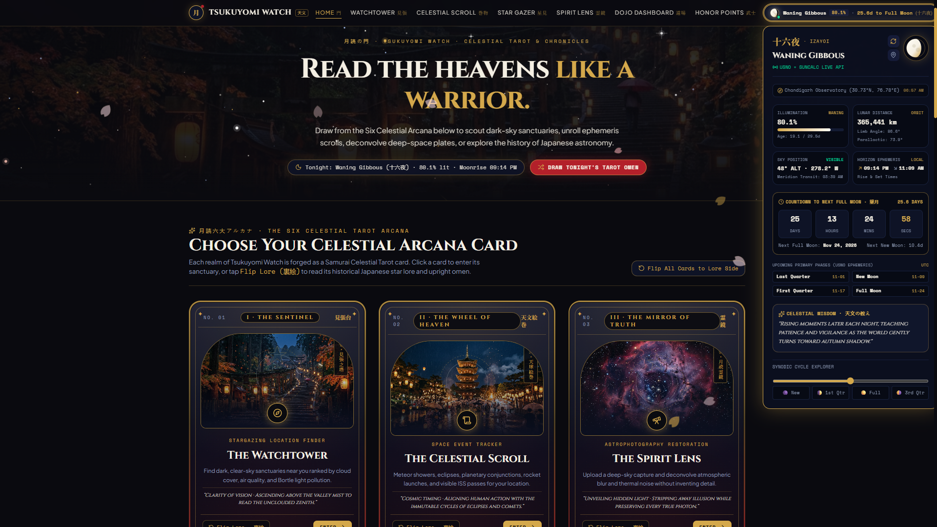
TSUKUYOMI WATCH / WORKING PROTOTYPE
07 / 08
End-to-end MVP showcase
All PS-002 modules + Star Gazer, gamification & accessibility fully implemented in codebase
MODULE 1: THE WATCHTOWER (`/watchtower`)
MODULE 2: THE CELESTIAL SCROLL (`/scroll`)
MODULE 3: THE STAR GAZER (`/stargazer`)
▫ Real-Time Weather & AQI Fusion: Fetches live Open-Meteo cloud cover, humidity, visibility, wind & US AQI (`pm2_5`, `pm10`).
▫ Parchment Scroll Leaflet Map: Custom sepia/katana-themed cartography displaying nearby peaks, shrines, and observatories.
▫ Interactive D3 Celestial Dome (`CelestialMapWidget.tsx`): Live Local Sidereal Time sky chart with 8+ constellations, star magnitudes & AQI haze simulation.
▫ Live ISS Pass Predictor (`/api/iss-passes`): 5-day visible pass table with max elevation, compass trajectory & magnitude.
▫ USNO + SunCalc Lunar Tracker (`/api/moon-phase`): Exact illumination fraction, bright limb angle, moonrise/set & distance (km).
▫ Traditional Lunar Calendar & Horizon Alerts: Filterable cosmic ledger (meteors, eclipses, launches) with 'View in sky' links into the Star Gazer.
▫ Live Stellarium Sky: Embedded Stellarium Web planetarium at your coordinates with Now / Tonight 22:00 / custom date-time presets.
▫ Sky Controls: Place search, GPS & saved observer location, FOV presets (120/90/60/30 deg), South & East horizon views and live lunar phase.
▫ Never-Stuck Fallback: URL telemetry panel, Fallback Card View & external launch if the embedded frame is blocked.
MODULE 4: THE SPIRIT LENS (`/lens`)
MODULE 5: DOJO DASHBOARD (`/dojo`)
BONUS: HONOR POINTS & CALM MODE (`/honor`)
▫ Faithful Deconvolution Engine (`/api/restore`): Adjustable Denoise & Deblur strength sliders processing uploads or NASA Hubble/JWST presets.
▫ Zero Fake Details: Preserves true photometric structure via Wavelet/NLM + Richardson-Lucy PSF restoration.
▫ Automated Star & Galaxy Detection: Extracts source centroids, brightness/flux, FWHM size & classification counts.
▫ Interactive Before/After Split Slider: Pixel-aligned comparison between raw noisy capture and restored output.
▫ Deep Zoom & Astrometric Overlays: Toggleable bounding reticles and telemetry tooltips for every detected star/galaxy.
▫ Faithfulness Metrics: Flux-conservation, object-count and noise-sigma before/after readouts for each restoration.
▫ Gamified Ranks: Ashigaru, Samurai (500), Daimyo (1,500) and Shogun (3,000) Honor Points.
▫ Earn by Observing: Points for events observed, alerts set, top spots visited, images restored & Star Gazer nights (+100 per day).
▫ Calm Mode & Audio: WCAG Calm Mode, IndexedDB persistence & Koto/Suzu audio.
PECATHON 2026 • OFFICIAL SUBMISSION
月読見張 • THE SAMURAI'S CELESTIAL GUIDE

Slide 8
TSUKUYOMI WATCH / RESEARCH & REFERENCES
08 / 08
Peer-reviewed references & data sources
Ethical, verifiable scientific foundations validating our deconvolution, photometry, orbital mechanics & sky simulation
PEER-REVIEWED SCIENTIFIC PAPERS (WITH VERIFIED DOIs)
▫ Richardson, W. H. (1972). 'Bayesian-Based Iterative Method of Image Restoration.' Journal of the Optical Society of America, 62(1), 55–59. DOI: 10.1364/JOSA.62.000055
▫ Lucy, L. B. (1974). 'An iterative technique for the rectification of observed distributions.' The Astronomical Journal, 79(6), 745–754. DOI: 10.1086/111605
▫ Stetson, P. B. (1987). 'DAOPHOT: A Computer Program for Crowded-Field Stellar Photometry.' Publications of the Astronomical Society of the Pacific, 99, 191–222. DOI: 10.1086/131977
▫ Bertin, E., & Arnouts, S. (1996). 'SExtractor: Software for source extraction.' Astronomy and Astrophysics Supplement Series, 117(2), 393–404. DOI: 10.1051/aas:1996164
▫ Buades, A., Coll, B., & Morel, J.-M. (2005). 'A Non-Local Algorithm for Image Denoising.' IEEE CVPR, Vol. 2, pp. 60–65. DOI: 10.1109/CVPR.2005.38
▫ Vallado, D. A., Crawford, P., Hujsak, R., & Kelso, T. S. (2006). 'Revisiting Spacetrack Report #3 (SGP4).' AIAA/AAS Astrodynamics Specialist Conference. DOI: 10.2514/6.2006-6753
▫ Zotti, G., Hoffmann, S. M., Wolf, A., Chéreau, F., & Chéreau, G. (2021). 'The Simulated Sky: Stellarium for Cultural Astronomy Research.' Journal of Skyscape Archaeology, 6(2), 221–258. DOI: 10.1558/jsa.17822
VERIFIED APIs & EPHEMERIS DATA SOURCES
OBSERVATIONAL ARCHIVES & CULTURAL REFERENCES
▫ US Naval Observatory (USNO) Astronomical Applications API: https://aa.usno.navy.mil/api/rstt/oneday & /moon/phases/date
▫ NORAD / CelesTrak GP TLE Ephemeris (CATNR 25544): https://celestrak.org/NORAD/elements/gp.php?CATNR=25544
▫ WhereTheISS.at & IvanStanojevic TLE Mirrors: https://api.wheretheiss.at/v1/satellites/25544/tles
▫ Open-Meteo Weather & Air Quality APIs: https://api.open-meteo.com/v1/forecast & air-quality-api.open-meteo.com
▫ OpenStreetMap Overpass & Nominatim GIS: https://overpass-api.de/api/interpreter
▫ Stellarium Web (embedded sky viewer): https://stellarium-web.org (query parameters lat, lng, date, fov, elev, az, alt)
▫ NASA / ESA / STScI Hubble & JWST Public Archive: Pillars of Creation (GSFC_20171208), Carina Nebula, Andromeda M31 (PIA04921) — https://images.nasa.gov
▫ Renshaw, S., & Ihara, S. (1999). 'Archaeoastronomy and Ethnoastronomy in Japan (Subaru, Hokuto Shichisei, Tsuzumi-boshi).' Journal of Astronomical History and Heritage.
▫ Shivalik / Chandigarh Dark-Sky Topographic Survey: Morni Hills (1220m), Kasauli (1927m), Chail (2250m), Siswan Dam (390m).
PECATHON 2026 • OFFICIAL SUBMISSION
月読見張 • THE SAMURAI'S CELESTIAL GUIDE

