Slide 1

PECATHON 2026 / PROBLEM STATEMENT 2
月読
Tsukuyomi
Watch
The Samurai’s Celestial Guide
Local stargazing plans and
image restoration you can check
The big 2
Team ID PF-EPB8S3
Notes:
We are The big 2, team PF-EPB8S3, presenting Tsukuyomi Watch for problem statement 2. Our project connects two parts of amateur astronomy: planning an observing night and understanding the images captured during it. The central idea is a local sky experience with recommendations and image processing that users can inspect.
Project sources:
D:/PROJECTS/Pecathon/README.md
D:/PROJECTS/Pecathon/docs/tsukuyomi-final-guideline.md
Artwork: generated with OpenAI ImageGen for this presentation. Japanese landscape and celestial motifs are decorative, not scientific observations.

Slide 2

Problem statement
Planning a useful observing night
takes too many separate tools
01
Where should we go?
Weather, light pollution and Moon conditions
need to agree at the same location.
02
What can we see tonight?
Events need a local viewing window,
with timing, direction and visibility.
03
Can we trust the image?
Noise and blur hide faint objects. Restoration
needs evidence that it preserves the signal.
For beginners, astronomy clubs and amateur astrophotographers
TSUKUYOMI WATCH / 02 OF 08
Notes:
The problem combines preparation and scientific trust. Observers cross-check weather, geography and sky events, while image processing introduces another set of tools. A global event date alone does not tell an observer whether an event is visible from their location. A sharper image alone does not establish whether its details are reliable. We propose one local observing workflow that addresses both questions.
Project sources:
D:/PROJECTS/Pecathon/README.md
D:/PROJECTS/Pecathon/docs/tsukuyomi-final-guideline.md
Artwork: generated with OpenAI ImageGen for this presentation. Japanese landscape and celestial motifs are decorative, not scientific observations.

Slide 3
Our solution
One journey through tonight’s sky
Tsukuyomi Watch connects your location and observing time
with the events you can see and the images you capture.
01
02
03
04
Find a spot
Choose a window
Restore an image
Inspect the result
Watchtower
Celestial Scroll
Spirit Lens
Dojo
Rank nearby places by
conditions and darkness.
Check visible events
and their local timing.
Reduce noise and blur
with measured inputs.
Compare the output and
explore detected objects.
TSUKUYOMI WATCH / 03 OF 08
Notes:
Walk through one night. Select a location, find a useful observing window, check a visible event, capture an image and inspect the restoration. The same time and location connect the modules. The Japanese theme supports orientation through the experience, while the underlying recommendations and image measurements remain explainable.
Project sources:
D:/PROJECTS/Pecathon/docs/tsukuyomi-final-guideline.md
D:/PROJECTS/Pecathon/frontend-main/AGENT_BRIEF.md
Artwork: generated with OpenAI ImageGen for this presentation. Japanese landscape and celestial motifs are decorative, not scientific observations.

Slide 4
Where and when to observe
WATCHTOWER + CELESTIAL SCROLL
Night Honor Score
Nearby observing spots
0–100
Rank real peaks, parks and viewpoints
by observing conditions and distance.
A local celestial calendar
An hourly score based on weather,
moonlight and local sky darkness.
Moon phases, meteor showers, eclipses,
ISS passes and launch schedules
with local timing and visibility context.
Each score exposes its inputs
and explains the best observing window.
TSUKUYOMI WATCH / 04 OF 08
Notes:
The 0–100 range is the defined Night Honor Score scale, not a performance result. Forecast inputs include clouds, humidity, visibility and aerosols, alongside computed darkness and Moon conditions. The planner ranks real geographic candidates and finds an observing window. Celestial events need location-specific interpretation. A launch schedule does not guarantee that a launch trail is visible from the observer’s site. The score is a transparent model rather than a calibrated probability of success.
Project sources:
D:/PROJECTS/Pecathon/README.md
D:/PROJECTS/Pecathon/docs/API.md
D:/PROJECTS/Pecathon/docs/tsukuyomi-final-guideline.md
Artwork: generated with OpenAI ImageGen for this presentation. Japanese landscape and celestial motifs are decorative, not scientific observations.

Slide 5
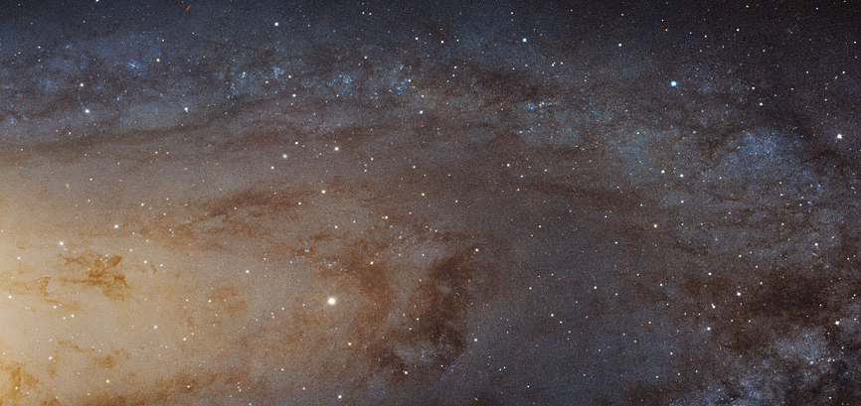
Image restoration with evidence
SPIRIT LENS + DOJO
01
Measure and restore
Estimate stellar blur, reduce noise and
apply Richardson–Lucy deconvolution.
02
Explore the objects
Compare original and restored views,
with detections and object measurements.
Andromeda Galaxy / original input sample
A katana comparison reveals
what changed in the image.
03
Inspect the Proof of Honesty
Reblur the output, inspect the residual
and check brightness and position changes.
TSUKUYOMI WATCH / 05 OF 08
Notes:
The displayed image is an original input sample, not a restored result. The proposed workflow measures the point-spread function from stars, reduces noise and applies deterministic deconvolution. The katana comparison and detection overlays let users inspect the result. Residual, flux and position checks provide evidence and can reveal unsupported changes, but they do not mathematically guarantee that every restored detail is true. JPEG and PNG measurements remain relative brightness and pixel sizes unless calibration is available. Image credit: NASA, ESA, J. Dalcanton, B.F. Williams, L.C. Johnson (University of Washington), the PHAT team, R. Gendler. Source manifest: backend/data/samples/samples.json, image ID heic1502a.
Project sources:
D:/PROJECTS/Pecathon/docs/tsukuyomi-final-guideline.md
D:/PROJECTS/Pecathon/docs/API.md
D:/PROJECTS/Pecathon/README.md
D:/PROJECTS/Pecathon/frontend-main/AGENT_BRIEF.md
D:/PROJECTS/Pecathon/backend/data/samples/samples.json
Artwork: generated with OpenAI ImageGen for this presentation. Japanese landscape and celestial motifs are decorative, not scientific observations.

Slide 6
Technical approach
One browser experience, one API and a scientific image worker
01
02
03
Browser
API & image worker
Data providers
React + TypeScript
Three.js sky view
Astronomy Engine
MapLibre maps
FastAPI
Astropy + Photutils
scikit-image
Background image jobs
Open-Meteo
OpenStreetMap
CelesTrak + launch data
SkyView + SIMBAD
Shared location and time keep the modules aligned.
Cached provider data, source timestamps and a recorded demo fallback
TSUKUYOMI WATCH / 06 OF 08
Notes:
The frontend presents the sky, maps and time control. FastAPI normalizes provider data and coordinates scientific image jobs. Astronomy Engine computes celestial positions, while image science uses Astropy, Photutils and scikit-image. The browser and service share one location and reference time. Caching and provenance help handle unreliable free APIs. Recorded replay carries its original timestamp and a visible replay label so observers can distinguish recorded conditions from current data.
Project sources:
D:/PROJECTS/Pecathon/docs/tsukuyomi-final-guideline.md
D:/PROJECTS/Pecathon/docs/API.md
D:/PROJECTS/Pecathon/frontend-main/AGENT_BRIEF.md
Artwork: generated with OpenAI ImageGen for this presentation. Japanese landscape and celestial motifs are decorative, not scientific observations.

Slide 7
Differentiation and expected impact
What makes it different
Who it helps
Explainable recommendations
Beginners
Each score exposes its inputs,
contributions and data sources.
Less manual cross-checking before
an observing trip.
Restoration that can be checked
Astronomy clubs
Residual, brightness and position checks
help identify unsupported changes.
A common local plan for
group observing sessions.
One shared sky
Astrophotographers
The time control connects sky positions,
events and observing conditions.
A clearer record of image processing
and catalogue matches.
Expected benefits. User testing and quantitative benchmarks remain validation steps.
TSUKUYOMI WATCH / 07 OF 08
Notes:
The differentiation is the connection between observing decisions and inspectable science. We expose the reasons for a score and the evidence behind an image restoration. Benefits on this slide are expected outcomes, not measured impact or user research findings. A next validation phase should assess whether observers can find a usable plan, understand the score and interpret image checks. Benchmark restoration with known synthetic truth and real observations, including false detections and flux preservation.
Project sources:
D:/PROJECTS/Pecathon/docs/tsukuyomi-final-guideline.md
D:/PROJECTS/Pecathon/README.md
Artwork: generated with OpenAI ImageGen for this presentation. Japanese landscape and celestial motifs are decorative, not scientific observations.

Slide 8
Roadmap and next steps
01
Core observing journey
Location, hourly scores, nearby spots
and a local celestial calendar.
02
Scientific image workflow
Restoration, object detection and
Proof of Honesty with reproducible checks.
03
Field use and deeper science
Offline plans, red field mode, observation
journals and transient analysis.
Thank you
The big 2 / PF-EPB8S3
TSUKUYOMI WATCH / 08 OF 08
Notes:
Our priorities begin with a complete observing journey: location, scores, spots and a local event calendar. The next priority is a reproducible scientific image workflow. Field mode, offline plans and journals extend the product into real observing sessions. Transient analysis adds a deeper science path after the core experience is reliable. Thank the judges and invite questions. Team: The big 2. Team ID: PF-EPB8S3. Problem statement: 2.
Project sources:
D:/PROJECTS/Pecathon/docs/tsukuyomi-final-guideline.md
D:/PROJECTS/Pecathon/README.md
Artwork: generated with OpenAI ImageGen for this presentation. Japanese landscape and celestial motifs are decorative, not scientific observations.

