Slide 1
PECATHON 2026 · PS-004 PRIVACYLENS
Zen.
A local privacy lens for AI browser agents
“Compute what is sensitive locally. Reason globally only on sanitized data.”
[REDACTED:CARD]
[REDACTED:AADHAAR]
[REDACTED:OTP]
[REDACTED:API_KEY]
Notes:
Zen is a Chrome extension plus a Python agent that lets AI agents work on web pages while sensitive data never reaches the external model.

Slide 2
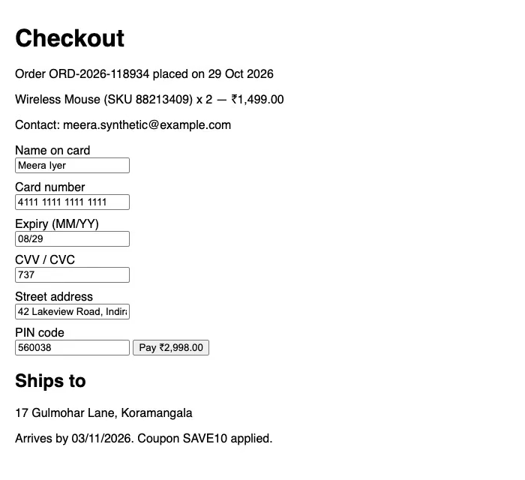
AI agents ship your screen to the cloud
To act on a page, agents send screenshots and DOM text to a cloud model
That payload carries cards, Aadhaar, PAN, passwords, OTPs, API keys and private messages
Prompting the model to “ignore” them does not help: the data has already left
21 of 34
sensitive values readable by OCR in a plain agent screenshot (5 test pages)
What an agent captures today
Notes:
Baseline from eval.shield_eval with the shield off: OCR reads 21 of the 34 synthetic sensitive values.

Slide 3
What Zen does differently
Typical privacy layer
Zen
Filters the text you send to one model
Shields the page itself: screenshots, DOM text and input values. Works for any agent, no integration
Blanks values out, so the AI loses the thread
Consistent pseudonyms ([EMAIL_1], [CARD_1]); the AI types the token, the real value is filled locally
Counts regex hits, ignores what can be inferred
Red-teams inference (“card ending 4242”, DOB + PIN) and minimises the hints away
Trusts the model's actions
Local executor checks every action; secrets stay in a vault as {{SECRET:name}}; risky clicks need approval
Fails open if a check breaks
Fail-closed egress gate with canaries; a scanner error blocks the send
Notes:
Also: India-specific IDs with real checksums (Aadhaar Verhoeff, GSTIN mod-36, UPI, IFSC), a JS port that runs offline in the extension, and an on-device planner option via Ollama.

Slide 4
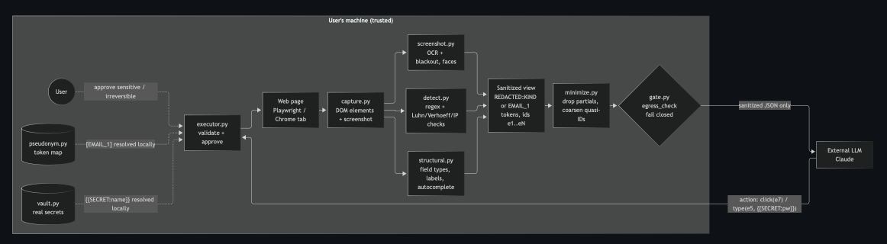
Everything sensitive is decided on the device
Only sanitized JSON crosses
Real values come back locally
Same detector everywhere
the trust boundary to the external LLM
pseudonym.py and vault.py resolve tokens inside the executor
detect.py and its JS port stay in parity, checked by a test
Notes:
Three surfaces share this pipeline: the Chrome extension (main), the Python agent, and the web app.

Slide 5
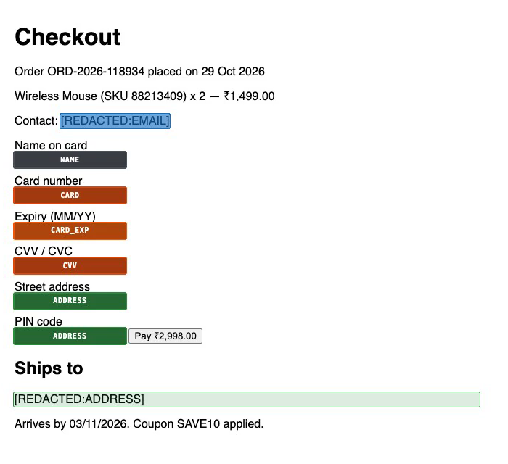
Agent Shield: protect the page, not the prompt
Finds data with patterns + checksums (Luhn, Verhoeff), field structure, and a face detector
Turns on by itself when automation or a debugger is attached
Covers screenshots and rewrites DOM text and input values to [REDACTED:KIND]
Works for Playwright, CDP and agent extensions with no integration
Without Zen
Shield on
Real values never leave the page; covers appear about 3 ms after new content.
Notes:
Measured with eval.shield_eval in real Chromium: 0 values in screenshots, page text or input values; mean field cover 87%; focus keeps 95% cover.

Slide 6
We also test what an AI could guess
“card ending 4242”, 98XXXXX210
partial values removed before the AI sees them
DOB → year, PIN code → district
quasi-identifiers coarsened; every anonymity set stays ≥ 20
0 of 260
harmless tokens changed: utility kept
Notes:
eval.inference.run: an offline attacker tries to recover each redacted value from context. Leak = exact recovery, at least 1 bit narrowed, or re-identification. 2 known-gap leaks remain after minimise.

Slide 7
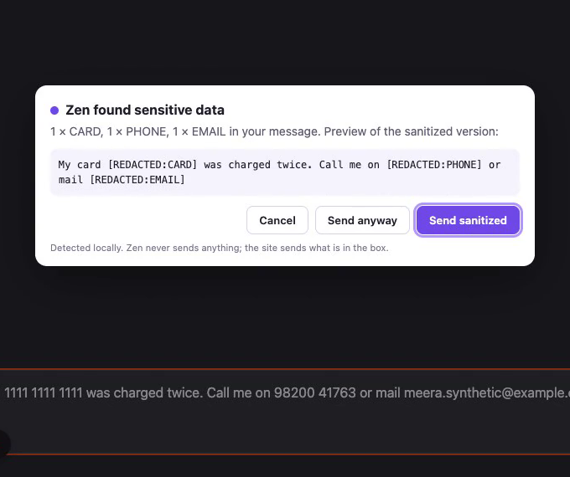
Unsafe sends and actions are stopped
Send guard fails closed
if the editor refuses the sanitized text, nothing is sent
Secrets the AI never sees
it types {{SECRET:login_password}}; the executor fills the real value after approval
Prompt injection rejected
5 of 5 hijack attempts on the test page blocked; navigation only to allowed sites
Fail-closed egress gate
every payload re-scanned; 5 of 5 canaries blocked
AI-chat send guard: “Send sanitized” is the default
Notes:
End-to-end tests prove vault values reach the page but never model payloads, logs or reports.

Slide 8
Measured results, honest limits
Known gaps
21 → 0
0 · 0
100%
Obfuscated PII (spaced digits, “at/dot” emails): adversarial recall 0.20
Person names need NER
Main-world page scripts can read their own variables
values readable by OCR in agent screenshots
values in page text / input values, shield on
non-sensitive context kept
0.99 / 1.00
0 / 260
263
detector recall / precision, 150 cases
hard-negative tokens changed by minimize
Python tests pass, JS parity holds
Claims cover the synthetic test pages and pathways only · github.com/PECathon-2026/Zen
Notes:
Reproduce: python -m eval.shield_eval, python -m eval.run_eval, python -m eval.inference.run, pytest -q, node --test extension/tests/.

