Slide 1
TITLE PAGE
Problem Statement ID - 1
Problem Statement Title - Autonomous AI Agent for Real-Time Building Energy Optimization
Theme - Clean & Green Technology / Smart Automation
PS Category - Software
Student Name (Registered on portal) – Shashank P Karajagi
Student ID – PES1UG23AM283

Slide 2
EcoLoop — LLM-Driven Autonomous HVAC Control Agent
A closed-loop AI agent that replaces static HVAC schedules with real-time, physics-grounded decisions.
An autonomous agent pairs EnergyPlus building-physics simulation with a self-hosted Qwen2.5-7B LLM, which sets cooling/heating setpoints every simulated hour based on live zone temperature, outdoor conditions, and thermal trend.
Traditional BMS use rigid fixed schedules that cannot adapt to real-time weather or occupancy shifts; our agent continuously reasons over live sensor data and self-corrects, discovering the building’s true efficient operating envelope instead of guessing at design time.
Combines native LLM tool-calling (zero fine-tuning) with day/night memory partitioning and rejection-as-feedback — turning hardware safety limits into a live, self-correcting signal, with every decision and model version fully auditable.

Slide 3
TECHNICAL APPROACH
Technologies: EnergyPlus 26.1 + PyEnergyPlus API (simulation engine), Qwen2.5-7B-Instruct served via Ollama with native tool-calling, Python orchestration layer, ngrok tunnel for remote LLM access, pandas-based savings dashboard.
Methodology: An Interval Governor triggers exactly one LLM inference per simulated hour; proposed setpoints pass through a rule-based Safety Net (physical + occupancy comfort bounds) before reaching EnergyPlus actuators; rejected actions feed back into a day/night memory buffer so the agent self-corrects, validated against a static baseline run for direct kWh comparison.

Slide 4
FEASIBILITY AND VIABILITY
Feasibility: Built entirely on open-source, self-hostable components (EnergyPlus, Ollama, Qwen2.5) — no proprietary APIs or licensing cost, deployable on any building with a BMS-exposed setpoint interface.
Challenges: LLM inference latency over network tunnels; risk of the model proposing physically invalid setpoints; balancing energy savings against occupant comfort.
Mitigation: a bounded memory context caps prompt/latency growth; a deterministic safety-net layer hard-rejects invalid actions and feeds structured correction text back to the model; occupancy-aware comfort bands are enforced in code regardless of AI output.

Slide 5
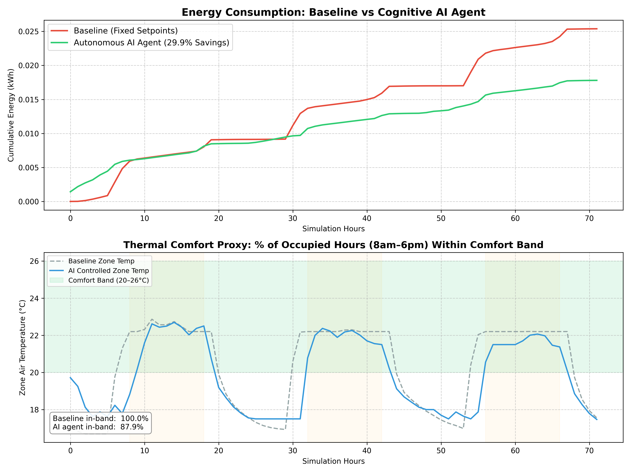
ARTIFACTS
Verified Results — 72-hr Simulation (3 Day/Night Cycles)
Baseline HVAC energy: 91.39 kWh
Autonomous AI-agent energy: 64.09 kWh
Net savings: 27.30 kWh (29.87%)
Comfort in-band (20–26°C, occupied hrs): Baseline 100% | AI 87.9%
Fail-static confirmed live: ngrok drop at Hour 0 → agent held last-known-good setpoints, no crash
Full code, architecture doc & dashboard included in repo

Slide 6
RESEARCH AND REFERENCES
References:
EnergyPlus Engineering Reference & PyEnergyPlus API docs (energyplus.net)
Qwen2.5 model card (Ollama library)
ASHRAE Standard 55 - Thermal Environmental Conditions for Human Occupancy
Ollama tool-calling API documentation.

